Slide 2
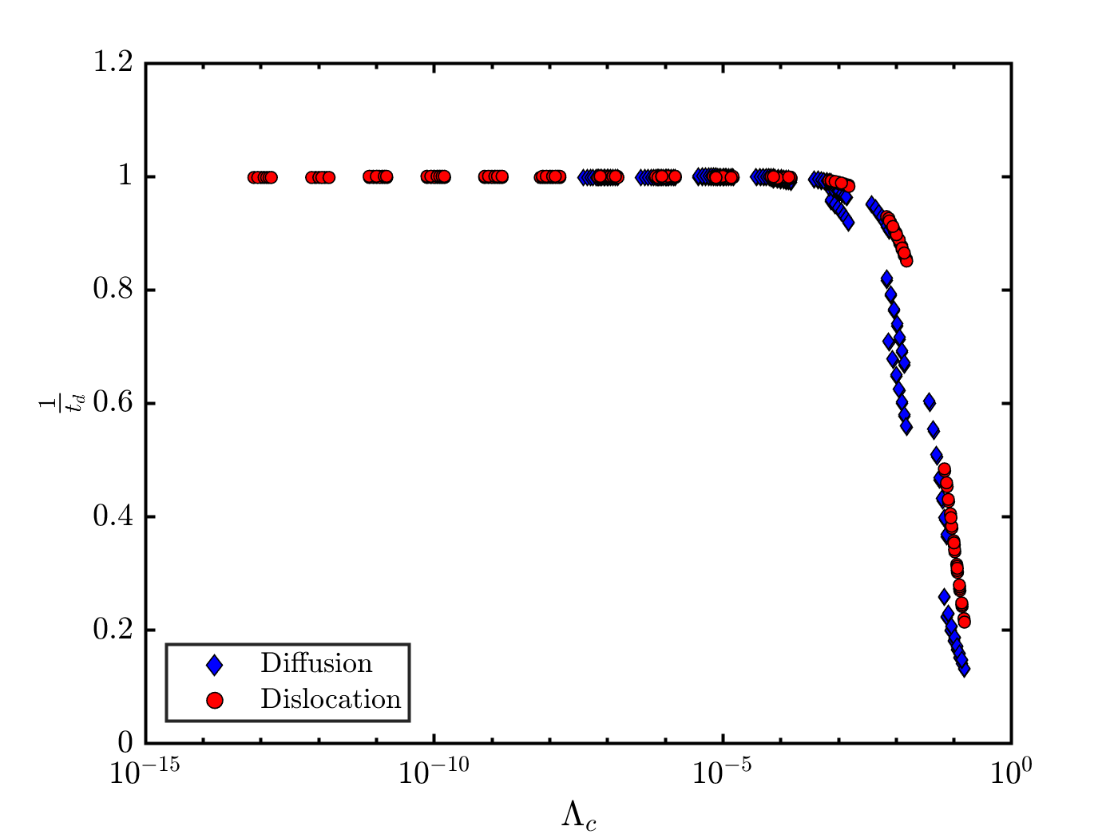
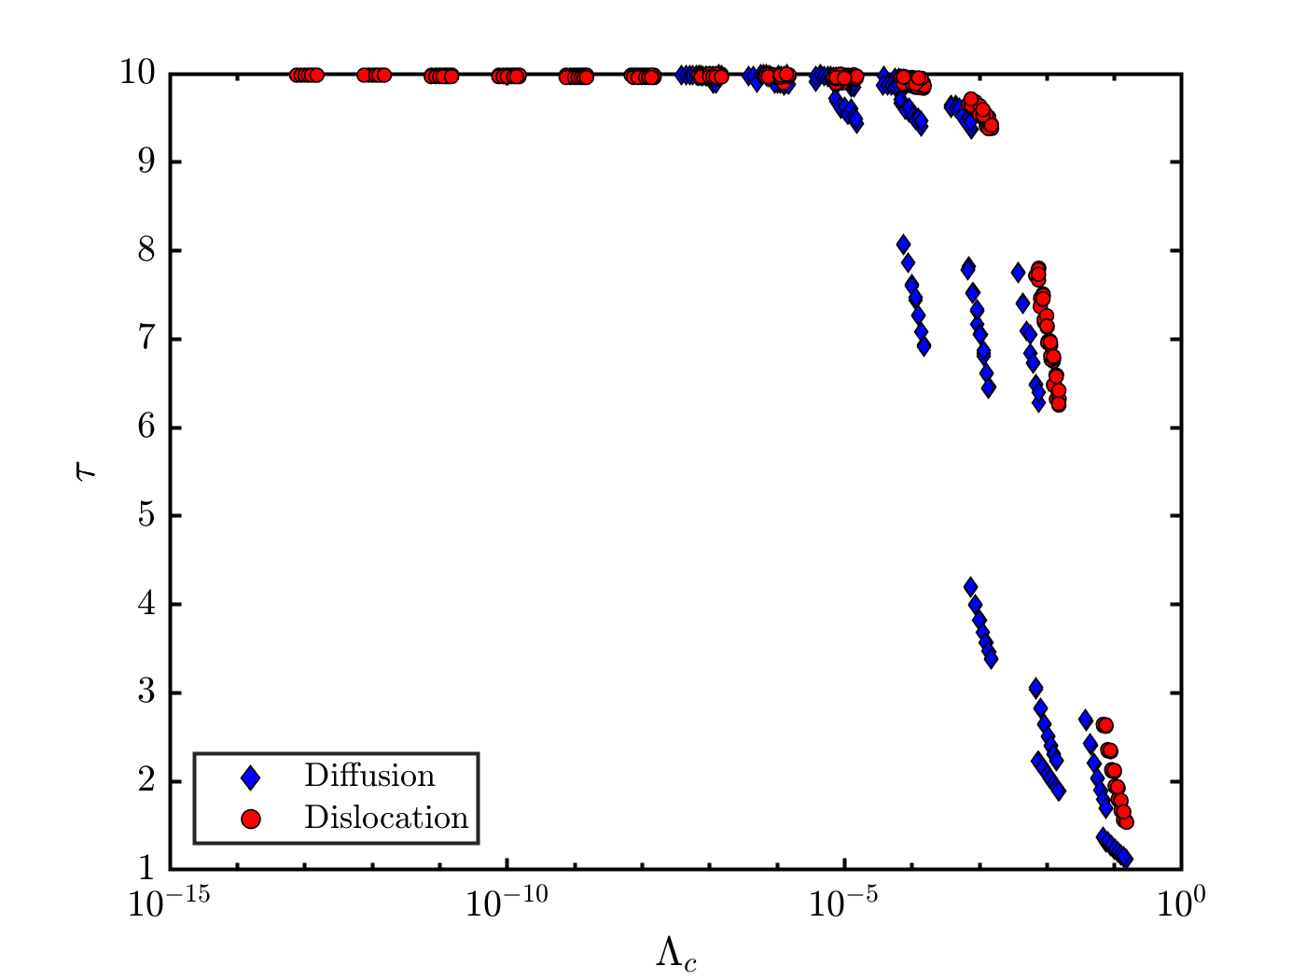


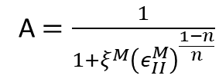
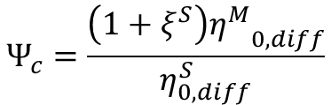

Non-linear 0D mantle experiments
I did not partition strain rate between diffusion and dislocation creep mechanism. I computed the drag force using the harmonic mean between diffusion and dislocation creep. So, the lower bounds for the stress and viscosity.
$$Ψ_{c}=\frac{\left(1+ξ^{S}\right){η^{M}}_{0,diff}}{η_{0,diff}^{S}}$$
A $=\frac{1}{1+ξ^{M}{\left(ε_{II}^{M}\right)}^{\frac{1−n}{n}}}$
$Λ_{c}=Ψ_{0}γ$
$$Λ\left(t\right)=Λ_{c}A$$
$Λ_{0}=\frac{Ψ_{0}γ}{1+ξ^{M}}$
Having an easy parameter that can be derived solely by the initial input
Easy to extract the time dependent part (i.e., the strain rate evolution with time, that depends on the necking rate)
BUT wrong

Slide 3
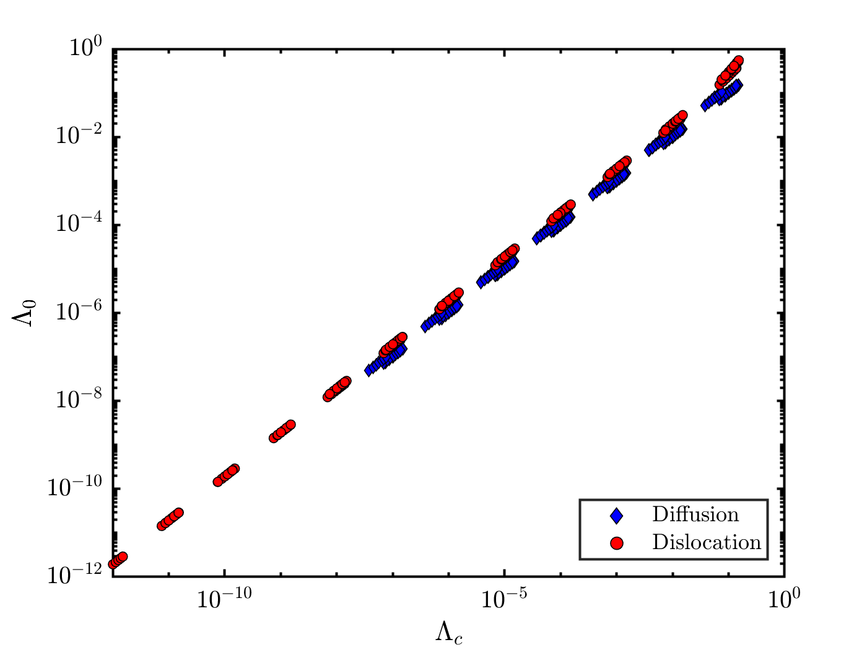
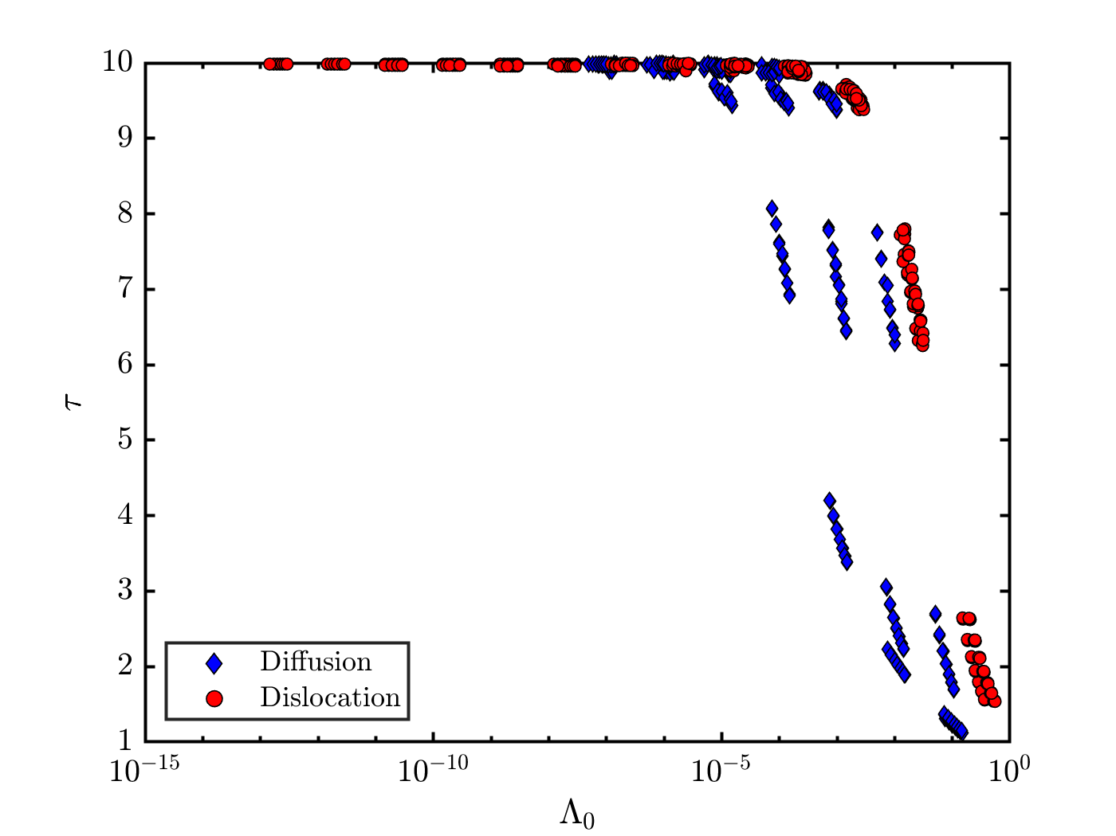
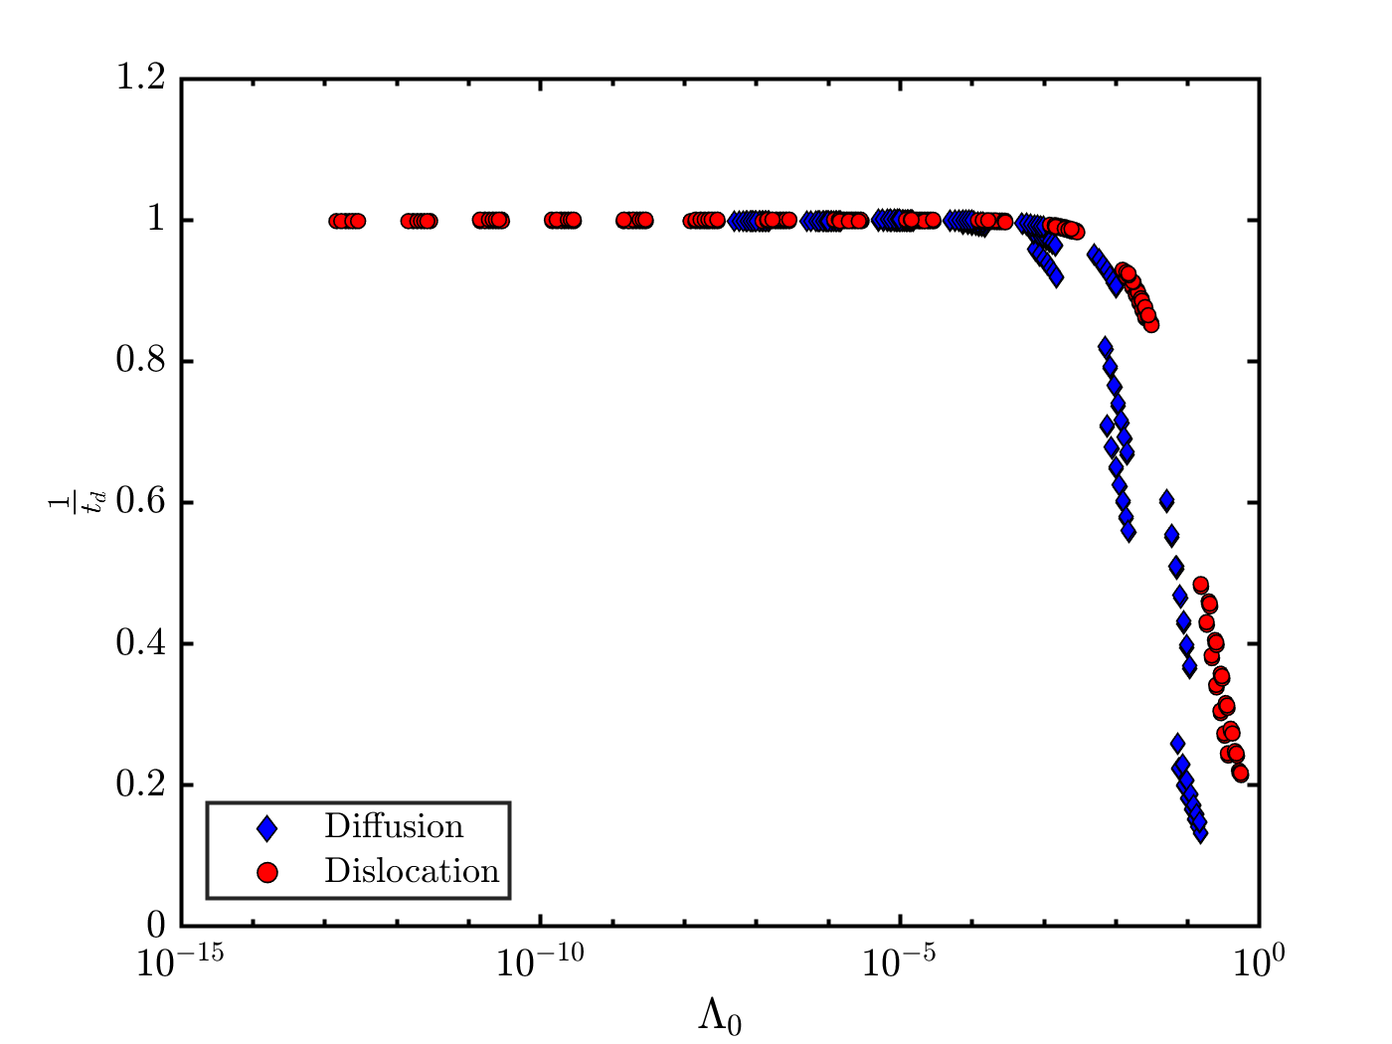
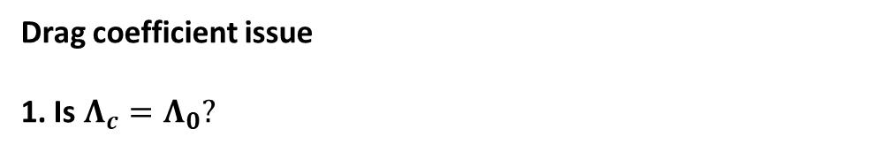
Drag coefficient issue
1. Is $Λ_{c}=Λ_{0}?$
Good enough, differences increases at drag coefficient higher than 1e-5
Ordering of the experiments does not change
Diffusion/Dislocation dominated experiments behave differently

Slide 4
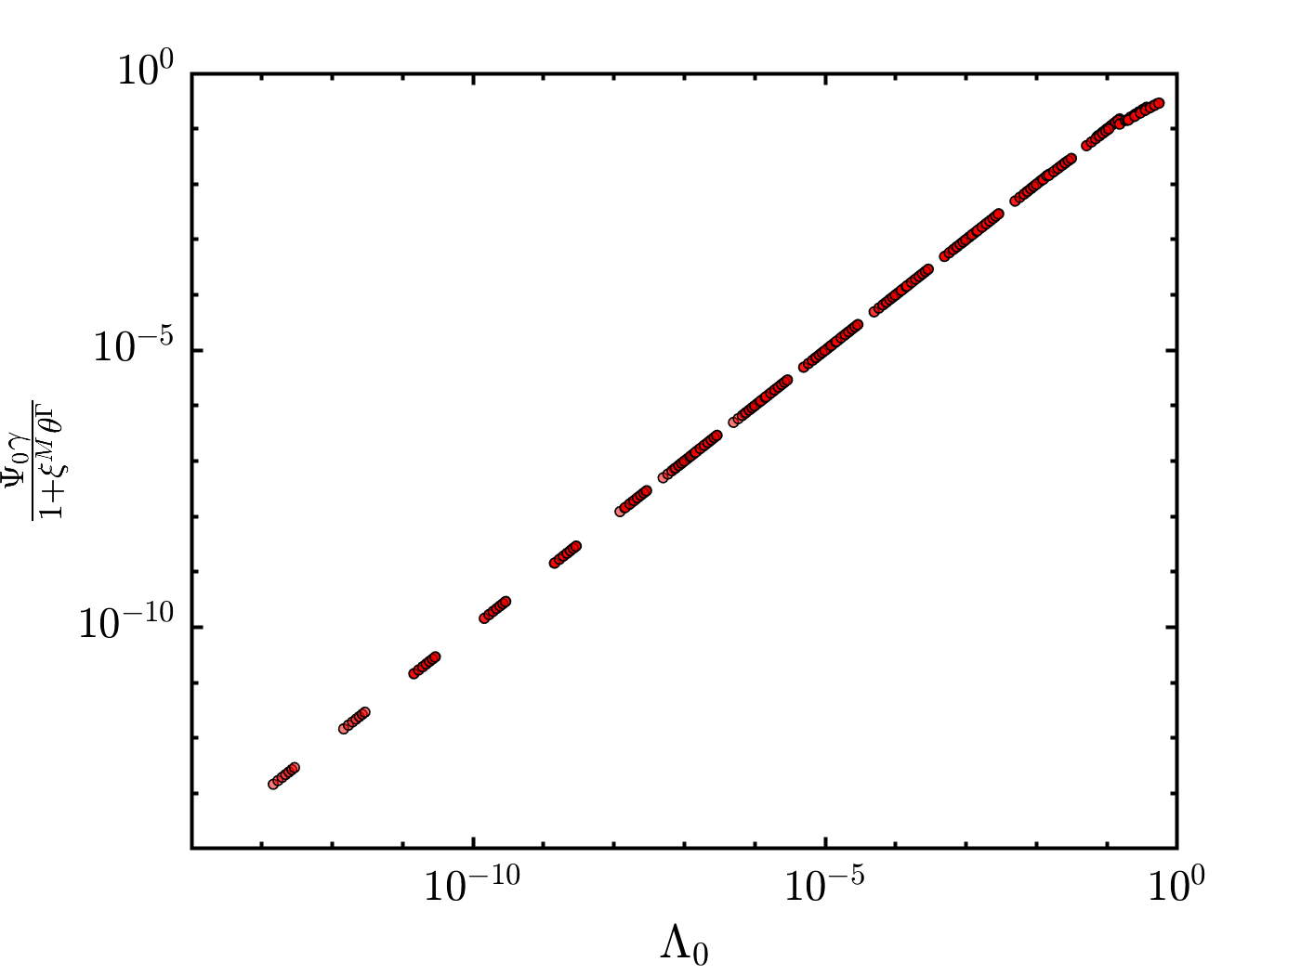
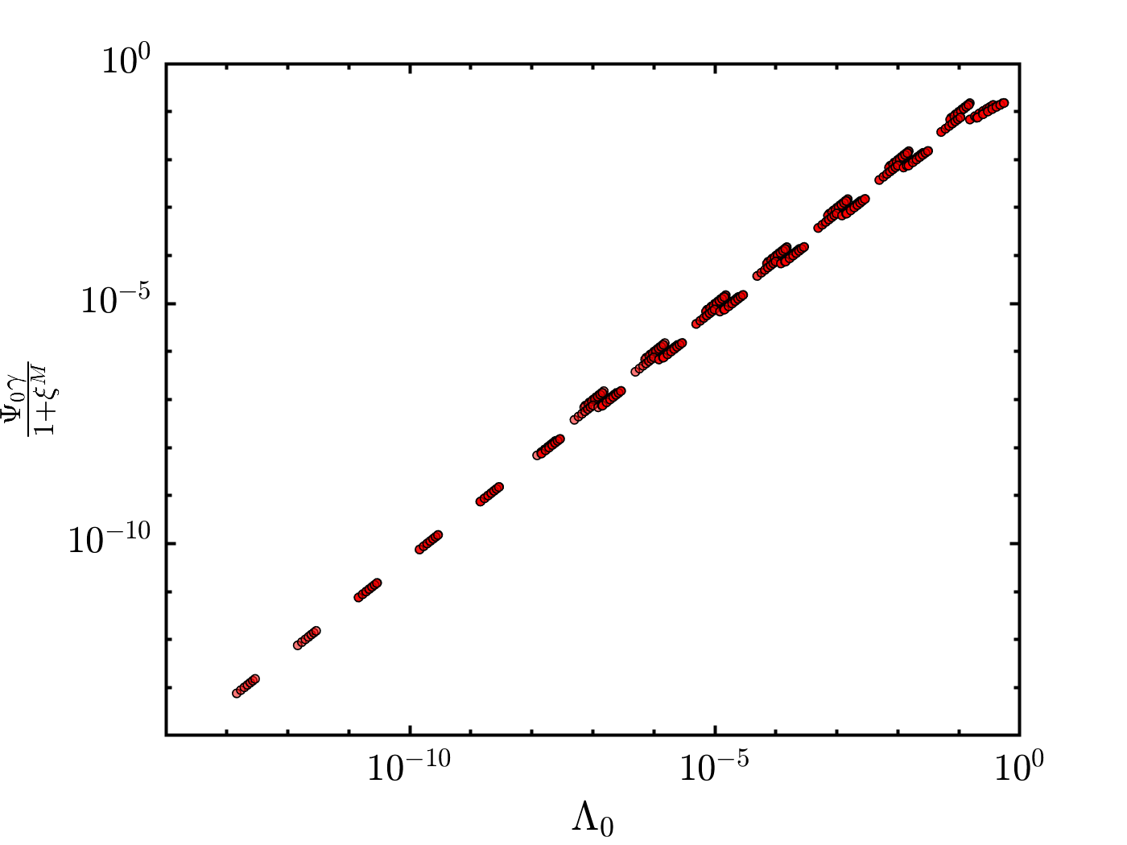
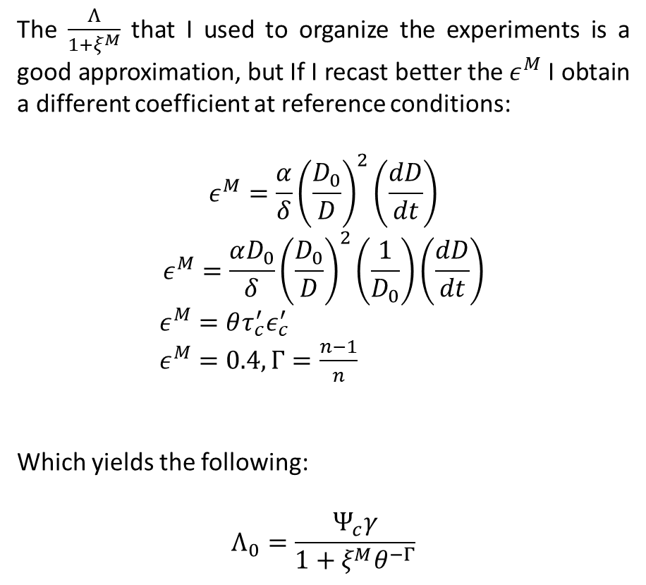
Additional derivation
The $\frac{Λ}{1+ξ^{M}}$ that I used to organize the experiments is a good approximation, but If I recast better the $ε^{M}$ I obtain a different coefficient at reference conditions:
$$ε^{M}=\frac{α}{δ}{\left(\frac{D_{0}}{D}\right)}^{2}\left(\frac{dD}{dt}\right)$$
$$ε^{M}=\frac{αD_{0}}{δ}{\left(\frac{D_{0}}{D}\right)}^{2}\left(\frac{1}{D_{0}}\right)\left(\frac{dD}{dt}\right)$$
$ε^{M}=θτ_{c}^{′}ε_{c}^{′}$
$ε^{M}=0.4, Γ=\frac{n−1}{n}$
Which yields the following:
$$Λ_{0}=\frac{Ψ_{c}γ}{1+ξ^{M}θ^{−Γ}}$$

Slide 5
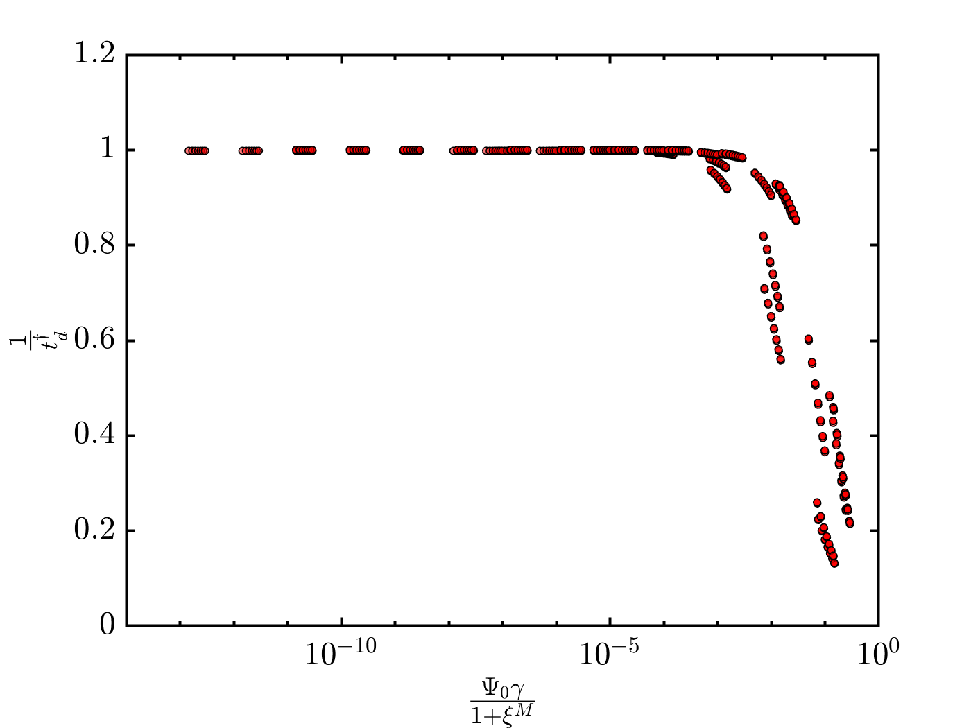
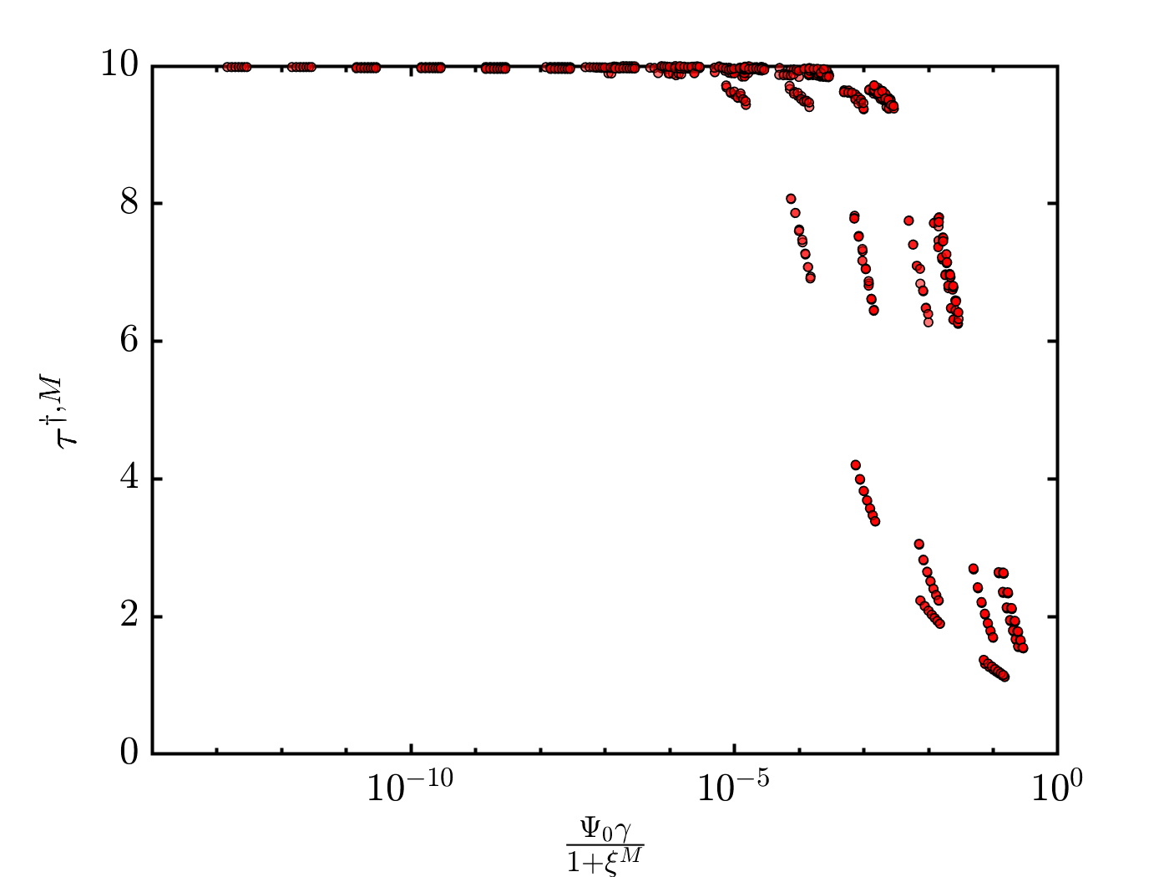
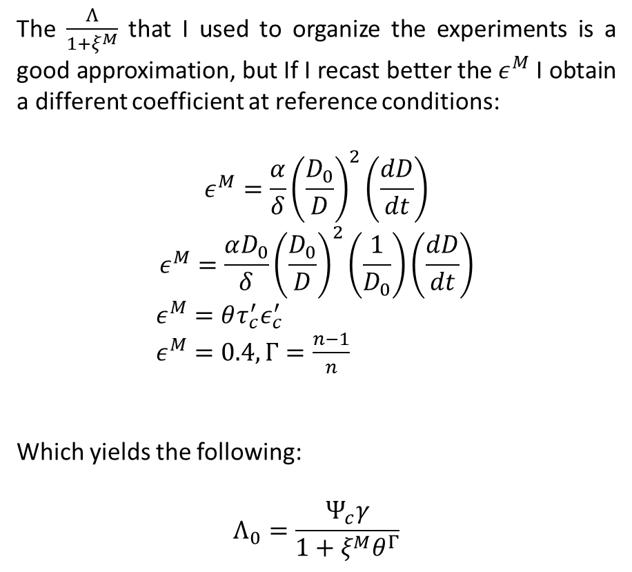
Additional derivation
The $\frac{Λ}{1+ξ^{M}}$ that I used to organize the experiments is a good approximation, but If I recast better the $ε^{M}$ I obtain a different coefficient at reference conditions:
$$ε^{M}=\frac{α}{δ}{\left(\frac{D_{0}}{D}\right)}^{2}\left(\frac{dD}{dt}\right)$$
$$ε^{M}=\frac{αD_{0}}{δ}{\left(\frac{D_{0}}{D}\right)}^{2}\left(\frac{1}{D_{0}}\right)\left(\frac{dD}{dt}\right)$$
$ε^{M}=θτ_{c}^{′}ε_{c}^{′}$
$ε^{M}=0.4, Γ=\frac{n−1}{n}$
Which yields the following:
$$Λ_{0}=\frac{Ψ_{c}γ}{1+ξ^{M}θ^{Γ}}$$

Slide 6

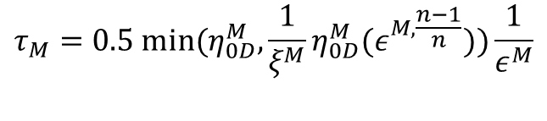


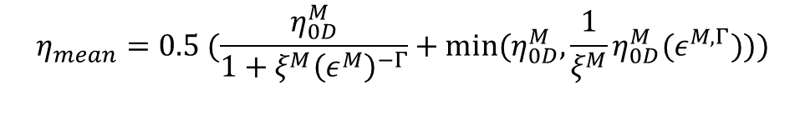
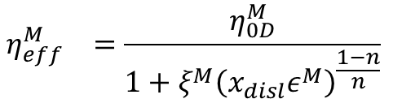



Alternatives?
Strain partitioning:
Iteration stress:
Stress cannot be lower than the harmonic average of the viscosities (assuming that the diffusion and dislocation creep are parallel)
Stress cannot be higher than the one computed assuming that the weakest mechanism is absorbing all deformation
Minimize the residuum between the total strain rate, and the diffusion+dislocation creep.
Finding the effective viscosity and plug it in the drag coefficient.
Average viscosity approach:
Using the minimum and maximum stress bounds to find the upper and lower bound of viscosity and using its average.
$$η_{mean}=0.5 (\frac{η_{0D}^{M}}{1+ξ^{M}{\left(ε^{M}\right)}^{−Γ}}+{min⁡(η}_{0D}^{M},\frac{1}{ξ^{M}}η_{0D}^{M}{(ε}^{M, Γ})))$$
${if ξ^{M}≤1 Π}_{diff}=(\frac{1}{2})\frac{ 2+ξ^{M}θ^{−Γ}}{1+ξ^{M}{\left(x_{disl0}θ\right)}^{−Γ} } (?)$
$$τ_{M}=0.5 {min⁡(η}_{0D}^{M},\frac{1}{ξ^{M}}η_{0D}^{M}{(ε}^{M, \frac{n−1}{n}}))\frac{1}{ε^{M}}$$
${if ξ^{M}>1 Π}_{disl}=(\frac{1}{2})\frac{ (2ξ^{M}+θ^{Γ})}{1+ξ^{M}{\left(θ\right)}^{−Γ} } (?)$
$$τ_{m}=0.5 η_{effD}^{M}/ε^{M}$$
$${η_{eff}^{M}}_{}=\frac{η_{0D}^{M}}{1+ξ^{M}{\left(x_{disl}ε^{M}\right)}^{\frac{1−n}{n}}}$$
$$res=ε^{M}−B_{n}τ^{n}−B_{d}τ$$
$Λ_{0}=Ψ_{0}γΠ_{\frac{diff}{disl}} (?)$
$Λ_{0}=\frac{Ψ_{0}γ}{1+ξ^{M}{\left(x_{disl0}θ\right)}^{−Γ} } (?)$

Slide 7
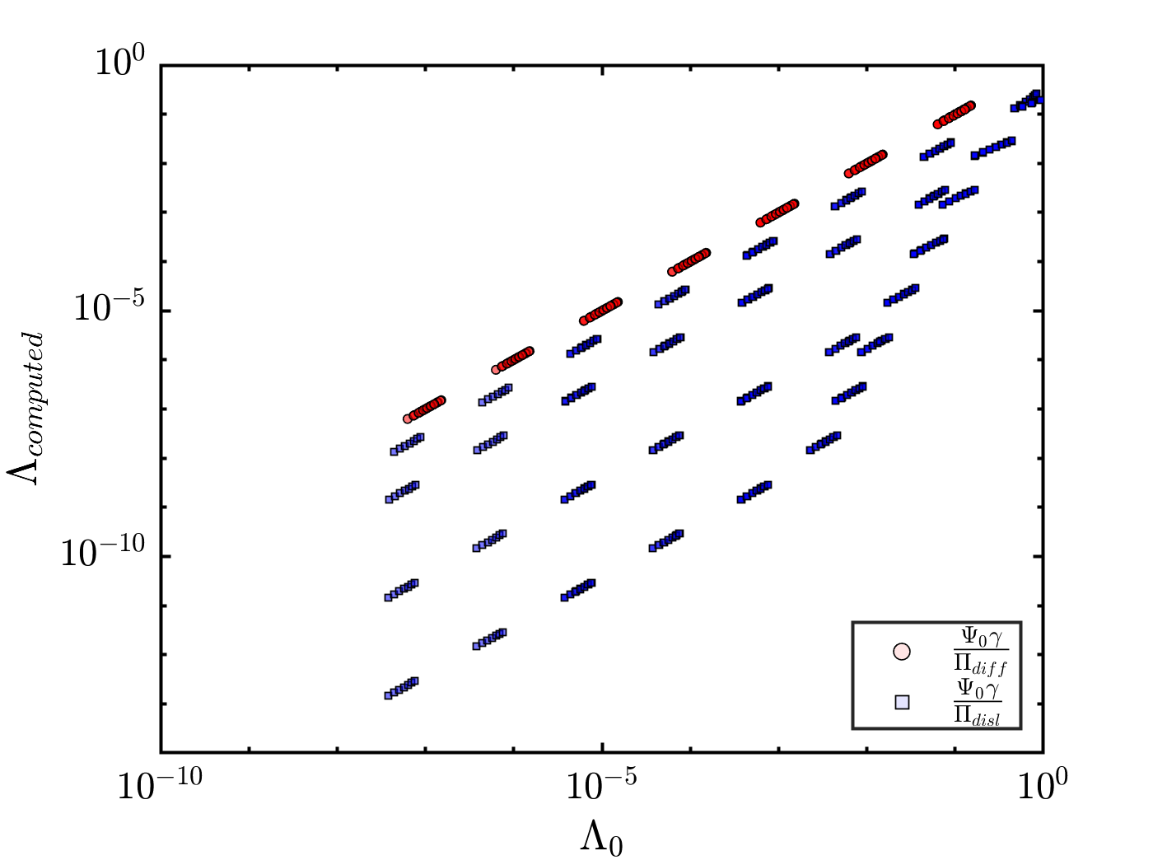
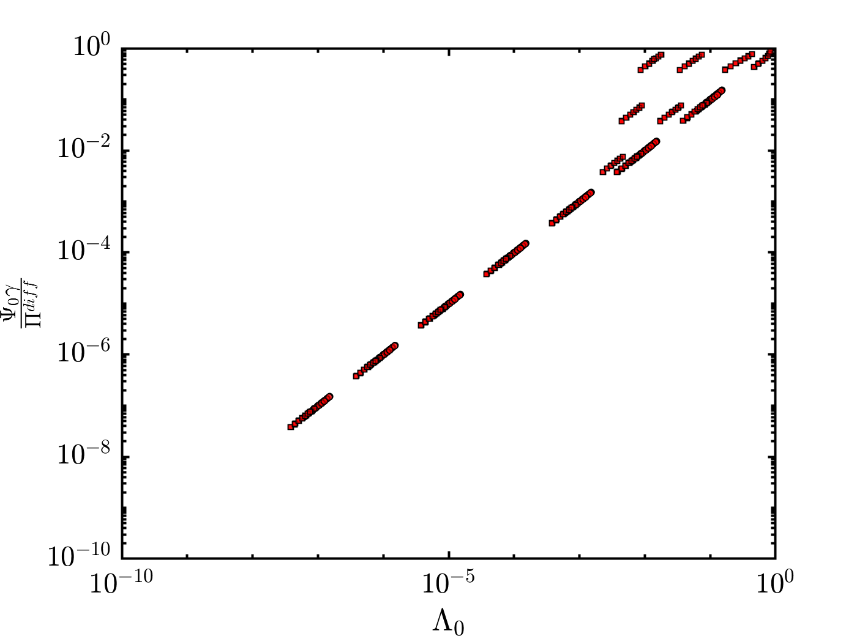
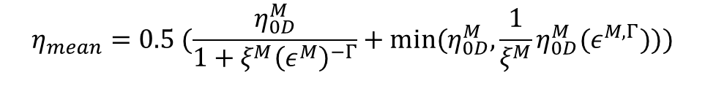



Average viscosity approach:
Using the minimum and maximum stress bounds to find the upper and lower bound of viscosity and using its average.
$$η_{mean}=0.5 (\frac{η_{0D}^{M}}{1+ξ^{M}{\left(ε^{M}\right)}^{−Γ}}+{min⁡(η}_{0D}^{M},\frac{1}{ξ^{M}}η_{0D}^{M}{(ε}^{M, Γ})))$$
${if ξ^{M}≤1 Π}_{diff}=(\frac{1}{2})\frac{ 2+ξ^{M}θ^{−Γ}}{1+ξ^{M}{\left(x_{disl0}θ\right)}^{−Γ} } (?)$
${if ξ^{M}>1 Π}_{disl}=(\frac{1}{2})\frac{ (2ξ^{M}+θ^{Γ})}{1+ξ^{M}{\left(θ\right)}^{−Γ} } (?)$
$Λ_{0}=Ψ_{0}γΠ_{\frac{diff}{disl}} (?)$

