Slide 1
PROTOTYPE SPECIFICATION & BLUEPRINT
Refrigerator & Pantry Inventory System
Smart Food Tracking, Category-Filtered Stock Management, Expiration Telemetry & Auto-Reordering

Slide 2
PROTOTYPE SYSTEM SPECIFICATION
1. Executive Summary & Prototype Scope
Pantry & Refrigerator Tracking
Batch-Level Expiration Tracking
Instant Modal Category Filters
Centralizes all food items across 6 structured categories. Tracks net stock, individual intake batches, and metric units (kg, liters, units, g).
Records distinct purchase and expiration dates for every batch. Automatically calculates nearest expiration date across active stock.
Interactive category selectors and keyword search inside Stock-In and Stock-Out modals for fast, immediate material location.
Real-time
3-Day Lookahead Expiration Alert
Automated Reorder Shopping List
Real-time visual indicators: Sufficient (Green), Low Stock (Yellow), Expiring Soon (Orange), Expired (Red), and Out of Stock (Red).
Proactively scans active inventory and displays an urgent top alert banner for batches expiring within 3 days or already expired.
Automatically generates replenishment lists when stock drops below minimum thresholds, with calculated order quantities.

Slide 3
PROTOTYPE SYSTEM SPECIFICATION
2. Food Category Architecture & Storage Classification
1. Fruits
2. Vegetables
3. Dairy Products
• Recommended Temp: 4°C to 7°C
• Storage Profile: Crisper storage; humidity controlled
• Items: Gala Apples, Strawberries, Lemons, Bananas
• Recommended Temp: 2°C to 4°C
• Storage Profile: Chilling-sensitive moisture preservation
• Items: Baby Spinach, Carrots, Yellow Onions, Garlic
• Recommended Temp: 1°C to 3°C
• Storage Profile: Strict cold-chain refrigeration
• Items: Whole Milk, Cheddar Cheese, Butter, Heavy Cream
4. Baking Products
5. Dessert Products
6. Raw Materials & Other
• Recommended Temp: 15°C to 20°C
• Storage Profile: Dry pantry storage; sealed bins
• Items: Flour, Granulated Sugar, Active Dry Yeast
• Recommended Temp: -18°C to 4°C
• Storage Profile: Freezer & chilled dessert bases
• Items: Dark Chocolate Chips, Tart Pastry Shells
• Recommended Temp: Ambient / Chilled
• Storage Profile: Cooking staples, oils, seasonings, proteins
• Items: Chicken Breast, Olive Oil, Black Pepper, Soy Sauce

Slide 4
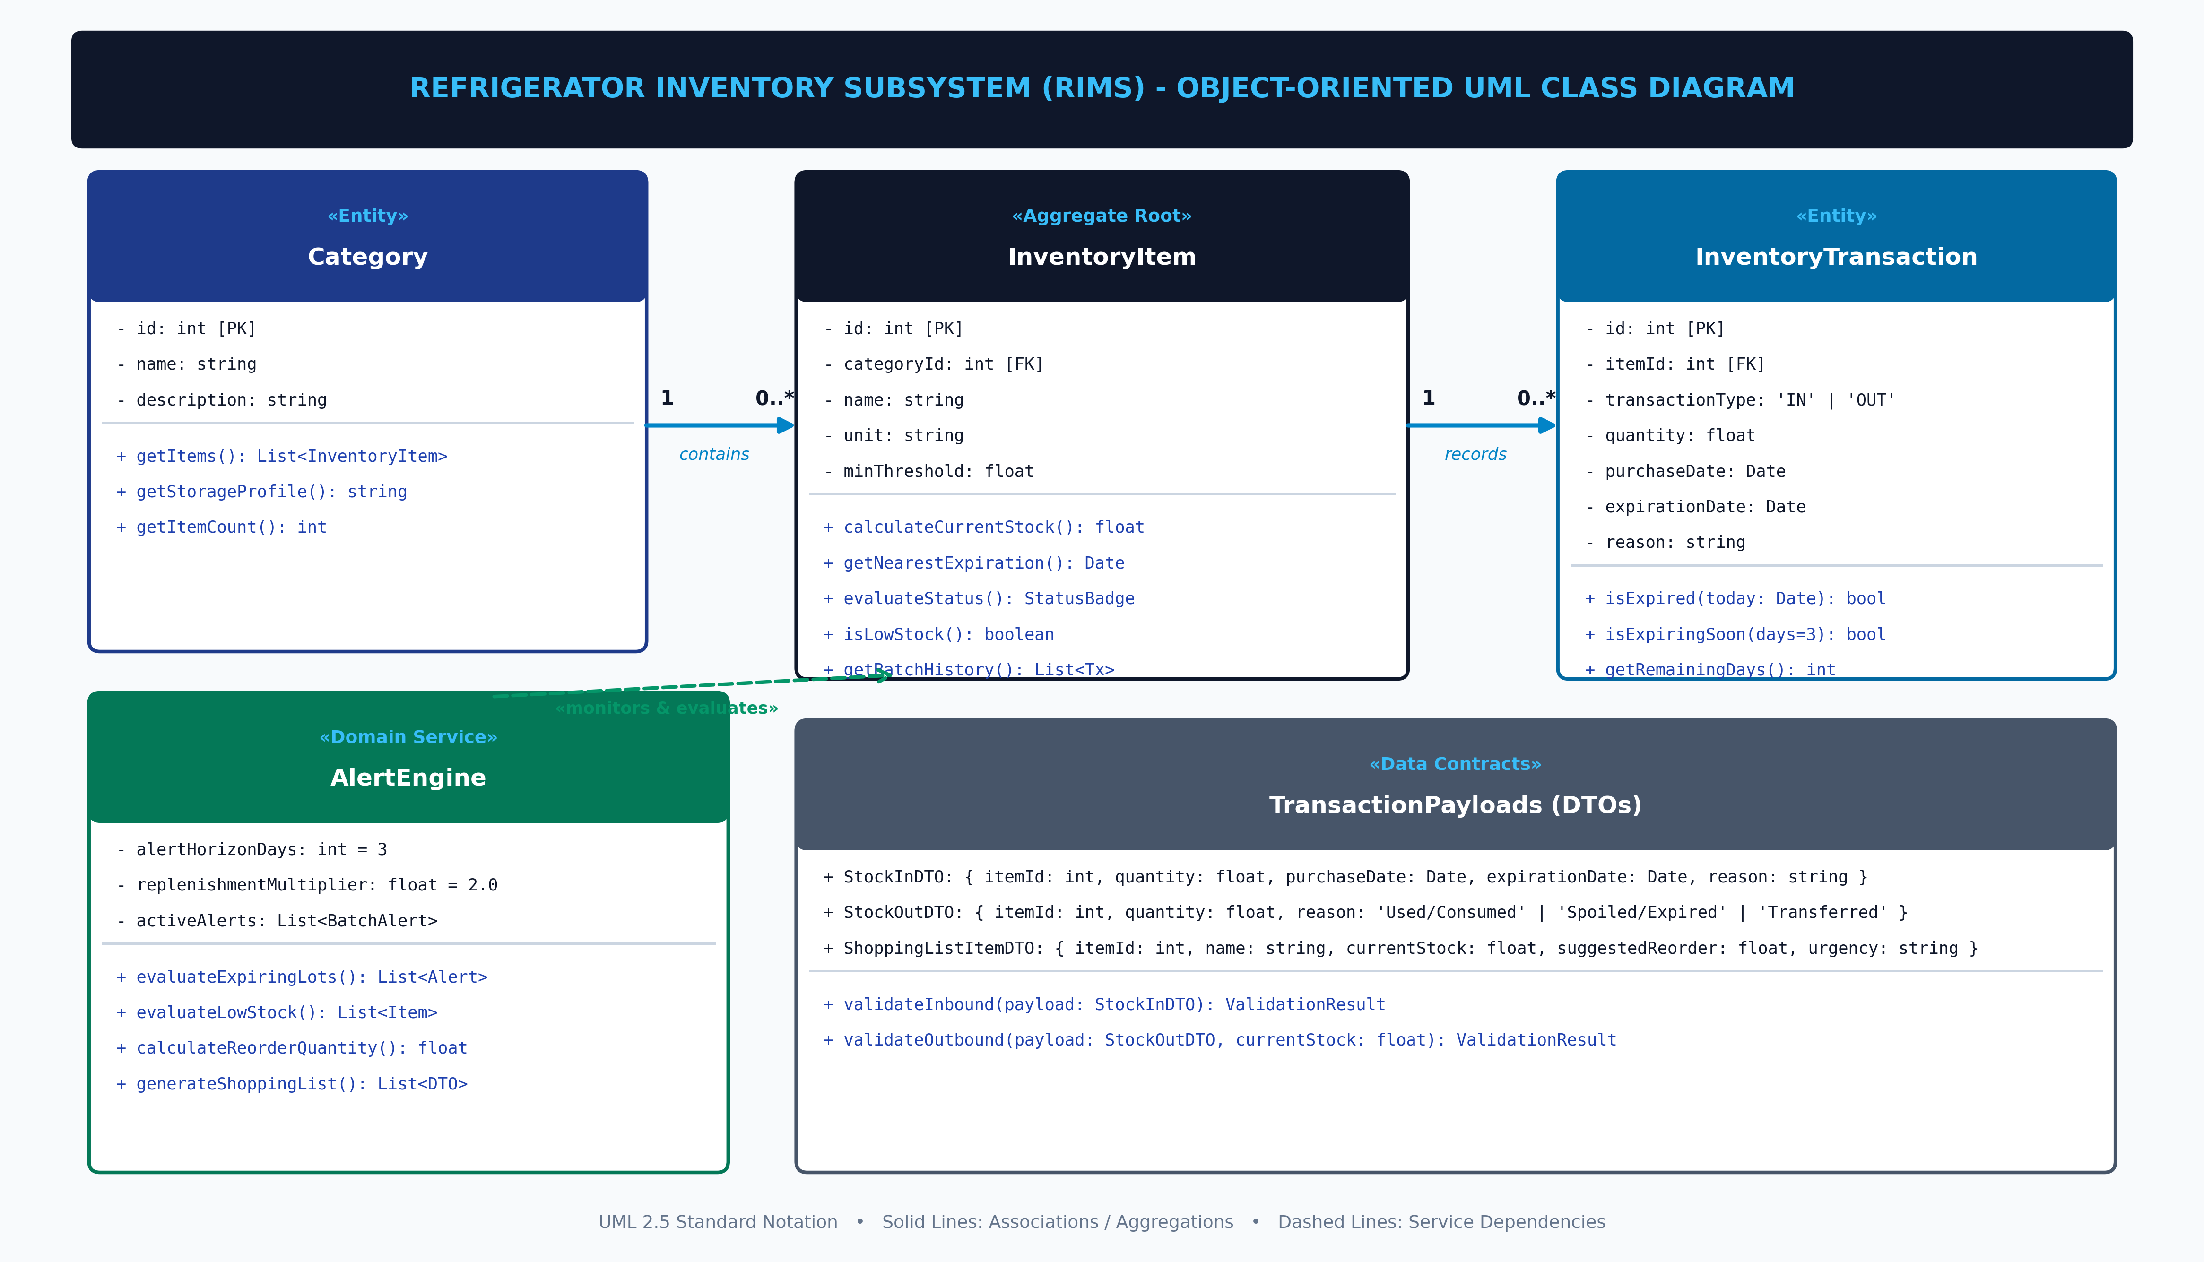
PROTOTYPE SYSTEM SPECIFICATION
3. Object-Oriented UML Class Diagram
Refrigerator & Pantry Inventory Subsystem (RIMS) | Slide 4 of 11

Slide 5
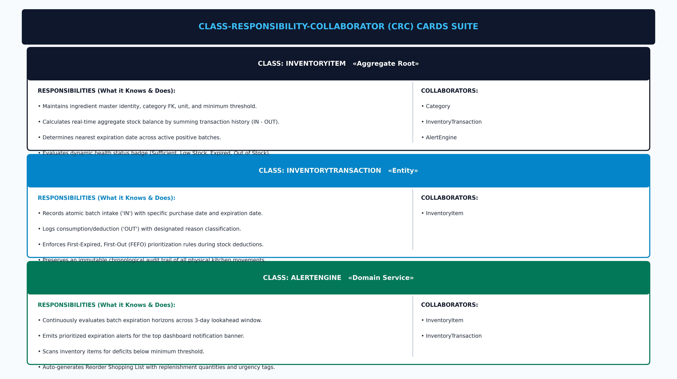
PROTOTYPE SYSTEM SPECIFICATION
4. Class-Responsibility-Collaborator (CRC) Cards
Refrigerator & Pantry Inventory Subsystem (RIMS) | Slide 5 of 11

Slide 6
PROTOTYPE SYSTEM SPECIFICATION
7. Inbound Stock-In Workflow & Category Filter Feature
1
Step 1: Open Stock-In Modal
User clicks '+ In' on an inventory row or '+ Stock In' from the dashboard.
2
Step 2: Instant Category & Keyword Filter
User selects a Category (e.g., 'Dairy Products') or types in the live search box. Modal dynamically filters dropdown to only matching materials.
3
Step 3: Quantity & Batch Dates Entry
User specifies intake quantity, purchase date, and batch expiration date.
4
Step 4: Reason Tagging
User selects reason: 'Initial Stock / Regular Purchase', 'Supplier Restock', or 'Fresh Produce Restock'.
5
Step 5: Database Commit & Real-Time Sync
POST /api/transactions/in logs the transaction, updates stock totals, and refreshes the UI dashboard instantly.

Slide 7
PROTOTYPE SYSTEM SPECIFICATION
8. Outbound Stock-Out Workflow & Validation Rules
Stock-Out Execution Flow
Deduction Reason Definitions
1. Material Selection
User filters by category or searches item name inside the Stock-Out modal.
2. Stock Sufficiency Check
Modal validates that deduction quantity <= available stock balance. Over-deductions are blocked with an error banner.
3. Reason Classification
User selects one of 3 clean reasons: 'Used / Consumed', 'Spoiled / Expired', or 'Transferred'.
4. Atomic Deduction Commit
POST /api/transactions/out writes the 'OUT' transaction and updates the item's balance.
• Used / Consumed (Default)
Standard culinary usage: ingredients cooked, eaten, or prepared for meals.
• Spoiled / Expired
Discarded inventory: food that reached past expiration, spoiled, or went bad.
• Transferred
Relocated inventory: stock transferred to another kitchen, station, or storage area.

Slide 8
PROTOTYPE SYSTEM SPECIFICATION
9. Real-Time Telemetry & 5 Status Badges
SUFFICIENT (Green Badge)
Trigger: current_stock >= min_threshold & No Expiring Batches • Healthy stock level; no immediate action required.
LOW_STOCK (Yellow Badge)
Trigger: 0 < current_stock < min_threshold • Inventory running low; automatically added to Reorder Shopping List.
EXPIRING_SOON (Orange Badge)
Trigger: 0 < (expiration_date - TODAY) <= 3 Days • Batch near expiration; highlighted in top banner to prioritize usage.
EXPIRED (Red Badge)
Trigger: Positive batch with expiration_date < TODAY • Batch past expiration; flagged for immediate inspection or discard.
OUT_OF_STOCK (Basic Indication)
Trigger: current_stock <= 0 • Completely depleted; urgent restock required.

Slide 9
PROTOTYPE SYSTEM SPECIFICATION
10. Automated Reorder Shopping List Engine
Reorder Calculation Formula
Shopping List Modal Features
Replenishment Target Formula:
Target Stock = 2 × min_threshold Suggested Reorder = MAX(1, Target Stock - current_stock)
Example Calculation (Lemons):
• Min Threshold: 10.0 units • Current Stock: 2.0 units • Target Level: 20.0 units • Suggested Reorder: 18.0 units (Urgency: HIGH)
✔ Automated Compilation
GET /api/alerts/shopping-list dynamically gathers all depleted items below threshold.
✔ One-Click Access
Top header button displays a live red badge count with total deficit items.
✔ Urgency Badges
Tags depleted stock (<= 0) as 'CRITICAL' and low stock as 'HIGH'.
✔ Category Breakdown
Organizes items by category with exact units for easy in-store or online grocery purchasing.

Slide 10
PROTOTYPE SYSTEM SPECIFICATION
11. Core Modules & Code Implementation Breakdown
Backend Modules (Node / Express / SQLite)
Frontend Modules (React 18 + Vite)
• server.js
Express REST server hosting /api/categories, /api/items, /api/transactions/in, /api/transactions/out, /api/dashboard/summary, and /api/alerts/*.
• db.js
SQLite database connection manager with async run(), get(), all() helper wrappers and auto-initialization.
• schema.sql & seed.sql
DDL script defining categories, items, and inventory_transactions with realistic sample items.
• App.jsx
Root orchestrator managing data fetch, search/category state, alert banners, and modal visibility.
• StockInModal.jsx / StockOutModal.jsx
Enhanced modals featuring live category dropdown filtering and instant material search.
• InventoryTable.jsx & CategoryGrid.jsx
Renderable interactive tables and cards with color-coded status badges.
• ShoppingListModal.jsx
Reorder modal displaying all low-stock items with suggested replenishment quantities.

Slide 11
PROTOTYPE SYSTEM SPECIFICATION
12. Summary & Live Prototype Deployment
1. Accurate Stock Tracking
2. Instant Material Discovery
Maintains exact real-time quantities and batch expiration dates across all 6 food groups with zero data loss.
Category filter dropdowns and keyword search in Stock-In/Out modals allow users to find items in seconds.
3. Proactive Spoilage Prevention
4. Automated Reordering
3-day lookahead expiration warnings and nearest expiry tags ensure perishable ingredients are used before spoiling.
Calculates required restock amounts automatically when stock falls below threshold, simplifying grocery planning.
🌐 LIVE PRODUCTION DEPLOYMENT (VERCEL)
https://refrigerator-inventory-system.vercel.app/

