Slide 1
Database Systems
Topic 1: Introduction to Database Systems

Slide 2
Learning Objectives
Learning Objectives:
Understand the role of data as a resource in an organisation
Provide definitions for: Data, Database and DBMS
Describe the database system environment
Understand the motivation for the database approach
State the objectives of the database approach
Explain what data independence means
Be aware of a database transaction
Be aware of database backup and recovery
Explain how a database improves the security of data
Understand how a database inter-relates data through a Data Model
Describe the major data models being: Relational, Hierarchical and Network
References:
Rob, P. & Coronel, C., Database Systems, 8th Edition, Chpt 1, Chpt 2 - Sections 2.1 - 2.5

Slide 3
Activity - Introduction to databases
For discussion: (5 minutes)
What is data?
What is information?
What is a database?

Slide 4
Data
Data refers to raw facts. Facts concerning people, places, events, or other objects/concepts
Data by itself is useless unless it is somehow processed
Data that is processed to reveal meaning becomes information
A lack of data leads to inadequate information and thus ill-informed decisions
Data represents a valuable corporate resource which needs adequate integrity and security controls
Data management is a discipline that focuses on the proper generation, storage and retrieval of data

Slide 5
Activity
In pairs, discuss the difference between data and information and think of 4 examples of each. (5 minutes)
We will talk about this using the board

Slide 6
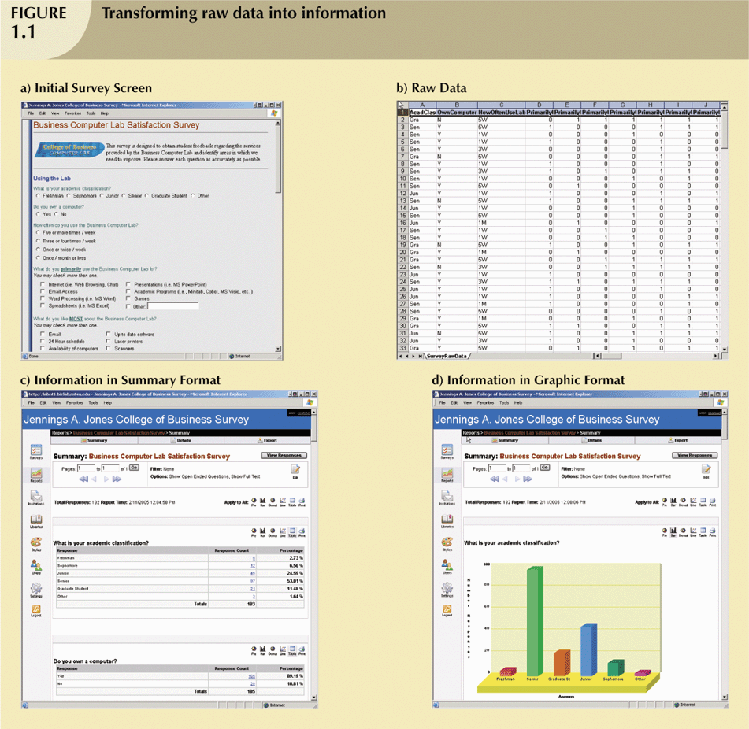
Data vs. Information
Notes:
It is essential to understand the difference between data and information as this drives the database design.
Fig a:Web Survery form
Fig b:Form’s raw data saved once the survey is completed
Fig c:Transformation of raw data into a data summary-information
Fig d: Data summary in graphical format to quickly extract meaning from data

Slide 7
Traditional File Systems
Databases are often contrasted to traditional file systems though the latter are now rarely used. But as the problems that existed were the impetus for the development of the “Database Concept” it is worth noting some of these.
Problems:
  Requires extensive programming in third-generation language (3GL)
  Data and structural dependence
  Data redundancy
Notes:
Structural dependence-Access to a file is dependent on it’s structure. File system programs must be modified to conform to the new file structure. Therefore all application programs are affected by change in the file structure.
Data dependence-All data access programs must be modified when any of the file’s data storage characteristics are changed.
Example changing a characteristics of data field from integer to decimal, require changes in all programs that access the file.
Data redundancy-Same data are stored unnecessarily at different places

Slide 8
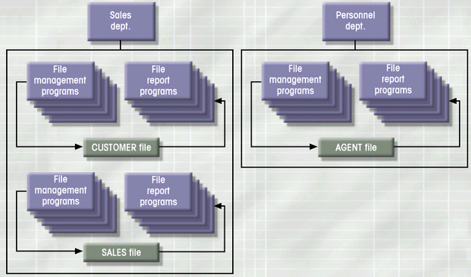
Traditional File Systems
Requests for information (reports) required a DP specialist to write programs for the department that required the report
File systems developed to address needs
Data was organized in the files according to expected use - led to islands of information
To retrieve data required extensive programming in third-generation language (3GL), this was time consuming and made ad hoc queries impossible
Often the same data was stored in many different locations, eg. agent details occurred in both the CUSTOMER and AGENT files

Slide 9
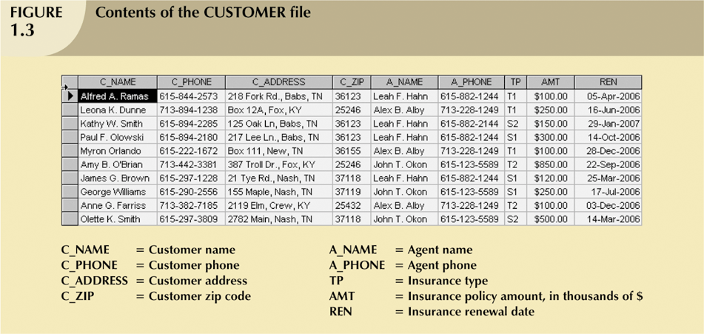
Traditional File Systems
Example of an insurance company file – can you see the problems here?
Notes:
It would be difficult to ensure that the data in these files is always consistent and up to date.
For example, when a policy holder changes their address, you would have to search thru several files to update this field otherwise you could end up with inconsistent data.
A system that is in an inconsistent state is capable of supplying incorrect or contradictory information to its users.
Redundant data - occurs when you store multiple copies of the same stored data.
Most DBMS can guarantee that the database is never in an inconsistent state (even when there is controlled redundancy) by ensuring that any change made to either of the two entries is automatically applied to the other one also.
Sometimes it is necessary to store multiple copies of data for performance reasons.

Slide 10
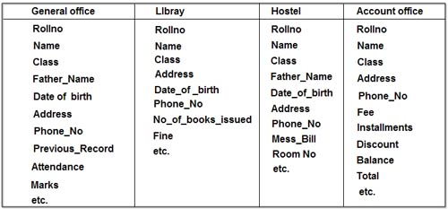
Traditional File Systems
Example of storing student records in different departments in a University, can you see the problems here?
Notes:
It would be difficult to ensure that the data in these files is always consistent and up to date.
For example, when a policy holder changes their address, you would have to search thru several files to update this field otherwise you could end up with inconsistent data.
A system that is in an inconsistent state is capable of supplying incorrect or contradictory information to its users.
Redundant data - occurs when you store multiple copies of the same stored data.
Most DBMS can guarantee that the database is never in an inconsistent state (even when there is controlled redundancy) by ensuring that any change made to either of the two entries is automatically applied to the other one also.
Sometimes it is necessary to store multiple copies of data for performance reasons.

Slide 11
Traditional File Systems
Data Dependence
  Changes in file’s data characteristics requires modification of data access programs
  Must tell program what to do and how
  Makes file systems cumbersome from a programming and data management views
Structural Dependence
  Change in file structure requires modification of related programs
Data Redundancy
  Different and conflicting versions of same data
  Results of uncontrolled data redundancy
    Data anomalies
      Modification, Insertion, Deletion

Slide 12
Traditional File Systems
Data Redundancy (cont)
  Data inconsistency
    Lack of data integrity
File Terminology
  Field
    group of characters with specific meaning
  Record
    logically connected fields that describe a person, place, or thing
  File
    collection of related records

Slide 13
Database System
Consists of related data stored in a single repository
Provides advantages over file system management approach
  Eliminates inconsistency, data anomalies, data dependency, and structural dependency problems
  Stores data structures, relationships, and access paths
The centralised control of data means that for many applications the data already exists
The data is no longer related by application programs, but by the structure defined in the database

Slide 14
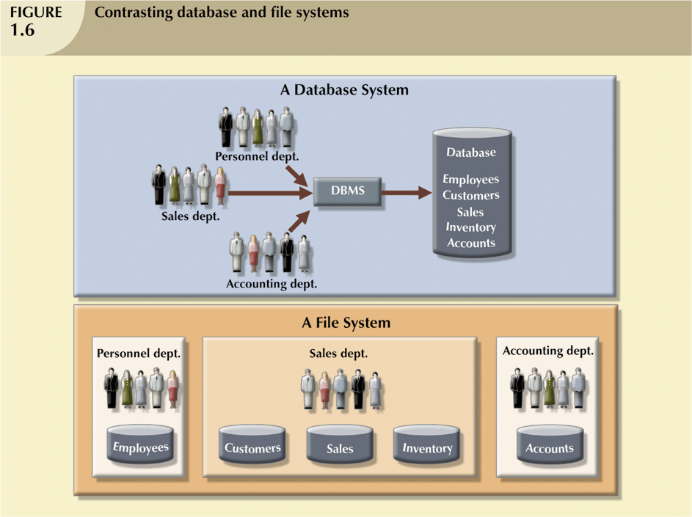
Database vs. File Systems

Slide 15
Objectives of Database Technology
Data Independence
Minimal Data Redundancy
Increased Data Sharing
Improved Data Quality
Improved Security of Data
Improved Access to Data
Reduced Program Maintenance
Inter-relate data thru the model
Notes:
Data Redundancy-When same data are stored at different places

Slide 16
Data Independence
Is the property of being able to change the logical or physical structure of data without requiring changes to application programs that manipulate that data
Results in a more complex structure
Data is stored independently of the programs
Data descriptions are not embedded in application programs.
Can the database structure be changed with no impact on application programs?
Role of the database catalog or dictionary (the metadata)

Slide 17
Logical vs Physical Data Independence
Global
Logical
Database
Description
Application
Program /
Local Views
Physical
Files
Logical Data
Independence
Physical Data
Independence
Notes:
Logical Data Independence
This is a measure of the degree to which a user's logical view of the data is independent of the "global" logical model.
eg. can new records, data items and relationships be added to the database without affecting local views?
Physical Data Independence
Can the physical storage mechanisms be altered and "tuned" for performance without affecting the global logical model?
Eg. Change the way the data is stored, Btree or HEAP
Adding indexes or moving the data to another disk
LOGICAL INDEPENDENCE
- the conceptual schema can grow and evolve over time without affecting the external schema
PHYSICAL INDEPENDENCE
- data structures or methods of representing data in secondary storage can be altered without modifying application programs

Slide 18
Minimal Data Redundancy
Returning to slide 8:
Minimise the duplication of data, separate into two 'piles' of data
  CUSTOMER data:
    c_no, c_name, c_address, c_zip, tp, amt, ren, a_code,
  AGENT data:
    a_no, a_name, a_phone
    Note agent details now only appears once for each agent

Slide 19
Sharing of Data – the problem
The DBMS should:
  support multiple concurrent users of the same data and
  ensure that the data remains consistent at all times
To avoid concurrency problems, transactions must be made logically serial
  One common technique used is record locking
  That is, a transaction can lock a record, preventing update by another transaction, until the update has completed.
Notes:
Here the update by transaction A is lost at time T4 . This is known as the lost update problem.

Slide 20
Data Integrity
Validation or integrity rules should be defined and automatically invoked at run time by the DBMS
Significant variation exists among DBMSs in the level of support for data integrity.
ANSI/ISO suggest that 100% of all enterprise rules should be held in the database, and specifically none in application programs.
An area of significant development during the 1990s.

Slide 21
Security
Protecting data against accidental or intentional use by unauthorised users
Each user requires identification with a user-id and password
Users can be restricted in the data they can see and what actions they can perform on that data.
The DBMS encrypts and decrypts data as it is stored and retrieved.
Views are often used to limit users access to data

Slide 22
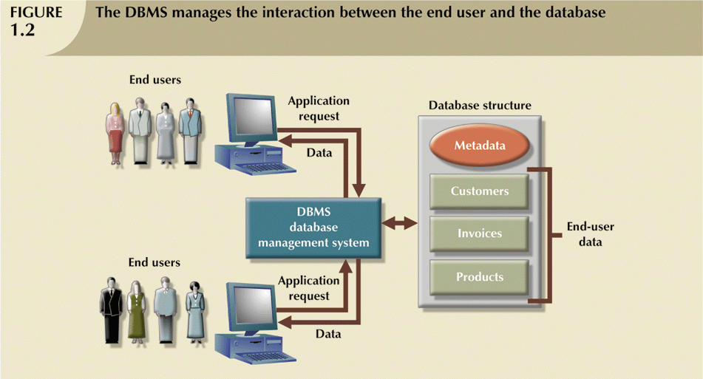
Database and DBMS
So…a database is a shared integrated computer structure that houses a collection of:
  end user data eg. product details, orders placed for these products
  metadata, or data about data, through which the data is integrated and managed
A database management system (DBMS) is
  a collection of programs that manages the database structure and controls access to the data stored in the database
  includes a query language
Notes:
Metadata stores information such as type of values(numeric, dates or text) stored on each data element

Slide 23
DBMS Functions
Data dictionary management
  stores the definitions of data and their relationships (metadata) in a data dictionary; any changes made are automatically recorded in the data dictionary.
Data storage management
  creates and manages the complex structures required for data storage.
Data transformation and presentation
  transforms entered data to conform to the data structures that are required to store the data

Slide 24
DBMS Functions
Security management
  creates a security system and enforces security within that system.
Multi-user access control
  creates complex structures that allow multiple‑user access to the data.
Backup and recovery management
  performs backup and data recovery procedures to ensure data safety.

Slide 25
DBMS Functions
Data integrity management
  promotes and enforces integrity rules to eliminate data integrity problems
Database language and application programming interfaces
  provides access to the data via utility programs and from programming languages interfaces.
Database communication interfaces
  provides end-user access to data within a computer network environment.

Slide 26
Database Models
Collection of logical constructs used to represent data structure and relationships within the database
  Conceptual models: logical nature of data representation
  Implementation/Physical models: emphasis on how the data are represented in the database
Conceptual Models consists of
  Context Model
  Key Model
  Fully attributed Model
Implementation/Physical Models consists of
  Hierarchical
  Network
  Relational

Slide 27
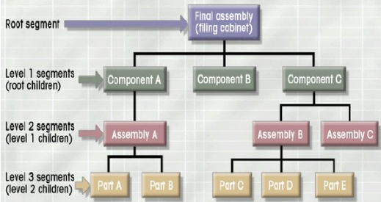
Implementation Models
Hierarchical
  Logically represented by an upside down tree
    Each parent can have many children
    Each child has only one parent

Slide 28
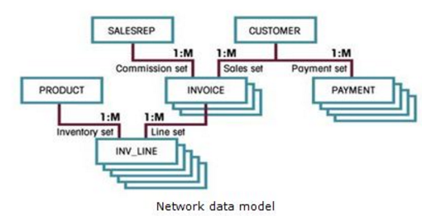
Implementation Models
Network
  Each record can have multiple parents
    Composed of sets
      Each set has owner record and member record
      Member may have several owners

Slide 29
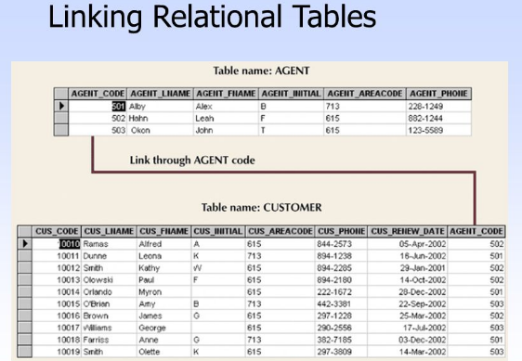
Relational Database Model
  Perceived by user as a collection of tables for data storage
  A table is a series of row/column intersections
  Tables related by sharing common entity characteristics
    This semester we will be concentrating on the Relational database model (the basis for most current DBMS)

Slide 30
Relational Database Model
Advantages
  Structural independence
  Improved conceptual simplicity
  Easier database design, implementation, management, and use
  Ad hoc query capability with SQL
  Powerful database management system
Disadvantages
  Substantial hardware and system software overhead
  Conceptual simplicity allows untrained people to potentially generate poor designs
  Ease of development may promote 'islands of information' as departments 'go their own way'

Slide 31
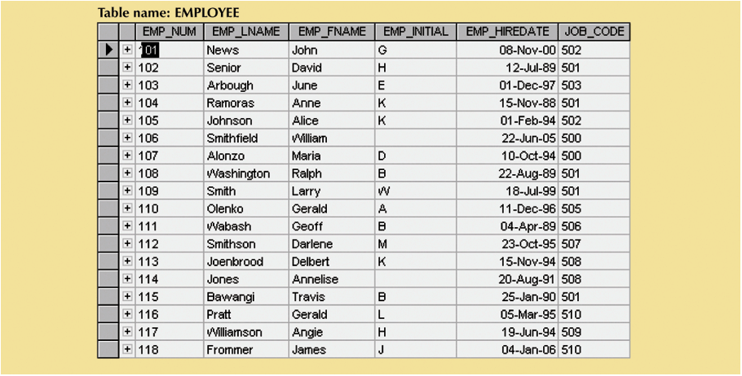
Relational Database Terminology
A relational database represents a collection of relations
_x0005_EMPLOYEE relation: EMPLOYEE (emp_num, emp_lname, emp_fname, emp_initial, emp_hiredate, job_code)
Row or TUPLE
Column or ATTRIBUTE
Tables, as above, are used as pictorial representations of relations
although there are some problems with this approach – see next week
Notes:
Terminology Used in a Relational Database
A relational database can contain one or many tables. A table is the basic storage structure of an RDBMS. A table holds all the data necessary about something in the real world—for example, employees, invoices, or customers.
The slide shows the contents of the EMP table or relation. The numbers indicate the following:
1. A single row or tuple representing all data required for a particular employee. Each row in a table should be identified by a primary key, which allows no duplicate rows. The order of rows is insignificant; specify the row order when the data is retrieved.
2. A column or attribute containing the employee number, which is also the primary key. The employee number identifies a unique employee in the EMP table. A primary key must contain a value.
3. A column that is not a key value. A column represents one kind of data in a table; in the example, the job title of all the employees. Column order is insignificant when storing data; specify the column order when the data is retrieved.
4. A column containing the department number, which is also a foreign key. A foreign key is a column that defines how tables relate to each other. A foreign key refers to a primary key or a unique key in another table. In the example, DEPTNO uniquely identifies a department in the DEPT table.
5. A field can be found at the intersection of a row and a column. There can be only one value in it.
6. A field may have no value in it. This is called a null value. In the EMP table, only employees who have a role of salesman have a value in the COMM (commission) field.
Note: Null values are covered further in subsequent lessons.

Slide 32
Summary
Information is derived from data, which are usually stored in a database
A DBMS is software that implements and manages a database
Databases were developed to address the weaknesses of file systems
A DBMS
  presents to the user a single data repository that promotes data sharing
  Enforces data integrity, eliminates redundancy and promotes data security

