Slide 1
Database Systems
Topic 3: Database Design& Life Cycle

Slide 2
3 Level ANSI-SPARC Database Architecture
ANSI/SPARC
  classified data models in the 1970s according to their degree of abstraction: conceptual, external and internal
System requirements
  All users should be able to access same data
  A user's view should be immune to changes made in other views
  Users should not need to know physical database storage details
  Database Administrator (DBA) should be able to change database storage structures without affecting the users' views.
  Internal structure of database should be unaffected by changes to physical aspects of storage.
  DBA should be able to change conceptual structure of database without affecting all users

Slide 3
3 Level ANSI-SPARC Database Architecture cont’d.
External Level
  Users' view of the database. Describes that part of database that is relevant to a particular user
Conceptual Level
  Global (community) view of the database. Is the basis for the identification and description of the main data objects.
  Describes what data are stored in the database and relationships among the data
Internal Level
  Physical representation of the database on the computer. Describes how the data is stored on storage media (sometimes referred to as the Physical Level)
Notes:
External Level and Conceptual Level are software and hardware independent.

Slide 4
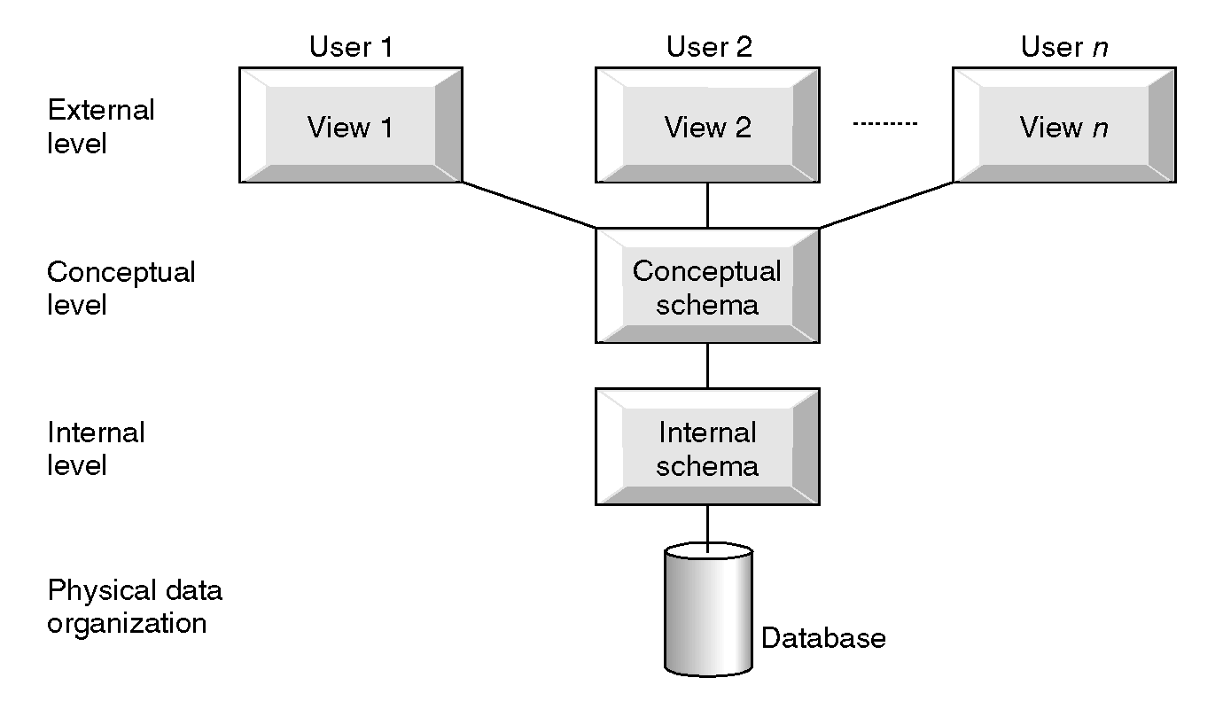
3 Level ANSI-SPARC Database Architecture

Slide 5
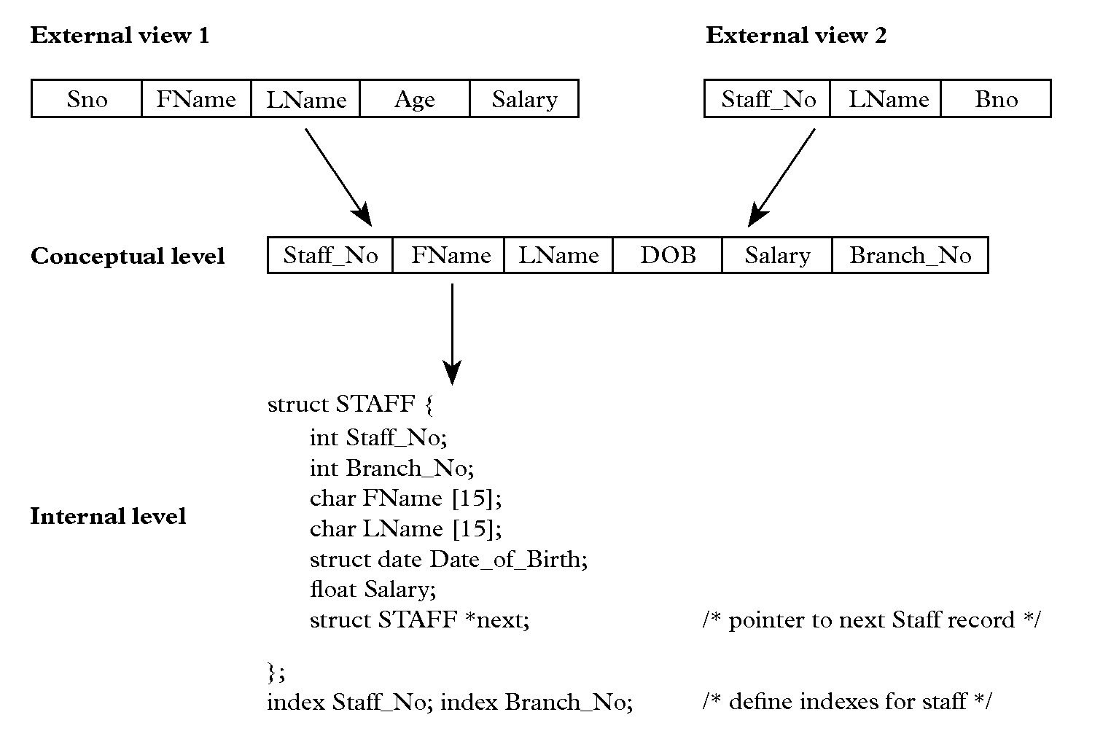
3 Level ANSI-SPARC Architecture Example
Notes:
Internal Level is software and hardware dependent

Slide 6
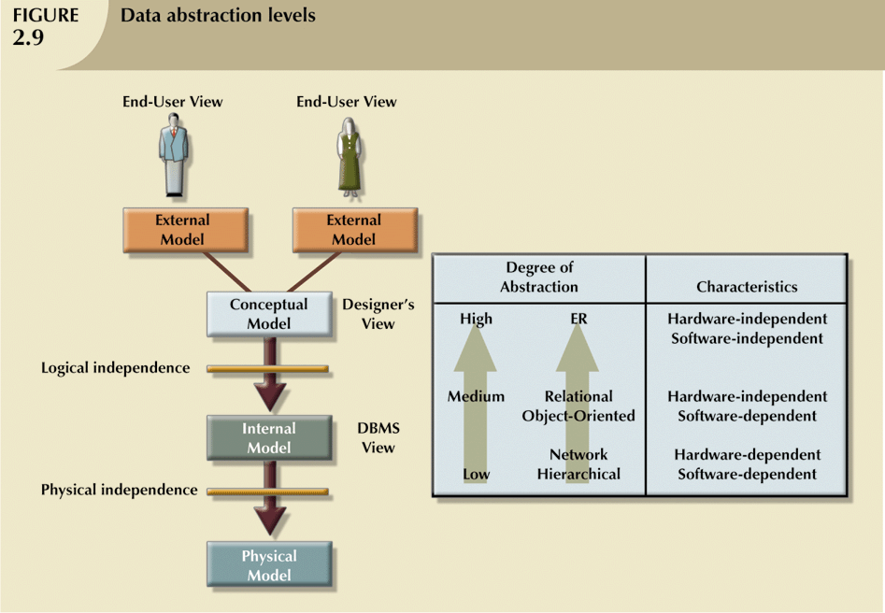
R&C “Modified” ANSI SPARC Architecture
Data Abstraction Levels
Notes:
Rob and Coronel’s Modified ANSI SPARC Architecture

Slide 7
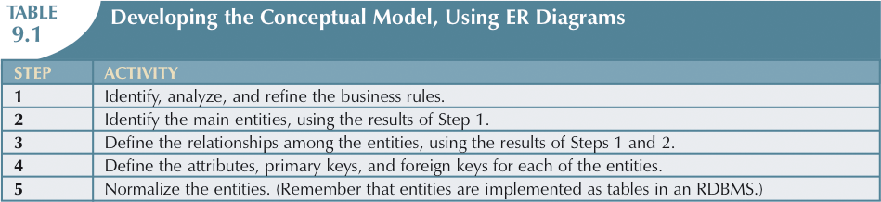
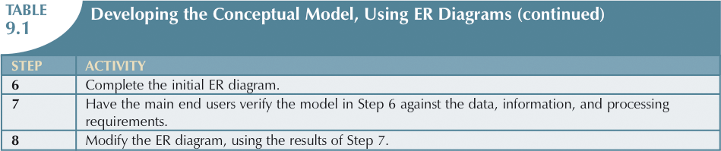
Developing the Conceptual Model
Using ER (Entity Relationship) Diagrams

Slide 8
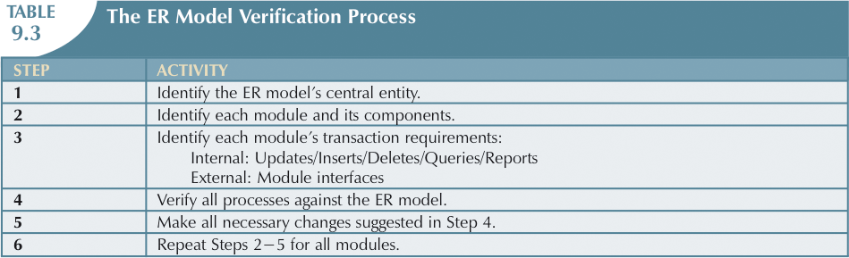
The ER Model Verification Process

Slide 9
ER Model Cont’d…
It is easier to examine structures graphically and so designers use a graphical tool to represent entities and their relationships.
ER Model are normally represented in an Entity Relationship Diagram (ERD).
ERD uses graphical representations to model database components.
Notes:
Steps to generate fully attributed Physical ERD:
1.Context ERD
2.Fully Attributed ERD
3.Physical ERD

Slide 10
Conceptual Model
Conceptual Model and Logical model refers to the same concept.
These models consists of:
-Context Model (M: N relationships)
-Key Model (Identify PK and FKs)
-Fully Attributed Model (All attributes identified with keys)
Here we focus on Context Model and Fully Attributed Model

Slide 11
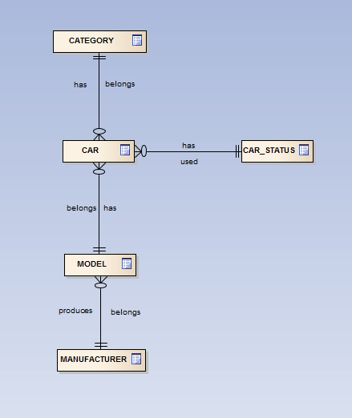
Context Model
Context ERD
Representation
generalised, non data
model specific (eg. NO PKs
NO FK’s) and non
DBMS specific
Notes:
Steps to generate Context ERD
Identify Entities
Find Relationships
Draw Rough ERD
Fill in cardinality

Slide 12
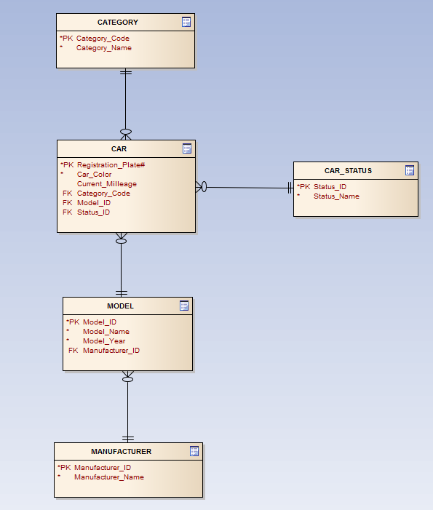
Fully Attributed Model
Fully Attributed ERD
Representation now specific to a data model, here Relational (PKs and FK’ have been added) but not specific to a particular DBMS.
No data types to be specified
Notes:
Steps to generate Fully Attributed ERD
Once the Conceptual ERD is ready then
Identify Primary keys
Identify Foreign Keys
Identify all Attributes
Map Attributes
Resolve any M:N relationships in the Context ERD

Slide 13
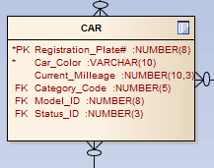
Physical Model
Can be represented as a
DBMS Schema:
CREATE TABLE CAR (
registration_Plate_number INT NOT NULL,
Model_ID INT NOT NULL,
category_code VARCHAR(3) NOT NULL,
status_code VARCHAR(3) NOT NULL,
colour VARCHAR(3) NOT NULL,
current_mileage NUMBER(12,3) NOT NULL,
CONSTRAINT pk_registration
PRIMARY KEY (registration_Plate_number)); …etc
or as a
Physical ERD:
Representation now specific to a particular relational DBMS, here for example Oracle (Data types and sizes must be specific to selected DBMS). Schema file can be run against database to create table structures
Notes:
Steps to generate Physical ERD
Identify Attributes types and sizes
Draw fully attributed ERD with data types mentioned

Slide 14
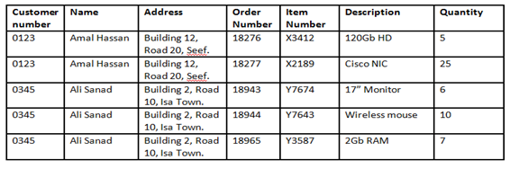
Activity – Orders ERD
Analyze the data above and identify problems with it.
Use the above data to create a Conceptual ERD for the data
  Create an ERD on paper
  Create Three entities, giving them appropriate names
  Identify one Primary Key per entity
  Once you are happy with your ERD, transfer it to the whiteboard for discussion with the class

Slide 15
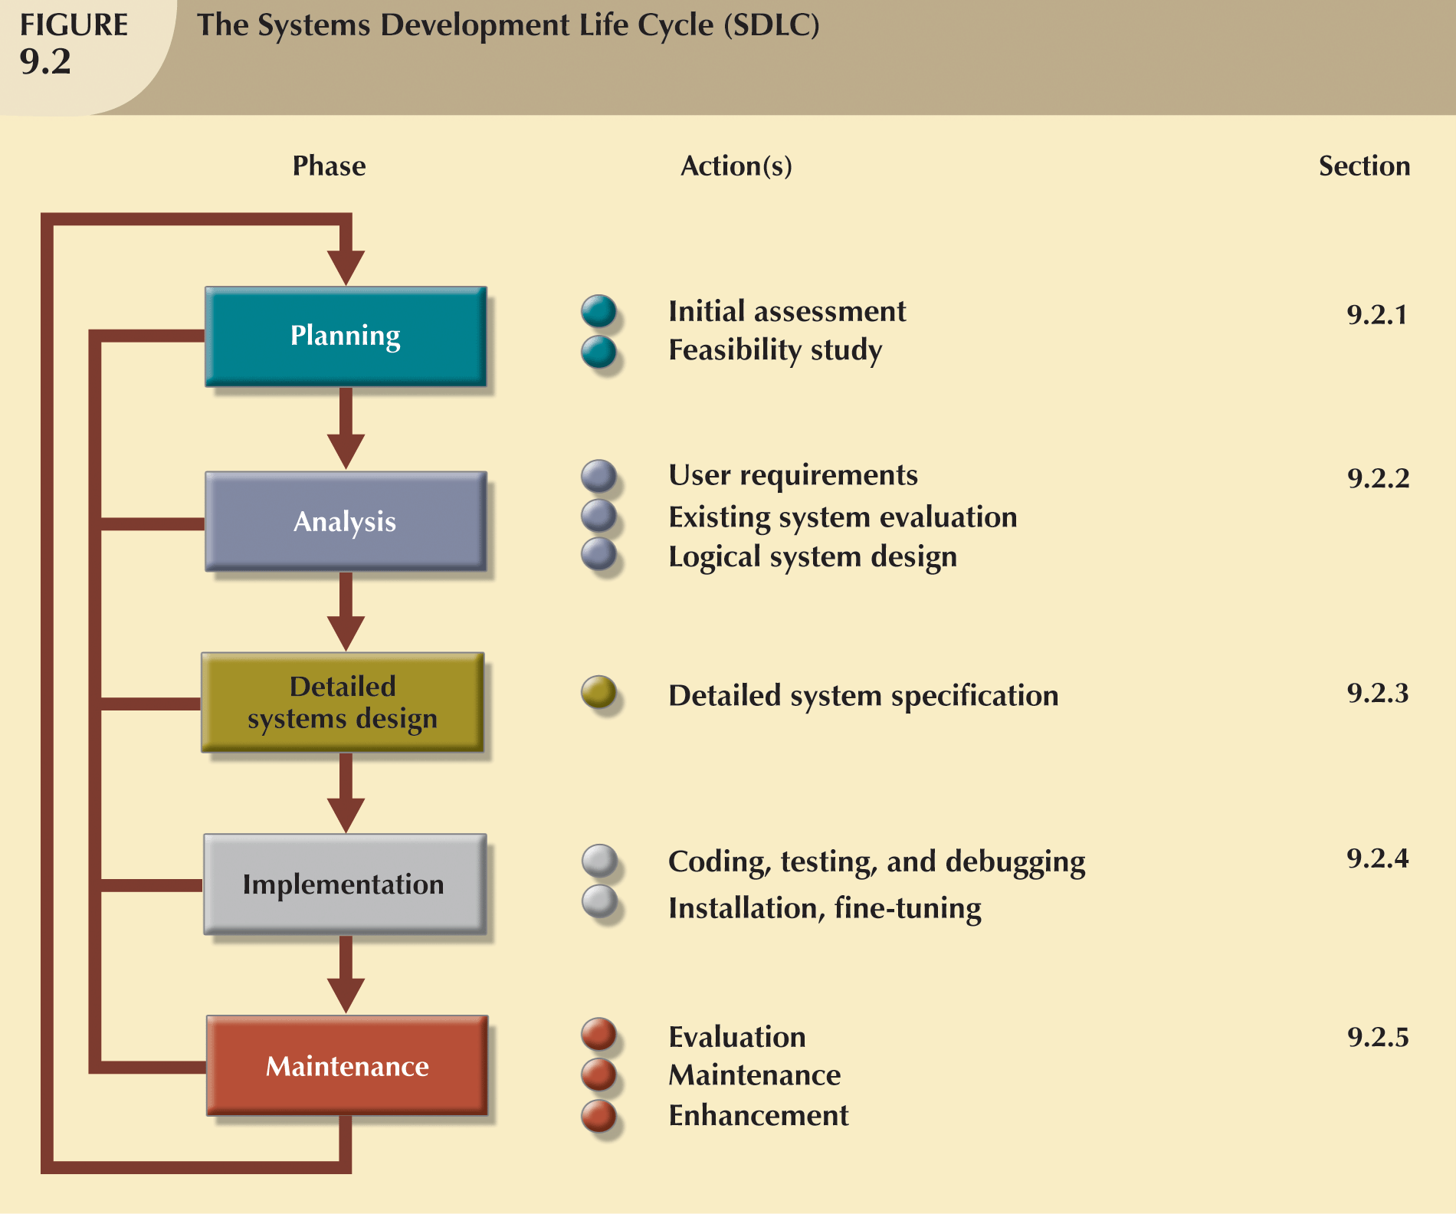
The Systems Development Life Cycle (SDLC)

Slide 16
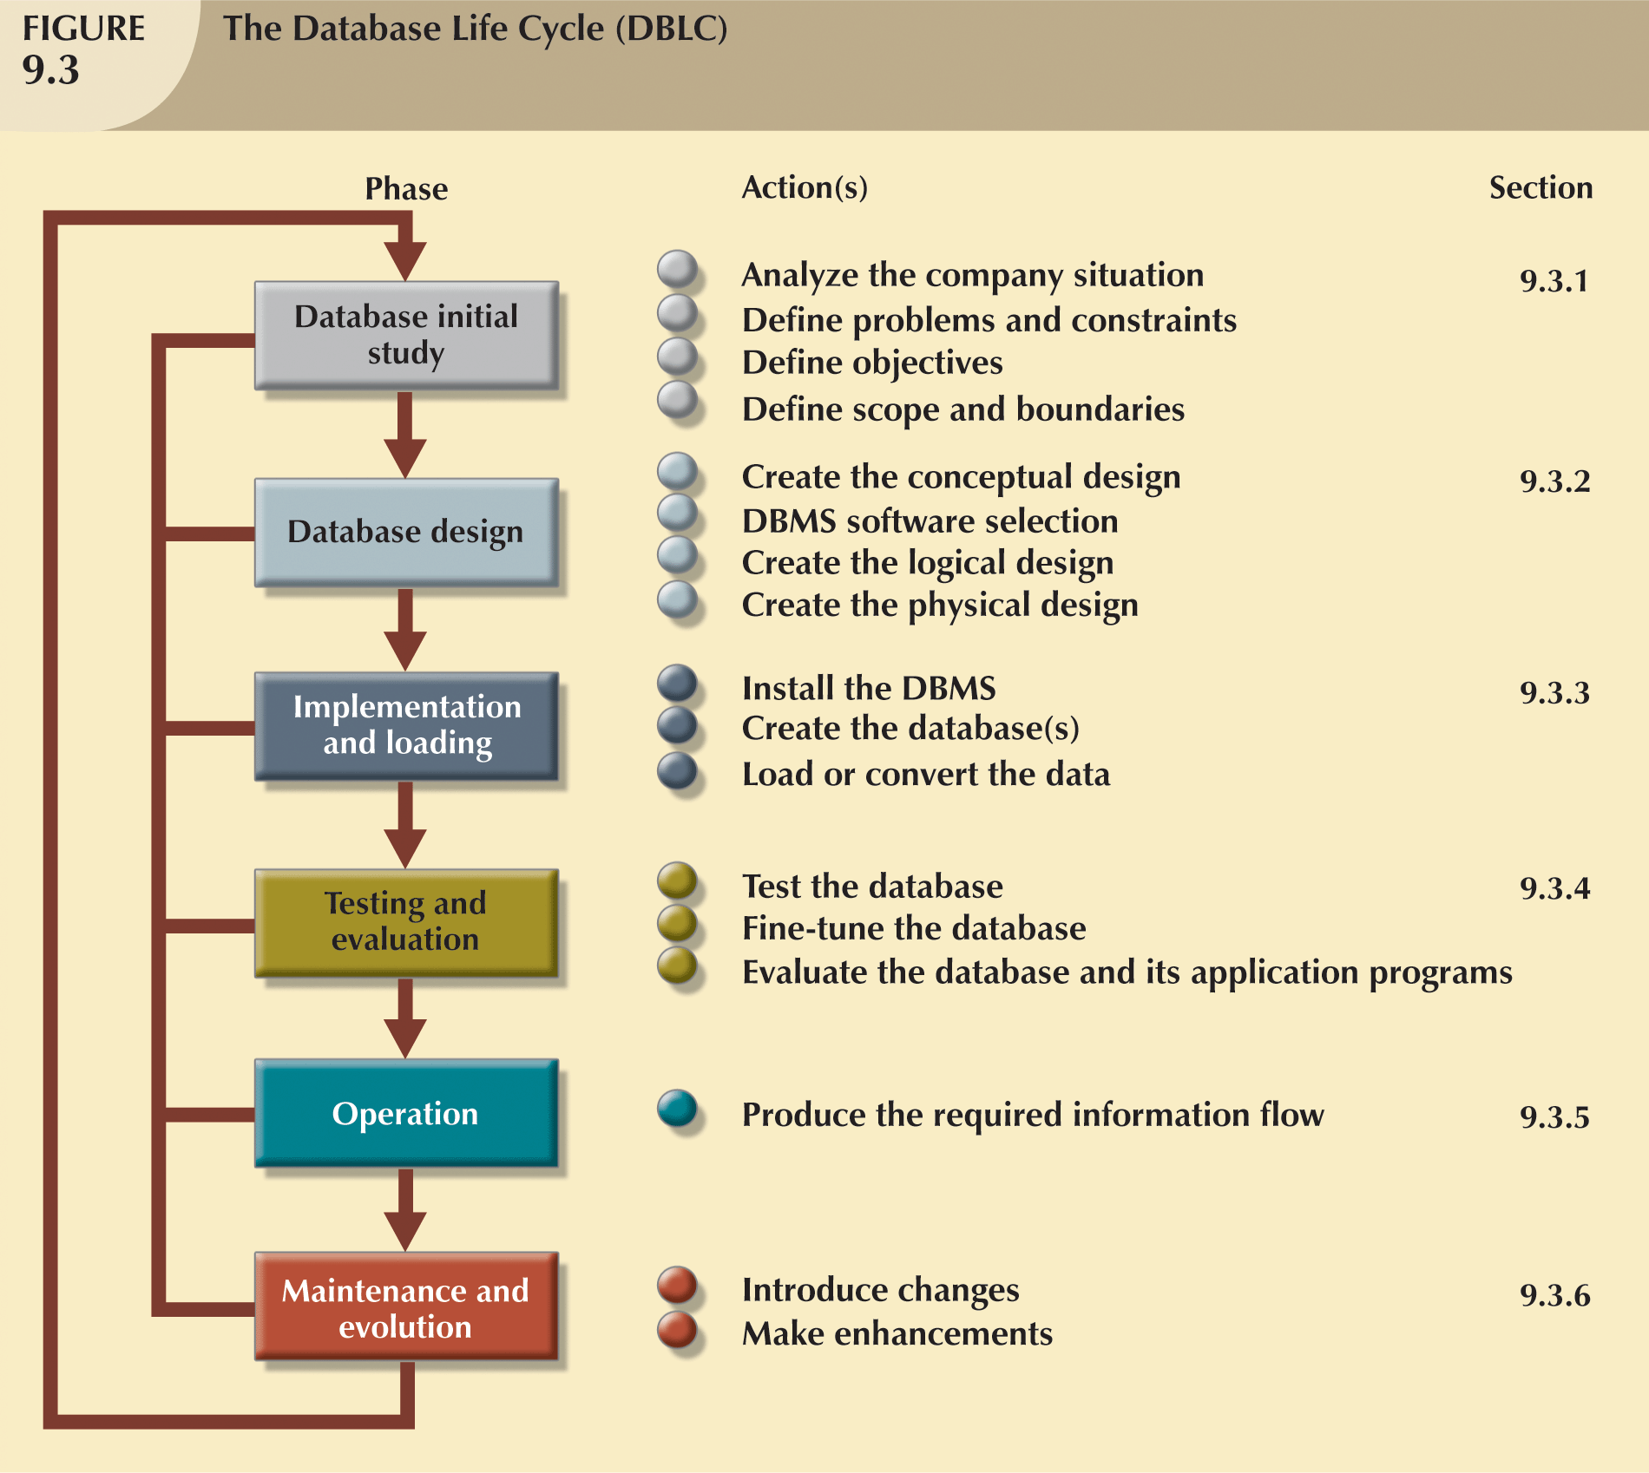
The Database Life Cycle (DBLC)

Slide 17
Phase 1: The Database Initial Study
Overall purpose:
  Analyse the company situation
    Discover what the company’s operational components are, how they function, and how they interact
  Define problems and constraints
  Define objectives
    Defines extent of design according to operational requirements
    Helps define required data structures, type and number of entities, and physical size of the database
  Define scope and boundaries
Interactive and iterative processes required to complete the first phase of the DBLC successfully

Slide 18
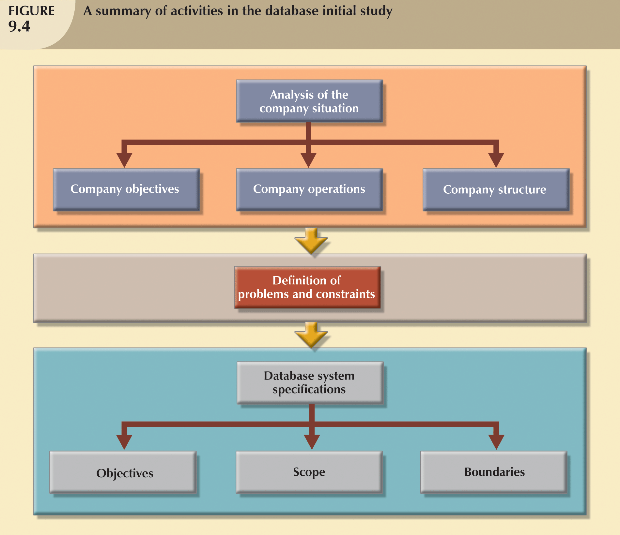
Activities in the Database Initial Study

Slide 19
Phase 2: Database Design
Necessary to concentrate on the data
Identify characteristics required to build database model
Two views of data within system:
  Business view of data as information source
  Designer’s view of data structure, its access, and the activities required to transform the data into information
Does not constitute a sequential process
  Iterative process that provides continuous feedback designed to retrace previous steps

Slide 20
Step I - Conceptual Design
Data modeling is used to create an abstract database structure that represents real-world objects in the most realistic way possible
Must embody a clear understanding of the business and its functional areas
Ensure that all data needed are in the model, and that all data in the model are needed
Requires four stages
  A: Data Analysis and Requirements
  B: ER Modeling
  C: Model Verification
  D: Distributed Database Design (if required)

Slide 21
Steps II-Logical Design
  Critical to the information system’s smooth operation
  Advantages and disadvantages should be carefully studied
  Used to translate conceptual design into internal model for a selected database management system
  Logical design is software-independent

Slide 22
Step III: Physical Design
Process of selecting data storage and data access characteristics of the database
Storage characteristics are a function of device types supported by the hardware, type of data access methods supported by system, and DBMS
Particularly important in the older hierarchical and network models
Becomes more complex when data are distributed at different locations
Although we will examine the issues involved with physical design during this unit, we will not be able to have significant practical experience with characteristics such as storage structures, access methods etc

Slide 23
The Database Life Cycle (DBLC)
Notes:
Next Phase 3 : Implementation and Loading

Slide 24
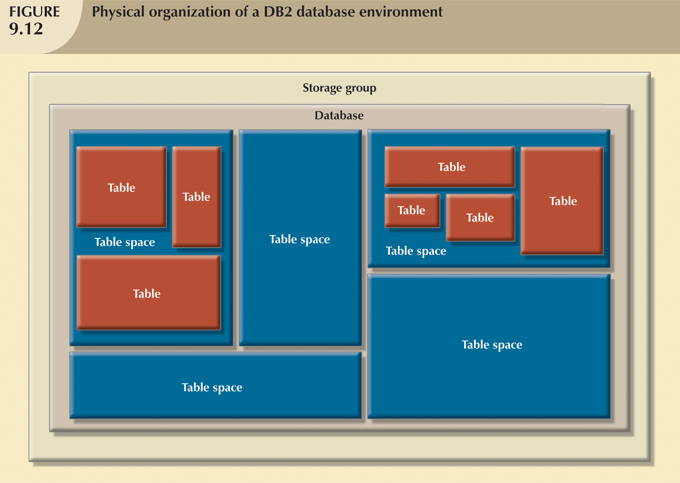
Phase 3 Implementation and Loading
New database implementation requires the creation of special storage-related constructs to house the end-user tables

Slide 25
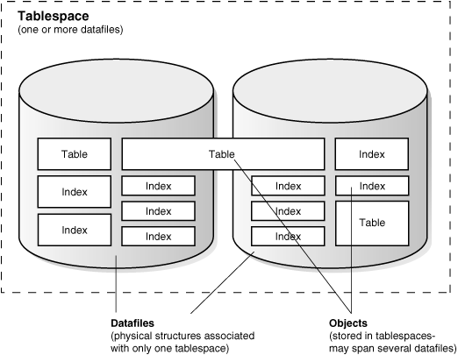
Phase 3 - Implementation
Oracle Physical structure*
*diagram from http://download.oracle.com/docs/cd/B19306_01/server.102/b14220/physical.htm#g21431

Slide 26
Phase 4 Testing and Evaluation
Once the data has been loaded into the database the DBA tests and fine tunes the database for performance, integrity, concurrent access and security constraints
Occurs in parallel with applications programming
Database tools used to prototype applications
If implementation fails to meet some of the system’s evaluation criteria
  Fine-tune specific system and DBMS configuration parameters
  Modify the logical design
  Modify the physical design
  Upgrade or change the DBMS software and/or the hardware platform

Slide 27
Phase 5 and 6
Operation and Maintenance / Evolution
Operation
  Once the database has passed the evaluation stage, it is considered operational
  Beginning of the operational phase starts the process of system evolution
Required periodic maintenance:
  Preventive maintenance (backup)
  Corrective maintenance (recovery)
  Adaptive maintenance (enhancing performance, adding entities, attributes, etc)
Assignment of access permissions and their maintenance for new and old users
Generation of database access statistics
Periodic security audits
Periodic system-usage summaries

Slide 28
A Special Note about
Database Design Strategies
Two classical approaches to database design:
  Top-down design
    Identifies data sets
    Defines data elements for each of those sets
    Involves the identification of different entity types and the definition of each entity’s attributes
  Bottom-up design
    Identifies data elements (items)
    Groups them together in data sets
    First defines the attributes and then groups them to form entities

Slide 29
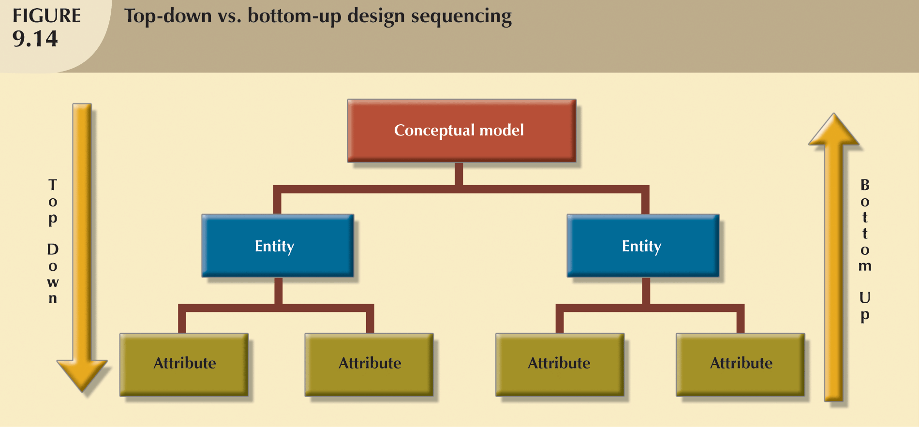
Top-Down vs. Bottom-Up Design Sequencing

Slide 30
Summary
This lecture
  Describe the 3 level ANSI SPARC Database Architecture
  Describe the steps involved in the Systems Development Life Cycle (SDLC)
  Explain the steps involved in the Database Life Cycle (DBLC)
  Explain, in detail, within the Database Design phase of the DBLC, the role of: ER modelling and Normalisation, Data Model Verification, Distributed Database Design, Logical and Physical Design
  Describe the database design strategies - Top-down vs. bottom-up design Conceptual Design – the ER Model

