Slide 1



Physics Simulation
Presented By
Alish Akadil

Slide 2



why this topic?
Physics is limitless! I have been interested in physics since my early years, and modeling and simulation of physics is my element.
In the code I used a lot of constants and knowledge of physics helped me a lot. The theme itself is ideal for me, my theme and my project are the best

Slide 3

First I had to study the pygame, math, sys libraries closely.
I watched tutorials on YouTube and AITU materials, various projects on GitHub and
I reached a perfect level
where did i start?
And how to implement without a sketch? Of course, I thought a lot about what simulators I should make. And I settled on three games
Made a menu for the game,
logical connections, and so on
And the main thing is to enter via PIN code

Slide 4
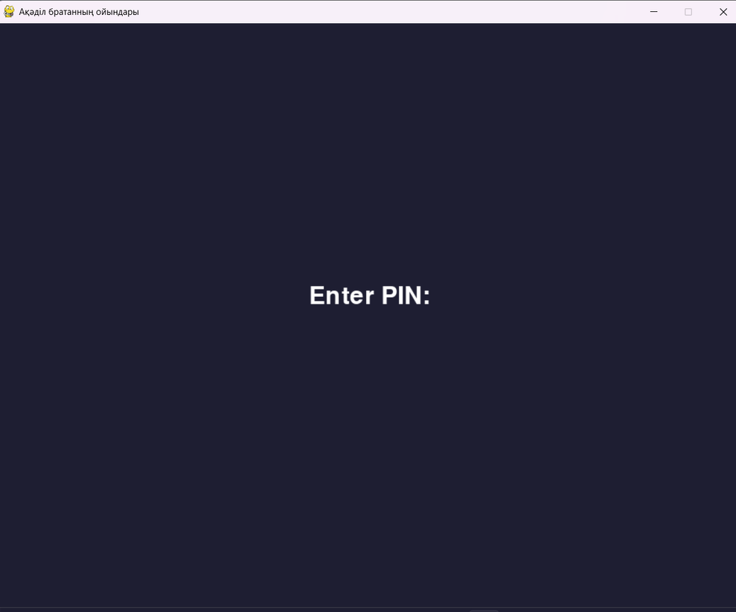
INNOVATION:Login via pin code
When we launch the game, we are greeted by such a window and asked to enter a pin code.
I suppose this is the innovation and relevance of my project

Slide 5
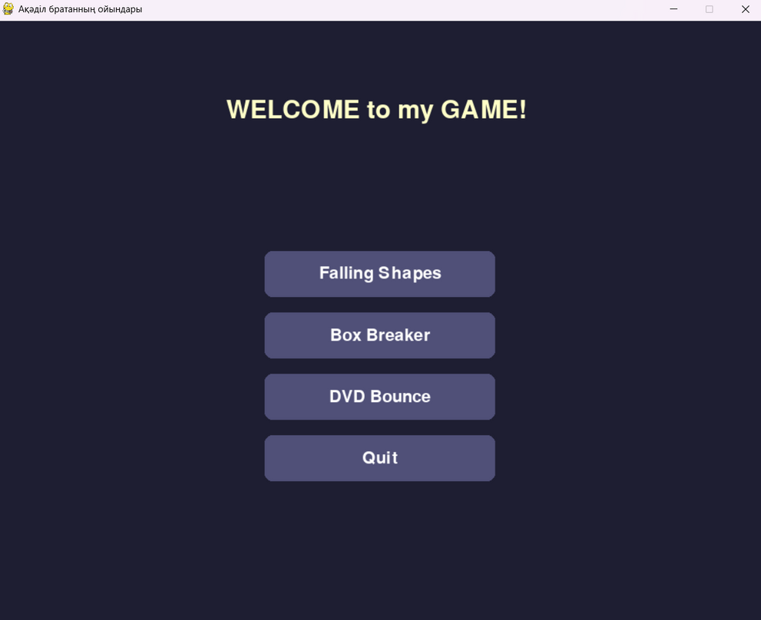
Menu:
When you enter the correct PIN code, you will be redirected to the menu
You are greeted by a beautiful menu with enticing music.
You are offered 3 games:
1. Falling Shapes, 2. Box Breaker, 3. DVD Bounce
and there is a button to exit (QUIT)

Slide 6



Oops! Bugs!
Everyone makes mistakes, even programmers! Sometimes there are errors in the code, called "bugs." Programmers need to find and fix these bugs to make their programs work properly. It's like being a detective!

Slide 7
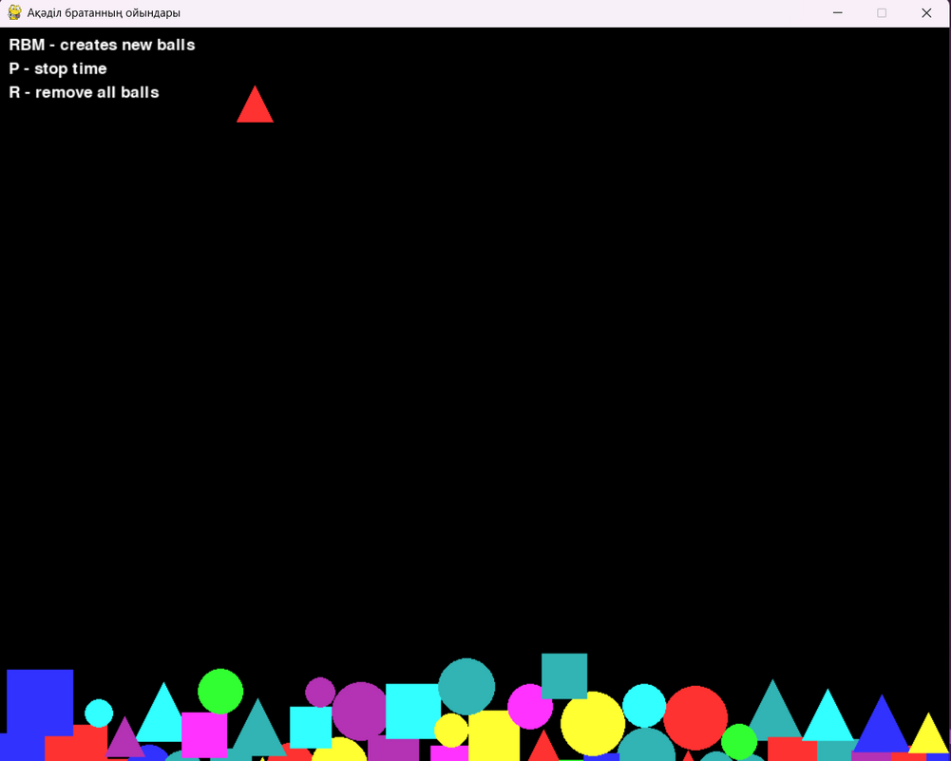
1st game:
FALLING SHAPES
The first game is falling figures, random three figures are served in a random shade.
They can also be controlled: P - stop the time for the balls, R - remove all
and RBM adds more figures.

Slide 8
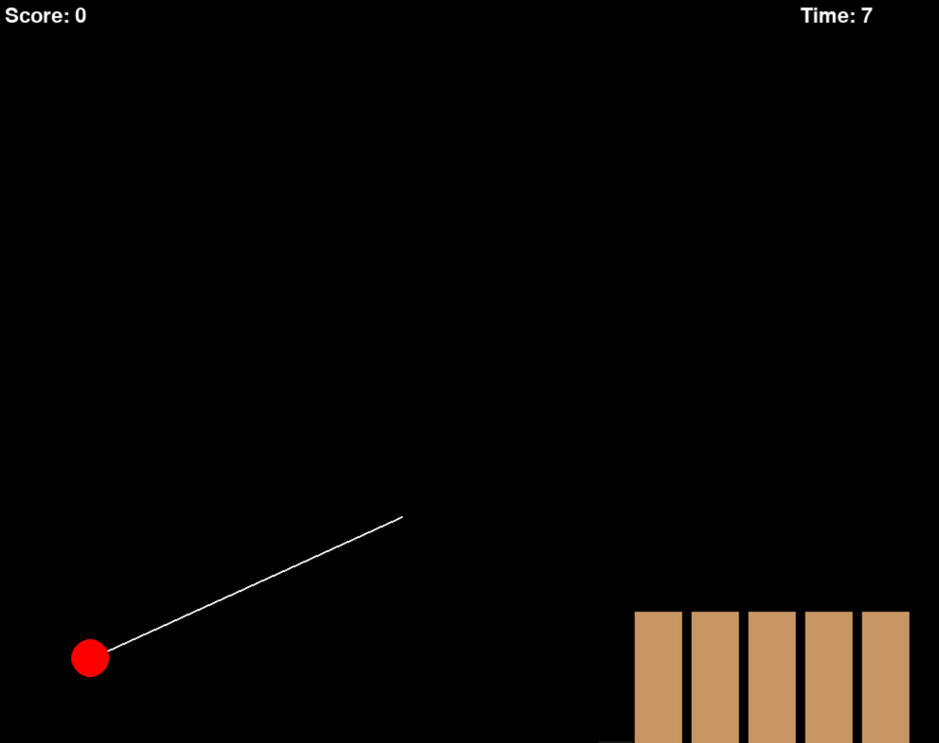
2nd game:
BOX BREAKER
The second game is a realization of the legendary game ANGRY BIRDS.
The principle: shooting from a slingshot. The goal: to break all the boxes in a certain time
And you can also manage objects

Slide 9
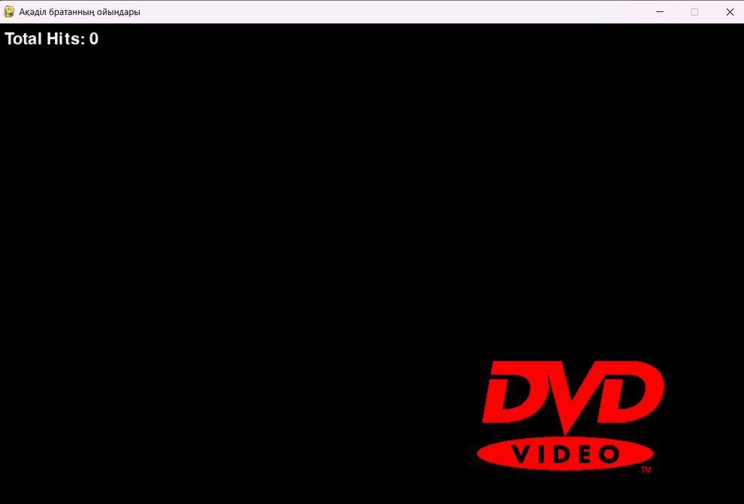
3rd (last)game:
DVD BOUNCE
It looks like a simple simulation of hitting the edges of the logo, but it hides all the potential of physics and probability theory

Slide 10

end... ?
If you enjoyed the game, you can close it.
Thank you for everything!

Slide 11


Thank You
for ur attention!

