Slide 1
Breadth First Search

Slide 2
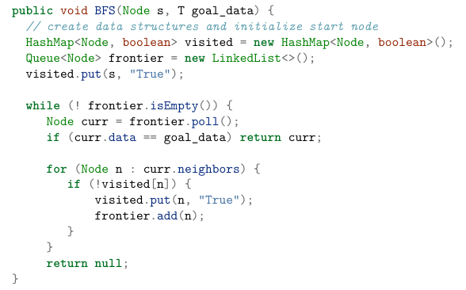
A
D
B
C
F

Slide 3
Depth First Search

Slide 4
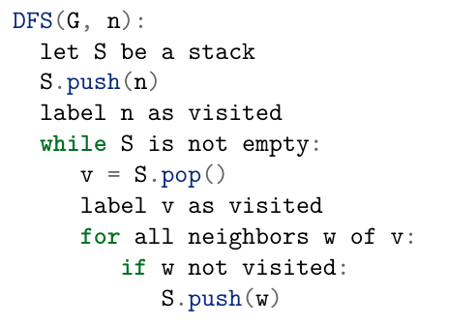
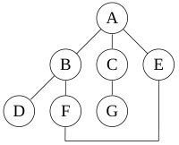
And print label!

Slide 5
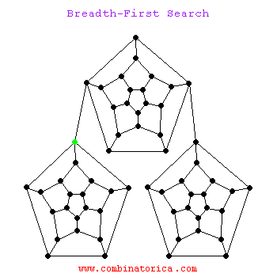

Source: Stony Brook CS

Slide 6
When to use one or the other?
Effect of graph size?
Effect of graph degree?
What do we know about solutions?
Example 1: playing chess, find valid move that isn't open to capture
Example 2: find youngest male descendant in family tree
Example 2: finding closest city in map
Example 4: check if any trajectories will lead to unsafe state (limited memory)

Slide 7
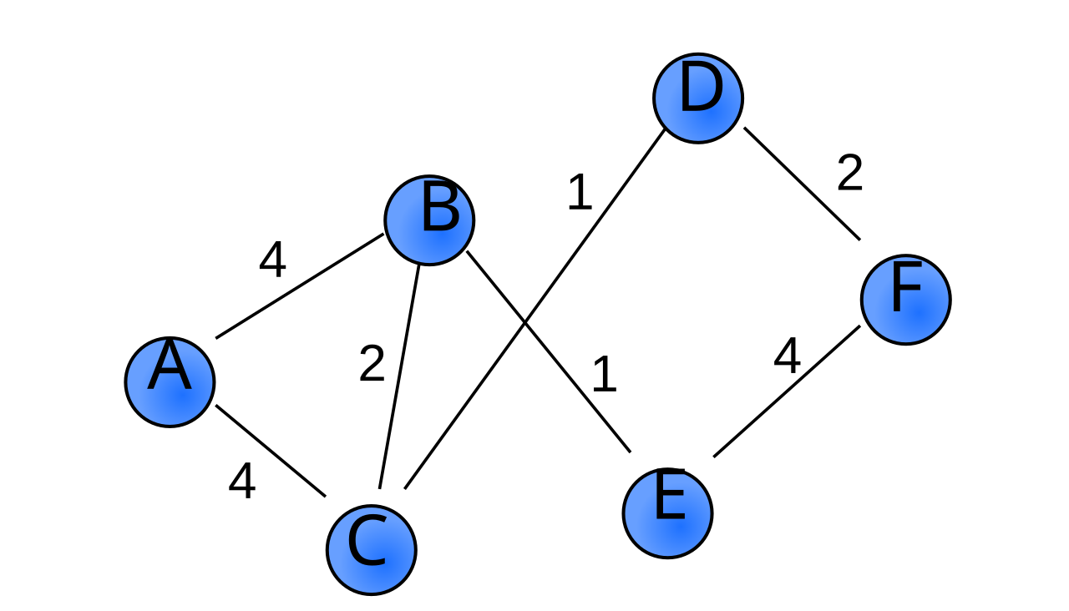
Intro to Weighted Graphs

Slide 8
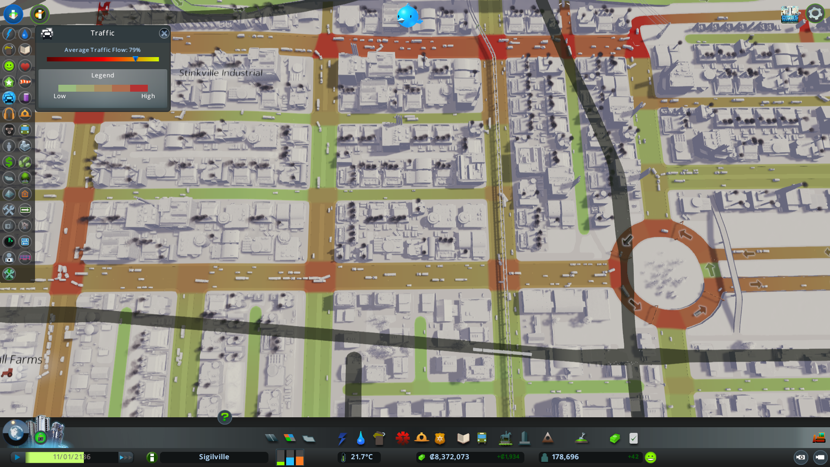
Use Cases
Maps (path finding)
Network traffic optimization
Social network structure (intensity of interactions)
Games (points given for each action)
Scheduling and process management
  Ex: making device with many parts. Each part may depend on other parts, and each step in manufacturing takes a certain amount of time

Slide 9
Minimum Spanning Trees

Slide 10
Minimum Spanning Trees

Slide 11
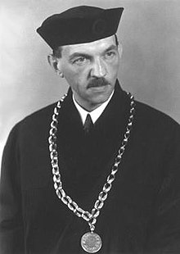
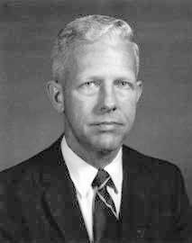
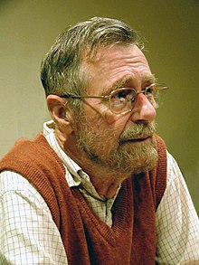
History
Vojtěch Jarník
1897 – 1970
1930: minimum spanning tree (greedy)
Robert C. Prim III
1921 - 2021
1957: independent discovery @ Bell Labs
Edsger Dijkstra
1930 - 2002
1956: independent discovery @ Mathematical Center in Amsterdam
Notes:
What is the shortest way to travel from Rotterdam to Groningen, in general: from given city to given city. It is the algorithm for the shortest path, which I designed in about twenty minutes. One morning I was shopping in Amsterdam with my young fiancée, and tired, we sat down on the café terrace to drink a cup of coffee and I was just thinking about whether I could do this, and I then designed the algorithm for the shortest path. As I said, it was a twenty-minute invention. In fact, it was published in '59, three years later. The publication is still readable, it is, in fact, quite nice. One of the reasons that it is so nice was that I designed it without pencil and paper. I learned later that one of the advantages of designing without pencil and paper is that you are almost forced to avoid all avoidable complexities. Eventually, that algorithm became to my great amazement, one of the cornerstones of my fame.
""After having programmed for some three years, I had a discussion with A. van Wijngaarden, who was then my boss at the Mathematical Center in Amsterdam, a discussion for which I shall remain grateful to him as long as I live. The point was that I was supposed to study theoretical physics at the University of Leiden simultaneously, and as I found the two activities harder and harder to combine, I had to make up my mind, either to stop programming and become a real, respectable theoretical physicist, or to carry my study of physics to a formal completion only, with a minimum of effort, and to become....., yes what? A programmer? But was that a respectable profession? For after all, what was programming? Where was the sound body of knowledge that could support it as an intellectually respectable discipline? I remember quite vividly how I envied my hardware colleagues, who, when asked about their professional competence, could at least point out that they knew everything about vacuum tubes, amplifiers and the rest, whereas I felt that, when faced with that question, I would stand empty-handed. Full of misgivings I knocked on Van Wijngaarden's office door, asking him whether I could "speak to him for a moment"; when I left his office a number of hours later, I was another person. For after having listened to my problems patiently, he agreed that up till that moment there was not much of a programming discipline, but then he went on to explain quietly that automatic computers were here to stay, that we were just at the beginning and could not I be one of the persons called to make programming a respectable discipline in the years to come? This was a turning point in my life and I completed my study of physics formally as quickly as I could."

Slide 12


