Slide 1
Data Augmentation for Object Detection
Neural Networks Course Project SoSe 2025
Aqsa Mohsin, Nasrul Huda
July 28 2025
Universität Hamburg

Slide 2
Motivation
Deep learning for object detection requires large annotated datasets.
But high-quality labeled data is hard to collect.
Data augmentation helps improve model generalization with limited data.

Slide 3
Methodology - Model Architecture & Setup
Model: Faster R-CNN MobileNet v3 Large 320 FPN
5 different models using Albumentations:
Baseline: No augmentation
Horizontal Flip: 50% flip probability
Random Crop: Partial object views
Rotation: Small-angle rotations
Combined: Flip + Crop + Rotation

Slide 4
Methodology - Model Architecture & Setup
Training configuration:
30 epochs
Batch size: 2
SGD
Learning rate: 0.001
Weight decay=0.0005

Slide 5
Methodology - Dataset Summary
Pascal VOC 2012:
We initially trained on the full Pascal VOC dataset (all classes, 5K+ images).
Training crashed repeatedly in Colab (resource limitations).
Even with 10 epochs, the model was underfitting.

Slide 6
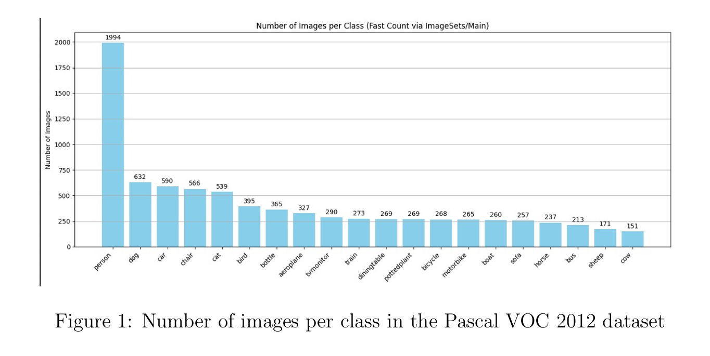
Methodology - Dataset Summary
Pascal VOC 2012: we filtered only the cow class.
Training images: 151, Validation images: 152

Slide 7
Methodology - Evaluation Metrics
Average Loss per Epoch: Training stability
Precision: Correct detection
Average IoU: Localization accuracy

Slide 8
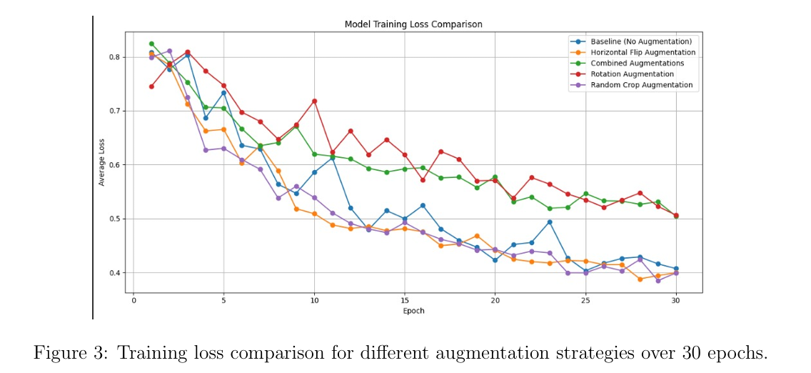
Evaluation Metrics - Average Loss

Slide 9
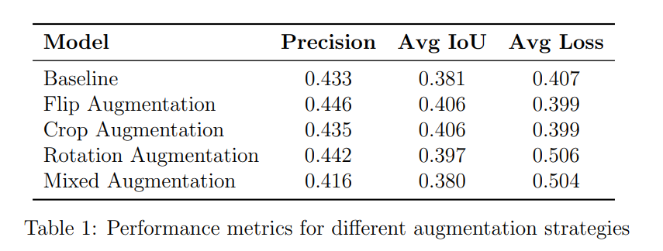
Evaluation Metrics - Precision

Slide 10
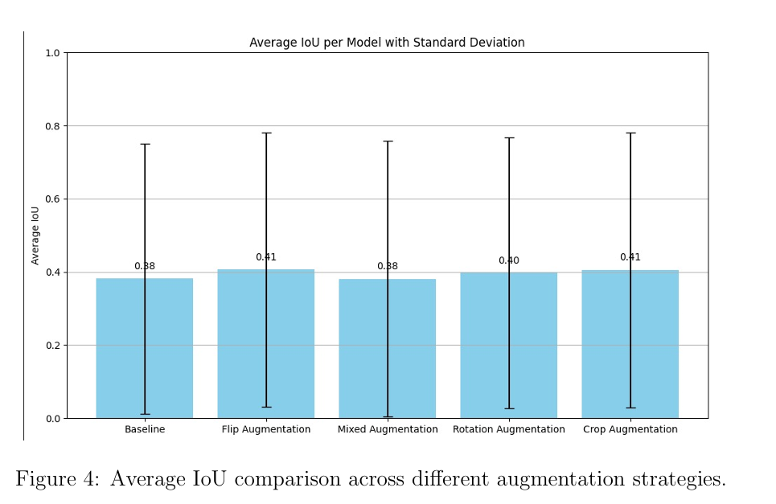
Evaluation Metrics - Average IoU

Slide 11
Results
Rotation = Moderate improvement but higher training cost
Combined = Too much noise, reduced effectiveness
Simpler transformations outperform complex ones in low-data settings.
Targeted augmentation (e.g., flip, crop) leads to better convergence.

Slide 12
Conclusion
Data augmentation can significantly boost detection performance under data scarcity.
Our experiment shows flip and crop are highly effective with limited images.
Balanced, minimal augmentation works best in constrained environments.

Slide 13
Future Work
Extend to other Pascal VOC classes
Experiment with: Color jitter, contrast, brightness changes
Experiment augmentation pair-wise

Slide 14
Thank You!

