Slide 1
Short-Term Weather Prediction Using Deep Learning
PDCL Project SoSe 2025
Aqsa Mohsin
July 14 2025
Universität Hamburg

Slide 2
Table of Contents
Motivation
Methodology
Results & Evaluation
Conclusion

Slide 3
Motivation

Slide 4
Motivation
Accurate weather forecasts are vital for agriculture, disaster management, and energy use
Traditional methods are physics-based and compute-heavy
Deep learning provides a fast, data-driven alternative to model temporal dependencies
This project explores whether LSTM and GRU can learn short-term temperature patterns

Slide 5
Methodology

Slide 6
Methodology
Predict next-day temperature using deep learning
Models: LSTM, GRU (RNN-based)
Baselines: Persistence, Climatology
Dataset: Melbourne daily minimum temperature (1981–1990)

Slide 7
Methodology
Split: 80% of the data used for training, 20% for testing
Preprocessing: Normalize (MinMax), create 7-day input sequences
Models trained with MSE loss, evaluated using MAE & RMSE

Slide 8
Results & Evaluation

Slide 9
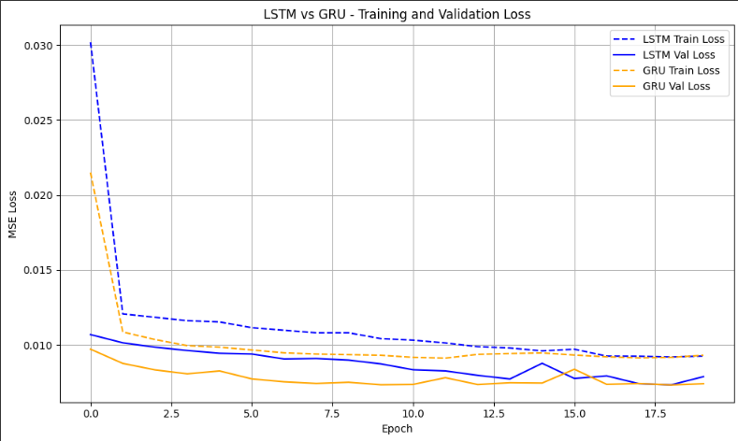
Evaluation (Training & Validation Loss)

Slide 10
Evaluation (MAE & RMSE)
Model | MAE | RMSE
GRU | 1.784904 | 2.263436
LSTM | 1.849126 | 2.334287
Persistence | 1.955144 | 2.48259
Climatology | 2.110734 | 2.704584

Slide 11
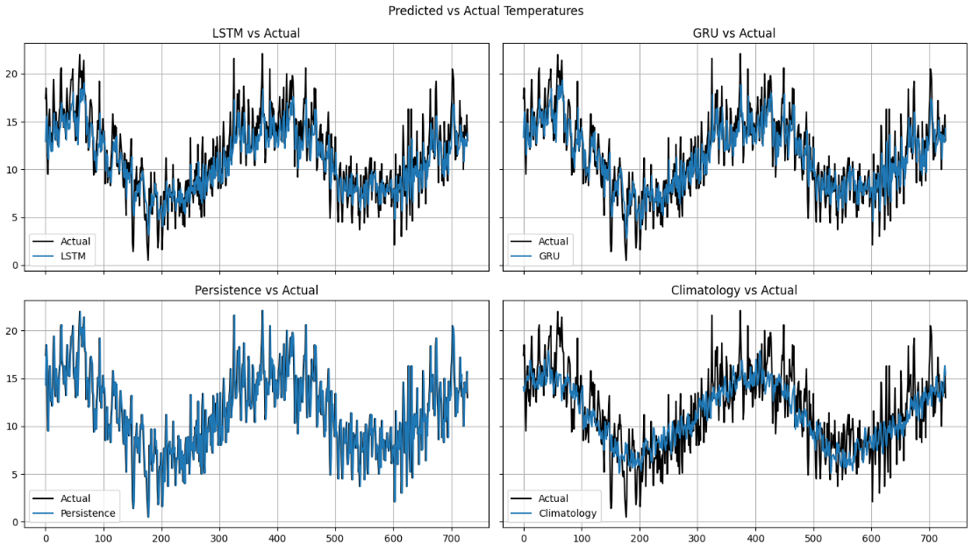
Evaluation (Predicted vs Actual )

Slide 12
Conclusion

Slide 13
Conclusion
LSTM and GRU outperform simple baselines
GRU slightly better and faster to converge
DL models track temporal patterns effectively

Slide 14
Conclusion (Future Work)
multivariate inputs
longer sequence
Transformer-based models

Slide 15
Thank You!

