Slide 1
Practice #3
2017.10.2

Slide 2
Lab 3.1 Average
Calculate average n of five subjects Chinese, English, Math, Technology and Biology, and grade the according to given conditions:
If average >= 90: Grade = A+
If average >= 80: Grade = A
If average >= 70: Grade = B
If average >= 60: Grade = C
If average >= 50: Grade = D
If average < 50: Grade = E

Slide 3
Lab 3.1 Average-Format
Input: Five integers (int)
Input format: Use space to separate each integers.
Output: A decimal (float) round off to the two decimal place (四捨五入至小數點第二位) of average n and the grade of average
Output format: Put “\n” after each result, and there are spaces before and after “=” (See the next page)

Slide 4
Lab 3.1 Sample I/O
Input:
Output:
95 95 97 98 90
Average = 95.00
Grade = A+
New line: This means you must type “\n”!!!!!!!

Slide 5
Lab 3.1 Average
NTHU online judge information:
Problem ID: 11570
Problem title: 231001_10/2_practice3-1

Slide 6
Lab 3.1 Average
The tools or the commands you may need:
if … else if … else
printf(“%.2f ”, n)
// or /* */

Slide 7

Lab 3.2 All roots of quadratic equation
Find all roots of a quadratic equation.
quadratic equation:
Coefficient a, b, and c are decimals.
Calculate two roots: r1 and r2

Slide 8
Lab 3.2 All roots of quadratic equation
Three cases of the roots:
Case1: Two distinct real roots
Case2: Two equal roots
Case3: Two distinct complex roots

Slide 9


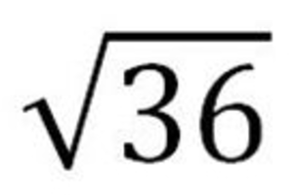
Lab 3.2 All roots of quadratic equation
Use to judge the roots.
Use to calculate the roots.
You need to #include math.h and use sqrt() to calculate the square root.
Ex: = sqrt(36)

Slide 10
Lab 3.2 All roots of quadratic equation
If you forget the property of quadratic equation, please see the following website:
https://en.wikipedia.org/wiki/Quadratic_equation

Slide 11
Lab 3.2 All roots of quadratic equation-Format
Input: Three decimals (float) , represent three coefficients a, b, and c respectively
Input format: Use space to separate each decimals
Output: Print the judgement of the roots and the roots round off to the four decimal place. (四捨五入至小數點第四位)
Output format: See the next page

Slide 12
Lab 3.2 All roots of quadratic equation-Format
Case1: print
Two distinct real roots: r1 and r2
Case2: print
Two equal roots: r1 and r2
Case3: print
Two distinct complex roots: r1 and r2

Slide 13
Lab 3.2 All roots of quadratic equation-Format
Attention: C cannot calculate sqrt() to the complex number automatically, that is, you need to use two parameters to compute the real number and the complex number of the complex root respectively, and you need to put “+” or “-” after the real number and “i” after the complex number.
There are spaces before and after “+” and “-”.
Put “\n” after the result.

Slide 14
Lab 3.2 Sample I/O
Input:
Output:
8 -4 -2
Two distinct real roots: 0.8090 and -0.3090

Slide 15
Lab 3.2 Sample I/O
Input:
Output:
1 4 4
Two equal roots: -2.0000 and -2.0000

Slide 16
Lab 3.2 Sample I/O
Input:
Output:
2.3 1 5.72
Two distinct complex roots: -0.2174 + 1.5620i and -0.2174 - 1.5620i

Slide 17
Lab 3.2 All roots of quadratic equation
NTHU online judge information:
Problem ID: 11573
Problem title: 231001_10/2_practice3-2

Slide 18
Lab 3.2 All roots of quadratic equation
The tools or the commands you may need to use:
if … else if … else
#include <math.h>
sqrt()
// or /* */

Slide 19
Sample I/O
If you have any question of the format, please download the sample input and sample output on the NTHU online judge.
Use cursor to check the format (the space or the new line.) 請利用游標來確認輸入輸出的格式

Slide 20


Sample I/O
Example1:
In txt. file, use cursor to check format.
There are two cursors between the number and “+”,
this means there is a space between these two things!!!

Slide 21
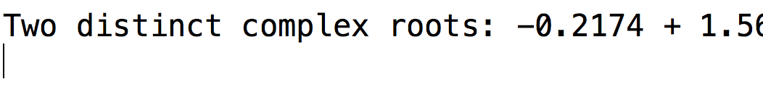
Sample I/O
Example2:
There is a cursor in the new line,
this means there is a “\n” after the result!!!

Slide 22
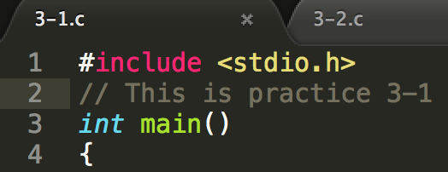
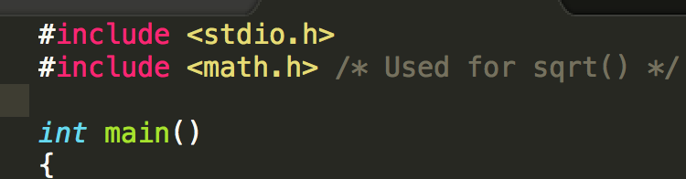
Comment
Please use // or /* */ to write the comment
Ex:

