Slide 1
HW2

Slide 2
Code
def step(state, action):
def draw_image(image):
def figure_2_1():
def figure_2_2():
if __name__ == '__main__':

Slide 3
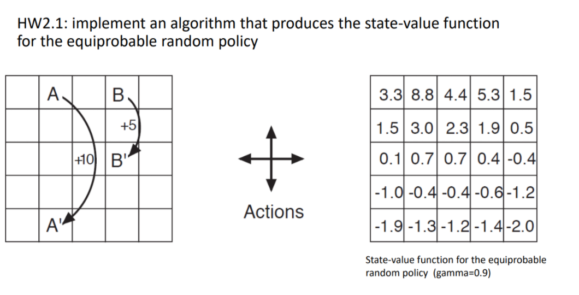
def figure_2_1():

Slide 4
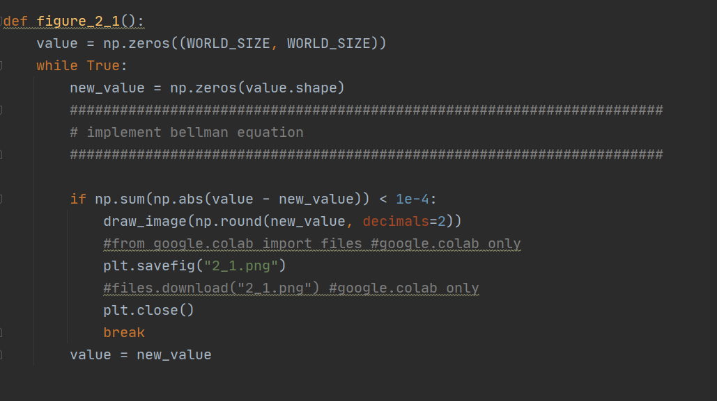

Slide 5
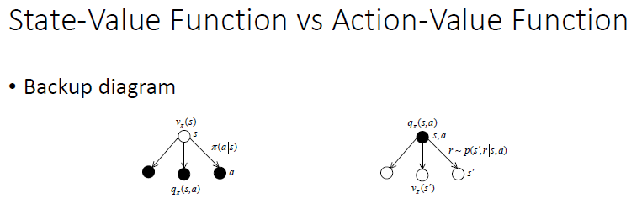

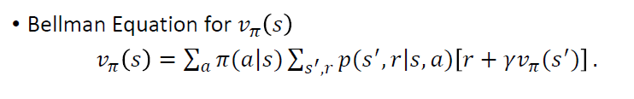
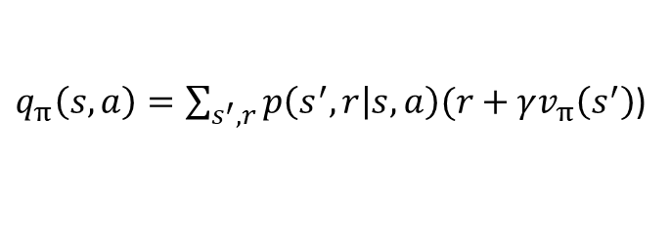

$$v_{π}\left(s\right)=\sum_{a}{π\left(a | s\right)q_{π}}(s,a)$$
$q_{π}\left(s,a\right)=\sum_{s^{′},r}{p\left(s^{′},r | s,a\right)(r}+γv_{π}\left(s^{′}\right)$)

Slide 6
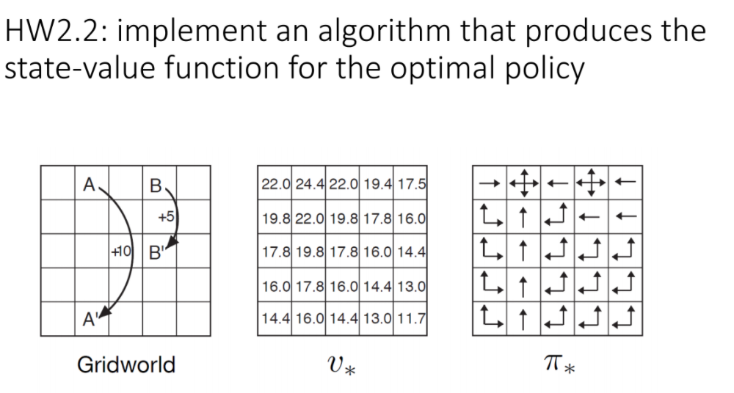
def figure_2_2():

Slide 7
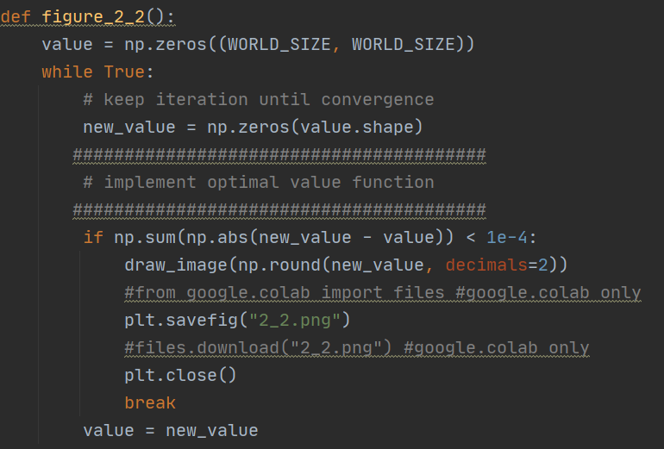

Slide 8


compare
Max
ª

Slide 9
Useful function
for i in range(0, WORLD_SIZE):
print(i)
values = []
values.append(x)
np.max(values)

