Slide 1

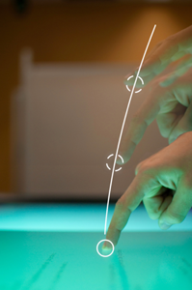
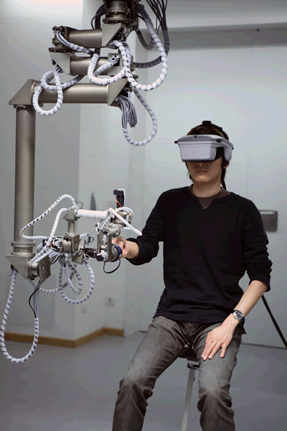
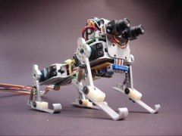
Opportunities and Importance of “Human Computer
Interaction (HCI)”
Research
Spring 2025-26
Course Teacher: Dr. Abdus Salam
Thanks to:
Dr. Muhammad Firoz Mridha

Slide 2
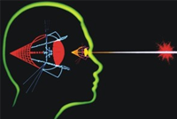
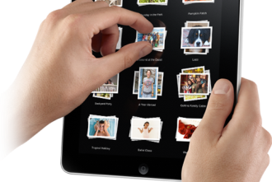
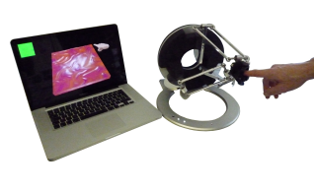
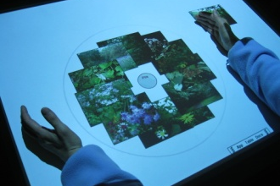
What is
HCI- Human Computer Interaction?

Slide 3
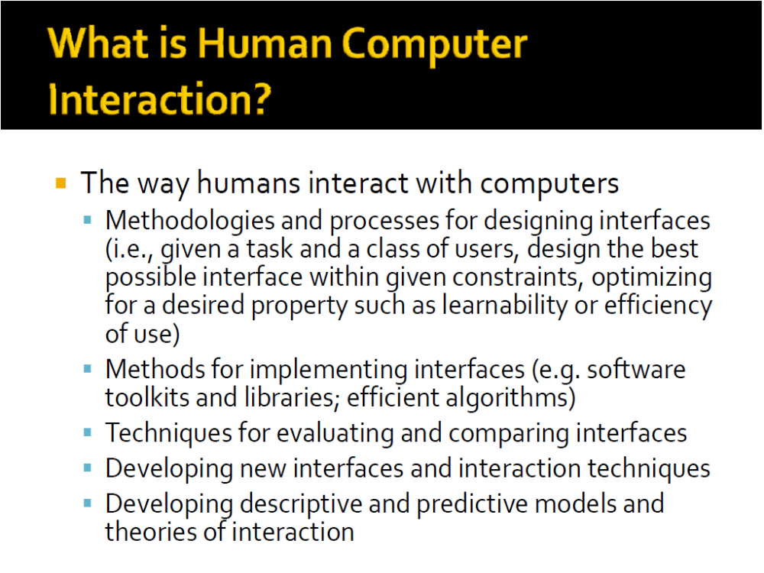

Slide 4
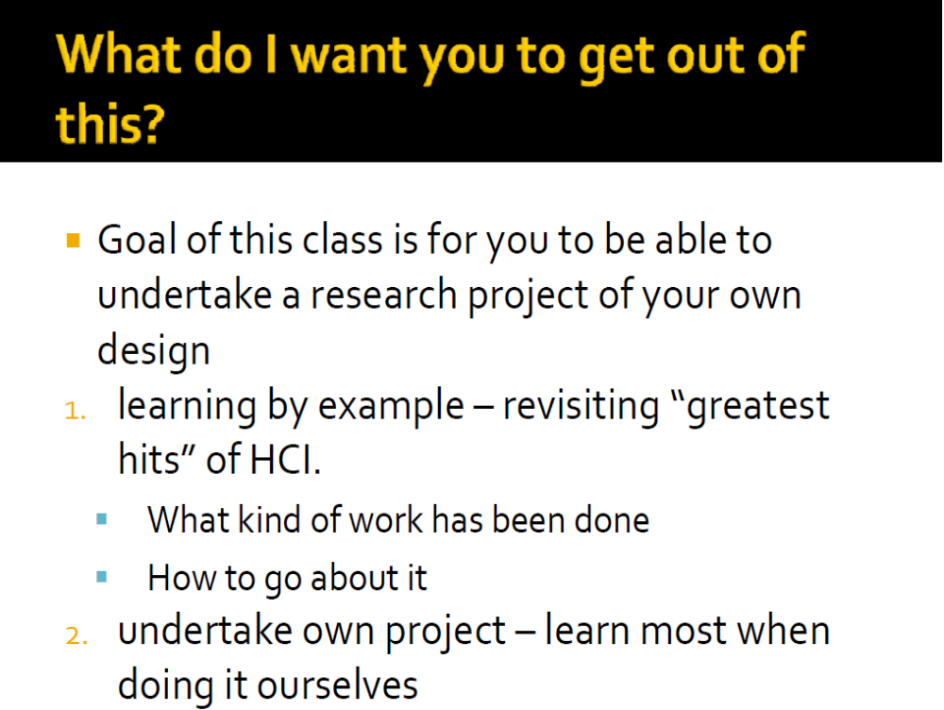

Slide 5
A survey undertaken by 350 US companies on over 8000 projects revealed that one third of the projects were never completed and one half succeeded only partially, that is, with partial functionalities, major cost overruns, or significant delays (Standish Group, 95).
Managers identified poor requirements as the major source of problems (about half of the responses) - more specifically, the lack of user involvement (13%), requirements incompleteness (12%), changing requirements (11%), unrealistic expectations (6%), and unclear objectives (5%).
This summed up 47% of failure is due to the absence of Methodology of Interaction Design which spruces up from the field of Human Computer Interaction (HCI), more generally called “Human Machine Interactions”.

Slide 6
The $300 Million Button
The problem: The problem wasn’t as much about the form’s layout as it was where the form lived. Users would encounter it after they filled their shopping cart with products they wanted to purchase and pressed the Checkout button. It came before they could enter the information to pay for the product.
The solution: The designers fixed the problem simply. They took away the Register button. In its place, they put a Continue button with a simple message: “You do not need to create an account to make purchases on our site. Simply click Continue to proceed to checkout. To make your future purchases even faster, you can create an account during checkout.”
The results: The number of customers purchasing went up by 45%. The extra purchases resulted in an extra $15 million the first month. For the first year, the site saw an additional $300,000,000.

Slide 7
Future computer users will never know or bother about five things -
1. What processor(s) they are using
2. How much memory do they have
3. How much storage do they use
4. What is the speed of their Internet and
5. What exactly a computer is
But they (will) always bother about one thing - how they would be interacting with them..

Slide 8
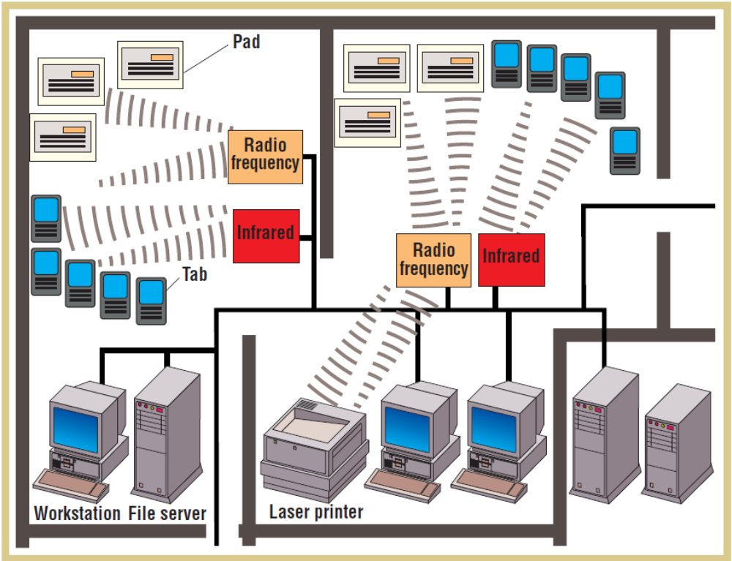

Slide 9
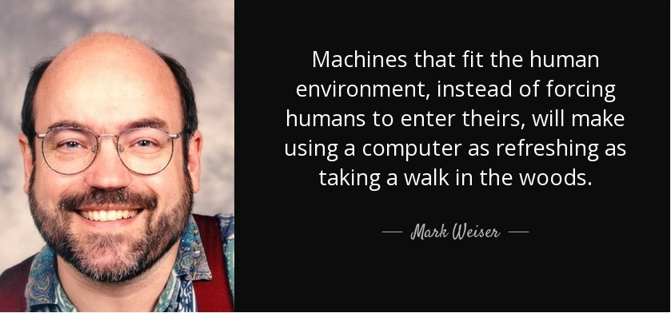
Mark Weiser's vision
Weiser outlined a set of principles describing ubiquitous/pervasive computing: (1996)
The purpose of a computer is to help you do something else.
The best computer is a quiet, invisible servant.
The more you can do by intuition the smarter you are; the computer should extend your unconscious.
Technology should create calm, "that which informs but doesn't demand our focus or attention."

Slide 10
ALIENATION (Marx) : The process whereby the worker is made to feel foreign to the products of his/her own labor.
The design of the product and how it is produced are determined, not by the producers who make it (the workers), nor by the consumers of the product (the buyers), but by the capitalist class who besides accommodating the worker's manual labour also accommodate the intellectual labour of the engineer and the industrial designer who create the product in order to shape the taste of the consumer to buy the goods and services at a price that yields a maximal profit.

Slide 11
Data-Process Model (DPM)
Basic System
Environment
Data
Process
Complex System
Data
Process
Data
Process
Data
Process

Slide 12
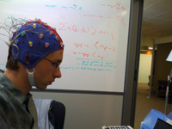

Interaction Modalities
Touch
Gesture
Haptic
Visual
Speech
Brain

Slide 13
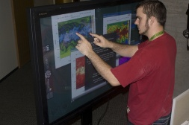
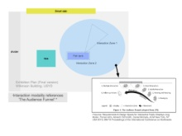
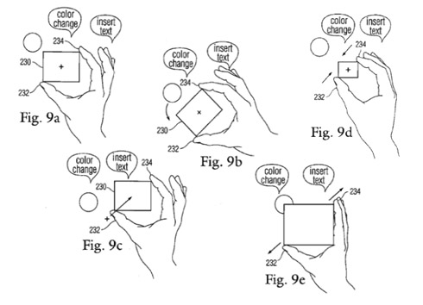
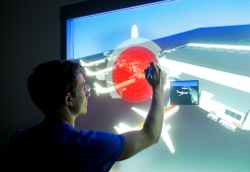
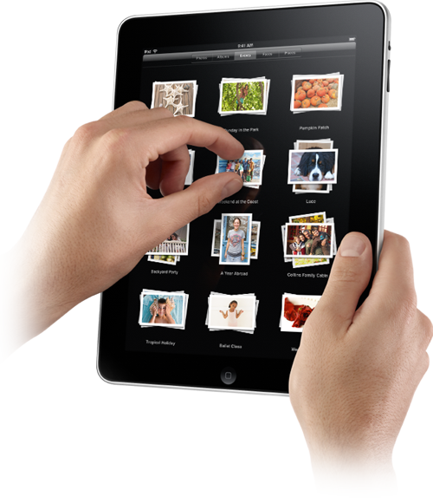
Touch

Slide 14
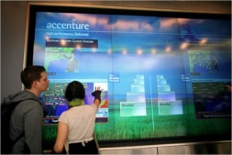
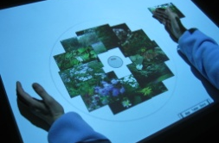
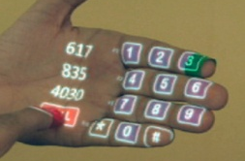
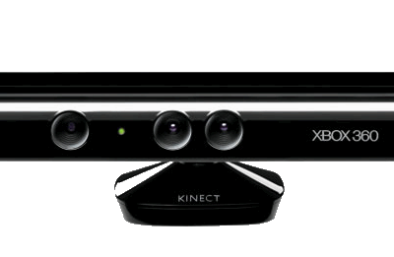
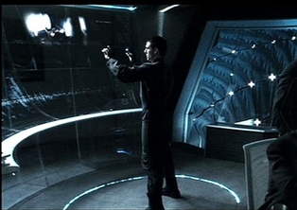
Gesture

Slide 15
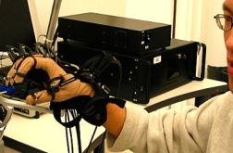
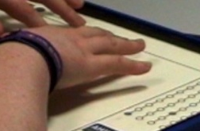

Haptic

Slide 16
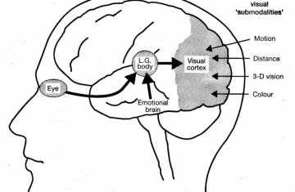
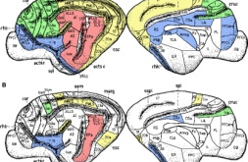
Visual

Slide 17
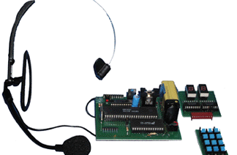
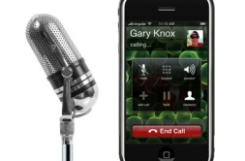
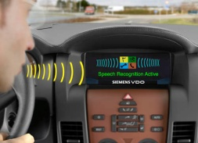


Speech

Slide 18
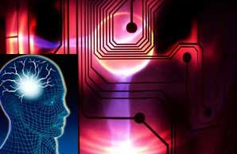
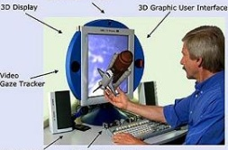

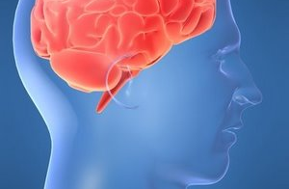
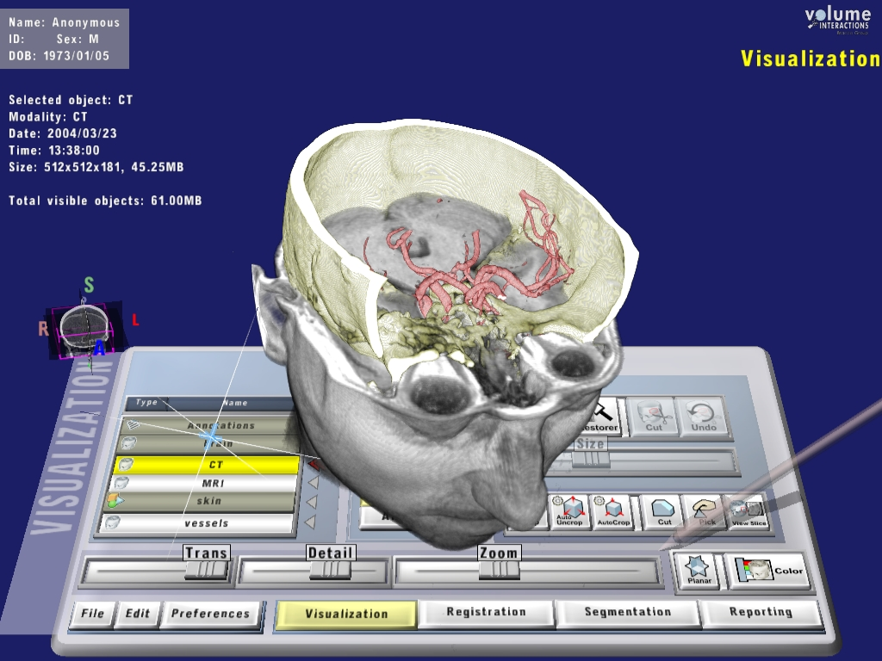
Brain

Slide 19
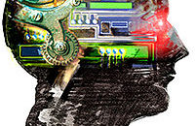
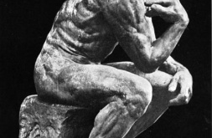

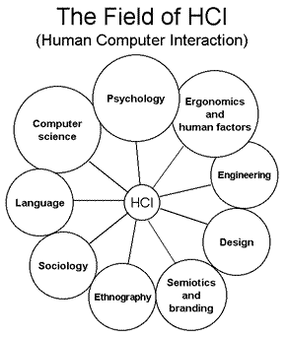
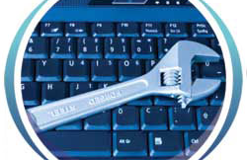
HCI Supporting Areas
Human Computer Interaction (HCI) is a multi-disciplinary field and designing an effective interactive system from a single discipline in isolation is almost impossible.

Slide 20
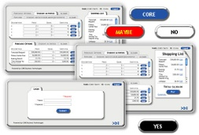
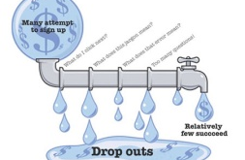
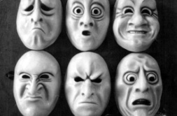
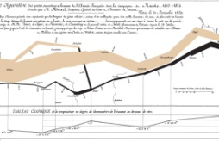
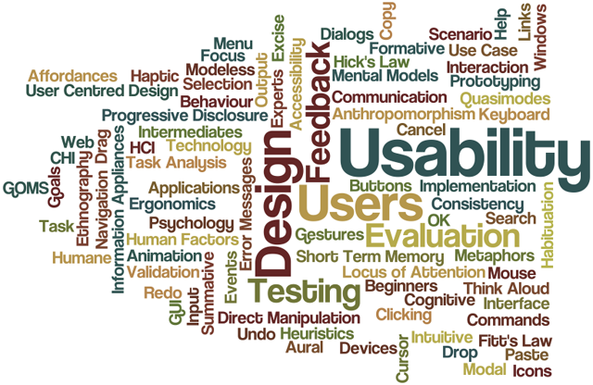
Domains
Usability
User experience
User modeling
UI
Interaction design
Affective interaction
Therapeutic
Info visualization
Ubiquitous Computing

Slide 21
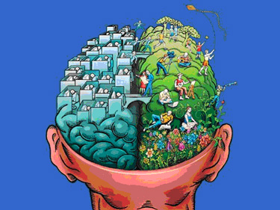
Conclusion

Slide 22
Questions & Answers
Questions?

