Slide 1
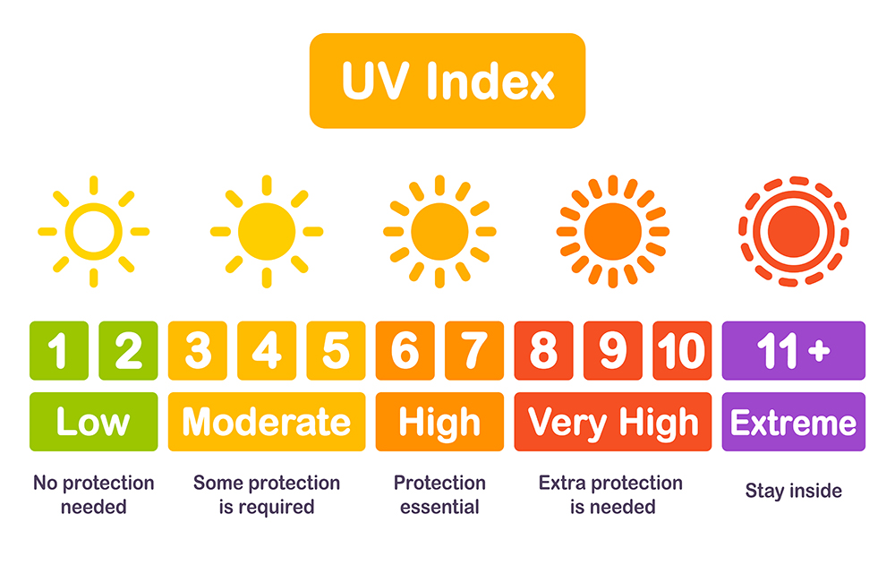
Western Australia UV Index
Analysis
Tourism WA has engaged our small firm to present the UV index and the temperature weather data for residents and tourists to increase the use of sunscreen and to prevent skin cancer.

Slide 2
Western Australia UV Index Analysis
Our Team (SASA)
http://127.0.0.1:5000/about
The purpose of this analysis:
Analysing UV index across Western Australia
Help planning a trip within Western Australia
Why only Western Australia?
Tourism WA has engaged us to do an analysis on WA UV index
Plus, where else we can go during Covid-19 😝

Slide 3


Western Australia UV Index
Data Source
UV Index for Western Australia:
https://openweathermap.org/api
Western Australia Cities Info:
https://simplemaps.com/data/au-cities

Slide 4


Western Australia UV Index
Extract Historical Data from OpenWeather API
OpenWeather API
csv and Json

Slide 5

Western Australia UV Index
Historical Data Storage
Python
Flask
csv file
SQLITE

Slide 6
Western Australia UV Index
Why SQLITE?
Structured data
The license for SQLite is open-source
SQLite does not require a server to run

Slide 7
Western Australia UV
Current UV Index
http://127.0.0.1:5000/index

Slide 8
Western Australia UV
Historical UV Index
http://127.0.0.1:5000/historical

Slide 9
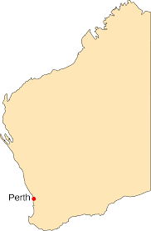
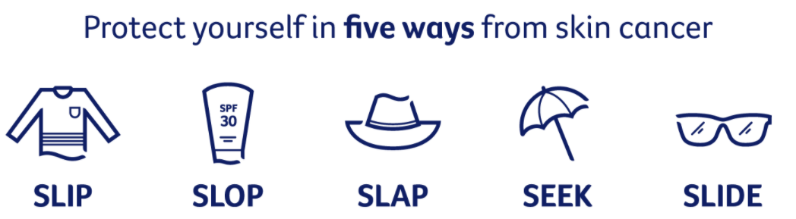
Western Australia UV Index
Analysis Conclusion/Summary
Perth UV Index in Year 2020
Average UV index in Perth:
Average: 11.74
Winter: 3.40
Spring: 8.88
Summer: 12.94
Autumn: 6.46

Slide 10
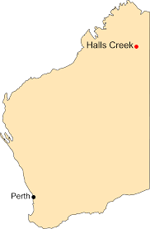
Western Australia UV Index
Analysis Conclusion/Summary
The highest UV Index in Year 2020
City: Halls Creek
UV index: 18.21
Date: 20th December 2020
Average UV index in Halls Creek:
Average: 11.74
Winter: 7.6
Spring: 13.43
Summer: 15.30
Autumn: 10.71

Slide 11
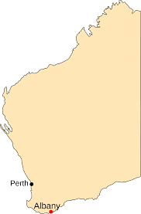
Western Australia UV Index
Analysis Conclusion/Summary
The lowest UV Index in Year 2020
City: Albany
UV index: 1.87
Date: 13th June 2020
Average UV index in Albany:
Average: 6.92
Winter: 2.64
Spring: 7.82
Summer: 11.98
Autumn: 5.37

Slide 12
Western Australia UV Index
Analysis Conclusion/Summary
Average UV Index Comparison (Halls Creek vs Albany)
 | Halls Creek | Albany | %
Average | 11.74 | 6.92 | 70%
Winter | 7.6 | 2.64 | 188%
Spring | 13.43 | 7.82 | 72%
Summer | 15.3 | 11.98 | 28%
Autumn | 10.71 | 5.37 | 99%

Slide 13
Western Australia UV Index
Analysis Conclusion/Summary
Through this analysis, we hope that we have raised awareness of the high UV index in WA throughout the year.
In general, WA has very high UV index. Therefore it is important that we always remember Slip, Slop, Slap, Seek and Slide.

