Slide 1
Implement basic family relationship using Prolog
Rifa Tasfia -19201045

Slide 2
Content
Problem Statement
Tree Diagram
Technical Report
Source Code
Conclusion

Slide 3
Introduction
Implement a basic family relationship tree structure of my own family using Prolog. Write rules against degree & removal for up to 3rd Degree & twice removed situation for cousin relationship.
First Cousin - Same Grandparent.
Second Cousin - Same Great Grandparent.
Third Cousin - Same Great Great Grandparent.

Slide 4
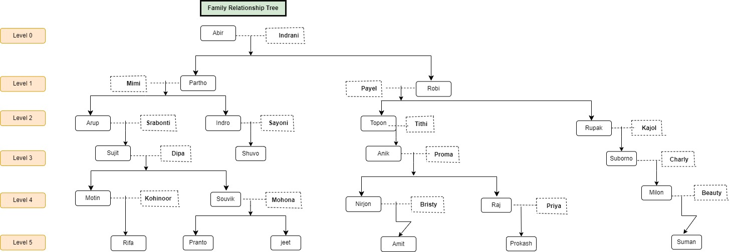
Diagram

Slide 5



Technical Report
Report
Source Code
Experiment & explanation
Contain all technical informations.
https://github.com/tasfiarifa/CSE-404-4.1-AI-lab-
Full Source Code with prolog.
Github Link-https://github.com/tasfiarifa/CSE-404-4.1-AI-lab-
Input/output check with screenshots & logical explanation.

Slide 6
Conclusion
To implement any knowledge-base, creating a decision tree and a structured logics can help a lot while troubleshooting. Naming conventions are case sensitive. Be careful of spellings.

Slide 7
THANK YOU

