Slide 1
How to train a Neural Network

Slide 2
The Basic Requirements for Training
What you need:
Training Dataset
Testing Dataset
Validation Dataset
Neural network architecture (Network Hyperparameters)
Loss Function
Optimization Function
Notes:
Training Dataset
Testing Dataset
Validation Dataset (used during training to verify the network is learning something)
Neural network architecture (Network Hyperparameters)
Loss Function
Optimization Function

Slide 3
The Basic Requirements for Training
What you need:
Training Dataset
Testing Dataset
Validation Dataset
Neural network architecture (Network Hyperparameters)
Loss Function
Optimization Function
Notes:
Training Dataset
Testing Dataset
Validation Dataset (used during training to verify the network is learning something)
Neural network architecture (Network Hyperparameters)
Loss Function
Optimization Function

Slide 4
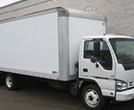
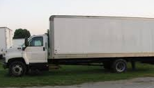
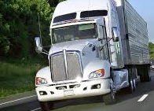
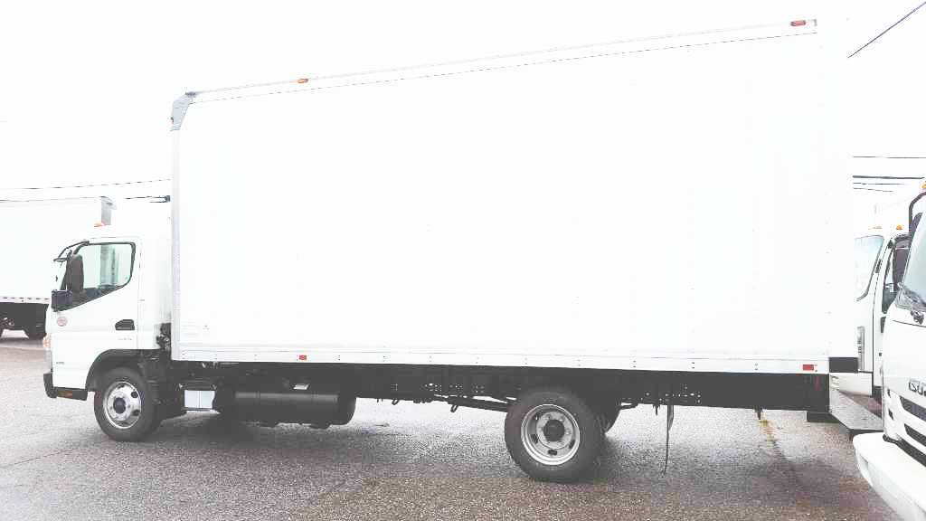
The Importance of a Good Training Dataset
TRAINING PROCEDURE:
Neural Network
Vehicle
Vehicle
Not Vehicle
…
TESTING PROCEDURE:
Neural Network
…
Not Vehicle
Notes:
So how does this learning process happen?
In training, a deep neural network is given images, which it learns to associate with correct labels.
Neural networks learn from its mistakes. During training, when the neural network incorrectly predicts or misinterprets an input, it is because some of the neural networks processing elements have the incorrect values and the algorithm produces the wrong answer.
So to learn to associate between input and output, the previously mentioned a values are changed to match the output label based upon the error
Ideally, we then could use this network on any test dataset.
However, the accuracy and quality of the mapping between images and is partially dependent upon what scene information that is captured in the training data.

Slide 5
The Importance of a Good Training Dataset
TRAINING PROCEDURE:
Neural Network
Vehicle
Vehicle
Not Vehicle
…
TESTING PROCEDURE:
Neural Network
…
Not Vehicle
Notes:
So in the case of autonomous vehicles, For example, if a network is only trained on images of side-facing cars, it could have a more difficult time reliably generating a correct association if presented with a view of the back of a car.
So a potential cause of the detection failure in the tesla crash could be that the vision system could not generalize well to overexposed data.
This means that, if datasets are biased towards specific scene/environmental factors, the algorithm could be as well.
A similar argument can be made for unsupervised learning, which for us refers to generative neural networks that take in information in some form and output images. Without a dataset that has a lot of variance in real world appearance, it will produce images that do not capture the real world.

Slide 6
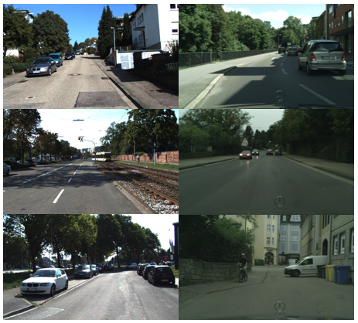
The Importance of a Good Training Dataset
What visual information exists in real datasets?
Types of scene structure:
Viewpoint
Lighting/Time of day
Spatial structure
Pixel Statistics:
Tone/Color Cast
Noise and Distortion Patterns
Saturation
Correlations between Color Channels
What role does the sensor/camera model have?
KITTI
Cityscapes
Notes:
So what visual features do we want represented in our datasets? The two datasets shown on the right, KITTI and Cityscapes, are both benchmark vehicle datasets.
Benchmark means that the vision community uses these datasets as standards for evaluating performance of new algorithms.
KITTI consists of approx. 7500 training images which are captured by driving around the mid-size city of Karlsruhe, Germany, in small neigborhoods and on highways.
Cityscapes is a dataset designed for semantic understanding of urban street scenes, which includes detection. It has ~2500 annotated training images taken in 50 cities in Germany.
In terms of possible variations, these two datasets are highly similar; both are taken during similar times of day, in similar weather and seasons, in similar cities in Germany, and focused on imaging cars in an urban environment (same camera orientation towards the road).

Slide 7
The Importance of a Good Training Dataset
What visual information exists in real datasets?
Types of scene structure:
Viewpoint
Shadows (Lighting/Time of day)
Buildings, Road, etc (Spatial structure)
Pixel Statistics:
Tone/Color Cast
Noise and Distortion Patterns
Saturation
Correlations between Color Channels
What role does the sensor/camera model have?
KITTI
Cityscapes
Notes:
Let’s discuss this idea of generalizability and robustness in the context of real vehicle datasets. The two datasets shown on the right, KITTI and Cityscapes, are both benchmark vehicle datasets.
Benchmark means that the vision community uses these datasets as standards for evaluating performance of new algorithms.
KITTI consists of approx. 7500 training images which are captured by driving around the mid-size city of Karlsruhe, Germany, in small neigborhoods and on highways.
Cityscapes is a dataset designed for semantic understanding of urban street scenes, which includes detection. It has ~2500 annotated training images taken in 50 cities in Germany.
In terms of possible variations, these two datasets are highly similar; both are taken during similar times of day, in similar weather and seasons, in similar cities in Germany, and focused on imaging cars in an urban environment (same camera orientation towards the road).

Slide 8
The Importance of a Good Training Dataset
What visual information exists in real datasets?
Types of scene structure:
Viewpoint
Shadows (Lighting/Time of day)
Buildings, Road, etc (Spatial structure)
Pixel Statistics:
Tone/Color Cast
Noise and Distortion Patterns
Saturation/Exposure
Correlations between Color Channels
What role does the sensor/camera model have?
KITTI
Cityscapes
Notes:
Lighting/Time of day/shadows
Distortion patters (weather)
Lets discuss this idea of generalizability and robustness in the context of real vehicle datasets. The two datasets shown on the right, KITTI and Cityscapes, are both benchmark vehicle datasets.
Benchmark means that the vision community uses these datasets as standards for evaluating performance of new algorithms.
KITTI consists of approx. 7500 training images which are captured by driving around the mid-size city of Karlsruhe, Germany, in small neigborhoods and on highways.
Cityscapes is a dataset designed for semantic understanding of urban street scenes, which includes detection. It has ~2500 annotated training images taken in 50 cities in Germany.
In terms of possible variations, these two datasets are highly similar; both are taken during similar times of day, in similar weather and seasons, in similar cities in Germany, and focused on imaging cars in an urban environment (same camera orientation towards the road).

Slide 9
The Importance of a Good Training Dataset
REAL WORLD
Notes:
So if we consider the space of real world scene factors (represented by the blue circle) that can impact the learning process in neural networks, sensor effects would be included because they can alter the appearance of the world.
Each real dataset captures a subset of these possible real world scenarios.
We can see through this example that the smaller the variance of the scene factors represented in a dataset, the further away it is from other datasets in this space, and hence, how less robust it is to different scenes when tested on novel data.
We would like to develop methods that bridge the gap between these worlds that would allow us to capture more real world variance (ie, more real world scenes) that would allow a deep learning algorithm trained in the ‘KITTI world’ to be deployed with no performance decrease in any other ‘dataset world’.

Slide 10
The Importance of a Good Training Dataset
Over Exposed White Truck
REAL WORLD
KITTI
KITTI
White Trucks
Truck Images
Cityscapes
Cityscapes
Notes:
So if we consider the space of real world scene factors (represented by the blue circle) that can impact the learning process in neural networks, sensor effects would be included because they can alter the appearance of the world.
Each real dataset captures a subset of these possible real world scenarios.
We can see through this example that the smaller the variance of the scene factors represented in a dataset, the further away it is from other datasets in this space, and hence, how less robust it is to different scenes when tested on novel data.
We would like to develop methods that bridge the gap between these worlds that would allow us to capture more real world variance (ie, more real world scenes) that would allow a deep learning algorithm trained in the ‘KITTI world’ to be deployed with no performance decrease in any other ‘dataset world’.

Slide 11
The Basic Requirements for Training
What you need:
Training Dataset
Testing Dataset
Validation Dataset
Neural network architecture (Network Hyperparameters)
Loss Function
Optimization Function
Notes:
Training Dataset
Testing Dataset
Validation Dataset (used during training to verify the network is learning something)
Neural network architecture (Network Hyperparameters)
Loss Function
Optimization Function

Slide 12
Designing Architecture and choosing Hyper-parameters
Connections
Network Architecture Hyper-parameters:
Number of layers
Number of Neurons per layer
Activation function
Connectivity pattern
How you initialize the weights and bias terms
Input Layer
Hidden Layers
Output Layer
Notes:
.

Slide 13
Designing Architecture and choosing Hyper-parameters
Connections
Network Architecture Hyper-parameters:
Number of layers
Number of Neurons per layer
Activation function
Connectivity pattern
How you initialize the weights and bias terms
Input Layer
Hidden Layers
Output Layer
Error F^{n}
Notes:
.

Slide 14
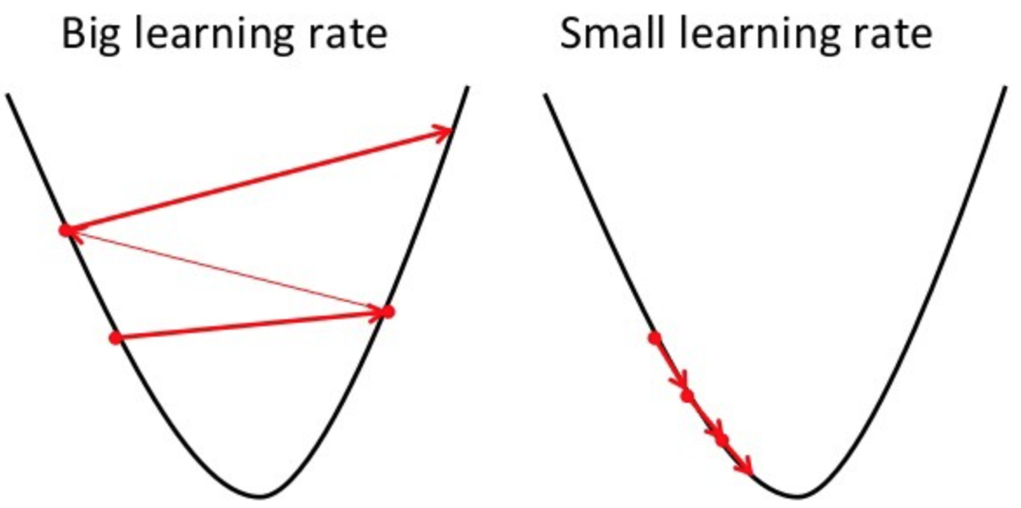
Designing Architecture and choosing Hyper-parameters
Hyper-parameters that control training:
Batch size
Learning rate
Number of Epochs
Notes:
The learning rate defines how quickly a network updates its parameters.
Low learning rate slows down the learning process but converges smoothly. Larger learning rate speeds up the learning but may not converge.

Slide 15
The Basic Requirements for Training
What you need:
Training Dataset
Testing Dataset
Validation Dataset
Neural network architecture (Network Hyperparameters)
Loss Function
Optimization Function
Notes:
Training Dataset
Testing Dataset
Validation Dataset (used during training to verify the network is learning something)
Neural network architecture (Network Hyperparameters)
Loss Function
Optimization Function

Slide 16
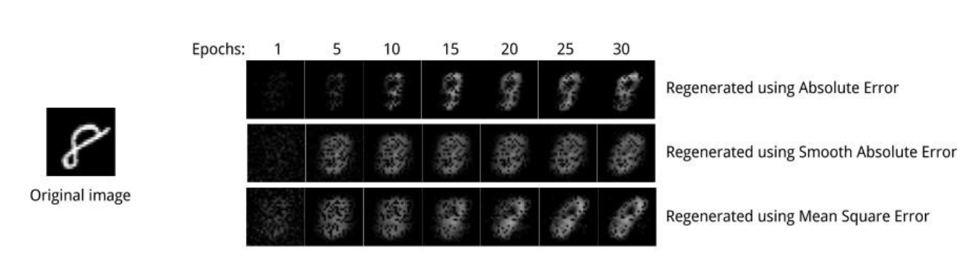
Choosing a Loss Function
Choice is Task Dependent
How we measure distance makes a difference!
Regression: Mean Square Error calculates distance between two points
Classification: Cross entropy quantifies the difference between two probability distribution.
Notes:
Error and Loss Function:
At its core, a loss function is incredibly simple: it’s a method of evaluating how well your algorithm models your dataset. In most learning networks, error is calculated as the difference between the actual output and the predicted output.
The function that is used to compute this error is known as Loss Function J(.). Different loss functions will give different errors for the same prediction, and thus have a considerable effect on the performance of the model. One of the most widely used loss function is mean square error, which calculates the square of difference between actual value and predicted value. Different loss functions are used to deal with different type of tasks, i.e. regression and classification.
MSE contains the assumption that an error of 100 is more than 100x as bad as an error of 1. That assumption may or may not be valid for your problem. MAE (mean absolute error) is another error function you can use, when that's not true. With MAE, you are saying an error of 100 is 100x as bad as an error of 1.

Slide 17
The Basic Requirements for Training
What you need:
Training Dataset
Testing Dataset
Validation Dataset
Neural network architecture (Network Hyperparameters)
Loss Function
Optimization Function
Notes:
Training Dataset
Testing Dataset
Validation Dataset (used during training to verify the network is learning something)
Neural network architecture (Network Hyperparameters)
Loss Function
Optimization Function

Slide 18
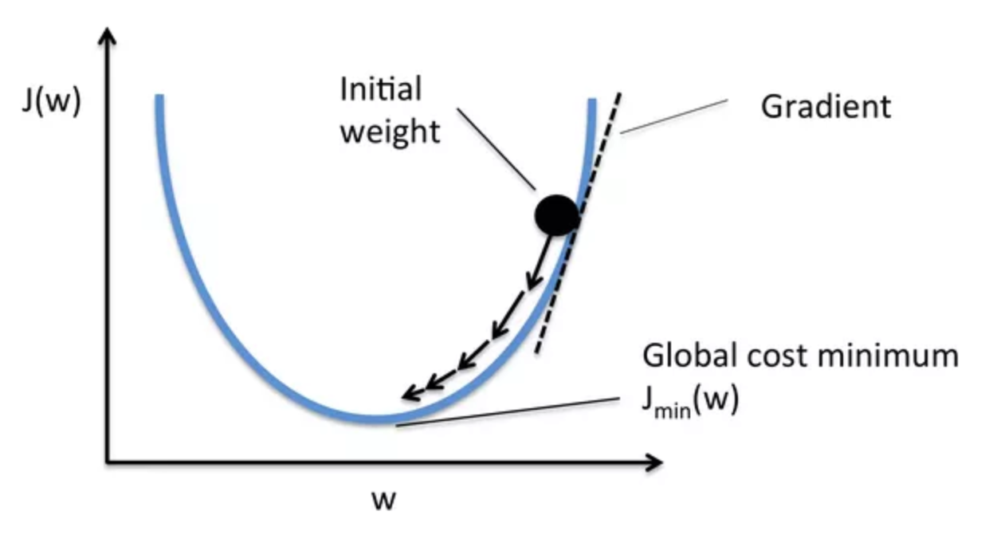
Choosing an Optimization function
Rule of thumb, use Adam Optimization
Notes:
Error J(w) is a function of internal parameters of model i.e weights and bias. For accurate predictions, one needs to minimize the calculated error. In a neural network, this is done using back propagation. The current error is typically propagated backwards to a previous layer, where it is used to modify the weights and bias in such a way that the error is minimized. The weights are modified using a function called Optimization Function.
Optimisation functions usually calculate the gradient i.e. the partial derivative of loss function with respect to weights, and the weights are modified in the opposite direction of the calculated gradient. This cycle is repeated until we reach the minima of loss function.

Slide 19
Example: Use convolutional neural nets to classify clothing in Fashion MNIST
Notes:
Thus, the components of a neural network model i.e the activation function, loss function and optimization algorithm play a very important role in efficiently and effectively training a Model and produce accurate results. Different tasks require a different set of such functions to give the most optimum results.

Slide 20
What are the Basics?
We are going to be using the following tools: Terminal, Python, and Tensorflow.
Terminal is built in to Linux and Macosx computers. In Windows OS it is known as cmd.
It is a non-gui way to move around your computer file system.

Slide 21
Bash/Shell Basics
Important Bash Shell commands to know:
mkdir directory_name: makes a folder in the current working directory
cd directory_name: moves the current working directory to directory_name
cd .. : moves you one level above the current working directory in the file hierarchy
cp /path/to/file.txt /new/location/ : copies file.txt to a new location
cp –r /path/to/folder /new/location/ : copies folder to a new location
ls : lists all files and folders in the current working directory
ls folder_name: lists all files and folders in directory folder_name
vim file_name.ext: creates and/or edits file_name.ext with vim
rm file_name: removes file_name PERMANENTLY!!
rm –r folder_name: removes folder_name PERMANENTLY!
NEVER EVER RUN: rm -rf

Slide 22
Bash/Shell Basics
Important Bash Shell commands to know:
mkdir directory_name: makes a folder in the current working directory
cd directory_name: moves the current working directory to directory_name
cd .. : moves you one level above the current working directory in the file hierarchy
cp /path/to/file.txt /new/location/ : copies file.txt to a new location
cp –r /path/to/folder /new/location/ : copies folder to a new location
ls : lists all files and folders in the current working directory
ls folder_name: lists all files and folders in directory folder_name
vim file_name.ext: creates and/or edits file_name.ext with vim
rm file_name: removes file_name PERMANENTLY!!
rm –r folder_name: removes folder_name PERMANENTLY!
NEVER EVER RUN: rm -rf

Slide 23
Bash/Shell Basics
Important Bash Shell commands to know:
mkdir directory_name: makes a folder in the current working directory
cd directory_name: moves the current working directory to directory_name
cd .. : moves you one level above the current working directory in the file hierarchy
cp /path/to/file.txt /new/location/ : copies file.txt to a new location
cp –r /path/to/folder /new/location/ : copies folder to a new location
ls : lists all files and folders in the current working directory
ls folder_name: lists all files and folders in directory folder_name
vim file_name.ext: creates and/or edits file_name.ext with vim
rm file_name: removes file_name PERMANENTLY!!
rm –r folder_name: removes folder_name PERMANENTLY!
NEVER EVER RUN: rm -rf

Slide 24
Bash/Shell Basics
Important Bash Shell commands to know:
mkdir directory_name: makes a folder in the current working directory
cd directory_name: moves the current working directory to directory_name
cd .. : moves you one level above the current working directory in the file hierarchy
cp /path/to/file.txt /new/location/ : copies file.txt to a new location
cp –r /path/to/folder /new/location/ : copies folder to a new location
ls : lists all files and folders in the current working directory
ls folder_name: lists all files and folders in directory folder_name
vim file_name.ext: creates and/or edits file_name.ext with vim
rm file_name: removes file_name PERMANENTLY!!
rm –r folder_name: removes folder_name PERMANENTLY!
NEVER EVER RUN: rm -rf

Slide 25
Bash/Shell Basics
Important Bash Shell commands to know:
mkdir directory_name: makes a folder in the current working directory
cd directory_name: moves the current working directory to directory_name
cd .. : moves you one level above the current working directory in the file hierarchy
cp /path/to/file.txt /new/location/ : copies file.txt to a new location
cp –r /path/to/folder /new/location/ : copies folder to a new location
ls : lists all files and folders in the current working directory
ls folder_name: lists all files and folders in directory folder_name
vim file_name.ext: creates and/or edits file_name.ext with vim
rm file_name: removes file_name PERMANENTLY!!
rm –r folder_name: removes folder_name PERMANENTLY!
NEVER EVER RUN: rm -rf

Slide 26
Bash/Shell Basics
Important Bash Shell commands to know:
mkdir directory_name: makes a folder in the current working directory
cd directory_name: moves the current working directory to directory_name
cd .. : moves you one level above the current working directory in the file hierarchy
cp /path/to/file.txt /new/location/ : copies file.txt to a new location
cp –r /path/to/folder /new/location/ : copies folder to a new location
ls : lists all files and folders in the current working directory
ls folder_name: lists all files and folders in directory folder_name
vim file_name.ext: creates and/or edits file_name.ext with vim
rm file_name: removes file_name PERMANENTLY!!
rm –r folder_name: removes folder_name PERMANENTLY!
NEVER EVER RUN: rm -rf

Slide 27
Bash/Shell Basics
For a cheat sheet on possible bash shell commands: https://learncodethehardway.org/unix/bash_cheat_sheet.pdf
For a vim tutorial: https://www.openvim.com/

Slide 28
Python Basics
Python is a general-purpose programming language.
Download Python from https://www.anaconda.com/download/#macos
We can use python for managing our input data, specifically images.
Optional: download Sublime Text (but can also use any text editor):
https://www.sublimetext.com/download
Notes:
Python is a general-purpose programming language on its own, but with the help of a few popular libraries (numpy, scipy, matplotlib) it becomes a powerful environment for scientific computing.
Make sure to code up a function definition in the simple_python_code_ex.py
And mention classes; more of an advanced python technique (use example of writing a car class for a video game)

Slide 29
Python Basics
Simple python file example

Slide 30
Python Basics
If you would like to learn more about the nitty-gritty of python, check out the basic python tutorial at: https://www.codecademy.com/
For more advanced Python Library usage (Numpy, Scipy, Matplotlib): http://cs231n.github.io/python-numpy-tutorial/

Slide 31
Tensorflow Basics
TensorFlow is an open-source machine learning library/module.
Uses dataflow graphs to represent algorithms.
In a dataflow graph, the nodes represent units of computation, and the edges represent the data consumed or produced by a computation.
X
D
Y
tf.Add(X,Y)

Slide 32
Tensorflow Basics
The basic anatomy of a Tensorflow program:
First, build the model
Import tensorflow as tf
X = tf.constant(0, name=”x")
Y = tf.constant(2, name=”y")
D = tf.add(X,Y)
Second, run the model
with tf.Session() as sess: # Run the graph sess.run(D)
X
D
Y
tf.Add(X,Y)

Slide 33

Tensorflow Basics
A Basic Neural Network
x = tf.constant([[37.0, -23.0], [1.0, 4.0]]) w = tf.Variable(tf.random_uniform([2, 2])) y = tf.matmul(x, w) output = tf.nn.softmax(y) init_op = w.initializer
with tf.Session() as sess: # Run the initializer on `w`. sess.run(init_op) # Evaluate `output`. `sess.run(output)` will return a NumPy array containing # the result of the computation. print(sess.run(output)) # Evaluate `y` and `output`. Note that `y` will only be computed once, and its # result used both to return `y_val` and as an input to the `tf.nn.softmax()` # op. Both `y_val` and `output_val` will be NumPy arrays. y_val, output_val = sess.run([y, output])
X
w₁
Node₁
$$\left({0 \atop 1}\right)$$
Y
w₂
Notes:
NOTE: WHY WE DO IT THIS WAY DUE TO GPU AND CPU COMMUNICATION
In short, CPUs have fewer compute nodes, and gpus are just really fucking fast
CPUs and GPUs process tasks in different ways. Regarding interrelations, they are often compared with brain and brawn. A CPU (the brain) can work on a variety of different calculations, while a GPU (the brawn) is best at focusing all the computing abilities on a specific task. That is because a CPU consists of a few cores (up to 24) optimized for sequential serial processing. It is designed to maximize the performance of a single task within a job; however, the range of tasks is wide. On the other hand, a GPU uses thousands of smaller and more efficient cores for a massively parallel architecture aimed at handling multiple functions at the same time.
Sess.run → is a feed dict method. Mention that this is now discouraged depending on your application because of CPU/GPU trade off

Slide 34
Simple Neural Network Tutorial
We are going to follow this tutorial: https://www.tensorflow.org/tutorials/keras/basic_classification
What is in it:
Basic intro to python, numpy, ipynotebook
Basic intro to Tensorflow

Slide 35
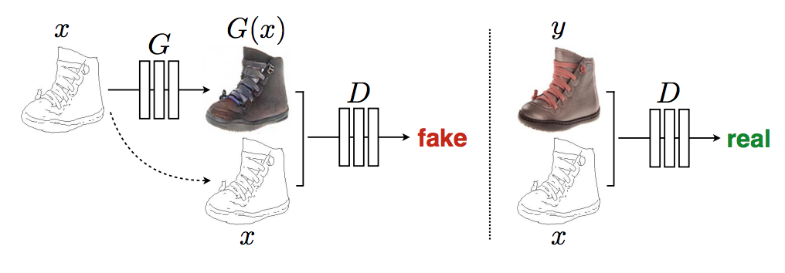
Pix2Pix Neural Network Tutorial
We are going to follow this tutorial: https://github.com/tensorflow/tensorflow/blob/r1.11/tensorflow/contrib/eager/python/examples/pix2pix/pix2pix_eager.ipynb
What is in it:
Step through training a style transfer network
Notes:
Generator is an autoencoder/encoder-decoder framework

Slide 36
More Tensorflow resources
If you would like to learn more about tensorflow, their website has extensive documentation: https://www.tensorflow.org/tutorials/

Slide 37
Accessing GPUs for training Deep Neural Networks
Notes:
A graphics processing unit (GPU) is a specialized electronic circuit designed to rapidly
manipulate and alter computer memory to accelerate the creation of images in a frame buffer
intended for output to a display device.
GPUs where initially developed for rendering video games, but now have been applied to other areas, like artificial intelligence and deep learning.

Slide 38
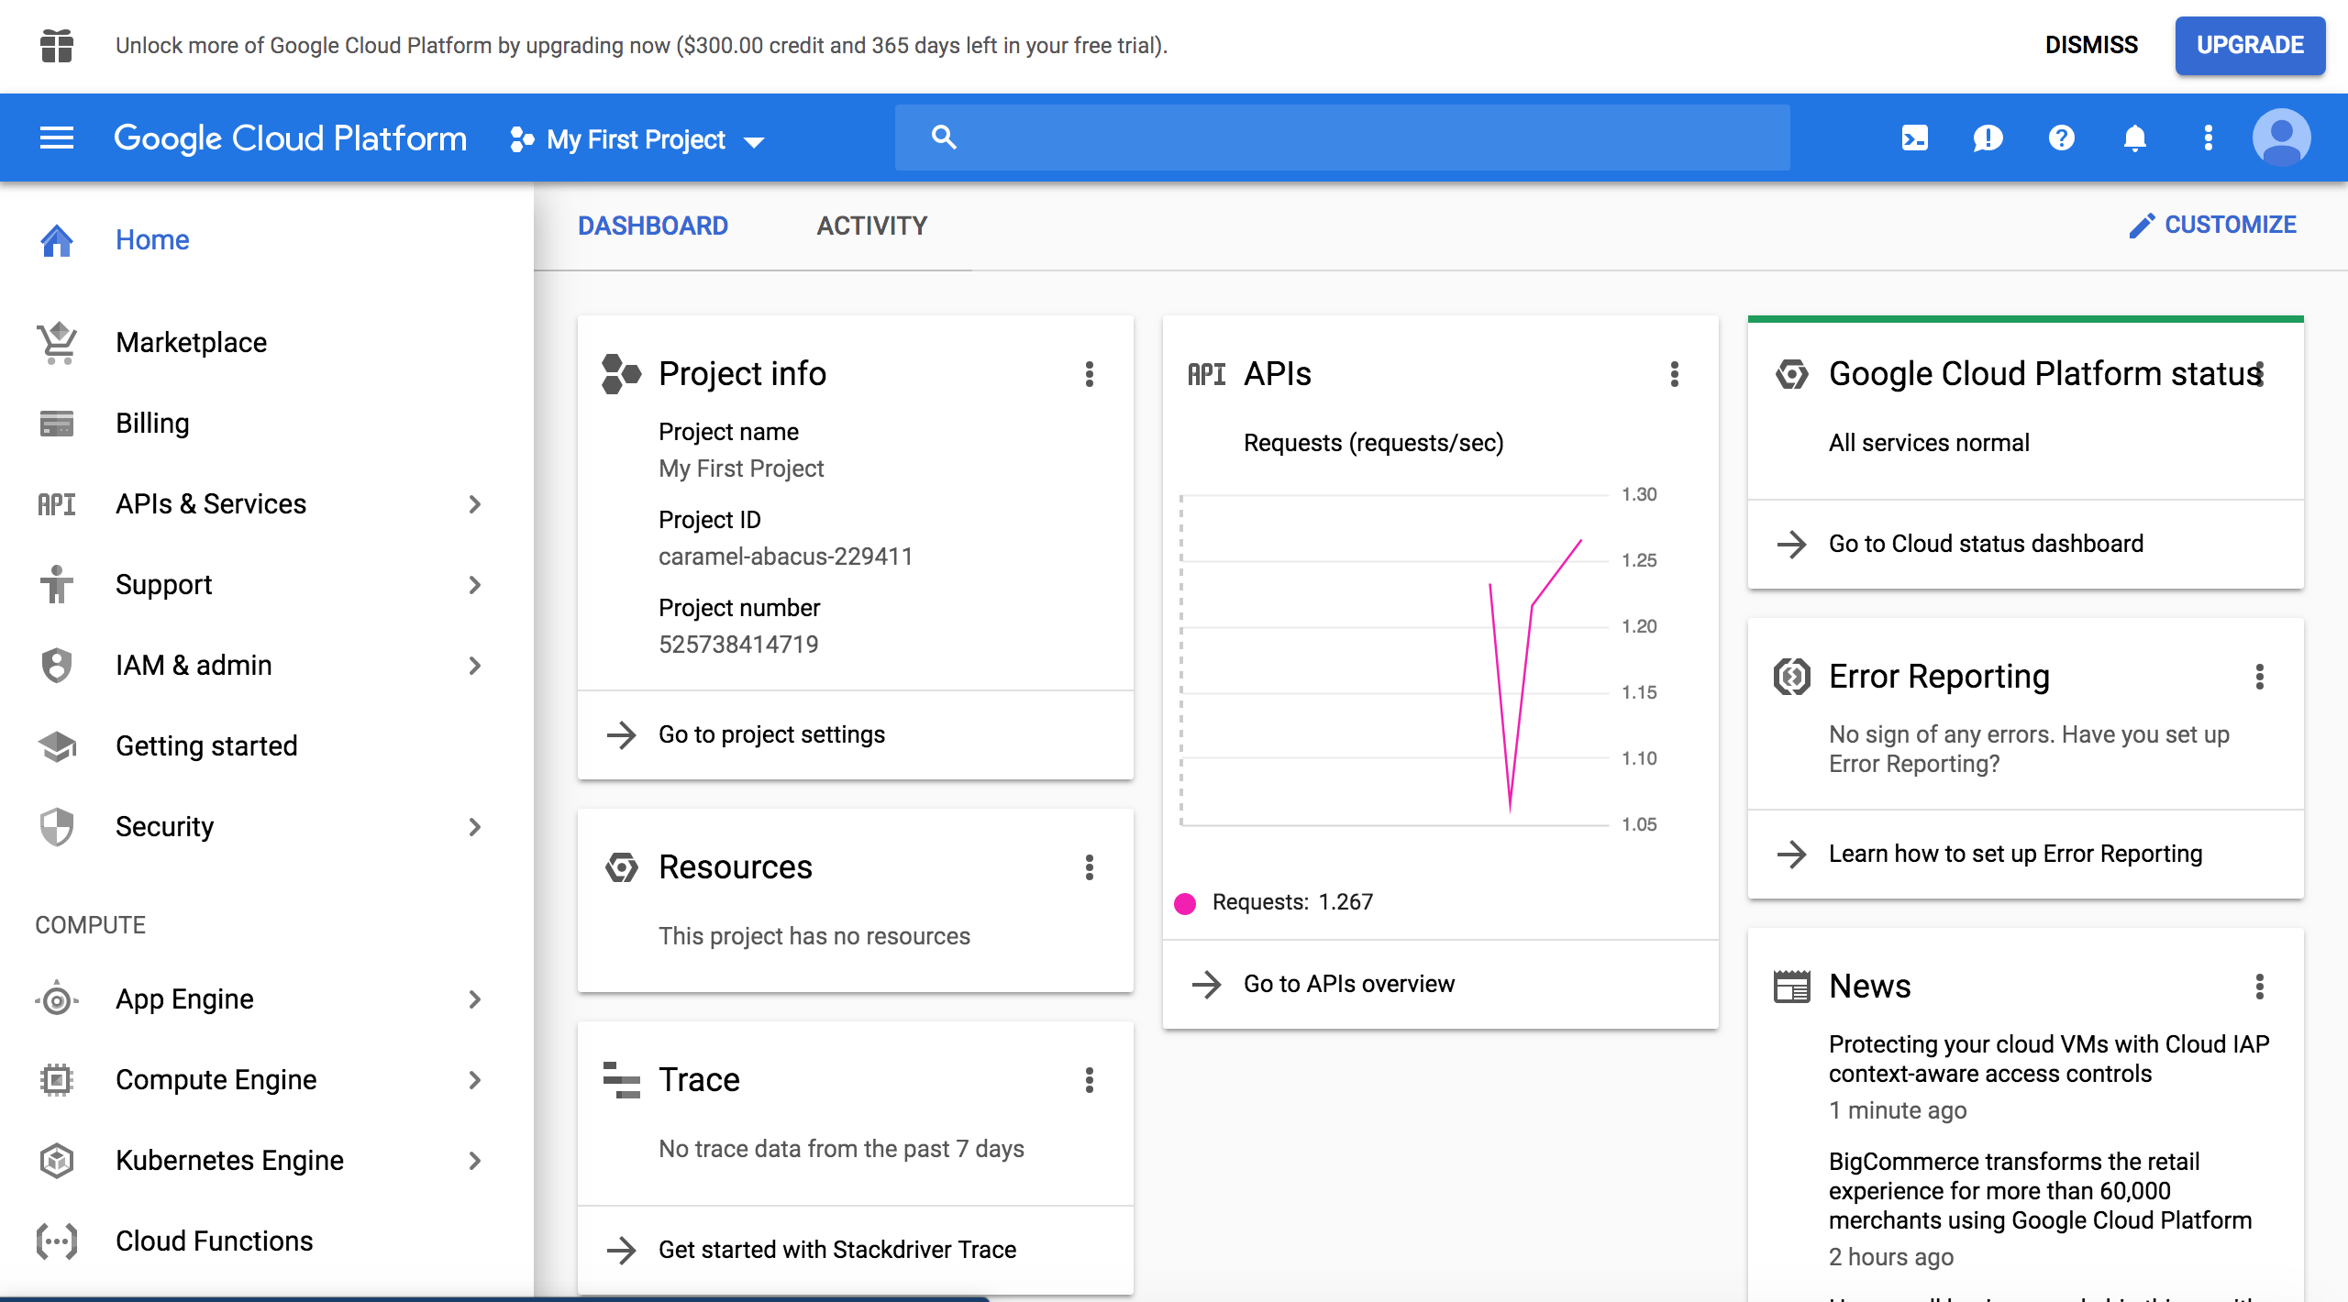
Set up your account on Google Cloud
First, you need to make an account on Google Cloud Platform: https://console.cloud.google.com/freetrial/signup
Once you have signed up, you should be directed to your google cloud home page, an example of which is shown to the right!
Notes:
I would recommend using your umich.edu email account to create your google cloud platform account.
While you get $300 for your twelve month trial, in order to sign up, you do need to input credit card information.
This is so, in case you use up all of your trial credit, that google will charge you for use of their computers.

Slide 39

Set up Budget Alerts
However, you can set email notifications when you have used up certain amounts of credit.
Notes:
In the upper left hand corner of the Compute Engine console page, click on the navigation menu,
then toggle ‘Billing’,
then toggle to ‘Budgets and Alerts’.
Here you can set up budget alerts (located the bottom half of the console page) when you have used up certain percentages of your credit.

Slide 40
Getting Started with Google Cloud Compute Engine
Basic components:
Boot images
Blueprints for an operating system
Instances
Use the ‘blueprint’ of an image to make an instance of it
You interact with each instance using a command line in the Google Cloud Platform Console (more on this later!)
Notes:
The basic idea behind the Compute Engine is that you can load boot images (which are like the operating system on your laptop)
as instances, and within these instances you can run software like deep learning frameworks.
A good way to think of the relationship between instances and images is that an image is like a cookie cutter that you use to make an instance, ie, cookie!

Slide 41
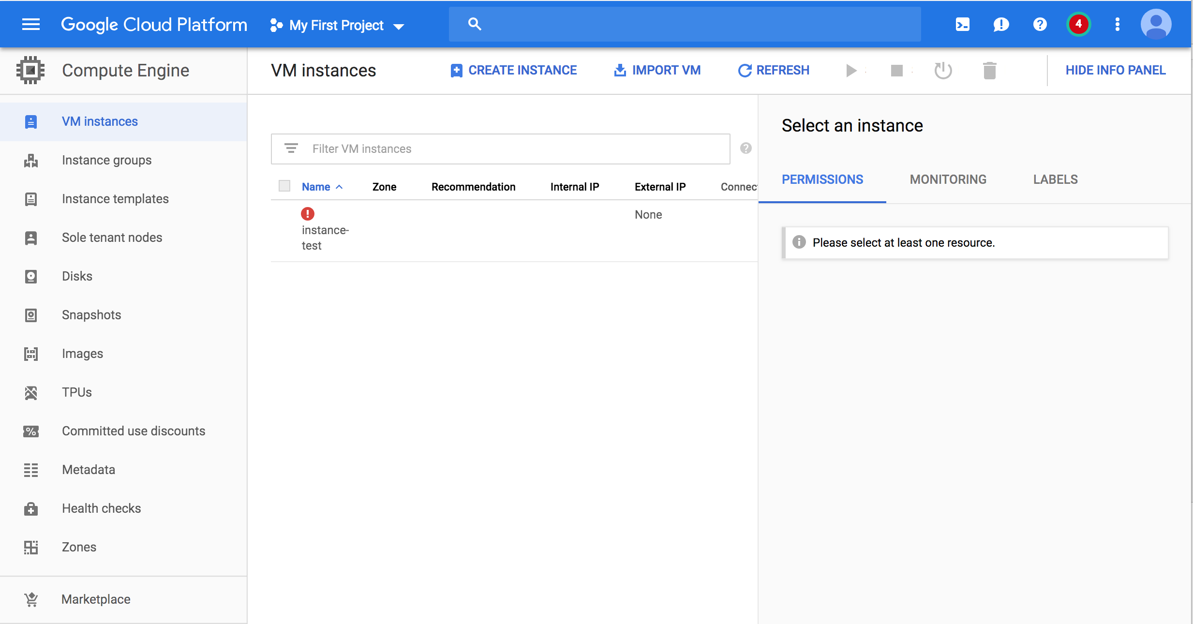
Getting Started with Google Cloud Compute Engine
Notes:
When you click on Compute Engine, you are brought to this screen.
The VM Instances section lists your created instances. The Images button allows you to search for images that have the software you want.

Slide 42
Starting on Google Cloud
For any task in Google Coud, you will need to do the following first:
1. In the GCP Console, go to the Manage resources page and create a project. https://console.cloud.google.com/cloud-resource-manager?_ga=2.167868001.-1599065120.1548156095&_gac=1.10604288.1548172394.EAIaIQobChMIu7C6yt-B4AIVgsDACh1bFgaCEAAYASAAEgJBD_D_BwE
2. Make sure that billing is enabled for your project. https://cloud.google.com/billing/docs/how-to/modify-project
3. Install the Cloud SDK When prompted, choose the project that you created above.
4. Install Python 2.7. If you are using Windows and you left the relevant checkbox selected when you installed the Cloud SDK, this was done automatically.

Slide 43
A good tutorial for starting on Google Cloud Compute Engine
This tutorial steps through setting up an instance and deleting it: https://cloud.google.com/compute/docs/quickstart-linux

Slide 44
Starting on Google Cloud
Next step: getting your training/testing data into Google Cloud.
Data is stored in a Bucket in Google Storage: https://cloud.google.com/storage/docs/creating-buckets
You upload your data as an Object into a bucket: https://cloud.google.com/storage/docs/uploading-objects
You can download Objects from a bucket: https://cloud.google.com/storage/docs/downloading-objects
Notes:
Buckets are the basic containers that hold your data in Cloud Storage:

Slide 45
A good tutorial for using Tensorflow on Google Cloud
This tutorial steps through setting up data, code and training for deep neural networks using the GPUs on google cloud: https://cloud.google.com/solutions/running-distributed-tensorflow-on-compute-engine
Notes:
NOTE: In this tutorial, it is unnecessary to use Cloud ML Engine.
This tutorial deals with distributed computing, which roughly means breaking your neural network training up into little bits that can be sent to different compute nodes.
While this can make the training time faster, it is tricky to set up if you have no familiarity with parallel computing techniques.

Slide 46
A good tutorial for using Tensorflow on Google Cloud
We are going to train a simple neural network using the Google Cloud Compute Engine
NOTE: this is for generic datasets and neural network frameworks. If you would like to train a classification network specifically, Google Cloud Engine has AutoML, which handles all the training/evaluation of a classification model under the hood.
Notes:
NOTE: In this tutorial, it is unnecessary to use Cloud ML Engine.
This tutorial deals with distributed computing, which roughly means breaking your neural network training up into little bits that can be sent to different compute nodes.
While this can make the training time faster, it is tricky to set up if you have no familiarity with parallel computing techniques.

Slide 47
A good tutorial for using Tensorflow on Google Cloud
This tutorial steps through setting up data, code and training for deep neural networks using the GPUs on google cloud: https://cloud.google.com/solutions/running-distributed-tensorflow-on-compute-engine
Notes:
NOTE: In this tutorial, it is unnecessary to use Cloud ML Engine.
This tutorial deals with distributed computing, which roughly means breaking your neural network training up into little bits that can be sent to different compute nodes.
While this can make the training time faster, it is tricky to set up if you have no familiarity with parallel computing techniques.

Slide 48
A case study: train a GAN on Google Cloud Engine
We are going to train a Generative adversarial network in the cloud!

Slide 49
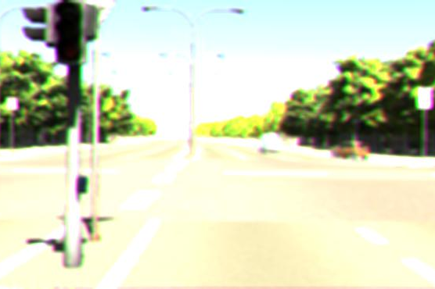
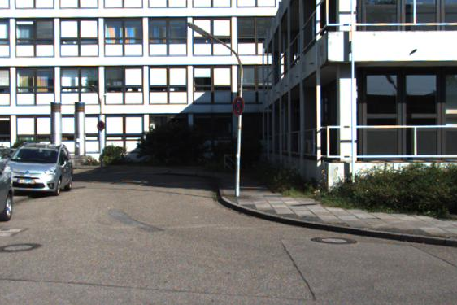
A case study: train a GAN on Google Cloud Engine
We are going to train a Generative adversarial network in the cloud!
What is a GAN?
Rendered Image
Real Image
Input Noise Vector
Generator Neural Network
Discriminator
Neural
Network
Real or Rendered
Notes:
A GAN is a type of generative neural network, which means that it generates a form a output, which is typically images.
A GAN is actually two neural networks: a Generator network and Discriminator network.

Slide 50
A case study: train a GAN on Google Cloud Engine
We are going to train a Generative adversarial network in the cloud!
What is a GAN?
Rendered Image
Target Image
Input Noise Vector
Generator Neural Network
Discriminator
Neural
Network
Real or Rendered
Notes:
A GAN is a type of generative neural network, which means that it generates a form a output, which is typically images.
A GAN is actually two neural networks: a Generator network and Discriminator network.

Slide 51
A case study: train a GAN on Google Cloud Engine
We are going to train a Generative adversarial network in the cloud!
What is a GAN?
Rendered Image
Target Image
Input Noise Vector
Generator Neural Network
Discriminator
Neural
Network
Real or Rendered
Notes:
A GAN is a type of generative neural network, which means that it generates a form a output, which is typically images.
A GAN is actually two neural networks: a Generator network and Discriminator network.
The generator is trained based upon the discriminator, and the discriminator is trained by the generator.
What results is a generator that has learned to make realistic images because it learns the distribution over real images.

