Slide 1
Part 1: Random Forest Results and the effect of hypertuning

Slide 2
The results
The average AUC for all K-fold sets was : 0.729 with a standard deviation of 0.027.
This was calculated using a Random Forest consisting of ”default” values.
100 Trees in the forest
No pruning
The maximum size of each tree was not set, so each tree grew until the leaves had full purity.

Slide 3
Hyper-Tuning
Hyper-tuning or Hyper-parameter tuning is a process of modification to the machine or algorithm used used in the project before the input of data
Fine-tuning or colloquially just tuning, is when the system is modified after the data is inputted or read.
For this presentation we will look at the 2 examples of the former of these processes, how can we make a machine more capable of predicting interface residues by changing the mechanics of the machine itself.
We will also look at post-pruning which is a tuning process

Slide 4
Parameter 1: Number of Trees
The number of trees populating the forest can be adjusted .
By default this value is 10 trees.
Below is a plot of average AUC as we increase from the number of trees in the forest.
The maximum AUC is reached with 100 trees

Slide 5
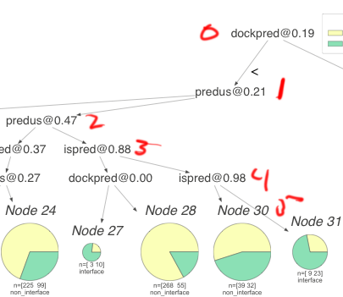
Parameter 2: Tree Depth
Tree depth is the amount of rows or layers in the trees that populate the forest. This is the “pre-pruning” parameter.
By default the tree can grow until all leaves are pure.
By limiting the tree growth, over-fitting is prevented.
Example of tree with depth = 5

Slide 6
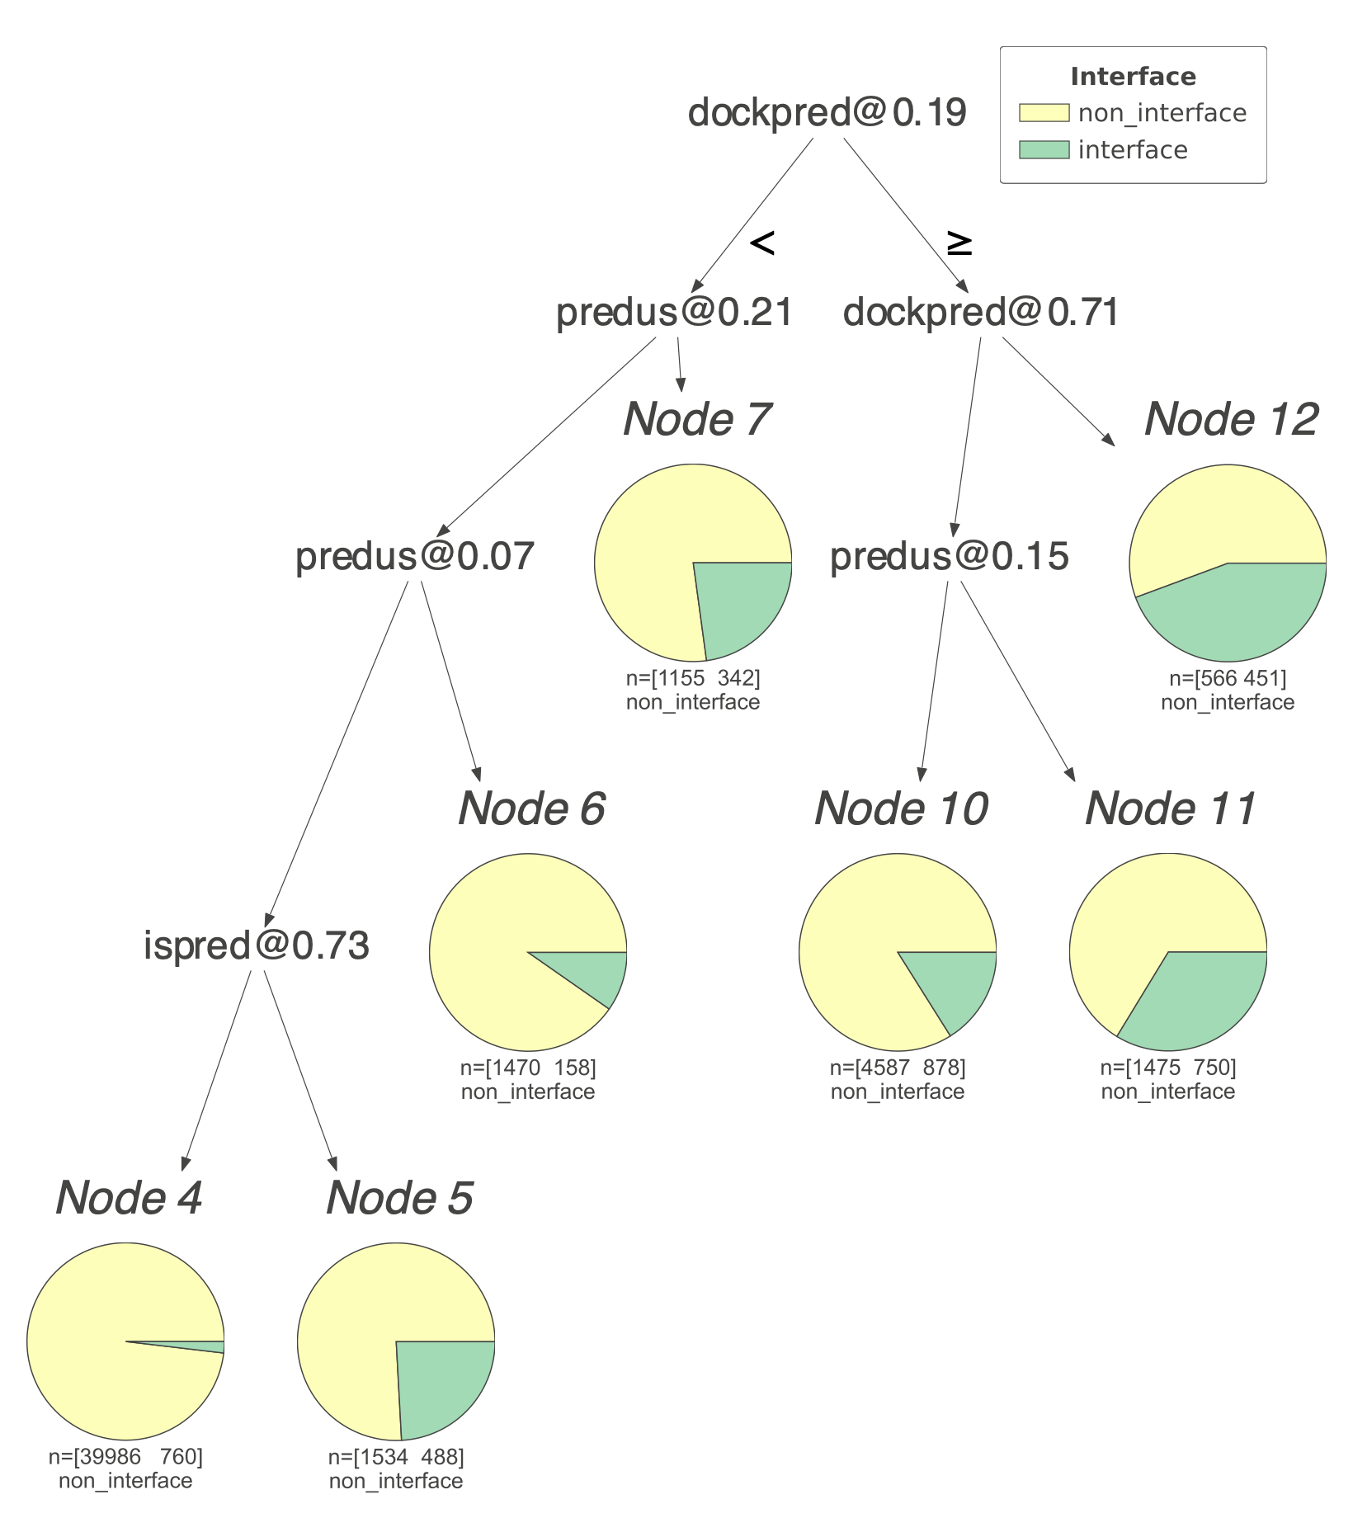
Tree Visualization
A visualization program was written on top of dtreeviz
dtreeviz generates a “shadow” on top of the tree in the forest
dtreeviz was modified to suit our needs.
The trees are saved as SVG or vector images for sake of size and scalability
This is a small example of a tree with depth = 10 and ccp_alpha = 0.00105 (harsh post-pruning)

Slide 7
Lets zoom in on a leaf
Each leaf contains three components
1) a pie chart for easy readability of sample composition. (there is a key at the top, yellow is non interface, green is interface)
2) n, or the sample composition of the node, the first index is non interface and the second is interface.
3) The voting label of the note used in a harsh vote classifier.(we are not using this)

Slide 8
Size matters
Depending on the post-pruning value and depth, the trees can range from 1mb to 23 mb, and that’s for only one of many trees in the forest.
This results in “Black-Blox” ML, where the exact path and prediction from the model is impossible to fully visualize but by randomly selecting one tree as well as adjusting parameters, we can try and uncover what is happening “beneath the hood”

Slide 9
Parameter 3: Pruning
Minimal cost complexity pruning recursively finds the node with the “weakest link”. The weakest link is characterized by an effective alpha, where the nodes with the smallest effective alpha are pruned first.
The parameter ccp_alpha controls the amount of pruning done after the trees are.
The greater the pruning parameter, the smaller the tree will be.

Slide 10
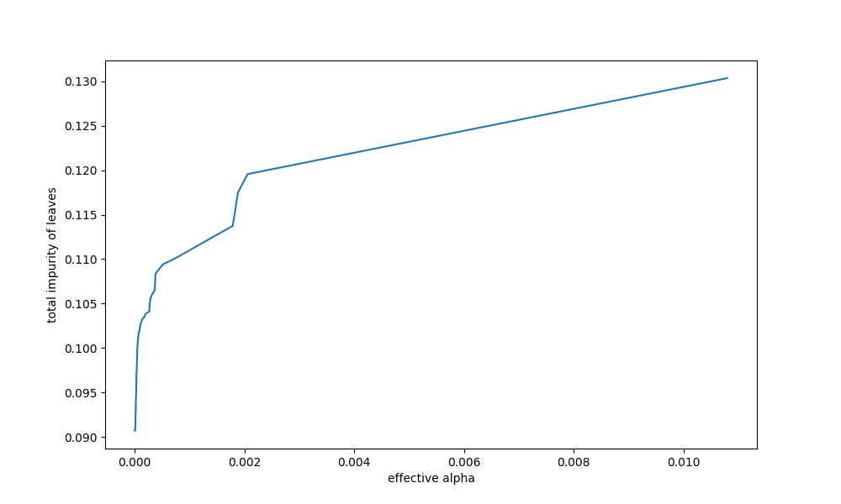
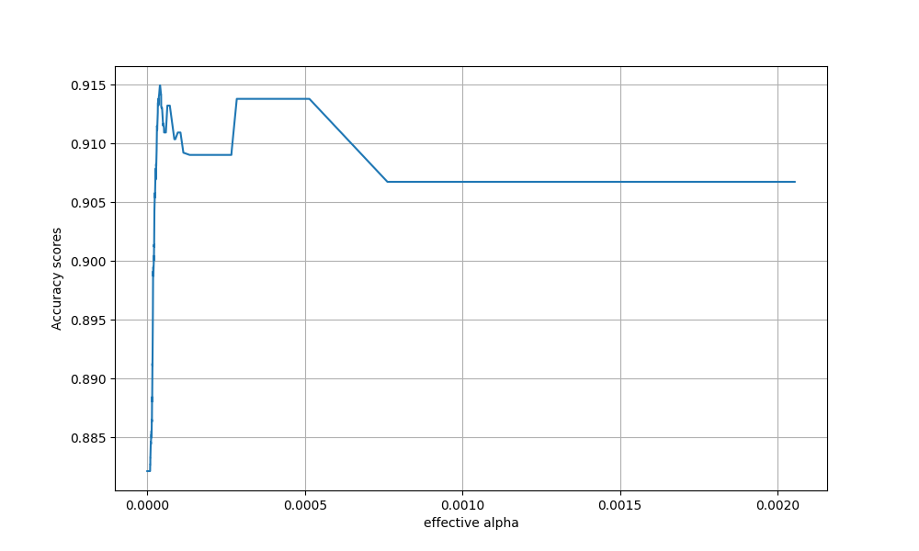
Finding effective alphas
Impurity over effective alphas
Accuracy over effective alphas

Slide 11
Testing the range of the ccp_alpha

Slide 12
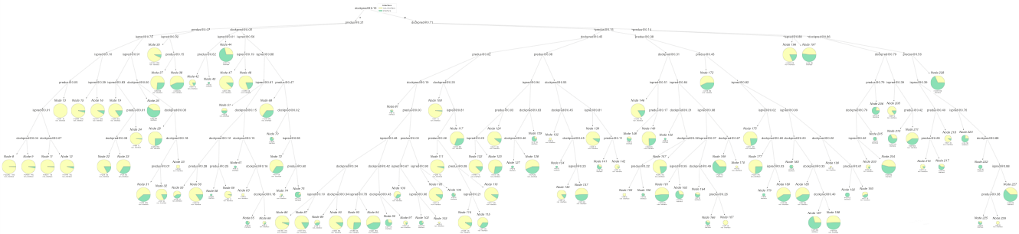
Full tree with optimal ccp_aplha

Slide 13

Tree without pruning

Slide 14
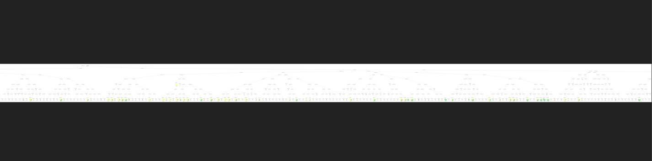
…

Slide 15
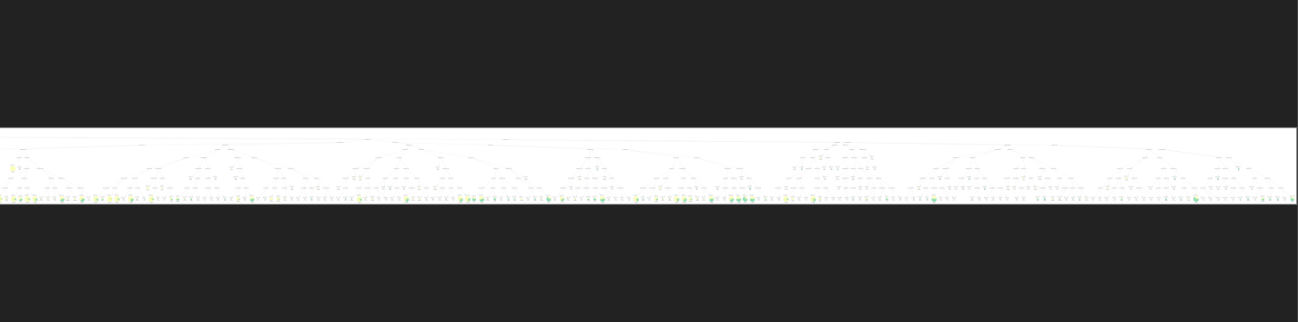
…And finally

Slide 16
Take Away
By adjusting the parameters for the random forest program we have drastically increased the successes at which it can predict interface residues.
The default RF has an AUC of 0.7290
By adjusting the parameters we were able to achieve an AUC of 0.8732 on par with the reported AUC of Meta-DPI
Looking forward we can feed Meta-DPI’s logistic regression score into the RF, along with the three predictors, to achieve a greater success.
We can also continue bolstering the RF model by looking into more state-of-the-art RF algorithms like Google’s TensorFlow.

Slide 17
Refrences
https://github.com/parrt/dtreeviz
https://arxiv.org/pdf/1703.05430.pdf

