Slide 1
Data Visualization and Meta-DPI

Slide 2
DATa type 1: Results page
This page lists the 5 predictors, Predus, Ispred, Dickpred, Logreg(metadpi) and Random forest.
It includes the n number of sets and their AUC. As well as the average and stdev of the n sets
The parameters for the Logreg and RF are also delineated in the results page.

Slide 3
Data type 2: Trees
In the first files a raw HTML/SVG file of a random decision tree in a forest(from the first set) is chosen. This file can be rendered into a SVG image for dynamic viewing
Secondly, the rendered SVG file is saved. This file requires an SVG reader to open ( any browser will do)

Slide 4
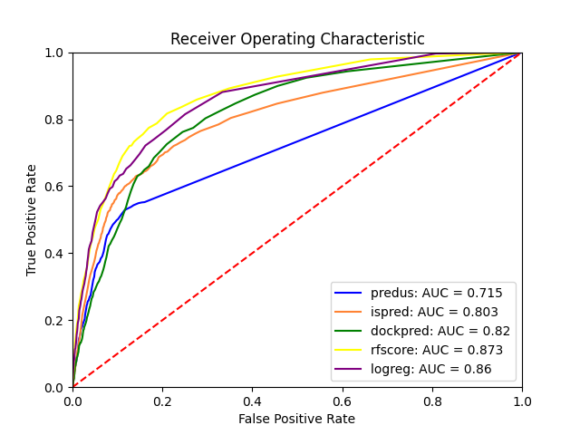
Data Type 3: ROC curve
For each set an ROC plot is saved.
This was made without the StAR program.
We imporved on the star program by using more defined colors without overlap.

Slide 5
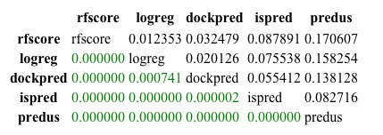
Data type 4: Star chart
This chart is saved as a jpeg and it includes two distinct pieces of information.
The top triangle is the AUC difference
The bottom triangle is is p-values.
Colored in red are points whose p-val is below the cutoff (0.05) and green for above the cutoff.
This allows us to visualize the statistical relevance of predictors.
We have improved on the original Star program by reformatting the index, columns and diagonal to be the full names of the predictors.

Slide 6
TO DO
Vorfip analyses is underway, hopefully will be completed by next week
Address parameters of RF across different set size and composition.

