Slide 1

Machine learning and Meta-DPI

Slide 2
Meta-DPI
Meta-DPI is a metamethod predictor for protein-protein interface.
Meta-DPI uses probability scores from 3 orthogonal prediction programs to calculate the residues most likely to be at the interface.
So far Meta-DPI has been tested on Benchmark and Nox, which contain general proteins.

Slide 3
Looking Forward
We will try to extend Meta-DPI’s prediction capability to immunological proteins. Specifically Epitopes.
To do so will require three key steps
A literature search to gain background in the subject, find successful algorithms to use as benchmarks, and to find suitable databases of known epitopes to train Meta-DPI on
Boosting Meta-DPI’s overall accuracy through incorporation of ML
Optimization of Meta-DPI for epitope prediction.

Slide 4
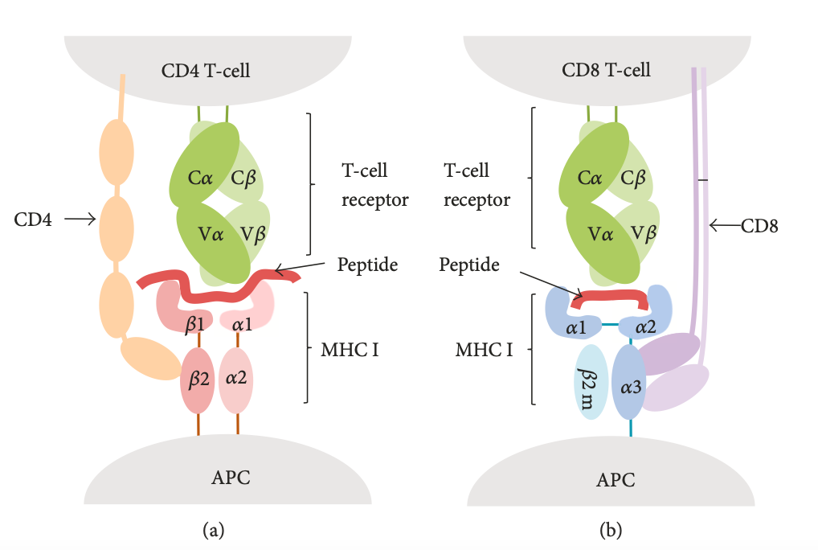
What is an Epitope? Antigen? Antibodies?
Cells communicate through interactions at there surfaces.
Antigens are proteins presented on the surface of pathogens (harmful cells).
Antibodies (Ab) are immune cells that target antigens in order to clear them.
For the immune system to work the Ab-Antigen interaction must occur, this is a unique and specialized interaction.
The site of Ab-Antigen interaction is known as the paratope-epitope site.
That is the part of the Ab that binds the antigen is the paratope and the part of the antigen that is bound to the Ab is the epitope.

Slide 5
Some things about epitopes
Two main classes of Ab - T-cells and B-cells
T–cells binds to the epitope through the MHC1/MHSC2 complex to promote immune response. The MHC1 Epitope is usually 9 res long and very demanding, in turn more specific. The MHC2 site is less demanding, is longer and less specific.
B-cell epitope can be of two types, linear and conformational. Linear means that the epitope is a sequential list of neighboring residues, conformational means the residues are not sequence neighbors but rather structural neighbors based in binding complex and folding.

Slide 6
The Literature, more work to be done.
T-cells:
Two-part process,
Find general site of epitope - qualitive
Rank residues in that site by propensity to be at the epitope biding complex. – quantitative
So far artificial Neural Networks and multiple ML algorithms work best.
B-cells:
For linear epitopes ML was very successful as was ANN
Structural predictors weren’t accurate
For conformational epitopes, CBTOPE was the notable because it didn’t require previous knowledge of 3D structure yet had a 86.6% accuracy.

Slide 7
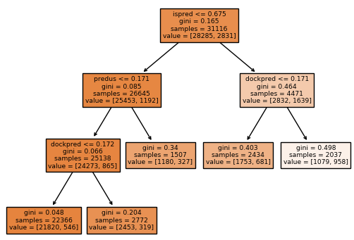

ML, Decision Tree
Decision tree is a recursive machine learning algorithm, that creates “rules” for classification of a data set.
It does this through multistep binary classification based on rules gleaned from the dataset.
The fitted tree is the used to predict classification on test set.
Accuracy was reported at 91.6%. Further metrics will be calculated
This trees were generated using a ccp_alpha value of 0.00105
These two trees are the same, expect samples and values are reported as percentage and proportions.

Slide 8
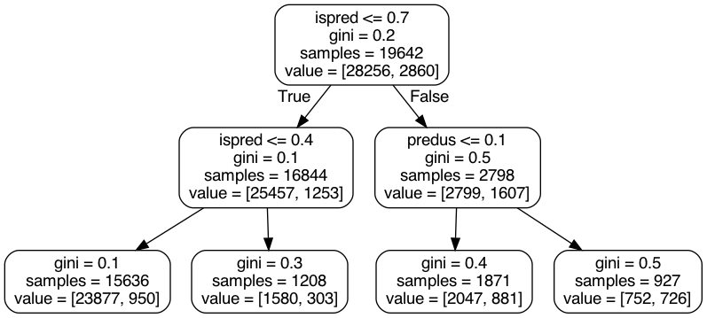
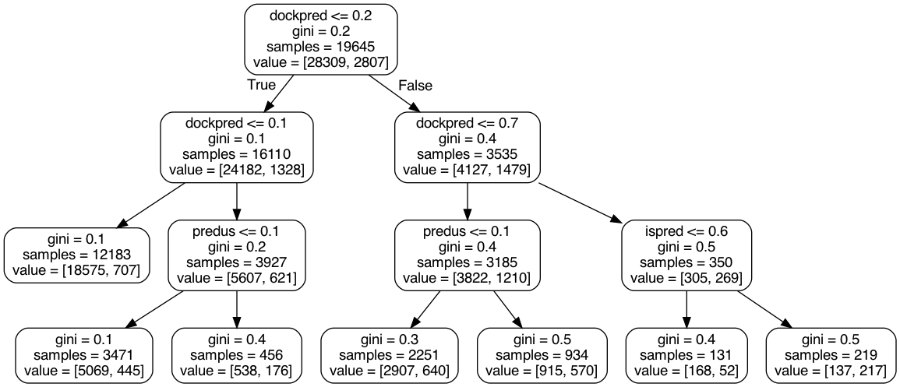
Random Forest
RF, is a collection of decision trees that are “averaged together”, each tree is created with a subset of the original data.
Improved accuracy.
1000 different tress were used to build the forest
The same ccp_alpha as the DT, 0.00105, was used
Below are two of the 100 trees in the forest

Slide 9
Epitope specific optimization
By further looking into the literature and code of the epitope predictors we can find different methods for improving epitope prediction.
By adding weight to each predictor based on the success of that specific predictors, ie adding weight to predus when a known homolog is present, can help improve meta-dpi

Slide 10
Plan for this week.
Read more, still have a lot of literature to read.
Run Mordechai's AUC and PR software on the ML prediction.
Look into ways to increase DT/RF prediction, by optimizing params, Gini, pruning, boostraping, adaboost.

