Slide 1


Slide 2
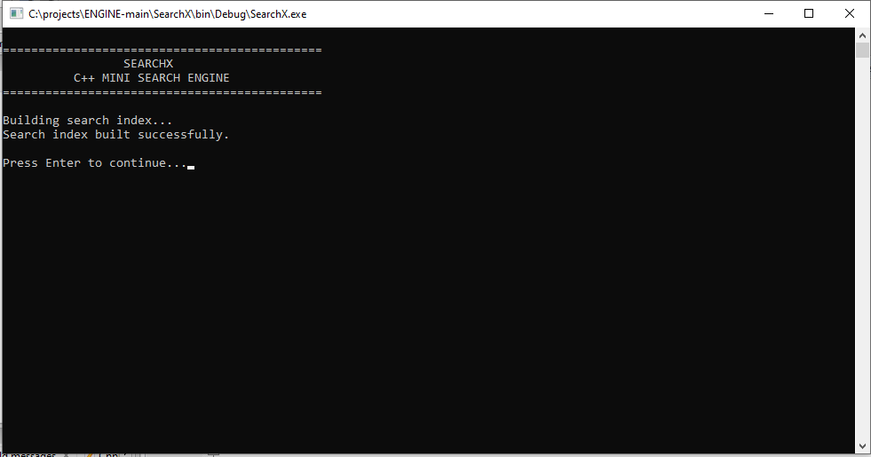

Slide 3
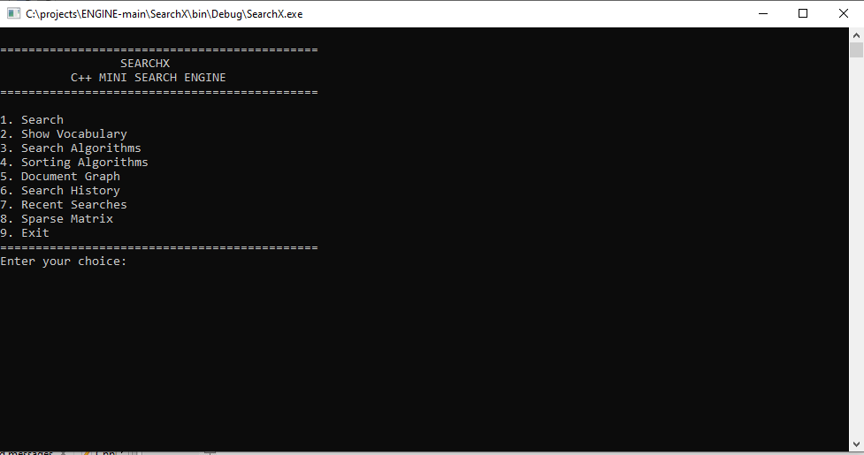

Slide 4
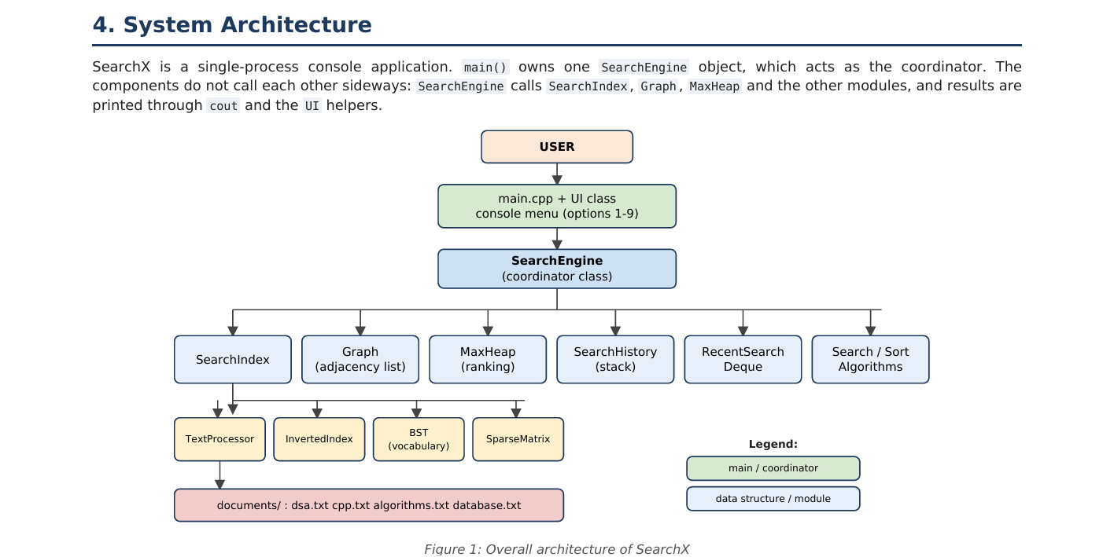

Slide 5
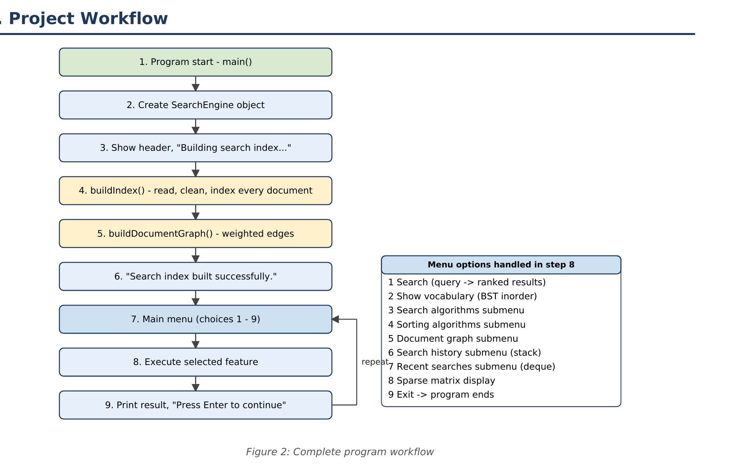

Slide 6
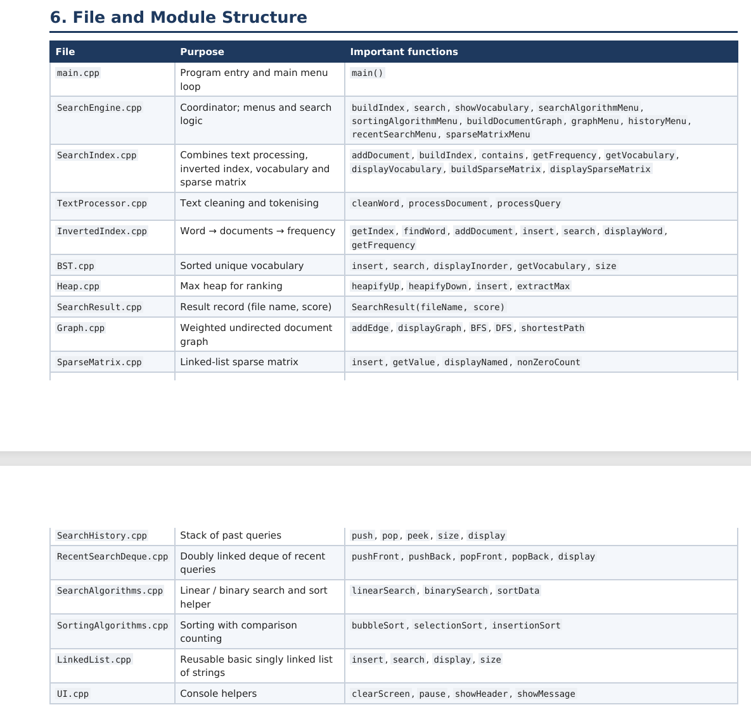

Slide 7
How SearchX Works
From raw text files to ranked results
Read file
Clean words
Inverted Index + BST
User query
Max Heap ranking
Text cleaning
Main menu
Lowercase every word
Keep only letters and digits
"Structures!" becomes structures
1 Search, 2 Vocabulary
3 Search algos, 4 Sorting
5 Graph, 6 History, 7 Recent
8 Sparse matrix, 9 Exit

Slide 8
Code · Text Cleaning
TextProcessor — every word is normalised before indexing or searching
What it does
// TextProcessor.cpp
string TextProcessor::cleanWord(string word)
{
string cleaned = "";
for (int i = 0; i < word.length(); i++)
{
char ch = tolower(word[i]);
if (isalnum(ch))
cleaned += ch;
}
return cleaned;
}
// processQuery / processDocument
stringstream ss(query);
while (ss >> word)
{
string cleaned = cleanWord(word);
if (cleaned != "") words.push_back(cleaned);
}
Lowercase each character
Keep letters and digits only
Split on whitespace; empty results are dropped
Same cleaning is used for documents and queries
"C++" becomes c, "Structures!" becomes structures
Source: TextProcessor.cpp

Slide 9
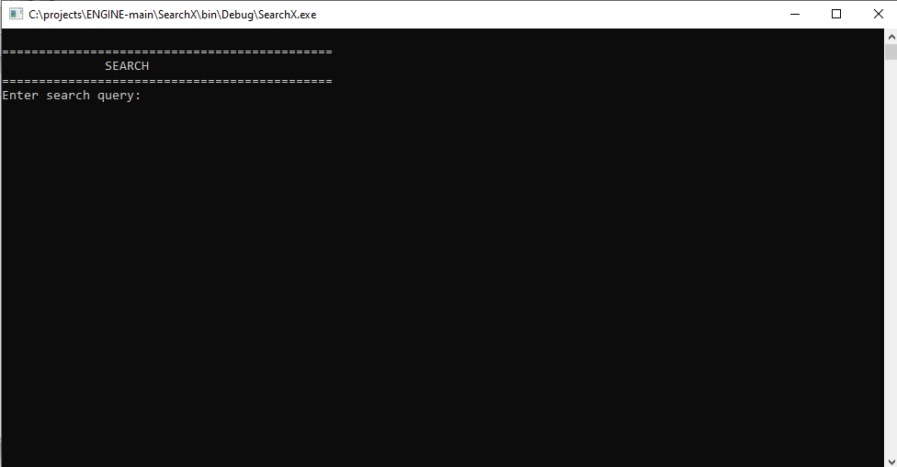

Slide 10
1 · Search
Inverted index (27 linked-list buckets) + Max Heap ranking
How it works
Enter search query: data
Query: data
Cleaned words: data
1. dsa.txt
Score: 3
2. algorithms.txt
Score: 3
Clean the query words
Score = sum of word frequency per document
Documents with score > 0 go into the Max Heap
extractMax() prints best match first
Enter search query: hello
No documents found.

Slide 11
Code · Inverted Index
InvertedIndex — 27 buckets (a–z + other), each a linked list of words
What it does
// InvertedIndex.cpp (condensed)
int InvertedIndex::getIndex(string word)
{
if (word == "") return 26;
char c = tolower(word[0]);
if (c >= 'a' && c <= 'z')
return c - 'a';
return 26;
}
void InvertedIndex::insert(string word, string fileName)
{
int index = getIndex(word);
WordNode* current = wordLists[index];
while (current != NULL)
{
if (current->word == word)
{ addDocument(current, fileName); return; }
current = current->next;
}
// word is new: create node, add document, insert at head
}
getIndex picks the bucket from the first letter
Each word node keeps a list of (document, frequency)
Existing word + document: frequency++
New word: node added at the head of its bucket
Lookup cost is O(B), the chain length
Source: InvertedIndex.cpp

Slide 12
Code · Scoring & Max Heap
SearchEngine::search() + MaxHeap — rank documents by total frequency
What it does
// SearchEngine.cpp
for (int i = 0; i < documentCount; i++)
{
int totalScore = 0;
for (int j = 0; j < queryWords.size(); j++)
totalScore += searchIndex.getFrequency(
queryWords[j], fileNames[i]);
if (totalScore > 0)
resultHeap.insert(
SearchResult(fileNames[i], totalScore));
}
while (!resultHeap.empty())
SearchResult result = resultHeap.extractMax();
// Heap.cpp : heapifyUp
while (index > 0) {
int parent = (index - 1) / 2;
if (heap[parent].score >= heap[index].score) break;
swap heap[parent] and heap[index];
index = parent;
}
Score = sum of query-word frequencies in a document
Only documents with score > 0 are inserted
heapifyUp keeps the largest score at the root
extractMax() prints the best match first
Insert / extract: O(log k)
Source: SearchEngine.cpp, Heap.cpp

Slide 13
2 · Show Vocabulary
Binary Search Tree — inorder traversal gives sorted unique words
BST rule: left < node < right
Total unique words: 84
Words in alphabetical order:
a, algorithm, algorithms, an,
and, are, arrange, arrays,
between, binary, by, c, can,
classes ...
Every token inserted, duplicates ignored
Inorder traversal = alphabetical order
Not self-balancing

Slide 14
Code · BST Insert
BST — recursive insertion, duplicates ignored, inorder = sorted
What it does
// BST.cpp
BSTNode* BST::insertNode(BSTNode* node, string word)
{
if (node == NULL)
return new BSTNode(word);
if (word < node->word)
node->left = insertNode(node->left, word);
else if (word > node->word)
node->right = insertNode(node->right, word);
return node;
}
void BST::inorderToVector(BSTNode* node,
vector<string> &words)
{
if (node == NULL) return;
inorderToVector(node->left, words);
words.push_back(node->word);
inorderToVector(node->right, words);
}
Smaller word goes left, larger goes right
Equal word: nothing is inserted
Inorder traversal visits left, node, right
getVocabulary() collects the sorted words in a vector
Average O(log V), worst O(V)
Source: BST.cpp

Slide 15
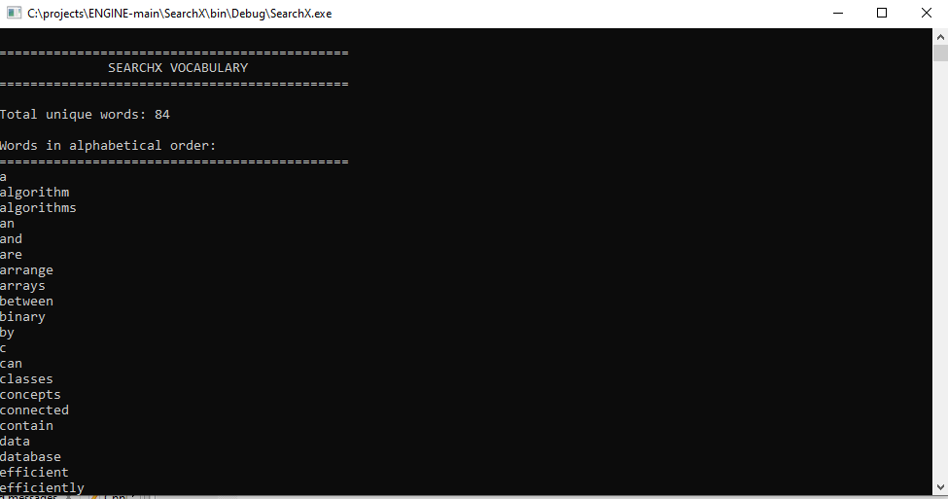

Slide 16
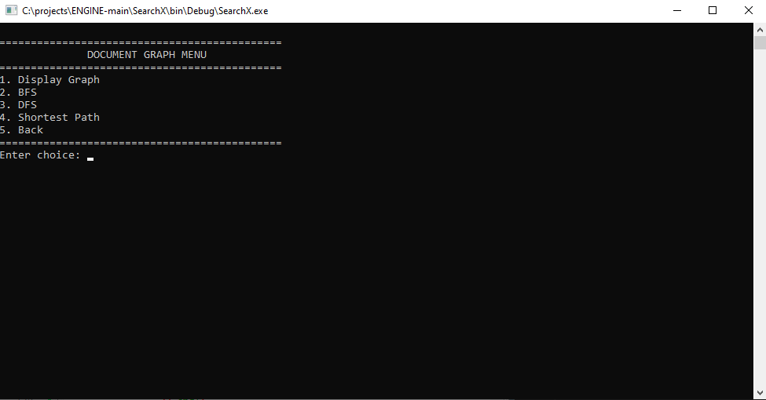

Slide 17
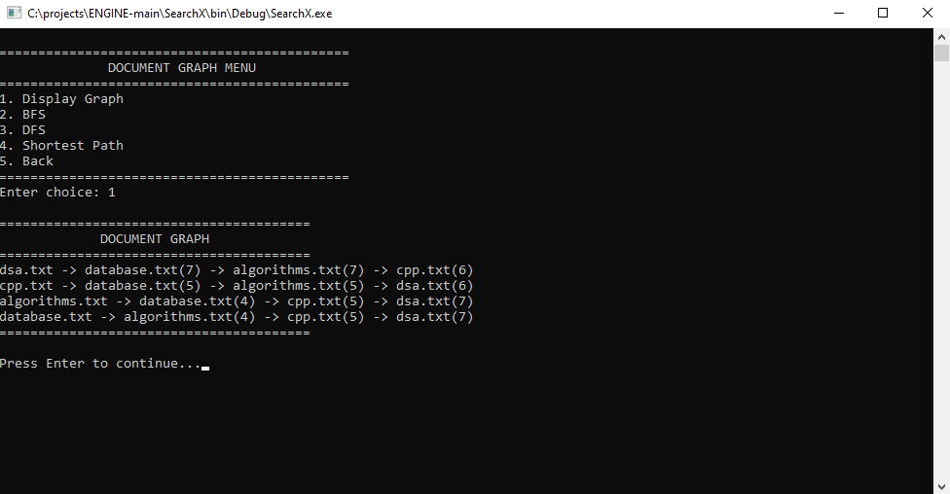

Slide 18
3 · Document Graph
Vertex = document, edge weight = shared distinct words
dsa.txt
6
cpp.txt
BFS: dsa.txt database.txt
algorithms.txt cpp.txt
DFS: dsa.txt database.txt
algorithms.txt cpp.txt
Shortest Path:
dsa.txt -> database.txt
Number of edges: 1
7
5
7
5
algorithms
database
Complete graph: every pair shares words. Shortest path uses BFS (fewest edges, weights ignored). Time O(V+E).
4

Slide 19
Code · Graph Build & BFS
Graph — adjacency list, undirected; weight = shared distinct words
What it does
// SearchEngine::buildDocumentGraph (condensed)
for (int i = 0; i < documentCount; i++)
for (int j = i + 1; j < documentCount; j++)
{
int commonWords = 0;
// count distinct words of document i found in j
if (commonWords > 0)
documentGraph->addEdge(i, j, commonWords);
}
// Graph.cpp : BFS loop
while (front < rear)
{
int currentVertex = queue[front++];
cout << vertexNames[currentVertex] << " ";
for (EdgeNode* e = adjacency[currentVertex];
e != NULL; e = e->next)
if (!visited[e->vertex]) {
visited[e->vertex] = true;
queue[rear++] = e->vertex; }
}
Every document pair (i, j) is compared
commonWords counts distinct words found in both
addEdge stores the edge in both directions
BFS uses an array queue and a visited array
Time O(V + E)
Source: SearchEngine.cpp, Graph.cpp (BFS loop shortened)

Slide 20
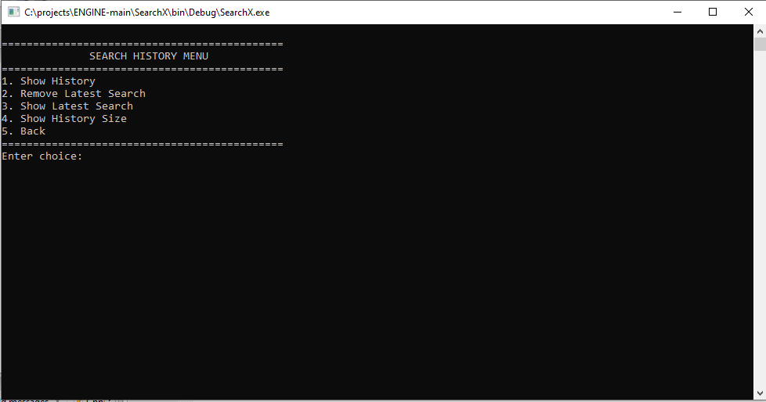

Slide 21
4 · Search History
Stack (LIFO) for history, Deque for recent searches
Stack — SearchHistory
Deque — RecentSearchDeque
push / pop
Shows newest search first
Doubly linked list, O(1) at both ends
Oldest first; remove oldest or latest
-- Search History --
1. data
2. code
3. dsa
4. hello
Removed search: data
Latest search: code
Number of searches: 3
-- Recent Searches --
1. dsa
2. code
Removed oldest search: dsa
Removed latest search: code
Recent search count: 0

Slide 22
Code · Stack & Deque
SearchHistory (LIFO) and RecentSearchDeque (both ends)
What it does
// SearchHistory.cpp : push
HistoryNode* newNode = new HistoryNode(query);
newNode->next = top;
top = newNode;
count++;
// RecentSearchDeque.cpp : pushBack
DequeNode* newNode = new DequeNode(query);
newNode->previous = rear;
rear->next = newNode;
rear = newNode;
// RecentSearchDeque.cpp : popFront
DequeNode* temp = front;
string query = front->query;
front = front->next;
if (front == NULL) rear = NULL;
else front->previous = NULL;
delete temp; count--;
return query;
search() calls history.push(query) and recentSearches.pushBack(query)
Stack: top is the newest search
Deque: front is the oldest, rear is the newest
popFront removes the oldest, popBack the latest
All of these run in O(1)
Source: SearchHistory.cpp, RecentSearchDeque.cpp (shortened)

Slide 23
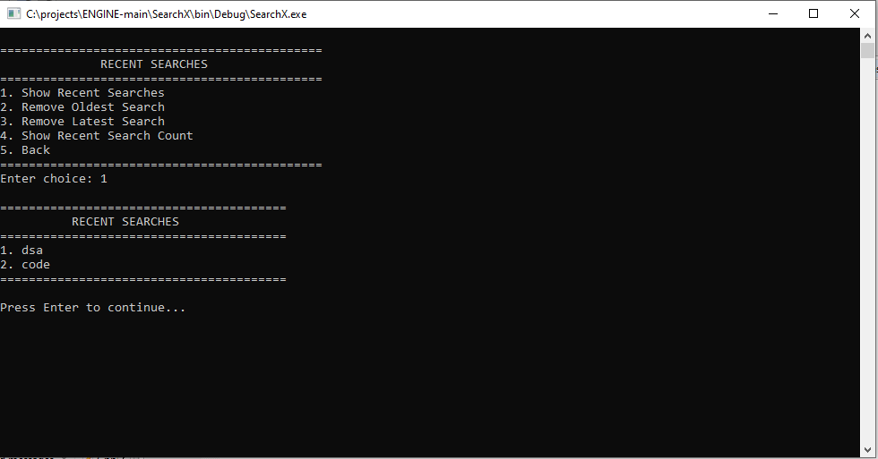

Slide 24
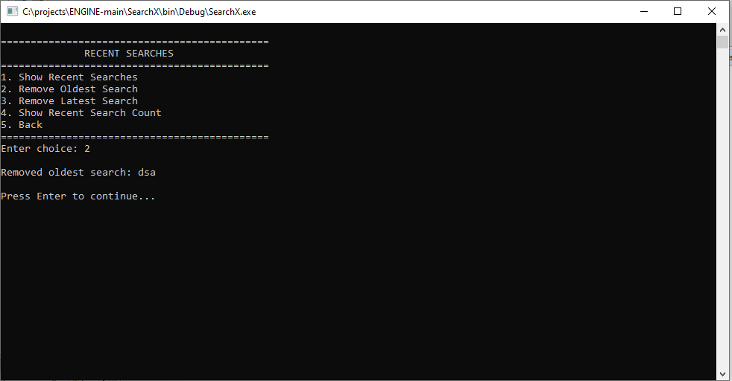

Slide 25
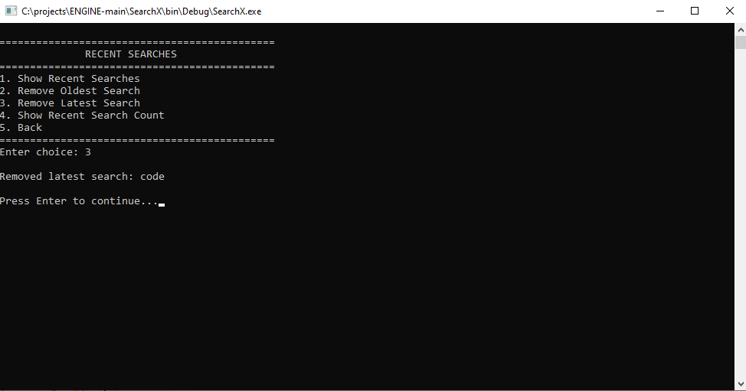

Slide 26
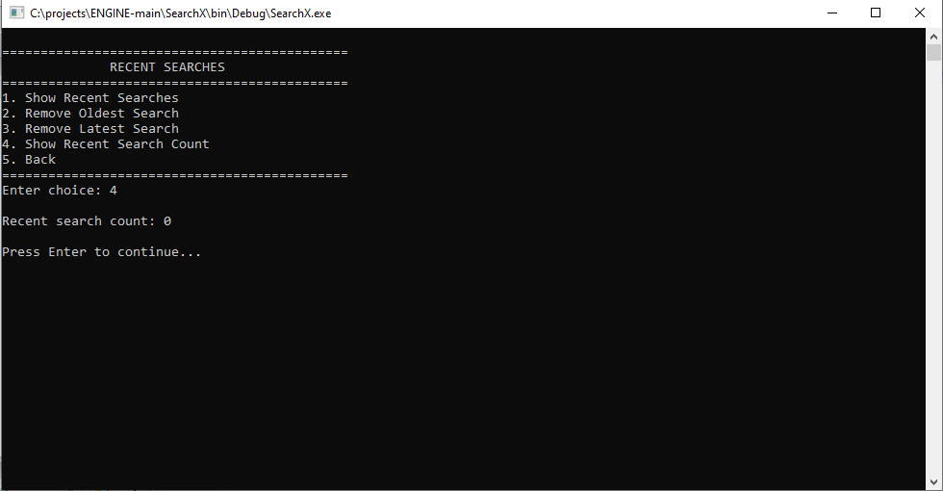

Slide 27
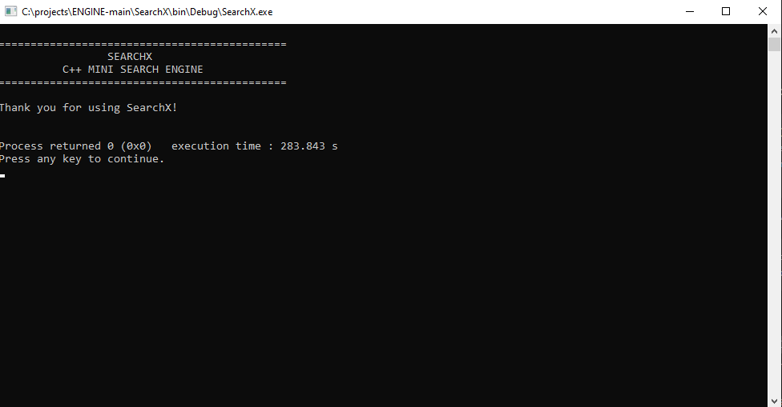

Slide 28
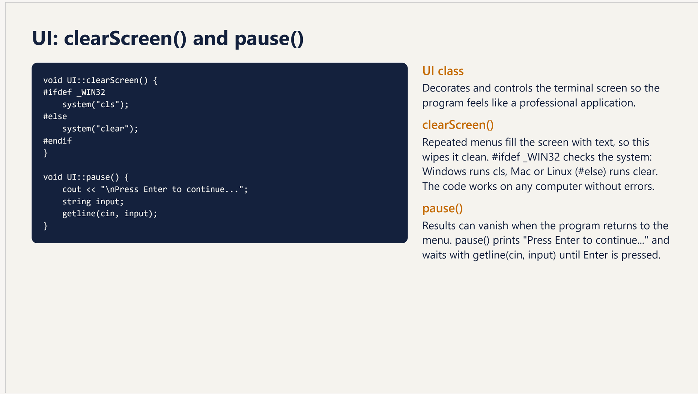

Slide 29
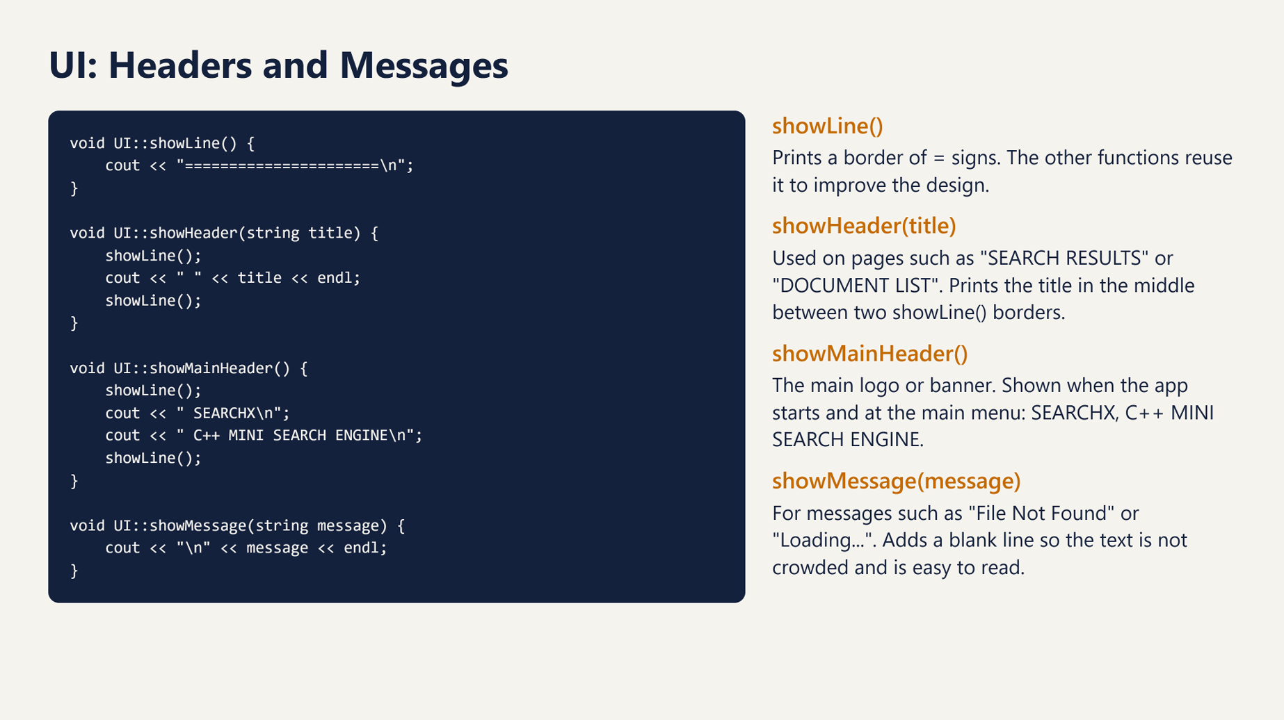

Slide 30
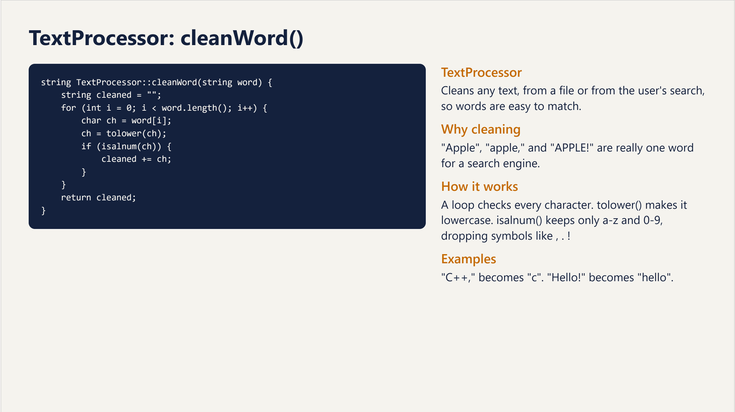

Slide 31
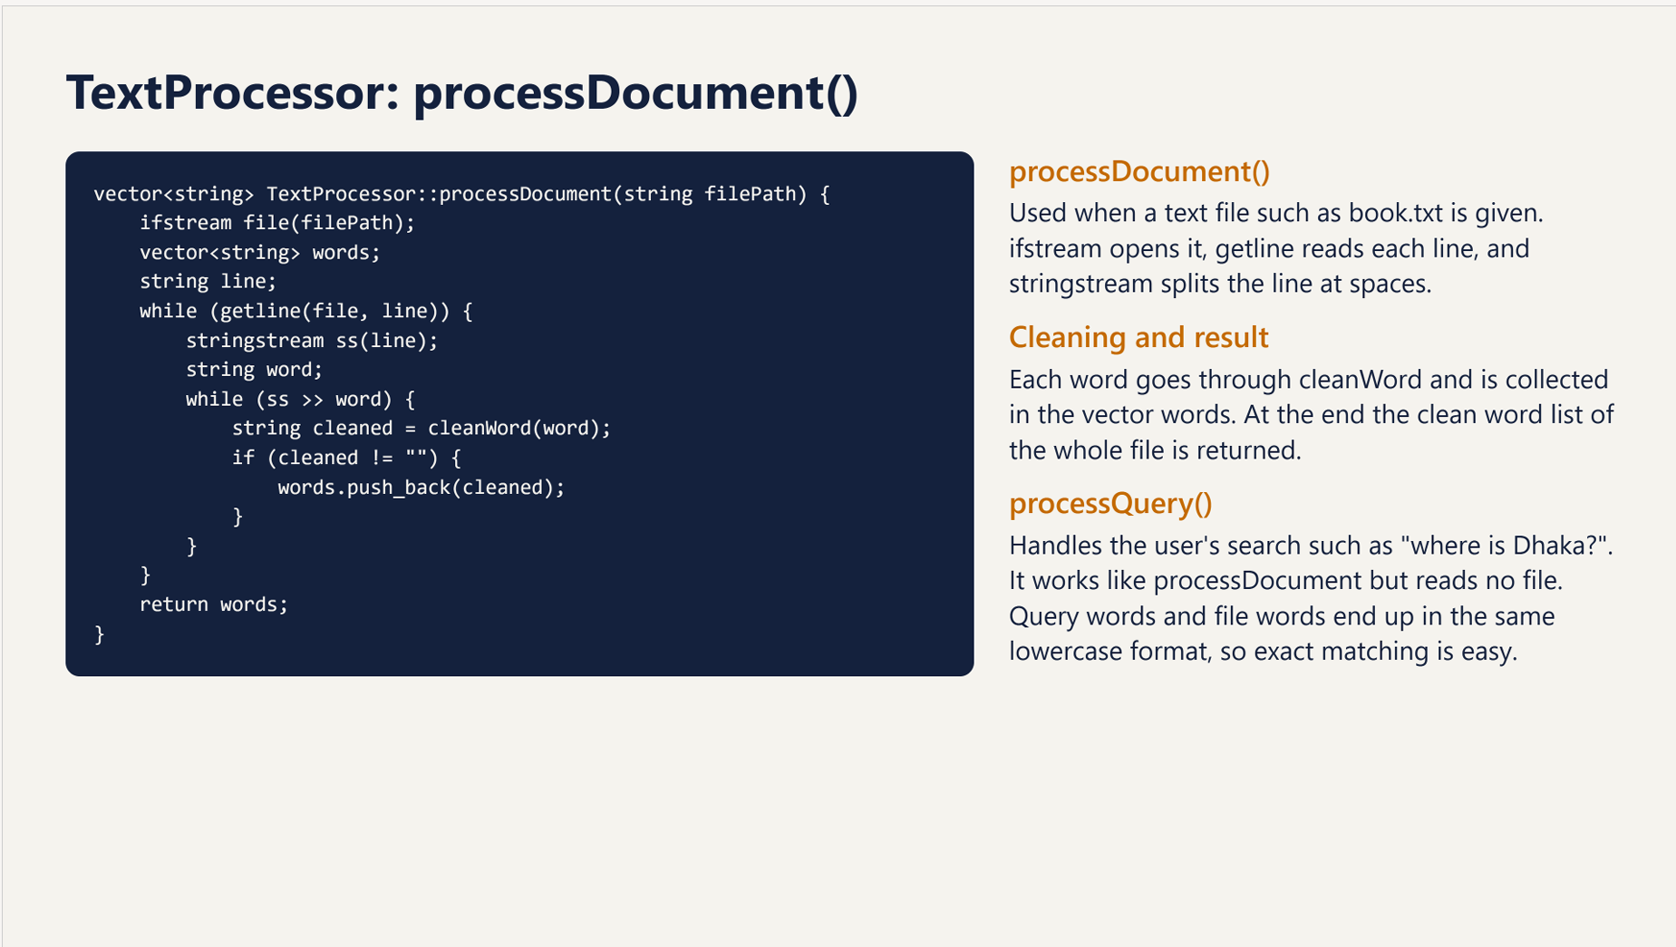

Slide 32
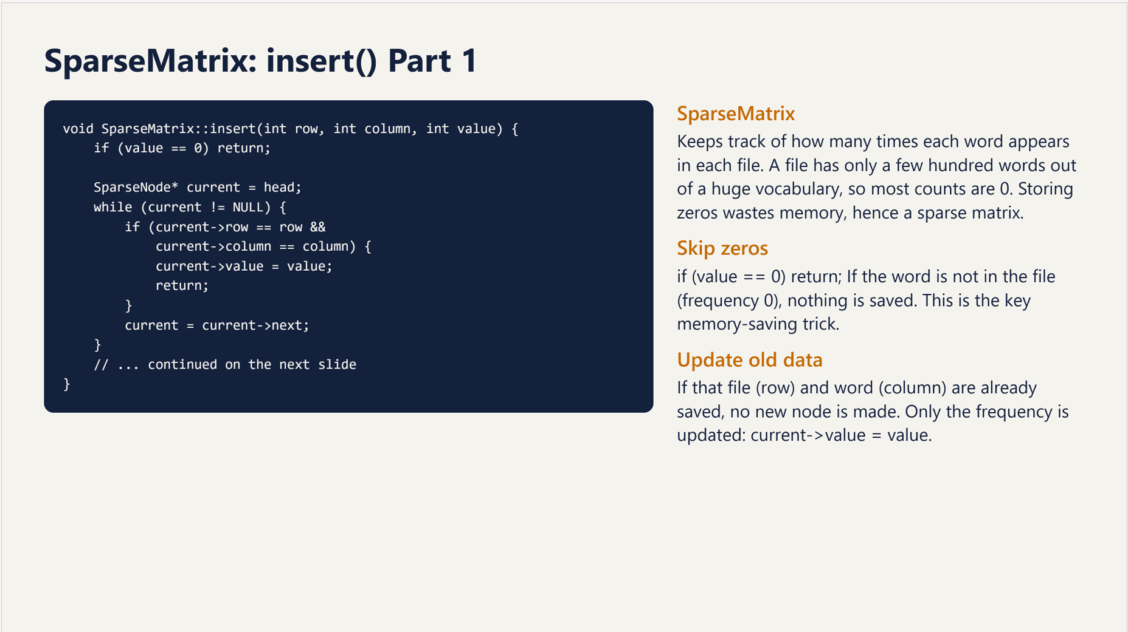

Slide 33
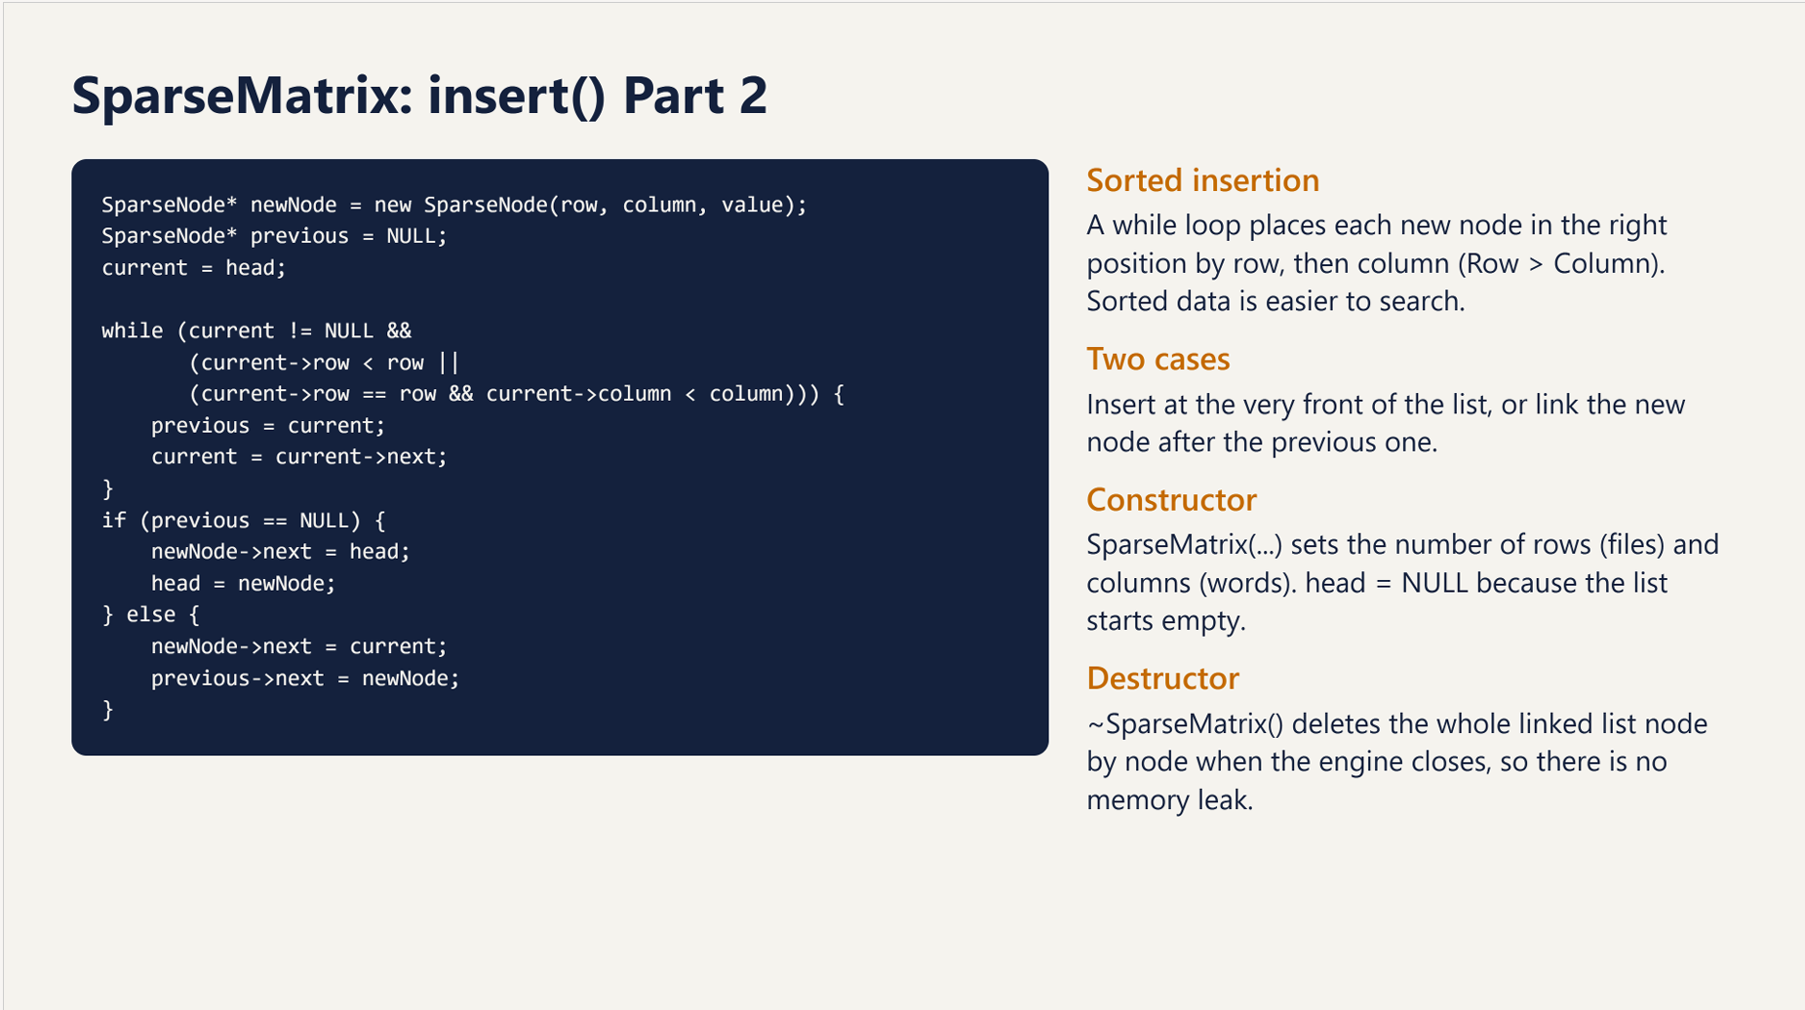

Slide 34
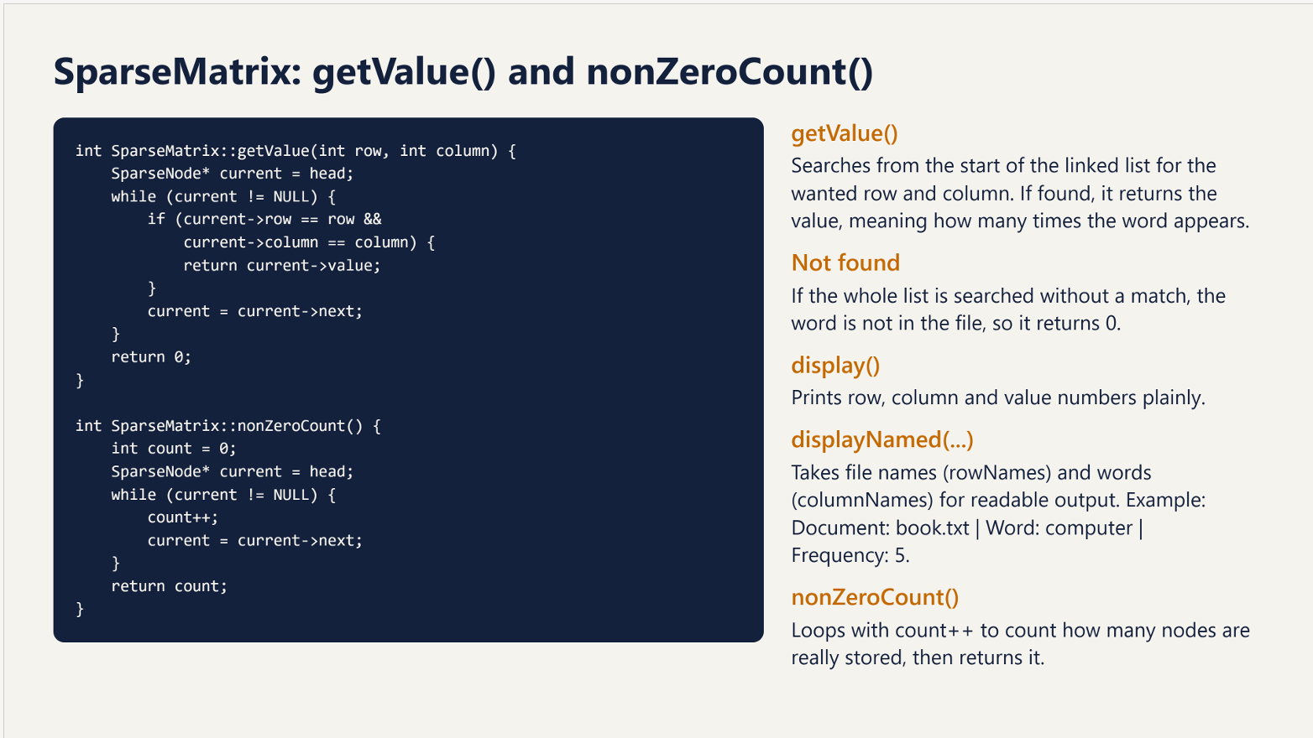

Slide 35
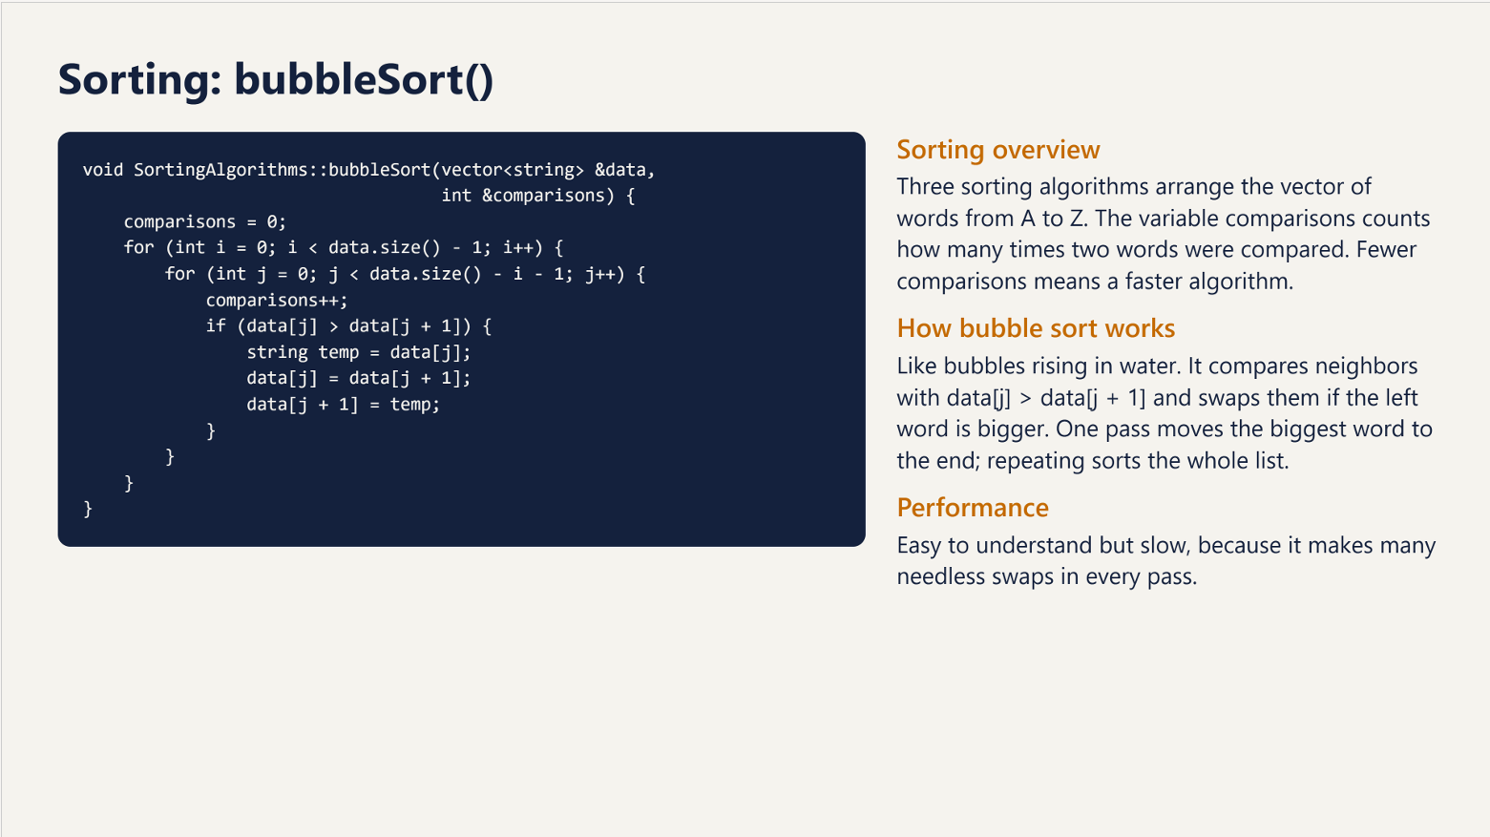

Slide 36
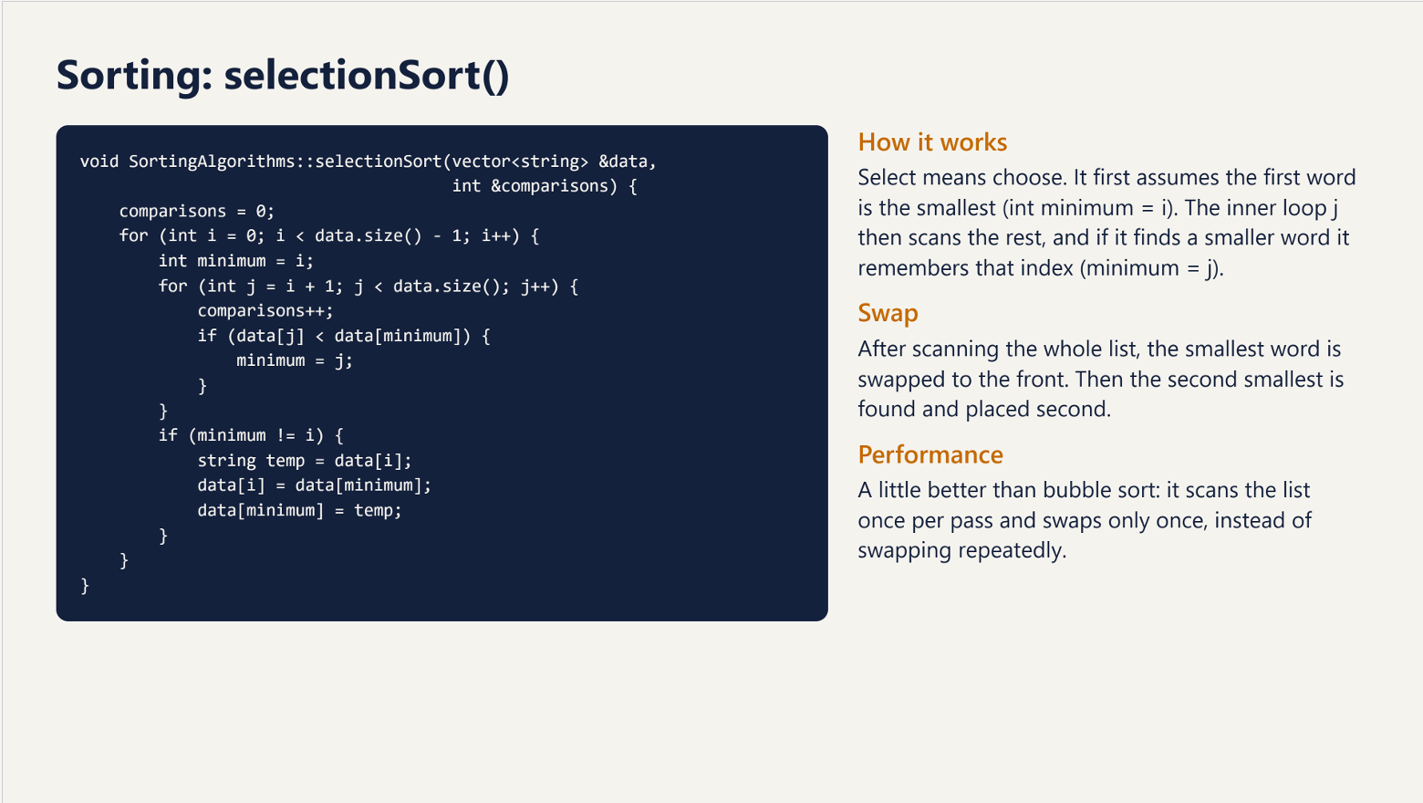

Slide 37
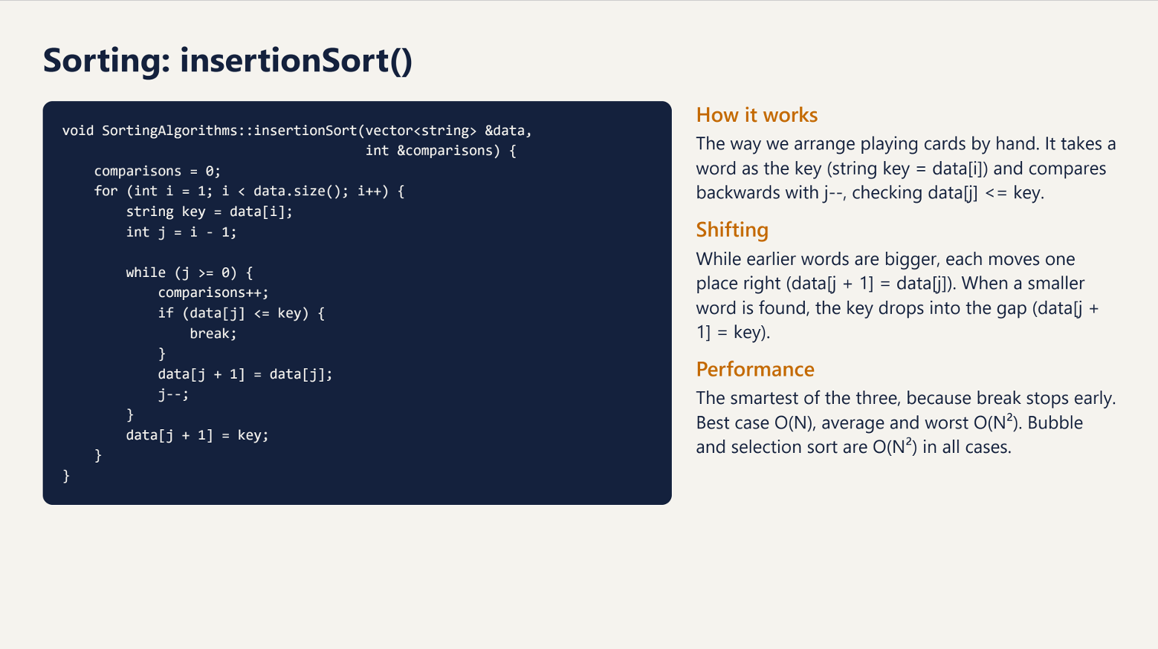

Slide 38
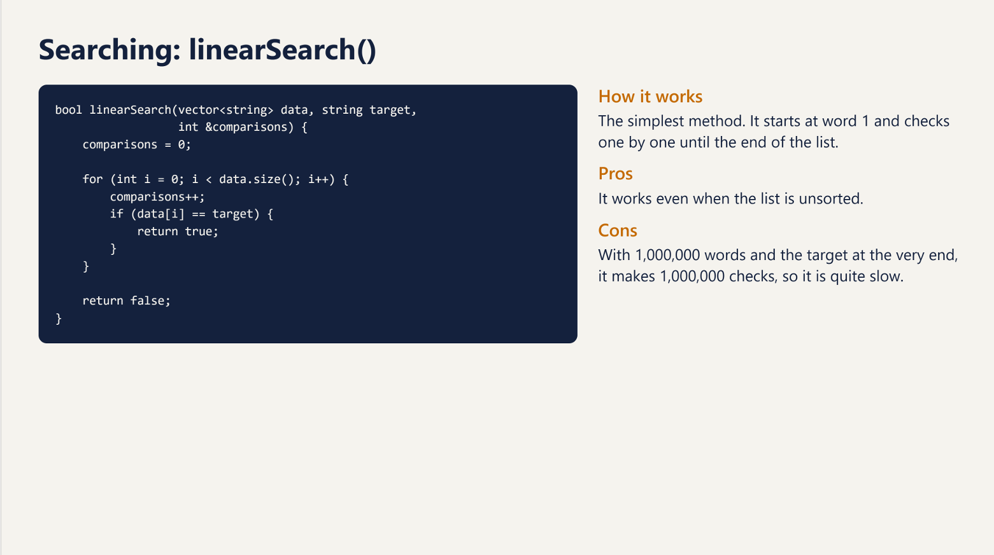

Slide 39
