Slide 1
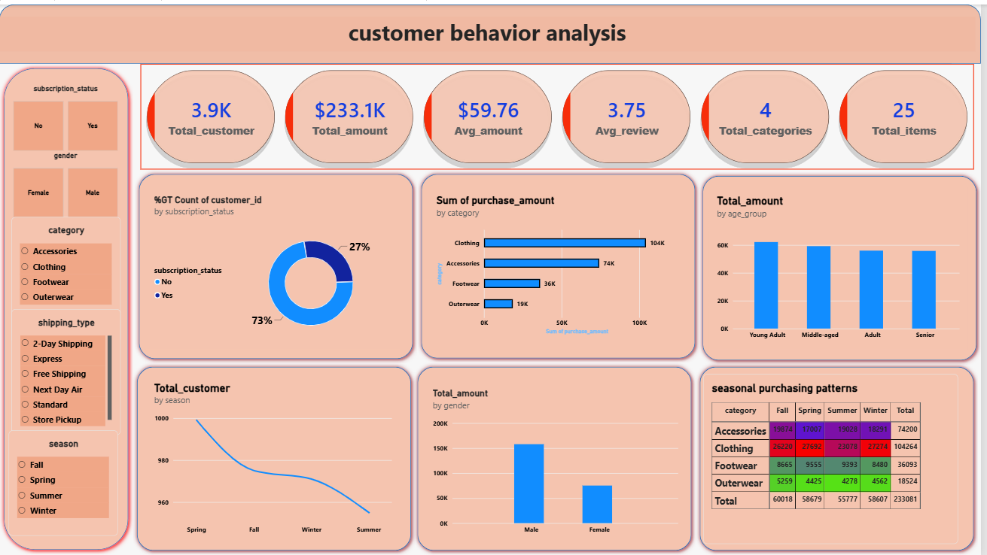
Customer Shopping Behavior Analysis
Uncovering insights from 3,900 purchases to guide strategic business decisions
Aragala Govardhan Reddy | Python · SQL · Power BI
Notes:
Introduce the project: end-to-end analysis with Python, SQL and Power BI.

Slide 2
Dataset Overview
3,900
18
37
Total Purchases
Raw Columns
Missing Values
One record per customer
19 after feature engineering
Only in Review Rating
Features: demographics, purchase details, discounts, shipping, payment, and review ratings

Slide 3
Data Preparation Process
01
Data Loading
02
Initial Exploration
03
Missing Data
Imported the CSV with pandas
info() and describe() for structure and statistics
Filled 37 ratings with the category median
04
New Features
05
SQL Analysis
Created age_group and purchase_frequency_days
Answered 32 business questions in SQL
Also verified 0 duplicates and dropped promo_code_used (identical to discount_applied)

Slide 4
Revenue by Gender
Key Insight
Male customers generate 68% of revenue ($157,890) versus 32% for female customers ($75,191)
Average spend per purchase is nearly equal ($59.54 vs. $60.25), so reaching more female shoppers is the opportunity

Slide 5
Revenue by Category
45%
of total revenue comes from Clothing, the top category
Total revenue: $233,081
Average purchase: $59.76

Slide 6
Top-Rated Products
3.86
3.84
3.82
Gloves
Sandals
Boots
Rank #1 by average rating
Rank #2 by average rating
Rank #3 by average rating
Overall average rating is 3.75 / 5. Footwear (3.79) and Accessories (3.77) score slightly above Clothing (3.72).

Slide 7
Discounts Do Not Raise Spend
$60.13
$59.28
Without discount
With discount
2,223 purchases (57%)
1,677 purchases (43%)
Average purchase amount is about the same either way. Outerwear has the highest discount share (44%), and Seniors use discounts most (44%).

Slide 8
Subscription Impact
27%
100%
22%
Subscribed
Subscribers using discounts
Non-subscribers using discounts
1,053 of 3,900 customers
Every subscriber purchase
624 of 2,847 customers

Slide 9
Spending by Age Group
Young Adults lead at $62,143, but spending is balanced across all four age groups.
Top locations:
Montana, Illinois, California

Slide 10
Power BI Dashboard

Slide 11
Strategic Recommendations
1
Boost Subscriptions
2
Review Discount Policy
Only 27% subscribe. Promote exclusive benefits.
Discounts do not raise spend. Protect margins.
3
Grow Key Segments
4
Loyalty and Positioning
Female and Outerwear customers spend as much but add less total revenue.
Reward repeat buyers and feature top-rated products.

