Slide 1
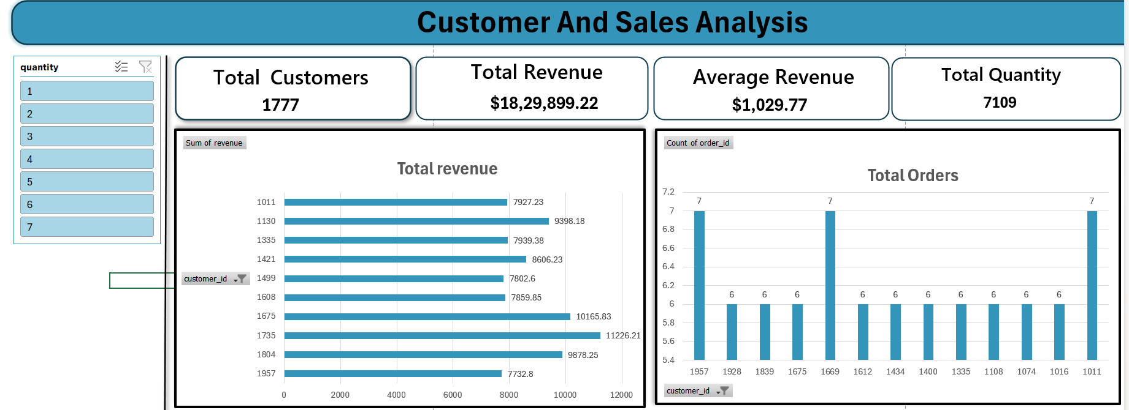
E-Commerce Sales Analytics Report
Insights from 5,000 orders and 989 customers to guide strategic business decisions
Aragala Govardhan Reddy | Excel · Pivot Tables · Business Insights

Slide 2
Dataset Overview
5,000
989
20
0
Orders
Customers
Columns
Missing Values
One record per order
IDs 1000 to 1999
12 raw, 8 engineered
0 duplicate order IDs
Orders span 29 Oct 2013 to 29 Oct 2026 across 4 product categories and 4 regions. Revenue equals quantity × unit price × (1 − discount) on all 5,000 rows.
Fields: order details, customer and service fields, and derived fields (YEAR, SEASON, Day Type, Revenue Category, DELIVERYTYPE, Rating Category)

Slide 3
Data Preparation Process
01
Data Loading
02
Duplicate Check
03
Revenue Validation
Confirmed column types, a consistent date range and no nulls
Every one of the 5,000 order IDs is unique
Recalculated revenue matched all 5,000 rows
04
Feature Engineering
05
Banding
06
Pivot Reporting
YEAR, MONTHYEAR, DAYS, Day Type and SEASON from the order date
Revenue, delivery and rating bands for segment analysis
Excel pivot tables and slicers across five analysis sheets

Slide 4
Revenue by Category
35.8%
of revenue comes from Electronics, the top category
Total revenue: $5,109,776
Average order: $1,021.96
Beauty is smallest (15.0%) but has the highest average order ($1,059)

Slide 5
A Quarter of Orders Drive Over Half of Revenue
54.8%
of revenue from High orders
1,262 orders, $2.80M
8.9%
of revenue from Low orders
35% of orders, $452K

Slide 6
Customer Behavior
96.1%
5.06
Repeat buyers
Orders per customer
$5,167
21.1%
Lifetime revenue each
Revenue from top 10%
Revenue is spread out, not concentrated in a few accounts. Top customer: #1663 with $17,681.

Slide 7
Discounts Do Not Raise Spend
18.0%
average discount, yet quantity stays flat at about 4 items and ratings stay near 3.0 in every band
Deeper discounts lower revenue per order without growing baskets or satisfaction.

Slide 8
Customer Satisfaction Is the Weakest Area
2.97 / 5
average rating, with 49.5% of orders rated negatively
Category, region and payment differences are under 0.1 points. Delivery speed barely matters: 2.99 for 1-day versus 2.89 for 11-day. This is a business-wide issue.

Slide 9
Payment and Regional Mix
Card brings 46% of revenue and COD 35%. The four regions are balanced at 24% to 26% each, with West slightly ahead.

Slide 10
Time and Seasonal Patterns
Growth is flat at about 385 orders a year. Monsoon is the top season and November the top month ($459,626); June is weakest.

Slide 11
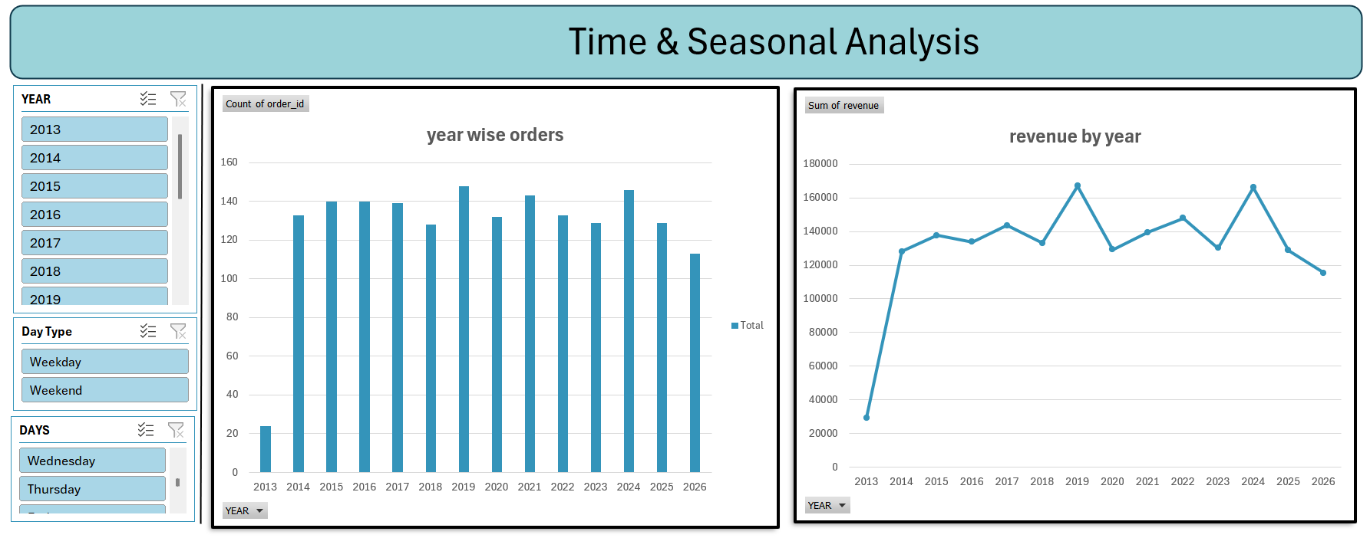
Excel Dashboard
Five pivot-table sheets with slicers: Executive Summary, Customer, Product, Time & Seasonal and Regional. The current pivots are filtered to Electronics only (1,777 orders, $1,829,899).

Slide 12
Strategic Recommendations
1
Fix Satisfaction
2
Review Discounts
3
Grow High-Value Orders
Half of orders are rated negatively. Look at quality, listings and packaging.
They do not lift basket size. Test a 20% cap or targeted offers.
Use bundles and free-shipping thresholds to lift Medium orders.
4
Reward Repeat Buyers
5
Break the Plateau
6
Plan Around Seasons
Launch loyalty perks and re-engage the 130 one or two-time buyers.
Volume is flat. Add acquisition campaigns, categories or regions.
Stock for Monsoon and November; promote in June and Autumn.

