Slide 1

EDS · DA.LIVE · EMA
Forms on Edge Delivery Services
Two working forms, built two ways: by hand in DA.live and with Ema. Same block, same site, same tests.
ALAN RAJI MANI
araji@adobe.com · 5 Nov 2026
© 2026 Adobe. All Rights Reserved. Adobe Confidential.
1
Notes:
SAY:
Over the last day I built two forms on our Edge Delivery Services sandbox. I built one by hand in DA.live and had Ema, the Experience Modernization Agent, build the other. They solve different business problems, but they run on the same form block and the same site and went through the same four tests, so the comparison is fair. Everything I show is labelled Tested, Documented, Limitation or Unknown.
TRANSITION:
First, what we set out to prove.
TIME: 0:30

Slide 2
GOAL
What we set out to prove in 24 hours
 | Form A: Contact WKND | Form B: Adventure Booking Request
Business use case | General enquiries: questions, partnerships, feedback | A visitor requests a specific trip on a specific date
Built with | DA.live, by hand (document-based authoring) | Ema, from one prompt, with author approval
Fields | 4: name, email, topic (dropdown), message | 7: name, email, adventure, start date, group size, experience level, consent
Field types | text, email, select, textarea | text, email, select, date, number, radio, checkbox
Page | /forms-poc/contact | /forms-poc/booking
Fair-test rules: same site · same form block · same branch · same browser · same four tests · same evidence labels
Constraints: shared environment, so no changes to existing pages, configuration or main. Preview only, nothing published live.
Out of scope (on purpose): styling, conditional logic, extra fields.
© 2026 Adobe. All Rights Reserved. Adobe Confidential.
2
Notes:
SAY:
Form A is a simple contact form, the kind of thing an author types up. Form B is a booking request with seven field types, which gives Ema something harder. To keep it fair, both use the same block on the same branch and are tested the same way. This is a shared environment, so nothing existing was changed and nothing was published live.
TRANSITION:
Here is the environment we worked in.
TIME: 1:00

Slide 3
ENVIRONMENT
Where everything lives
Part | Value | Status
EDS site | araji-adobe / bv-poc-wknd-aln (WKND sandbox) | Tested
Content source | DA.live: content.da.live/araji-adobe/bv-poc-wknd-aln | Tested
Code | GitHub ARAJI-ADOBE/bv-poc-wknd-aln, branch forms-poc (main untouched) | Tested
Form block | Adobe Block Collection "form" block, plus small fixes (see slide 10) | Tested
DA content | /forms-poc: contact-form (sheet), contact (page), booking-form (sheet), booking (page) | Tested
Publishing | Preview only (aem.page). Nothing published to aem.live. | Tested
Saving entries | Form A → Microsoft Power Automate → Excel table in OneDrive (no AEM Forms) | Tested
Licence | Adobe docs: "a valid AEM Forms license is required" | Documented
Tested = proved on our site Documented = Adobe docs Limitation = observed constraint Unknown = not tested
© 2026 Adobe. All Rights Reserved. Adobe Confidential.
3
Notes:
SAY:
The site is our WKND sandbox. Content lives in DA.live and code in GitHub. All form code is on a separate branch called forms-poc, so main and the live site were never touched. Note the licence line: Adobe documents that EDS forms need an AEM Forms licence.
EVIDENCE LABELS:
Tested: every row except the licence, which is Documented (aem.live/developer/forms).
TRANSITION:
How does a document-based form actually work?
TIME: 1:00

Slide 4
HOW IT WORKS
A document-based form in four pieces
1 Sheet
(the fields)
2 Preview
(sheet → JSON)
3 Page
(form block table + link)
4 Form block code
(builds the form)
Piece | What the author does | Plain-language meaning
Sheet | One row per field: field, label, type, placeholder, options, required | A spreadsheet that describes the form
Preview | Click Preview on the sheet | Turns the sheet into data the website can read (…/contact-form.json)
Page | Insert a table, name it "form", link the sheet in the first cell | Tells the page "put a form here, using that sheet"
Block code | Nothing (a developer adds it once) | Small piece of site code that draws the fields and checks the input
Finding: a DA sheet works as the form definition. Adobe's forms page names SharePoint and Google Drive only.
© 2026 Adobe. All Rights Reserved. Adobe Confidential.
4
Notes:
SAY:
There are four pieces. A sheet lists the fields. Preview turns it into data. A page holds a table called form that links to the sheet. Then the block code builds the form in the browser. The author only touches the first three, and the code is added once.
HOW TO EXPLAIN THE FINDINGS:
Adobe's forms overview lists SharePoint and Google Drive for document-based forms. We tested that a DA.live sheet works the same way for the form definition.
EVIDENCE LABELS:
Tested: DA sheet as the form definition. Documented: the source list on aem.live.
TRANSITION:
Next, the content model behind it.
TIME: 1:15

Slide 5
CONTENT MODEL
Content modelling in EDS, and the model our forms use
Piece | What the author does | In our POC
Default content | Normal headings, text, images, links (no table) | —
Block | A table; the top cell names the block, the rows below hold its content | form table: cell 1 = sheet link, cell 2 = submit address
Section | Split the page with ---; a Section Metadata table can style it | —
Page metadata | A metadata table: title, description, image | —
Sheet | Rows of structured, repeating data, served as JSON | 6 lowercase columns: field · label · type · placeholder · options · required
Prefer default content; use a block only when it adds real value
Keep blocks simple: few columns, no blocks inside blocks
Easy for authors: no hidden codes; the code handles missing or extra cells
Same model for Form A and Form B, so a hand-built form and an Ema-built form behave identically
Adobe: https://www.aem.live/docs/davidsmodel · https://www.aem.live/developer/markup-sections-blocks
© 2026 Adobe. All Rights Reserved. Adobe Confidential.
5
Notes:
SAY:
Content modelling means deciding how authors structure content so the site can turn it into the right design. EDS has five pieces: default content, blocks, sections, page metadata and sheets. Our forms use one block with two cells, a link to the field sheet and an optional submit address, plus a six-column sheet. Ema and the hand-built form follow the same model, which is why they behave the same.
EVIDENCE LABELS:
Documented: aem.live content-modelling guidance (David's Model). Tested: our form model.
TRANSITION:
Here is Form A, built by hand.
TIME: 1:00

Slide 6
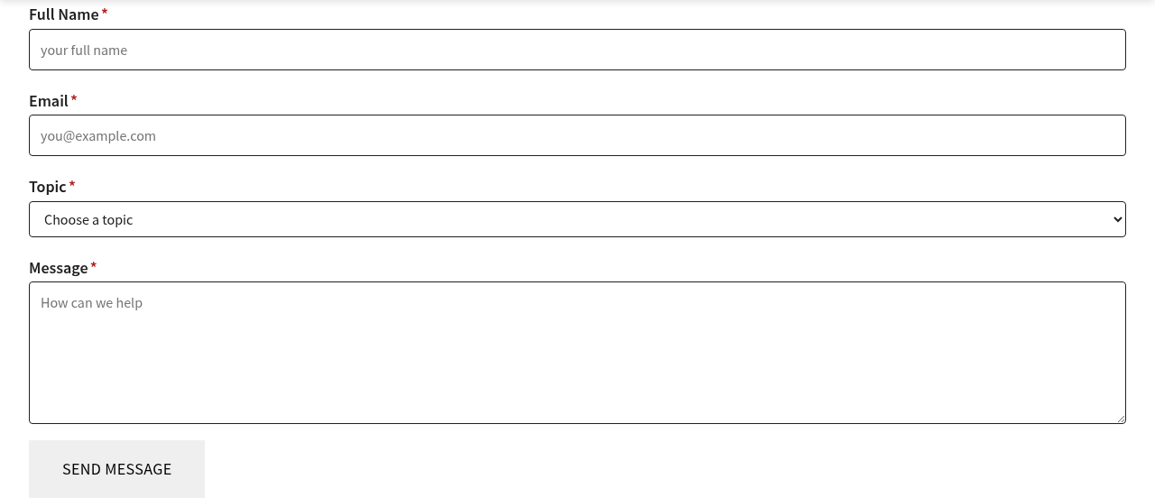
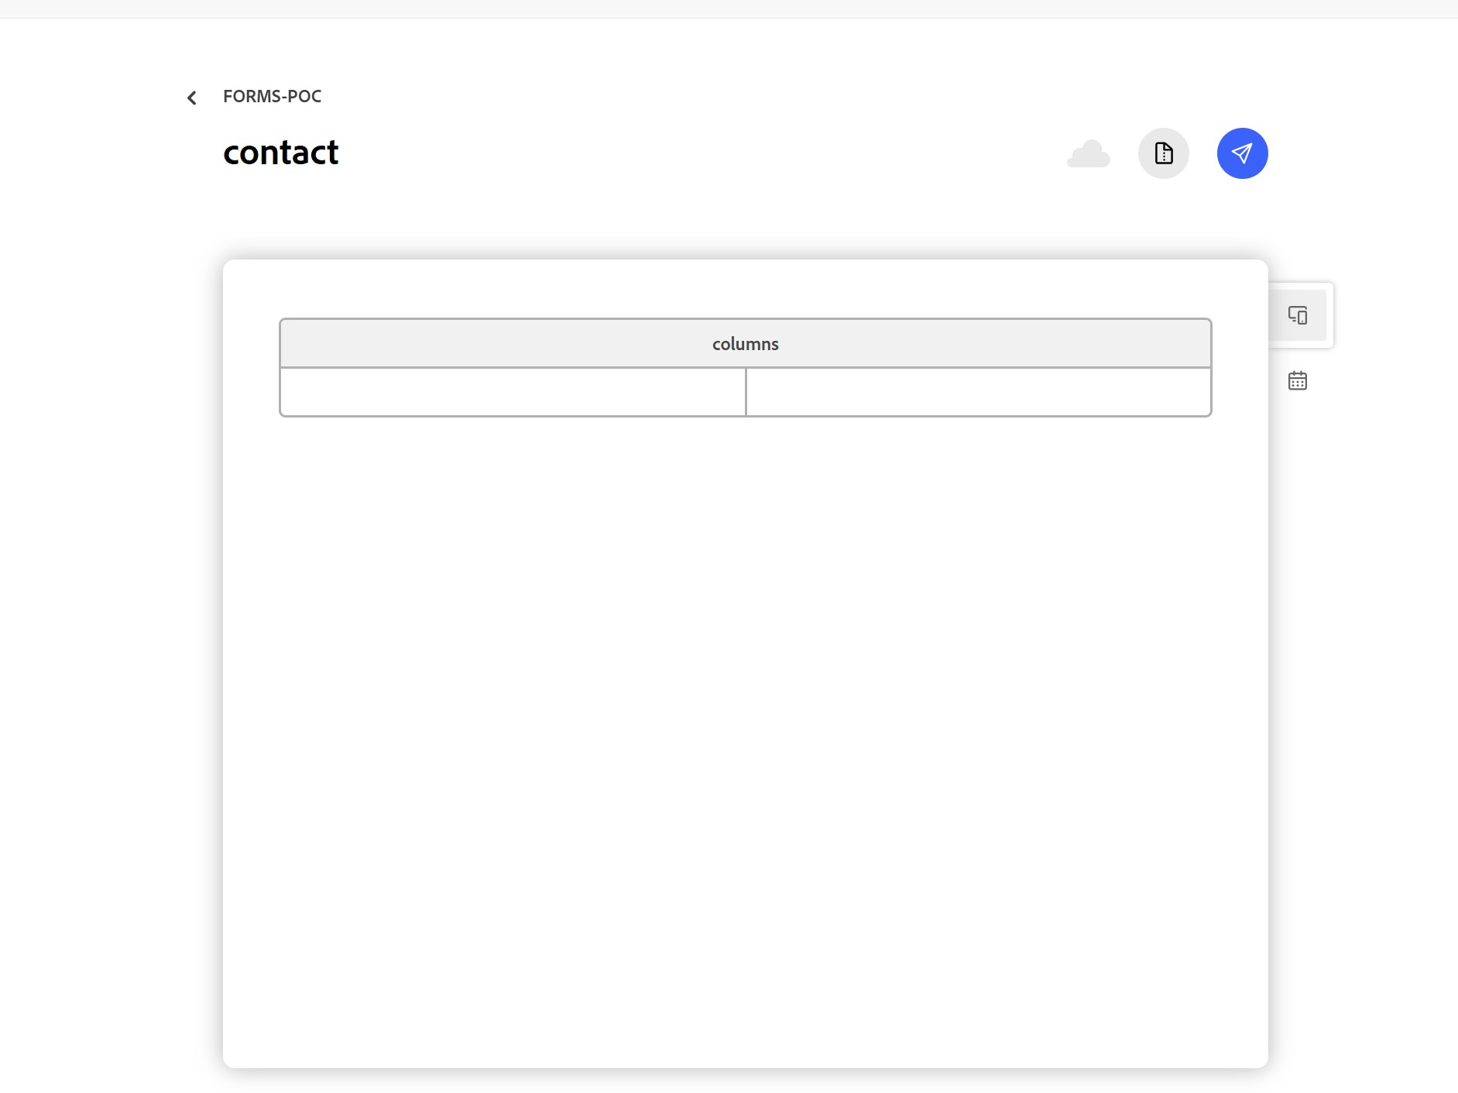
FORM A · DA.LIVE BY HAND
Contact WKND: 10 author steps, about 35 minutes
Create folder forms-poc
Create sheet contact-form (the menu says "Sheet")
Type 6 headers in lowercase: field · label · type · placeholder · options · required
Type 5 field rows
Preview the sheet: JSON served
Create page contact (the menu says "Page", not "Document")
Insert a block table. DA names it "columns" by default, so rename it to "form"
Type the link /forms-poc/contact-form.json in the first cell
Preview the page, then open it on the forms-poc branch
Observed: the first round of typing the rows was not saved. 5 small text slips (cosmetic only).
Figure 1: Form A rendered on the forms-poc branch preview
Figure 2: DA inserts a block table named "columns"
LIVE https://forms-poc--bv-poc-wknd-aln--araji-adobe.aem.page/forms-poc/contact
© 2026 Adobe. All Rights Reserved. Adobe Confidential.
6
Notes:
SAY:
Form A took ten author steps and about thirty-five minutes of hands-on time. Two things caught us out. DA calls the item "Page", not "Document". The default table is called columns and has to be renamed to form. The first round of typing the rows never saved, so we lost it and retyped it.
CLICK / DEMONSTRATE:
Open https://forms-poc--bv-poc-wknd-aln--araji-adobe.aem.page/forms-poc/contact
AUDIENCE SHOULD OBSERVE:
Four required fields and a Send Message button.
EVIDENCE LABELS:
Tested: every step, verified from DA after each step.
TRANSITION:
Now the same job done by Ema, on a harder form.
TIME: 1:30

Slide 7
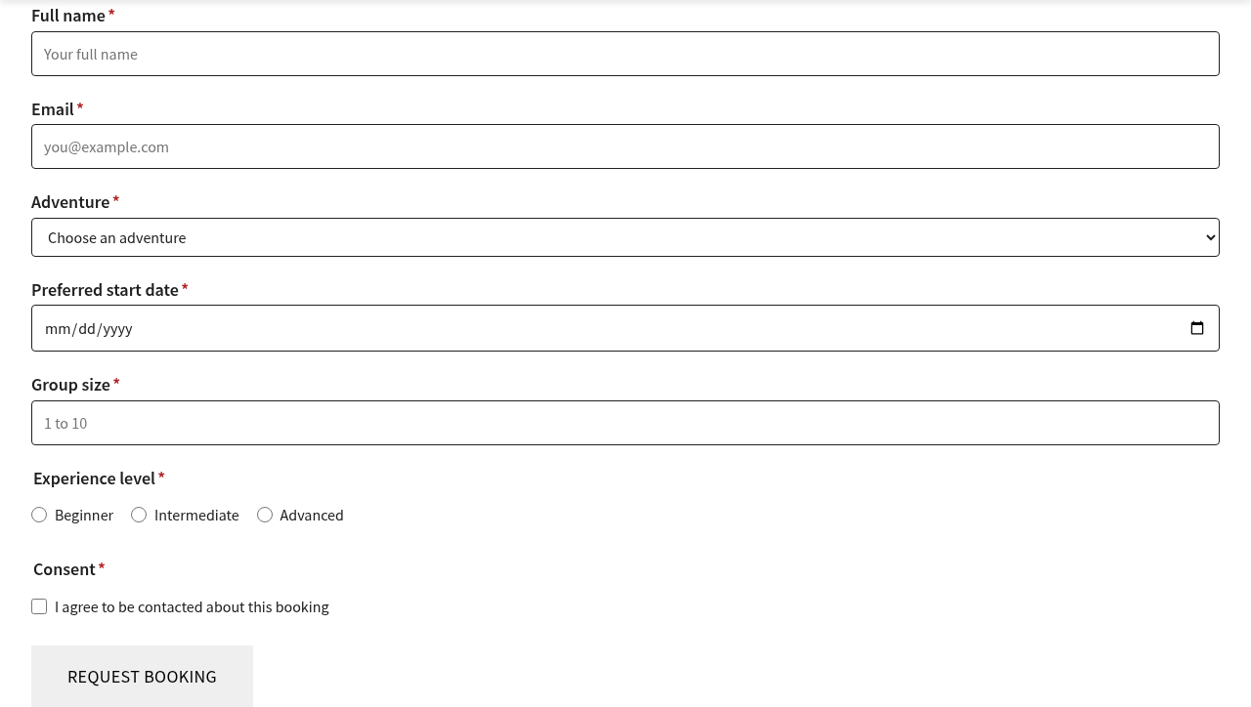
FORM B · EMA
Adventure Booking Request: 1 prompt, 2 approvals, about 4 minutes
Ema read the site's real adventure list and chose 6 WKND trips for the dropdown
Generated the sheet (8 rows, 7 field types) and the page with the same structure as Form A
Test-rendered it in a browser before anything was uploaded
Author approval 1: upload 2 new items to DA /forms-poc and preview them
Checked the uploaded sheet against the local copy: 8 of 8 rows match
Previewed both items and checked the branch page renders
Author approval 2: code fix on the branch (slide 10)
Limits: Ema lost DA and GitHub access after an overnight session restart. A person had to re-enable the permission and push the code with Sync.
Figure 3: Form B rendered on the forms-poc branch preview
LIVE https://forms-poc--bv-poc-wknd-aln--araji-adobe.aem.page/forms-poc/booking
© 2026 Adobe. All Rights Reserved. Adobe Confidential.
7
Notes:
SAY:
For Form B I gave Ema one request. It used the real adventure names from the site, generated the sheet and page, and test-rendered them before touching DA. It then asked me before uploading. The upload matched the local copy exactly. Hands-on time was about four minutes plus two approval clicks. Ema still needs a human: after the overnight restart it lost DA and GitHub access, and I had to push the code myself with the Sync button.
CLICK / DEMONSTRATE:
Open https://forms-poc--bv-poc-wknd-aln--araji-adobe.aem.page/forms-poc/booking
AUDIENCE SHOULD OBSERVE:
Seven field types: dropdown, date picker, number, radio buttons and a consent checkbox.
EVIDENCE LABELS:
Tested: upload (201), row match 8 of 8, preview (200), render. Limitation: access lost after restart; code push needed Sync.
TRANSITION:
Both forms then went through the same four tests.
TIME: 1:30

Slide 8
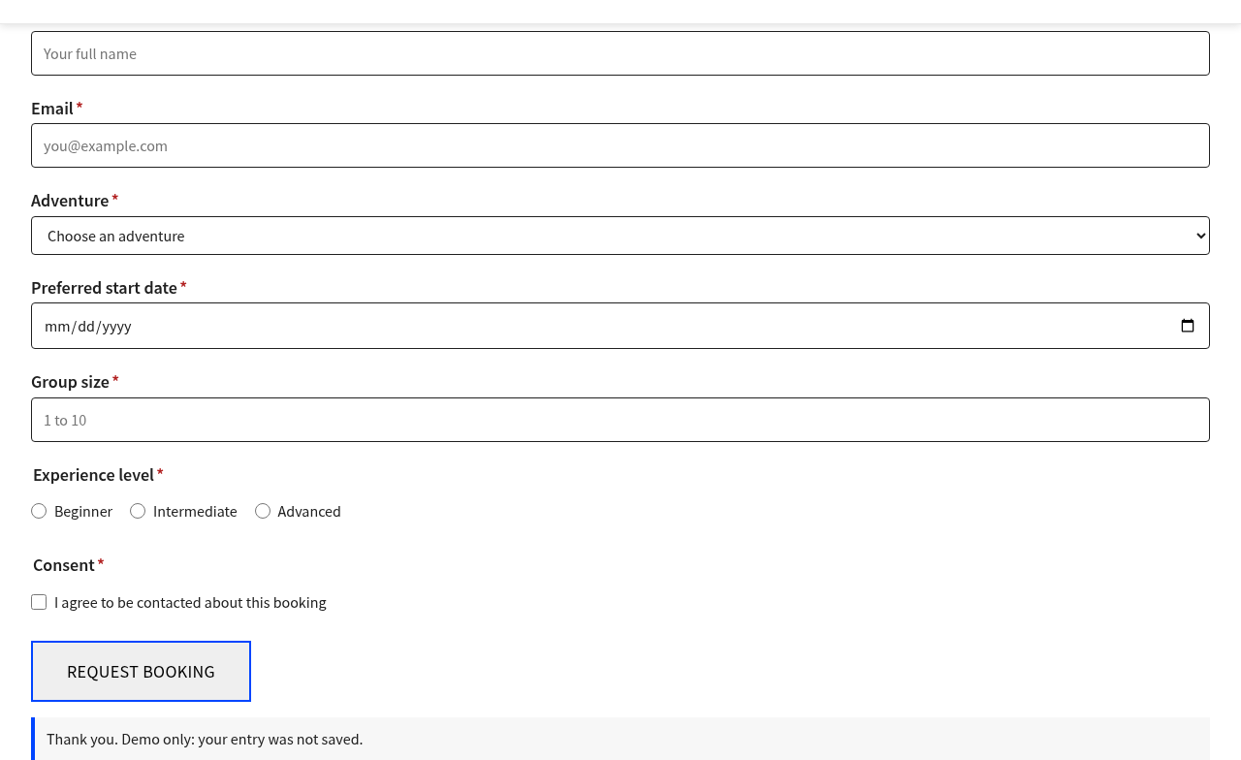
TEST RESULTS
Same four tests, both forms, real branch preview
# | Test | Form A: Contact | Form B: Booking
T1 | Click Send with everything empty | Pass: stays on page, focus on Full Name | Pass: stays on page, focus on Full name
T2 | Enter an invalid email (not-an-email) | Pass: stops at Email | n/a (the email check is the same code)
T3 | Leave a radio button / checkbox empty | n/a (no radio or checkbox) | Pass: stops at Experience level, then Consent
T4 | Fill every field correctly and send | Pass: "Thank you. Your entry was received."; row added in Excel | Pass: same; the dropdown resets
— | Typed values appear in the web address | No | No
— | Entry saved anywhere | Yes: OneDrive Excel via Power Automate (slide 11) | Not connected yet: "Demo only" notice
Retested 5 Nov on the forms-poc branch; Form A live save tested at 6:20 pm IST. Green = Tested pass, amber = Limitation.
Figure 4: T4: demo notice after a valid entry
© 2026 Adobe. All Rights Reserved. Adobe Confidential.
8
Notes:
SAY:
Both forms pass all the tests that apply to them. Empty submissions are blocked, a bad email is caught, unchecked radios and checkboxes are caught, and a valid entry shows a clear demo message. Form A entries are saved to OneDrive; Form B is not connected yet. Slide eleven shows how Form A saves to OneDrive.
CLICK / DEMONSTRATE:
Live: click Send on the empty contact form, then fill the booking form and send.
AUDIENCE SHOULD OBSERVE:
The cursor jumps to the first missing field. The thank-you message is labelled "Demo only".
EVIDENCE LABELS:
Tested: T1–T4 on both branch preview pages. Limitation: no saving.
TRANSITION:
Here is the head-to-head comparison.
TIME: 1:30

Slide 9
DA VS EMA
Head-to-head comparison
Measure | Form A: DA by hand | Form B: Ema | Edge
Hands-on time | About 35 min | About 4 min + 2 approvals | Ema
Author steps | 10 UI steps | 1 request + 2 approvals | Ema
Form complexity | 4 fields, 4 types | 7 fields, 7 types | Ema
Typing slips / lost work | 5 cosmetic slips, 1 lost save | 0 (checked row by row) | Ema
Verification | Author checks visually | Self-tests before upload, checks after upload | Ema
Needs a human for | Everything | Approving DA writes, re-enabling access, pushing code (Sync) | Shared
Learning value | Author learns how forms are built | Little, unless the author reads the output | DA
Works without Ema access | Yes | No: blocked twice by lost access after a restart | DA
Same block, same output | Yes | Yes | Equal
Saving entries | Connected (Power Automate → OneDrive) | Same method, not connected in the POC | DA (only one tested)
© 2026 Adobe. All Rights Reserved. Adobe Confidential.
9
Notes:
SAY:
Ema was about eight times faster to hands-on completion and built a more complex form with no typing slips. DA is the more reliable path when the agent has no access, and it teaches the author how forms work. In both cases the output is the same block, so whichever way a form is built, it behaves the same for visitors.
HOW TO EXPLAIN THE FINDINGS:
Times are hands-on minutes from the progress log, not elapsed time. Form A spans an overnight pause, which is excluded.
EVIDENCE LABELS:
Tested: all rows, from the progress log testing/forms/forms-progress.md.
TRANSITION:
What went wrong, and what we fixed.
TIME: 1:30

Slide 10
DEFECTS AND FINDINGS
What broke and how we handled it
ID | What happened | Impact | Resolution
D1 | With no submit address, the block skipped validation. Send reloaded the page and put typed values in the web address. | Privacy risk; no error messages | Fixed on forms-poc: always validate; show a demo notice. Retested.
F1 | The first round of typed sheet rows was not saved in DA | Lost author work | Wait a few seconds before leaving; reload to confirm
F2 | DA labels: "Page" (not Document); the default block table is "columns" | Author confusion | Covered in the SOP
F3 | Ema lost DA access (401) and GitHub access after an overnight restart | Ema blocked | Re-enable in Settings → LLM Permissions; push code with Sync
F4 | Chat attachments turn .pptx files into plain text | Corporate template could not be used | Deck uses the Adobe default style
F5 | The main preview shows no form: the block exists only on forms-poc | Expected | Merge forms-poc to main when approved
F6 | Sync → Code pushed every untracked file (deck, evidence) to the public repo | Confidential file public | Review what Sync stages; the owner decides on clean-up
© 2026 Adobe. All Rights Reserved. Adobe Confidential.
10
Notes:
SAY:
One real defect. With no submit address, the standard form block skipped its checks, so clicking Send reloaded the page with the visitor's details in the address bar. I approved a three-line fix on our branch: always validate, and show a clear demo message instead. Both forms were retested. The other items are process lessons, and they are all in the SOP.
EVIDENCE LABELS:
Tested: D1 before and after the fix. F1–F5 observed during the POC.
TRANSITION:
Why is nothing saved yet?
TIME: 1:30

Slide 11
SAVING ENTRIES
Saving to OneDrive without AEM Forms: Power Automate
Form A
(Send Message)
Power Automate
"When an HTTP request
is received" (Premium)
Excel Online
"Add a row into a table"
OneDrive
wknd-contact-
submissions.xlsx
Check | Result
Premium HTTP trigger available on our Microsoft account; "Who can trigger" = Anyone allowed | Tested
Browser permission (CORS): preflight 204, allow-origin *; sending returns 202 | Tested
Ema test entry and a live website entry both arrived as rows in Excel | Tested
No code change for sending: the flow address goes in the 2nd cell of the form block table | Tested
Adobe route (Forms Submission Service) needs an AEM Forms licence, allowlist and Adaptive Forms Block | Documented: not used
Risks: anyone with the address can post rows (no spam protection); depends on a Microsoft Premium licence | Limitation
Adobe docs: https://experienceleague.adobe.com/en/docs/experience-manager-cloud-service/content/edge-delivery/build-forms/forms-submission-service
© 2026 Adobe. All Rights Reserved. Adobe Confidential.
11
Notes:
SAY:
We wanted entries saved in OneDrive without paying for AEM Forms. Adobe's own submission service needs an AEM Forms licence. Instead, the form sends each entry to a Microsoft Power Automate flow, which adds a row to an Excel table in OneDrive. The form block already supports a submit address, so sending needed no code change, only the address in the second cell of the block table. Both my test entry and a live entry from the website arrived in Excel.
CLICK / DEMONSTRATE:
Show the Excel file wknd-contact-submissions with rows 2 and 3.
HOW TO EXPLAIN THE FINDINGS:
This is fine for a POC. For production, add spam protection and choose between Power Automate Premium and AEM Forms.
EVIDENCE LABELS:
Tested: trigger, CORS, 202, rows in Excel. Documented: AEM Forms requirements. Limitation: open endpoint, Microsoft Premium.
TRANSITION:
Next: how far can Ema go with advanced forms?
LIKELY QUESTIONS AND ANSWERS:
Q: Is the address secret? A: No. It is in the page source, so anyone could post to it. That is why production needs spam protection or a server-side relay.
TIME: 1:30

Slide 12
ADVANCED FORMS CAPABILITIES
Can Ema build advanced forms from business requirements?
Test | Requirement (plain language) | How Ema did it | Result
1 Validation | Name: letters, spaces, - and '. Email: name@example.com. Phone: exactly 10 digits. Address required. A message under each field. | Sheet + Ema code (new pattern and error columns) | Pass (live)
2 Multi-step | 3 steps (Personal / Address / Review), Next and Previous, progress, values kept, submit only at the end, Enter does not advance | Sheet + Ema code (new step and review rows) | Pass (live)
3 Conditional | Business shows Company (required) and Job title; Personal hides them and they do not block | Sheet only: the block already supported it | Pass (live)
Bug found | After submit, the Business fields stayed visible on the cleared form | Ema code fix, retested | Fixed
Regression | Forms A and B unchanged (new features are opt-in per sheet) | — | Pass (live)
Manual intervention: 1 approval (DA upload + preview) and 1 Sync push by the author. No hand-typed rows or fixes.
Finding: the free form block covers required, email and conditional fields. Format rules, custom messages and steps needed a code extension, which Ema wrote, tested and kept opt-in.
Test data only (Test User, test.user@example.com, 9876543210).
Tested = proved on our site Documented = Adobe docs Limitation = observed constraint Unknown = not tested
© 2026 Adobe. All Rights Reserved. Adobe Confidential.
12
Notes:
SAY:
We then asked whether Ema can turn plain business requirements into an advanced form. It covered validation rules, a three-step wizard and fields that appear only for business enquiries. All three passed on the live branch preview. Conditional fields worked with sheet rows alone. Format rules, field messages and steps needed the form block to be extended. Ema wrote that code, tested it and made it opt-in, so the earlier forms did not change. Testing also found one bug, which was fixed and retested.
EVIDENCE LABELS:
Tested: every row on the forms-poc branch preview on 11 Nov (G01 to G05).
TRANSITION:
Here is the requirement-by-requirement matrix.
TIME: 1:30

Slide 13
ADVANCED FORMS CAPABILITIES
Capability matrix
Requirement | Ema configuration | Tested behaviour | Status | Manual | Limitation
Full name rule | pattern + error | "John3", "J@ne Doe" rejected; "Mary-Jane O'Neil" OK | Pass | None | A–Z letters only
Email format | type email + pattern | "name@example" rejected (the browser alone accepts it) | Pass | None | —
Phone: 10 digits | type tel + pattern + help | Letters, 5 digits, 11 digits, spaces rejected; value kept as typed | Pass | None | No country code
Address | required + pattern | Empty and "<…>" rejected | Pass | None | Also allows ' # /
Field messages | inline errors (opt-in) | 4 messages at once; focus on the first | Pass | None | —
Steps + progress | step rows | "Step 1 of 3" … "Step 3 of 3" | Pass | None | —
Next validates / Previous keeps | built-in | Blocked while invalid; values kept both ways | Pass | None | —
Review step | review row | All answers listed; hidden fields left out | Pass | None | Read-only
No early submit / Enter | submit only in step 3 | Enter in steps 1–2: no move, no submit | Pass | None | Enter does not advance
Keyboard | native buttons | Tab to Next, Enter moves on | Pass (local) | None | Screen reader not tested
Business / Personal | conditional column | Company required only for Business | Pass | None | Condition syntax
Mobile 375 px | existing CSS | No sideways scroll | Pass (local) | None | —
Full matrix with evidence: testing/forms/advanced-capability-matrix.md
© 2026 Adobe. All Rights Reserved. Adobe Confidential.
13
Notes:
SAY:
This is the requirement-by-requirement view. Every rule was tested with good and bad test values. For example, a phone number with a space is rejected and the message explains the rule, but what the user typed is left untouched. Two rows were tested locally only: keyboard and mobile. A real screen-reader check is still open.
EVIDENCE LABELS:
Pass = tested live on the branch preview. Pass (local) = tested in the browser with the branch code before the upload.
TRANSITION:
And this is what a visitor sees.
TIME: 1:30

Slide 14
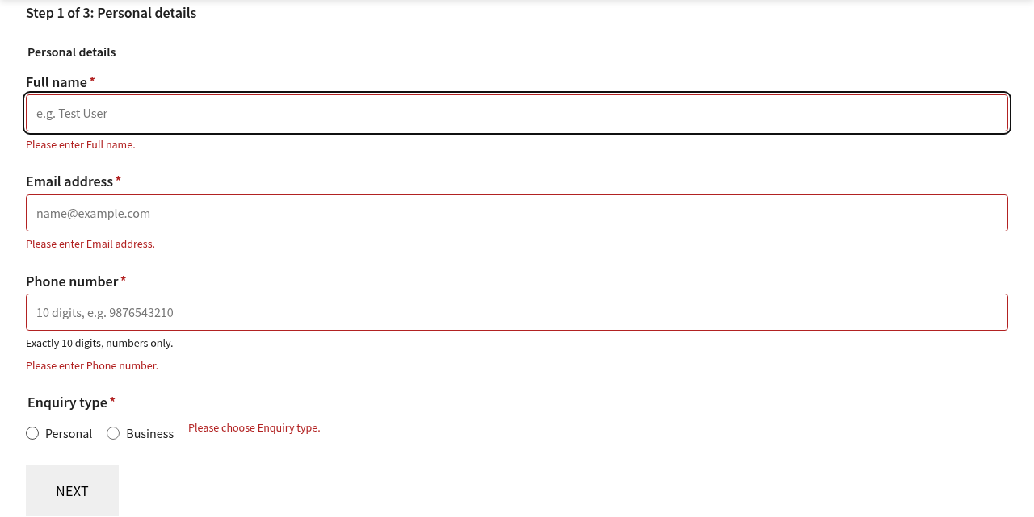
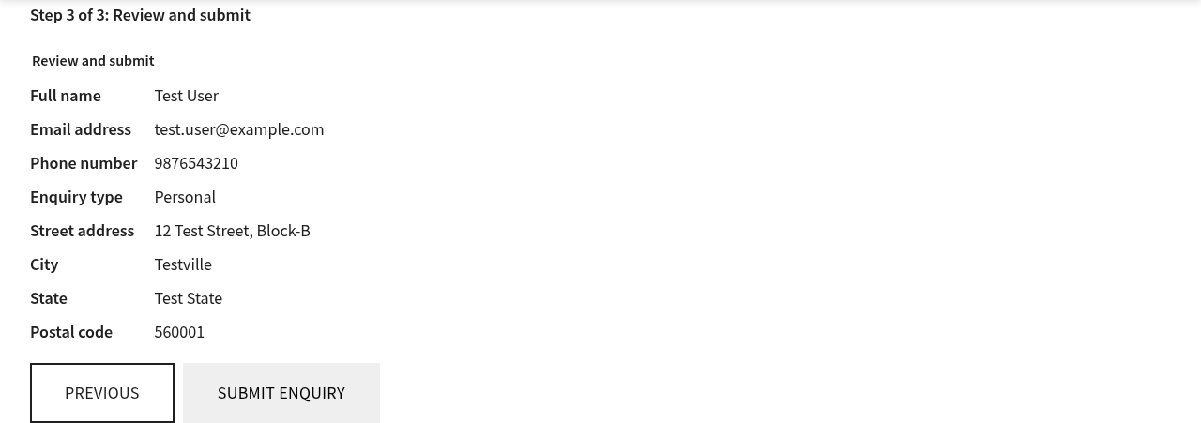
ADVANCED FORMS CAPABILITIES
What the visitor sees, and what comes next
Figure 6: Step 3: review of all answers before submitting
Figure 5: Step 1: a message under every missing field
Optional (Test 4) | Current status | Needs
Calculated fields | Not supported | Ema code
Dynamic dropdowns | In the block (options from another sheet), untested | Sheet only
Submission confirmation | Pass (live): Submit opens /forms-poc/advanced-thank-you | Sheet row + 3 lines of Ema code
Accessibility audit | ARIA + focus done; screen reader not tested | Manual test
© 2026 Adobe. All Rights Reserved. Adobe Confidential.
14
Notes:
SAY:
On the left, step one with an error under every missing field. On the right, the review step just before submitting. Of the optional extras, the confirmation page was approved and built. The block only followed a confirmation row after a real send, so Ema added a three-line opt-in change, and Submit now opens a thank-you page. Calculated fields and dynamic dropdowns were not built.
CLICK / DEMONSTRATE:
Live: https://forms-poc--bv-poc-wknd-aln--araji-adobe.aem.page/forms-poc/advanced
TRANSITION:
So when should you use which approach?
TIME: 1:00

Slide 15
RECOMMENDATION
When to use DA by hand, and when to use Ema
Use DA by hand
Use Ema
Small forms (up to about 5 fields), quick edits to labels or options
Authors who need to own and understand the form
When Ema has no DA or GitHub access
New or larger forms, or many similar forms
Fields that must match real site data (adventure names)
When you want self-testing before upload and a row-by-row check after
Best of both: Ema drafts → the author reviews the sheet in DA → the author previews → the author tests T1–T4 → publish via the normal process.
© 2026 Adobe. All Rights Reserved. Adobe Confidential.
15
Notes:
SAY:
My recommendation is to use both. Ema drafts the form fast and accurately. The author reviews the sheet in DA, previews it and runs the four tests. DA by hand stays the fallback for small changes and for times when the agent has no access.
TRANSITION:
Let me show you both forms live.
TIME: 1:00

Slide 16
LIVE DEMO
End-to-end demo flow (about 6 minutes)
# | Open | Show and say
1 | da.live → bv-poc-wknd-aln → forms-poc | One folder: 3 sheets (the fields) + 4 pages. "Every form is a sheet plus a page."
2 | contact-form sheet | The 6 lowercase columns: field, label, type, placeholder, options, required. "Form A, typed by hand."
3 | contact page in DA | The form block table: cell 1 = sheet link, cell 2 = Power Automate address
4 | https://forms-poc--bv-poc-wknd-aln--araji-adobe.aem.page/forms-poc/contact | Send empty (focus jumps to Full Name), then a real test entry → "Thank you. Your entry was received."
5 | Excel: wknd-contact-submissions (OneDrive) | The new row appears: saved without AEM Forms
6 | https://forms-poc--bv-poc-wknd-aln--araji-adobe.aem.page/forms-poc/booking | Form B by Ema: 7 field types from one request
7 | https://forms-poc--bv-poc-wknd-aln--araji-adobe.aem.page/forms-poc/advanced | Type John3 → letters-only message; phone 98765 → 10-digit rule; Business → Company required; Personal → hidden
8 | advanced: Next / Previous / review | Step 1 of 3 → 2 → Previous keeps values → review lists all answers
9 | Submit enquiry | Opens the thank-you page (confirmation row)
10 | https://github.com/ARAJI-ADOBE/bv-poc-wknd-aln/tree/forms-poc | All code on the forms-poc branch; main and the live site untouched
Test data only (Test User, test.user@example.com, 9876543210). Backup if the network fails: figures on slides 6–8, 11 and 14.
© 2026 Adobe. All Rights Reserved. Adobe Confidential.
16
Notes:
SAY:
Let me show the whole journey, from the DA folder to the saved entry and the advanced form. Everything is preview only on the forms-poc branch, with test data.
CLICK / DEMONSTRATE:
Open the tabs in this order. Prepare all of them before the session. On Form A use test data only, because it really writes a row to OneDrive.
AUDIENCE SHOULD OBSERVE:
Forms are sheets plus a page; Form A saves to Excel; the advanced form validates, branches and steps; Submit opens the thank-you page.
TIME: 6:00

Slide 17
NEXT STEPS
From POC to production
# | Action | Owner
1 | Choose the production saving route: Power Automate (add spam protection) or AEM Forms (licence) | Alan + team
1b | Connect Form B to its own flow and Excel table (same steps as Form A) | Author
2 | Trial the Adaptive Forms Block + Submission Service on a new branch | Developer
3 | Review and merge forms-poc to main (needs a PR with a preview link) | Code owner
4 | Publish /forms-poc pages through the normal (scheduled) publish process | Author
5 | Add the SOP to the team wiki; reuse T1–T4 as the standard form test | Alan
© 2026 Adobe. All Rights Reserved. Adobe Confidential.
17
Notes:
SAY:
To go to production: confirm the licence and allowlist, trial the submission service, merge the branch through a normal pull request, and publish through our usual process. The SOP and the four tests are reusable for every future form.
TRANSITION:
Questions.
TIME: 0:45

Slide 18
APPENDIX
Sources and evidence
Adobe documentation (linked, not copied)
  https://www.aem.live/developer/forms
  https://experienceleague.adobe.com/en/docs/experience-manager-cloud-service/content/edge-delivery/build-forms/forms-submission-service
Evidence in the repo (branch forms-poc)
  testing/forms/forms-progress.md: step-by-step log with labels and times
  testing/forms/evidence/: E01/E02 (rendered, empty submit, demo notice), E03 (sheet JSON), A07 (block table)
  testing/forms/SOP-Forms-DA-and-Ema.md · testing/forms/speaking-script.md
  Author-side screenshots (A01–A13, B01–B02) are kept by the presenter
© 2026 Adobe. All Rights Reserved. Adobe Confidential.
18
Notes:
Reference slide, not presented.

