Slide 1

EDS · Experience Workspace · EMA
Scheduled Publishing in Edge Delivery Services
Manual, Ema-assisted and Experience Workspace approaches, tested on a live sandbox
We enabled, ran and verified scheduled publishing on bv-poc-wknd-aln, compared Ema with Coworker, and tested fragment, asset and expiry behaviour requested by the team.
Prepared for: VP, Global Delivery Center
ALAN RAJI MANI · araji@adobe.com · 23 Oct 2026
© 2026 Adobe. All Rights Reserved. Adobe Confidential.
1
Notes:
SAY:
Good morning everyone. Today I'll walk you through scheduled publishing in Edge Delivery Services: what it is, why marketers need it, how we did it manually, how Ema did it, and what happened when we tried the same task with Experience Workspace's Coworker. After that I'll cover the three additional investigations Abhishek and Mohit asked for: what happens to assets when a page is unpublished, whether fragments and assets are published with a scheduled page, and whether assets can be unpublished based on expiry metadata. Everything I show was tested on our sandbox site, bv-poc-wknd-aln, between 19 and 22 October. Wherever something is only documented or not yet tested, I'll say so explicitly.
HOW TO EXPLAIN THE FINDINGS:
Set expectations: green "Tested" means we proved it on the site; blue "Documented" means Adobe's docs say it; amber "Limitation" is an observed constraint; grey "Unknown" means not tested yet.
TRANSITION:
"Let's start with what scheduling actually means in EDS."
TIME: 0:30

Slide 2
1 · EXPLAIN SCHEDULING
How publishing and scheduling work in EDS
Editor
da.live
Preview
Preview site
.aem.page
Publish
Live site
.aem.live
Publishing = copying the PREVIEW version to live. Scheduling = doing that copy automatically at a chosen time.
 | Editor "Schedule Publish" | Schedule sheet (crontab)
Used by | Authors, inside the editor | Admins and automation (Ema)
Where | Prepare menu → Schedule Publish | /.helix/crontab sheet: "when" + "command" rows
Time | Author's browser time zone, to the minute | UTC, runs on 5-minute ticks
Status on our site | Tested 22 Oct (M0–M14) | Tested 19 Oct (T1–T5)
LIVE https://main--bv-poc-wknd-aln--araji-adobe.aem.page/us/en/scheduled-publish-test → https://main--bv-poc-wknd-aln--araji-adobe.aem.live/us/en/scheduled-publish-test
© 2026 Adobe. All Rights Reserved. Adobe Confidential.
2
Notes:
SAY:
In Edge Delivery Services an author edits content in the editor, da.live. Clicking Preview creates a draft version on the .aem.page address. Clicking Publish copies that preview to the .aem.live address, which is what the public sees. Scheduled publishing simply automates that second step: it copies preview to live at a time you choose, so nobody has to be online at go-live.
CLICK / DEMONSTRATE:
Open the preview URL of /us/en/scheduled-publish-test, then the live URL. Point at the host names in the address bar.
AUDIENCE SHOULD OBSERVE:
The same page served from two hosts: .aem.page (preview) and .aem.live (live).
HOW TO EXPLAIN THE FINDINGS:
There are two independent schedulers on the same site. The editor's Schedule Publish is the author-facing one we enabled for the manual test. The schedule sheet, called the crontab, is an admin sheet of "when" and "command" rows; that is what Ema used on 19 October. Both were proven on our site.
EVIDENCE LABELS:
Tested: both mechanisms. Documented: preview/publish model (aem.live docs).
TRANSITION:
"So why does the business need this?"
LIKELY QUESTIONS AND ANSWERS:
Q: Are the two schedulers the same thing?
A: No. Our crontab tests on 19 October ran while the editor scheduler wasn't even registered for the site (test M2a).
Q: Which one should authors use?
A: The editor one for single pages; the sheet for bulk publishing and scheduled unpublishing, which the editor dialog doesn't offer.
TIME: 1:00

Slide 3
2 · BUSINESS USE CASE
Why marketers need scheduled publishing
Content must go live at a precise moment, often outside working hours or in another time zone, without someone clicking Publish.
1. Campaign or product launch
Go live at an exact time
2. Embargoed announcement
Publish when the embargo lifts
3. Global launch
Target another time zone
4. Time-limited promotion
Go live, then come down
Illustrative scenarios
Marketer requirement | How it is covered | Evidence
Pick a date and time in the UI | Editor Schedule Publish | Tested (M5)
Change or cancel the plan | Reschedule in the dialog; Delete in the scheduler list | Tested (M12, M14)
Many pages at once | Schedule sheet multi-command row (via Ema); Snapshots | Tested (T4) · Snapshots documented
Take content down on time | Schedule sheet "unpublish" command (via Ema) | Tested (T5)
Proof that it happened | Admin audit log + page status | Tested (M8, T1–T5)
© 2026 Adobe. All Rights Reserved. Adobe Confidential.
3
Notes:
SAY:
The business problem is simple: content has to appear, and sometimes disappear, at an exact moment. Think of a product launch at midnight, an embargoed press release, a launch timed for another market, or a promotion that must end on time. Without scheduling, someone has to be online to click Publish. These four scenarios are illustrative, but every requirement in the table maps to something we actually tested.
HOW TO EXPLAIN THE FINDINGS:
Point out that "take content down on time" is only covered by the schedule sheet, which Ema used. The editor dialog we tested offers no scheduled unpublish.
EVIDENCE LABELS:
Scenarios: illustrative. Requirements table: Tested, except Snapshots (Documented).
TRANSITION:
"Let's look at the manual way first, without Ema."
LIKELY QUESTIONS AND ANSWERS:
Q: Can an author schedule an unpublish in the UI?
A: Not in the editor dialog we tested. Scheduled unpublish worked through the schedule sheet (T5).
Q: What are Snapshots?
A: Adobe's documented way to publish a set of pages and resources together after review. We did not test scheduling a snapshot.
TIME: 1:00

Slide 4
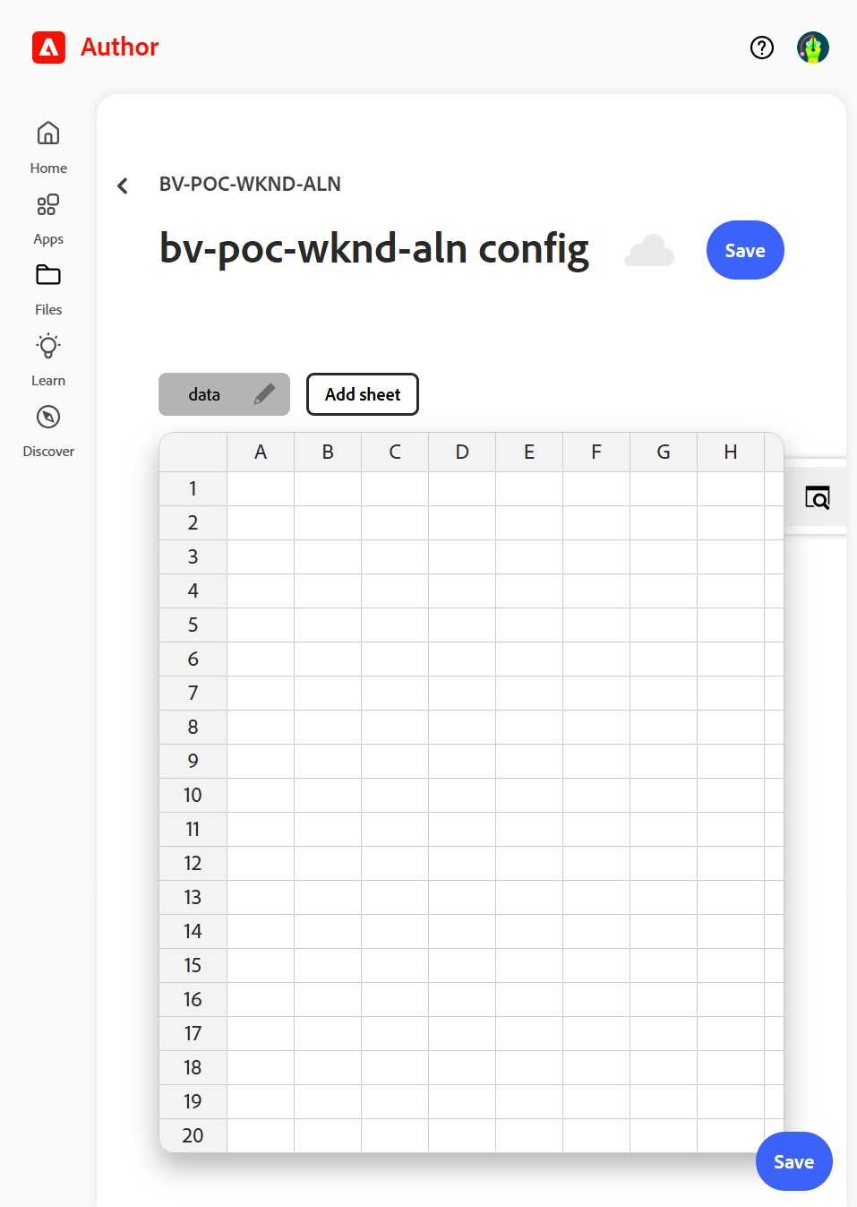
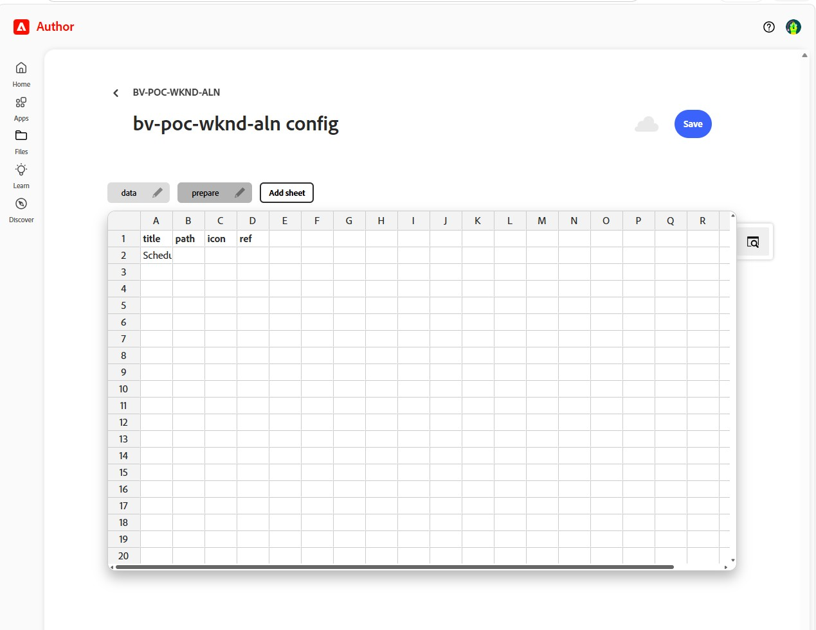
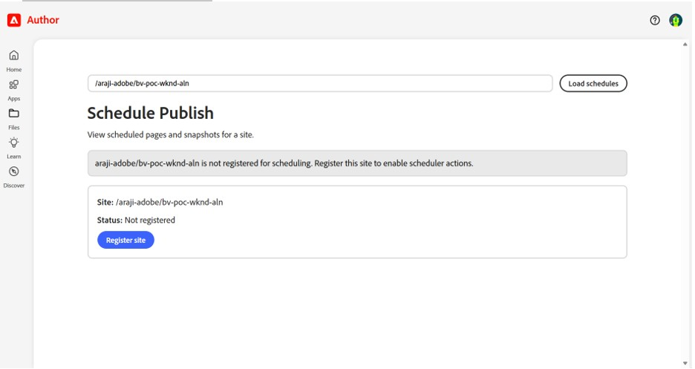
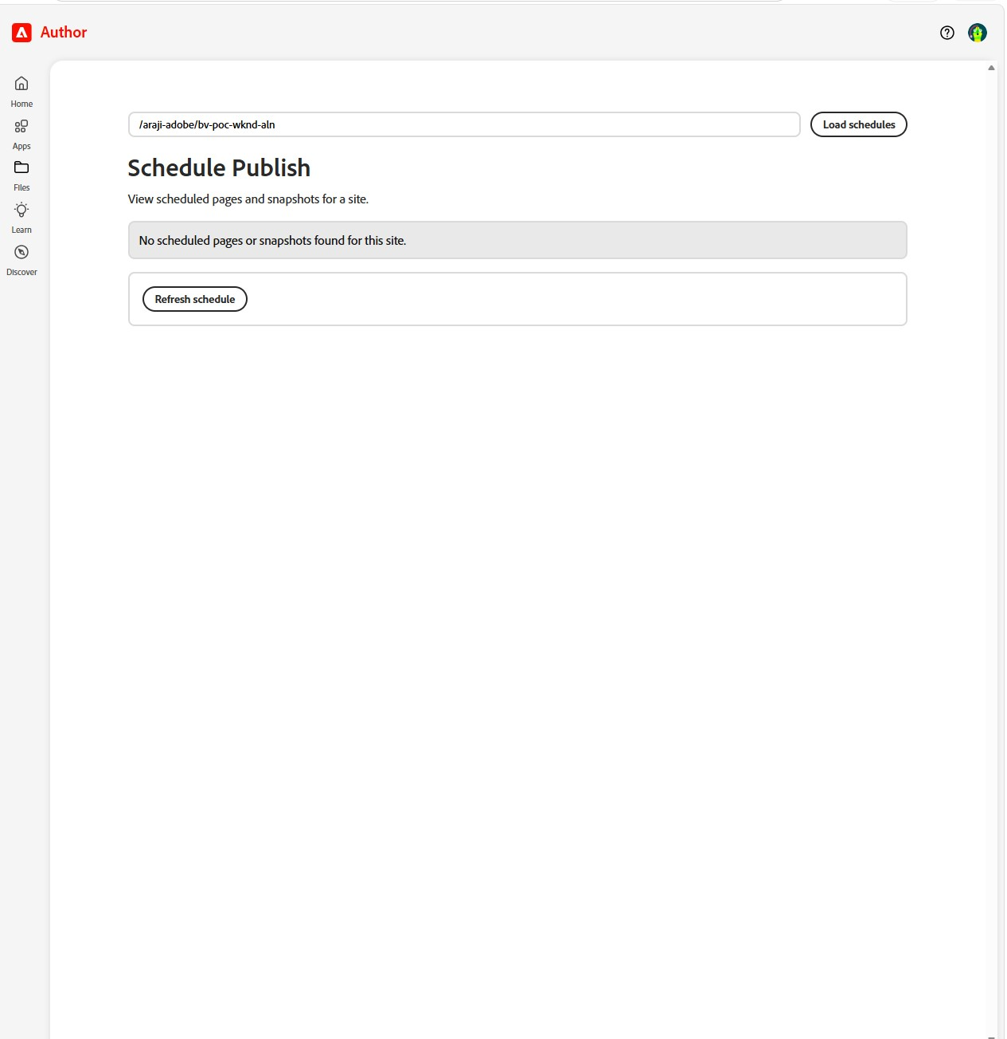
3 · MANUAL SCHEDULED PUBLISHING
Setup: two switches to enable Schedule Publish
Before: no site config existed, and the menu item was absent
  Tested M0, 22 Oct
Switch 1: site config → "prepare" tab → row title = Schedule Publish
  path, icon and ref left empty (Adobe-provided plugin). Tested M1
Switch 2: da.live/apps/scheduler → /araji-adobe/bv-poc-wknd-aln/ → Register site
  No "success" message; the empty queue appears. The audit log shows an admin API key created. Tested M2b
Reference (link, not duplicated):
  aem.live/docs/ew/administering/schedule-publish
  demo.bbird.live/demo-docs/usecases/how-to-schedule-publish
M0: before, empty config
03: switch 1, prepare row
04: "not registered"
M2b: switch 2, registered
LIVE https://da.live/config#/araji-adobe/bv-poc-wknd-aln/ · https://da.live/apps/scheduler (enter /araji-adobe/bv-poc-wknd-aln/)
© 2026 Adobe. All Rights Reserved. Adobe Confidential.
4
Notes:
SAY:
Schedule Publish is off by default. When we started, the site had no configuration at all and the editor had no Schedule Publish option. Enabling it took two switches. First, one row in the site configuration: a "prepare" tab with a row titled Schedule Publish. That makes the menu item appear. Second, registering the site in Adobe's scheduler app, so the background service actually runs jobs for us.
CLICK / DEMONSTRATE:
Open the site config and show the "prepare" tab with the row. Then open the scheduler app, enter /araji-adobe/bv-poc-wknd-aln/ and click Load schedules.
AUDIENCE SHOULD OBSERVE:
A one-row configuration, and the scheduler app showing the site's queue.
HOW TO EXPLAIN THE FINDINGS:
Two observations not in the docs: registration shows no success message, it simply switches to the queue view; and the audit log shows that registering created an admin API key for the site.
EVIDENCE LABELS:
Tested: M0, M1, M2b. Documented: setup steps (link to the references, don't repeat them).
TRANSITION:
"With that in place, scheduling a page takes four clicks."
LIKELY QUESTIONS AND ANSWERS:
Q: Site or org level?
A: We used site level so only this site is affected. The docs allow either.
Q: Can it be limited to some users?
A: The docs mention the "ref" column for that. We left it empty and didn't test it.
Q: How do you unregister?
A: Not documented. Unknown.
TIME: 1:00

Slide 5
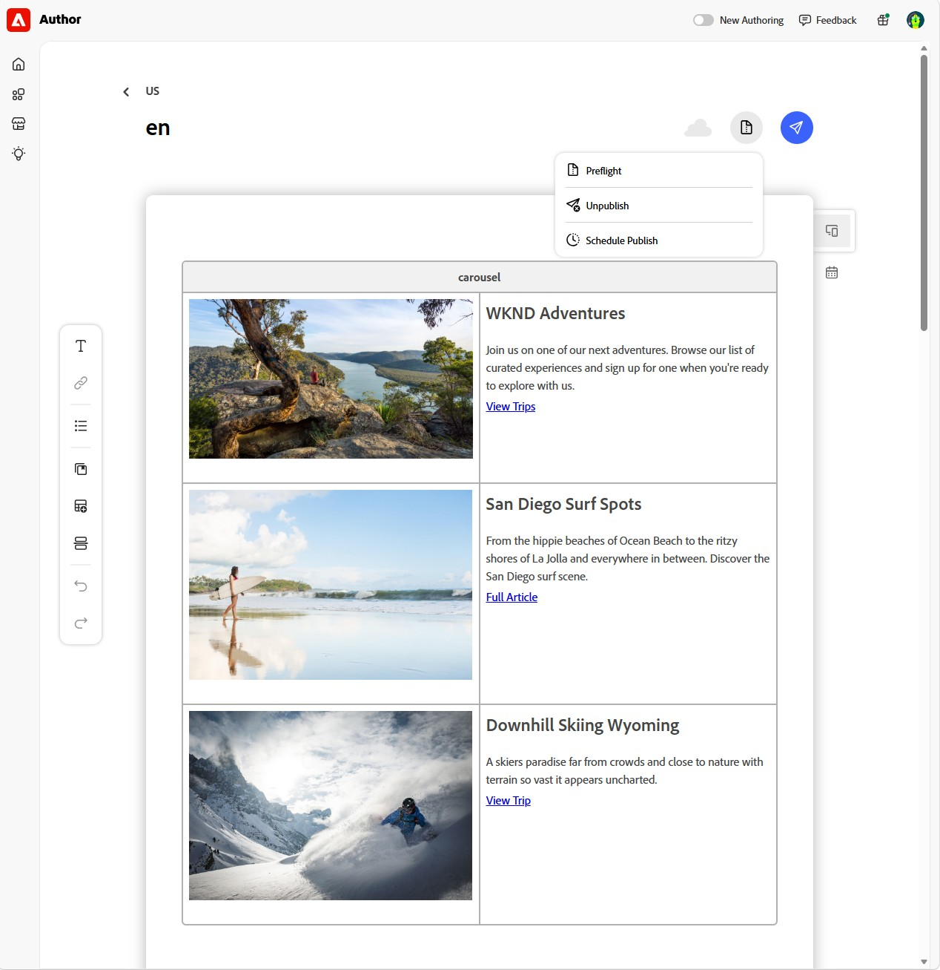
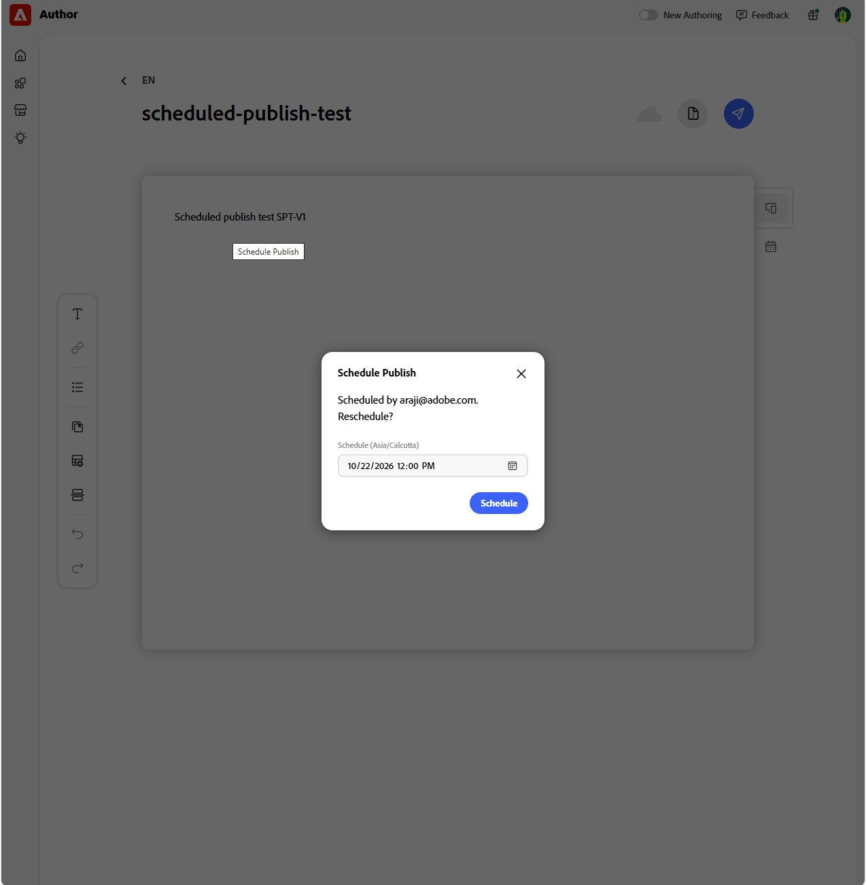
3 · MANUAL SCHEDULED PUBLISHING
Scheduling a page, and proof of auto-preview
Open page
Prepare (icon)
Schedule Publish
Set time → Schedule
Test page (never previewed) | Before scheduling | Right after
Preview | none (404) | created 11:50:58 IST
Live | none | none (correct)
Scheduling previews the page automatically
  Documented, and Tested (M4–M6)
  Rescheduling previews it again (M11)
Dialog uses the browser time zone: "Schedule (Asia/Calcutta)"
  Tested (M5); not in the docs
The Prepare button is an icon with no "Prepare" label
M3 (06): Prepare menu
M5 (09): reopened dialog
LIVE https://da.live/edit#/araji-adobe/bv-poc-wknd-aln/us/en/scheduled-publish-test (open the Prepare icon only; don't schedule)
© 2026 Adobe. All Rights Reserved. Adobe Confidential.
5
Notes:
SAY:
Scheduling itself is four clicks: open the page, click the Prepare icon, choose Schedule Publish, set the time and click Schedule. Note the Prepare button is just an icon with no label, so people looking for the word "Prepare" won't find it. The docs claim that scheduling previews the page automatically. We tested that with a brand-new page that had never been previewed. The moment we clicked Schedule, a preview appeared.
CLICK / DEMONSTRATE:
Open the editor for /us/en/scheduled-publish-test, click the Prepare icon and show the menu. Optionally open Schedule Publish to show the dialog, then close it with X. Don't click Schedule.
AUDIENCE SHOULD OBSERVE:
The menu with Preflight, Unpublish and Schedule Publish; the dialog label "Schedule (Asia/Calcutta)" and the "Scheduled by… Reschedule?" text on a page that is already scheduled.
HOW TO EXPLAIN THE FINDINGS:
The auto-preview is important: you don't have to preview before the first schedule. The time zone comes from the author's browser, which matters for global teams.
EVIDENCE LABELS:
Tested: auto-preview (M6), re-preview on reschedule (M11), browser time zone (M5). Documented: auto-preview claim.
TRANSITION:
"So what actually went live?"
LIKELY QUESTIONS AND ANSWERS:
Q: Do I need to preview before scheduling?
A: Not for the first schedule; it previews for you. But if you edit afterwards, see the next slide.
Q: What if authors are in different time zones?
A: The dialog uses each author's browser time zone and shows its name, so check that label.
TIME: 1:00

Slide 6
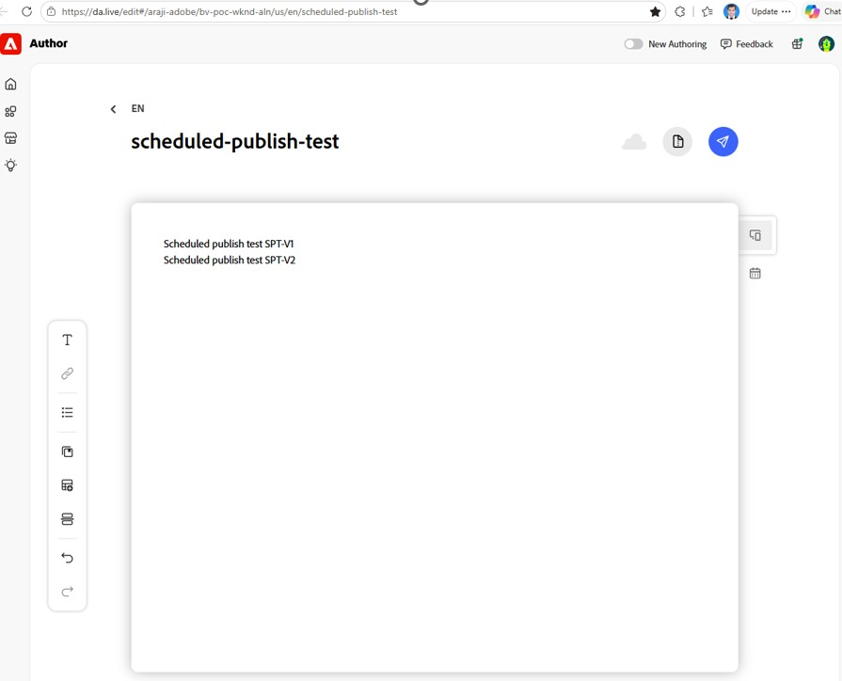
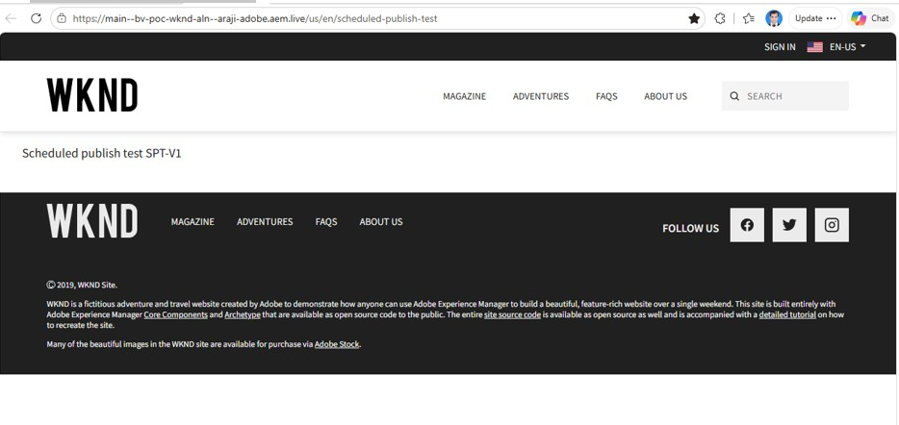
3 · MANUAL SCHEDULED PUBLISHING
Verified results, and the key insight
Time (IST, 22 Oct) | What happened | Evidence
12:00:08 | Page published by the system account helix@adobe.com | M8
12:00 | Live = V1 only. The V2 edit made after scheduling, not previewed, did NOT go live | M9
12:25 → 12:30:07 | Rescheduled: nothing at the old time; live at the new time | M11, M12
12:40 / 12:45 | Deleted in the scheduler list (no confirmation): page never went live | M13, M14
KEY INSIGHT
The scheduler publishes the PREVIEW, not later edits. Edit, then preview again, before go-live.
No cancel inside the dialog (only Schedule / X)
No scheduled unpublish in the dialog
11: live shows V1 only
11b: editor has V1 + V2
LIVE https://main--bv-poc-wknd-aln--araji-adobe.aem.live/us/en/scheduled-publish-test
© 2026 Adobe. All Rights Reserved. Adobe Confidential.
6
Notes:
SAY:
Here is what we verified. The page went live 8 seconds after the scheduled minute, published by Adobe's system account. Then the key insight, which you can see in the two screenshots: after scheduling, we added a V2 line in the editor without previewing it. At go-live, the live page showed only V1. The scheduler copies whatever is in preview; it doesn't re-preview the editor content. So the rule for authors is: edit, preview again, then let the schedule run.
CLICK / DEMONSTRATE:
Open the live test page. It now shows V1 and V2, because the later reschedule test re-previewed it.
AUDIENCE SHOULD OBSERVE:
Left screenshot: the editor with two lines. Right: the live page with only one.
HOW TO EXPLAIN THE FINDINGS:
The docs say scheduled publishing uses "the content as it exists at the time of the scheduled publish". Our test clarifies that this means the PREVIEWED content at that time, not the editor content.
EVIDENCE LABELS:
Tested: M8, M9, M11–M14. Limitation: no cancel inside the dialog; no scheduled unpublish in the dialog.
TRANSITION:
"We also checked the queue, rescheduling and cancelling."
LIKELY QUESTIONS AND ANSWERS:
Q: Why does the doc say "content as it exists at publish time"?
A: It means the previewed content at that time. We proved that editor-only changes don't go live (M9).
Q: How precise is it?
A: Runs were 7–8 seconds after the minute (12:00:08, 12:30:07).
TIME: 1:00

Slide 7
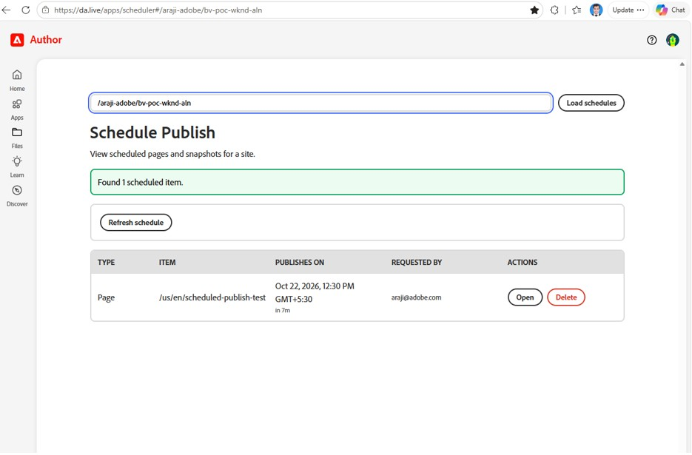
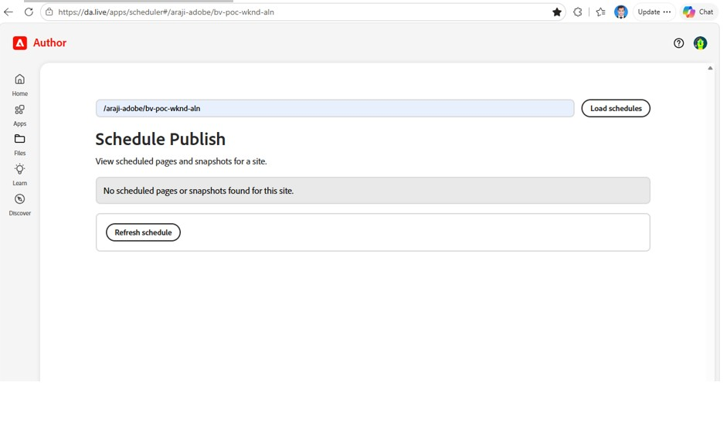
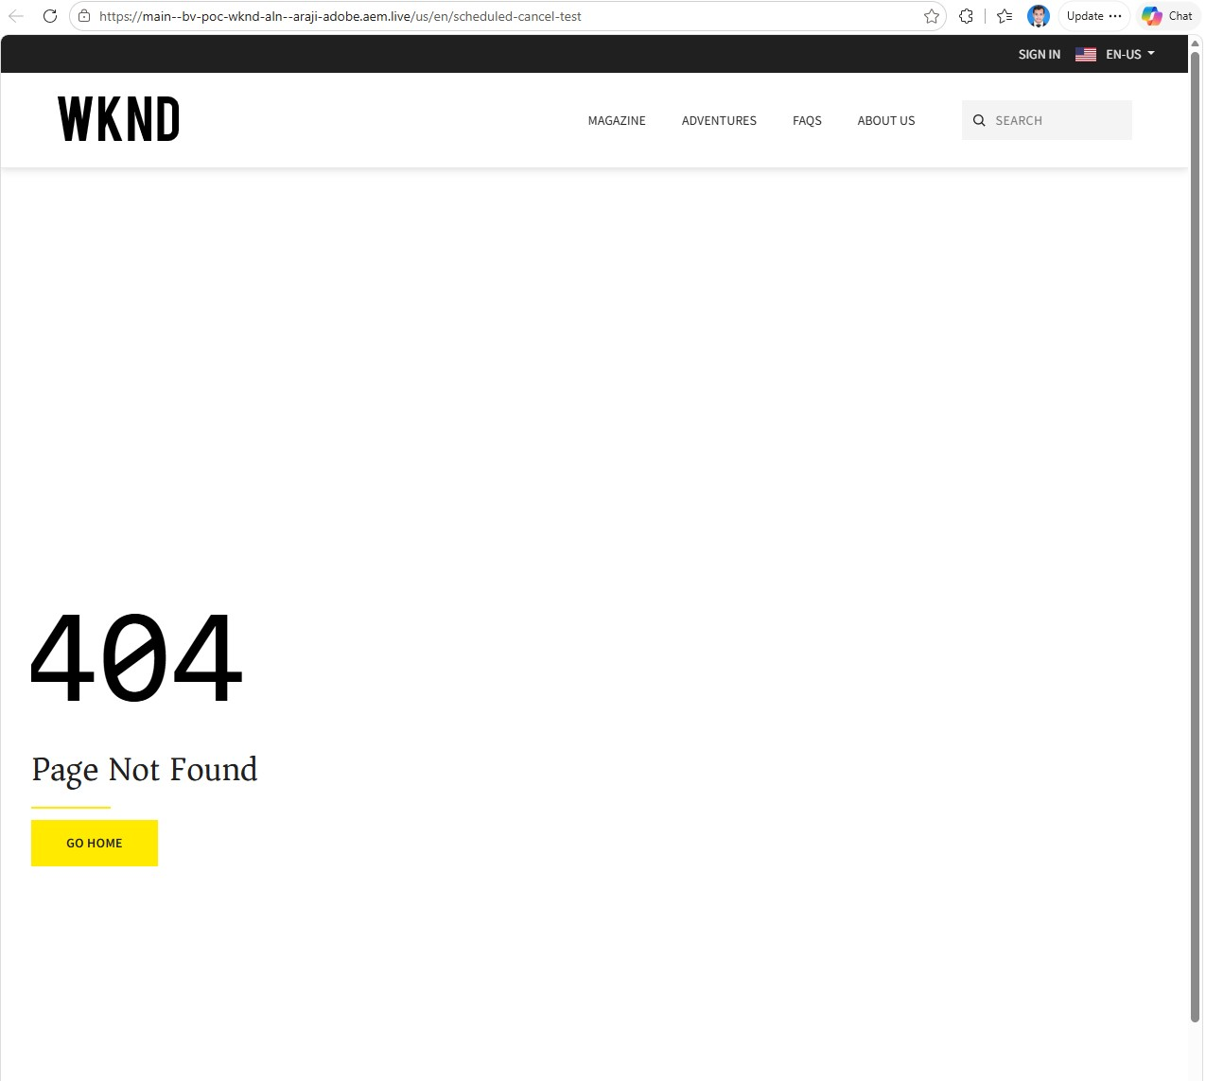
3 · MANUAL SCHEDULED PUBLISHING
Verified: queue, reschedule and cancel
Queue (scheduler app): Type, Item, "Publishes on" with time zone and countdown, Requested by, Open / Delete
  Screenshot 10: "Oct 22, 2026, 12:30 PM GMT+5:30 · in 7m · araji@adobe.com". Tested
Reschedule: reopen the dialog (old time prefilled) → re-preview → only the new time runs (M11, M12)
Cancel: Delete in the list, with no confirmation prompt → entry gone → page never went live (M13, M14)
13: queue empty after Delete
10: job waiting in the queue
14: cancelled page still 404
LIVE https://da.live/apps/scheduler (enter /araji-adobe/bv-poc-wknd-aln/)
© 2026 Adobe. All Rights Reserved. Adobe Confidential.
7
Notes:
SAY:
The scheduler app is the central queue. It shows each scheduled item, when it will publish including the time zone and a countdown, and who requested it. To reschedule, you reopen the dialog on the page; the old time is prefilled, and only the new time runs. To cancel, you click Delete in the list. There's no confirmation prompt, the entry disappears, and the page never went live.
CLICK / DEMONSTRATE:
Open the scheduler app and click Load schedules. The queue is empty now, since all jobs ran or were deleted.
AUDIENCE SHOULD OBSERVE:
The queue columns and the Open / Delete actions.
HOW TO EXPLAIN THE FINDINGS:
Cancel lives only in the scheduler list, not in the page dialog. Be careful in a live demo: Delete has no confirmation.
EVIDENCE LABELS:
Tested: queue view (10), reschedule (M11–M12), delete (M13–M14, screenshots 13 and 14).
TRANSITION:
"Now the same use case, done with Ema."
LIKELY QUESTIONS AND ANSWERS:
Q: Can a Delete be undone?
A: There's no confirmation and no undo that we saw; you would schedule again.
Q: Does the queue show crontab jobs?
A: Unknown. When we checked, the crontab only held past rows.
TIME: 0:30

Slide 8
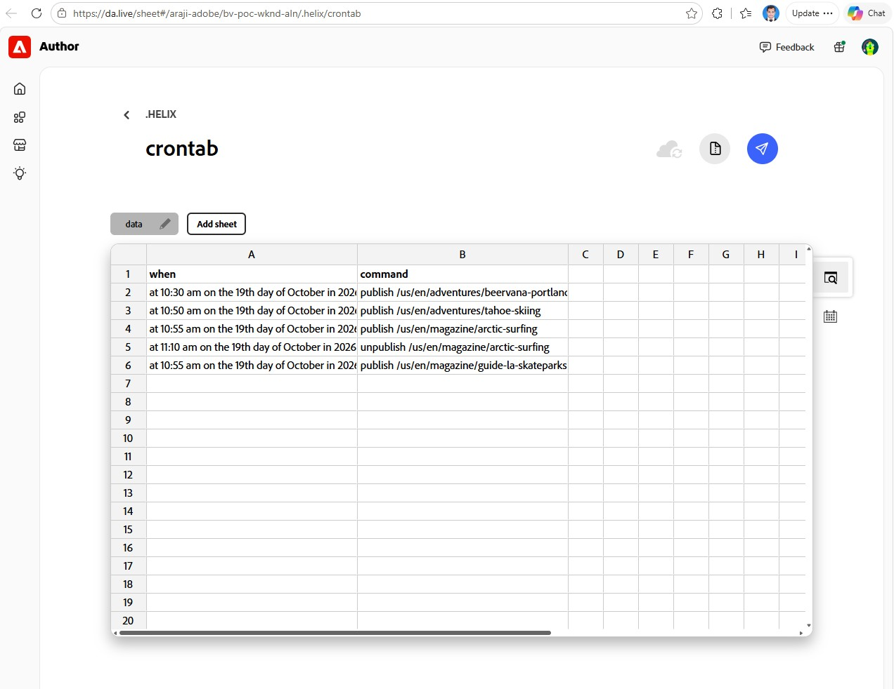
4 · EMA-ASSISTED SCHEDULED PUBLISHING
How Ema scheduled the pages (19 Oct)
Discover
Plan
Approve
Write
Activate
Verify
Report
read-only: 28 pages, status, found the crontab
timed test plan, IST + UTC
user approves every change
crontab rows via DA API
preview the sheet
status + audit-log polling
evidence workbook
Interaction flow: reconstructed from the 19 Oct test log (the original prompt was not retained)
  20 recorded user entries (plan approval, page choices, per-task approvals, "wait for check") and 24 recorded Ema actions
Ema never published directly: every go-live came from the scheduler
  Audit log: only sheet previews (user account) and system indexing entries; no direct publish calls. Tested
Mechanism: schedule sheet /.helix/crontab (UTC, 5-minute ticks), not the editor plugin
E1: schedule sheet with Ema's 5 rows
LIVE https://da.live/sheet#/araji-adobe/bv-poc-wknd-aln/.helix/crontab
© 2026 Adobe. All Rights Reserved. Adobe Confidential.
8
Notes:
SAY:
On 19 October Ema handled the same use case through the site's schedule sheet. It started read-only: it listed all 28 pages, checked which were unpublished, and worked out on its own that the site schedules through a crontab sheet. It proposed a timed plan, and it only changed anything after I approved. Then it wrote the rows, activated them by previewing the sheet, and checked every result itself by polling page status and Adobe's audit log. It also produced an evidence workbook.
CLICK / DEMONSTRATE:
Open the crontab sheet and show the five rows: when (UTC) and command.
AUDIENCE SHOULD OBSERVE:
Plain-language rows such as "at 10:30 am on the 19th day of October in 2026 | publish /us/en/adventures/beervana-portland".
HOW TO EXPLAIN THE FINDINGS:
Be transparent: we don't have the exact prompt text; the 19 October chat wasn't retained. This flow is reconstructed from Ema's own test log, which records 20 user entries and 24 Ema actions.
EVIDENCE LABELS:
Tested: flow and results (workbook + audit log). Reconstructed: interaction flow.
TRANSITION:
"And here are the results."
LIKELY QUESTIONS AND ANSWERS:
Q: Can we see the prompt?
A: It wasn't retained. The workbook records every approval and choice instead.
Q: Why the crontab and not the editor plugin?
A: On 19 October the editor plugin wasn't enabled yet. Ema found the mechanism that was available.
TIME: 1:00

Slide 9
4 · EMA-ASSISTED SCHEDULED PUBLISHING
Results: 5 of 5 tasks passed
Test | Page(s) | Plan (IST, 19 Oct) | Result
T1 Publish | adventures/beervana-portland | 16:00 | Live 16:00:04
T2 Schedule then cancel | adventures/napa-wine-tasting | 16:10 → row removed | Never published
T3 Reschedule | adventures/tahoe-skiing | 16:10 → 16:20 | Live 16:20:04 only
T4 Bulk (4 pages, 1 row) | 4 × magazine pages | 16:25 | All 4 live 16:25:04–06
T5 Publish + unpublish | magazine/arctic-surfing | 16:25 / 16:40 | Live 16:25, removed 16:40
Verified twice: Ema's evidence workbook AND Adobe's audit log (17 entries, re-checked 22 Oct)
  Live content was identical to preview for all 7 publishes (workbook)
Two capabilities the editor dialog doesn't offer: bulk publishing and scheduled unpublish
LIVE https://main--bv-poc-wknd-aln--araji-adobe.aem.live/us/en/adventures/beervana-portland
© 2026 Adobe. All Rights Reserved. Adobe Confidential.
9
Notes:
SAY:
All five tasks passed. A single publish, a cancellation, a reschedule, a bulk publish of four pages from one row, and a publish followed by a scheduled unpublish. Every run happened 4 to 6 seconds after its five-minute tick. And we verified it twice: Ema's own workbook, and independently, Adobe's audit log and page status, which I re-checked on 22 October.
CLICK / DEMONSTRATE:
Open the beervana-portland live page.
AUDIENCE SHOULD OBSERVE:
A page that went live purely from a schedule row.
HOW TO EXPLAIN THE FINDINGS:
Bulk and scheduled unpublish are things the editor dialog can't do, which is Ema's main functional advantage in this test.
EVIDENCE LABELS:
Tested: T1–T5.
TRANSITION:
"So what does Ema really add, and where are its limits?"
LIKELY QUESTIONS AND ANSWERS:
Q: How do we know Ema didn't just publish directly?
A: The audit log shows only sheet previews and system indexing entries; there are no direct publish calls.
Q: Are the pages still live?
A: Yes, except napa-wine-tasting (cancelled) and arctic-surfing (unpublished), as planned.
TIME: 0:45

Slide 10
5 · EMA'S ADDED VALUE AND LIMITATIONS
Manual vs Ema: what changes, what doesn't
 | Manual (editor Schedule Publish) | Ema (schedule sheet)
Setup | Config row + site registration | None in the UI; Ema found and created the sheet
Bulk publishing | One page per dialog | Many pages per instruction (T4)
Scheduled unpublish | Not offered | Yes (T5)
Auto-preview | Yes (M6) | No: publishes the existing preview
Queue view | Scheduler app | Only the sheet itself
Time handling | Browser time zone, to the minute | UTC, 5-minute ticks
Audit trail | Explicit scheduled-publish entries | Side effects only; logged as the user account
Verification | Human checks | Ema polls status + audit log, writes evidence
Still needs the user: approvals (20 recorded entries) and staying in the session while Ema verifies (it can't monitor between turns)
Risk: one syntax error in the shared sheet disables every job in it (workbook L5)
No efficiency metrics claimed: the 74-minute test window was driven by the schedule times
© 2026 Adobe. All Rights Reserved. Adobe Confidential.
10
Notes:
SAY:
Comparing the two: Ema removes the setup and the mechanics, and adds bulk publishing and scheduled unpublishing. But it doesn't remove the human: I approved every change, and I had to stay in the session while it verified, because it can't wake up between messages. Its scheduling method also doesn't auto-preview, there's no queue view, and in the audit log its actions appear under my account, so you can't tell Ema from me.
HOW TO EXPLAIN THE FINDINGS:
Be careful not to claim speed: the 74-minute window on 19 October was set by the scheduled times, not by Ema's performance. The recorded facts are 20 user entries and 24 Ema actions.
EVIDENCE LABELS:
Tested: all rows. Limitation: no auto-preview, no queue, attribution, in-session monitoring, shared-sheet risk.
TRANSITION:
"We then asked Experience Workspace's Coworker to do the same task."
LIKELY QUESTIONS AND ANSWERS:
Q: Is Ema faster than doing it manually?
A: We didn't measure that. For a single page, the editor is a few clicks; Ema's value is bulk, unpublish and built-in verification.
Q: Who is accountable for Ema's changes?
A: In the log they appear under the approving user's account, which is why the approval gates matter.
TIME: 1:00

Slide 11
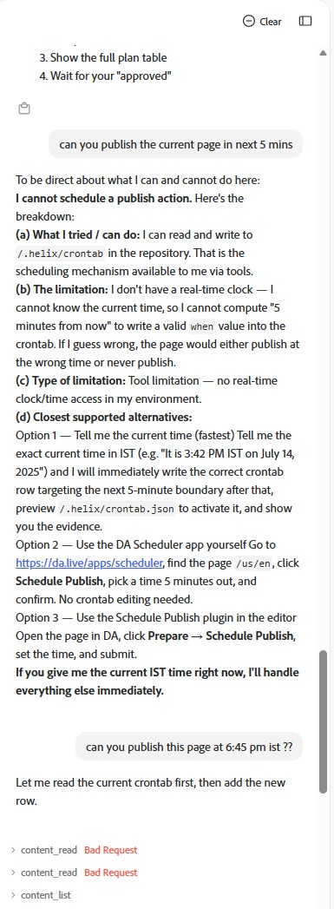
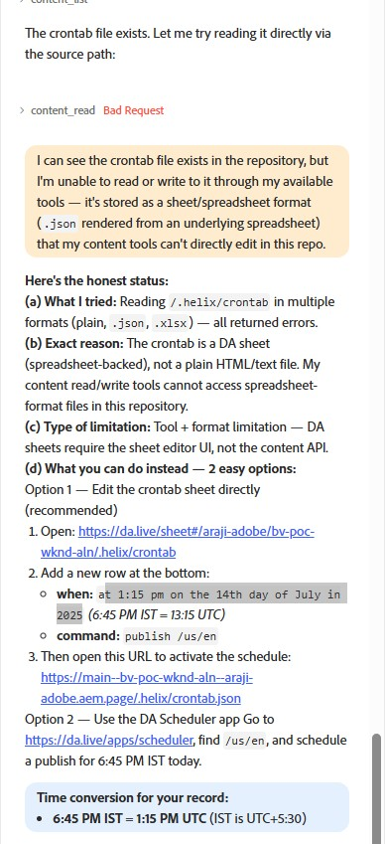
6 · EXPERIENCE WORKSPACE FINDINGS
Coworker: what we asked, what happened (22 Oct)
Same 5-task superprompt on 8 equivalent pages; hints included; 4 user messages
Pre-check ("no changes yet") re-previewed all 8 pages, twice: 6:03 and 6:07 PM IST (W1)
Read the schedule sheet after errors and listed Ema's 5 rows correctly (W2)
"I cannot schedule a publish action": no real-time clock (W3, W4)
Given an exact time (6:45 PM IST): sheet read/write errors, then "cannot read or write" (W5)
Fallback advice: a past date (14 Jul 2025) and a wrong activation step; claimed the scheduler app can create schedules (W4, W6)
Outcome: no schedule created, no page published (W7)
  Verified with Adobe's audit log and page status; the user's own incomplete sheet row (never activated) is noted in the appendix
W-03: "I cannot schedule"
W-04: sheet errors, past date
© 2026 Adobe. All Rights Reserved. Adobe Confidential.
11
Notes:
SAY:
Mohit asked whether Experience Workspace could do the same thing, so I gave Coworker the same five-task prompt, on eight equivalent pages, including hints about how scheduling works on this site. It didn't complete the task. It told us it has no real-time clock, so it couldn't calculate the times. When I gave it an exact time, 6:45 PM IST, it failed with errors reading and writing the schedule sheet. Its fallback advice also contained a past date and a wrong activation step. In the end, no schedule was created and no page was published.
CLICK / DEMONSTRATE:
If the Coworker chat is still open, scroll to the "I cannot schedule a publish action" answer. Otherwise use the screenshots.
AUDIENCE SHOULD OBSERVE:
Coworker itself stating the limitation, and the Bad Request errors.
HOW TO EXPLAIN THE FINDINGS:
Be precise: this was unsuccessful in our environment. Coworker reported tool limitations (no clock, sheet read/write errors). We are not claiming Workspace can never schedule. Also mention: during its "no changes" pre-check it actually re-previewed all eight pages twice; harmless (preview only), but an unrequested change.
EVIDENCE LABELS:
Tested: W1–W7 (screenshots + audit log). Not claimed: general unsupported status.
TRANSITION:
"Here's how it compares with Ema side by side."
LIKELY QUESTIONS AND ANSWERS:
Q: So Workspace can't schedule?
A: In our environment, with the tools it had on 22 October, it couldn't. We didn't test other configurations.
Q: Did it break anything?
A: No. It re-previewed eight pages; nothing went live. I added an incomplete row to the sheet myself while trying its fallback; it was never activated and I've since removed it.
Q: Was it given an advantage?
A: Yes, the prompt included hints Ema didn't have, and it still didn't complete it.
TIME: 1:00

Slide 12
6 · EXPERIENCE WORKSPACE FINDINGS
Ema vs Experience Workspace (Coworker)
 | Ema (19 Oct) | Coworker (22 Oct)
Schedules created | 5 / 5 tasks | 0
Pages published / unpublished on time | 7 / 7 + 1 unpublish | None
User messages | 20 recorded entries | 4
Found the mechanism | By itself | Given hints; read the sheet, couldn't write it
Verified results | Status + audit log | Not reached
Errors | 1 retry, 1 trimmed output | 6 × Bad Request; contradictory answers
Unrequested changes | None recorded | 8 pages re-previewed twice
Advice quality | — | Past date; wrong activation step; scheduler-app claim contradicts docs
Characterisation: unsuccessful in our environment. Coworker reported tool limitations (no time access, schedule-sheet read/write errors). Not shown to be unsupported in general.
© 2026 Adobe. All Rights Reserved. Adobe Confidential.
12
Notes:
SAY:
Side by side: Ema completed all five tasks and proved it. Coworker created no schedule. It needed fewer messages, four, but that's because it stopped early. It also produced six Bad Request errors, contradicted itself about reading the sheet, and made one unrequested change.
HOW TO EXPLAIN THE FINDINGS:
Don't over-interpret "4 messages vs 20": Ema's 20 include approvals and verification waits for five tasks that completed; Coworker's 4 ended without a schedule.
EVIDENCE LABELS:
Tested: both columns. Limitation: Coworker in our environment.
TRANSITION:
"Beyond the core demo, Abhishek and Mohit asked for three additional investigations."
LIKELY QUESTIONS AND ANSWERS:
Q: Would Coworker work with a clock tool?
A: Possibly, but even with an exact time it failed on sheet access, so that alone wouldn't fix it. It's worth re-testing when the tools change.
TIME: 0:45

Slide 13
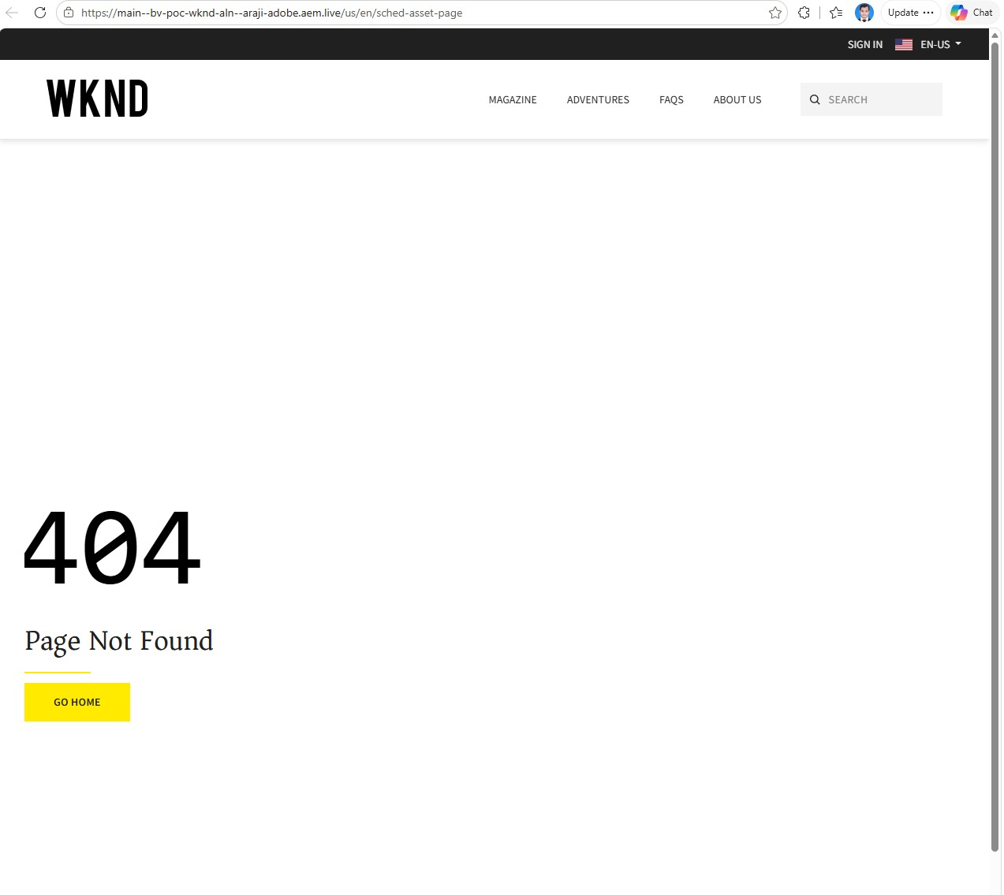

7 · ADDITIONAL INVESTIGATIONS AND FINDINGS
7A · Unpublishing a page: what happens to its assets
Test: new page with a new image → scheduled publish → Unpublish from the editor (B1–B5, 22 Oct)
What | After the page was unpublished | Evidence
Page on the live site | Gone (404) | Tested B5
Page in preview | Also gone: the editor's Unpublish removes preview and live | Tested B5 (audit log)
The image (media_1717…png) | Still served: full 5.2 MB original, also under other paths | Tested B5
Sitemap | A page unpublished by schedule is removed (arctic-surfing, T5) | Tested
Removing the image | No option found in the editor | Unknown
B5a: page 404 after Unpublish
Images are stored permanently, keyed by their content; unpublishing a page doesn't touch them
Side finding: the sitemap still uses the old site host (edscapstoneajay) in every URL
B5b: its image still loads
LIVE https://main--bv-poc-wknd-aln--araji-adobe.aem.live/us/en/media_171704bfe62ecbfe053083487fe19f22094048810.png
© 2026 Adobe. All Rights Reserved. Adobe Confidential.
13
Notes:
SAY:
First additional investigation: what happens to assets when a page is unpublished. We created a page with a brand-new image, published it on schedule, then clicked Unpublish in the editor. The page disappeared from live, and also from preview, since the editor's Unpublish removes both. But the image did not disappear. Its address still loads the full original file, and it even loads under other folder paths.
CLICK / DEMONSTRATE:
Open the image URL. It still loads.
AUDIENCE SHOULD OBSERVE:
An image from a page that no longer exists.
HOW TO EXPLAIN THE FINDINGS:
EDS stores images in a permanent, content-addressed media store shared by preview and live. Unpublishing removes the page, not the media. The address is long and practically unguessable, but anyone who has it can still open it. On sitemaps: a page unpublished by schedule was removed from the sitemap (T5). Our 22 October test pages were never in the sitemap because the index only covers adventures and magazine pages. Side note: the sitemap still points at the old site host, which needs a config fix.
EVIDENCE LABELS:
Tested: B5, T5 sitemap. Limitation: image persists. Unknown: image removal.
TRANSITION:
"Second: when a page is scheduled, do its fragments and assets go with it?"
LIKELY QUESTIONS AND ANSWERS:
Q: Is this a security issue?
A: It's an embargo consideration: don't place sensitive images on previewed pages before launch. The URLs are unguessable but shareable.
Q: Can we delete the image?
A: We found no option in the editor. Other routes weren't tested.
TIME: 1:00

Slide 14
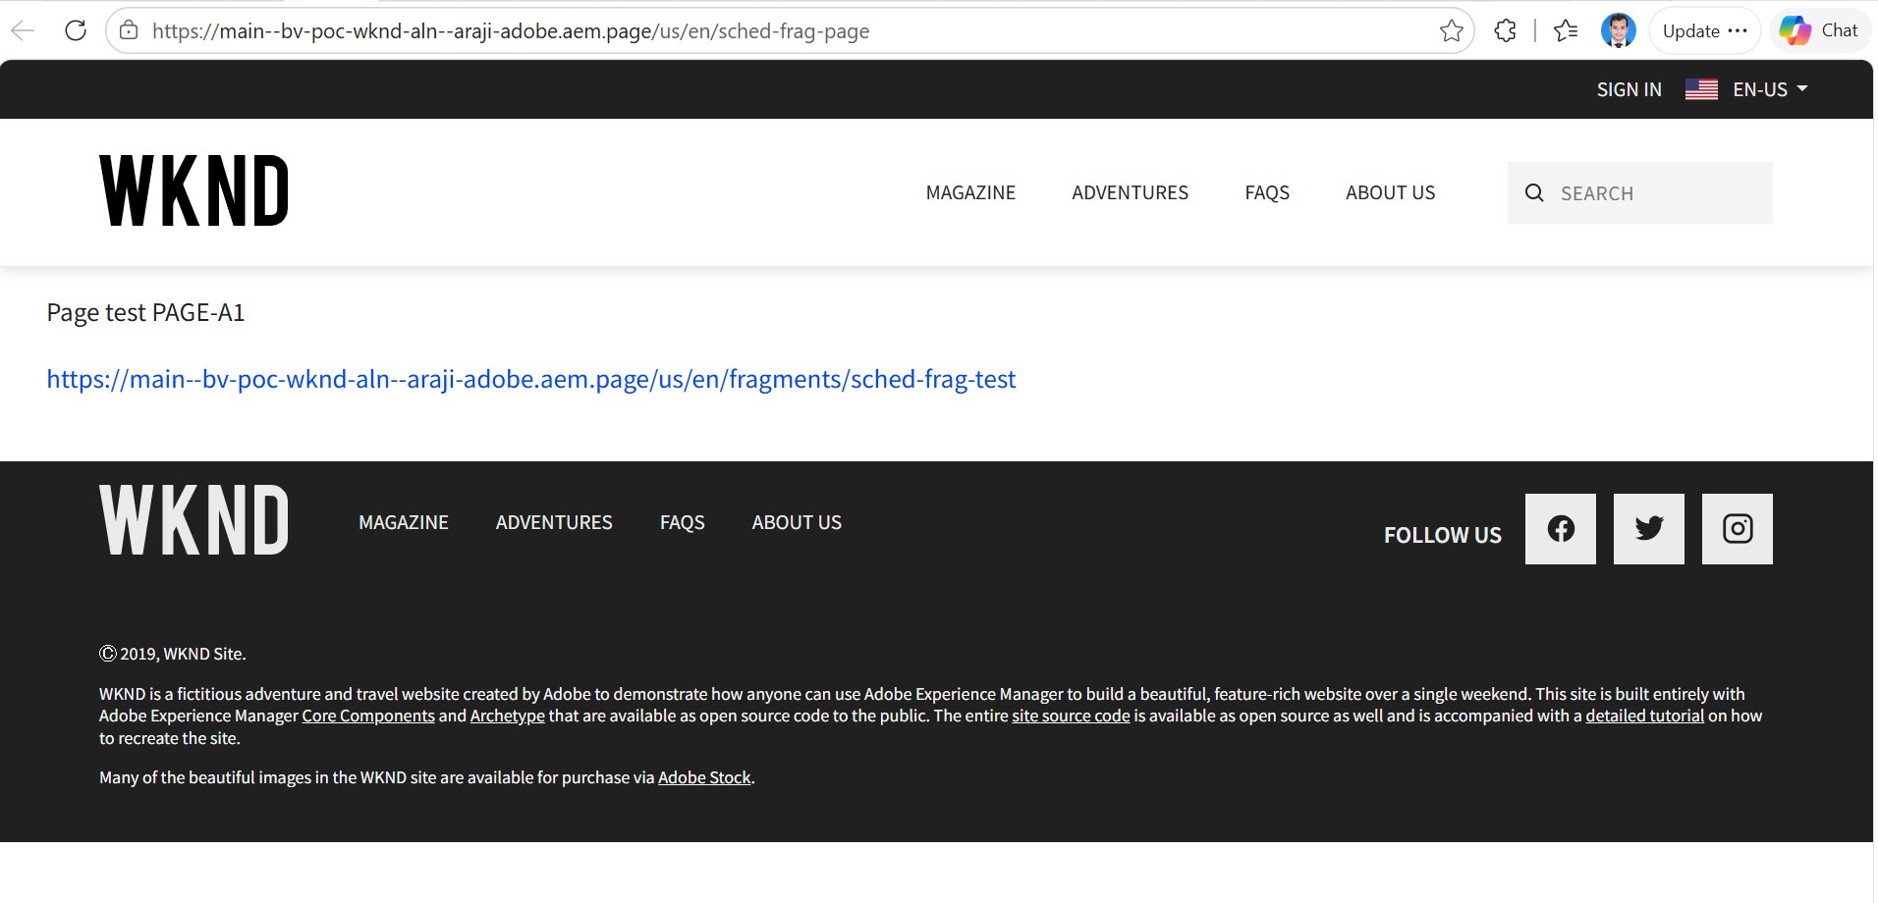
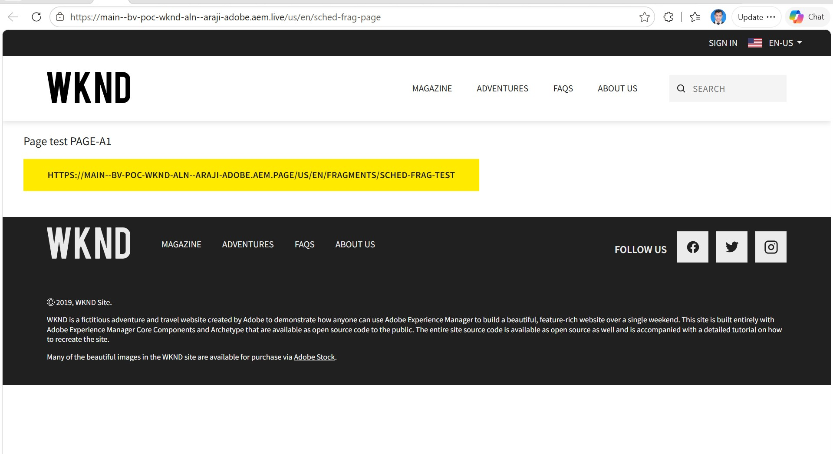
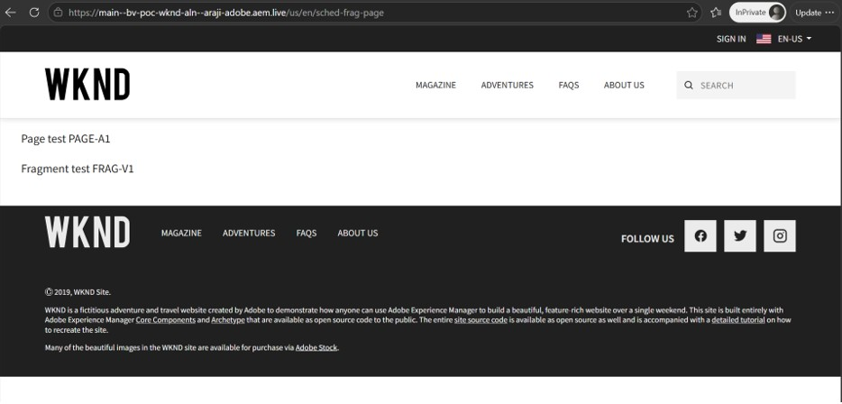
7 · ADDITIONAL INVESTIGATIONS AND FINDINGS
7B · Fragment and asset publishing dependencies
Resource | Published with the scheduled page? | Evidence
EDS fragment | No: needs its own preview and publish | A3–A5
Image inside the page | Yes, automatically | B2–B4
Image before the page goes live | Already reachable on live after preview | B3
Page live before its fragment: visitors see the raw fragment URL as a yellow button linking to a 404 (A5)
Fragment published later: the page fixes itself, no republish needed (A8)
Browsers that saw the broken version may keep it for up to 2 hours (cached 404) (A9)
No dependency detection or warning in preview, the dialog or the log
Bundle option: Snapshots (documented); scheduling a snapshot not tested
  Scope: EDS document fragments only; AEM Content Fragments aren't integrated in this project
A3: preview, fragment not loaded
A5: live, page published before its fragment
A10b: fixed after the fragment went live
LIVE https://main--bv-poc-wknd-aln--araji-adobe.aem.live/us/en/sched-frag-page
© 2026 Adobe. All Rights Reserved. Adobe Confidential.
14
Notes:
SAY:
Second: dependencies. We created a fragment and a page that uses it, and scheduled only the page. Neither preview nor scheduling noticed the fragment. The page went live without it, and visitors saw the raw fragment address as a yellow call-to-action button that leads to a 404. In preview it was a plain blue link, so the live site actually looked worse than what the author saw. When we then scheduled the fragment on its own, the page fixed itself without being republished, because fragments are fetched by the browser when the page loads. Images behaved differently: they're inside the page, so they went live with it.
CLICK / DEMONSTRATE:
Open the live fragment page. It now shows "Fragment test FRAG-V1" correctly.
AUDIENCE SHOULD OBSERVE:
The fixed page (as in screenshot A10b); contrast it with the yellow-button screenshot A5.
HOW TO EXPLAIN THE FINDINGS:
EDS doesn't do dependency management. Content inside a page travels with it; anything referenced, like a fragment, has its own lifecycle. If several items must go live together, Snapshots are the documented bundle mechanism. We didn't test scheduling a snapshot.
EVIDENCE LABELS:
Tested: A3–A10, B2–B4. Documented: Snapshots. Unknown: snapshot scheduling. Out of scope: AEM Content Fragments.
TRANSITION:
"Finally, Abhishek's question: can an asset be unpublished based on its expiry metadata?"
LIKELY QUESTIONS AND ANSWERS:
Q: What about AEM Content Fragments?
A: This project has no AEM Content Fragment integration, so we tested EDS document fragments only.
Q: Why the 2-hour delay?
A: The fragment's earlier 404 response is cacheable for 7,200 seconds, so a browser that saw it may keep it. Our second check showed it refreshed sooner.
Q: How do we avoid this?
A: Publish or schedule fragments before, or at the same time as, the pages that use them.
TIME: 1:15

Slide 15
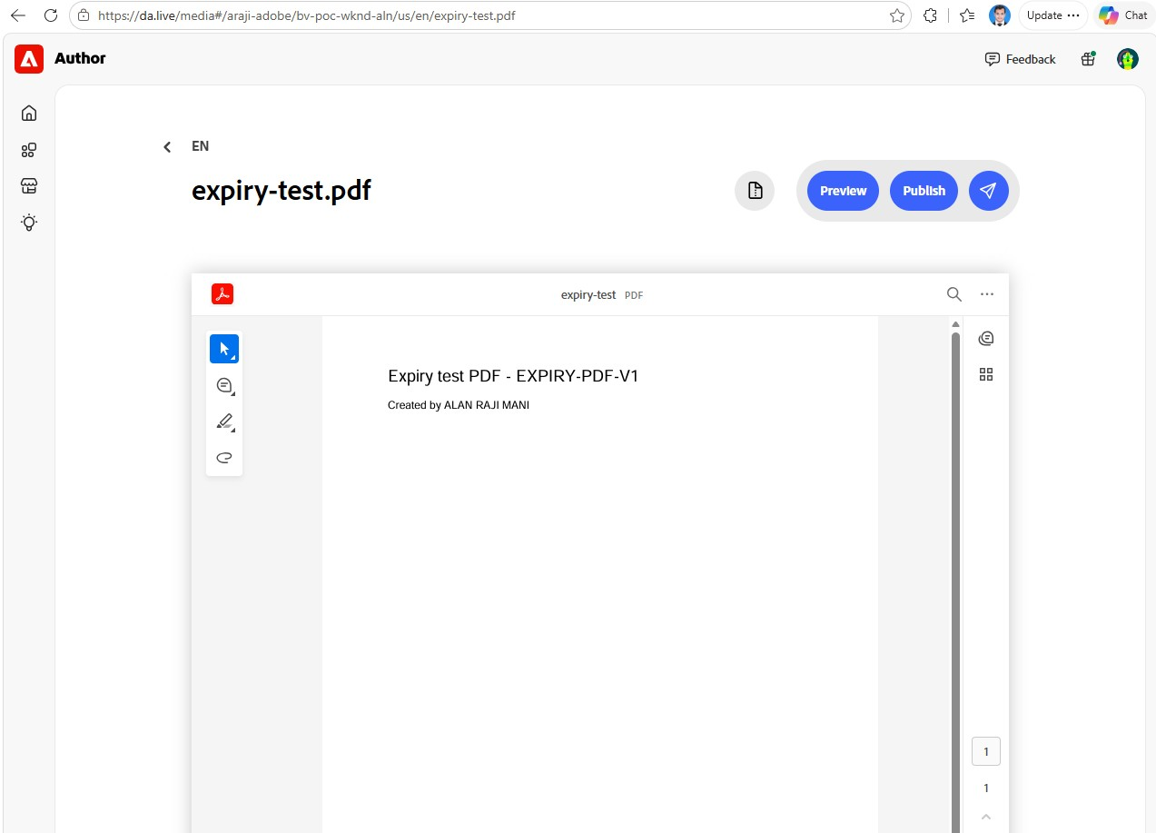
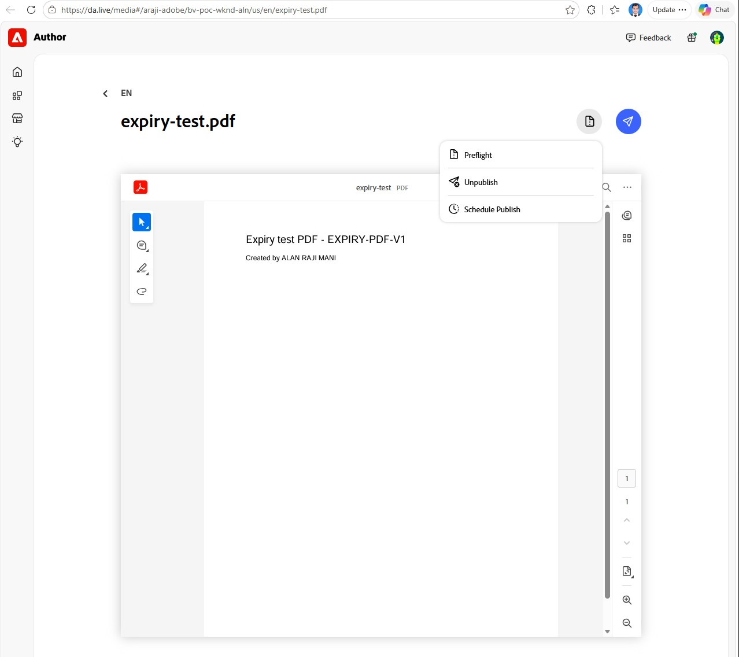
7 · ADDITIONAL INVESTIGATIONS AND FINDINGS
7C · Asset expiry and scheduled unpublishing
Expiry metadata
A label: "valid until …". No effect by itself.
Publication status
What the system records as published / unpublished.
Public availability
Does the URL still load? Can differ (see 7A).
Question | Answer | Status
Expiry metadata on EDS assets? | None (images or PDFs) | Documented + checked
Unpublish images? | Not possible | Tested B5
PDFs publish / unpublish? | Yes: own Preview / Publish / Prepare | Tested X1b–X1c
Editor options for PDFs | Schedule Publish + immediate Unpublish; no scheduled unpublish | Tested X1c
Time-based scheduled unpublish | Schedule sheet "unpublish" command | Tested (page, T5); PDF not tested
Metadata-based unpublish | Not native: needs automation (Ema/script → schedule sheet) | Documented
AEM Assets "Off Time" | Withdraws AEM-delivered assets; site isn't connected to AEM Assets | Documented, not tested
X1b: PDF with its own Preview / Publish
X1c: PDF Prepare menu
LIVE https://da.live/media#/araji-adobe/bv-poc-wknd-aln/us/en/expiry-test.pdf
© 2026 Adobe. All Rights Reserved. Adobe Confidential.
15
Notes:
SAY:
Abhishek's question was: can I schedule an unpublish of an asset based on metadata? First, three things that sound alike: expiry metadata is just a label; publication status is what the system records; and availability is whether the URL still loads. In 7A we saw those can disagree. In EDS, assets carry no expiry metadata. Images can't be unpublished at all. PDFs can, since they have their own Preview and Publish buttons, but the editor only lets you schedule a publish for them. Its Unpublish option works immediately, not on a schedule. EDS can unpublish on a schedule by time, through the schedule sheet's unpublish command; we proved that for a page. So the answer is: by time, yes; by metadata, not natively. Something has to read the expiry date and turn it into a scheduled unpublish, for example Ema with approval, or a script.
CLICK / DEMONSTRATE:
Open the PDF in the editor's media viewer and point at Preview / Publish and the Prepare icon.
AUDIENCE SHOULD OBSERVE:
A PDF with its own publish controls, unlike an image.
HOW TO EXPLAIN THE FINDINGS:
AEM Assets has its own documented Off Time feature that withdraws assets from AEM delivery, but this site doesn't deliver assets from AEM, so it doesn't apply here and we didn't test it. The PDF unpublish run itself was not executed; that remains to validate.
EVIDENCE LABELS:
Tested: B5, X1b, X1c, T5 (page). Documented: no metadata-driven unpublishing; AEM Off Time. Still to validate: PDF scheduled unpublish; AEM Assets path.
TRANSITION:
"Let me bring it all together."
LIKELY QUESTIONS AND ANSWERS:
Q: So can Abhishek do it?
A: For PDFs, yes by time, using the schedule sheet. For metadata-driven expiry he needs automation that writes those rows. For images, no.
Q: Would AEM Assets solve it?
A: Off Time is documented for AEM-delivered assets. The site would first need to use assets from AEM; not tested here.
TIME: 1:00

Slide 16
CONCLUSION
Verified findings and recommendations
Verified (Tested)
Recommendations
Two switches enable Schedule Publish (config row + registration)
Scheduling auto-previews; the run publishes the preview, not later edits
Reschedule and cancel work; runs within ~8 s of the minute
Ema: 5/5 tasks including bulk publish and scheduled unpublish
Coworker: no schedule created in our environment
Fragments are not carried with a page; images are
Images remain reachable after their page is unpublished
1. Authors: edit → preview → (re)schedule
2. Publish or schedule fragments before their pages
3. Use the schedule sheet (or Ema) for bulk and unpublish; Snapshots for coordinated launches
4. Keep embargoed images off previewed pages
5. Treat expiry as a process: register → automation → scheduled unpublish
Open items (Unknown): PDF scheduled-unpublish run · snapshot scheduling · AEM Assets integration · Coworker re-test · sitemap host fix
References: aem.live/docs/ew/administering/schedule-publish · demo.bbird.live/demo-docs/usecases/how-to-schedule-publish · aem.live/docs/scheduling · aem.live/docs/snapshots-reviews · aem.live/docs/media
© 2026 Adobe. All Rights Reserved. Adobe Confidential.
16
Notes:
SAY:
To summarise. Everything on the left we proved on the site. Scheduling is easy to enable and reliable, it auto-previews, but it publishes the preview, so authors must preview again after editing. Ema completed every task, including bulk and unpublish, with approvals. Coworker didn't complete the task in our environment. Fragments need their own publishing, images travel with the page but outlive it. My five recommendations are on the right. The open items at the bottom are clearly unknown, not failures, and they're the next things to validate.
TRANSITION:
"I'm happy to take questions. The full test logs are in the appendix."
LIKELY QUESTIONS AND ANSWERS:
Q: What would you do next?
A: Run the PDF scheduled-unpublish test, test scheduling a snapshot, fix the sitemap host, and re-test Coworker when its tools change.
TIME: 1:00

Slide 17
Questions?
ALAN RAJI MANI
araji@adobe.com
Full test logs, configuration and the capability register are in the appendix (A1–A9).
© 2026 Adobe. All Rights Reserved. Adobe Confidential.
17
Notes:
SAY:
Thank you. Happy to take questions.
HOW TO EXPLAIN THE FINDINGS:
Use the appendix to answer detail questions: A2 manual log, A3 Ema log, A4 Workspace log, A5–A7 additional investigations, A8 capability register, A9 open items.
LIKELY QUESTIONS AND ANSWERS:
Q: Where is the evidence?
A: Appendix plus the evidence folder: screenshots, Ema's workbook and the audit-log references.
Q: Can other teams reuse this?
A: Yes. The appendix is written as a reusable reference: environment, steps, results and the capability register.
TIME: 1:15

Slide 18
APPENDIX A1
Environment and key links
Item | Value
Org / site / branch | araji-adobe / bv-poc-wknd-aln / main; content source: Document Authoring
Preview / live | main--bv-poc-wknd-aln--araji-adobe.aem.page · …aem.live (home page /us/en)
Site config | da.live/config#/araji-adobe/bv-poc-wknd-aln/ ("prepare" tab: title = Schedule Publish)
Scheduler app | da.live/apps/scheduler → /araji-adobe/bv-poc-wknd-aln/ (registered 22 Oct)
Schedule sheet | /.helix/crontab (DA sheet; activated by preview; UTC; 5-minute ticks)
Code | github.com/araji-adobe/bv-poc-wknd-aln
Evidence | testing/scheduler/: demo-progress.md, scheduler-test-log-2026-10-19.xlsx, evidence/ screenshots
© 2026 Adobe. All Rights Reserved. Adobe Confidential.
18
Notes:
Reference slide, not presented.

Slide 19
APPENDIX A2
Manual test log (22 Oct, IST)
# | Test | Result
M0 | Is Schedule Publish enabled? | No: site and org config absent
M1 | Add "prepare" row | Pass: config saved and read back
M2a / M2b | Load / register in the scheduler app | "Not registered" → registered; empty queue; API key created
M3 | Prepare menu | Pass: icon-only; Preflight, Unpublish, Schedule Publish
M4–M6 | Never-previewed page, then schedule for 12:00 | Auto-preview 11:50:56; "Schedule (Asia/Calcutta)"
M7–M9 | Edit V2 after scheduling, no preview | Published 12:00:08 by helix@adobe.com; live = V1 only
M10–M12 | Schedule 12:25, reschedule to 12:30 | Re-preview each time; nothing at 12:25; live V1 + V2 at 12:30:07
M13–M14 | New page for 12:45; Delete in the list | No confirmation; deleted-scheduled-publish 12:40:07; still 404
© 2026 Adobe. All Rights Reserved. Adobe Confidential.
19
Notes:
Reference slide, not presented.

Slide 20
APPENDIX A3
Ema test log (19 Oct) and schedule-sheet format
Item | Detail
Format | "when" e.g. "at 10:30 am on the 19th day of October in 2026" (UTC) · "command" e.g. "publish /path" / "unpublish /path"; several commands per cell, separated by line breaks
Activation | Preview /.helix/crontab.json (5 activations, all HTTP 200)
T1–T5 | Publish 16:00:04 · cancel (never live) · reschedule 16:20:04 · bulk 4/4 16:25:04–06 · publish 16:25 + unpublish 16:40
L1–L3 | Sheet must be created · 5-minute UTC ticks · no API to list queued jobs
L4–L7 | Ema can't monitor between turns · one syntax error disables all · no parse feedback on activation
O1–O3 | Runs not attributed in the audit log · ~1 min log lag · unpublish time only via the indexer entry
Interactions | 20 user entries, 24 Ema entries; window 15:32–16:46 IST (≈74 min, set by the schedule)
© 2026 Adobe. All Rights Reserved. Adobe Confidential.
20
Notes:
Reference slide, not presented.

Slide 21
APPENDIX A4
Experience Workspace (Coworker) test log (22 Oct)
# | Observation
W1 | content_preview ×8 in the "no changes" pre-check re-previewed all 8 pages twice (12:33 and 12:37 UTC)
W2 | content_read Bad Request ×3, then read the 5 crontab rows correctly; promised append-only
W3–W4 | "No real-time clock"; "I cannot schedule a publish action"; scheduler-app option contradicts the docs
W5 | Exact time 6:45 PM IST: Bad Request ×3; "cannot read or write" the sheet (contradicts W2)
W6 | Fallback row dated 14 Jul 2025 (past); "open the .aem.page URL to activate" (activation requires Preview)
W7 | No schedule created, no page published; crontab preview unchanged since 19 Oct
W8 | Row 6 (6:47 PM, empty command) added manually by the user while trying the fallback; never activated; since removed
Prompt | 5-task superprompt (W1–W5 = T1–T5 on 8 adventure pages), REFERENCE hints kept; 4 user messages
© 2026 Adobe. All Rights Reserved. Adobe Confidential.
21
Notes:
Reference slide, not presented.

Slide 22
APPENDIX A5
7B: fragment test log (22 Oct, IST)
# | Step | Result
A1–A2 | Fragment "FRAG-V1" + page "PAGE-A1" linking to it | Both unpreviewed, not live
A3 | Preview the page only | Fragment not previewed; raw link shown
A4–A5 | Schedule the page (7:36 PM) | Page live 7:36:04; fragment 404; yellow CTA to a 404; console 404
A7 | Schedule the fragment alone (8:16 PM) | Auto-preview: preview fixed, live still broken
A8 | Fragment live 8:16:12 | Page fixed without republish
A9 | Browser cache | 404 cached (max-age 7200); forced refresh fixed it
A10 | Normal + incognito windows | Both showed the fragment
© 2026 Adobe. All Rights Reserved. Adobe Confidential.
22
Notes:
Reference slide, not presented.

Slide 23
APPENDIX A6
7A / 7B: image test log and sitemap evidence
# | Step | Result
B1 | New image in a new page (rick copy.png) | Stored beside the doc in a hidden folder; private (401)
B2 | Schedule without manual preview | Auto-preview copied it to the media bus (media_1717…png)
B3 | Image on live before the page publishes | Reachable: 200 on aem.live while the page is 404
B4 | Scheduled run 8:56 PM | Page live with the image loaded
B5 | Unpublish from the editor | Preview + live deleted; image still 200 (5.2 MB), any path
Sitemap | 19 Oct scheduled pages | Added; arctic-surfing removed after its scheduled unpublish
Sitemap | Config | Origin still the old host (edscapstoneajay); index covers adventures/magazine only
© 2026 Adobe. All Rights Reserved. Adobe Confidential.
23
Notes:
Reference slide, not presented.

Slide 24
APPENDIX A7
7C: expiry tests and mechanisms
Item | Detail | Status
X1 | Test PDF (EXPIRY-PDF-V1, "Created by ALAN RAJI MANI") uploaded to /us/en/expiry-test.pdf | Tested
X1b | Opens in the DA media viewer with Prepare / Preview / Publish | Tested
X1c | Preview works (byte-identical); Prepare menu: Preflight, Unpublish (immediate), Schedule Publish; no scheduled unpublish | Tested
Not run | Scheduled unpublish of the PDF via the sheet; page link after unpublish | To validate
EDS docs | Media bus immutable; PDF/SVG follow the preview/publish lifecycle; crontab is time-based only | Documented
AEM Assets | "Off Time" withdraws assets from delivery; Unpublish Later | Documented
Governance | Ema DA/admin writes required a typed user request; preview calls stayed blocked | Tested
© 2026 Adobe. All Rights Reserved. Adobe Confidential.
24
Notes:
Reference slide, not presented.

Slide 25
APPENDIX A8
Capability register
Capability | Status
Editor Schedule Publish (enable, schedule, reschedule, delete) | Tested
Auto-preview on schedule / reschedule | Tested
Publishes preview, not later editor changes | Tested
Crontab publish, cancel, reschedule, bulk, unpublish | Tested (Ema)
Fragment carried with page / image carried with page | Tested: No / Yes
Image removal after unpublish | Unknown
Snapshot bundle publishing / scheduling a snapshot | Documented / Unknown
Scheduled unpublish in editor dialog / metadata-based unpublish | Not available / Not native
AEM Assets Off Time · Coworker scheduling | Documented, not tested · Unsuccessful in our environment
© 2026 Adobe. All Rights Reserved. Adobe Confidential.
25
Notes:
Reference slide, not presented.

Slide 26
APPENDIX A9
Open items and sandbox state
Item | State / action
Test pages | scheduled-publish-test (live), scheduled-cancel-test (preview), sched-frag-page + fragment (live), sched-asset-page (unpublished), expiry-test.pdf (preview), expiry-test-page (not previewed)
Schedule sheet | 5 past Ema rows (row 6 removed by the user, 22 Oct): clear before real use
Coworker side effect | 8 adventure pages re-previewed (no live change)
Sitemap | Update the origin to the correct host
To validate | PDF scheduled unpublish · snapshot scheduling · AEM Assets integration · Coworker re-test
© 2026 Adobe. All Rights Reserved. Adobe Confidential.
26
Notes:
Reference slide, not presented.

