Slide 1

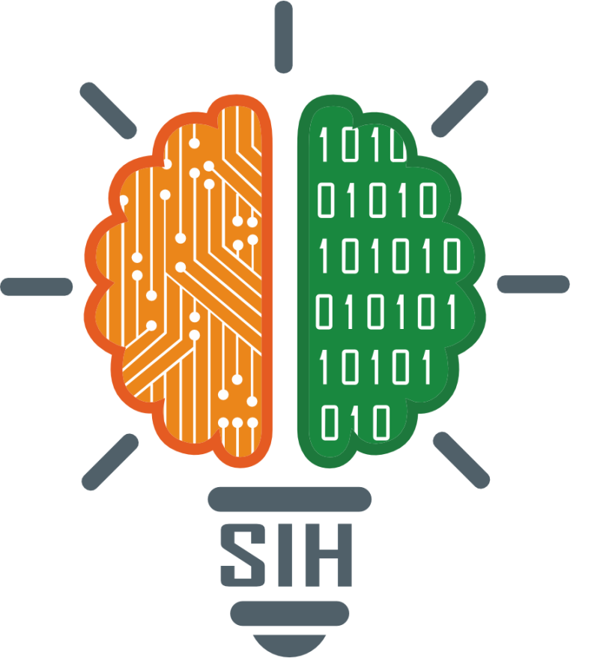
SMART INDIA HACKATHON 2025
PROJECT OVERVIEW
Problem Statement ID –SIH25049
Problem Statement Title- AI-Driven Public Health Chatbot
Theme- Healthcare & Biomedical Devices
PS Category- Software
Team ID-
Team Name- Team Byteforge

Slide 2
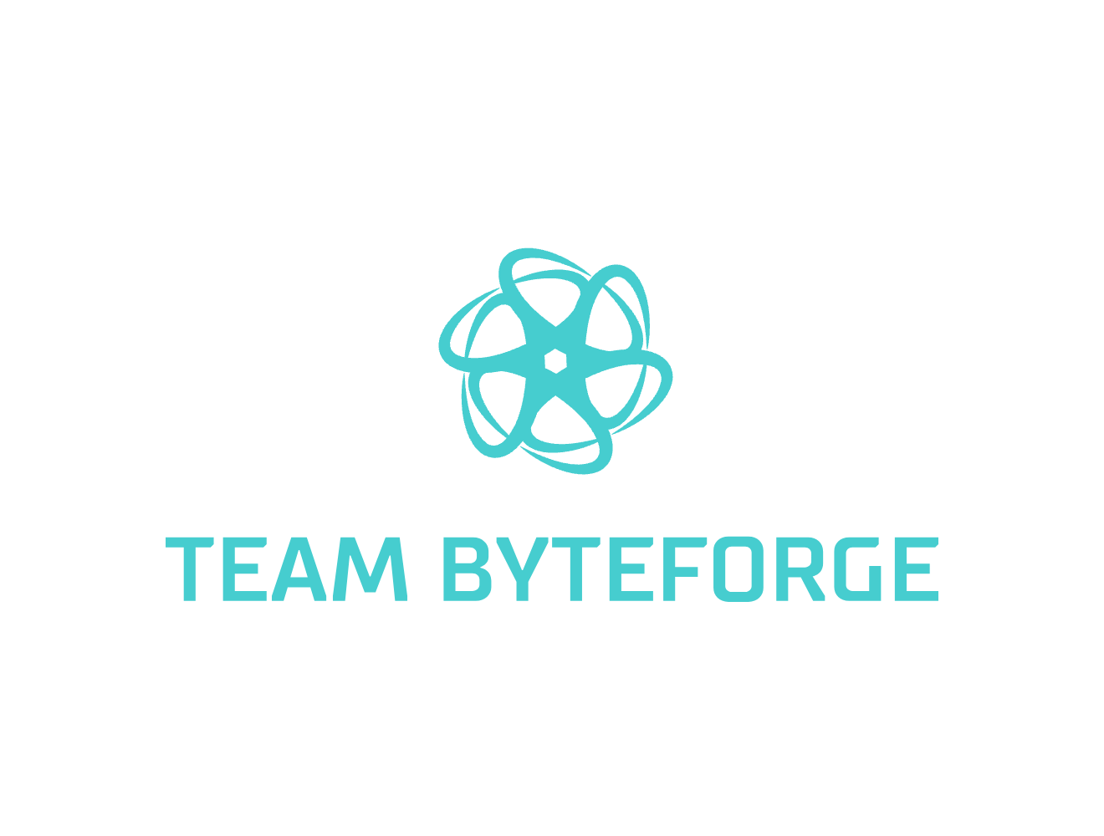
THE BIG IDEA
Proposed Solution
An AI-powered multilingual chatbot that:
Provides verified health information.
Offers symptom checking and preventive care advice.
Spreads awareness about government health schemes.
Guides users to nearest hospitals and emergency helplines.
Supports regional languages + voice input.
USER INPUT
It will communicate with backend and fetch relevant answer from faq_data dictionary
If not in faq_data
Googletrans translates non-English terms to English and then again converts in desired output language
response = "I'm sorry, I don’t have info on that. Please consult a nearby health center."
Display it in the text box
END

Slide 3
TECHNICAL APPROACH
Programming Languages and Framework
Python : (Backend logic)
Flask : A lightweight python framework
Library : Googletrans (Google translate API for Python)
HTML Template(index.html) & CSS:
Javascript (Ajax/fetch)
Database: Currently none(FAQ is hardcoded in a python dictionary). Could use SQLite /MySQL if you want to store more FAQs.

Slide 4
FEASIBILITY AND VIABILITY
Feasibility (Can it be built?)
✅ Technically feasible – Uses open-source frameworks (Flask, Python, Rasa, Google Translator API).
✅ Low infrastructure needs – Cloud hosting + lightweight database (MySQL/MongoDB).
✅ Scalable architecture – Can handle increasing users with cloud deployment.
✅ Multilingual support – Achieved via existing NLP/translation models.
✅ Integration ready – Can connect with WhatsApp, web, mobile, and govt APIs.
Viability (Will it work in real-world?)
💡 Cost-effective solution – Open-source tools minimize development cost.
💡 Wide adoption potential – Works on WhatsApp/SMS, even in rural areas with low internet.
💡 Government alignment – Supports Ayushyman Bharat & Digital Health Mission.
💡 High social impact – Reduces misinformation, increases healthcare awareness.
💡 Sustainability – Can be maintained by NGOs/government health departments with minimal cost.

Slide 5
IMPACT AND BENEFITS
Impacts
🌍 Improved Healthcare Accessibility – Rural and remote populations can access basic health guidance 24/7.
📉 Reduced Burden on Healthcare System – Filters common/FAQ queries, allowing doctors to focus on critical cases.
🛡️ Combat Misinformation – Provides verified, reliable health information (WHO, ICMR, MoHFW).
📊 Public Health Insights – Aggregated data can help government track health concerns and outbreaks.
🤝 Supports Digital India & Ayushyaman Bharat – Strengthens national digital health initiatives.
Benefits
✅ For Citizens – Free, multilingual, voice-enabled health assistance anytime.
✅ For Government – Promotes health schemes, improves awareness, reduces misinformation spread.
✅ For Healthcare Workers – Saves time by handling repetitive queries automatically.
✅ For Society – Promotes preventive healthcare, better awareness, and healthier communities.

Slide 6

RESEARCH AND REFERENCES
WHO & MoHFW guidelines
🔗 https://www.who.int/publications/i/item/9789241550505?utm_source=chatgpt.com
ICMR data
🔗 ICMR Data Repository
Case studies: Aarogya Setu, WHO Health Bot
🔗 Aarogya Setu on Google Play
🔗 https://www.who.int(botmd)
Datasets & Guidelines
🔗 Vaccination Schedule (ICMR Guidelines)
🔗 National Digital Health Mission (NDHM) – https://ndhm.gov.in

