Slide 1

Dr. Mahalingam College of Engineering and Technology
Department of Artificial Intelligence and Data Science
19ADPN6601 – Innovative and Creative Project
First Review
Title : Customer Segmentation & Personalized
Energy Services
Batch Number : 21
Domain : Public Sector Analysis
Team Members : Sivanithi S ( 727621BAD005 )
Aravindh R ( 727621BAD036 )
Anish M ( 727621BAD056 )
Faculty Supervisor : Mr. Selva Kumar T AP/ADS
Mr. Vijayakumar T AP/ADS
1

Slide 2
CONTENTS
Problem Statement
Literature survey
Objective
Existing System Block Diagram
Drawbacks of Existing System
Module description
Proposed System Block Diagram
Snapshots
Online Course
Conclusion
References
2

Slide 3
PROBLEM STATEMENT
Develop a system to analyze and predict Satisfaction score specifically from customer segmentation, utilizing real-time data of usage of energy.
Predict satisfaction score value from gaining data from the customer helps in improving the energy services.
3

Slide 4
LITERATURE SURVEY
4

Slide 5
RIDGE REGRESSION:
Ridge regression is a model-tuning method that is used to analyze any data that suffers from multicollinearity. This method performs L2 regularization.
Overall, ridge regression is a valuable tool in the machine learning toolkit for improving the stability and generalization performance of linear regression models, particularly in situations where the data is noisy or highly correlated
REFERENCE: Roger W. Hoerl ”Ridge Regression: A Historical Context”.2020

Slide 6
STANDARDIZATION:
StandardScaler is a method used in machine learning for standardizing features by removing the mean and scaling to unit variance. This preprocessing step is crucial for many machine learning algorithms, as it helps to ensure that features are on a similar scale and have a mean of zero and a standard deviation of one.
It is a fundamental step in data preprocessing pipelines to improve the performance and convergence of machine learning models.
REFERENCE: Roger W. Hoerl ”Ridge Regression: A Historical Context”.2020

Slide 7
LONG SHORT TERM MEMORY:
LSTM is a special kind of recurrent neural network and suitable for dealing with long-term dependence problems.
Compared with the general recurrent neural net works, LSTMaddsacellstate that preserves long-term infor mation in the hidden layer and is more effective to avoid gradient vanishing problem and gradient exploding problem in dealing with long sequence problems.
REFERENCE: “Vehicle Emission Forecasting Based on Wavelet Transform and Long Short-Term Memory Network” - QIANG ZHANG1, FENG LI1, FEI LONG2, AND QIANG LING 1,(Senior Member, IEEE). 2018

Slide 8
Machine learning based time series model for effective Satisfaction Score prediction in United States:
This paper intended to provide information about machine learning based time series model for effective Satisfaction score prediction using Machine learning techniques like Linear regression, Random forest and Ridge Regression.
REFERENCE:Lee, Young-Jae; Tsai, Heng-Hsun Predicting Customer Satisfaction with Electric Utilities in the United States: A Regression Analysis of Survey Data (2015)

Slide 9
OBJECTIVE
The primary objective of the project is to develop a model that can accurately predict Satisfaction score based on different features of customer details and energy consumption.
The goal is to estimate the numerical variable score using the provided customer data.
9

Slide 10
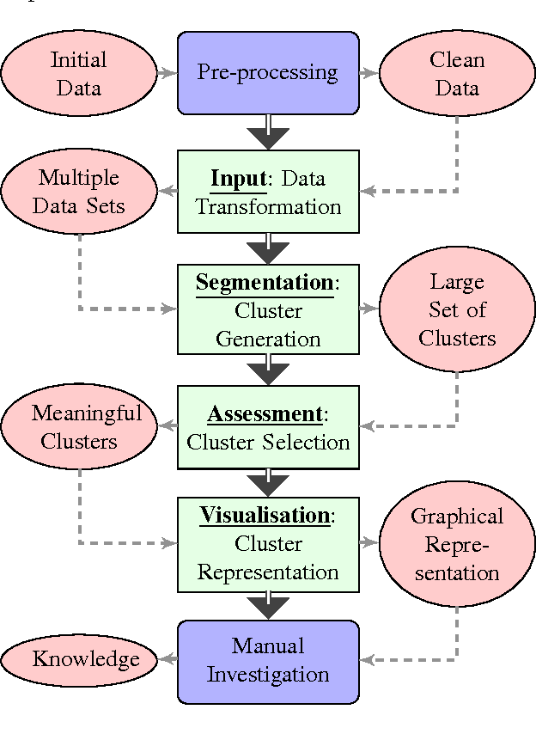
Existing System Block Diagram
10

Slide 11
DRAWBACKS
The drawbacks of existing Customer Segmentation and Energy Services are :
Not Ideal for Regression
Time-delay effect
Limited Accuracy
Complexity and Uncertainty
Instability with Small Changes
11

Slide 12
MODULE DESCRIPTION
Data acquisition:
Allows to gather data from source that further allows to conclude on satisfiable magnitude.
Data preparation:
Involves in cleaning and producing an acceptable data that is forwarded are appropriate.
Model planning:
This module is used for planning the model in a correct way that allows the Standardization, ridge regression(To create and train model to predict).
12

Slide 13
Model training:
This module allow to train model that allows that particular model to produce a numerical value.
User Interface:
This module allow to create a user interface of project using HTML and CSS.
13

Slide 14
PROPOSED BLOCK DIAGRAM
Analysis and Prediction
(Streamlit)
User
GitHub
User Interface
Developer
Data Preprocessing
Model Building
14

Slide 15
ONLINE COURSE DETAILS
Course Name : Data Visualization With Power BI
Platform : Online course
Provider : Great Learning
Status : 15% completed
Level : Intermediate
15
Customer Segmentation & Personalized Energy Services

Slide 16
CONCLUSION
The project was deployed using Streamlit, allowing users to interact with the model and make analysis and predictions on Satisfaction score that customer might wish based on car customer details and energy consumption.
16

Slide 17
REFERENCES
Dimitrios G. Karyampas, George Doukidis, Vasilios Pappas (2015) "Customer Segmentation in Energy Markets: Empirical Evidence from the ResidentialSector“
https://doi.org/10.1016/j.enpol.2015.05.002
Jonn Axsen, Kenneth S. Kurani (2012) "Segmenting the Residential Energy Market: A Study of Consumer Perceptions and Behaviors“
https://doi.org/10.1016/j.enpol.2011.09.055
E. Z. Troncoso, S. A. Morris, M. W. Jenkins, R. A. Shaw (2018) "Personalised Smart Energy Services: A Data-Driven Approach“
https://doi.org/10.1016/j.apenergy.2018.08.050
17

Slide 18
REFERENCES
Javad Barabady, Masoud Rabbani, Mohammad Mahdi Paydar (2015) "Segmentation of residential electricity consumers: A review“
https://doi.org/10.1016/j.rser.2014.12.010
Riccardo Accorsi, Carlo Alberto Nucci (2017) "Customer segmentation of a utility company based on energy consumption data“
https://doi.org/10.1016/j.enbuild.2017.02.065
18

Slide 19
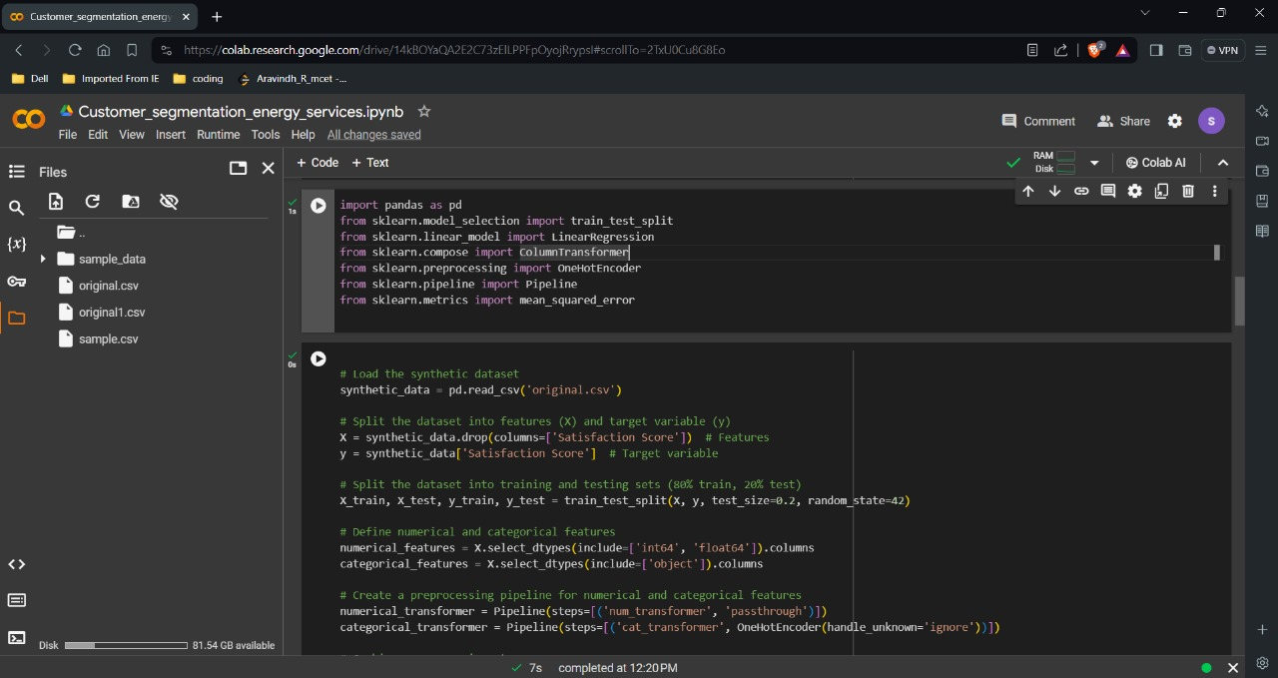
SNAPSHOT

Slide 20
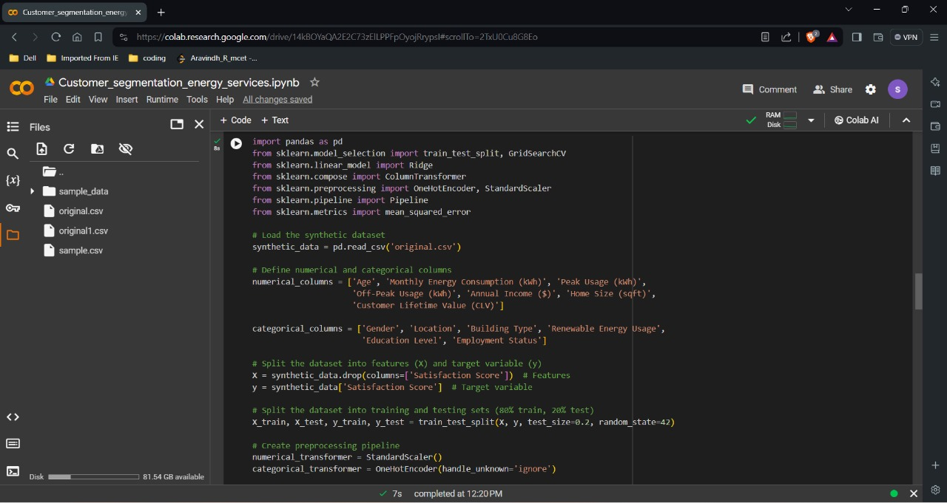
SNAPSHOT

Slide 21
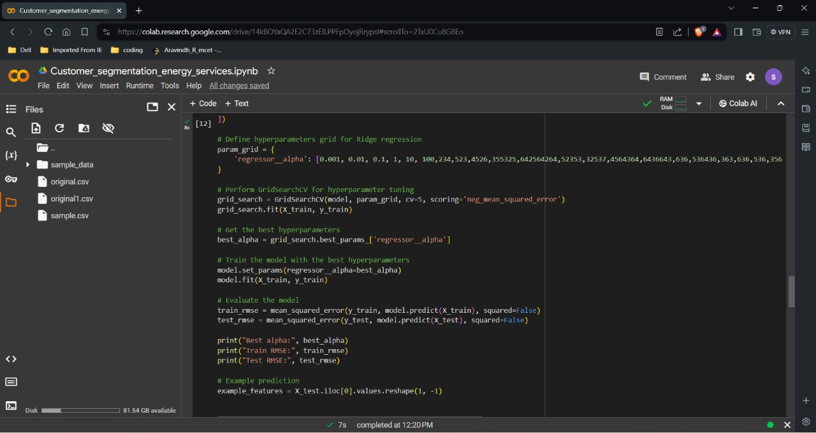
SNAPSHOT

Slide 22
THANK YOU

