Slide 1
Python pygame

Slide 2
TEAM NAME
ABD

Slide 3
TEAM NUMBER
16

Slide 4
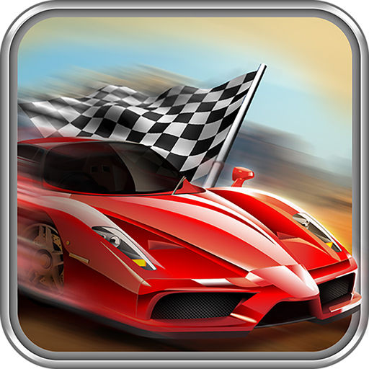
TITLE
Street racing
game

Slide 5
academic Mentor
Mr.Joel Anandraj

Slide 6
INDUSTRY MENTOR

Slide 7
TEAM MEMBERS
Aravindraj sundaramurthi
Balaganapathy . V
Deepa. K

Slide 8
ABSTRACT
The title of the program is street racing . The main objective of the program is car should not be crashed in the highway. We are focusing on developing a 2d street racing game using pygame. This will cover implementation of real time graphics, physical engine, as well as sound effect and background music. It has several levels and score is based on distance and time.

Slide 9
modules
Car moving without crashing.
There will be pause .
After crashing we lose.

Slide 10
requirements
Hardware :
Software :
THONNY

Slide 11
Model program
if event.type == pygame.KEYDOWN:
if event.key == pygame.K_LEFT:
x_change = -5
elif event.key == pygame.K_RIGHT:
x_change = 5
elif event.key == pygame.K_UP:
y_change = -5
elif event.key == pygame.K_DOWN:
y_change = 5
elif event.key==pygame.K_p:
pause=True
paused()
if event.type == pygame.KEYUP:
if event.key == pygame.K_LEFT or event.key == pygame.K_RIGHT or event.key == pygame.K_UP or event.key == pygame.K_DOWN:
x_change=0 y_change=0 x+=x_change y+=y_change

Slide 12
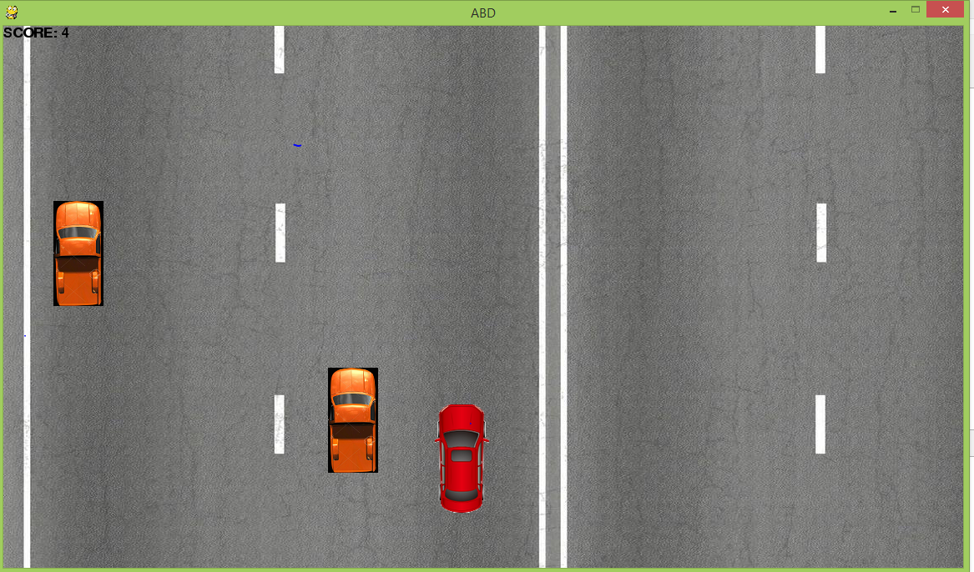
pygame

Slide 13
THANK YOU

