Slide 1
Honors Track: Competitive Programming & Problem Solving Tree Isomorphism
Pantea Haghighatkhah

Slide 2
Isomorphism
What does isomorphism mean in graphs?
What are isomorphic graphs?
Exactly similar but their nodes ha been moved around.

Slide 3
Isomorphism
Other examples

Slide 4

Isomorphism in trees
Isomorphism for general graphs:
Takes too much time
Hard to compute
Isomorphism in trees:
Takes linear time to check
Easier to compute
We focus on tree isomorphism.

Slide 5


Isomorphism in trees
The definition of isomorphism for trees = definition of isomorphism for general graphs.

Slide 6
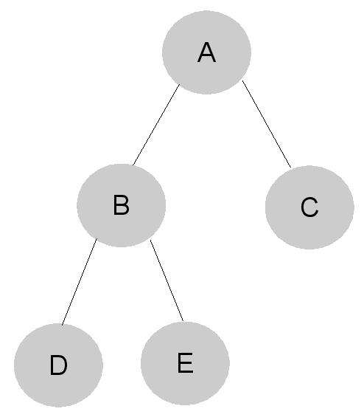
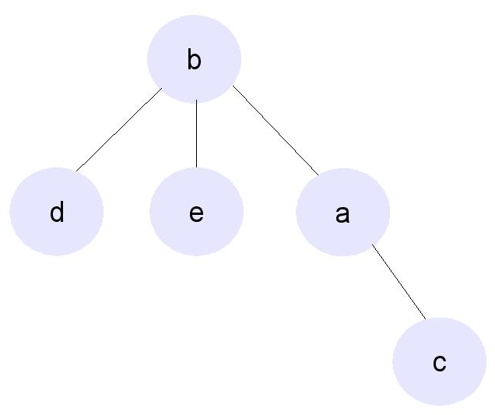

Isomorphism
Definition:
Isomorphism of graphs $G1(E1,V1)$ and $G2(E2,V2)$ is a bijection between the vertex sets $V1$and $V2$ $φ:V1→V2$ such that
$$∀ u,v∈V1 \left(u,v \right)∈E1⇔(φ\left(u\right),φ(v))∈E2$$
But how to check if two arbitrary graphs are isomorphic?

Slide 7

Takes Too Long

Slide 8
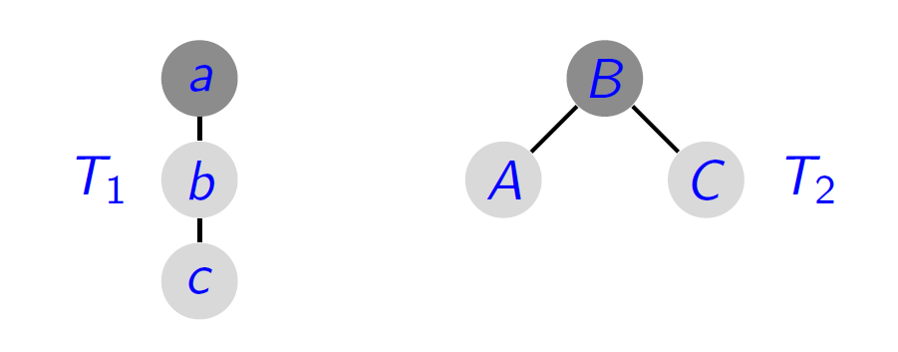
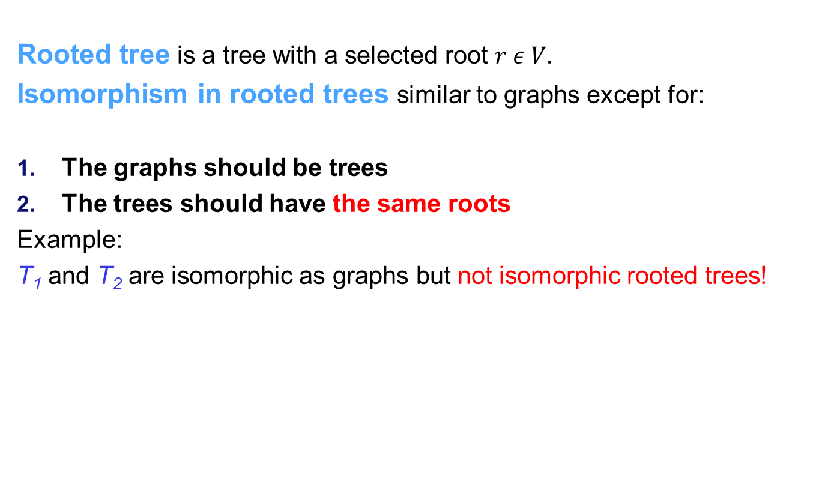
Rooted Trees
Rooted tree is a tree with a selected root $r ε V.$
Isomorphism in rooted trees similar to graphs except for:
The graphs should be trees
The trees should have the same roots
Example:
T₁ and T₂ are isomorphic as graphs but not isomorphic rooted trees!

Slide 9
Rooted Trees
Choosing the root(s) for your trees
The center of the two trees is the root.
How to find the middle node(s) of a tree?
Run DFS twice to find the diameter of your tree.
Take the middle node(s) of the diametrical path to be your root.

Slide 10
Rooted trees
Keep in mind
Trees have either 1 center (Centered tree) or 2 centers (bicentered tree)
Diametrical path with even length

Slide 11
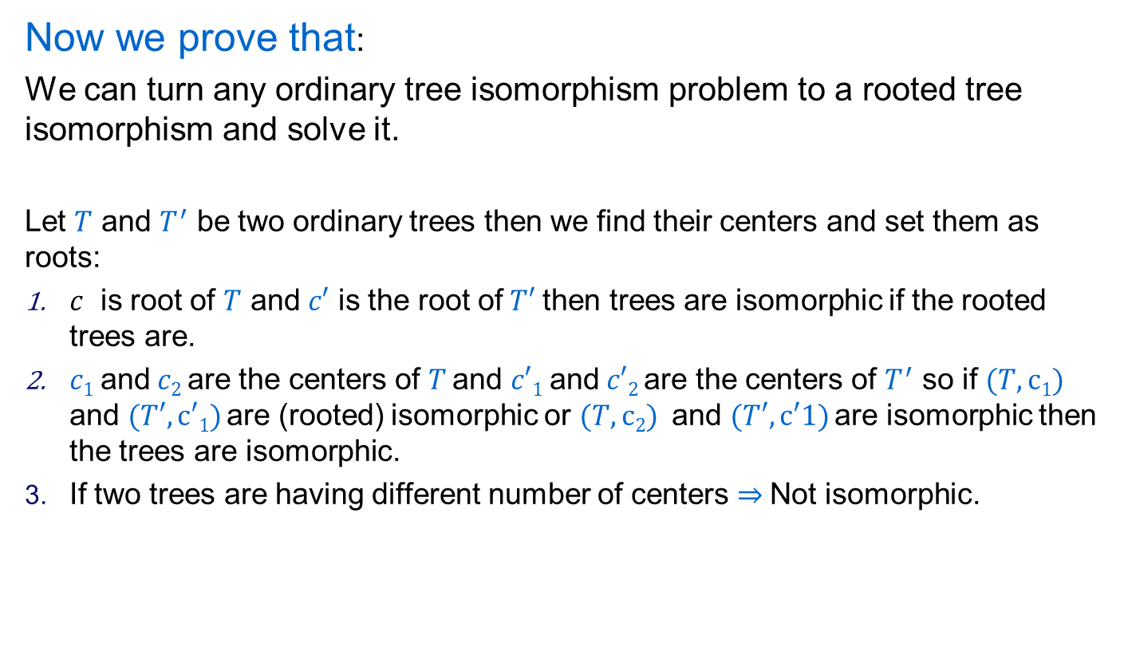
Rooted trees
Now we prove that:
We can turn any ordinary tree isomorphism problem to a rooted tree isomorphism and solve it.
Let $T$ and $T^{′}$ be two ordinary trees then we find their centers and set them as roots:
$c$ is root of $T$ and $c′$ is the root of$T′$ then trees are isomorphic if the rooted trees are.
$c1$and$c2$ are the centers of $T$ and $c′1$and$c′2$ are the centers of $T^{′}$ so if $(T,c1)$ and $(T′,c′1)$ are (rooted) isomorphic or $(T,c2)$ and $(T′,c′1)$ are isomorphic then the trees are isomorphic.
If two trees are having different number of centers $⇒$Not isomorphic.

Slide 12
ATTENTION
From now on
TREE
ROOTED TREE

Slide 13

Finding a solution
Let’s try to find an invariant $f(T)$for isomorphism such that
$f(T1) =f(T2)$for all pairs of isomorphic trees $T1$ and $T2$
In other words $T1$ and $T2$ are isomorphic iff $f(T1) =f(T2)$
Once we have an invariant we can build an algorithm on it.

Slide 14
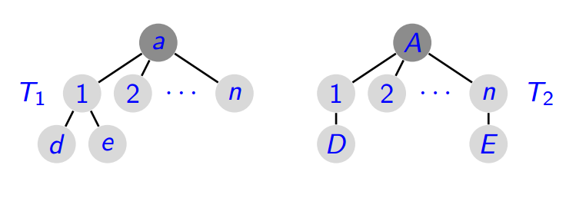
Finding a solution
Idea #1:
The number of levels and vertices are tree isomorphism invariant.
Conjecture
Two trees are isomorphic iff they have the same number of levels and the same number of vertices on each level.
Counter example:

Slide 15
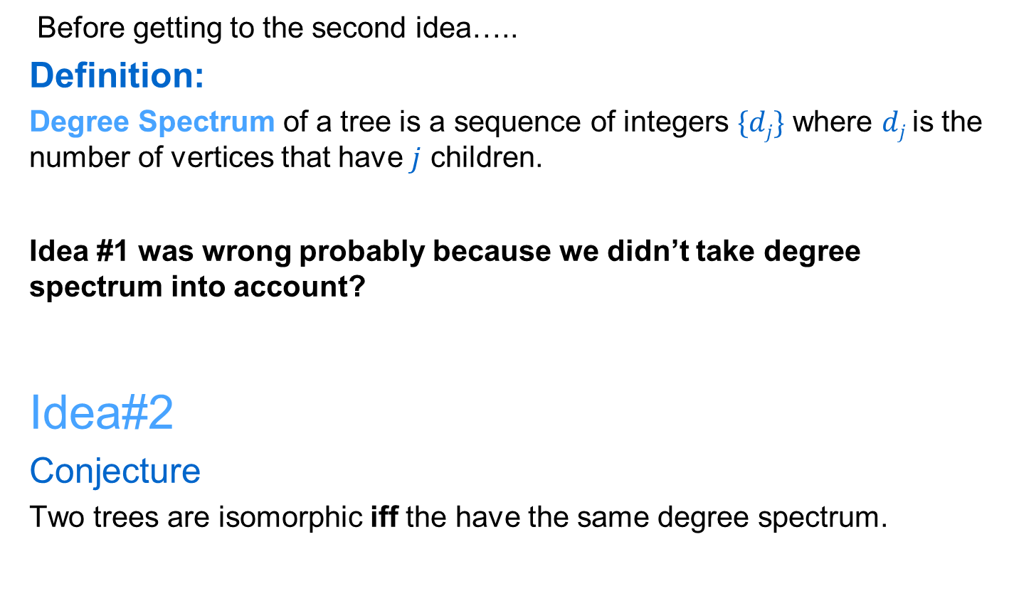
Finding a solution
Before getting to the second idea…..
Definition:
Degree Spectrum of a tree is a sequence of integers $\{dj\}$ where $dj$ is the number of vertices that have $j$ children.
Idea #1 was wrong probably because we didn’t take degree spectrum into account?
Idea#2
Conjecture
Two trees are isomorphic iff the have the same degree spectrum.

Slide 16
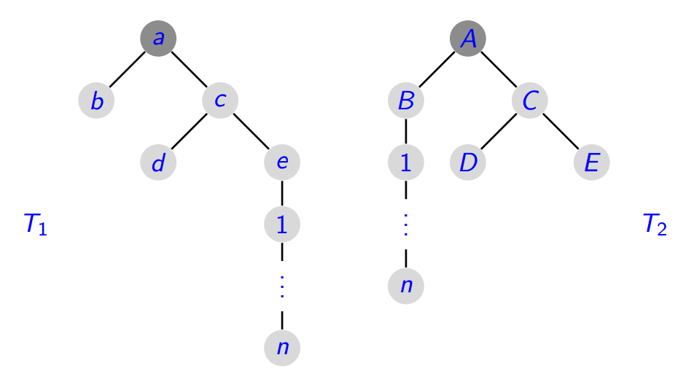
Finding a solution
Counter example:
Degree of spectrum is the same in both trees but they are not isomorphic

Slide 17
Finding a solution
Idea #3
Conjecture
Two trees are isomorphic iff they have the same degree of spectrum at each level.
If two trees have the same degree spectrum at each level:
the same number of levels
the same number of vertices at each level
the same global degree spectrum

Slide 18
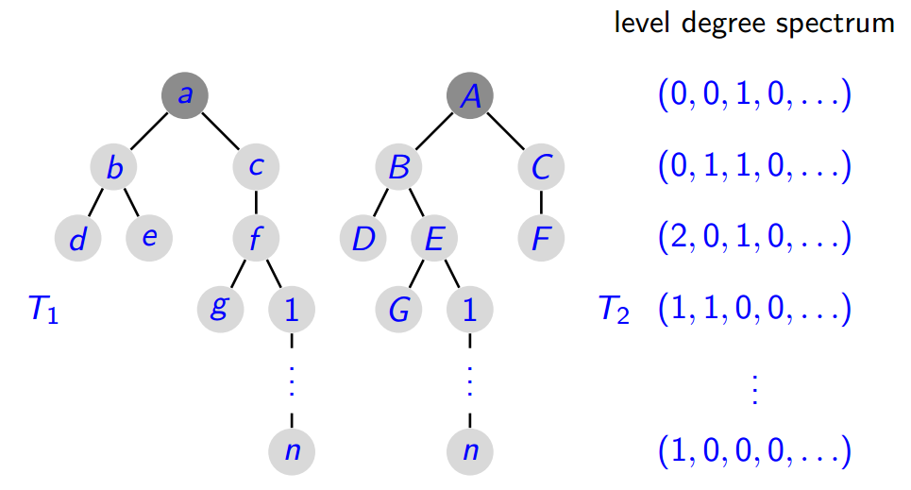
Finding a solution
Counter example:
The degree of spectrum is the same in each level but trees are not isomorphic

Slide 19
Finding a solution
Disappointed?
Sad?
Do you want to cry?
I found the solution for you….
AHA…!
AHU

Slide 20
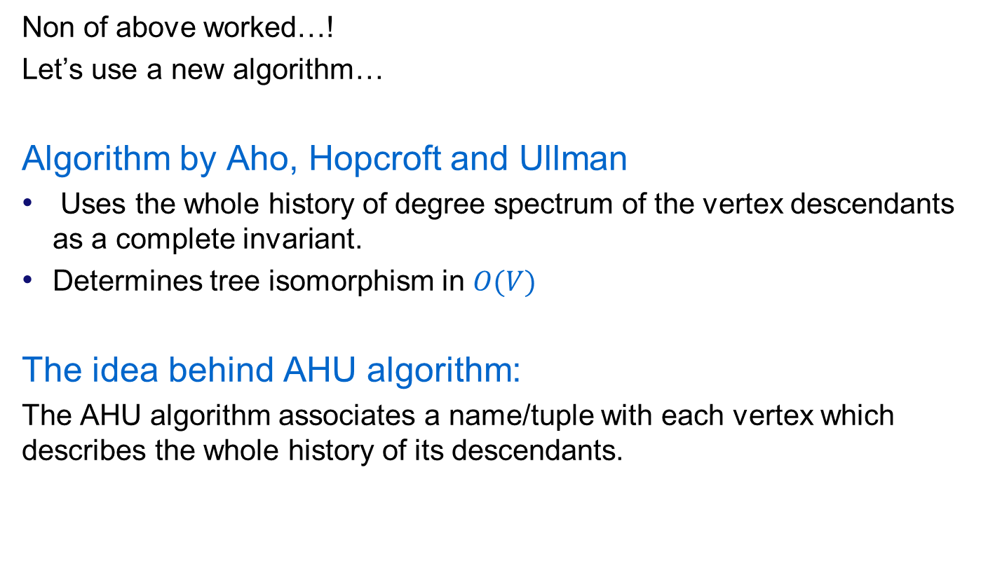
AHU (Aho, Hopcroft, Ullman)
Non of above worked…!
Let’s use a new algorithm…
Algorithm by Aho, Hopcroft and Ullman
Uses the whole history of degree spectrum of the vertex descendants as a complete invariant.
Determines tree isomorphism in $O(V)$
The idea behind AHU algorithm:
The AHU algorithm associates a name/tuple with each vertex which describes the whole history of its descendants.

Slide 21
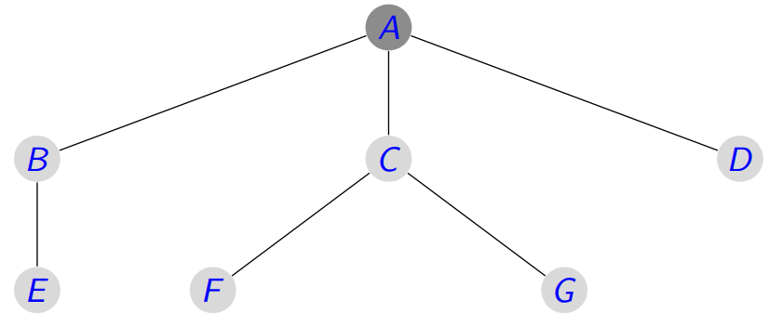
Understanding AHU algorithm
Knuth tuples
Assign parenthetical tuples to all vertices.
Example:

Slide 22
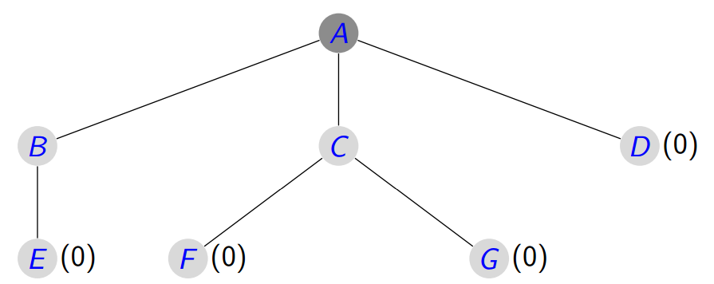
Understanding AHU algorithm
Knuth tuples
Assign parenthetical tuples to all vertices.
Example:

Slide 23
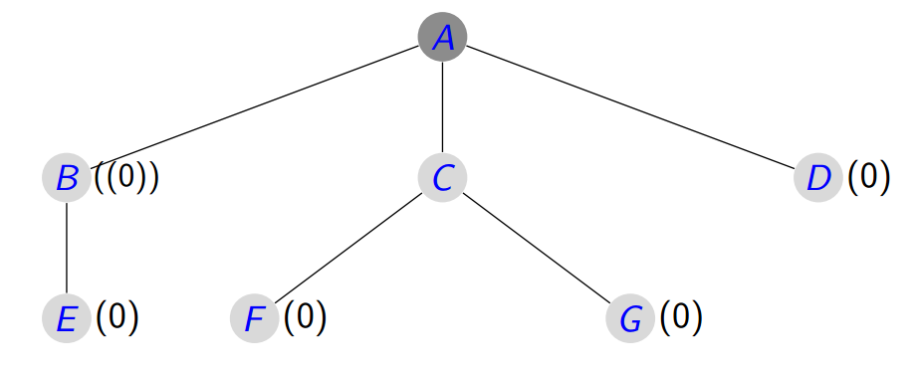
Understanding AHU algorithm
Knuth tuples
Assign parenthetical tuples to all vertices.
Example:

Slide 24
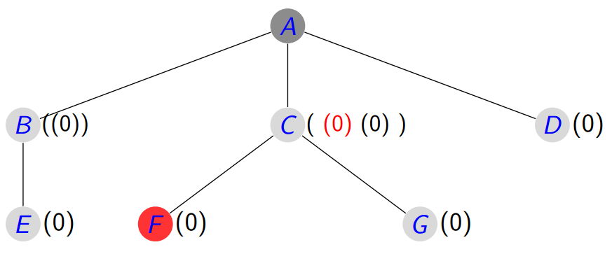
Understanding AHU algorithm
Knuth tuples
Assign parenthetical tuples to all vertices.
Example:

Slide 25
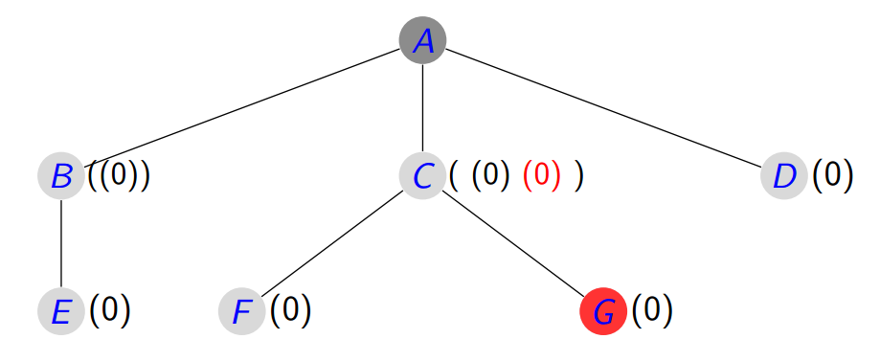
Understanding AHU algorithm
Knuth tuples
Assign parenthetical tuples to all vertices.
Example:

Slide 26
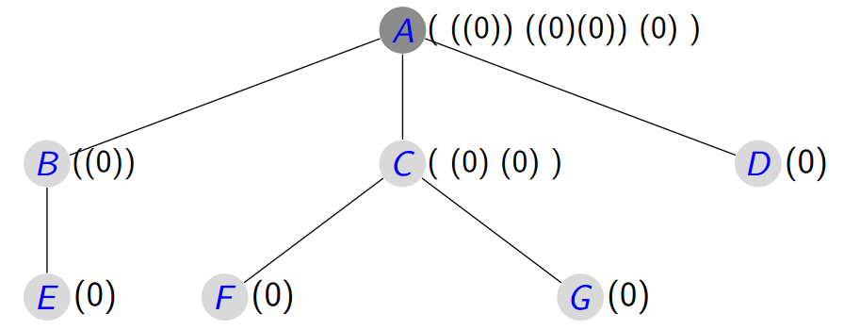
Understanding AHU algorithm
Knuth tuples
Assign parenthetical tuples to all vertices.
Example:

Slide 27
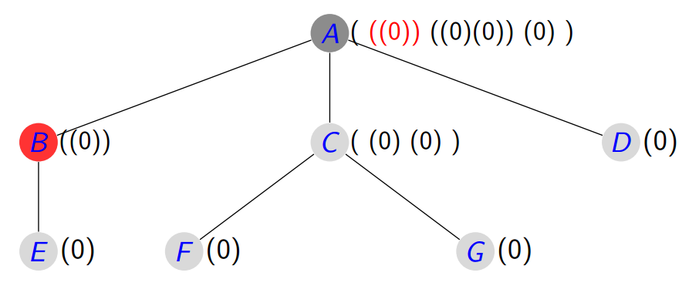
Understanding AHU algorithm
Knuth tuples
Assign parenthetical tuples to all vertices.
Example:

Slide 28
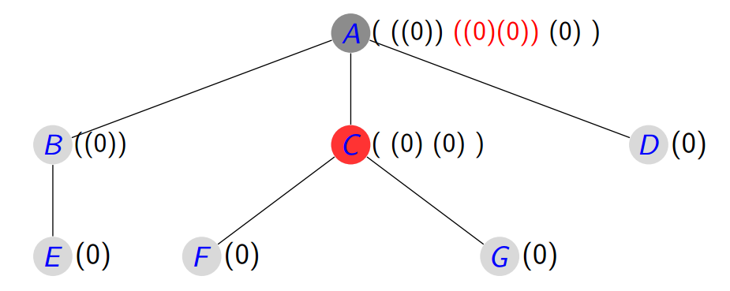
Understanding AHU algorithm
Knuth tuples
Assign parenthetical tuples to all vertices.
Example:

Slide 29
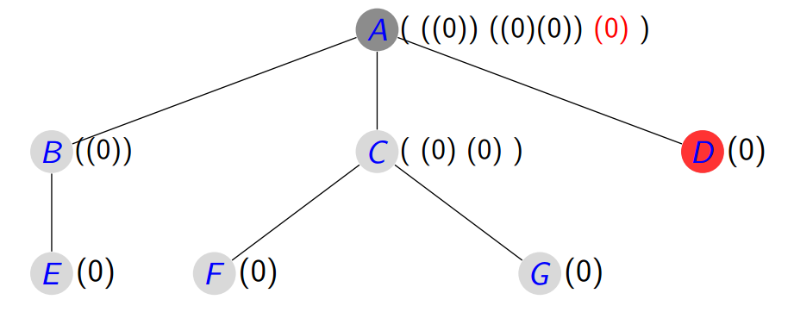
Understanding AHU algorithm
Knuth tuples
Assign parenthetical tuples to all vertices.
Example:

Slide 30
Understanding AHU algorithm
Pseudocode for assigning knuth tuples
.
Assign_Knuth-Tuples(v)
1: if v is a leaf then
2: Give v the tuple name (0)
3: else
4: for every child w of v do
5: Assign_Knuth-Tuples(w)
6: end for
7: end if
8: Concatenate the names of all children of v and name it t
9: Set t as tuple name of v

Slide 31
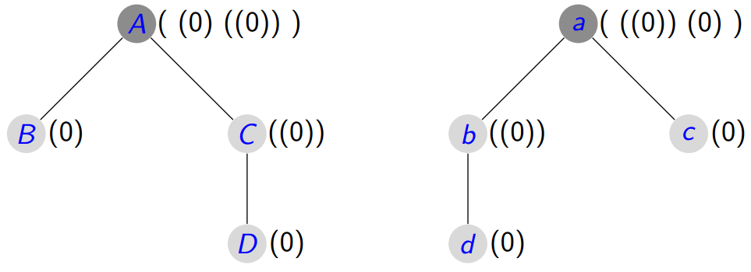
Understanding AHU algorithm
*Parenthetical tuples do not have orders
Example:
We’ll use canonical names jut because we would like to have orders so that in this case the root A and a have the same canonical name.

Slide 32
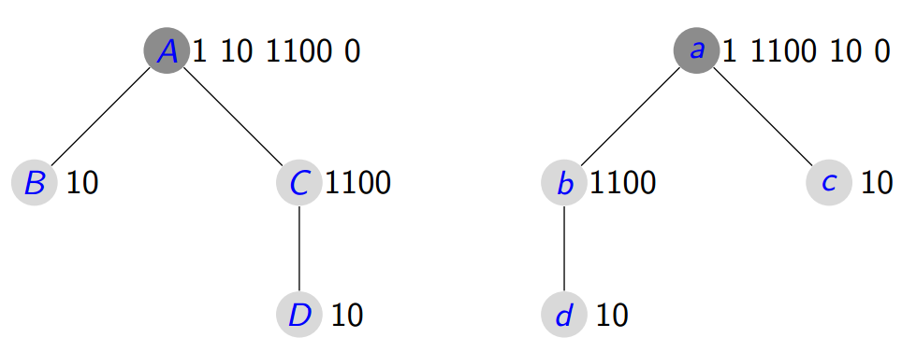
Understanding AHU algorithm
*Parenthetical tuples do not have orders
Example:
We’ll use canonical names jut because we would like to have orders so that in this case the root A and a have the same canonical name.

Slide 33
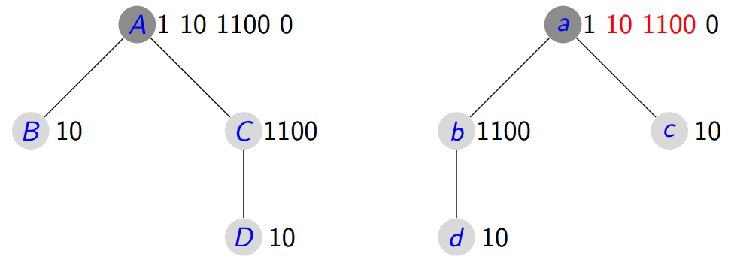
Understanding AHU algorithm
*Parenthetical tuples do not have orders
Example:
We’ll use canonical names jut because we would like to have orders so that in this case the root A and a have the same canonical name.

Slide 34
Understanding AHU algorithm
Canonical names:
Dropping all the “0”-s and replacing “(“ and “)” with “1” and “0” respectively.
Assign_Canonical-Names(v)
1: if v is a leaf then
2: Give v the tuple name “1”
3: else
4: for every child w of v do
5: Assign_Knuth-Tuples(w)
6: end for
7: end if
8: Concatenate the names of all children of v and name it t
9: Set 1t0 as tuple name of v

Slide 35
Faster Ways
Canonical names can get pretty huge pretty fast.
Solution to it is to use hashing:
Assign_Names(v)
1: Let c be 0
2: Let hm be a HashMap hashing array(lists)s to integers
1: if v is a leaf then
2: Give v the tuple name 0 and return
3: else
4: for every child w of v do
5: Assign_Name(w)
6: end for
7: end if
8: let array A consist of names of children of v

Slide 36
9: radix sort A
10: if the A is not in hm it
11: then hm.put(A, ++c)
12: v.name = hm.get(A)

Slide 37
Tree isomorphism
Find_Centers(v)
1: run DFS(v)
2: let n be the furthest node from v and run DFS(n)
3: let m be the furthest node from n
4: return array of median node(s) in the path from n to m
Tree_Isomorphism(r, s)
1: put result of Find_Centers(r) in A
2: put result of Find_Centers(s) in B
3: if A and B both have length 1
4: then do Assign_Names(A[0]) and Assign_Names(B[0])
5: if name of A[0] is the same as name of B[0]
6: then return true

Slide 38
Tree Isomorphism
7: if A and B both have length 2
8: then do Assign_Names(A[0]) and Assign_Names(B[0])
9: if name of A[0] is the same as name of B[0]
10: then return true
11: else do Assign_Names(A[1]) and Assign_Names(B[0])
12: if name of A[1] is the same as name of B[0]
13: then return true
14:return false

Slide 39
More…
Same size tree isomorphism
Subtree isomorphism
Reduce and simplify your tree

Slide 40

Question

