Slide 1
Square Root Decomposition and Mo’s Algorithm

Slide 2
Applicable problems - characteristics
Involve many queries of the same object
We have a linear solution for each query, but this is too slow
Operations on a range of indexes in an array
Mo’s algorithm – ordering of queries is not important and can be stored

Slide 3
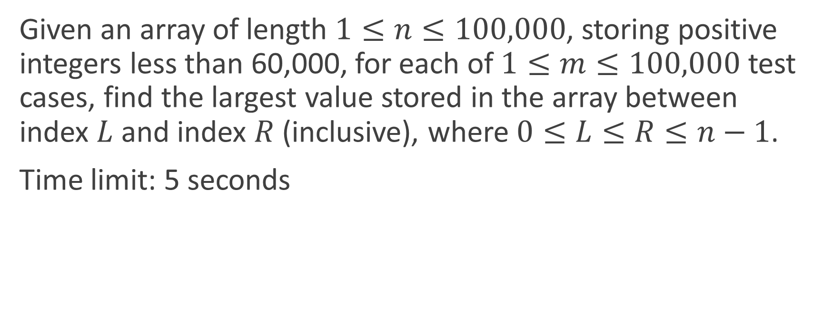
Example problem
Given an array of length $1≤n≤100,000$, storing positive integers less than 60,000, for each of $1≤m≤100,000$ test cases, find the largest value stored in the array between index $L$ and index $R$ (inclusive), where $0≤L≤R≤n−1$.
Time limit: 5 seconds

Slide 4
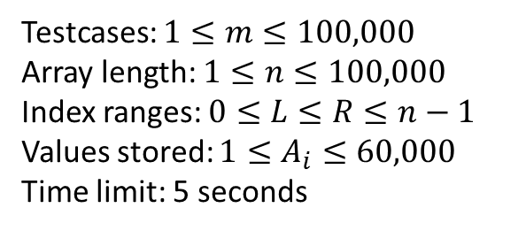
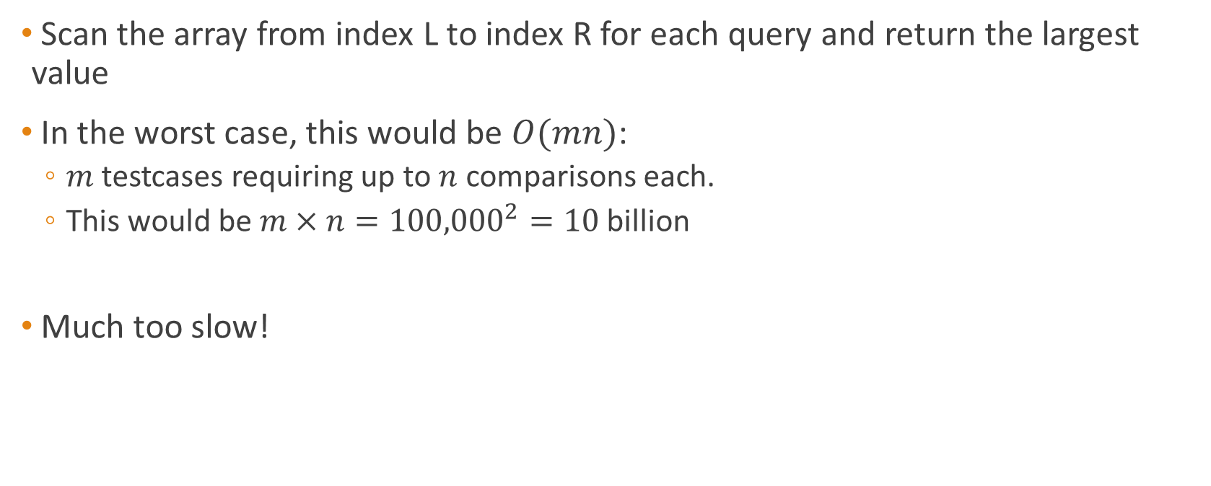
Analysis of naïve solution
Scan the array from index L to index R for each query and return the largest value
In the worst case, this would be $O(mn)$:
$m$ testcases requiring up to $n$ comparisons each.
This would be $m×n={100,000}^{2}=10$ billion
Much too slow!
Testcases: $1≤m≤100,000$
Array length: $1≤n≤100,000$
Index ranges: $0≤L≤R≤n−1$
Values stored: $1≤A_{i}≤60,000$
Time limit: 5 seconds

Slide 5
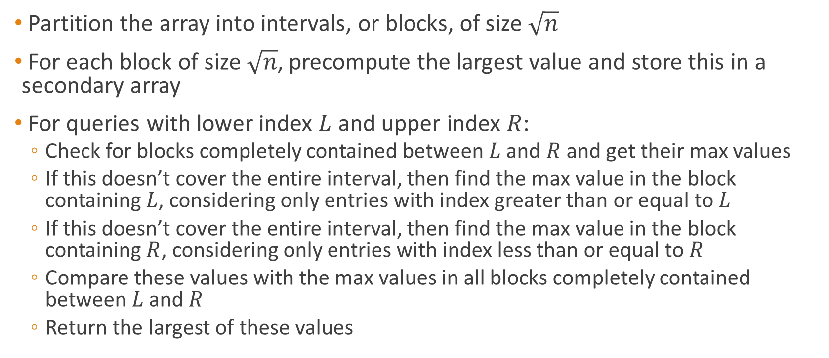
Square root decomposition idea
Partition the array into intervals, or blocks, of size $\sqrt{n}$
For each block of size $\sqrt{n}$, precompute the largest value and store this in a secondary array
For queries with lower index $L$ and upper index $R$:
Check for blocks completely contained between $L$ and $R$ and get their max values
If this doesn’t cover the entire interval, then find the max value in the block containing $L$, considering only entries with index greater than or equal to $L$
If this doesn’t cover the entire interval, then find the max value in the block containing $R$, considering only entries with index less than or equal to $R$
Compare these values with the max values in all blocks completely contained between $L$ and $R$
Return the largest of these values

Slide 6


0 1 2 3 4 5 6 7 8 9 10 11 12 13 14 15
$$a$$
10
3
17
4
5
9
10
3
24
8
11
6
7
1
21
22
0 1 2 3
$$b$$
17
10
24
22
Queries:
2,9
4,7
9,13
0,15
Answers:
24
10
11
24

Slide 7
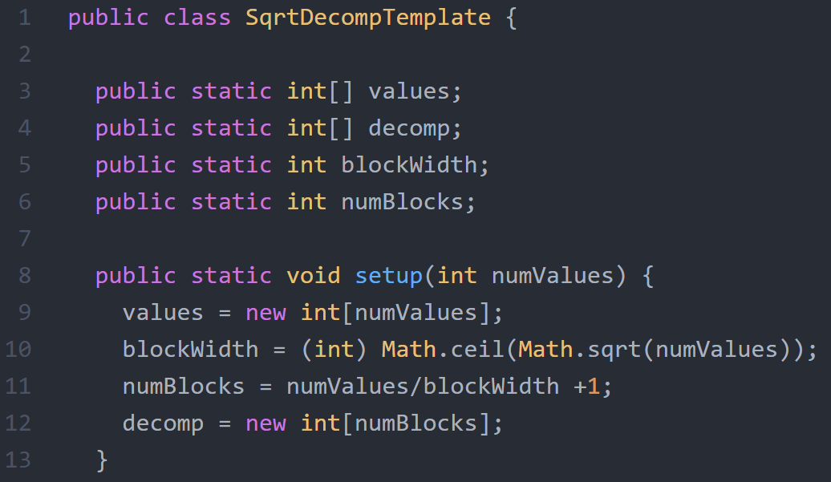
values[] is the array storing all entries of information to be processed
decomp[] is the array that will store the answers to queries over entire blocks

Slide 8
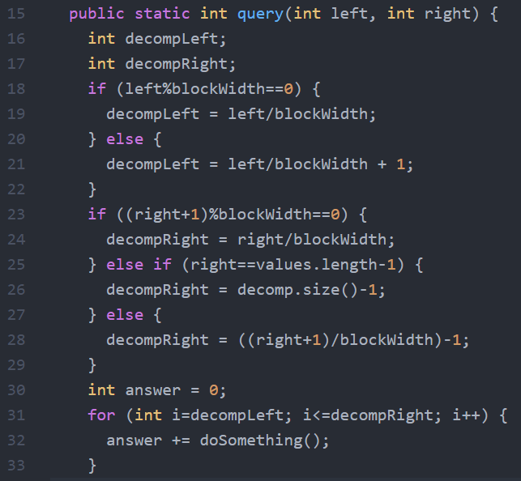
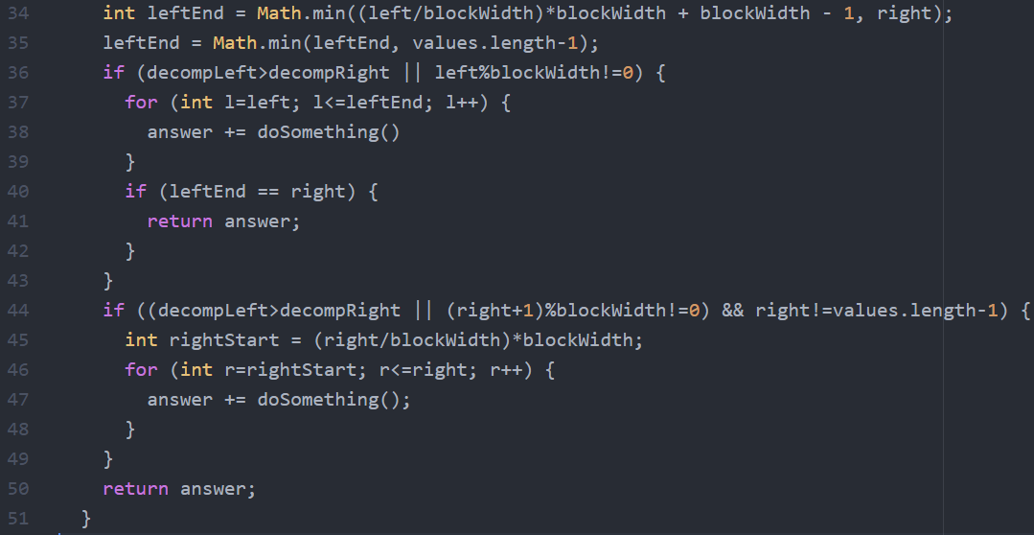

Slide 9
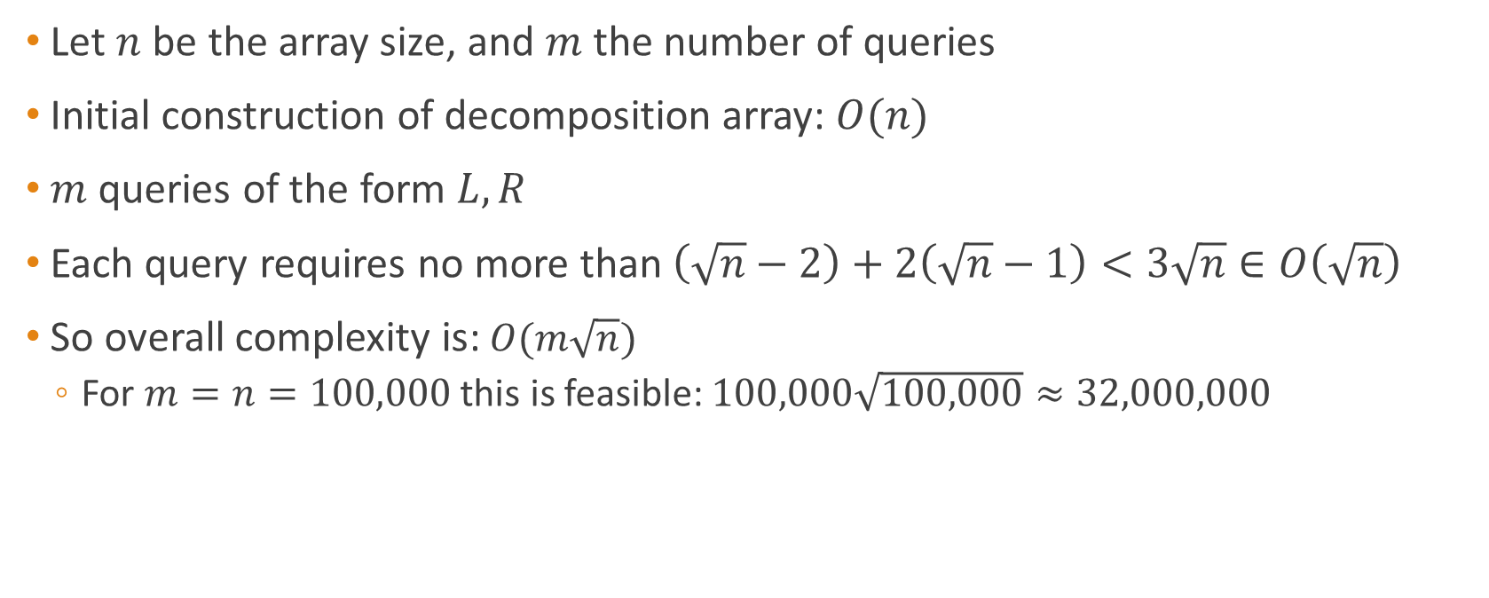
Complexity Analysis
Let $n$ be the array size, and $m$ the number of queries
Initial construction of decomposition array: $O(n)$
$m$ queries of the form $L,R$
Each query requires no more than $\left(\sqrt{n}−2\right)+2\left(\sqrt{n}−1\right)<3\sqrt{n}∈O\left(\sqrt{n}\right)$
So overall complexity is: $O(m\sqrt{n})$
For $m=n=100,000$ this is feasible: $100,000\sqrt{100,000}≈32,000,000$

Slide 10
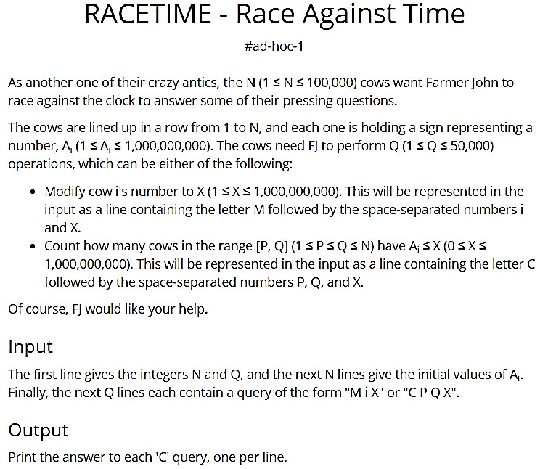

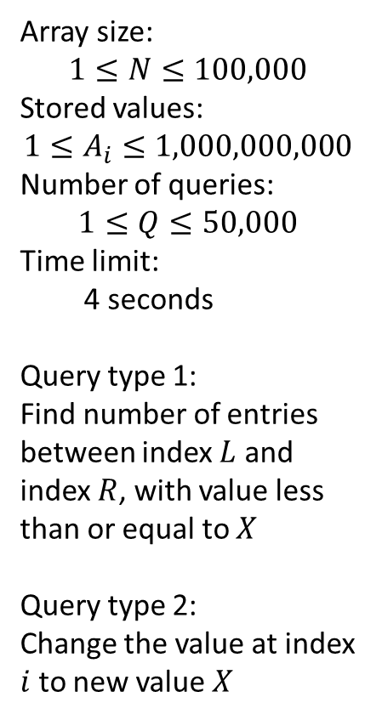
http://www.spoj.com/problems/RACETIME/
Array size:
$$1≤N≤100,000$$
Stored values:
$$1≤A_{i}≤1,000,000,000$$
Number of queries:
$$1≤Q≤50,000$$
Time limit:
4 seconds
Query type 1:
Find number of entries between index $L$ and index $R$, with value less than or equal to $X$
Query type 2:
Change the value at index $i$ to new value $X$

Slide 11

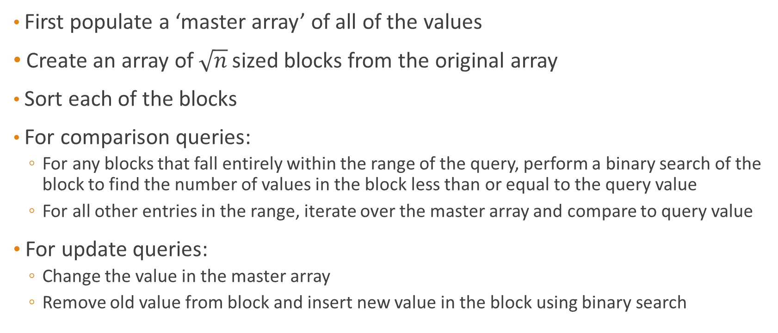
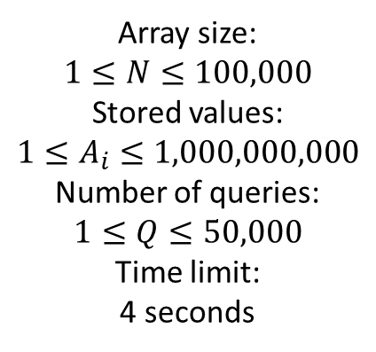

Solution idea:
Array size:
$$1≤N≤100,000$$
Stored values:
$$1≤A_{i}≤1,000,000,000$$
Number of queries:
$$1≤Q≤50,000$$
Time limit:
4 seconds
First populate a ‘master array’ of all of the values
Create an array of $\sqrt{n}$ sized blocks from the original array
Sort each of the blocks
For comparison queries:
For any blocks that fall entirely within the range of the query, perform a binary search of the block to find the number of values in the block less than or equal to the query value
For all other entries in the range, iterate over the master array and compare to query value
For update queries:
Change the value in the master array
Remove old value from block and insert new value in the block using binary search
$$O(log⁡(n)\sqrt{n})$$
$$O(\log\left(n\right))$$

Slide 12
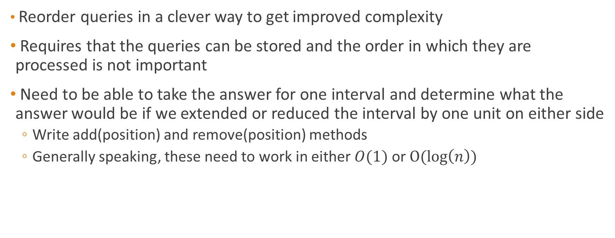
Mo’s Algorithm
Reorder queries in a clever way to get improved complexity
Requires that the queries can be stored and the order in which they are processed is not important
Need to be able to take the answer for one interval and determine what the answer would be if we extended or reduced the interval by one unit on either side
Write add(position) and remove(position) methods
Generally speaking, these need to work in either $O(1)$ or $O(\log\left(n\right))$

Slide 13
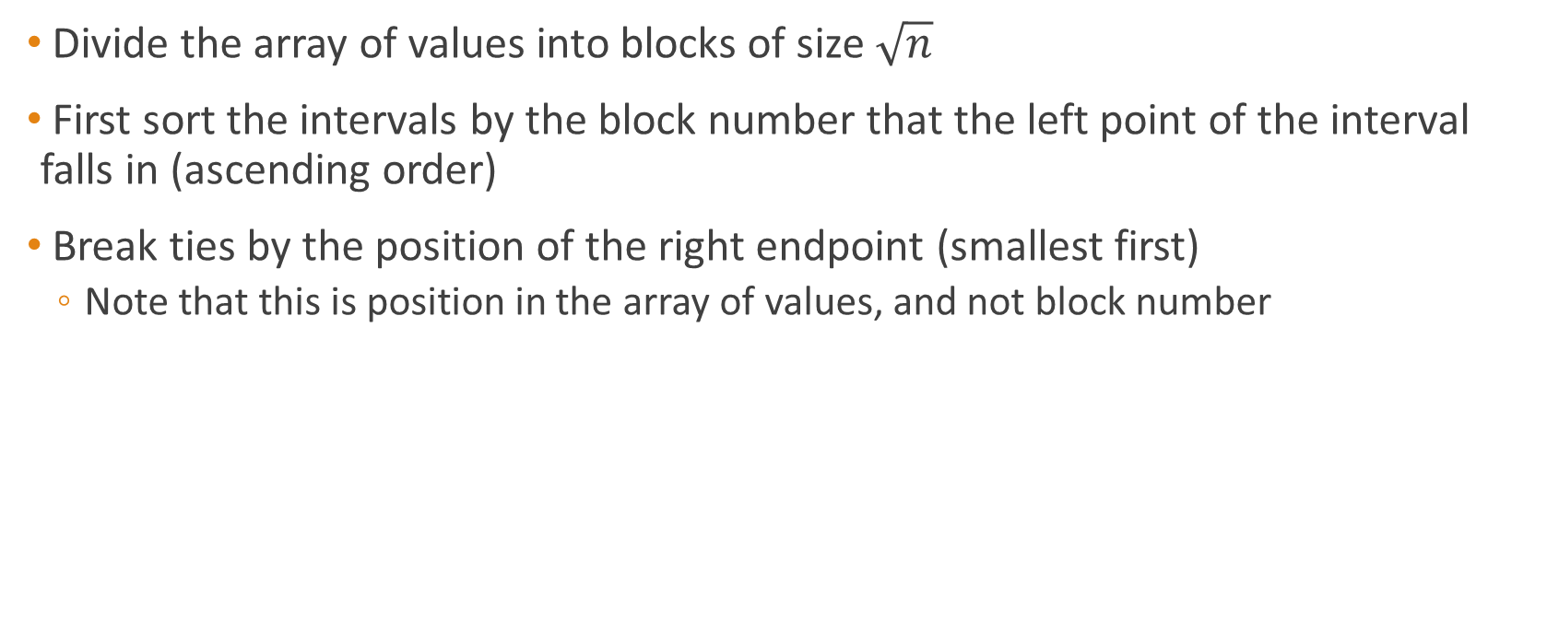
Query ordering
Divide the array of values into blocks of size $\sqrt{n}$
First sort the intervals by the block number that the left point of the interval falls in (ascending order)
Break ties by the position of the right endpoint (smallest first)
Note that this is position in the array of values, and not block number

Slide 14
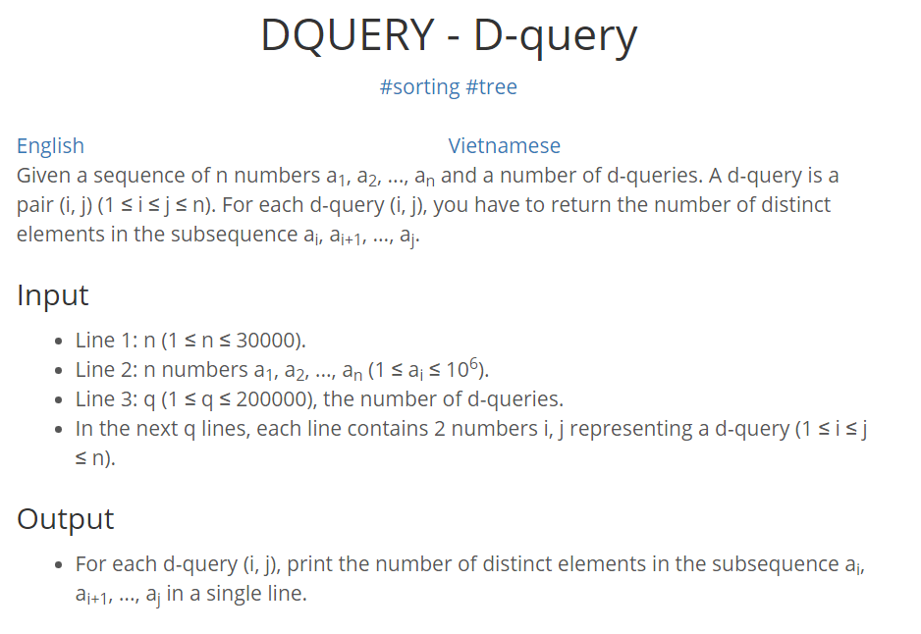
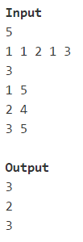
http://www.spoj.com/problems/DQUERY/

Slide 15
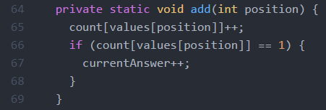
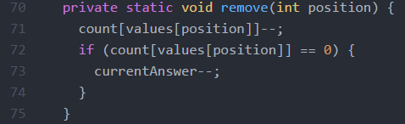
Constructing the add and remove methods
values[] is the array that we are working with
count[] is an array storing the frequency of each possible number
Adding a position to the interval can only increase the number of distinct elements. So if we increased the count of an element from 0 to 1, increment the current answer.
Removing a position from the interval can only decrease the number of distinct elements. So if we decreased the count of an element from 1 to 0, decrement the current answer.

Slide 16
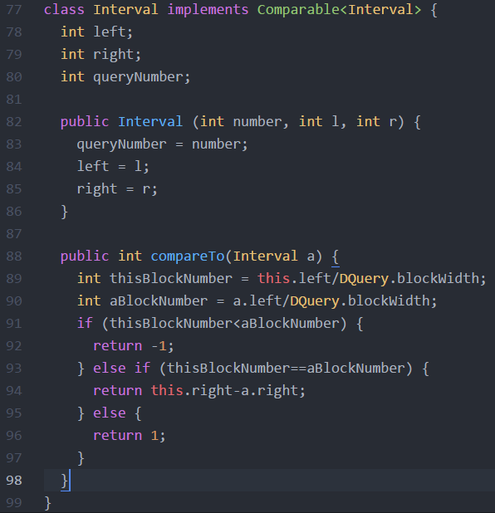
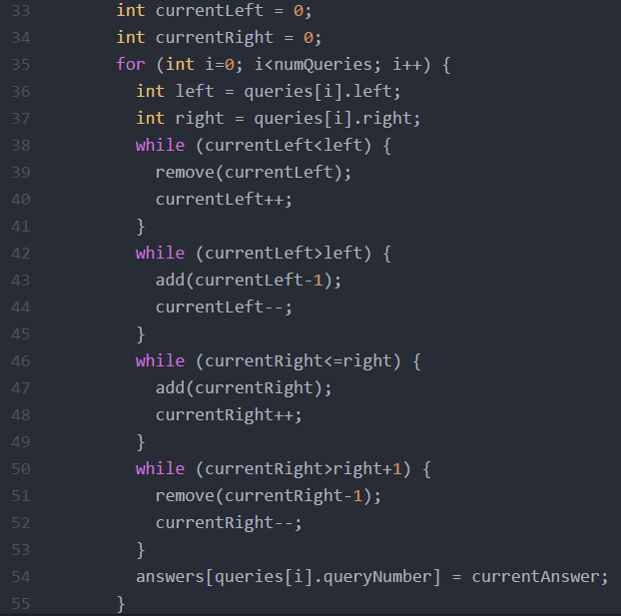
queries[] is an array of ordered Interval objects

Slide 17
Query ordering
Divide the array of values into blocks of size $\sqrt{n}$
First sort the intervals by the block number that the left point of the interval falls in (ascending order)
Break ties by the position of the right endpoint (smallest first)
Note that this is position in the array of values, and not block number

Slide 18
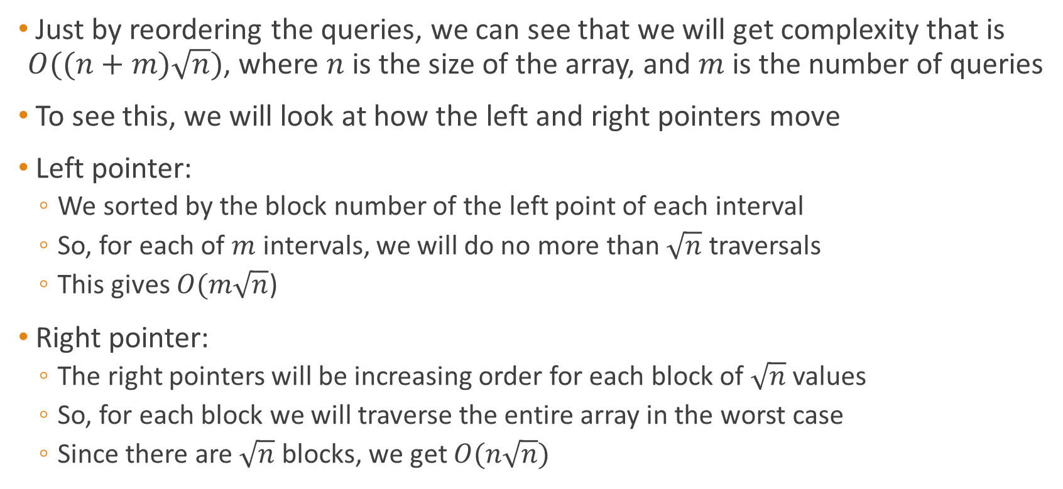
Complexity Analysis
Just by reordering the queries, we can see that we will get complexity that is $O((n+m)\sqrt{n})$, where $n$ is the size of the array, and $m$ is the number of queries
To see this, we will look at how the left and right pointers move
Left pointer:
We sorted by the block number of the left point of each interval
So, for each of $m$ intervals, we will do no more than $\sqrt{n}$ traversals
This gives $O(m\sqrt{n}$)
Right pointer:
The right pointers will be increasing order for each block of $\sqrt{n}$ values
So, for each block we will traverse the entire array in the worst case
Since there are $\sqrt{n}$ blocks, we get $O(n\sqrt{n})$

Slide 19
Other Mo’s algorithm example problems
http://codeforces.com/contest/86/problem/D - “Powerful array”
https://www.codechef.com/MARCH14/problems/GERALD07 – Mo’s algorithm on a graph
https://open.kattis.com/problems/worstweather - “Worst Weather,” possible, but too slow
Main source for Mo’s algorithm explanation:
http://blog.anudeep2011.com/mos-algorithm/

