Slide 1
Select Topics in Computational Geometry
Comp4951 – Advanced Problem Solving
Finn Lidbetter

Slide 2
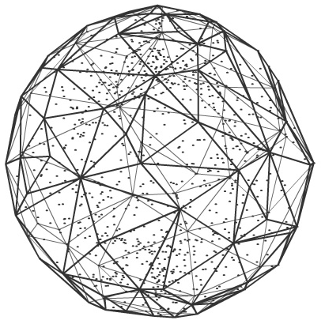
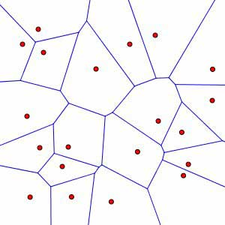
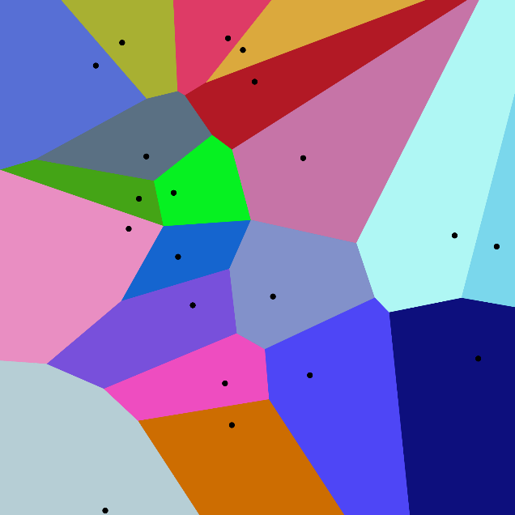
Outline
3D convex hull
Volumes of 3D convex polyhedra
Intersection of lines
Intersection of halfplanes
Voronoi diagrams

Slide 3
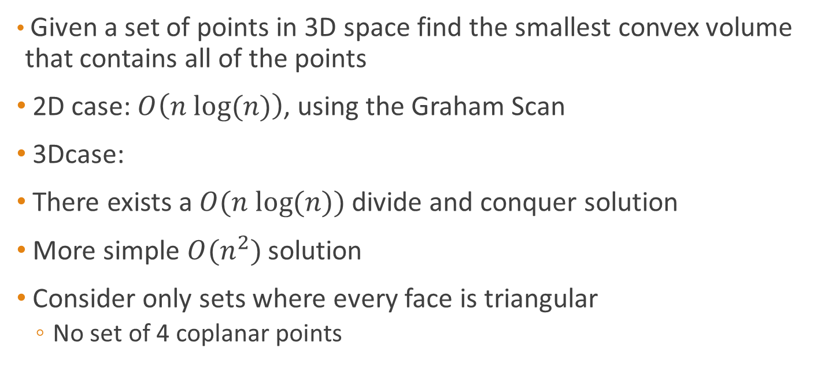
3D Convex Hull
Given a set of points in 3D space find the smallest convex volume that contains all of the points
2D case: $O\left(n log⁡(n)\right)$, using the Graham Scan
3Dcase:
There exists a $O(n log⁡(n))$ divide and conquer solution
More simple $O(n^{2})$ solution
Consider only sets where every face is triangular
No set of 4 coplanar points

Slide 4
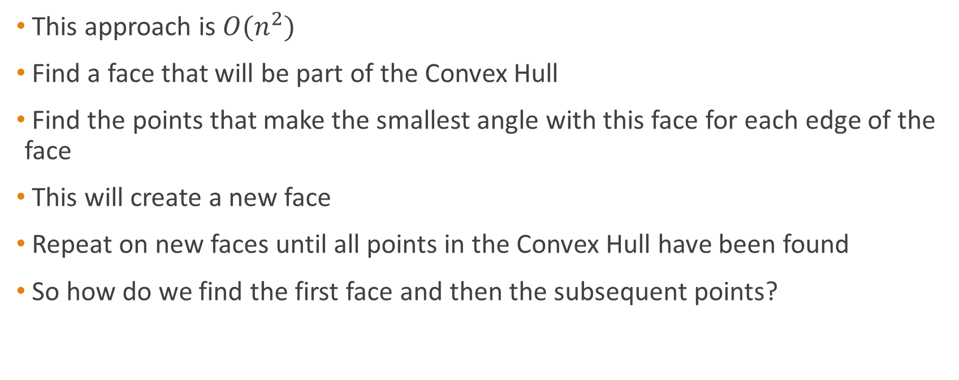
3D Convex Hull Approach
This approach is $O(n^{2})$
Find a face that will be part of the Convex Hull
Find the points that make the smallest angle with this face for each edge of the face
This will create a new face
Repeat on new faces until all points in the Convex Hull have been found
So how do we find the first face and then the subsequent points?

Slide 5
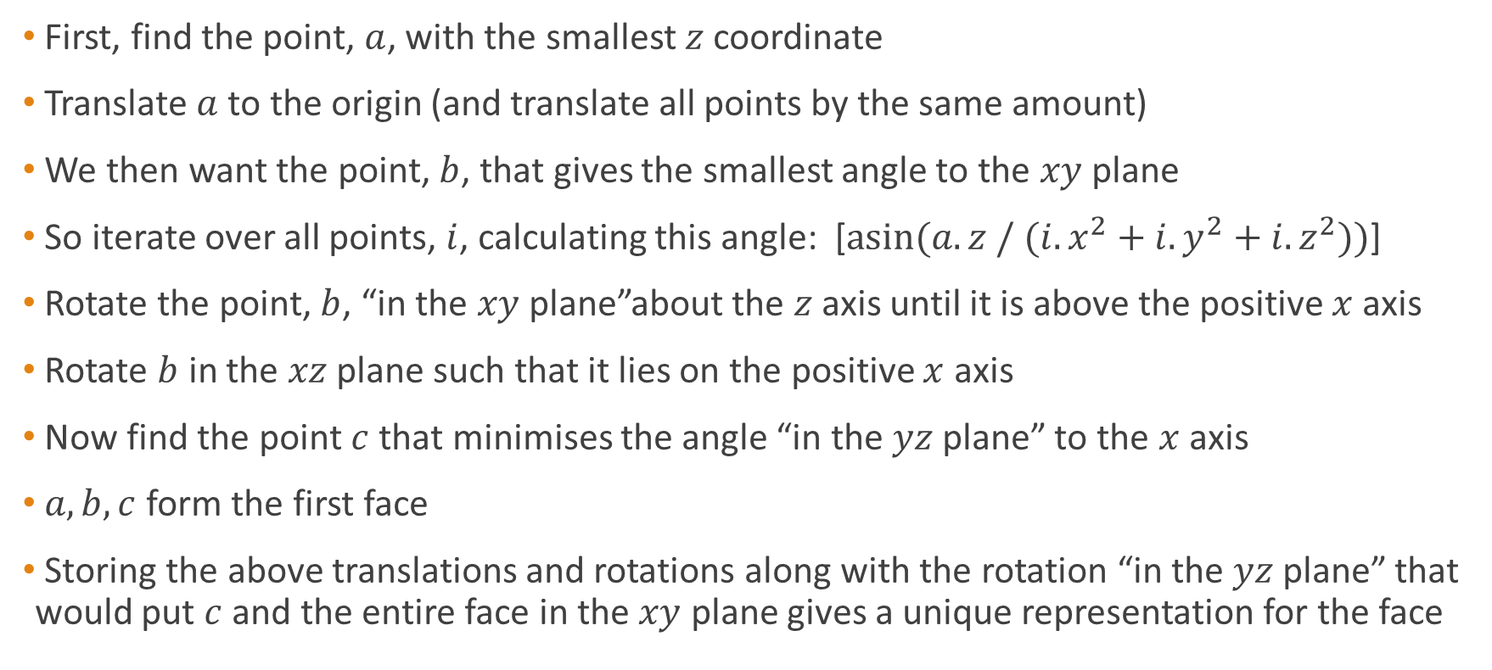
3D Convex Hull – The first face
First, find the point, $a$, with the smallest $z$ coordinate
Translate $a$ to the origin (and translate all points by the same amount)
We then want the point, $b$, that gives the smallest angle to the $xy$ plane
So iterate over all points, $i$, calculating this angle: [$asin⁡(a.z / (i.x^{2}+i.y^{2}+i.z^{2}))$]
Rotate the point, $b$, “in the $xy$ plane”about the $z$ axis until it is above the positive $x$ axis
Rotate $b$ in the $xz$ plane such that it lies on the positive $x$ axis
Now find the point $c$ that minimises the angle “in the $yz$ plane” to the $x$ axis
$a,b,c$ form the first face
Storing the above translations and rotations along with the rotation “in the $yz$ plane” that would put $c$ and the entire face in the $xy$ plane gives a unique representation for the face

Slide 6
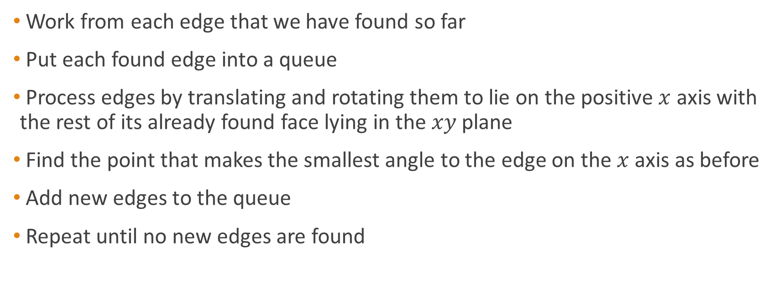
3D Convex Hull – The Remaining Faces
Work from each edge that we have found so far
Put each found edge into a queue
Process edges by translating and rotating them to lie on the positive $x$ axis with the rest of its already found face lying in the $xy$ plane
Find the point that makes the smallest angle to the edge on the $x$ axis as before
Add new edges to the queue
Repeat until no new edges are found

Slide 7
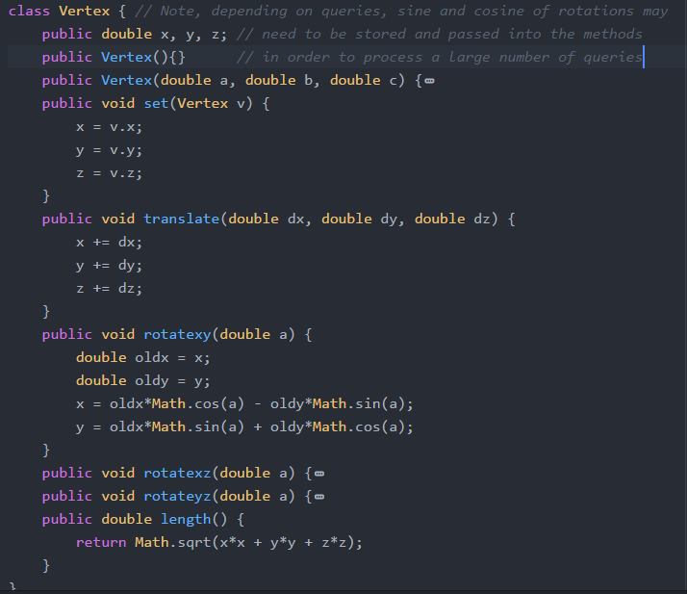
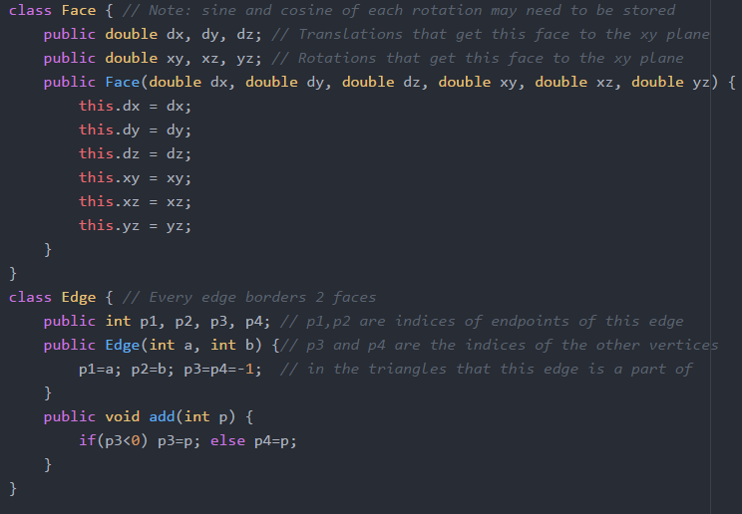
http://problemvault.com/#snippet66

Slide 8
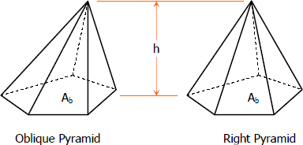
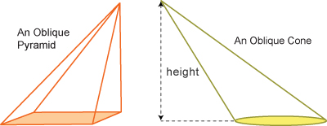
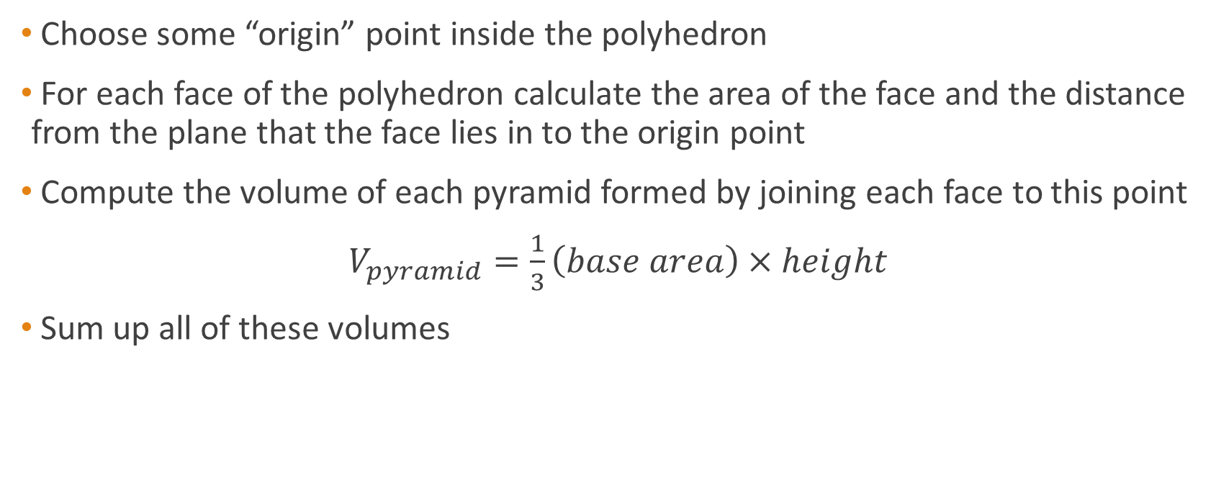
Volumes of Convex 3D Polyhedra
Choose some “origin” point inside the polyhedron
For each face of the polyhedron calculate the area of the face and the distance from the plane that the face lies in to the origin point
Compute the volume of each pyramid formed by joining each face to this point
$V_{pyramid}=\frac{1}{3}\left(base area\right)×height$
Sum up all of these volumes

Slide 9
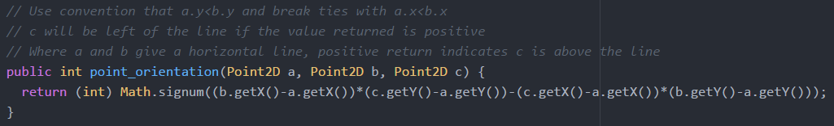
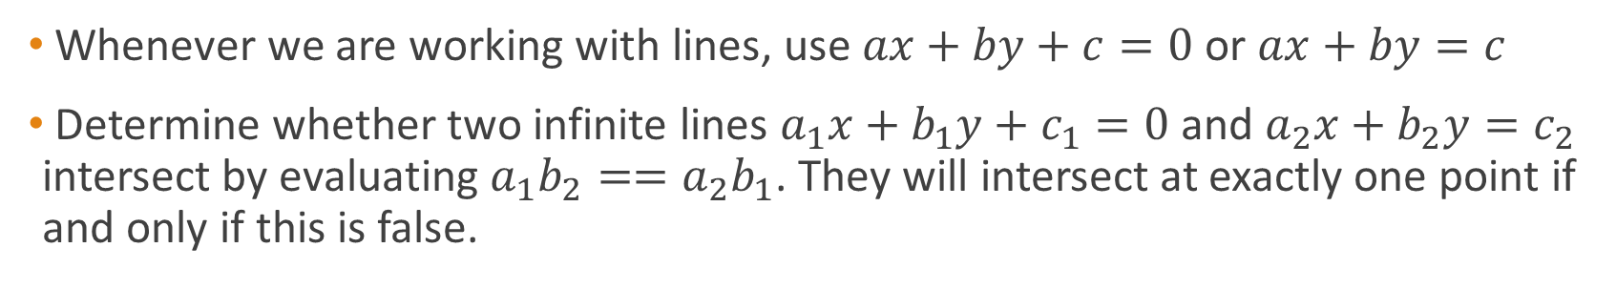
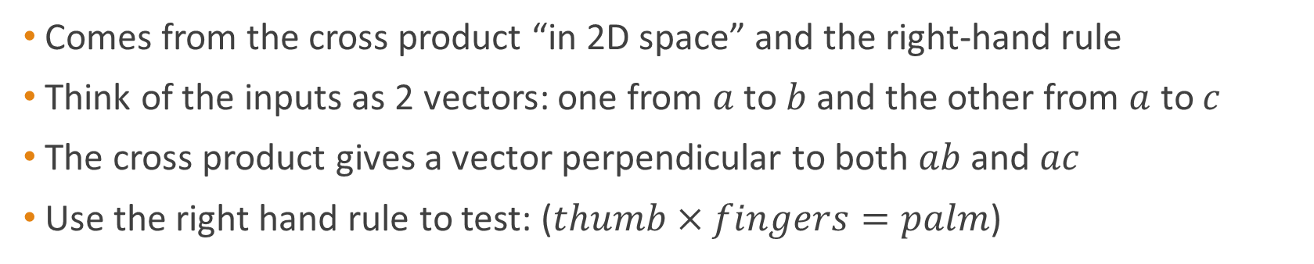
Intersection of Lines
Whenever we are working with lines, use $ax+by+c=0$ or $ax+by=c$
Determine whether two infinite lines $a_{1}x+b_{1}y+c_{1}=0$ and $a_{2}x+b_{2}y=c_{2}$ intersect by evaluating $a_{1}b_{2}==a_{2}b_{1}$. They will intersect at exactly one point if and only if this is false.
Point Orientation
Comes from the cross product “in 2D space” and the right-hand rule
Think of the inputs as 2 vectors: one from $a$ to $b$ and the other from $a$ to $c$
The cross product gives a vector perpendicular to both $ab$ and $ac$
Use the right hand rule to test: ($thumb×fingers=palm$)

Slide 10
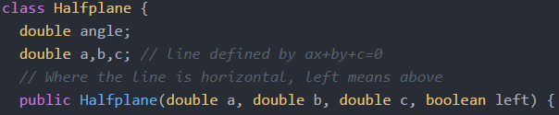


Halfplanes
A halfplane is the set of all points lying on one side of an infinite straight line
These can be represented by equations of the form:
$ax+by+c≥0$, or
$ax+by+c≤0$ (Note that the inequalities could be strict)
How can we represent them in code?
Angle will be a value in the interval $[−π,π)$ indicating the “direction” of the halfplane
Given a line equation and the side of the line that we care about, we can calculate the appropriate angle

Slide 11






Halfplane angle/direction
Angle: $−\frac{3π}{4}∈[−π,π)$
Angle: $0∈[−π,π)$
Angle: $\frac{π}{4}∈[−π,π)$
$$−\frac{3π}{4}$$
$$\frac{π}{4}$$
Angle: $\frac{π}{2}∈[−π,π)$

Slide 12
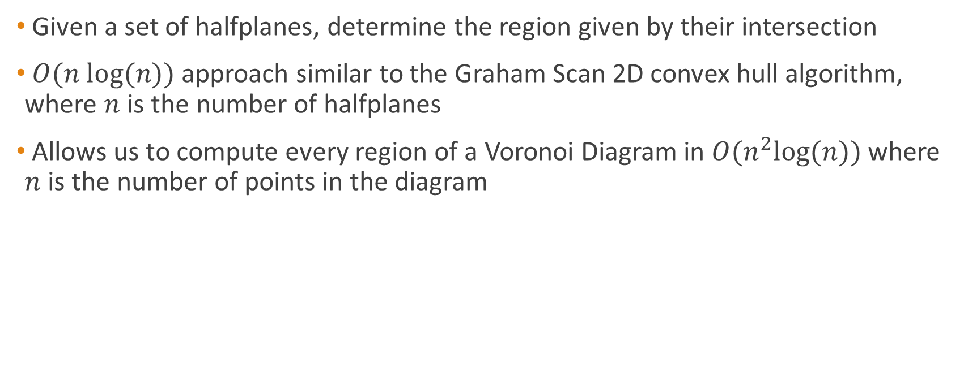
Intersection of Halfplanes
Given a set of halfplanes, determine the region given by their intersection
$O(n log(n))$ approach similar to the Graham Scan 2D convex hull algorithm, where $n$ is the number of halfplanes
Allows us to compute every region of a Voronoi Diagram in $O(n^{2}log(n))$ where $n$ is the number of points in the diagram

Slide 13
Intersection of Halfplanes Algorithm
Sort all halfplanes by their angle from lowest to highest
For any halfplanes with the same angle, keep only the most restrictive halfplane
Using the ArrayDeque data structure, add the 2 halfplanes with the smallest angle to the back of the ArrayDeque
Compute and keep track of the intersection points of the intersection of the top 2 halfplane lines in the ArrayDeque and the bottom 2 halfplane lines
For each remaining halfplane, check whether or not the halfplane contains the back intersection and the front intersection
While the halfplane does not contain the back intersection, remove the last halfplane from the ArrayDeque and re-compute the back intersection
While the halfplane does not contain the front intersection, pop the top halfplane from the ArrayDeque and re-compute the front intersection
Add the halfplane to back of the ArrayDeque and re-compute the back intersection

Slide 14
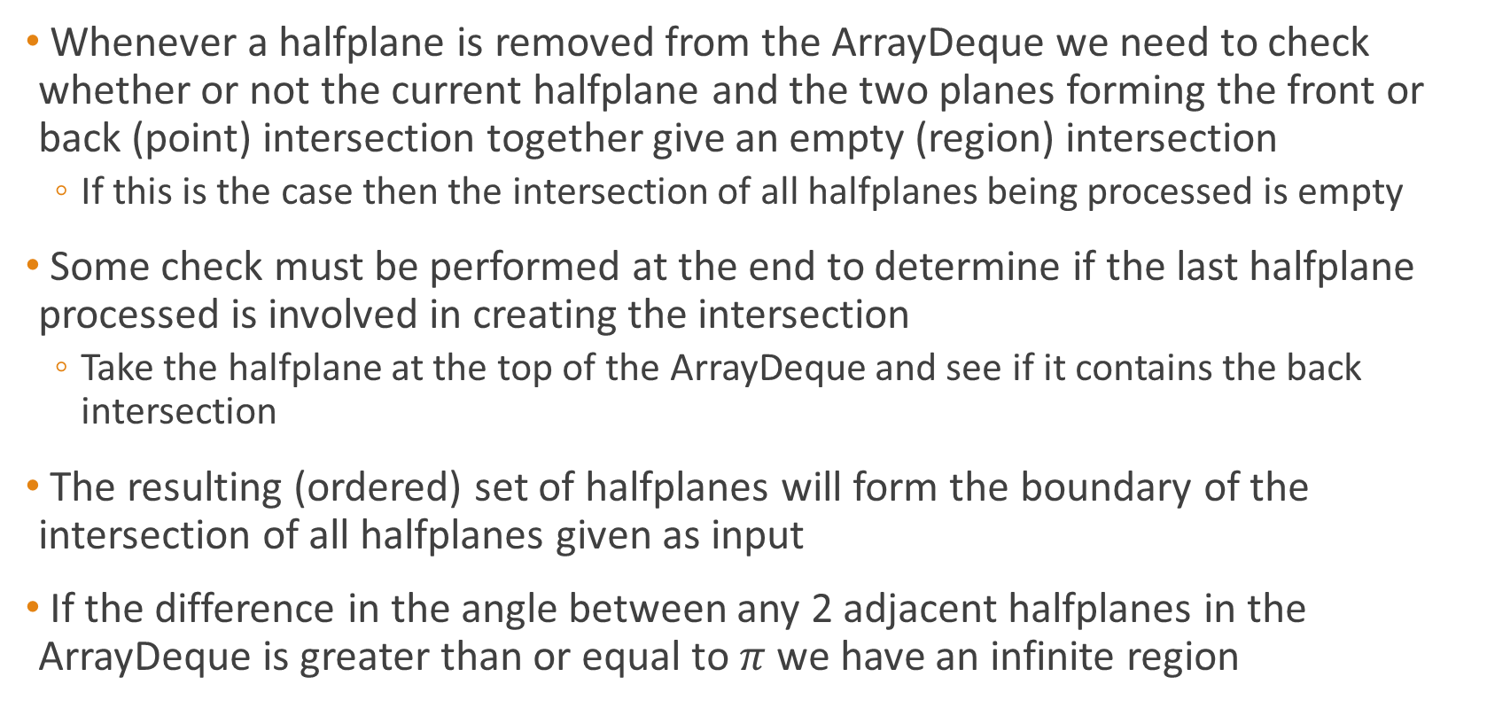
Intersection of Halfplanes Algorithm
Whenever a halfplane is removed from the ArrayDeque we need to check whether or not the current halfplane and the two planes forming the front or back (point) intersection together give an empty (region) intersection
If this is the case then the intersection of all halfplanes being processed is empty
Some check must be performed at the end to determine if the last halfplane processed is involved in creating the intersection
Take the halfplane at the top of the ArrayDeque and see if it contains the back intersection
The resulting (ordered) set of halfplanes will form the boundary of the intersection of all halfplanes given as input
If the difference in the angle between any 2 adjacent halfplanes in the ArrayDeque is greater than or equal to $π$ we have an infinite region

Slide 15
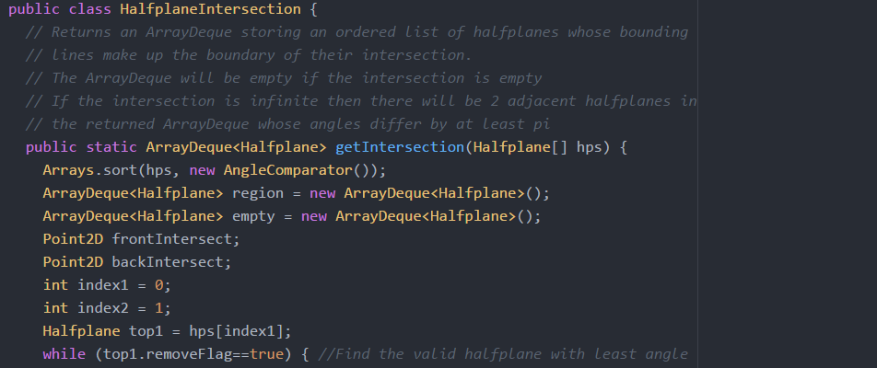

Slide 16
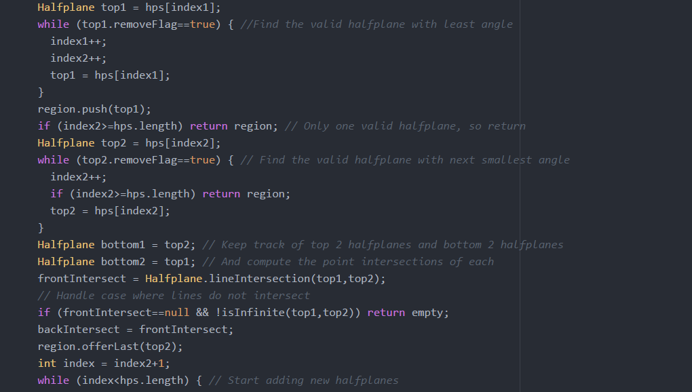

Slide 17
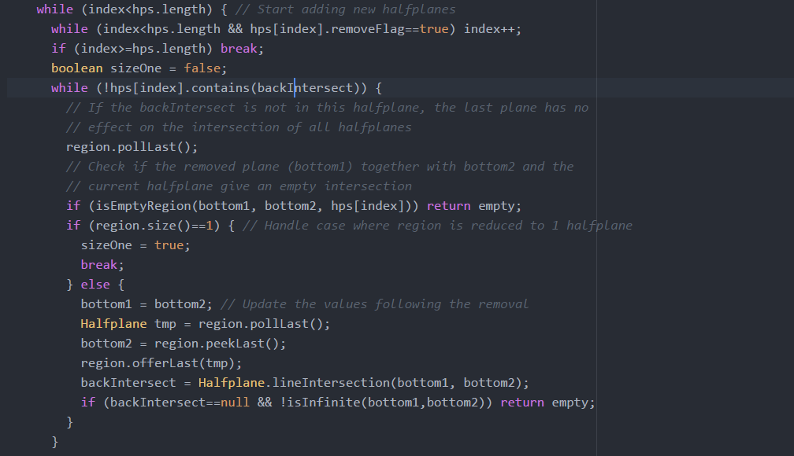

Slide 18
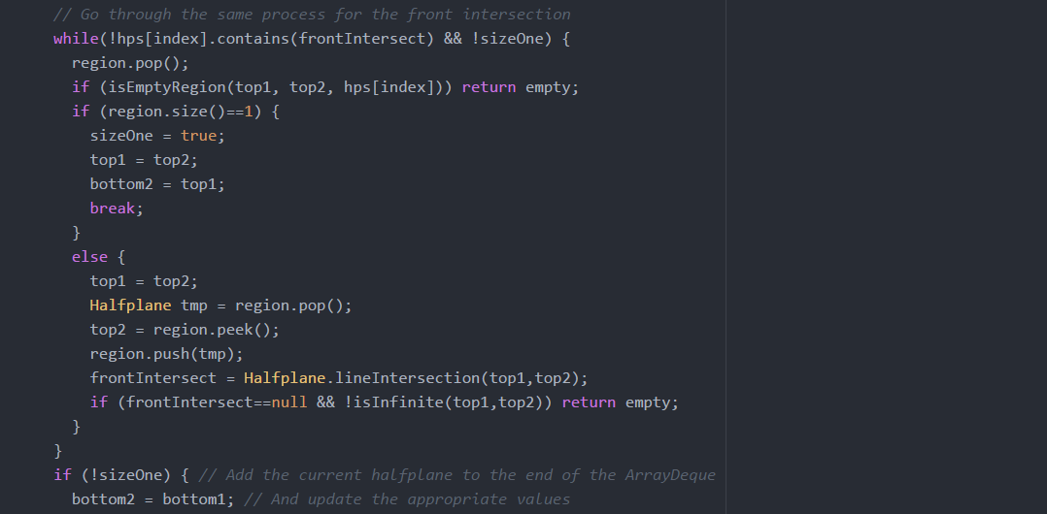

Slide 19
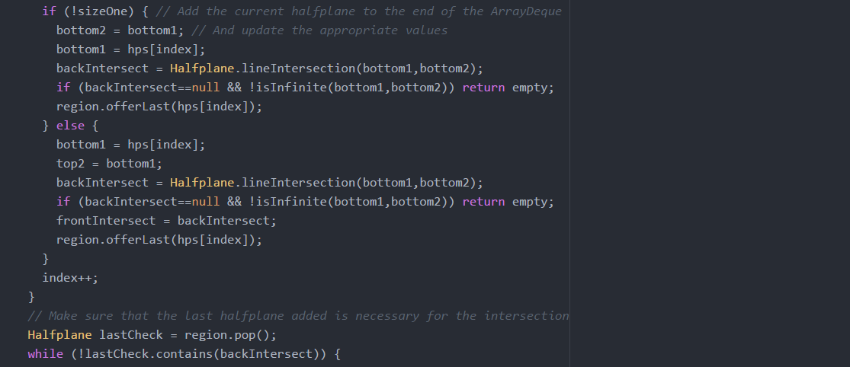

Slide 20
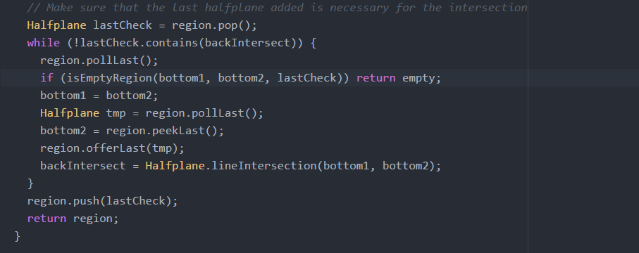
Code over the last 6 slides is 101 lines (including comments). This does not include lines of code needed for helper methods.

Slide 21
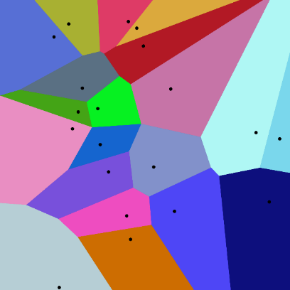
Voronoi Diagram
A Voronoi diagram is a partitioning of the plane into regions such that for a set of “seeds”, each seed lies in a distinct region and each region is made up of the set of points that are closer to the seed than any other seed
Properties:
The points on the edge of a region are equidistant to 2 seeds
A vertex in the Voronoi diagram is equidistant to at least 3 seeds – the 3 seeds in the regions containing the vertex
So the largest circle not containing any seeds is centered at a vertex of the Voronoi diagram
The path from one side of the diagram to the other that maximises the closest distance to a seed will be along the edges of the diagram

Slide 22
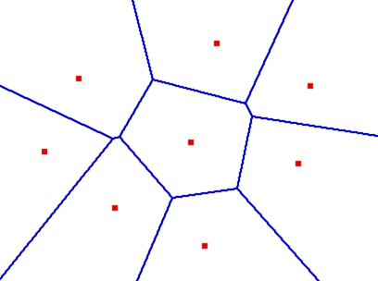
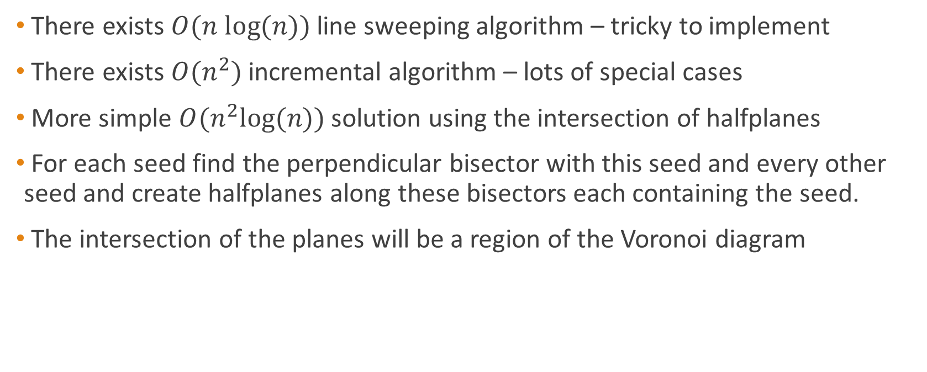
Constructing a Voronoi diagram
There exists $O(n log(n))$ line sweeping algorithm – tricky to implement
There exists $O(n^{2})$ incremental algorithm – lots of special cases
More simple $O(n^{2}log⁡(n))$ solution using the intersection of halfplanes
For each seed find the perpendicular bisector with this seed and every other seed and create halfplanes along these bisectors each containing the seed.
The intersection of the planes will be a region of the Voronoi diagram

Slide 23
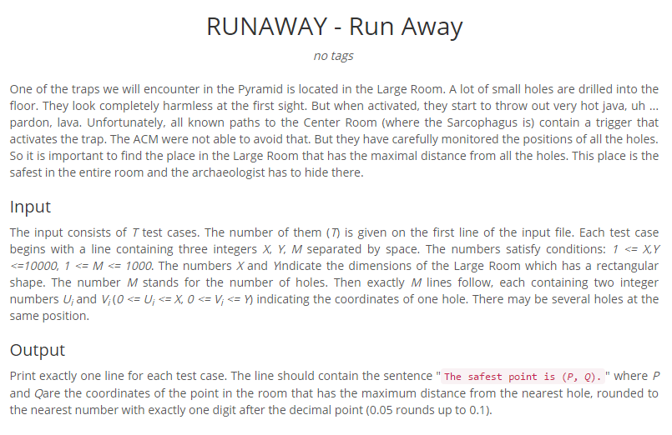
http://www.spoj.com/problems/RUNAWAY/

Slide 24
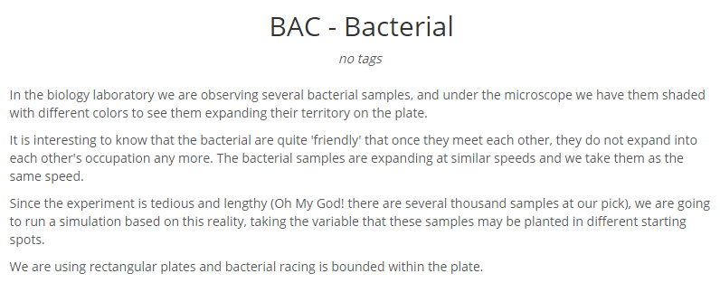
http://www.spoj.com/problems/BAC/

Slide 25
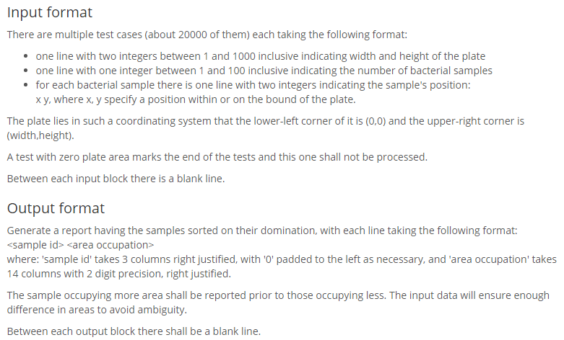
http://www.spoj.com/problems/BAC/

