Slide 1
Computational Geometry
With a focus on triangles and polygons
William Fiset

Slide 2
Problems in computational geometry Problem solving approaches Tips & Tricks Binary search Triangle area Polygon area Point in a polygon

Slide 3
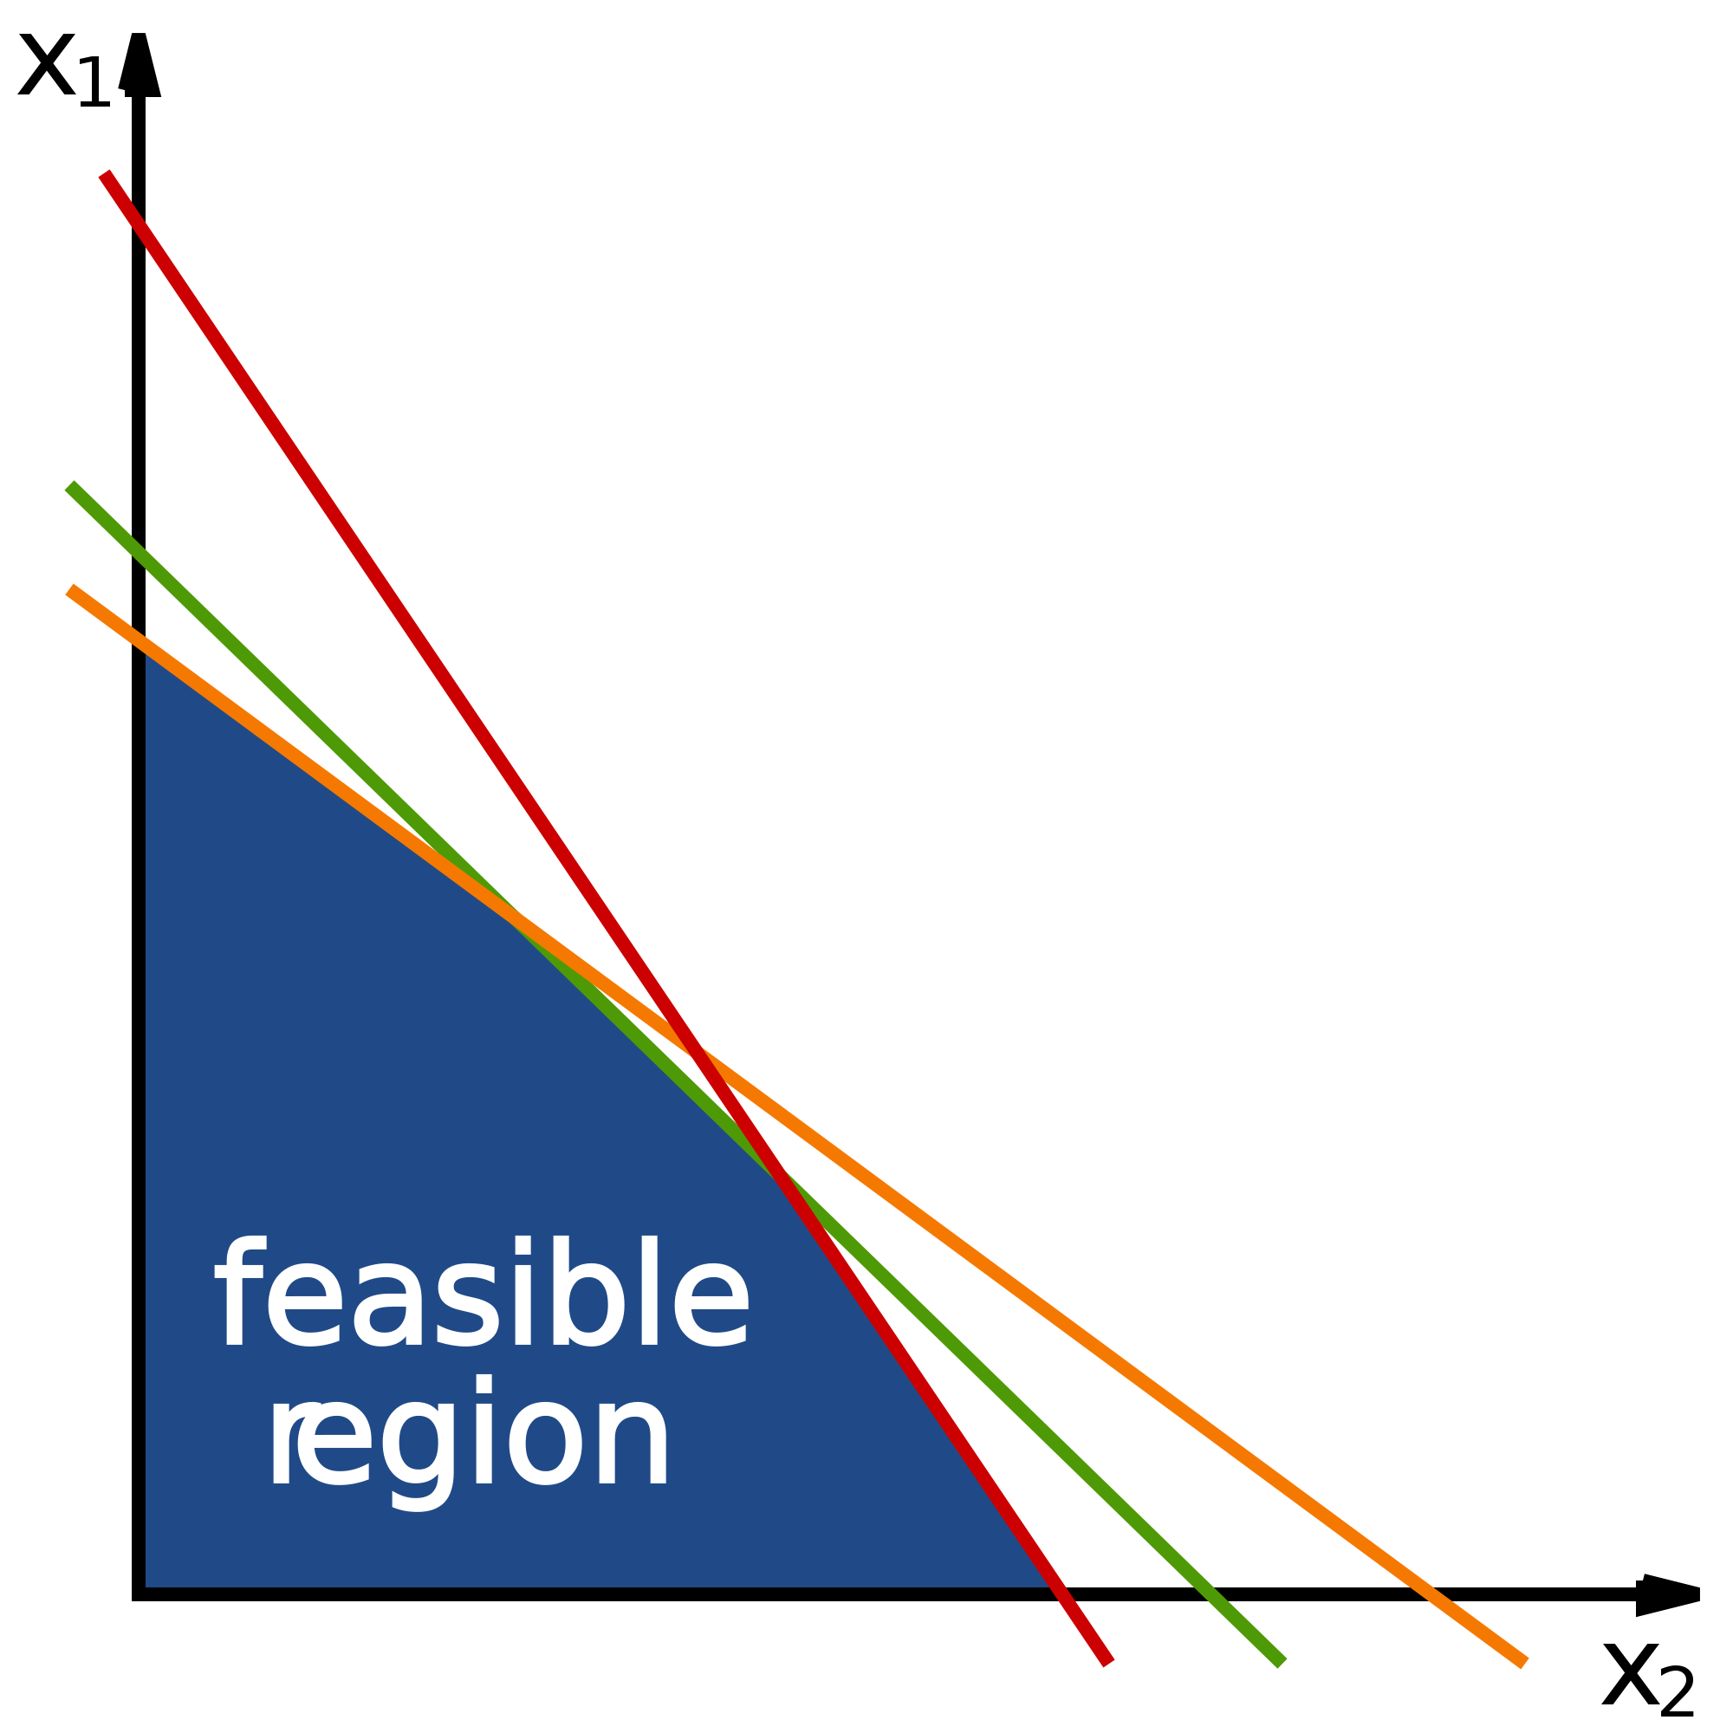
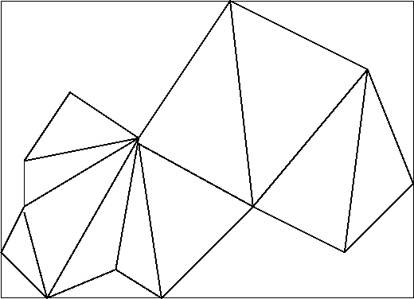
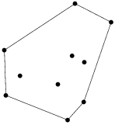
Standard Problems in Computational Geometry
Convex Hull
Line segment intersections
Closest Pair of points
Linear programming optimization
Polygon area, polygon intersection, polygon triangulation.
Point inside polygon
Many many more…

Slide 4
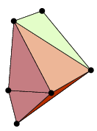
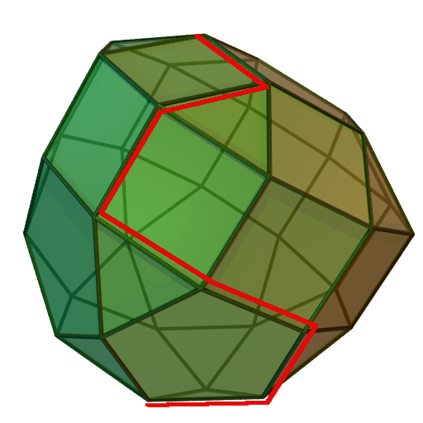
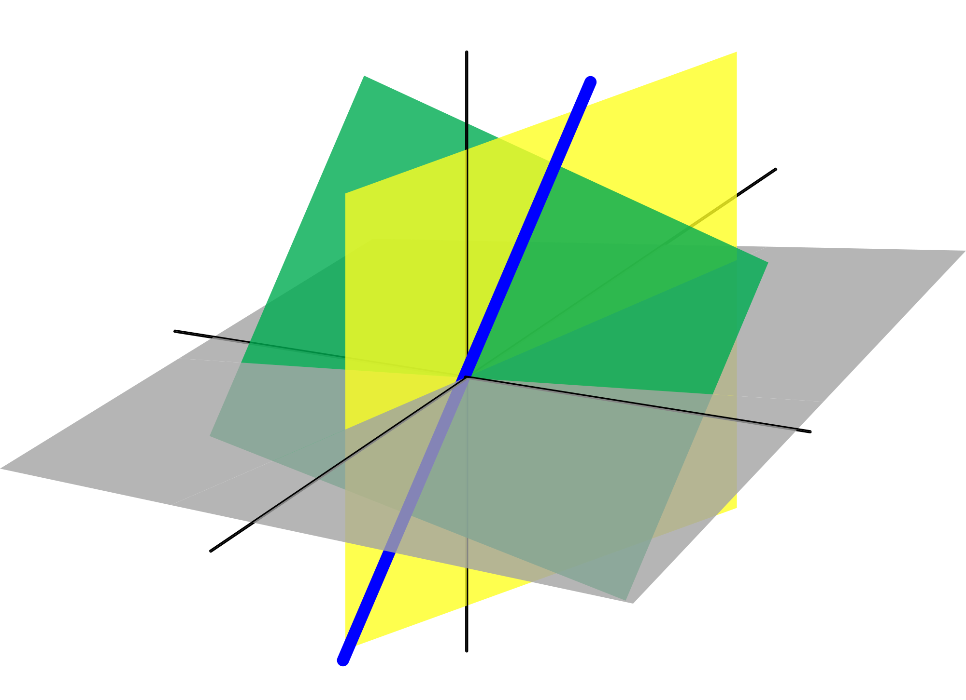
Standard ways of solving Computational Geometry Problems:
Lookup a formula
Linear search
Binary search
Line sweeping
Plane sweeping
Simplex method
Linear algebra
Kick ass snippets

Slide 5
Tips & Tricks - Precision & floating point equality
Let a, b ∈ R
Never do a == b, this is not guaranteed to be exact.
Instead try |a-b| < THRESHOLD where THRESHOLD is small
NOTE: Concerning precision avoid floats if possible, the reduced accuracy is likely to bite you at times you would not expect. This is why we like Point2D.Double instead of the Point2D.Float class. Floats use less memory and are faster to work with, but are not worth it at the expense of the accuracy we seek.

Slide 6
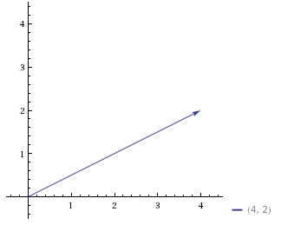
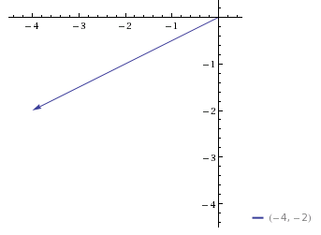
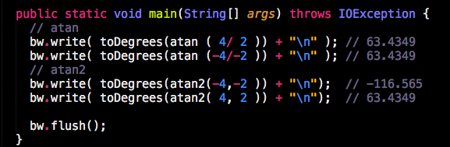
Tips & Tricks - Arctangent issue

Slide 7
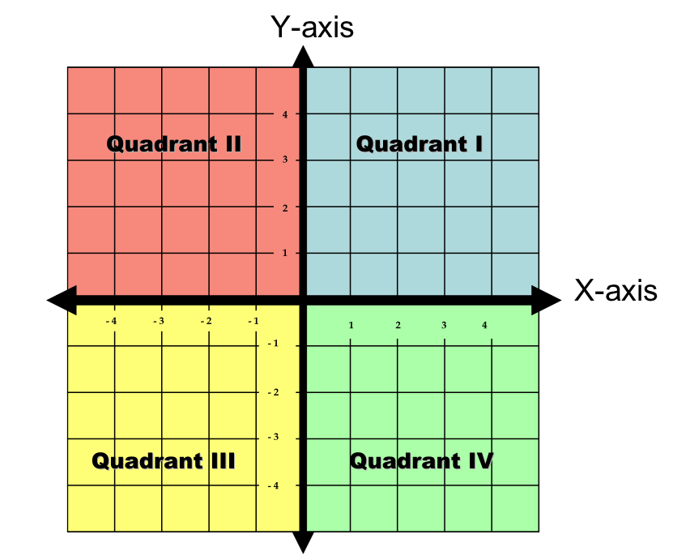
Tips & Tricks - Arctangent issue
Since atan2 takes two arguments instead of
Just one it does not lose any information.
Atan is subject to only being able to tell you
Information If you are in the first or fourth quadrant.
You can think of atan2 as returning the angle θ
when converting (x, y) to polar coordinates. This is
generally what you want.

Slide 8
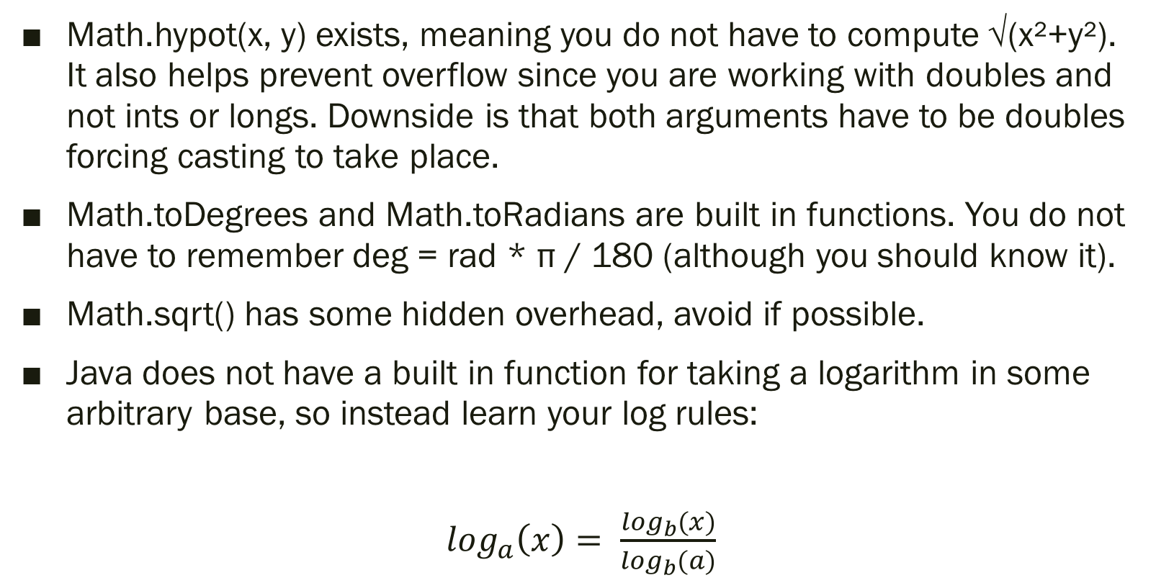
Tips and Tricks – General tips
Math.hypot(x, y) exists, meaning you do not have to compute √(x²+y²). It also helps prevent overflow since you are working with doubles and not ints or longs. Downside is that both arguments have to be doubles forcing casting to take place.
Math.toDegrees and Math.toRadians are built in functions. You do not have to remember deg = rad * π / 180 (although you should know it).
Math.sqrt() has some hidden overhead, avoid if possible.
Java does not have a built in function for taking a logarithm in some arbitrary base, so instead learn your log rules:
$\log_{a}\left(x\right)= \frac{\log_{b}(x)}{\log_{b}(a)}$

Slide 9
Binary Search
A typical method for searching for some unknown quantity in geometry problems is to use a binary search. This can make the difference between a solution which is O(log(n)) and O(n).
Standard problems which have are those where you are “filling” something, such as a water bottle or container.

Slide 10

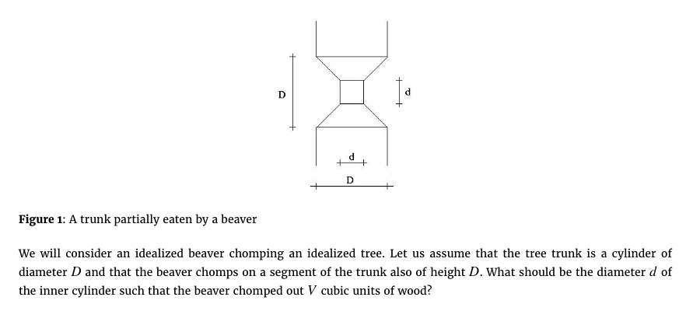

Slide 11
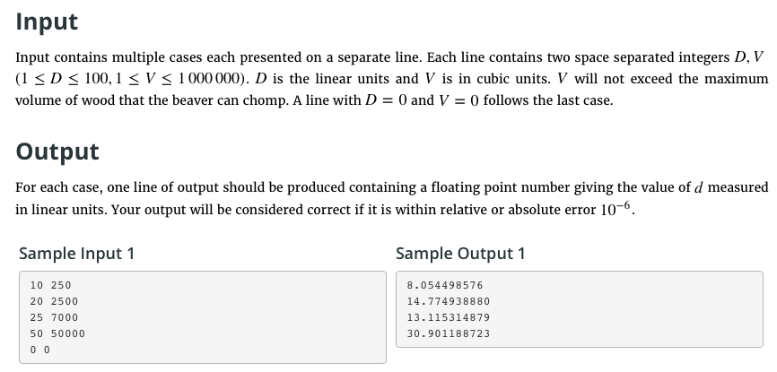

Slide 12
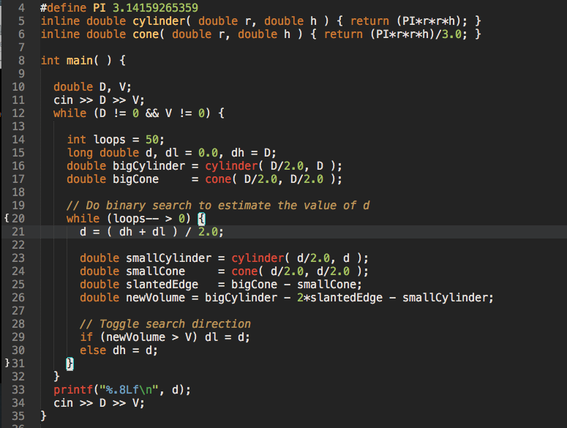

Slide 13
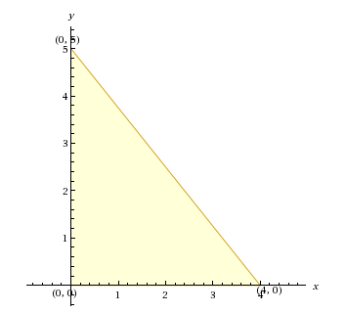
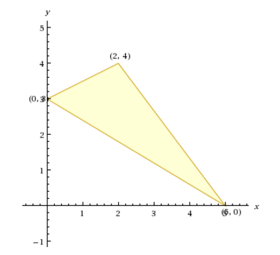

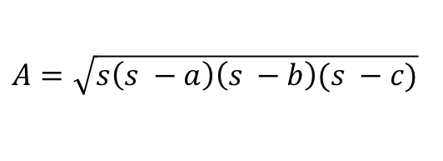

Triangle Area
For triangles where you know the base and the height
you can use: $A= \frac{bh}{2}$
A = (4*5)/2 = 10
Can use Heron’s formula if you know all three sides
a = √(0 – 2)² + (4 – 3)² = √5
b = √(0 – 5)² + (0 – 3)² = √34
c = √(2 – 5)² + (0 – 4)² = 5
s = (a + b + c)/2 = (√5 + √34 + 5)/2
A = √s(s-a)(s-b)(s-c) = 11/2 = 5.5
$$s= \frac{a+b+c}{2}$$
$A=\sqrt{s\left(s −a\right)\left(s −b\right)(s −c)}$

Slide 14
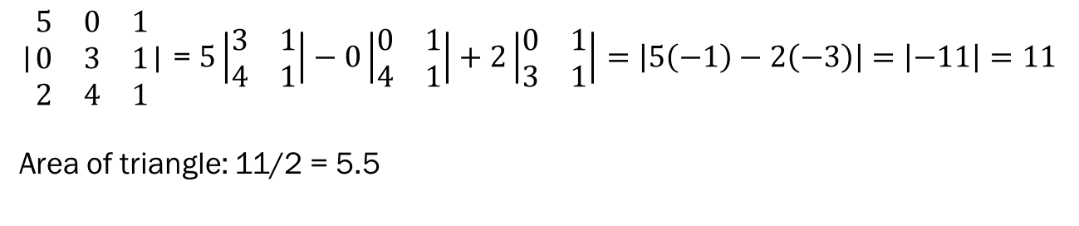
Triangle Area
Heron’s formula is nice, but requires a lot of square roots, is there a better way?
The determinant can assist us in computing the area of triangles (this can even be modified for higher dimensions if need be[1]).
Find the area of the triangle: (5, 0), (0, 3), (2, 4) [same triangle as last slide]
Let A be an nxn matrix with the first n-1 column being the coordinates and the last column being 1’s
Compute the absolute value of the determinant and divide by two
In general area of (a₀, a₁), (b₀, b₁), (c₀, c₁) = |(b₀ – a₀)(c₁-a₁) – (c₀-a₀)(b₁-a₁)|/2
|$\begin{matrix}5 & 0 & 1 \\ 0 & 3 & 1 \\ 2 & 4 & 1\end{matrix}$| = $5\left|\begin{matrix}3 & 1 \\ 4 & 1\end{matrix}\right|−0\left|\begin{matrix}0 & 1 \\ 4 & 1\end{matrix}\right|+2\left|\begin{matrix}0 & 1 \\ 3 & 1\end{matrix}\right|=\left|5\left(−1\right)−2\left(−3\right)\right|=\left|−11\right|=11$
Area of triangle: 11/2 = 5.5

Slide 15
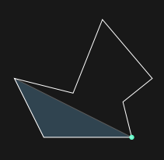
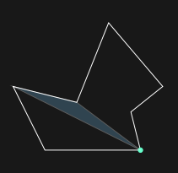
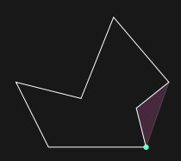
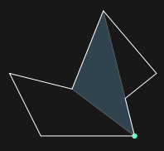
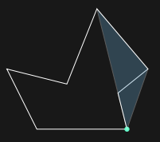
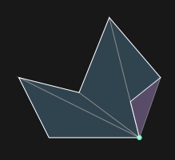
Polygon Area
We can use the previous method for finding areas of triangles to find the area of a simple polygon. To find the area of a simple polygon compute the sum of the signed triangles created by fixing a point and selecting every pair of adjacent points.
Images taken from:
https://algo.is

Slide 16
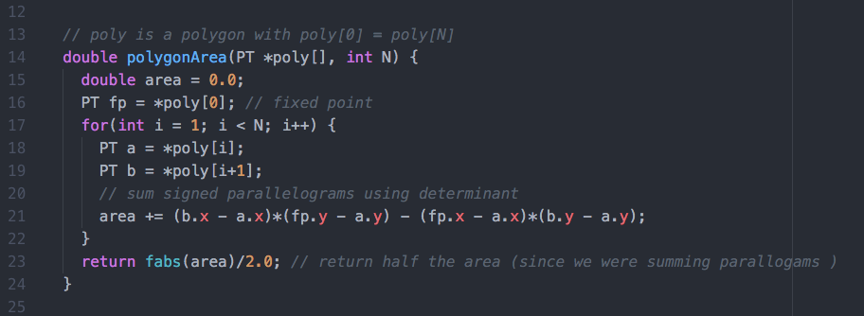
Polygon Area

Slide 17
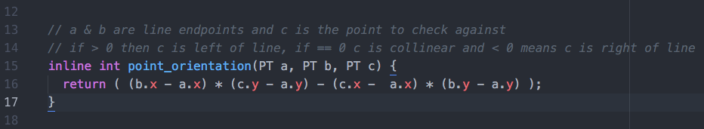
Point Orientation
We are often concerned about where a point is relative to a line. That is whether a point is to the left of the line, to the right of the line or collinear with the line.
We can reuse the code for finding the area of a triangle to check the position of a point relative to a line, here’s how:
This code is used in the Graham scan convex hull algorithm to sort points.

Slide 18

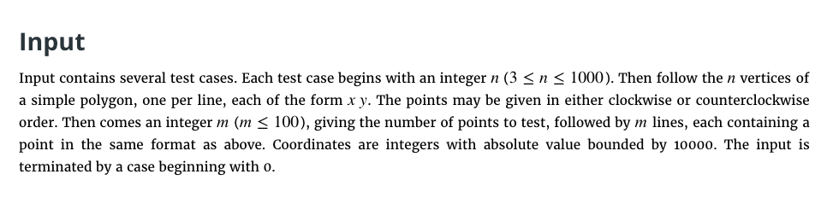

Slide 19
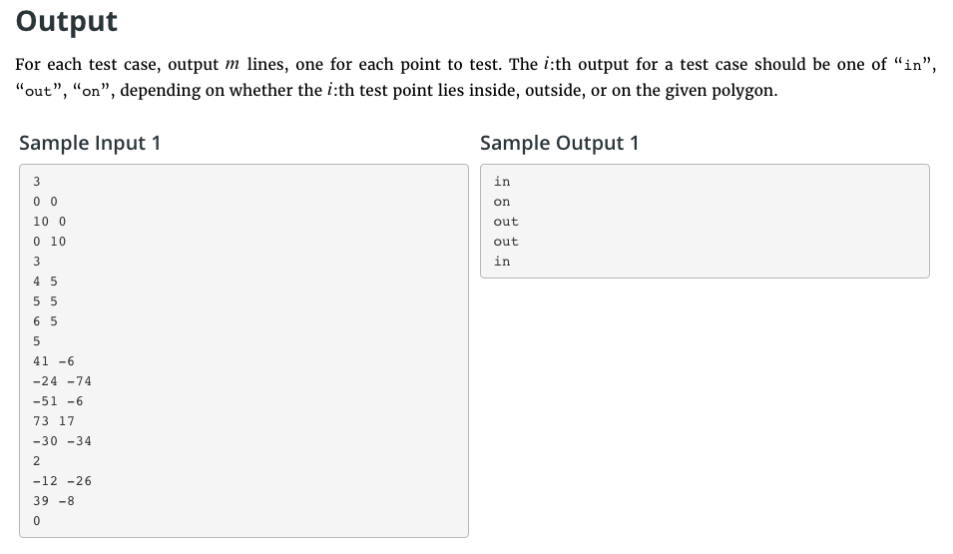

Slide 20
Point in a Polygon
Approach:
Determine whether point is on polygon
Determine whether point is outside or within polygon.
Hackish way of determining whether a point is on a line:

Slide 21
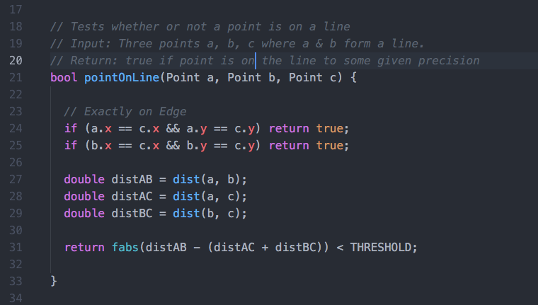
Point in a Polygon

Slide 22
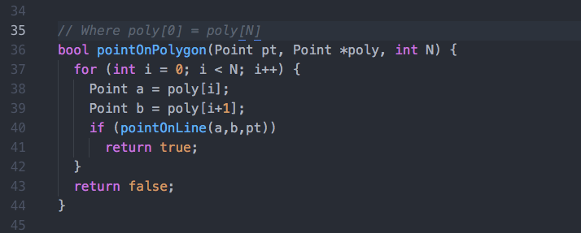
Point in a Polygon
This makes the pointOnPolygon function quite simple:

Slide 23
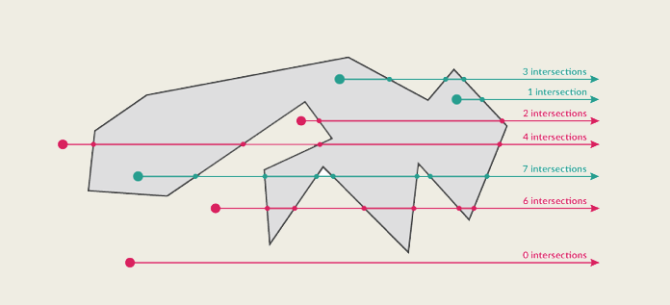
Point in a Polygon (Method #1)
Use the ray casting algorithm to determine if a point lies within a polygon.
If the number of intersections is odd then the point is inside, otherwise the point is outside.
This is known as the even-odd rule.

Slide 24
Point in a Polygon (Method #2)
Use the winding number count
The winding number of a polygon is how many times you can turn counter clockwise around a point.
If the winding number is greater than zero then we know the point is somewhere inside the polygon.
Works for non-simple (self intersecting) polygons [3].

Slide 25
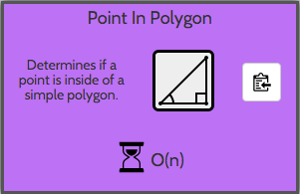
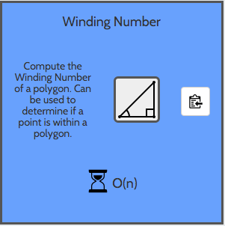
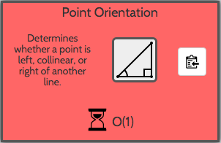
Point In Polygon
Winding Number requires Point Orientation
Point in Polygon uses ray casting.

Slide 26
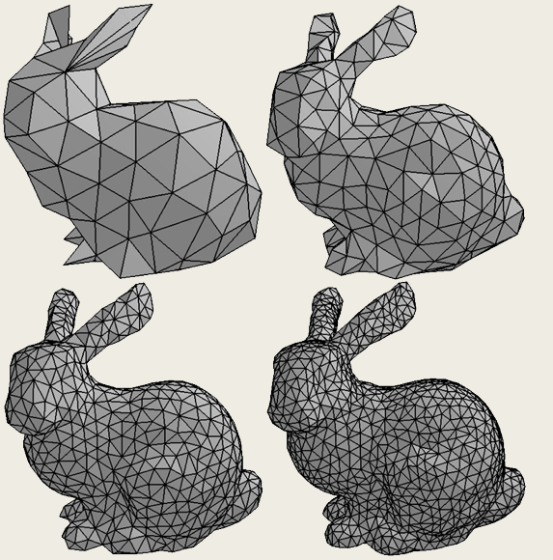
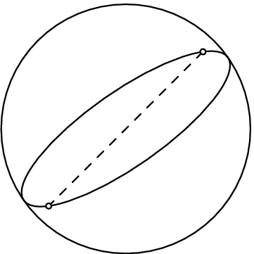
Other topics in computational geometry:
Circles
3D convex hulls
Linear Programming
Minkowski Sums
Spherical Geometry
Mesh Generation

Slide 27
References
[1] Koenderink, J.J. (1990), Solid Shape, MIT Press, Cambridge, MA
[2] Joseph O’Rouke, Computational Geometry in C, second edition
[3] Sunday, Dan (2001), Inclusion of a Point in a Polygon.
http://geomalgorithms.com/a03-_inclusion.html

