Slide 1
Strongly Connected Components (SCCs) and 2-SAT
Michael Bradet-Legris

Slide 2
Table of Contents
Strongly Connected Components (SCCs)
Tarjan’s Algorithm (Solution to SCC)
Rundown
Example 1
Pseudocode
Examples 2 / 3
2-SAT
Description
Solution
Kattis Problem: Running MoM
If time allows:
Shortest Path Faster Algorithm
Linear Time Sorting Algorithms
Counting Sort
Radix Sort
References

Slide 3
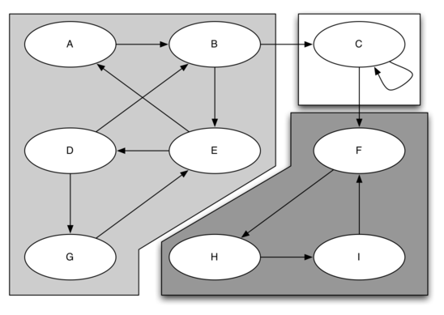
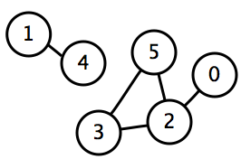
Strongly Connected Components
Clause: Each node in the component has a path to every other node in the component
Connected Components: Undirected Graph
Strongly Connected Components: Directed Graph

Slide 4
Tarjan’s Algorithm: Rundown
Linear Time algorithm: O(V + E)
Perform a single modified DFS (may need to do multiple if one DFS doesn’t reach all nodes)
Tarjan(node v): //Basic idea, extremely rudimentary
Index[v] = lowIndex[v] = next available index
lowIndex[v] = Min(index[v], lowIndex of all adjacent nodes not in a SCC)
If lowIndex is undefined for an adjacent node, call Tarjan on that node
If Index[v] = lowIndex[v], found a SCC.
The SCC consists of all nodes u with lowIndex[u] = lowIndex[v]
*Kosaraju’s Algorithm: Another linear solution, but more complex to code and more overhead, and (probably) higher constant factor for complexity.

Slide 5
Tarjan’s Algorithm: Example 1
Top Value: Index
Bottom Value: LowIndex
Adjacent Node has undefined lowIndex. Recurse.
1
1
?
?
?
?
?
?
?
?

Slide 6
Tarjan’s Algorithm: Example 1
Adjacent Node has undefined lowIndex. Recurse.
1
1
2
2
?
?
?
?
?
?

Slide 7
Tarjan’s Algorithm: Example 1
Adjacent Node has undefined lowIndex. Recurse.
1
1
2
2
3
3
?
?
?
?

Slide 8
Tarjan’s Algorithm: Example 1
Adjacent Node has undefined lowIndex. Recurse.
1
1
2
2
3
3
4
4
?
?

Slide 9
Tarjan’s Algorithm: Example 1
We have lowIndex = Index = 5 so create the SCC with all nodes with lowIndex = 5, then recurse back.
1
1
2
2
3
3
4
4
5
5

Slide 10
Tarjan’s Algorithm: Example 1
Created one SCC (purple)
Update lowIndex of current Node, then recurse back.
1
1
2
2
3
3
4
2
5
5

Slide 11
Tarjan’s Algorithm: Example 1
Update lowIndex of current Node, then recurse back.
1
1
2
2
3
2
4
2
5
5

Slide 12
Tarjan’s Algorithm: Example 1
We have lowIndex = Index = 2 so create the SCC with all nodes with lowIndex = 2, then recurse back.
1
1
2
2
3
2
4
2
5
5

Slide 13
Tarjan’s Algorithm: Example 1
Created one SSC (blue)
We have lowIndex = Index = 1 so create the SCC with all nodes with lowIndex = 1, then recurse back.
1
1
2
2
3
2
4
2
5
5

Slide 14
Tarjan’s Algorithm: Example 1
Created one SCC (red)
Algorithm terminates. We now have 3 SCCs.
1
1
2
2
3
2
4
2
5
5

Slide 15
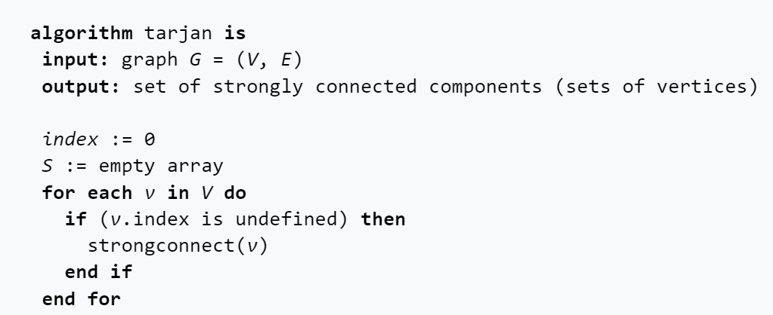
Tarjan’s Algorithm: Pseudocode

Slide 16
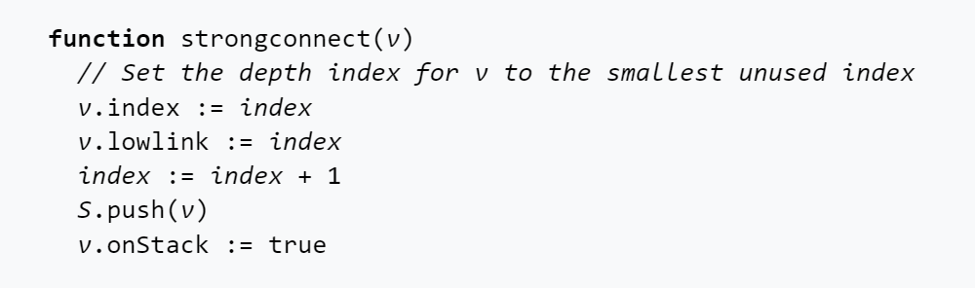
Tarjan’s Algorithm: Pseudocode

Slide 17
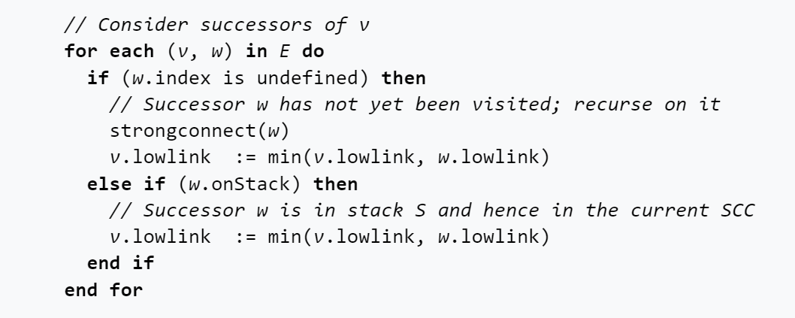
Tarjan’s Algorithm: Pseudocode

Slide 18
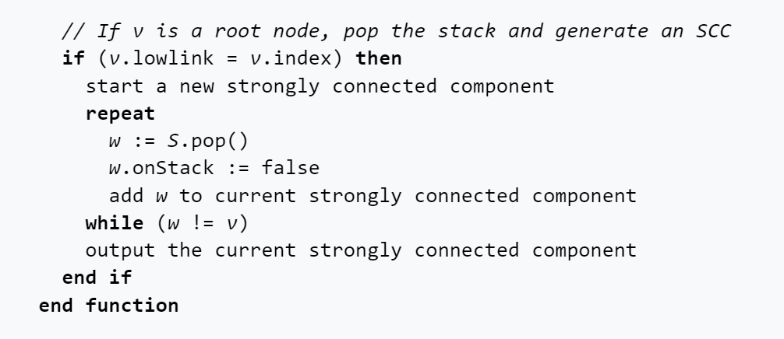
Tarjan’s Algorithm: Pseudocode

Slide 19
Tarjan’s Algorithm: Example 2
Top Value: Index
Bottom Value: LowIndex
Adjacent Node has undefined lowIndex. Recurse.
1
1
?
?
?
?
?
?
?
?

Slide 20
Tarjan’s Algorithm: Example 2
Adjacent Node has undefined lowIndex. Recurse.
1
1
2
2
?
?
?
?
?
?

Slide 21
Tarjan’s Algorithm: Example 2
Adjacent Node has undefined lowIndex. Recurse.
1
1
2
2
?
?
3
3
?
?

Slide 22
Tarjan’s Algorithm: Example 2
No adjacent nodes that have not been processed.
Set LowIndex of current node to 2 since it is the minimum of 4 and the lowIndex of adjacent nodes.
Recurse back.
1
1
2
2
?
?
3
3
4
2

Slide 23
Tarjan’s Algorithm: Example 2
No adjacent nodes that have not been processed.
Set LowIndex of current node to 2 since it is the minimum of 3 and the lowIndex of adjacent nodes.
Recurse back.
1
1
2
2
?
?
3
2
4
2

Slide 24
Tarjan’s Algorithm: Example 2
No adjacent nodes that have not been processed.
LowIndex is the lowest of all adjacent nodes.
Have LowIndex = Index = 2. Found a SCC. Create the SCC with all nodes having lowIndex = 2.
Recurse back.
1
1
2
2
?
?
3
2
4
2

Slide 25
Tarjan’s Algorithm: Example 2
Created one SCC (purple)
Adjacent Node has undefined lowIndex. Recurse.
1
1
2
2
?
?
3
2
4
2

Slide 26
Tarjan’s Algorithm: Example 2
Note here that we cannot make lowIndex of the current node 2, since the adjacent purple node with index 4 is already in an SCC. If node 5 was in the purple SCC, then it would have been found in the DFS of one of the purple nodes, but it wasn’t.
Have LowIndex = Index = 5. Found a SCC. Create the SCC with all nodes having lowIndex = 5.
Recurse back.
1
1
2
2
5
5
3
2
4
2

Slide 27
Tarjan’s Algorithm: Example 2
Created one SCC (blue)
LowIndex is the lowest of all adjacent nodes.
Have LowIndex = Index = 1. Found a SCC. Create the SCC with all nodes having lowIndex = 1.
1
1
2
2
5
5
3
2
4
2

Slide 28
Tarjan’s Algorithm: Example 2
Created one SCC (red)
Algorithm terminates.
1
1
2
2
5
5
3
2
4
2

Slide 29
Tarjan’s Algorithm: Example 3

Slide 30
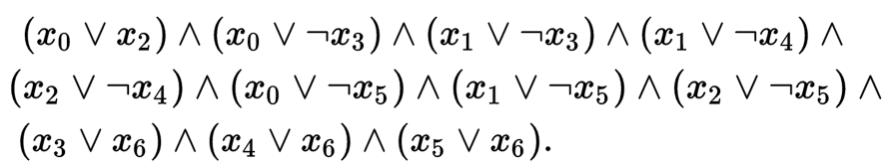
2-SAT: Description
Set of “or” expressions of two Boolean variables connected together by “and” operators.
How do we represent this problem so that we can solve it easily?
Does a solution exist?
What is a solution?

Slide 31
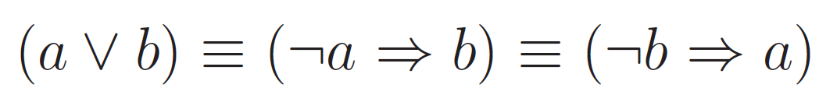
2-SAT: Solution Part 1 – Visualization
Note that we can convert this problem into a graph problem!
For each Boolean variable v, create one node for v and one for v. Add in all the edges created by the implications.
Note: for the rest of the presentation, I will be using boldface + underscore to represent negation (ie: v is equivalent to “not v”)

Slide 32
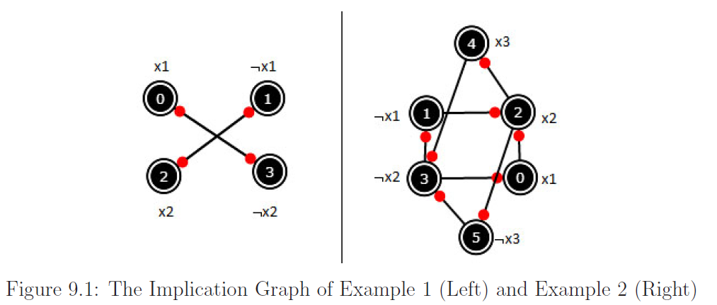
2-SAT: Solution Part 1 – Visualization

Slide 33
2-SAT: Solution Part 2 – Existence
How do we know if there is a solution?
Intuitively, if there is a variable v where v implies v and v implies v, there is no solution.
In our case, this means that if some v has a path to v and v has a path to v, there is no solution.
It turns out that there is a tighter constraint that fully characterizes this problem: there is a solution if and only if each pair of nodes v and v are not in the same SCC.
Can find SCCs using Tarjan’s Algorithm
Note: There are other ways to solve 2-SATs, but this is the one we will be covering.

Slide 34
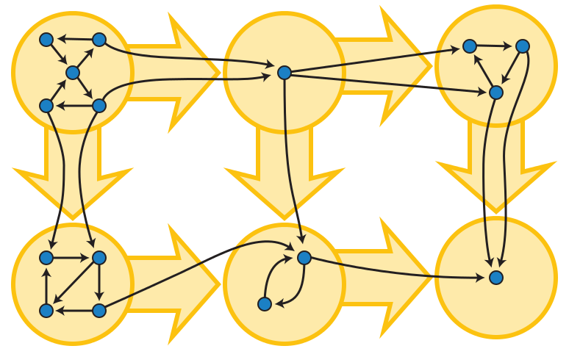
2-SAT: Solution Part 3 – Solution
This is assuming existence of a solution was shown with previous step.
Construct the condensation of the graph (with “Super nodes” being SCCs)
Topological sort the strongly connected components
Iterate through the reverse order of the topological sort. Assign to each variable the truth value of the first Boolean variable representing it (ie: if v comes before v in this reverse topological sort, then assign the value of v to be false).

Slide 35
Kattis Problem: Running MoM
https://open.kattis.com/problems/runningmom
Abridged: Given up to 5000 cities and (one directional) flights between cities each day.
Up to 1000 queries: given some starting city, is there an infinite path starting from that city?

Slide 36
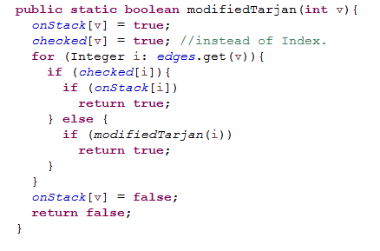
Kattis Problem: Running MoM
…

Slide 37
Shortest Path Faster Algorithm
Uses a queue to remove redundant checks in the Bellman-Ford algorithm.
Is an optimization of Bellman-Ford, but feels more like Dijkstra's
Complexity is O(kE), where k depends on the graph and k ≤ V.
Worst case is fully connected graph: no optimization on BF, but extra overhead.
In practice (according to the book Competitive Programming 3), this algorithm is as fast as Dijkstra’s, but can also handle negative edges.

Slide 38

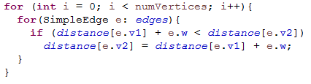
Recall: Bellman-Ford
…

Slide 39
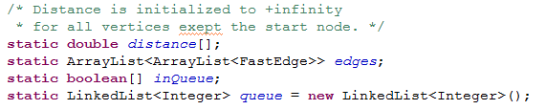
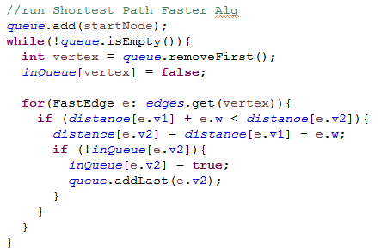
Shortest Path Faster Algorithm
…

Slide 40
Counting Sort
Linear Time!
Let N be the number of elements to sort, and K be the set of possible values of the N numbers.
Complexity: O(N + K)
Can only be done if there is a small range of possible values (otherwise O(NlogN) might be better)

Slide 41
Counting Sort
Original Elements
[0, 1, 3, 6, 3, 6, 2, 6, 0, 4, 5]
Do a single linear scan of the original array to build a frequency array
0 1 2 3 4 5 6
[2, 1, 1, 2, 1, 1, 3]
Do a single linear scan of frequency array to build the sorted array (can do this on top of original array)
[0, 0, 1, 2, 3, 3, 4, 5, 6, 6, 6]

Slide 42
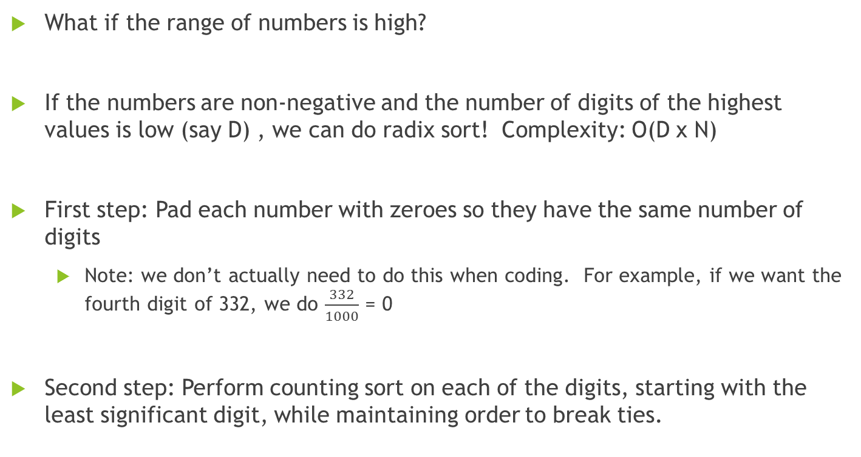
Radix Sort
What if the range of numbers is high?
If the numbers are non-negative and the number of digits of the highest values is low (say D) , we can do radix sort! Complexity: O(D x N)
First step: Pad each number with zeroes so they have the same number of digits
Note: we don’t actually need to do this when coding. For example, if we want the fourth digit of 332, we do $\frac{332}{1000}$ = 0
Second step: Perform counting sort on each of the digits, starting with the least significant digit, while maintaining order to break ties.

Slide 43
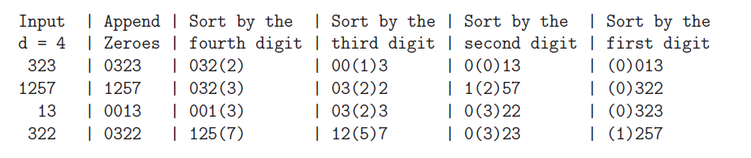
Radix Sort

Slide 44
Which sort is better?
Example: Suppose range of number is [0, 10⁹].
Note: here we are referring to log base 2
Number of entries to sort | NlogN sort operations | Counting Sort operations | Radix Sort operations | Best Algorithm
1000 | 1000 x log(1000) → 10⁴ | 1000 + 10⁹ → 10⁹ | 1000*9 → 10⁴ | NlogN (Radix has a lot of overhead)
10⁶ | 10⁶ x log(10⁶) → 2 x 10⁷ | 10⁶ ⁺ 10⁹ → 10⁹ | 10⁶ x 9 → 10⁷ | Radix Sort
10⁹ | 10⁹ x log(10⁹) → 3 x 10¹⁰ | 10⁹ + 10⁹ → 2 x 10⁹ | 10⁹ x 9 →10¹⁰ | Counting Sort

Slide 45
References
Halim, S., & Halim, F. (2013). Competitive Programming 3: the new lower bound of programming contests. Singapore: Lulu.com.
The one and only most accurate resource on the internet, Wikipedia.

