Slide 1
Combinatorial Games
Finn Lidbetter
Comp 4951: Advanced Problem Solving

Slide 2
Impartial games
Partisan Games
The moves available to the player depend on whose turn it is
e.g. Tic-Tac-Toe (can only place X’s or O’s)
Often require some determination of properties of the particular game or some intelligent search of the state-space
At any game state, both players have the same set of moves available to them
We will see a method for determining the winner from any state
(Partisan game methods can also be applied to impartial games)

Slide 3
Nim
Setup:
2 players
A number of piles of counters
Can have any finite number of piles and each pile can be of any finite size
Play:
On each player’s turn, they choose a pile and remove any number of counters from that pile
The winner is the last player to make a move

Slide 4
Nim Strategy
One pile:
First player wins, just take all of the counters
Two piles:
First player to move should make the piles the same size
This player can then mimic the other player’s moves as they are made
The player that makes the piles the same size will win
Three or more piles:
Less obvious…

Slide 5
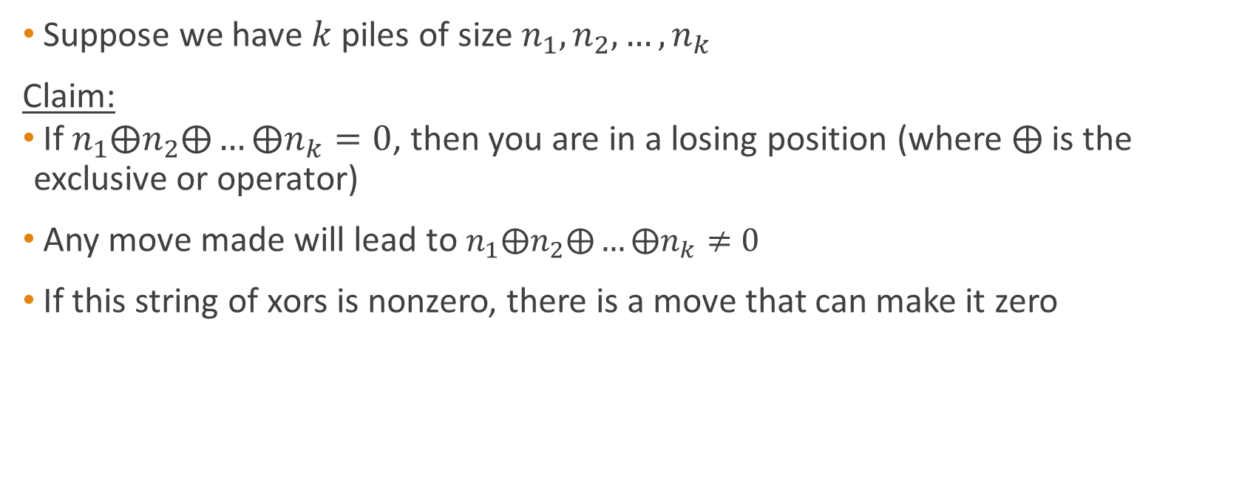
Nim 3+ piles strategy
Suppose we have $k$ piles of size $n_{1},n_{2},…, n_{k}$
Claim:
If $n_{1}⨁n_{2}⨁…⨁n_{k}=0$, then you are in a losing position (where $⨁$ is the exclusive or operator)
Any move made will lead to $n_{1}⨁n_{2}⨁…⨁n_{k}≠0$
If this string of xors is nonzero, there is a move that can make it zero

Slide 6
The Sprague-Grundy Theorem
Theorem:
Every impartial game where the last player to move wins, is equivalent to some game of Nim.
We can compute a value for any state in a game, and this will correspond to some pile size in a game of Nim
Having multiple “subgames” will correspond to having multiple piles in Nim

Slide 7
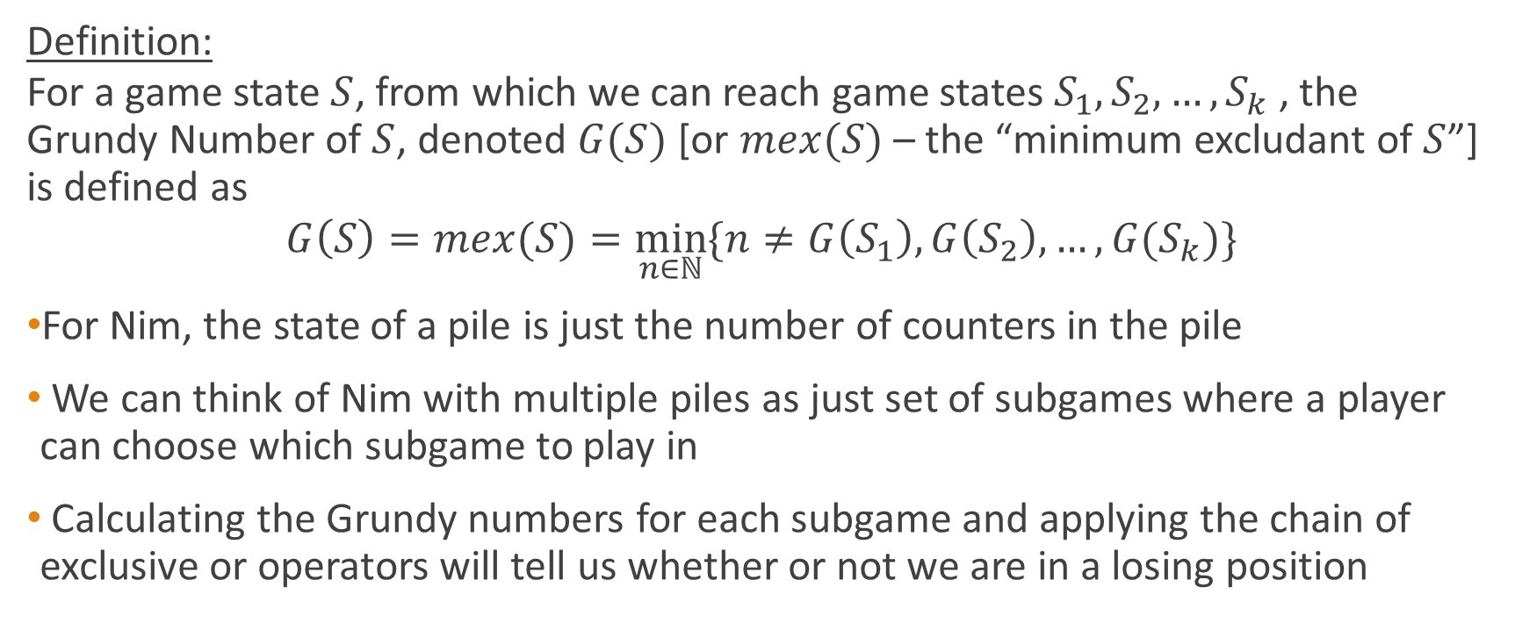
Grundy Numbers/Nimbers
Definition:
For a game state $S$, from which we can reach game states $S_{1},S_{2},…,S_{k}$, the Grundy Number of $S$, denoted $G(S)$ [or $mex(S)$ – the “minimum excludant of $S$”] is defined as
$$G\left(S\right)=mex(S)=\min_{n∈ℕ}{\{n≠G\left(S_{1}\right),G\left(S_{2}\right),…,G(S_{k})\}}$$
For Nim, the state of a pile is just the number of counters in the pile
We can think of Nim with multiple piles as just set of subgames where a player can choose which subgame to play in
Calculating the Grundy numbers for each subgame and applying the chain of exclusive or operators will tell us whether or not we are in a losing position

Slide 8
Example: The Matrix Game
Two players A and B play the following game. 1) First, a matrix M of size N*M is chosen, and filled with positive integers.
2) Player A starts the game and the players play alternately.
3) In his turn, a player chooses any row which has at least one non zero number in it. In this row, the leftmost non zero number is chosen. Let this number be K. The player subtracts any number between 1 and K inclusive from it.
4) The game ends when all the numbers in the matrix M are 0.
5) The player who plays last wins the game.
(Source: http://www.spoj.com/problems/MATGAME/)

Slide 9
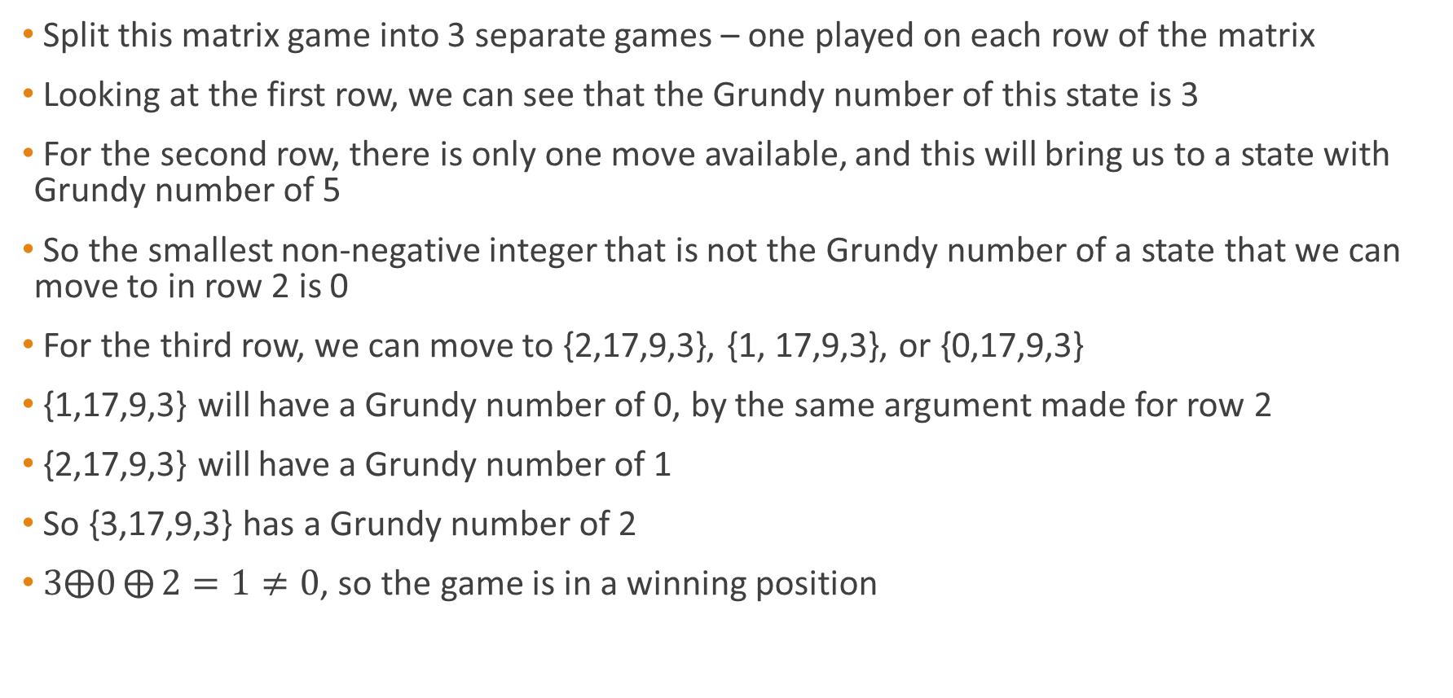
Matrix Game
0 | 0 | 0 | 3
0 | 0 | 1 | 5
3 | 17 | 9 | 3
Split this matrix game into 3 separate games – one played on each row of the matrix
Looking at the first row, we can see that the Grundy number of this state is 3
For the second row, there is only one move available, and this will bring us to a state with Grundy number of 5
So the smallest non-negative integer that is not the Grundy number of a state that we can move to in row 2 is 0
For the third row, we can move to {2,17,9,3}, {1, 17,9,3}, or {0,17,9,3}
{1,17,9,3} will have a Grundy number of 0, by the same argument made for row 2
{2,17,9,3} will have a Grundy number of 1
So {3,17,9,3} has a Grundy number of 2
$3⨁0⨁{2}=1≠0$, so the game is in a winning position

Slide 10
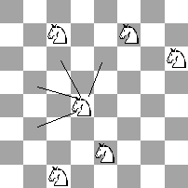
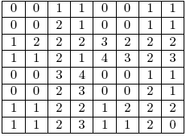
Example: Knights game
N x N chessboard with K knights on it.
Unlike a knight in a traditional game of chess, these can move only as shown in the picture below (so the sum of coordinates is decreased in every move).
There can be more than one knight on the same square at the same time.
Two players take turns moving and, when it is a player’s, turn he chooses one of the knights and moves it.
A player who is not able to make a move is declared the loser.
Grundy Numbers for each square on the board:
Source: https://www.topcoder.com/community/data-science/data-science-tutorials/algorithm-games/

Slide 11
Example: String Game
Teddy and Tracy like to play a game based on strings. The game is as follows.
Initially, Tracy writes a long random string on a whiteboard.
Then, each player starting with Teddy makes turn alternately.
Each turn, the player must erase a contiguous substring that exists in the dictionary.
The player that can't erase any substring in his turn loses the game, and the other player is declared the winner.
Note that after a substring R is erased, the remaining substring becomes separated, i.e. they cannot erase a word that occurs partially to the left of R and partially to the right of R.
Determine the winner of the game, assuming that both players play optimally.
Source: https://www.codechef.com/problems/ASTRGAME

Slide 12
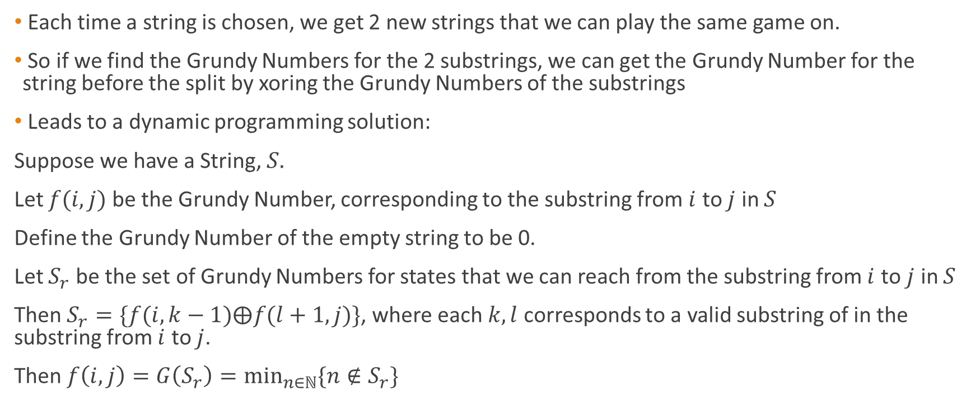
String Game Solution
Each time a string is chosen, we get 2 new strings that we can play the same game on.
So if we find the Grundy Numbers for the 2 substrings, we can get the Grundy Number for the string before the split by xoring the Grundy Numbers of the substrings
Leads to a dynamic programming solution:
Suppose we have a String, $S.$
Let $f(i,j)$ be the Grundy Number, corresponding to the substring from $i$ to $j$ in $S$
Define the Grundy Number of the empty string to be 0.
Let $S_{r}$ be the set of Grundy Numbers for states that we can reach from the substring from $i$ to $j$ in $S$
Then $S_{r}=\{f(i,k−1)⨁f(l+1,j)\}$, where each $k,l$ corresponds to a valid substring of in the substring from $i$ to $j$.
Then $f\left(i,j\right)=G\left(S_{r}\right)=\min_{n∈ℕ}{\{n∉S_{r}\}}$
Source: http://letuskode.blogspot.ca/2014/08/grundy-numbers.html

Slide 13
Partisan Game Approaches
Sadly there doesn’t seem to be any generally applicable strategy for partisan games
If the state space is small, perform a search of the state space
Use dynamic programming or memoisation where possible to reduce search
Play out small examples by hand and look for patterns!
Is there a simple greedy strategy?
Look for possible quantities in the game to optimise for a greedy strategy

Slide 14
Takeover Wars
Source: https://open.kattis.com/problems/takeover
2 players, each has a list of “subsidiaries” represented by integers
Lists are not necessarily the same length
A player can make either a takeover move, or a merge move
A takeover can be made if one player has a larger subsidiary the other player
A player may remove any number from his opponent’s list if the player has a number greater than the number he wishes to remove
A merge move joins two subsidiaries in the player’s own list
This has the effect of removing the individual numbers in the list being merged and adding their sum to the list
The winner is the player that performs a takeover of his opponent’s last subsidiary
Determine which player will win if both play optimally

Slide 15
Takeover Wars Approach
Play the game!
Determine what seems to be a good strategy and put it to the test
Come up with intuitive rules and try to prove them to be correct
In this case:
1. If performing a takeover, takeover the largest one that you can
2. If merging only merge your 2 largest subsidiaries
3. Only perform a takeover if you can takeover the opponent’s largest subsidiary

Slide 16
Takeover Wars continued
We can show that the game will be determined after the first move if (2) and (3) from above are correct
4. If a player, A, is able to perform a takeover according to (3) after their opponent, B, has merged according to (2), then A will win
This is because B won’t be able to make a subsidiary large enough to takeover A’s largest subsidiary
5. If A performs a takeover, then B will be forced to merge
If a takeover is done then A must have a subsidiary larger than B’s largest subsidiary. In this case, B will not be able to perform a takeover according to (3), so B must perform a merge.

Slide 17
Takeover Wars continued
So to find the answer, simulate the game in two cases
Suppose that A’s first move is a merge
Suppose that A’s first move is a takeover (if possible to takeover B’s largest)
Perform merges and takeovers according to (2), (3), and (5)
If A can win either of these cases, then A is the winner, otherwise B wins
This all relies on (2) and (3) being correct…
But we can prove it!
A should merge on first turn:
5 5
4 4 4 4
A should takeover on first turn:
5 1
4 4

Slide 18
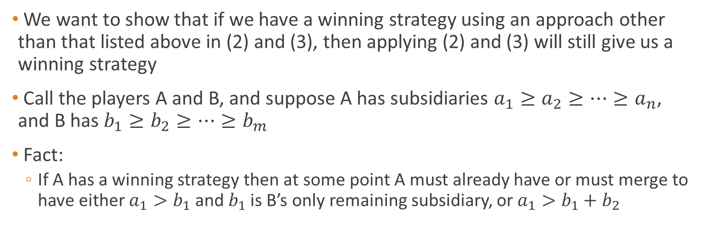
Proof Approach
We want to show that if we have a winning strategy using an approach other than that listed above in (2) and (3), then applying (2) and (3) will still give us a winning strategy
Call the players A and B, and suppose A has subsidiaries $a_{1}≥a_{2}≥…≥a_{n}$, and B has $b_{1}≥b_{2}≥…≥b_{m}$
Fact:
If A has a winning strategy then at some point A must already have or must merge to have either $a_{1}>b_{1}$ and $b_{1}$ is B’s only remaining subsidiary, or $a_{1}>b_{1}+b_{2}$

