Slide 1
Combinatorics
William Fiset

Slide 2
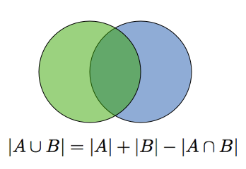
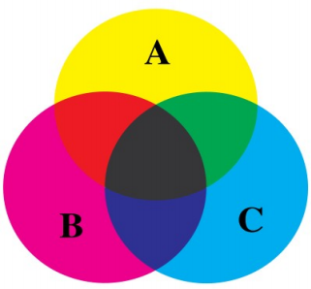
Inclusion Exclusion Principle
Idea: This concept extends to multiple sets

Slide 3
Problem
Q: Suppose that each of the 293 million adults in South America is fluent in Portuguese and Spanish. If 160 million are fluent in Portuguese and 155 million in Spanish, how many are fluent in both languages?
How many seven digit numbers are even and have a 3 in the hundreds place?
_ _ _ _ _ _ _
9 10 10 10 1 10 5
Let A be the set of people who speak Portuguese
Let B be the set of people who speak Spanish
By the inclusion exclusion principle we have:
|A∪B| = |A| + |B| - |A∩B|
|A∩B| = |A| + |B| - |A∪B|
= 160 + 155 - 293
= 22 million
0 is not a valid digit!
Needs to be even
We require a 3 in this position.
Seven digit numbers are even and have a 3 in the hundreds place 5 * 9 * 10⁴ = 450000

Slide 4
Multiplication Principle
Suppose we have a task that consists of T choices performed consecutively. Suppose that choice 1 can be performed in m₁ ways; for each of these choice 2 in m₂ ways; for each of these, choice 3 in m₃ ways; and so fourth. Then the task can be completed in m₁m₂m₃m₄ … m_{T} ways.
m₁ = 2 m₂ = 3 m₃ = 2 m₄ = 1
The number of paths = m₁m₂m₃m₄ = 2 * 3 * 2 * 1 = 12

Slide 5
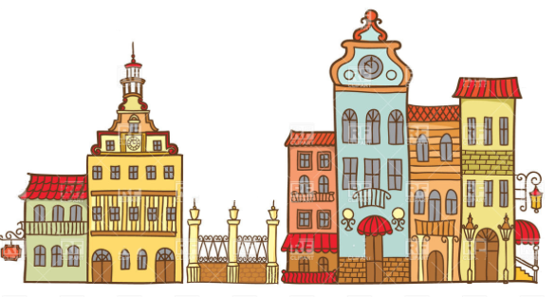
Problem
How many five digit palindromes are there?
Six houses in a row are each painted with one of the following colors: red, green, blue, and yellow. In how many different ways can the houses be painted so that no two adjacent houses are of the same color?
Let our five digit palindrome be: abcba
The digit at position a can only have 9 digits: [1, 9]
The digit at position b can only have 10 digits: [0, 9]
The digit at position c can only have 10 digits: [0, 9]
By the multiplication principle the number of five
Digit palindromes is equal to: 9 * 10 * 10 = 900
When we place the first box we can pick all four colors. For the second box we can pick all colors except the color of the first box, for the third box we can pick all the colors except the one of the second box and etc…
Thus there are 4*3⁵ ways

Slide 6
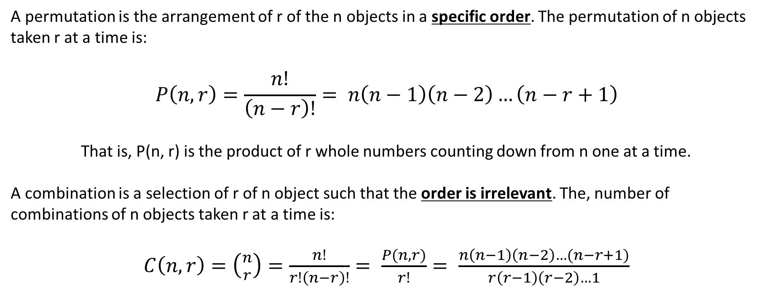
Combinations and Permutations
A permutation is the arrangement of r of the n objects in a specific order. The permutation of n objects taken r at a time is:
$$P\left(n,r\right)=\frac{n!}{\left(n−r\right)!}= n\left(n−1\right)\left(n−2\right)…\left(n−r+1\right)$$
That is, P(n, r) is the product of r whole numbers counting down from n one at a time.
A combination is a selection of r of n object such that the order is irrelevant. The, number of combinations of n objects taken r at a time is:
$C\left(n,r\right)=\left({n \atop r}\right)=\frac{n!}{r!\left(n−r\right)!}= \frac{P(n,r)}{r!}= \frac{n\left(n−1\right)\left(n−2\right)…(n−r+1)}{r\left(r−1\right)\left(r−2\right)…1}$

Slide 7
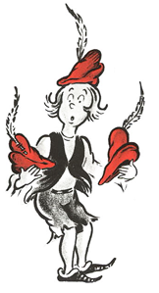
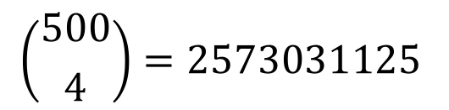
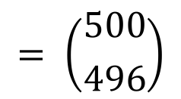

Combinations and Permutations
Bartholomew Cubbins owns 500 hats.
How many ways can he take four of them to class?
How many ways can he leave four hundred ninety six of them at home?
$$\left({500 \atop 4}\right)=2573031125$$
$$= \left({500 \atop 496}\right)$$
$Cliam: \left({n \atop k}\right)=\left({n \atop n−k}\right)$
Proof: $\left({n \atop n−k}\right)$ = $\frac{n!}{\left(n−k\right)!\left(n−\left(n−k\right)\right)!}=$ $\frac{n!}{\left(n−k\right)!\left(k\right)!}= \left({n \atop k}\right)$

Slide 8
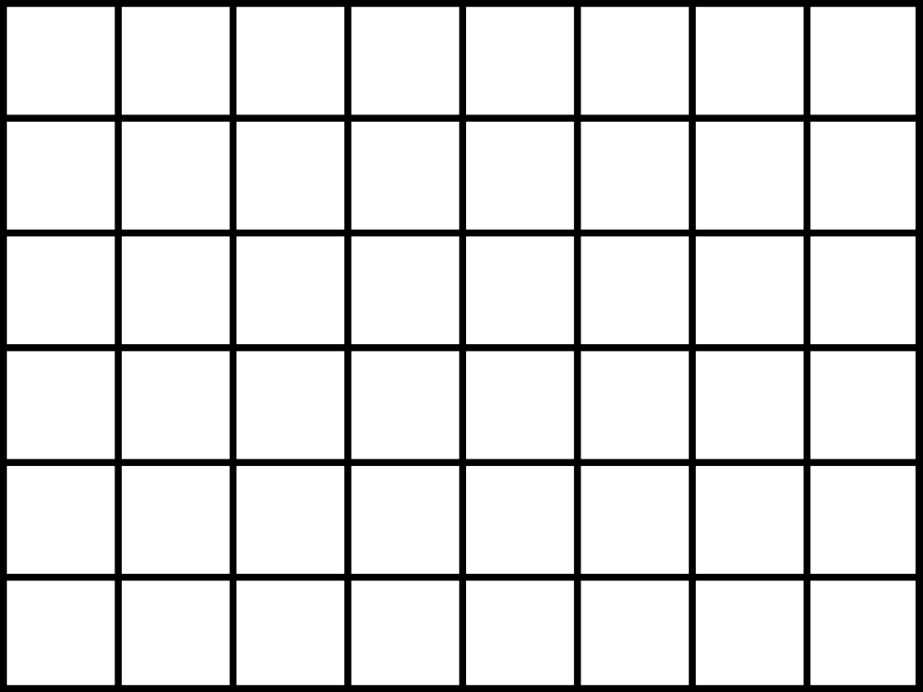

Grids!
How many paths are there from the orange dot to the blue dot going only right and down?
Solution: Any path we trace must go 8 units East
and 6 units south.
Therefore there are
$$\left({14 \atop 8}\right)= \left({14 \atop 6}\right)=3003 paths$$

Slide 9

Grids!
How many paths (without backtracking) go from the orange circle to the purple circle to the blue circle?
Hint: Use the multiplication principle
?
Answer:
$$\left({6 \atop 3}\right)\left({8 \atop 3}\right)=20∗56=1120$$

Slide 10
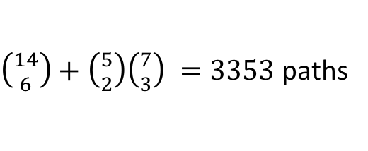
Grids!
How many paths (without backtracking) go from the orange circle to the blue circle?
First start by counting all the paths ignoring the diagonal line
Account for the paths only going through the diagonal
$\left({14 \atop 6}\right)+\left({5 \atop 2}\right)\left({7 \atop 3}\right) =3353$ paths

Slide 11
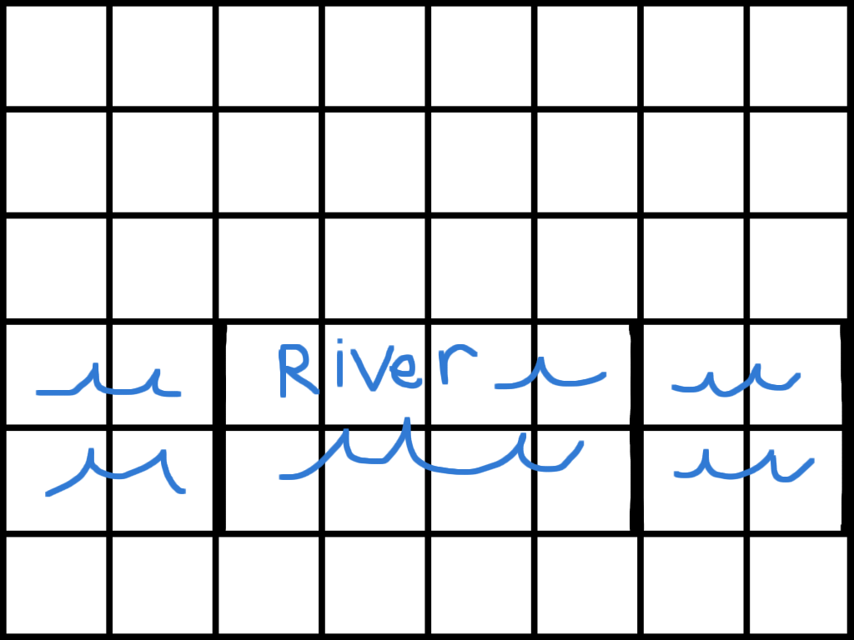

Grids!
How many paths (without backtracking) go from the orange circle to the blue circle now that there is a river?
?
Answer:
$$\left({5 \atop 2}\right)\left({7 \atop 6}\right)+\left({9 \atop 6}\right)\left({3 \atop 2}\right)+\left({11 \atop 8}\right)\left({1 \atop 1}\right)=487$$

Slide 12
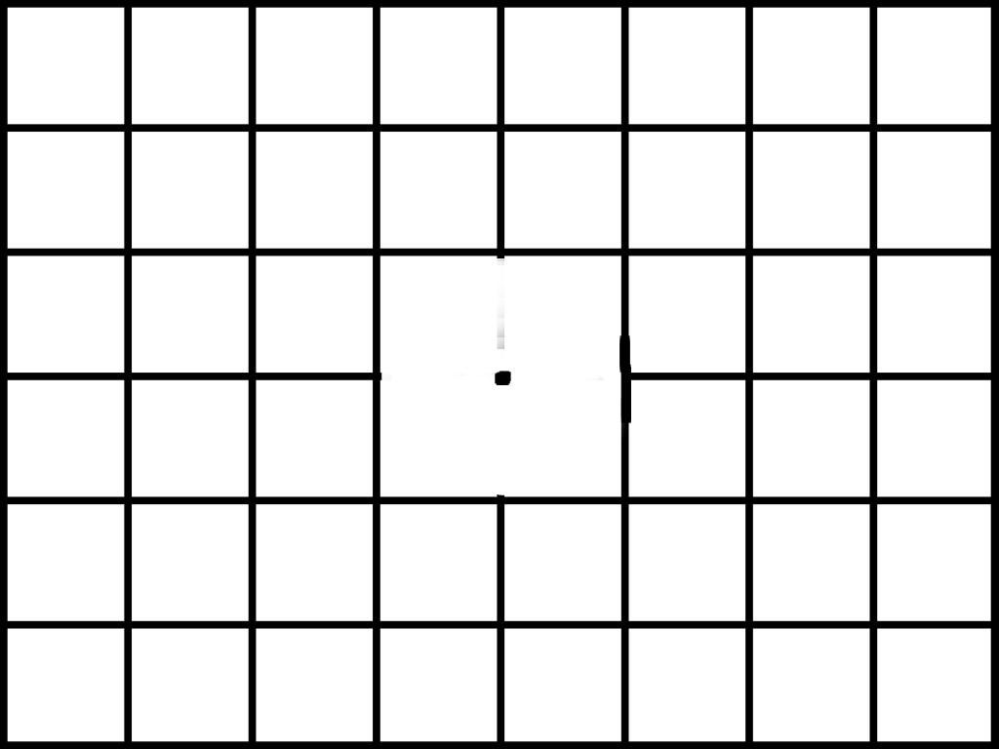

Grids!
How many paths (without backtracking) go from the orange circle to the blue circle now that there is a hole?
Consider all paths
Remove all paths going through the hole
?
Answer:
$$\left({14 \atop 8}\right) −{\left({7 \atop 4}\right)}^{2}$$

Slide 13


Ordered Partitions (Permutations with repetition)
The number of ordered partitions of a set of n elements of the type {n₁, n₂, n₃ … n_{m}} is denoted as:
Think of the n₁, n₂ ... n_{m} terms as the multiplicity of an element.
$$\frac{n!}{n1!n2!n3!…nm!} where n1+n2+ …nm=n$$
How many different ways can we order nine-letter words using only four As and five Bs?
For example valid orderings include: AAABABBBB and BABABABAB
?
Solution: $\frac{9!}{5!4!}$

Slide 14
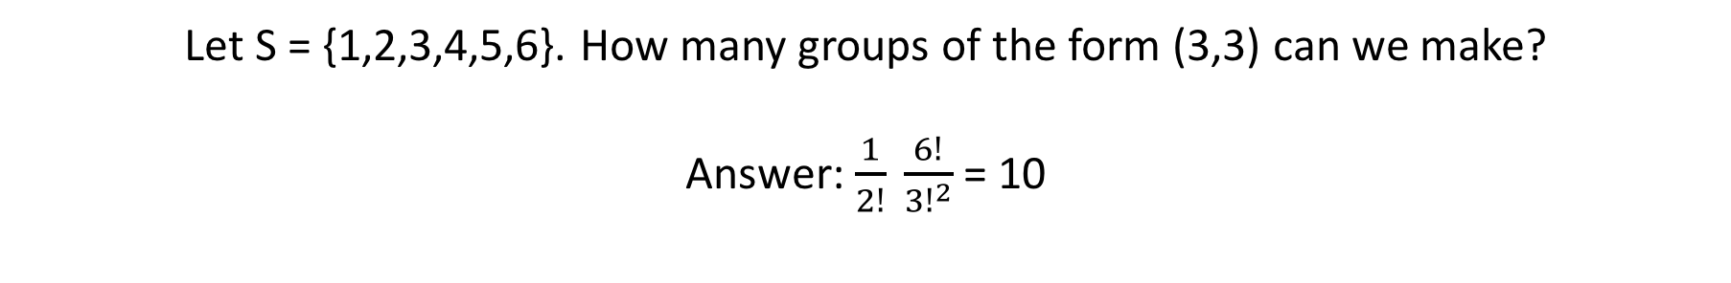

Unordered Partitions
The number of unordered partitions is given by:
n is the number of elements
r is the partition size
m = n/r
$$\frac{1}{m!}\frac{n!}{{r!}^{m}}$$
Let S = {1,2,3,4,5,6}. How many groups of the form (3,3) can we make?
Answer: $\frac{1}{2!} \frac{6!}{{3!}^{2}}$ = 10
?
(1, 2, 3) (1, 2, 4) (1, 2, 5) (1, 2, 6) (1, 3, 4) (1, 3, 5) (1, 3, 6) (1, 4, 5) (1, 4, 6) (1, 5, 6)
(4, 5, 6) (3, 5, 6) (3, 4, 6) (3, 4, 5) (2, 5, 6) (2, 4, 6) (2, 4, 5) (2, 3, 6) (2, 3, 5) (2, 3, 4)

Slide 15


Stars and Bars
How many solutions exist to the equation: a + b + c = 10 where 0 ≤ a, b, c ≤ 10 and are whole numbers?
★★★|★★|★★★★★ = 3 + 2 + 5 = 10
This allows us to ask a new but equivalent question: how many ways can we place two bars among 12 items?
?
Answer:
$$\left({12 \atop 2}\right)=66$$
n = 10 and k = 3
$$\left({n+k−1 \atop k−1}\right)= \left({n+k−1 \atop n}\right)= \left({10+3 −1 \atop 3 −1}\right)= \left({12 \atop 2}\right)$$

Slide 16

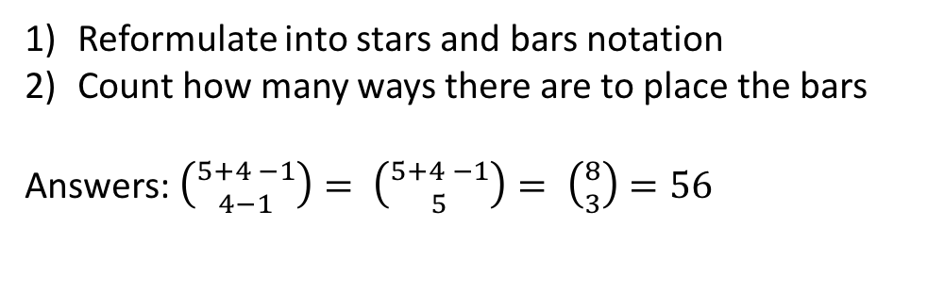
Balls and Urns – Standard problem
How many ways can we distribute five identical balls into 4 distinct urns?
Possible configurations:
★|★★||★★
|||★★★★★
★|★|★★|★
Reformulate into stars and bars notation
Count how many ways there are to place the bars
Answers: $\left({5+4 −1 \atop 4−1}\right)= \left({5+4 −1 \atop 5}\right)= \left({8 \atop 3}\right)=56$
?

Slide 17
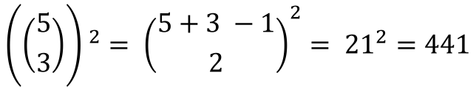
More Balls and Urns
How many ways can we distribute five red and five blue balls into 3 distinct urns?
(Hint: Start with one color)
?
$${\left(\left({5 \atop 3}\right)\right) }^{2}= {\left({5+3 −1 \atop 2}\right)}^{2}= {21}^{2}=441$$
Answer:

Slide 18

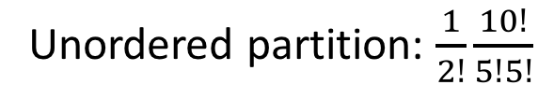

Review Questions
How many different ways can we place ten people into five rooms?
A set of books can be arranged on a bookshelf in 120 different
ways. How many books are in the set?
Ten flowers are to be planted into two separate gardens divided into
five flowers for each garden. How many ways can the two gardens be planted?
?
?
?
Five since P(5,5) = 5! = 120
Unordered partition: $\frac{1}{2!}\frac{10!}{5!5!}$
$$5^{10}$$

Slide 19
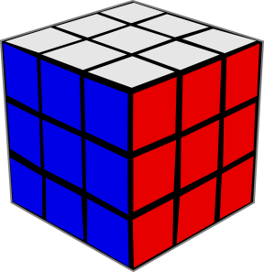
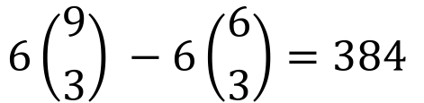
Ant on a Rubik’s Cube
How many paths can an ant starting at the top of the Rubik’s cube take to reach the bottom if it can only move downwards?
?
$$6\left({9 \atop 3}\right) −6\left({6 \atop 3}\right)=384$$
Paths going along each pair of top half and bottom half faces
Subtract all the paths going through a corner.

Slide 20
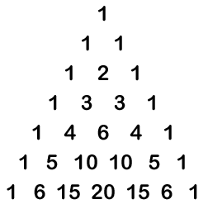
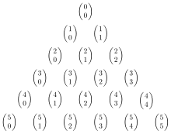
Pascal's Triangle
Ones
Natural Numbers
Triangular Numbers
Tetrahedral Numbers
Pentatope Numbers

Slide 21
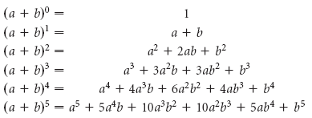


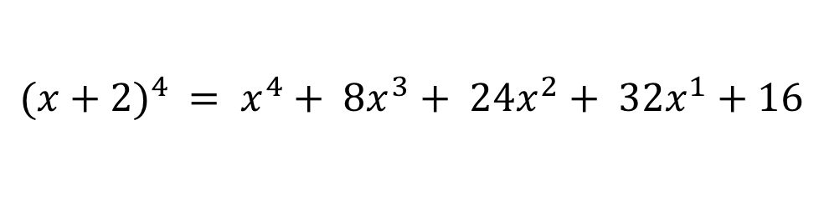
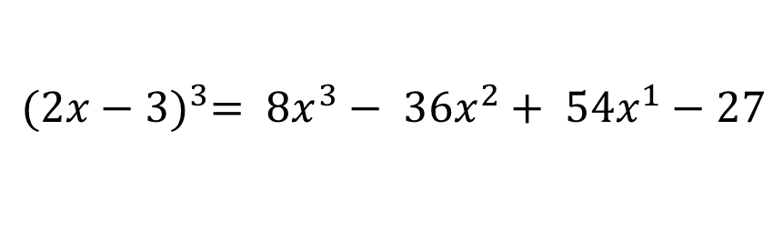
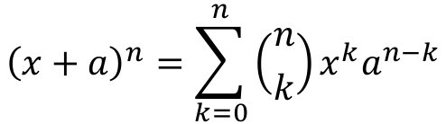
Binomial Theorem
$${\left(x+a\right)}^{n}=\sum_{k=0}^{n}{\left({n \atop k}\right)x^{k}a^{n−k}}$$
Find and expansions using the binomial theorem
$${(x+2)}^{4}$$
$${(2x−3)}^{3}$$
$${(x+2)}^{4} = x^{4}+ {8x}^{3}+ {24x}^{2}+ {32x}^{1}+16$$
$${(2x−3)}^{3}= {8x}^{3}− {36x}^{2}+ {54x}^{1}−27$$

Slide 22
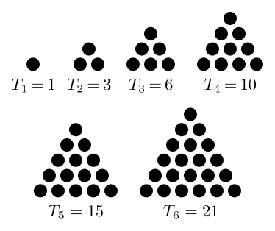
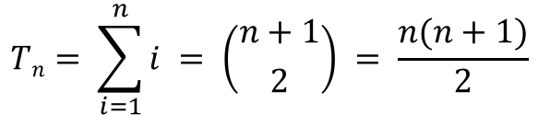
Triangular Numbers
Positive Integers: 1, 2, 3, 4, 5, 6, 7, 8, 9 …
The triangular numbers are the sum of the positive integers from 1...n
$$Tn= \sum_{i=1}^{n}{i} = \left({n+1 \atop 2}\right) = \frac{n(n+1)}{2}$$

Slide 23
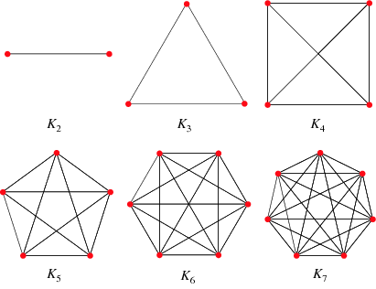
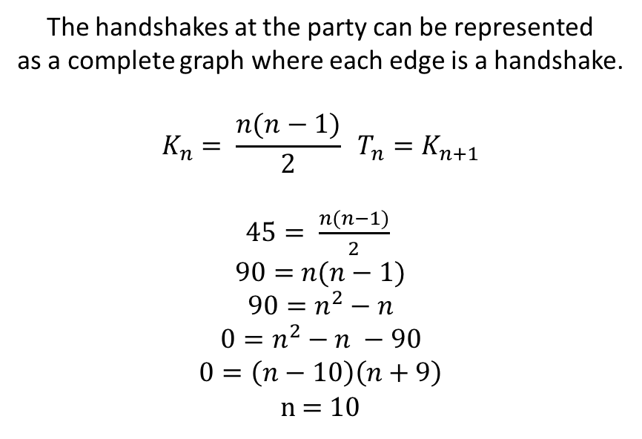
Triangular Numbers
At a party everyone shakes hands with everyone else. If 45 handshakes take place, how many people are at the party?
The handshakes at the party can be represented
as a complete graph where each edge is a handshake.
$$K_{n}= \frac{n(n−1)}{2} T_{n}=K_{n+1}$$
$45= \frac{n(n−1)}{2}$
$90=$ $n(n−1)$
$$90=n^{2}−n$$
$$0=n^{2}−n −90$$
$$0=\left(n−10\right)\left(n+9\right)$$
n = 10

Slide 24

Bell Numbers
The bell numbers count the number of ways in which we can arrange n distinct objects into n identical boxes, where we allow boxes to be empty (We can also think of this as the count of the number of partitions of a set).
Let S = { 1, 2, 3} The partitions of S are P(S) = { {{1,2,3}}, {{1,2},{3}}, {{1},{2,3}}, {{1,3},{2}}, {{1},{2},{3}} }
We can see that |P(S)| = B₃
How many ways are there to place differently colored balls into identical urns if the urns can be empty?
?
Answer: B₅ = 52

Slide 25
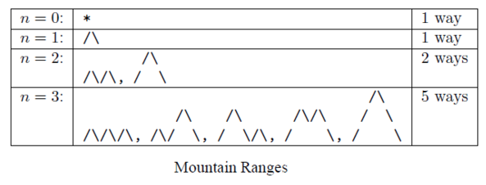

Catalan Numbers
$$C_{n}= \frac{1}{n+1}\left({2n \atop n}\right)$$
1, 1, 2, 5, 14, 42, 132, 429, 1430, 4862, 16796, 58786, 208012
Cn counts the number of expressions containing n pairs of parentheses:
((())) ()(()) ()()() (())() (()())

Slide 26
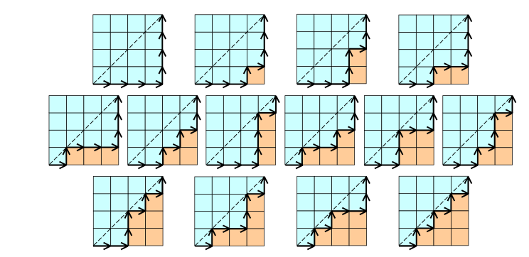
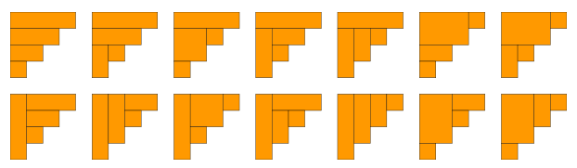
Catalan Numbers

Slide 27
More Patterns
The Online Encyclopedia of Integer Sequences
https://oeis.org/

Slide 28
More Combinatorics
Derangements (Sub-factorial !n)
Multinomial coefficients (a+b+c)³ or (a+b+c+d+e)⁹
Sterling numbers of the first and second kind
Recurrence relations
Generating functions
Combinatorial games
Probabilistic combinatorics

Slide 29
References
Combinatorics a Problem Oriented Approach - Daniel A. Marcus
Finite Mathematics and its Applications Eleventh Edition - Goldstein, Schneider, Siegel
https://brilliant.org/

