Slide 1
Chapter 5: Mathematics
Michaël Bradet-Legris

Slide 2
Table of Contents
Java BigInteger
Combinatorics
Combinations / Permutations
Catalan Numbers
Binomial Coefficients
Number Theory
GCD / LCD
Primality & Prime Factorization
Linear Diophantine / Extended Euclidian Alg.
Chinese Remainder Thm.
Other useful formulas
Cycle Finding (skipped)
Game Theory
Kattis
Pseudoprime Numbers
Bobby’s Bet
Prime Reduction
Divisors
Chinese Remainder
The Magical 3
List of Mathematics-related problems
References

Slide 3
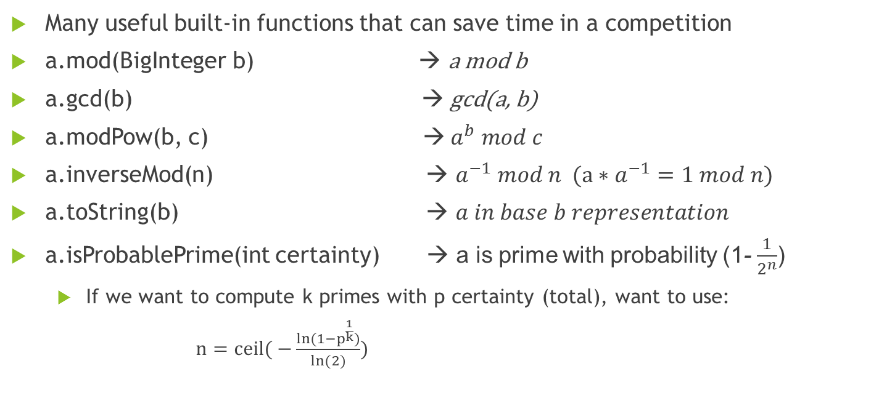
Java BigInteger
Many useful built-in functions that can save time in a competition
a.mod(BigInteger b) → a mod b
a.gcd(b) →$\text{gcd}\text{(}\text{a}\text{, }\text{b}$)
a.modPow(b, c) →${ a}^{b} mod c$
a.inverseMod(n) → $a^{−1} mod n (a∗a^{−1}=1 mod n)$
a.toString(b) → $a in base b representation$
a.isProbablePrime(int certainty) → a is prime with probability (1- $\frac{1}{2^{n}}$)
If we want to compute k primes with p certainty (total), want to use:
$n=ceil( −\frac{ln⁡(1−p^{\frac{1}{k}})}{ln⁡(2)}$)

Slide 4
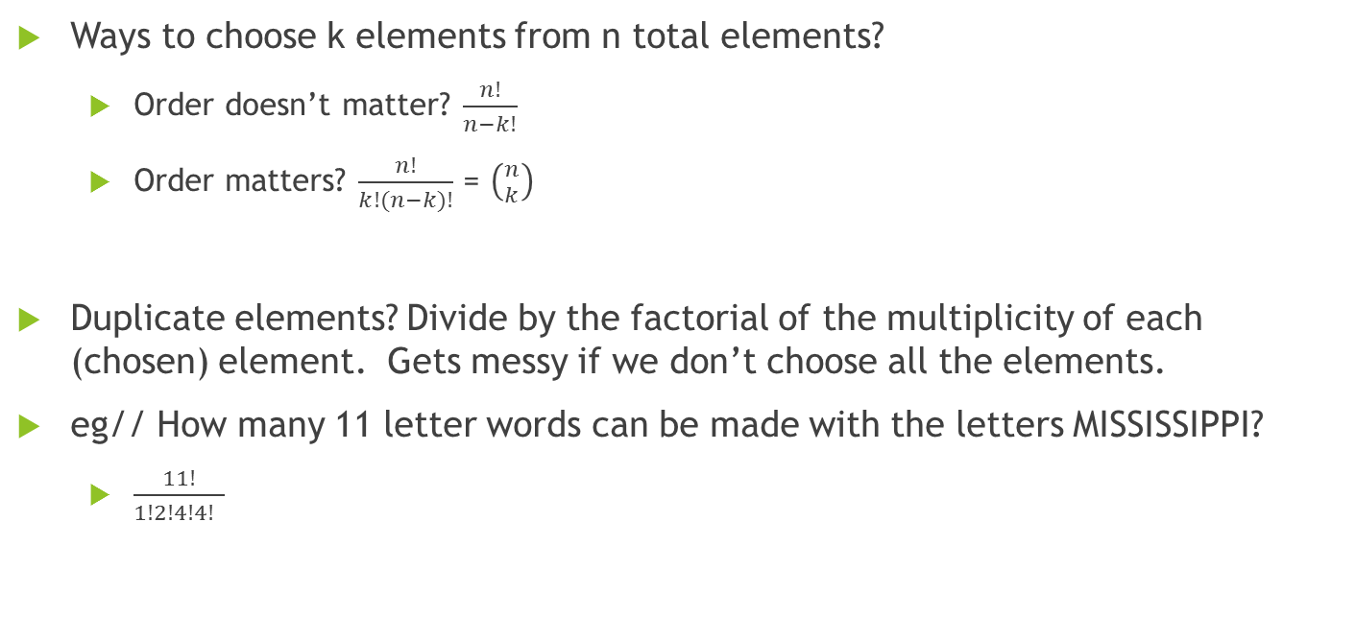
Combinatorics: Combinations / Permutations
Ways to choose k elements from n total elements?
Order doesn’t matter? $\frac{n!}{n−k!}$
Order matters? $\frac{n!}{k!(n−k)!}$ = $\left({n \atop k}\right)$
Duplicate elements? Divide by the factorial of the multiplicity of each (chosen) element. Gets messy if we don’t choose all the elements.
eg// How many 11 letter words can be made with the letters MISSISSIPPI?
$\frac{11!}{1!2!4!4! }$

Slide 5
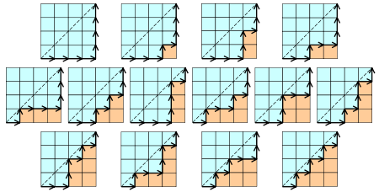
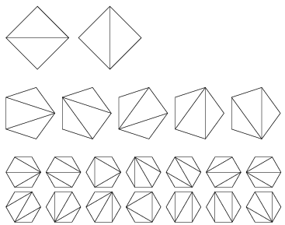
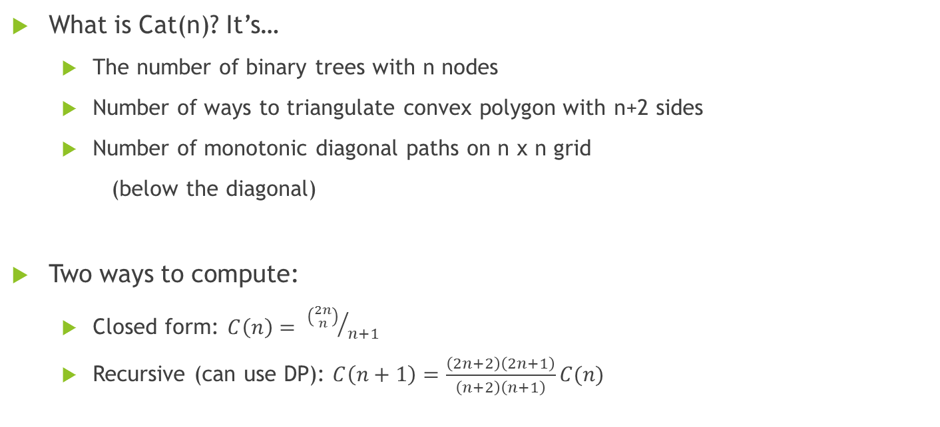
Combinatorics: Catalan Numbers
What is Cat(n)? It’s…
The number of binary trees with n nodes
Number of ways to triangulate convex polygon with n+2 sides
Number of monotonic diagonal paths on n x n grid
(below the diagonal)
Two ways to compute:
Closed form: $C\left(n\right)= {\left({2n \atop n}\right)}/{n+1}$
Recursive (can use DP): $C\left(n+1\right)=\frac{\left(2n+2\right)\left(2n+1\right)}{\left(n+2\right)\left(n+1\right)}C(n)$

Slide 6
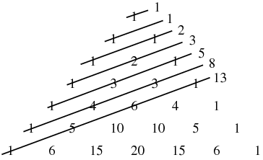
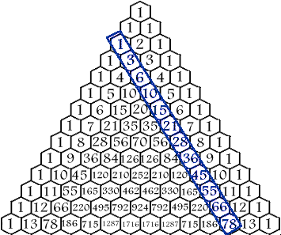
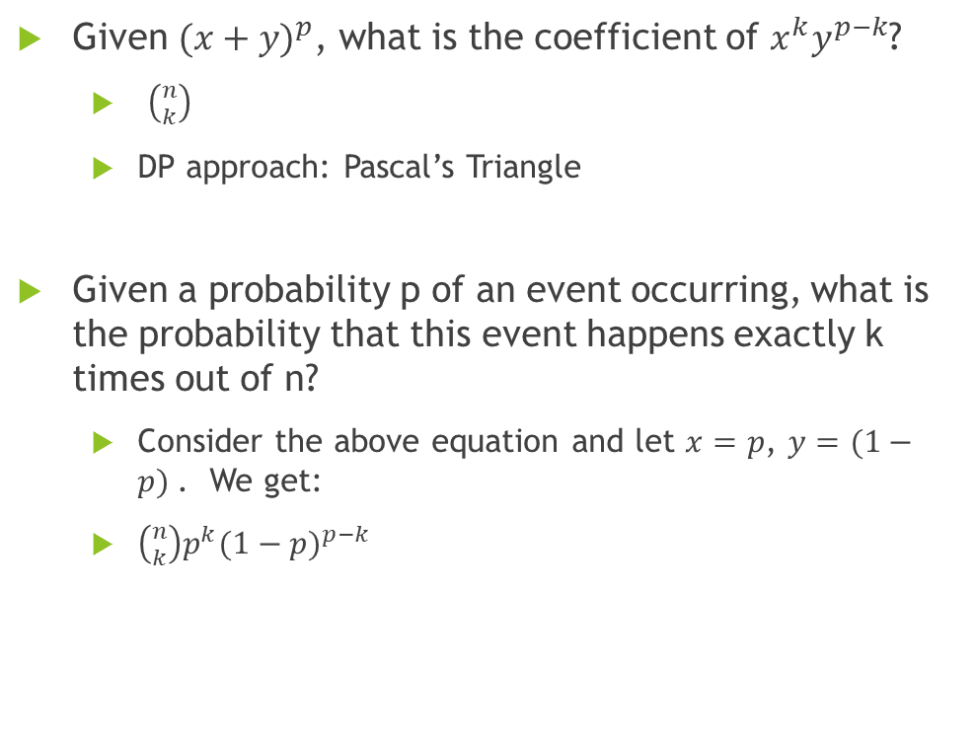
Combinatorics: Binomial Coefficients
Given ${(x+y)}^{p}$, what is the coefficient of $x^{k}y^{p−k}$?
$\left({n \atop k}\right)$
DP approach: Pascal’s Triangle
Given a probability p of an event occurring, what is the probability that this event happens exactly k times out of n?
Consider the above equation and let $x=p$, $y=(1−p)$. We get:
$\left({n \atop k}\right)p^{k}{(1−p)}^{p−k}$

Slide 7
Number Theory: GCD / LCD
GCD : Greatest Common Divisor (Integers)
For n < m, gcd(n, m) = gcd(n, m mod n). Can do this recursively.
Used for other computations, like Chinese Remainder Thm, Extended Euclidean Algorithm & LCM
Can use BigInteger.gcd(), but this is slower.
LCM : Least Common Multiple (Integers)
//n < m
int gcd(int n, int m){
if (n == 0)
return m;
return gcd(m nod n, n);
}
int lcm (int n, int m){
return (n*m)/gcd(n,m);
}

Slide 8
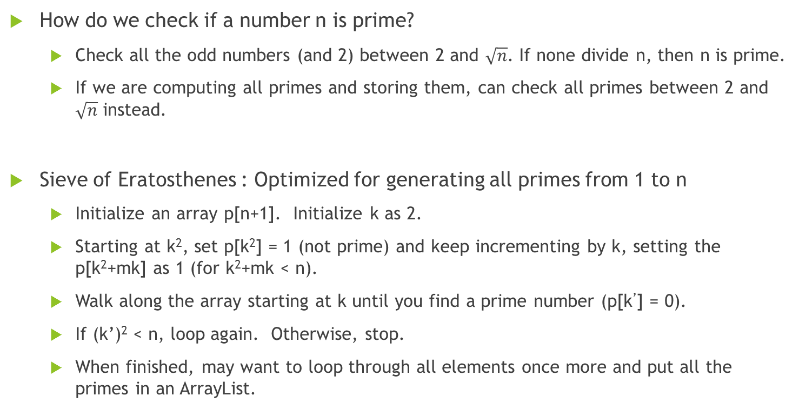
Number Theory: Primality / Prime Factorization
How do we check if a number n is prime?
Check all the odd numbers (and 2) between 2 and $\sqrt{n}$. If none divide n, then n is prime.
If we are computing all primes and storing them, can check all primes between 2 and $\sqrt{n}$ instead.
Sieve of Eratosthenes : Optimized for generating all primes from 1 to n
Initialize an array p[n+1]. Initialize k as 2.
Starting at k², set p[k²] = 1 (not prime) and keep incrementing by k, setting the p[k²+mk] as 1 (for k²+mk < n).
Walk along the array starting at k until you find a prime number (p[k’] = 0).
If (k’)² < n, loop again. Otherwise, stop.
When finished, may want to loop through all elements once more and put all the primes in an ArrayList.

Slide 9
Number Theory: Primality / Prime Factorization

Slide 10
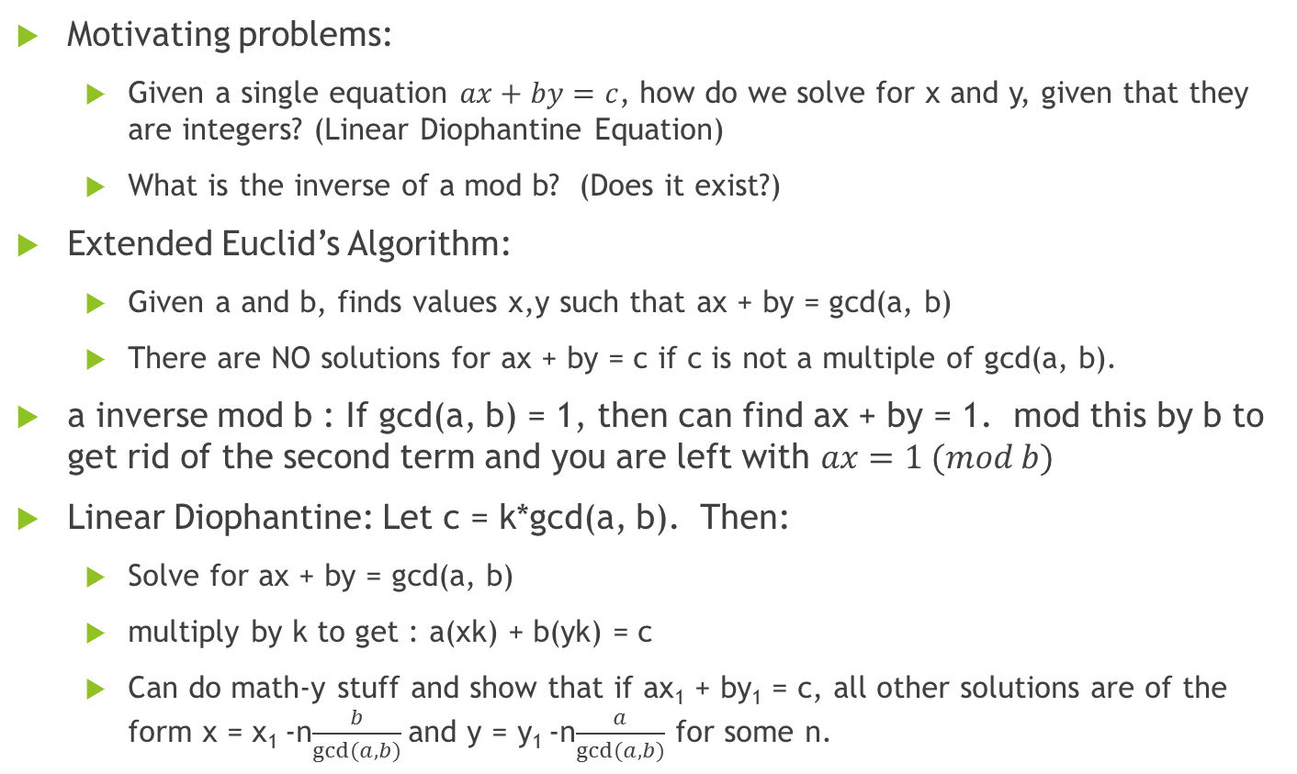
Number Theory: Linear Diophantine / Extended Euclidian Alg.
Motivating problems:
Given a single equation $ax+by=c$, how do we solve for x and y, given that they are integers? (Linear Diophantine Equation)
What is the inverse of a mod b? (Does it exist?)
Extended Euclid’s Algorithm:
Given a and b, finds values x,y such that ax + by = gcd(a, b)
There are NO solutions for ax + by = c if c is not a multiple of gcd(a, b).
a inverse mod b : If gcd(a, b) = 1, then can find ax + by = 1. mod this by b to get rid of the second term and you are left with $ax=1 (mod b)$
Linear Diophantine: Let c = k*gcd(a, b). Then:
Solve for ax + by = gcd(a, b)
multiply by k to get : a(xk) + b(yk) = c
Can do math-y stuff and show that if ax₁ + by₁ = c, all other solutions are of the form x = x₁ -n$\frac{b}{gcd⁡(a,b)}$and y = y₁ -n$\frac{a}{gcd⁡(a,b)}$ for some n.

Slide 11
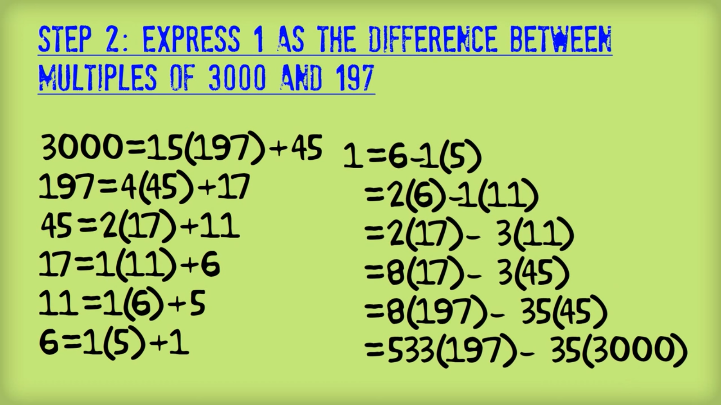
Number Theory: Linear Diophantine / Extended Euclidian Alg.

Slide 12
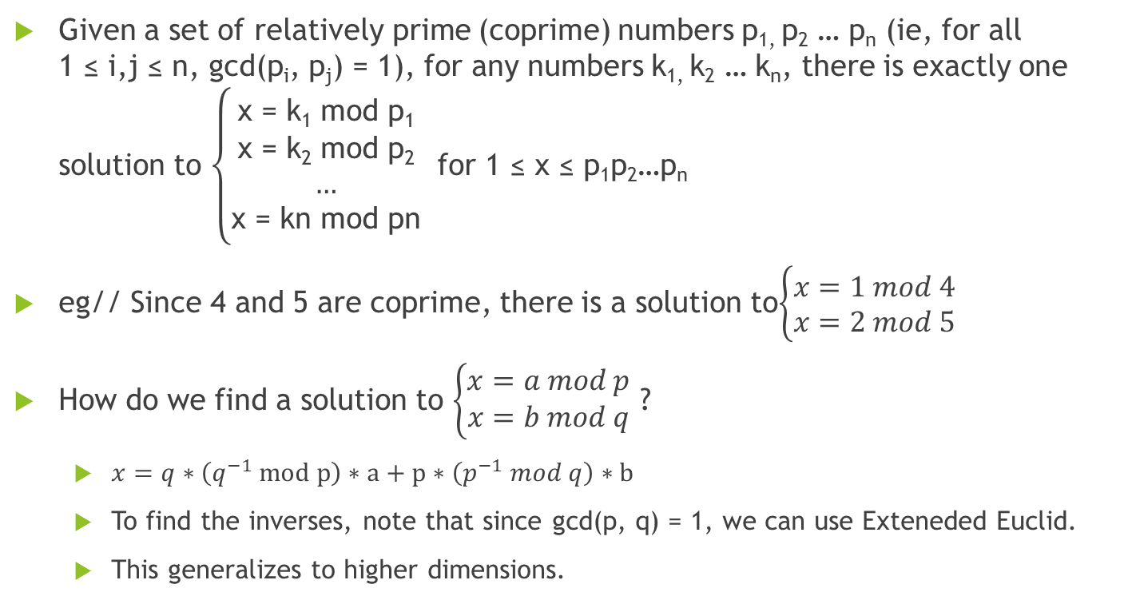
Number Theory: Chinese Remainder Thm
Given a set of relatively prime (coprime) numbers p_{1,} p₂ … p_{n} (ie, for all 1 ≤ i,j ≤ n, gcd(p_{i}, p_{j}) = 1), for any numbers k_{1,} k₂ … k_{n}, there is exactly one solution to $\left\{\begin{aligned}\text{x}\text{ = }\text{k}\text{1} \text{mod} \text{p}\text{1} \\ \text{x}\text{ = }\text{k}\text{2} \text{mod} \text{p}\text{2} \\ … \\ \text{x}\text{ = }\text{kn} \text{mod} \text{pn}\end{aligned}\right.$ for 1 ≤ x ≤ p₁p₂…p_{n}
eg// Since 4 and 5 are coprime, there is a solution to$\left\{\begin{aligned}x=1 mod 4 \\ x=2 mod 5\end{aligned}\right.$
How do we find a solution to $\left\{\begin{aligned}x=a mod p \\ x=b mod q\end{aligned}\right.$ ?
$x=q∗\left(q^{−1} mod p\right)∗a+p∗\left(p^{−1} mod q\right)∗b$
To find the inverses, note that since gcd(p, q) = 1, we can use Exteneded Euclid.
This generalizes to higher dimensions.

Slide 13
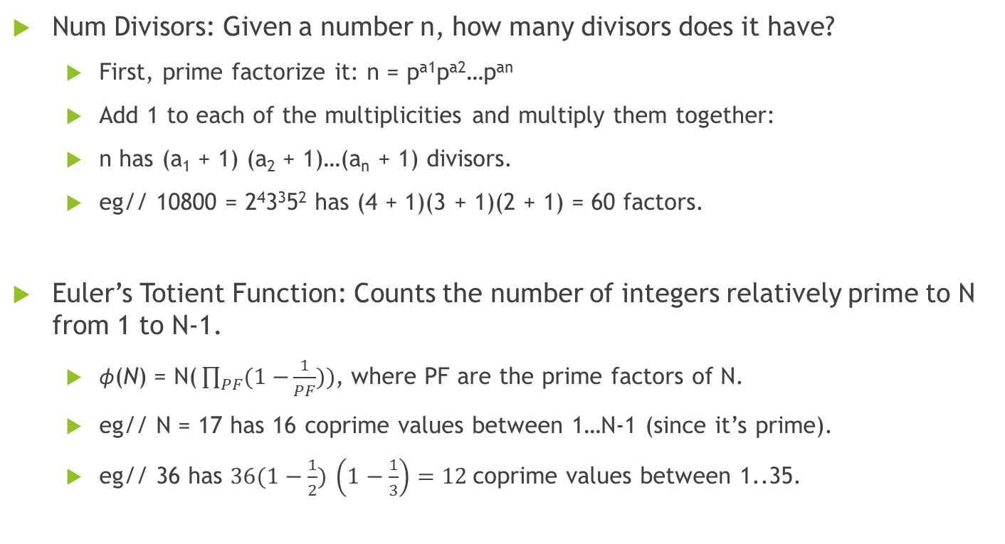
Number Theory: Other useful formulas
Num Divisors: Given a number n, how many divisors does it have?
First, prime factorize it: n = p^{a1}p^{a2}…p^{an}
Add 1 to each of the multiplicities and multiply them together:
n has (a₁ + 1) (a₂ + 1)…(a_{n} + 1) divisors.
eg// 10800 = 2⁴3³5² has (4 + 1)(3 + 1)(2 + 1) = 60 factors.
Euler’s Totient Function: Counts the number of integers relatively prime to N from 1 to N-1.
$\text{ϕ}\text{(}\text{N}\text{)}\text{ = }\text{N}\text{(}\prod_{PF}{(1−}\frac{1}{PF}))$, where PF are the prime factors of N.
eg// N = 17 has 16 coprime values between 1…N-1 (since it’s prime).
eg// 36 has $36(1−\frac{1}{2})$ $\left(1−\frac{1}{3}\right)=12$coprime values between 1..35.

Slide 14
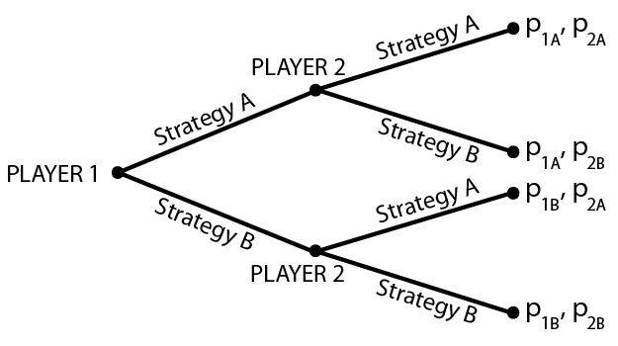
Game Theory
Most game theory problems can be solved one of
three/four ways:
Dynamic Programming
2 sticks game
Tree Traversals / Backtracking / Decision Trees
Pattern Finding (may or may not be some sort of mathematical formula)
Probability (You make your decisions without knowing your opponent’s decisions)
Rock-Paper-Scissors-Lizard-Spock

Slide 15
Kattis: Pseudoprime Numbers Difficulty : 3.8
Fermat’s Little Theorem: for a ≥ 0, if p is a prime then a^{p} ≡ a (mod p).
This sometimes works even if p is not a prime. In this case, p is a base-a pseudoprime.
Input: p, a values where 2 ≤ p ≤ 1 000 000 000, 1 < a< p. Terminated by 0 0.
Output: “yes” or “no” (if p is a base-a pseudoprime)
Sample Input:
3 2
10 3
341 2
341 3
1105 2
1105 3
0 0
Sample Output:
no
no
yes
no
yes
yes

Slide 16
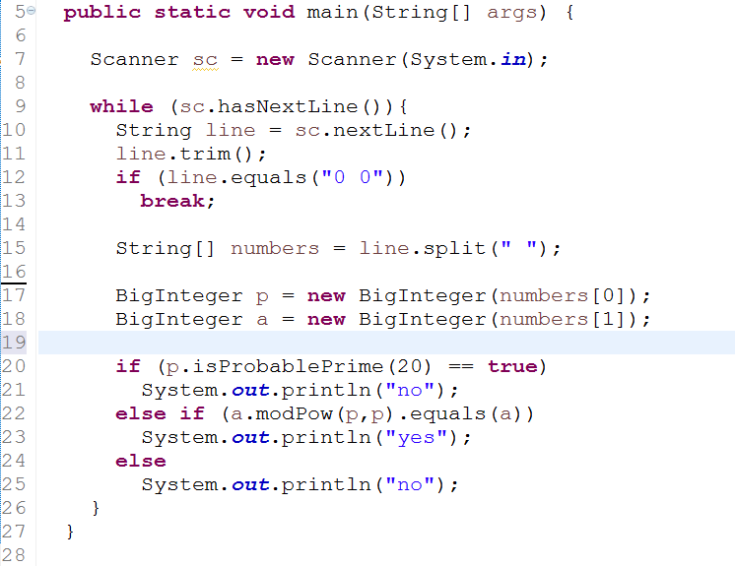

Slide 17
Kattis: Bobby’s Bet Difficulty: 3.5
Roll an S-sided Y times and want at least X of them to be ≥ R.
If his return is W times his bet if this happens, should he take the bet or not?
1 ≤ N ≤ 10 000 test cases
Input: R S X Y W, 1 ≤ R ≤ S ≤ 20, 1 ≤ X ≤ Y ≤ 10, 1 ≤ W ≤ 100
Output: “yes” or “no”, if he should take the bet.
Sample Input:
2
5 6 2 3 3
5 6 2 3 4
Sample Output:
no
yes

Slide 18
Kattis: Prime Reduction Difficulty: 4.2
Sample Input:
2
3
5
76
100
2001
4
Write a function that does these four things:
If x is prime, stop.
Prime factor x.
Call the function again with n = sum of distinct primes of x.
Input: ≤ 20 000 test cases, each an integer between 2 and 10⁹. Terminated by 4.
Output: The number that was a parameter to the last function call and the number of function calls.
Sample Output:
2 1
3 1
5 1
23 2
5 5
5 6

Slide 19

Kattis: Divisors Difficulty: 4.8
How many divisors does $\left({n \atop k}\right)$ have?
Input: at most 11 000 lines of 0 ≤ k ≤ n ≤ 431
Output: the number of divisors (does not overflow 64 bits)
Sample Input:
5 1
6 3
10 4
Sample Output:
2
6
16

Slide 20

Kattis: Chinese Remainder Difficulty: 4.7
Input: 1 ≤ T ≤ 1000 test cases. Each line : a n b m, 1 ≤ n, m ≤ 10⁹, 0 < b < m, 0 < a < n.
Output: x < nm and nm, where x satisfies $\left\{\begin{aligned}x=a (mod n) \\ x=b (mod m)\end{aligned}\right.$
Sample Input:
2
1 2 2 3
151 783 57 278
Sample Output:
5 6
31471 217674

Slide 21
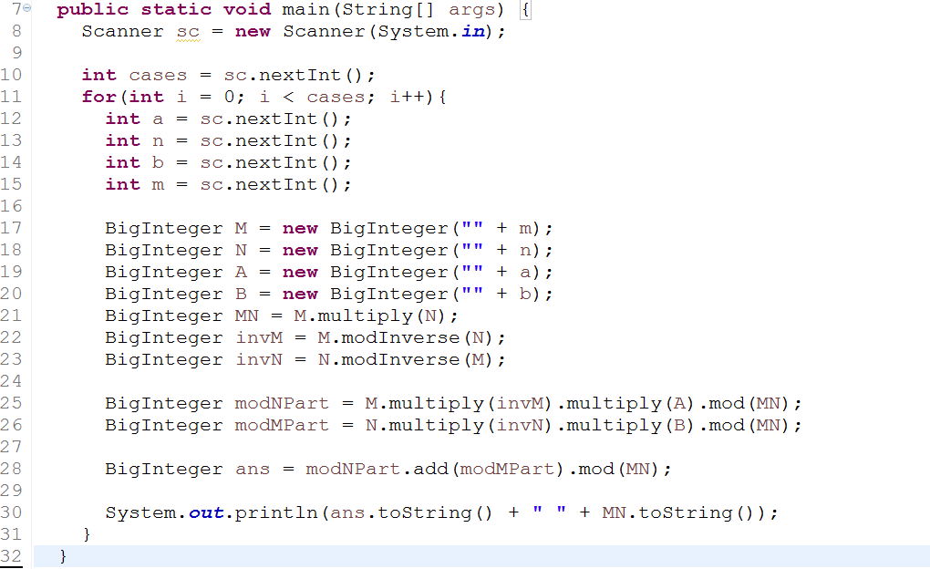

Slide 22
Kattis: The Magical 3 Difficulty: 5.4
Input: ≤ 1000 lines, each with a single positive integer n. Terminates with ‘0’. n fits in a 32-bit int.
Output: The smallest base b for which n ends with 3 in base b, or “No such base”.
Sample Input:
11
123
104
2
3
0
Sample Output:
4
4
101
No such base
4

Slide 23
Kattis: List of Mathematics related problems
Almost Perfect
Candy Division
Crypto
Divisors
Factovisors
Fareysums
Fundamental Neighbors
Goldbach2
Industrial Spy
Catalan Numbers

Slide 24
Kattis: List of Mathematics related problems
List game
Magical 3
Perfect Powers
Primal
Prime Path
Primes
Primal Presentation
Prime Reduction
Primes 2
Catalan Square

Slide 25
Kattis: List of Mathematics related problems
Pseudoprime
Relatives
Smallest Multiple
Farey
CPU
CPU2
Happy Prime
LCM Pair Sum
Number Set Easy

Slide 26
Kattis: List of Mathematics related problems
Number Set Hard
List Game 2
PXS
Bakterjie
Chinese Remainder
General Chinese Remainder
Heliocentric
Radar
Substitution

Slide 27
References
Wikipedia
Competitive Programming 3 – Stephen Halim
https://www.youtube.com/watch?v=ru7mWZJlRQg
https://www.youtube.com/watch?v=mgvA3z-vOzc

