Slide 1

Aravinth Sankar
*

Slide 2
Frequent Flyer ( Train Ticket Booking )
Requirements
* Sign up
* Login
* Search and Book tickets
* View and Cancel tickets

Slide 3
Front end - AngularJS, JQuery, HTML5, Bootstrap
Backend - Java
Data Base - Microsoft SQL

Slide 4
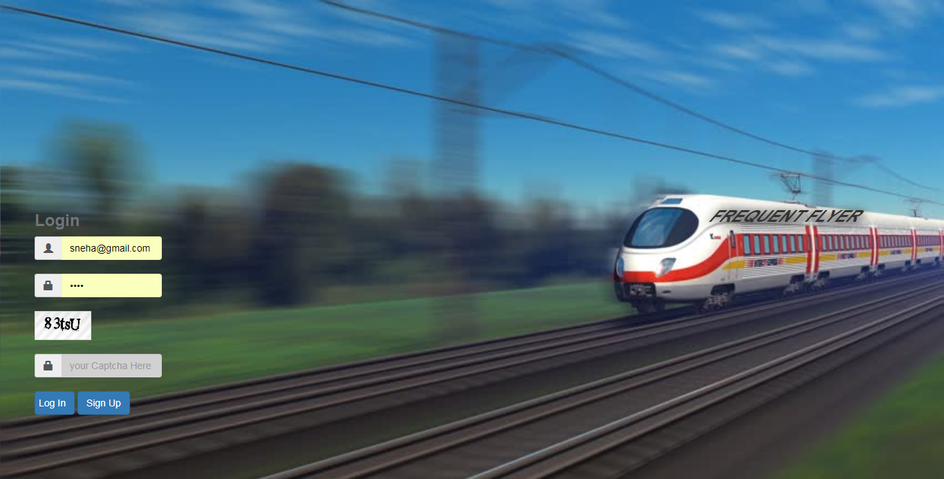

Slide 5
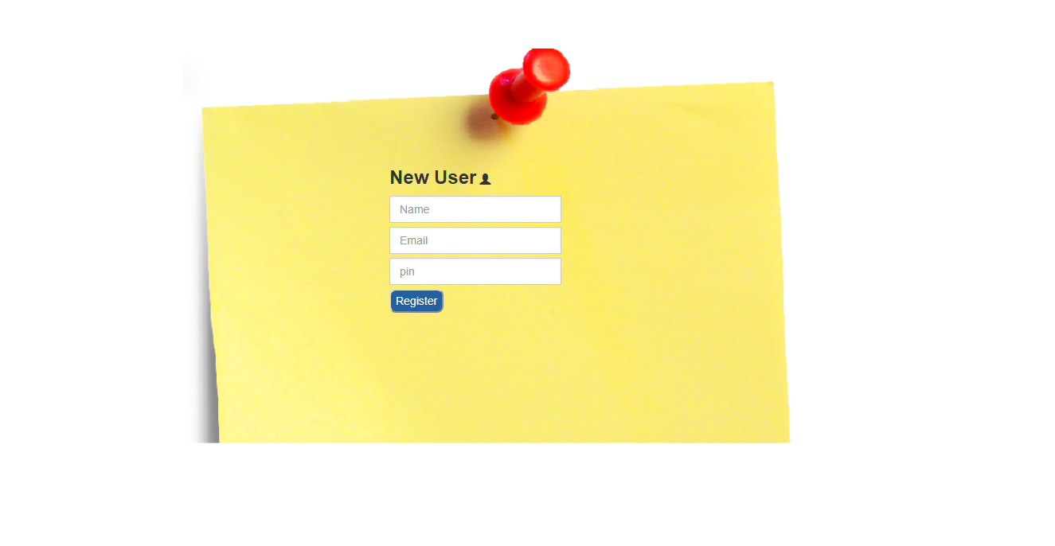

Slide 6
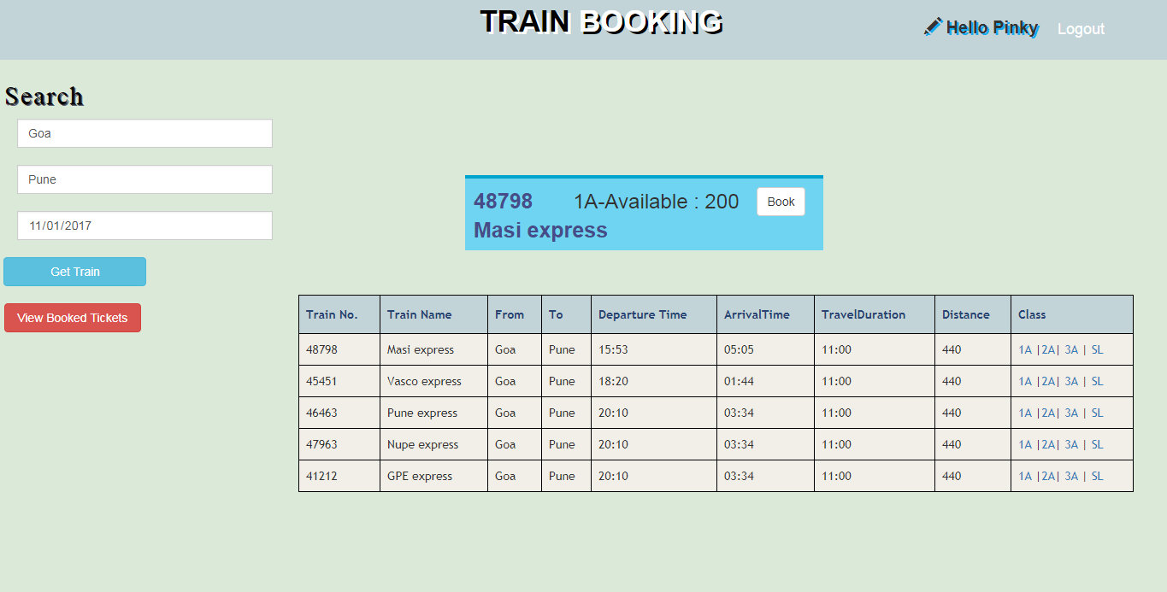

Slide 7
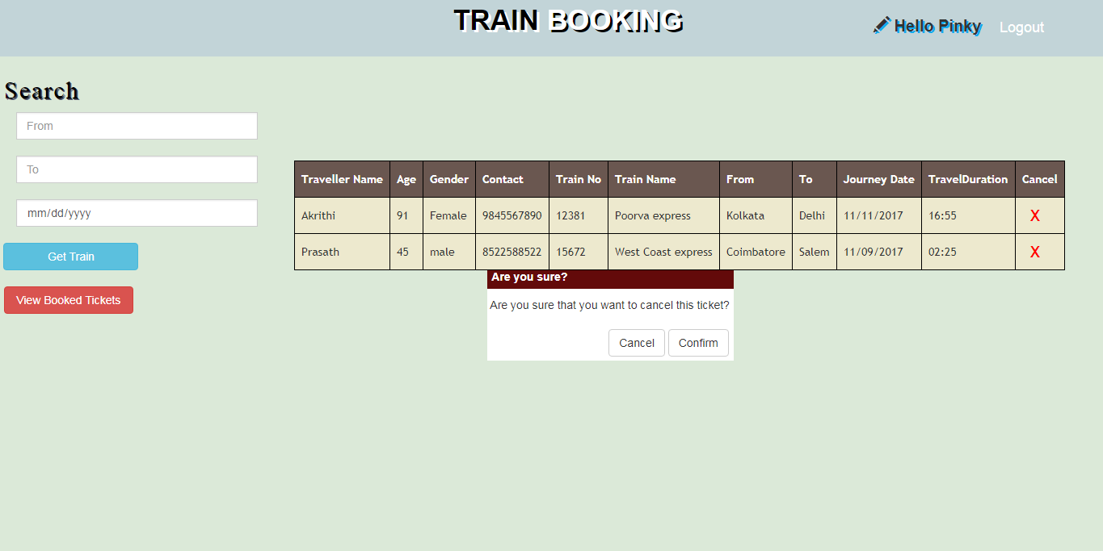

Slide 8
Follow Coding Standards
Know what you do
Errors are our friends
Several ways for a single solution
Google is the best teacher

Slide 9



