Slide 1
A Journey to the Amazon Porting the User App Interface Onto Amazon’s EC2 F1 FPGAs
Megan knight, Gabriel ore

Slide 2
Introduction to the Application
Amazon Web Services (AWS) cloud provides an EC2 F1 instance
Xilinx UltraScale Plus FPGAs are used as hardware accelerators and communicate with Xeon processors using PCI express
Cloud computing datacenters face the struggle of the slowdown in CPU scaling and Moore’s Law
FPGAs provide a solution to this obstacle
Issue with using FPGAs is the usability and programmability of them due to the need for RTL coding
Goal of this project: Port the user app interface used in EEL4720 labs to the EC2 F1 FPGAs

Slide 3
Hardware Development Kit (HDK) Software Development Kit (SDK)
Amazon AWS provides a Github with all relevant files for the EC2 F1 HDK and SDK
HDK includes example code (hello world and DMA) and all tools needed to create an Amazon FPGA Image (AFI)
SDK includes AFI management tools such as commands to run and load AFIs on an FPGA
AFIs (similar to bitstreams) are what is loaded onto the FPGAs
Creating an AFI can take a couple hours
C code is used to read and write from addresses the same way as in EEL4720 labs

Slide 4
Current Code Structure in HDK Examples
cl_hello_world
cl_vhdl_wrapper
AXI Signals
nnnn hello_world
AXI Signals
AXI Signals

Slide 5
User App Code Structure
cl_hello_world
cl_vhdl_wrapper
hello_world
AXI Signals
user_app
AXI Signals
AXI Signals
mmap_sigs
cl_hello_world
mmap_sigs
hello_world_sigs
memory_map

Slide 6
User App Code Structure
hello_world
user_app
s_axi_aclk
mmap_rst
s_axi_wready
AXI Signals
clk
wr_addr
rst
wdata
mmap_wr_en
arvalid_q
mmap_wr_addr
input
araddr_q
mmap_wr_data
memory_map
hello_world_code
s_axi_rdata
mmap_rd_en
mmap_rd_addr
output
mmap_rd_data

Slide 7
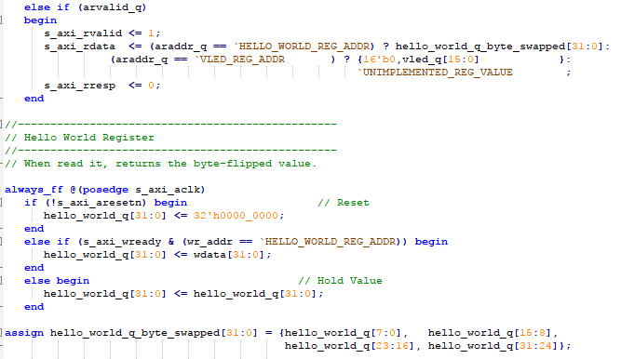
Current Structure vs. User App Structure
Current Structure
Requires the use of AXI signals to write/read from addresses
Must test using EC2 instances
Slight errors in code can cost many hours due to having to rebuild AFI each time
Sufficient for very simple code

Slide 8
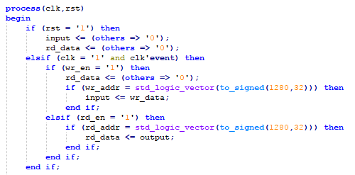
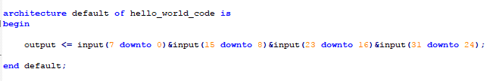
Current Structure vs. User App Structure
User App Structure
Does not require manipulation of AXI signals
Can test outside of EC2 instances using same procedure from labs in EEL4720
Can save a lot of time since this process of testing is much faster
More organized for more complicated code

Slide 9
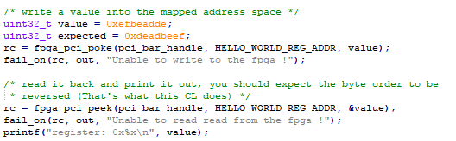
Software
C code is used to read/write from addresses
Provided read/write functions
fpga_pci_poke(pci_bar_handle, address, value)
Equivalent to board->write(value, address, size)
fpga_pci_peek(pci_bar_handle, address, &variable)
Equivalent to board->read(&variable, address, size)
Prewritten C code for hello world example handles all initializations
Only need to modify where to read/write from in the peek_poke_example function

Slide 10
Fibonacci Calculator with the User App Structure
Can use the exact same format as the hello world example
Only need to change memory mapping, C code, and replace hello_world_code.vhd with desired code (fib.vhd)
hello_world
s_axi_aclk
user_app
mmap_rst
s_axi_wready
AXI Signals
clk
wr_addr
clk
rst
rst
wdata
mmap_wr_en
arvalid_q
mmap_wr_addr
go
araddr_q
mmap_wr_data
memory_map
fib
n
s_axi_rdata
mmap_rd_en
mmap_rd_addr
result
done
mmap_rd_data

Slide 11
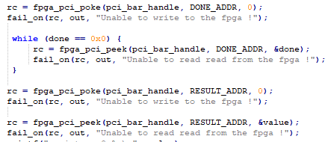
User App Structure Issue and Fix
Cannot read from an address if not previously written to
Temporary Fix: Write to the address prior to reading from it

Slide 12
Hello World and Fibonacci Code Demonstration

Slide 13
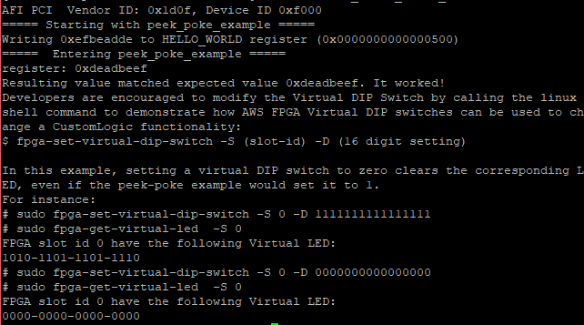
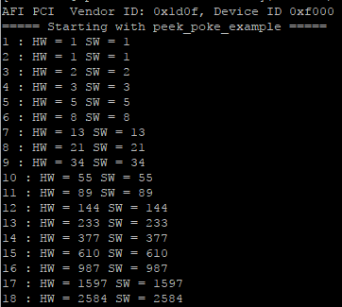
Results
Hello World Fibonacci

Slide 14
Provided Documentation
Tutorials
How to SSH into an EC2 instance
How to build/run an AFI
How to create your own custom logic
Hello World and Fibonacci code with user app structure

Slide 15
Conclusion
What we have learned
How to use Putty to SSH into an EC2 instance
How to build AFIs and run them on F1 FPGAs
How to use the user app structure from EEL4720 to create our own custom logic
The User App structure we have created for the F1 FPGAs will allow them to be more useable and possibly save a lot of debugging time
Provided tutorials so that others can learn how to use Amazon’s EC2 F1 FPGAs for their own applications
Next steps
Fix read issue
Add virtual LED and Switch functionality to user app interface
Test more applications and collect performance data to write a paper

