Slide 1
Intel DevCloud Training Module
Intel Platform Acceleration Card (PAC) Overview
Greg Stitt
Associate Professor
Department of Electrical and Computer Engineering
University of Florida

Slide 2
Introduction: Heterogeneous Computing
General-purpose microprocessors are flexible
But, can be slow for some types of computation
Heterogeneous computing
Partition app across different computing resources
Use “accelerators” for intensive functions
Often provide much higher parallelism than microprocessor
Microprocessor handles less intensive parts
Examples:
Microprocessor + GPU
Microprocessor + FPGA (field-programmable gate array)
int main() {
…
slow_func();
…
}
µP
FPGA/
GPU

Slide 3
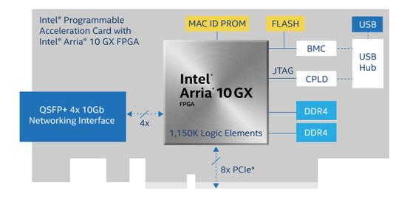
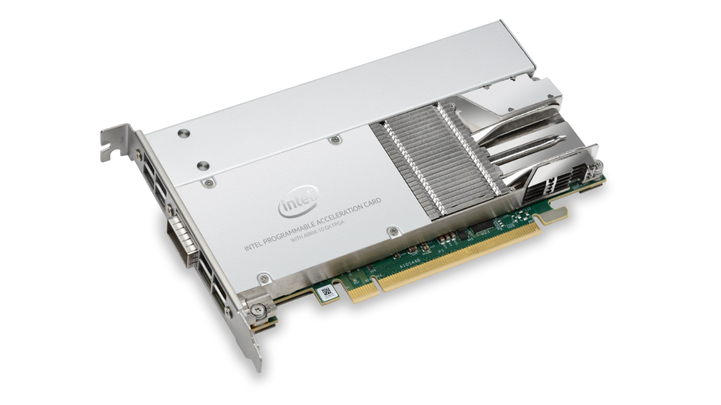
Intel Platform Acceleration Card (PAC)
PCI Express (PCIe) accelerator card
Uses Arria 10, Stratix 10 field-programmable gate array (FPGA)
FPGAs implement custom hardware to accelerate software
Especially effective for energy-efficient acceleration
PAC provides FPGA with on-board DDR4 RAM
Can also access host processor’s main memory
Provides networking interface for low-latency networking
*images from https://www.intel.com/content/www/us/en/programmable/products/boards_and_kits/dev-kits/altera/acceleration-card-arria-10-gx/overview.html

Slide 4
PAC Applications
Where is PAC used?
Networking
Security, monitoring, function virtualization
Streaming analytics
Financial technology (Fintech)
Banking, investment, risk management
Genomic sequencing
Video transcoding, media processing
Machine learning
Anything with significant parallelism
See Intel FPGA Acceleration Hub for detailed examples
https://www.intel.com/content/www/us/en/programmable/solutions/acceleration-hub/solutions.html

Slide 5
FPGAs vs GPUs
How do FPGAs and Intel PAC compare to GPUs?
Highly application dependent
GPUs have higher peak computational throughput
But, not always possible to achieve peak throughput
FPGAs are generally lower power
10s of Watts vs. 100-200 Watts
FPGAs can be more energy efficient
Large-scale systems: data centers and supercomputers
Power and cooling costs millions of dollars per year
Embedded systems
FPGA system-on-a-chip (SoC) provides low “SWaP”
Size, weight, and power
FPGAs are much more difficult to program in most cases

Slide 6
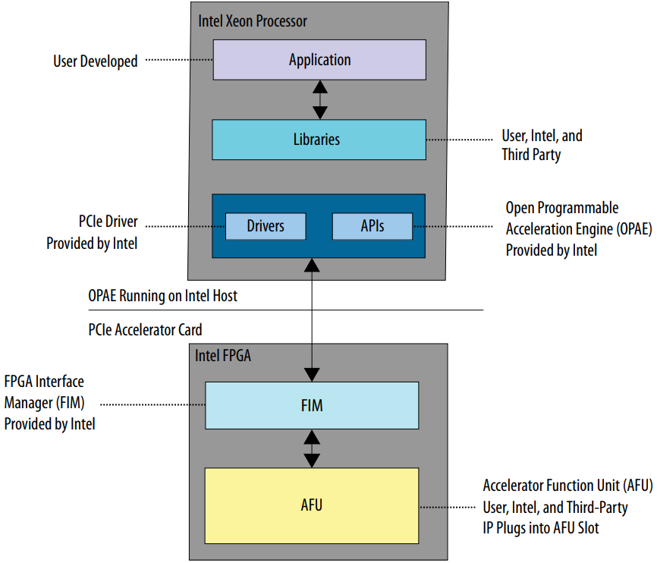
Acceleration Functional Units (AFUs)
Intel refers to custom hardware in FPGA as “AFU”
Common PAC application:
Software on host processor
AFU running on PAC’s FPGA
Host processor uses OPAE API for FPGA communication
Open Programmable Acceleration Engine
FPGA Interface Manager (FIM) provides hardware interface for communication
*image from Intel Acceleration Stack Quick Start Guide for Intel® Programmable Acceleration Card with Intel® Arria® 10 GX FPGA

Slide 7
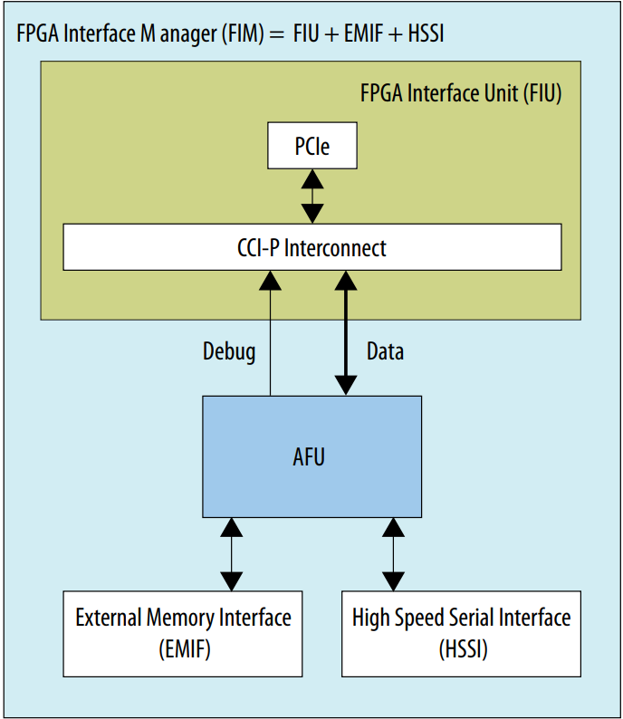
FPGA Interface Manager (FIM)
FIM provides three interfaces for AFU
Host processor over PCIe
Host memory (FPGA-initiated)
Memory-mapped I/O (SW initiated)
Uses CCI-P
Core Cache Interface Protocol
External (on-board) memory
e.g. DDR4 RAM
High-speed serial interface
e.g. networking
*image from Intel Acceleration Stack Quick Start Guide for Intel® Programmable Acceleration Card with Intel® Arria® 10 GX FPGA

Slide 8
How to Design AFUs?
Register-transfer-level (RTL) code
Summary: Use hardware description languages to specify low-level hardware details
Tradeoffs: High flexibility, high performance and efficiency, very difficult, low productivity
Examples: Verilog, SystemVerilog, VHDL
High-level code
Summary: Use higher-level descriptions that abstract away low-level hardware
Tradeoffs: higher productivity, less flexible specification, possibly lower performance
Examples:
OpenCL: language for writing parallel code on heterogeneous platforms
DPC++: data-parallel C++ that can be compiled to different accelerators
Accelerator-specialized libraries
Summary: call pre-implemented functions that can run on multiple accelerators
Tradeoffs: highly optimized, easy to use, only beneficial if appropriate functions exist
Examples:
OneAPI: provides libraries that can run on different accelerators
OpenVINO: Machine-learning-specialized toolkit for emulating human vision using convolutional neural nets (CNNs)

Slide 9
Intel DevCloud
Follow-up presentations will demonstrate how to develop PAC applications using Intel DevCloud
Development cloud of Intel hardware
DevCloud provides:
Development nodes with FPGA tools for designing AFUs
PAC nodes for testing and evaluating AFU performance
Training modules will demonstrate AFU design for different design-entry methods
Can also be done on local resources

