Slide 1
Intel DevCloud Training Module
FPGA Timing Optimization
Multicycle Paths
Greg Stitt
Professor
Department of Electrical and Computer Engineering
University of Florida

Slide 2
Multicycle Paths
Consider simple pipeline with adders of two widths
64-bit adder will be critical path
How to optimize?
What if in2 and in3 only arrive every two cycles at best?
Solution 1: use a ½ frequency clock for the 64-bit add paths
Not ideal for small sub-circuits
Extra overhead if input arrival rate is not constant
Solution 2: use multicycle paths
Tell synthesis to allow 2 cycles for 64-bit add
in0
in1
in2
in3
in0_r
in1_r
in2_r
in3_r
32
32
64
64
Allow 2 cycles for this path
32-bit Add
64-bit Add
32
64
out0_r
out1_r
out0
out1
= FF or register

Slide 3
Setup and Hold Edges
Review:
Setup time: time before a FF’s edge that data must arrive by
Hold time: amount of time after an edge that FF must be stable
Alternatively, the amount of time that must pass before the FF input changes
Basically defines the minimum delay between FFs
But, to what edge does the setup and hold apply?
Setup edge: the clock edge which the data must arrive before
Actual deadline is the setup edge - setup time (ignoring skew)
Hold edge: the clock edge which new data must arrive after
Actual threshold is hold edge + hold time (ignoring skew)

Slide 4
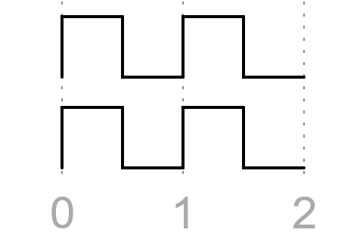
Single-Cycle Paths
Synthesis tools assume all register pairs are single-cycle paths
Setup edge is the rising edge of the destination clock, 1 cycle after the source clock
Hold edge is the rising edge of the destination clock, the same cycle as the source clock
Setup Edge
Source Clock
Hold Edge
Dest Clock

Slide 5
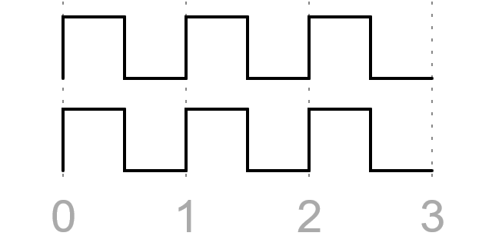
Multicycle Paths
Need to tell the synthesis tool the setup edge
Provided by multicycle path constraint
set_multicycle_path -from {source} -to {dest} -setup 2
Specifies that the setup check should be done relative to rising edge 2
Essentially moves the setup edge over by 1 cycle
But, also moves the hold edge over by 1 cycle
Setup Edge
Source Clock
Hold Edge
Dest Clock

Slide 6
Why does the hold edge move?
For synthesis, an N-cycle path means that the destination register is loaded every N cycles
Alternatively, the destination register holds its output for N cycles
If data arrives before cycle N-1, the register will be incorrectly overwritten
Example: 5-cycle path
If data arrives in cycles 1-3, it will overwrite the contents of the register
Cycle 4 is the only cycle data can arrive to preserve register for 5 cycles
Same thing applies to single-cycle paths
Data arriving too early within same cycle overwrites destination FF
Synthesis must guarantee the hold timing (w/ buffers, delays)
Generally not what you want (greatly slows down FPGA clocks)

Slide 7
Changing the Hold Edge
How can we design our circuit so the hold edge does not have to move?
Solution: make destination register immune to data arriving early with delayed enable
Enable asserted at most every N cycles
Hold edge no longer matters, early data will be ignored
Tell synthesis about the new hold edge:
set_multicycle_path -from {source} -to {dest} -hold 1
Specified as negative offset from the setup edge
For setup of N, usually want hold of N-1
e.g.:
set_multicycle_path -from {source} -to {dest} -setup 5
set_multicycle_path -from {source} -to {dest} -hold 4
enable
Source Reg
Multicycle Logic
N FFs
….
Dest Reg
= FF or register

Slide 8
Complete Design
enable
Constraints:
set_multicycle_path -from {in2_r*} -to {out1_r*} -setup 2
set_multicycle_path -from {in3_r*} -to {out1_r*} -setup 2
set_multicycle_path -from {in2_r*} -to {out1_r*} -hold 1
set_multicycle_path -from {in3_r*} -to {out1_r*} -hold 1
in0_r
in1_r
in2_r
in3_r
32
32
64
64
en0_r
32-bit Add
64-bit Add
Setup Edge
Source Clock
en1_r
32
64
Hold Edge
out0_r
out1_r
Dest Clock
MAX10 FPGA experiment shows improvement from 167.7 MHz to 242.4 MHz
= FF or register

Slide 9
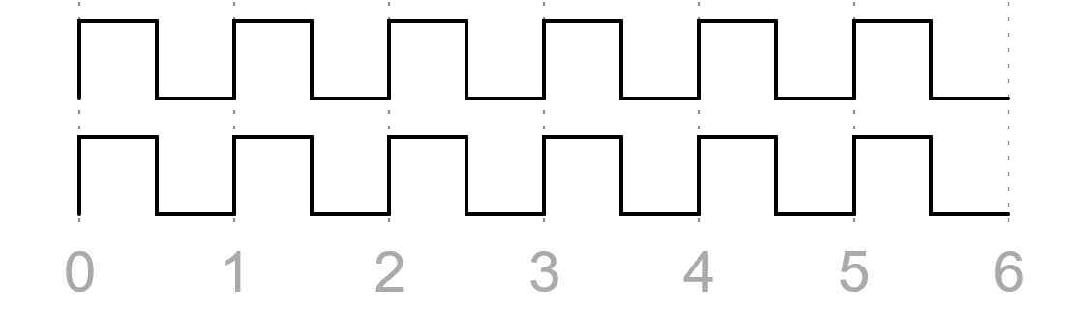
Synthesis Constraints

Slide 10
Summary
Timing optimization involves iterative optimization of cell/logic and interconnect delays
Logic optimizations
Reduce logic inputs
Pipelining, retiming
Many device-specific optimizations
Interconnect optimizations
Minimize resources and fanout
Pipelined interconnect
NoC, time-multiplexing
Next presentation will demonstrate simple code example

Slide 11
Original Circuit
Simple pipeline with adders of two widths
64-bit adder will be critical path
What if in2 and in3 only arrive every two cycles?
Solution 1: use a separate clock domain that runs at ½ the frequency
Not ideal
Solution 2: use multicycle paths
in0_r
in1_r
in2_r
in3_r
32
32
64
64
32-bit Add
64-bit Add
32
64
out0_r
out1_r
= FF or register

Slide 12
Multicycle Path Optimization
Strategy: allow the timing bottleneck to take multiple cycles
64-bit add now has 2 cycles to complete
Enable asserted every 2 cycles
Loads inputs to all input registers
Extra register on the 32-bit add to align out0 and out1
Two FFs enable out1 after 2 cycles
Can be extended to any # of cycles
enable
in0_r
in1_r
in2_r
in3_r
32
32
64
64
32-bit Add
64-bit Add
en0_r
32
add_r
64
en1_r
32
out0_r
out1_r
= FF or register

Slide 13
Multicycle Path Optimization
in0_r
in1_r
in2_r
in3_r
32
32
64
64
32-bit Add
64-bit Add
32
Allow 2 cycles for this path
Extra register to align outputs
add_r
64
32
out0_r
out1_r
= FF or register

Slide 14
Synthesis Constraints
Previous design will work in simulation, but has synthesis problems
Synthesis assumes all paths between register should take 1 cycle
Need to inform synthesis about multicycle paths using constraints:
set_multicycle_path -from {in2_r*} -to {out1_r*} -setup 2
set_multicycle_path -from {in3_r*} -to {out1_r*} -setup 2
set_multicycle_path -from {in2_r*} -to {out1_r*} -hold 1
set_multicycle_path -from {in3_r*} -to {out1_r*} -hold 1
What do these constraints mean?

Slide 15
Complete Design
enable
Constraints:
set_multicycle_path -from {in2_r*} -to {out1_r*} -setup 2
set_multicycle_path -from {in3_r*} -to {out1_r*} -setup 2
set_multicycle_path -from {in2_r*} -to {out1_r*} -hold 1
set_multicycle_path -from {in3_r*} -to {out1_r*} -hold 1
in0_r
in1_r
in2_r
in3_r
32
32
64
64
32-bit Add
64-bit Add
en0_r
32
Setup Edge
add_r
64
en1_r
Source Clock
Hold Edge
32
Dest Clock
out0_r
out1_r
= FF or register

