Slide 1
Intel DevCloud Training Module
Designing AFUs for the Intel PAC w/ RTL Code
Basics + Memory-Mapped I/O using Core Cache Interface Protocol
Greg Stitt
Associate Professor
Department of Electrical and Computer Engineering
University of Florida

Slide 2
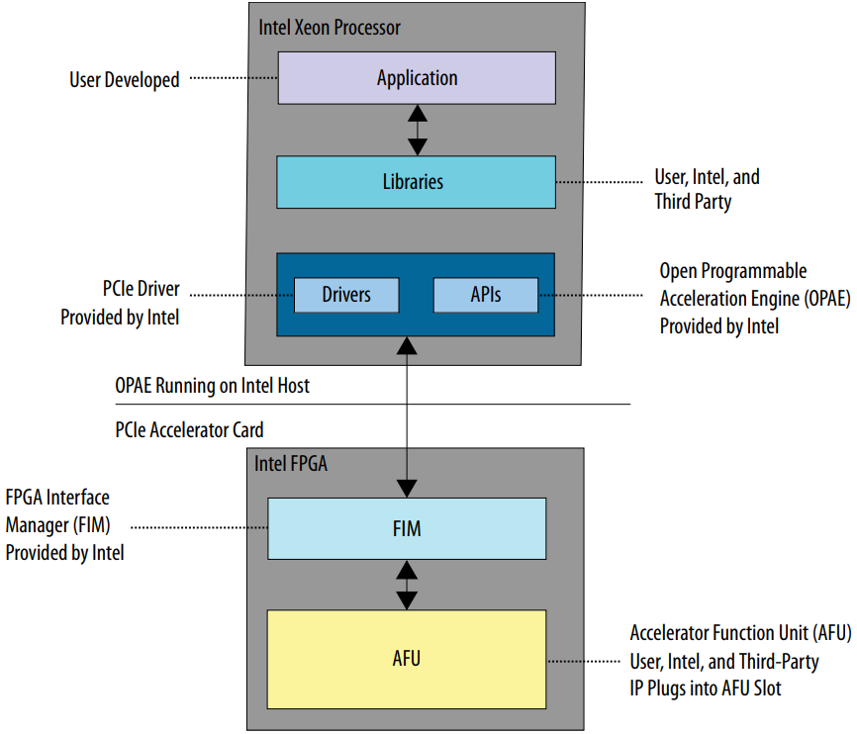
Introduction
FPGA-implemented functions: Acceleration Functional Units (AFUs)
These slides will demonstrate:
How to create AFUs with RTL code
Basic AFU requirements
AFU communication with processor
Using memory-mapped I/O
FPGA can also read/write processor memory (not covered in these slides)
Will focus on RTL issues
OPAE software API discussed in another video
Code examples and exercises provided to expand on slides
https://github.com/ARC-Lab-UF/intel-training-modules/tree/master/RTL
*image from Intel Acceleration Stack Quick Start Guide for Intel® Programmable Acceleration Card with Intel® Arria® 10 GX FPGA

Slide 3
AFU RTL Design Considerations
Designer responsibilities:
Identify what function to accelerate
Identify potential parallelism in function
For FPGAs, usually “deep” pipeline parallelism for streaming data
Pipelines take multiple cycles to produce output, but can start new inputs before previous output
Works well with data “streams,” where inputs arrive continuously
Create parallel circuit in a hardware-description language
SystemVerilog, Verilog, VHDL
Test and verify AFU functionality and performance
Integrate AFU into software
Intel APIs, libraries, tools
OPAE (Open Programmable Acceleration Layer): software API for AFU communication
ASE (AFU Simulation Environment): hardware/software co-simulation
Quartus: RTL synthesis, placement-and-routing, timing closure

Slide 4
AFU Top-Level Module
AFU interface provided in ccip_std_afu.sv
Clocks
Reset and status
CCI-P structure for communication with host processor
module ccip_std_afu
(
// CCI-P Clocks and Resets
input logic pClk, // Primary CCI-P interface clock.
input logic pClkDiv2, // Aligned, pClk divided by 2.
input logic pClkDiv4, // Aligned, pClk divided by 4.
input logic uClk_usr, // User clock domain.
input logic uClk_usrDiv2, // Aligned, user clock divided by 2.
input logic pck_cp2af_softReset, // CCI-P ACTIVE HIGH Soft Reset
input logic [1:0] pck_cp2af_pwrState, // CCI-P AFU Power State
input logic pck_cp2af_error, // CCI-P Protocol Error Detected
// CCI-P structures
input t_if_ccip_Rx pck_cp2af_sRx, // CCI-P Rx Port
output t_if_ccip_Tx pck_af2cp_sTx // CCI-P Tx Port
);

Slide 5
AFU Basics
AFU exists in partial reconfiguration (PR) region
AFU can be reconfigured separately from rest of the FPGA
PR regions are configured with a bitstream
“Green” bitstream configures AFU
“Blue” bitstream configures FPGA Interface Manager
PR regions require all I/O to be registered
Implemented by ccip_interface_reg in ccip_std_afu.sv:
ccip_interface_reg inst_green_ccip_interface_reg
(
.pClk (pClk),
.pck_cp2af_softReset_T0 (pck_cp2af_softReset),
.pck_cp2af_pwrState_T0 (pck_cp2af_pwrState),
.pck_cp2af_error_T0 (pck_cp2af_error),
.pck_cp2af_sRx_T0 (pck_cp2af_sRx),
.pck_af2cp_sTx_T0 (pck_af2cp_sTx_T0),
…
*image from Intel Acceleration Stack Quick Start Guide for Intel® Programmable Acceleration Card with Intel® Arria® 10 GX FPGA

Slide 6
AFU Basics
AFU Module Definition (afu.sv)
Provided examples use simplified afu module (afu.sv)
Instantiated within ccip_std_afu.sv
Single clock signal, can be changed within ccip_std_afu to any clock
Simplified interface names
pck_cp2af_sRx => rx, pck_af2cp_sTx => tx, etc.
All I/O already registered
See ccip_mmio example in provided code:
https://github.com/ARC-Lab-UF/intel-training-modules/tree/master/RTL/examples/ccip_mmio
module afu
(
input clk,
input rst,
// CCI-P signals
input t_if_ccip_Rx rx,
output t_if_ccip_Tx tx
);
AFU Instantiation (in ccip_std_afu.sv)
afu afu
(
.clk (pClk),
.rst (pck_cp2af_softReset_T1),
.rx (pck_cp2af_sRx_T1),
.tx (pck_af2cp_sTx_T0)
);

Slide 7
Auto-Generated Headers
Both RTL code and C++ code require access to same information
e.g. AFU name, identifier
Shared information is specified in JSON file
Compilation, simulation, and synthesis scripts auto-generate C++ and SystemVerilog headers with constants
Avoids coherency problems
Data Needed
by Software
and Hardware
JSON
Configuration File
Header Generation Scripts
afu_json_info.h
afu_json_info.vh
#define AFU_ACCEL_NAME "afu"
…
`define AFU_ACCEL_NAME "afu"
…

Slide 8
JSON Configuration File
JSON file provides many configuration options
For tutorial example, we just need:
Accelerator name (e.g. “afu”)
Universally unique identifier (UUID), produced by running uuidgen from command line
{
"version": 1,
"afu-image": {
"power": 0,
"afu-top-interface":
{
"class": "ccip_std_afu"
},
"accelerator-clusters":
[
{
"name": "afu",
"total-contexts": 1,
"accelerator-type-uuid": "c8c59ff8-a22c-49f1-851f-a04c1217c7ee"
}
]
}
}

Slide 9
CCI-P: Core Cache Interface Protocol
Enables communication between processor and FPGA/AFU
Memory-mapped I/O (MMIO)
Allows processor to access FPGA resources
All requests initiated by processor, FPGA responds to requests
Transfers one 32-bit or 64-bit word
FPGA access to processor memory (not explained in these slides)
FPGA-initiated requests to main memory of host processor
Transfers arbitrary number of cache lines
Cache lines can arrive out of order
Tradeoffs
MMIO: simple to use, low bandwidth
Useful for control or non-streaming inputs
Host-processor memory: harder to use, high bandwidth
Useful for streaming data from memory, or accessing large arrays

Slide 10
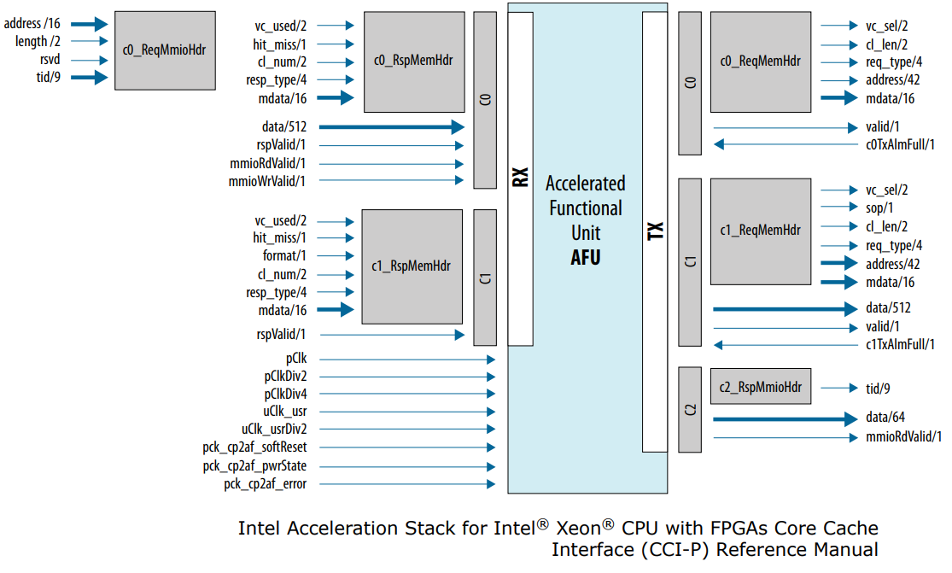
CCI-P: Core Cache Interface Protocol
Basic structure:
One receive (Rx) port, and one transmit (Tx) port (from point of view of FPGA)
Several channels within each port (c0 to c2)

Slide 11
CCI-P: MMIO Write
MMIO write transfers data from processor into the FPGA
Only uses CCI-P receive (Rx) channel 0
Assertion of c0.mmioWrValid specifies processor is writing data to FPGA
Corresponding address and write data provided in the same cycle
CCI-P provides no explicit acknowledgement system for MMIO writes
AFU must store write data somewhere in the cycle that it appears
New write data can potentially show up every cycle
*c0.hdr.address doesn’t directly exist in the interface
c0.hdr is overloaded for different uses, explained in next slide
Provided addresses are 32-bit word addresses

Slide 12
CCI-P: MMIO Write
Example: write to 64-bit register user_reg mapped to addr 0x0020
Note: reset code omitted on slide but included in provided afu.sv code
logic [63:0] user_reg;
// Get the header for an MMIO request
t_ccip_c0_ReqMmioHdr mmio_hdr;
assign mmio_hdr = t_ccip_c0_ReqMmioHdr'(rx.c0.hdr);
// Write to a register when the MMIO write valid is asserted
// and the MMIO header address matches the register’s address
always_ff @(posedge clk)
begin
if (rx.c0.mmioWrValid == 1)
begin
case (mmio_hdr.address)
16'h0020: user_reg <= rx.c0.data[63:0];
endcase
end
end

Slide 13
CCI-P: MMIO Write
Suggestion: understand synthesized circuit
Non-blocking assignment on rising edge of clk creates register
Case statement creates an equals comparator for each case
Register enabled when MMIO write address matches register address and when rx.c0.mmioWrValid is asserted
Note: may synthesize differently depending on the FPGA lookup tables
mmio_hdr.address
0x0020
rx.c0.data
=
enable
clk
user_reg
rx.c0.mmioWrValid

Slide 14
CCI-P: MMIO Read
Read request from software specified by assertion of c0.mmioRdValid
Corresponding address and transaction ID (tid) provided during same cycle
FPGA responds by asserting c2.mmioRdValid when the corresponding read data is available
In same cycle, FPGA provides transaction ID to specify which read request is being responded to (in case of multiple pending requests), along with read data
*c0.hdr.address and c0.hdr.tid don’t directly exist in the interface
c0.hdr is overloaded for different uses, will explain in later slides

Slide 15
CCI-P: MMIO Read
In most use cases, FPGA provides read data one cycle after request
Possible because MMIO generally accesses registers and RAMs
Figure illustrates this common use case
Allows for simpler implementation of MMIO
No need to save transaction IDs because the response is always one cycle later
Reads can be responded to out of order
But, requires buffering of transaction IDs
In most cases, best to use method illustrated here

Slide 16
CCI-P: MMIO Read
Example: read from 64-bit register user_reg mapped to addr 0x0020
always_ff @(posedge clk or posedge rst)
begin
if (rst) begin
.... // Reset code omitted on slide, see code example
end
else begin
// Clear read response flag every cycle
tx.c2.mmioRdValid <= 0;
// Check for MMIO read request
if (rx.c0.mmioRdValid == 1) begin
// Respond with the TID of the request, and specify the data is valid
tx.c2.hdr.tid <= mmio_hdr.tid;
tx.c2.mmioRdValid <= 1;
// Provide the data
case (mmio_hdr.address)
16'h0020: tx.c2.data <= user_reg;
default: tx.c2.data <= 64'h0; // Return 0 for invalid addresses
endcase

Slide 17
CCI-P: MMIO Read
Synthesized circuit
Non-blocking assignments on rising edge of clk creates registers
Registers conveniently delay TID and mmioRdValid by a cycle
Encoder selects mux input to store in tx.c2.data register based on MMIO address
Combine with MMIO write code to define input to user_reg
mmio_hdr.address
0x0020
=
….
….
user_reg
….
Encoder
mmio_hdr.tid
enable
rx.c0.mmioRdValid
tx.c2.data
tx.c2.hdr.tid
tx.c2.mmioRdValid
= register (clk not shown)

Slide 18
CCI-P: MMIO Read
AFUs require several MMIO addresses to return specific information
AFU ID must be generated with uuidgen and specified in AFU’s JSON file
OPAE afu_json_mgr script extracts UUID from JSON file into afu_json_info.vh
After afu_json_info.vh is generated, can directly use constants in header file
e.g. logic [127:0] afu_id = `AFU_ACCEL_UUID;
case (mmio_hdr.address)
// AFU header
16'h0000: tx.c2.data <= {
4'b0001, // Feature type = AFU
8'b0, // reserved
4'b0, // afu minor revision = 0
7'b0, // reserved
1'b1, // end of DFH list = 1
24'b0, // next DFH offset = 0
4'b0, // afu major revision = 0
12'b0 // feature ID = 0 };
// AFU_ID_L
16'h0002: tx.c2.data <= afu_id[63:0];
// AFU_ID_H
16'h0004: tx.c2.data <= afu_id[127:64];
// DFH_RSVD0 and DFH_RSVD1
16'h0006: tx.c2.data <= 64'h0;
16'h0008: tx.c2.data <= 64'h0;

Slide 19
Summary
Specify AFU information in JSON configuration file
Assign user registers addresses within the FPGA address space
64-bit transfers must be supported
32-bit transfers are optional
64-bit transfers must use even addresses
Every AFU must implement MMIO reads to specify AFU information
MMIO reads can be handled across multiple cycles, and out of order
Read logic simplified when responding within a single cycle
Delay mmioRdValid and transaction ID by one cycle with a register
MMIO writes must be handled in the cycle they show up
See ccip_mmio example code for all details:
https://github.com/ARC-Lab-UF/intel-training-modules/tree/master/RTL/examples/ccip_mmio

