Slide 1
Intel DevCloud Training Module
FPGA Timing Optimization
3-Input Adder
Greg Stitt
Professor
Department of Electrical and Computer Engineering
University of Florida

Slide 2
3-Input Adder
Is it possible to create a 3-input adder that uses the same number of resources as a 2-input adder?
x[0]
y[0]
x[1]
y[1]
z[1]
a
b
a
b
???
FA
FA
z[0]
cin
cout
cin
cout
s
s
s[0]
s[1]
Problem: No place to add z[1], or z[i] for i > 0
Looks like it requires more resources than 2-input adder
Maybe not…………

Slide 3
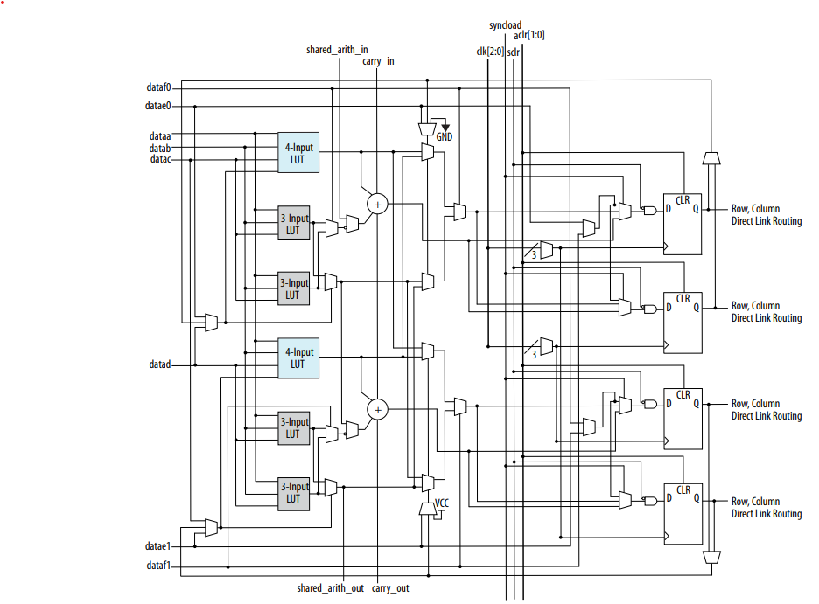
Cylone 10 GX, Arria 10 ALM
Intel® Arria® 10 Core Fabric and General Purpose I/Os Handbook

Slide 4
3-Input Adder (bit 0)
x[0]
y[0]
a
b
FA
z[0]
cin
cout
carry_out1[0]
s
0
a
b
FA
0
cin
cout
carry_out2[0]
s
s[0]

Slide 5
3-Input Adder (bit 1)
x[1]
y[1]
a
b
FA
z[1]
cin
cout
carry_out1[1]
s
carry_out1[0]
a
b
FA
carry_out2[0]
cout
carry_out2[1]
cin
s
s[0]

Slide 6
3-Input Adder (bit i)
x[i]
y[i]
a
b
FA
z[i]
cin
cout
carry_out1[i]
For an FPGA that provides 2 FAs (or a 5-input, 3-ouput LUT) per “basic resource”, we can have a 3-input adder with the same # of resources as a 2-input adder
s
carry_out1[i-1]
a
b
FA
carry_out2[i-1]
cout
carry_out2[i]
cin
s
s[0]

Slide 7
Cylone 10 GX, Arria 10 ALM
ALM is basic logic resource
Provides 2 FAs, but a 2-input adder would only need 1 of those per bit
Could potentially use 3-input,
2-output LUT in front of FA to accomplish goal
3 LUTs in front of adder, but none of them have two outputs
Any tricks we can do?
FA
FA
Intel® Arria® 10 Core Fabric and General Purpose I/Os Handbook

Slide 8
3-Input Adder (bit i)
x[i]
y[i]
a
b
FA
z[i]
cin
cout
carry_out1[i]
s
This structure is equivalent to………
carry_out1[i-1]
a
b
FA
carry_out2[i-1]
cout
carry_out2[i]
cin
s
s[0]

Slide 9
3-Input Adder (bit 0)
x[0]
y[0]
x[0]
y[0]
a
b
a
b
SUM
CARRY
z[0]
cin
z[0]
cin
c
carry_out1[0]
s
0
a
b
FA
0
cin
cout
carry_out2[0]
s
s[0]

Slide 10
3-Input Adder (bit 1)
x[1]
y[1]
x[1]
y[1]
a
b
a
b
SUM
CARRY
z[1]
cin
z[1]
cin
c
carry_out1[1]
s
carry_out1[0]
a
b
FA
carry_out2[0]
cin
cout
carry_out2[1]
s
s[1]

Slide 11
3-Input Adder (bit i)
x[i]
y[i]
x[i]
y[i]
Needs a 3-input, 1-output LUT
Needs a 3-input, 1-output LUT
a
b
a
b
SUM
CARRY
z[i]
cin
z[i]
cin
c
carry_out1[i]
s
carry_out1[i-1]
a
b
FA
carry_out2[i-1]
cin
cout
carry_out2[i]
Needs a 3-input, 2-output LUT, or a full adder
s
s[i]

Slide 12
Cylone 10 GX, Arria 10 ALM
SUM
FA
CARRY
carry_out1
carry_out2
Intel® Arria® 10 Core Fabric and General Purpose I/Os Handbook

Slide 13
Conclusions
Arria 10, Cyclone 10 GX (not LP), Stratix 10 can do a 3-input add with the same number of ALM resources as a 2-input adder
1 ALM for every 2 bits
Unfortunately doesn’t scale up to arbitrary sizes
Only equivalent when both carries have hardened connections between ALMs
ALM chains don’t extend past LABs
In my tests, results were equivalent up to a width of 16 bits
Quartus calls carry_out1 SHAREOUT in the technology mapped view
Each ALM FA adds the output of the 4-input LUT, the SHAREIN, and the CIN
SHAREOUT comes from the output of the 3-input LUT in the previous bit of the adder, connects to SHAREIN of the FA for the current bit

