Slide 1
Intel DevCloud Training Module
FPGA Timing Optimization
Quartus Timing Analyzer Tutorial
Greg Stitt
Associate Professor
Department of Electrical and Computer Engineering
University of Florida

Slide 2
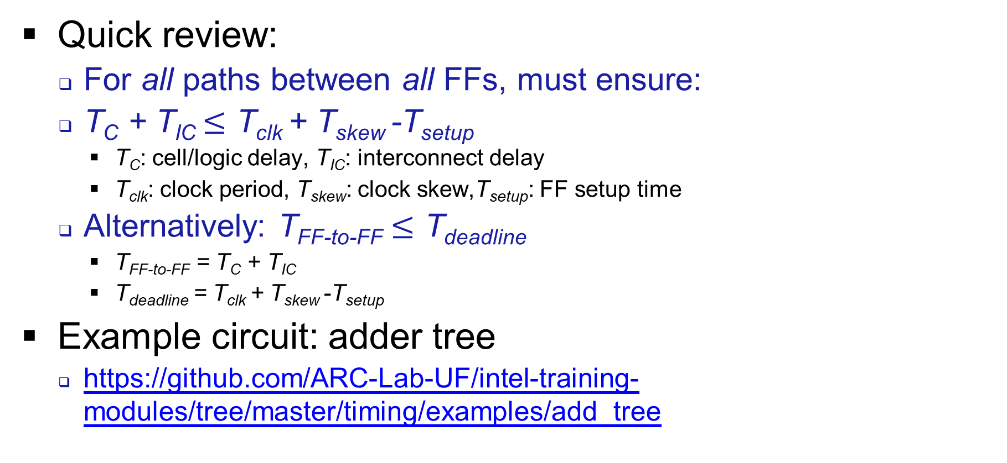
Introduction
Quick review:
For all paths between all FFs, must ensure:
T_{C} + T_{IC} $≤$ T_{clk} + T_{skew} -T_{setup}
T_{C}: cell/logic delay, T_{IC}: interconnect delay
T_{clk}: clock period, T_{skew}: clock skew,T_{setup}: FF setup time
Alternatively: T_{FF-to-FF} $≤$ T_{deadline}
T_{FF-to-FF} = T_{C} + T_{IC}
T_{deadline} = T_{clk} + T_{skew} -T_{setup}
Example circuit: adder tree
https://github.com/ARC-Lab-UF/intel-training-modules/tree/master/timing/examples/add_tree

Slide 3
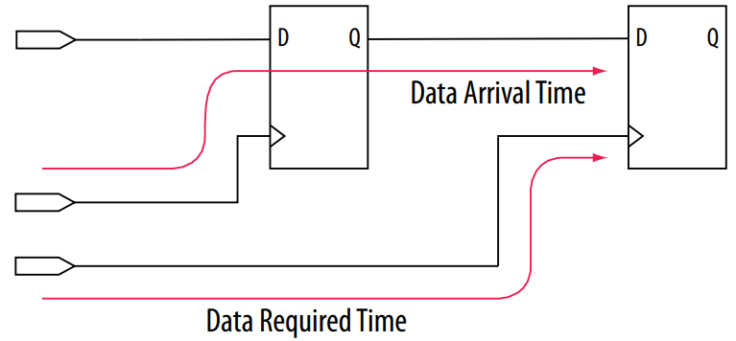
Intel Quartus Timing Analyzer
Quartus uses different naming convention
Data Arrival Time: time for source FF output to arrive at destination FF
Data Required Time: time when source FF output is required to have arrived at destination FF
Timing violation when Data Arrival Time > Data Required Time
Image from Intel® Quartus® Prime Pro Edition User Guide: Timing Analyzer
https://www.intel.com/content/dam/www/programmable/us/en/pdfs/literature/ug/ug-qpp-timing-analyzer.pdf

Slide 4
Data Arrival Time
Launch Edge + Source Clock Delay + µt_{co} + Register-to-Register Delay
Launch Edge: time of rising clock edge of source register (usually 0 ns)
Source Clock Delay: delay from clock source to clock input of source register
µt_{co} : clock-to-output delay (aka clk-to-Q)
Time between clock edge and output of FF
Ignore the µ symbol, time is usually < 1 ns
Register-to-Register Delay
Source Clock Delay
Image from Intel® Quartus® Prime Pro Edition User Guide: Timing Analyzer
https://www.intel.com/content/dam/www/programmable/us/en/pdfs/literature/ug/ug-qpp-timing-analyzer.pdf

Slide 5
Data Required Time
Latch Edge + Dest Clock Delay - µt_{su}
Latch Edge: time of clock edge for dest register (usually clock period)
Dest Clock Delay: delay from clock source to clock input of dest register
µt_{su} : setup time of destination register
Ignore the µ symbol, time is < 1 ns
Image from Intel® Quartus® Prime Pro Edition User Guide: Timing Analyzer
https://www.intel.com/content/dam/www/programmable/us/en/pdfs/literature/ug/ug-qpp-timing-analyzer.pdf

Slide 6
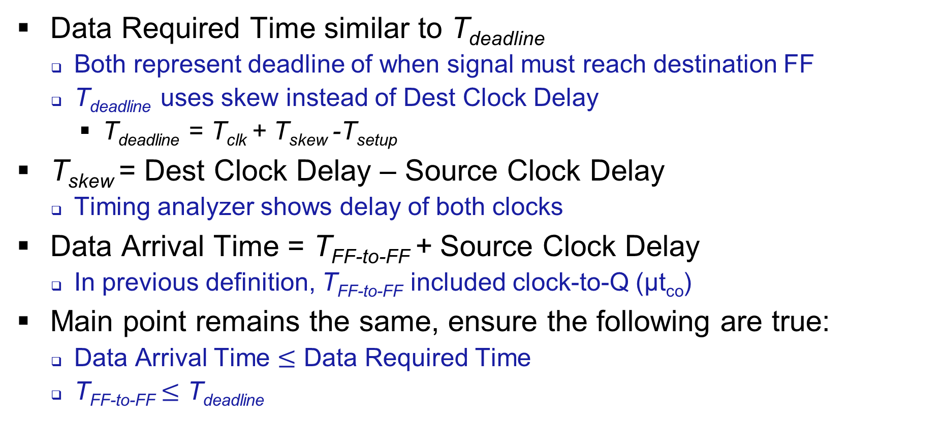
Comparison of Explanations
Data Required Time similar to T_{deadline}
Both represent deadline of when signal must reach destination FF
T_{deadline} uses skew instead of Dest Clock Delay
T_{deadline} = T_{clk} + T_{skew} -T_{setup}
T_{skew} = Dest Clock Delay – Source Clock Delay
Timing analyzer shows delay of both clocks
Data Arrival Time = T_{FF-to-FF} + Source Clock Delay
In previous definition, T_{FF-to-FF} included clock-to-Q (µt_{co})
Main point remains the same, ensure the following are true:
Data Arrival Time $≤$ Data Required Time
T_{FF-to-FF} $≤$ T_{deadline}

Slide 7
Adder-Tree Example
Adder tree
Adds 8 WIDTH-bit numbers in a balanced tree
Registered inputs and outputs
inputs:
0
1
2
3
4
5
6
7
module add_tree #(parameter int WIDTH=16)
(
input clk,
input rst,
input [WIDTH-1:0] inputs[8],
output logic [WIDTH-1:0] sum
);
+
+
+
+
+
+
+
sum

Slide 8
Adder-Tree Code
logic [WIDTH-1:0] inputs_r[$size(inputs)];
logic [WIDTH-1:0] add0_0, add0_1, add0_2, add0_3;
logic [WIDTH-1:0] add1_0, add1_1, add2_0;
always_ff @(posedge clk or posedge rst) begin
if (rst) begin
// Reset the input registers
…
end else begin
// Register the inputs and output (required for timing analysis).
inputs_r <= inputs;
sum <= add2_0;
end
end
inputs:
0
1
2
3
4
5
6
7
+
+
+
+
+
+
+
sum

Slide 9
Adder-Tree Code
// Implement the adder tree as combinational logic
always_comb begin
// First row of adders (add the pairs of registered inputs)
add0_0 = inputs_r[0] + inputs_r[1];
add0_1 = inputs_r[2] + inputs_r[3];
add0_2 = inputs_r[4] + inputs_r[5];
add0_3 = inputs_r[6] + inputs_r[7];
// Second row of adders
add1_0 = add0_0 + add0_1;
add1_1 = add0_2 + add0_3;
// Final adder
add2_0 = add1_0 + add1_1;
end
inputs:
0
1
2
3
4
5
6
7
+
+
+
+
+
+
+
sum

Slide 10
Quartus Settings
Before performing timing analysis, must set a clock constraint
See Quartus documentation for full details
Constraints specified in sdc (Synopsys Design Constraint) file
add_tree.sdc
create_clock -name {clk} -period 5.000 -waveform { 0.000 2.500 } [get_ports {clk}]
Name flag gives the clock a name within Quartus
Period flag specifies clock period in nanoseconds
5 ns = 200 MHz clock constraint
Waveform flag specifies duty cyle
50% in this example: rising edge at 0 ns, falling edge at 2.5 ns
get_ports command connects the clock constraint to the code’s clock
SystemVerilog module has clock input called clk

Slide 11
Quartus Settings
Quartus connects top-level module I/O to FPGA pins
Normally, pin mapping also done with constraints
When analyzing individual modules, we do not want I/O connected to pins
Pins represent unrealistic use case and module I/O can exceed the total pins
Modules normally connected to other nearby modules
Mapping to pins creates excessively long delays
Solution: Quartus allows I/O to be mapped to virtual pins
Internal FPGA resources used as pins for timing analysis
Specified in add_tree.qsf (or through assignment editor in Quartus)
Apply to module inputs and outputs:
set_instance_assignment -name VIRTUAL_PIN ON -to inputs
set_instance_assignment -name VIRTUAL_PIN ON -to sum
Clock and reset are generally left mapped to actual pins

Slide 12
Timing Analysis Results
Clock constraint violated for original code
Significant logic/cell delay bottleneck
Bottleneck caused by long combinational path through adders
How to optimize?
inputs:
0
1
2
3
4
5
6
7
+
+
+
+
+
+
Logic delay creates timing bottleneck
+
sum

Slide 13
Pipelining
Add registers after every adder
Logic delay never more than one adder
Trades off latency and flip-flop usage for reduced logic delay
inputs:
0
1
2
3
4
5
6
7
+
+
+
+
+
+
+
sum

Slide 14
Code with Pipelining
always_ff @(posedge clk or posedge rst) begin
if (rst) begin
…
end else begin
// Register the inputs
inputs_r <= inputs;
// Register the first row of adders
add0_0 <= inputs_r[0] + inputs_r[1];
add0_1 <= inputs_r[2] + inputs_r[3];
add0_2 <= inputs_r[4] + inputs_r[5];
add0_3 <= inputs_r[6] + inputs_r[7];
// Register the second row of adders
add1_0 <= add0_0 + add0_1;
add1_1 <= add0_2 + add0_3;
// Register the final output
add2_0 = add1_0 + add1_1;
sum <= add2_0;
end
inputs:
0
1
2
3
4
5
6
7
+
+
+
+
+
+
+
sum

