Slide 1
Intel DevCloud Training Module
FPGA Timing Optimization
Background and Challenges
Greg Stitt
Associate Professor
Department of Electrical and Computer Engineering
University of Florida

Slide 2
Introduction
Designers specify timing constraints related to circuit
e.g., desired clock frequency
Synthesis tools verify if designs meet all timing constraints
Uses static timing analysis (STA)
If constraints not met, designer performs timing optimization/closure
A design “meets timing” or “closes timing” when all constraints met
Challenging problem
These slides explain background and underlying challenges
Follow up slides will explain how to optimize timing
Examples and exercises included on Github repo
https://github.com/ARC-Lab-UF/intel-training-modules/tree/master/timing

Slide 3
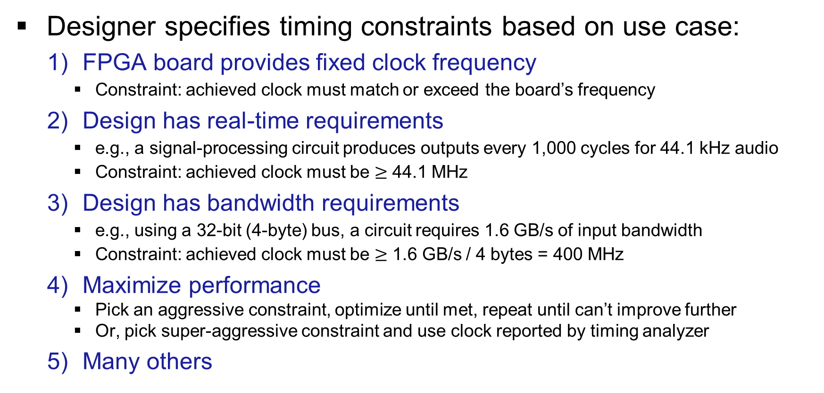
How to Determine Timing Constraints?
Designer specifies timing constraints based on use case:
FPGA board provides fixed clock frequency
Constraint: achieved clock must match or exceed the board’s frequency
Design has real-time requirements
e.g., a signal-processing circuit produces outputs every 1,000 cycles for 44.1 kHz audio
Constraint: achieved clock must be $≥$ 44.1 MHz
Design has bandwidth requirements
e.g., using a 32-bit (4-byte) bus, a circuit requires 1.6 GB/s of input bandwidth
Constraint: achieved clock must be $≥$ 1.6 GB/s / 4 bytes = 400 MHz
Maximize performance
Pick an aggressive constraint, optimize until met, repeat until can’t improve further
Or, pick super-aggressive constraint and use clock reported by timing analyzer
Many others

Slide 4
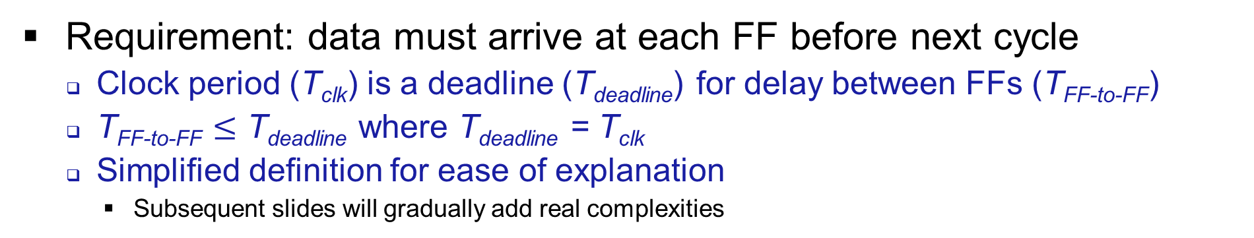
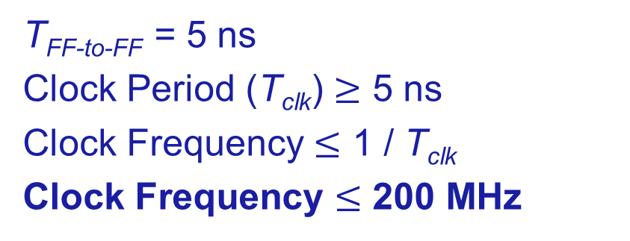
Clock Frequency
Requirement: data must arrive at each FF before next cycle
Clock period (T_{clk}) is a deadline (T_{deadline}) for delay between FFs (T_{FF-to-FF})
T_{FF-to-FF} $≤$ T_{deadline} where T_{deadline} = T_{clk}
Simplified definition for ease of explanation
Subsequent slides will gradually add real complexities
1 ns
3 ns
1 ns
T_{FF-to-FF} = 5 ns
Clock Period (T_{clk}) $≥$ 5 ns
Clock Frequency $≤$ 1 / T_{clk}
Clock Frequency $≤$ 200 MHz
FF1
FF3
FF2
5 ns = T_{FF-to-FF}

Slide 5
FF-to-FF Delays
FF-to-FF delays (T_{FF-to-FF}) determined by summation of:
“Cell” delays (T_{C})
Any non-interconnect resource (FFs, CLBs, LUTs, RAM, DSP, etc.)
Note that FFs have a clk-to-Q delay: time between clock edge and appearance of output Q
Interconnect delays (T_{IC})
Connections between cells (wires, connection boxes, switch boxes, etc.)
T_{C} = 0.2 ns + 1.5 ns + 1.5 ns = 3.2 ns
T_{IC} = 1 ns + 0.8 ns + 0.6 ns = 2.4 ns
T_{FF-to-FF} = T_{C} + T_{IC} = 3.2 ns + 2.4 ns = 5.6 ns
frequency = 1 / T_{FF-to-FF} = 1 / 5.6 ns = 178 MHz
FF_{src}
1 ns
LUT
0.8 ns
LUT
0.6 ns
FF_{dst}
0.2 ns (clk-to-Q)
1.5 ns
1.5 ns

Slide 6
Delays, Cont.
There are frequently multiple paths between same FFs
Must consider the path with the maximum delay
Interconnect delays often vary across paths due to routing differences
T_{C} of both paths = 0.2 + 1.5 + 1.5 = 3.2 ns
T_{IC} of longer bottom path = 1.1 ns + 1.2 ns + 0.6 ns = 2.9 ns
max T_{FF-to-FF} = 3.2 ns + 2.9 ns = 6.1 ns
frequency = 1 / 6.1 ns = 163 MHz
1 ns
LUT
0.8 ns
FF_{src}
LUT
FF_{dst}
1.5 ns
0.6 ns
0.2 ns
LUT
1.5 ns
1.1 ns
1.2 ns
1.5 ns

Slide 7
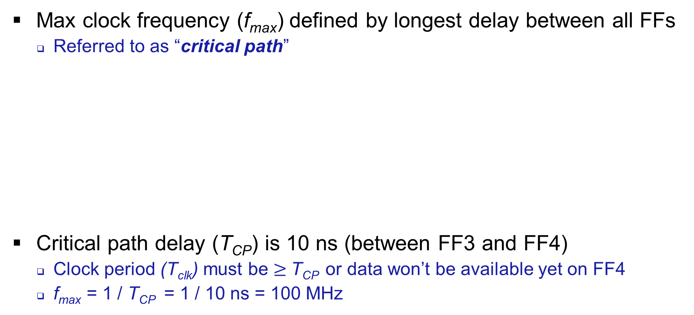
Maximum Clock Frequency
Max clock frequency (f_{max}) defined by longest delay between all FFs
Referred to as “critical path”
Critical path delay (T_{CP}) is 10 ns (between FF3 and FF4)
Clock period (T_{clk}) must be $≥$T_{CP} or data won’t be available yet on FF4
f_{max} = 1 / T_{CP} = 1 / 10 ns = 100 MHz
4 ns
10 ns
FF1
FF2
FF3
FF4
6 ns
FF5
FF6

Slide 8
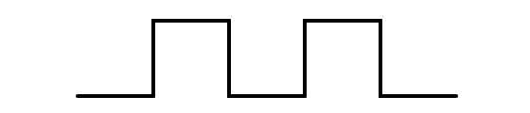

Setup Times
Flip-flops have a setup time (T_{setup})
Window of time before rising clock edge where changing input causes metastable output
Data must arrive at flip-flip before setup window of next clock
T_{C} + T_{IC} $≤$ T_{clk} - T_{setup} (note this is still T_{FF-to-FF} $≤$ T_{deadline} with T_{deadline} = T_{clk} - T_{setup})
Condition must be met for all paths between all FFs
Any path with T_{C} + T_{IC} $>$ T_{clk} - T_{setup} has a setup violation
Maximum Possible
T_{C} + T_{IC}
T_{setup}
T_{deadline}
T_{clk}

Slide 9
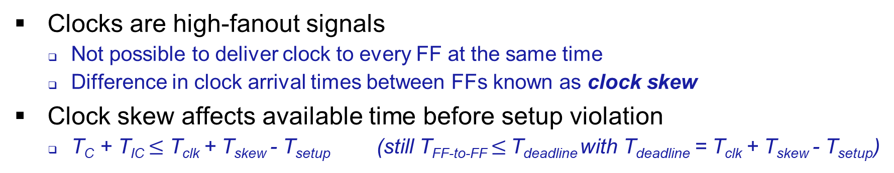
Clock Skew
Clocks are high-fanout signals
Not possible to deliver clock to every FF at the same time
Difference in clock arrival times between FFs known as clock skew
Clock skew affects available time before setup violation
T_{C} + T_{IC} $≤$ T_{clk} + T_{skew} - T_{setup} (still T_{FF-to-FF} $≤$ T_{deadline} with T_{deadline} = T_{clk} + T_{skew} - T_{setup})
Maximum Possible
T_{C} + T_{IC}
Positive skew increases deadline
Can help avoid setup violations
Clk_{src}
Clk_{dst}
T_{deadline}
T_{skew}
T_{setup}

Slide 10
Setup Slack
Setup slack (S_{setup}) = time between setup deadline and data arrival
S_{setup} = (T_{clk} + T_{skew} - T_{setup}) - (T_{C} + T_{IC}) = T_{deadline} - T_{FF-to-FF}
A path with S_{setup} < 0 has a setup violation, must be optimized
Large positive slack can help with optimizing other paths (e.g., retiming)
T_{C} + T_{IC}
S_{setup}
Clk_{src}
Clk_{dst}
T_{skew}
T_{setup}

Slide 11

Hold Times
FF hold time (T_{hold}) is window of time after rising clock edge
Input changing within hold window causes metastable FF output
New data must not arrive at flip-flip during hold window
T_{C} + T_{IC} $≥$ T_{hold} + T_{skew}
T_{FF-to-FF} must exceed skew and hold times
Minimum Possible
T_{C} + T_{IC}
Clk_{src}
Positive skew increases min T_{C} + T_{IC}
Counter-intuitive, but data arriving too fast at next FF is a problem
Clk_{dst}
T_{skew}
T_{hold}

Slide 12
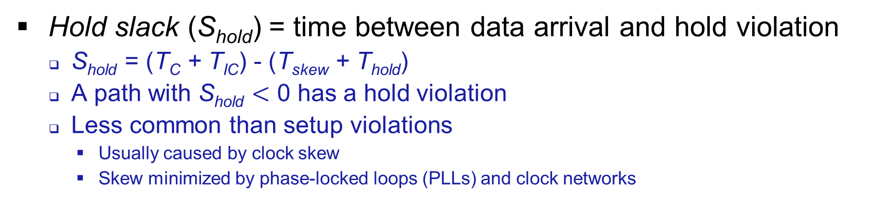
Hold Slack
Hold slack (S_{hold}) = time between data arrival and hold violation
S_{hold} = (T_{C} + T_{IC}) - (T_{skew} + T_{hold})
A path with S_{hold} $<$ 0 has a hold violation
Less common than setup violations
Usually caused by clock skew
Skew minimized by phase-locked loops (PLLs) and clock networks
T_{C} + T_{IC}
Clk_{src}
Clk_{dst}
T_{skew}
T_{hold}
S_{hold}

Slide 13
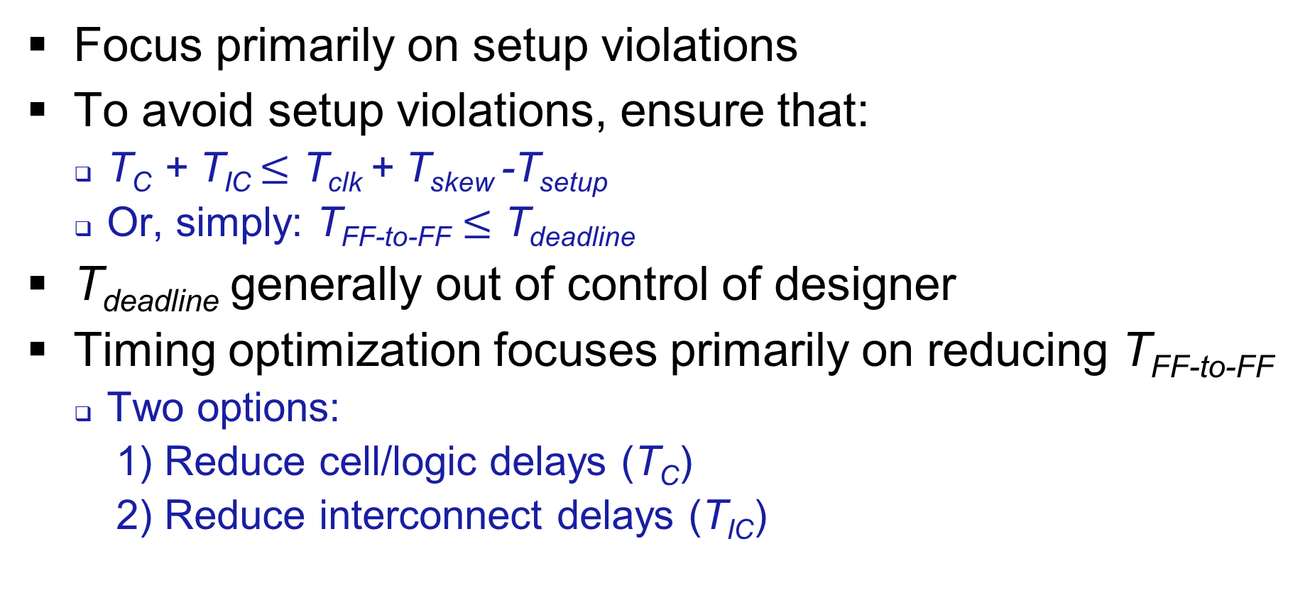
Timing Optimization Preview
Focus primarily on setup violations
To avoid setup violations, ensure that:
T_{C} + T_{IC} $≤$ T_{clk} + T_{skew} -T_{setup}
Or, simply: T_{FF-to-FF} $≤$ T_{deadline}
T_{deadline} generally out of control of designer
Timing optimization focuses primarily on reducing T_{FF-to-FF}
Two options:
1) Reduce cell/logic delays (T_{C})
2) Reduce interconnect delays (T_{IC})

Slide 14
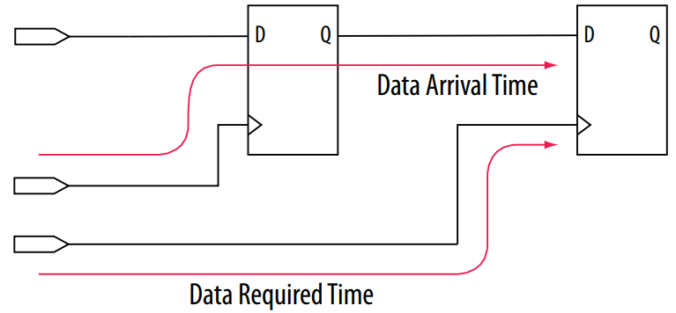
Intel Quartus Timing Analyzer
Quartus uses different naming convention
Data Arrival Time : time signal takes to arrive at destination FF
Data Required Time : time when signal is required to have arrived at destination FF
Timing violations occur when Data Arrival Time > Data Required Time
Image from Intel® Quartus® Prime Pro Edition User Guide: Timing Analyzer
https://www.intel.com/content/dam/www/programmable/us/en/pdfs/literature/ug/ug-qpp-timing-analyzer.pdf

Slide 15
Data Arrival Time
Launch Edge + Source Clock Delay + µt_{co} + Register-to-Register Delay
Launch Edge : time of clock edge of source register (usually 0 ns)
Source Clock Delay : delay from clock source to clock input of source register
µt_{co} : clock-to-output delay (aka clk-to-Q)
Time between clock edge and output of FF
Ignore the µ symbol, time is usually < 1 ns
Register-to-Register Delay
Source Clock Delay
Image from Intel® Quartus® Prime Pro Edition User Guide: Timing Analyzer
https://www.intel.com/content/dam/www/programmable/us/en/pdfs/literature/ug/ug-qpp-timing-analyzer.pdf

Slide 16
Data Required Time
Data Required Time = Latch Edge + Dest Clock Delay - µt_{su}
Latch Edge : time of clock edge for dest register (usually clock period)
Dest Clock Delay : delay from clock source to clock input of dest register
µt_{su} : setup time of destination register
Ignore the µ symbol, time is < 1 ns
Image from Intel® Quartus® Prime Pro Edition User Guide: Timing Analyzer
https://www.intel.com/content/dam/www/programmable/us/en/pdfs/literature/ug/ug-qpp-timing-analyzer.pdf

Slide 17
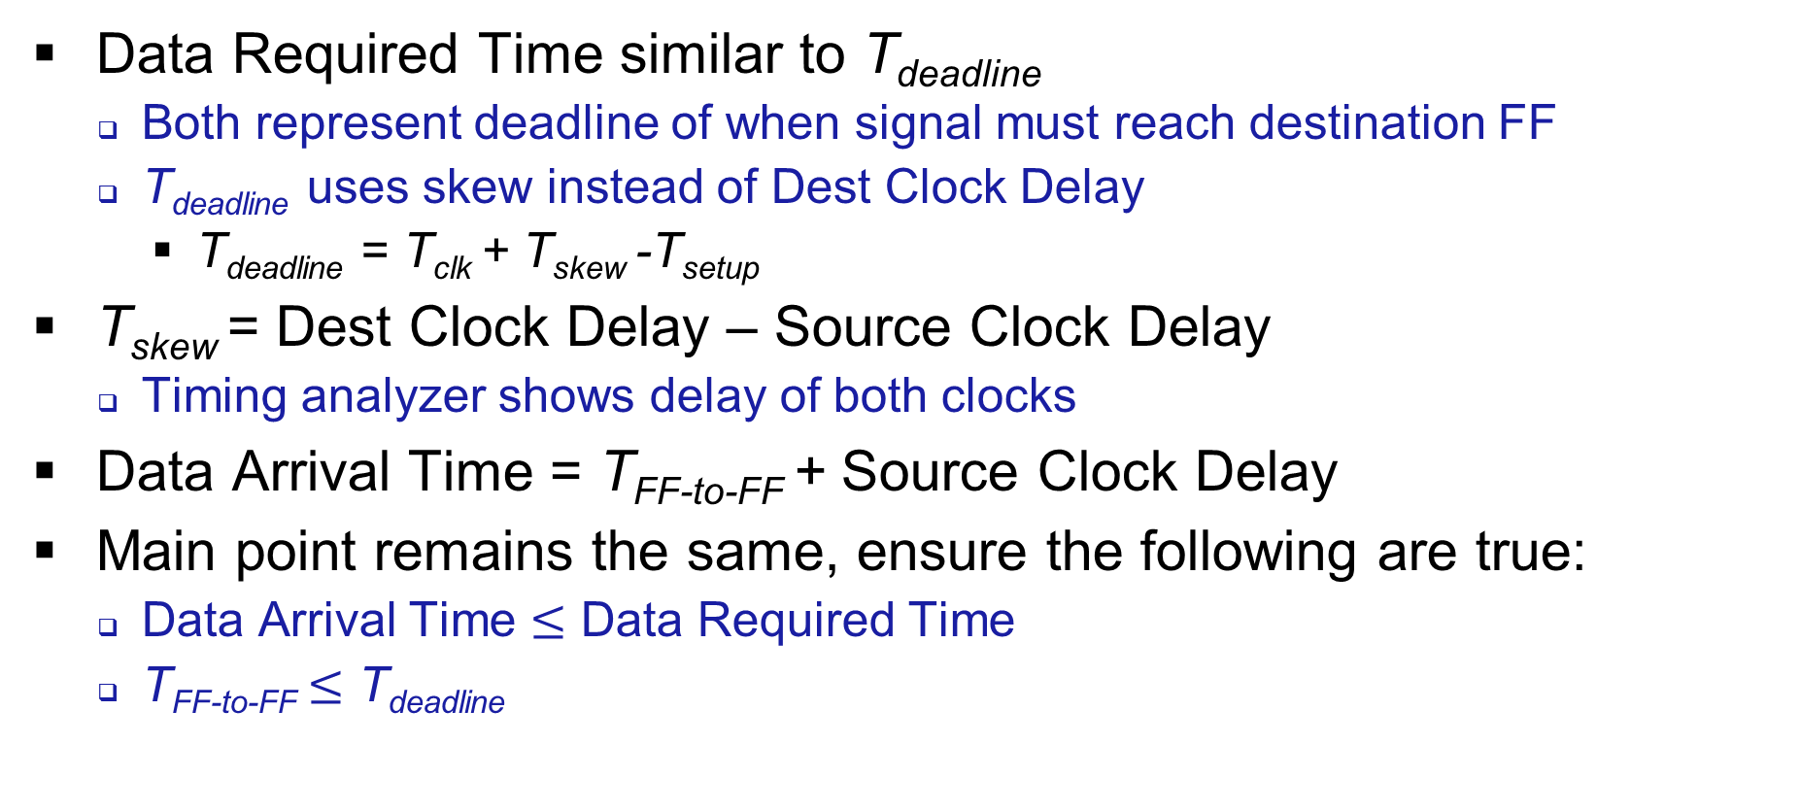
Comparison of Explanations
Data Required Time similar to T_{deadline}
Both represent deadline of when signal must reach destination FF
T_{deadline} uses skew instead of Dest Clock Delay
T_{deadline} = T_{clk} + T_{skew} -T_{setup}
T_{skew} = Dest Clock Delay – Source Clock Delay
Timing analyzer shows delay of both clocks
Data Arrival Time = T_{FF-to-FF} + Source Clock Delay
Main point remains the same, ensure the following are true:
Data Arrival Time $≤$ Data Required Time
T_{FF-to-FF} $≤$ T_{deadline}

