Slide 1
Intel DevCloud Training Module
FPGA Timing Optimization
Optimization Strategies
Greg Stitt
Associate Professor
Department of Electrical and Computer Engineering
University of Florida

Slide 2
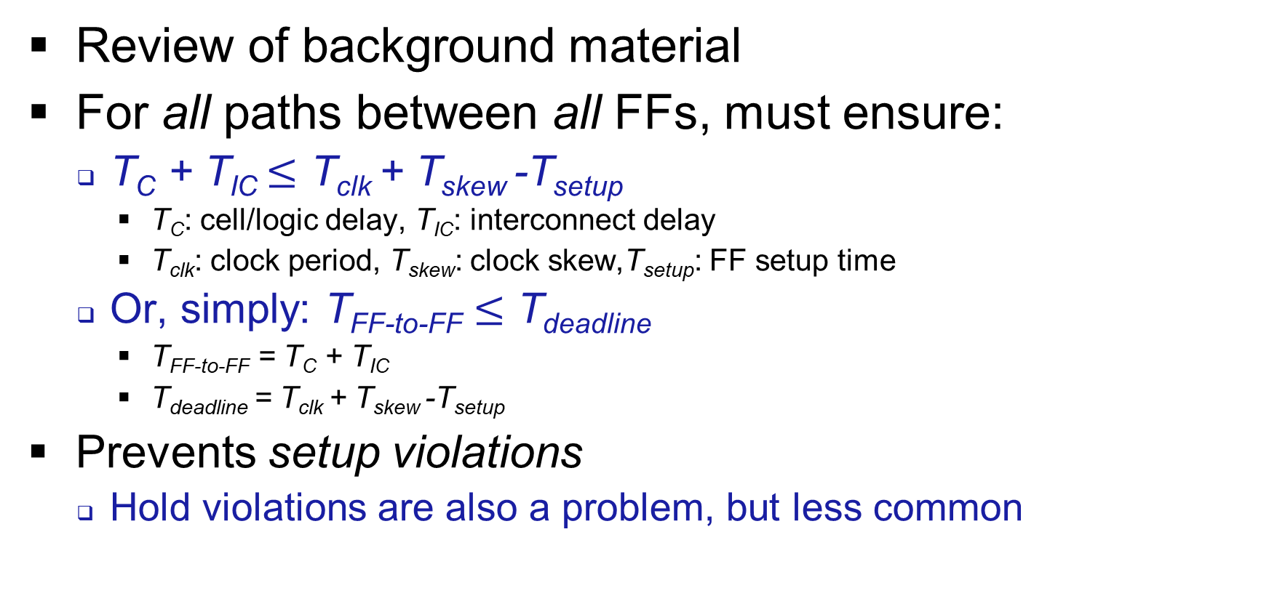
Introduction
Review of background material
For all paths between all FFs, must ensure:
T_{C} + T_{IC} $≤$ T_{clk} + T_{skew} -T_{setup}
T_{C}: cell/logic delay, T_{IC}: interconnect delay
T_{clk}: clock period, T_{skew}: clock skew,T_{setup}: FF setup time
Or, simply: T_{FF-to-FF} $≤$ T_{deadline}
T_{FF-to-FF} = T_{C} + T_{IC}
T_{deadline} = T_{clk} + T_{skew} -T_{setup}
Prevents setup violations
Hold violations are also a problem, but less common

Slide 3
Introduction
Setup slack (S_{setup}) = (T_{clk} + T_{skew} - T_{setup}) - (T_{C} + T_{IC})
Or, S_{setup} = T_{deadline} - T_{FF-to-FF}
Timing analyzer will evaluate setup slack for all paths
If S_{setup} < 0 for a path, that path must be optimized
For a given clock, only have control over T_{FF-to-FF}
Two options for optimization:
Reduce cell/logic delays (T_{C})
Reduce interconnect delays (T_{IC})
These slides explain common strategies for optimizing delays
Not exhaustive, but sufficient for many applications

Slide 4
Timing-Optimization Methodology
Set constraints
Compile design, run timing analyzer
Identify Total Negative Slack (TNS)
Summation of slack on all failing paths
Estimate of how much effort will be involved for timing optimization
Sort failing paths based on negative slack
Identify bottlenecks on path with worst negative slack
Look for both logic/cell and interconnect bottlenecks
Apply relevant timing optimizations based on bottlenecks
Repeat from 5 for next most-negative path until no more failing paths
Occasionally restart from 2 to make sure bottlenecks haven’t changed
Note: Steps 4-5 can alternatively focus on paths that fail in many instances

Slide 5
Cell/Logic Delays
For each failing path, identify types of cells along the path
Examples: lookup tables (LUTs), embedded RAM (e.g., M20K), DSPs
Check device-specific suggestions for each cell type, e.g.:
Register RAM outputs
Avoid read-during-write in RAM
Structure multiply-accumulates to map efficiently to DSPs
Write code to ensure inference of specific FPGA primitive
Usually under “Recommended HDL Coding Styles”
Most common bottleneck is LUT delays
Combinational logic divided into hierarchy of LUTs
Optimize longest path through that hierarchy

Slide 6
Optimizing LUT Delays
Goal: optimize logic to decrease max LUT hierarchy depth
An n-input LUT can implement any n-input, 1-output logic function
Does not matter how many gates are in that function
Any function with > n inputs will use > 1 LUT
Original Circuit
Synthesized Circuit for 6-input LUTs
a
b
a₅
a₄
a₃
b₅
b₄
b₃
a₂
a₁
a₀
b₂
b₁
b₀
6
6
=
LUT
LUT
1
a₅₋₃ = b₅₋₃
a₂₋₀ = b₂₋₀
3 total LUTs
Max T_{C} = 2 LUTs
1
LUT
eq
eq
= FF or register

Slide 7
Optimizing LUT Delays
Strategy 1: reduce logic inputs
Comparator example
Try to replace some inputs with constants
e.g., count down from input to 0 instead of 0 to input
Count (a₅₋₀) only ever compared with 0 vs. comparison with input
Optimized Circuit
Synthesized Circuit for 6-input LUTs
a
0
1 total LUT
Max T_{C} = 1 LUT
a₅
a₄
a₃
a₂
a₁
a₀
6
6
=
LUT
1
1
eq
eq
= FF or register

Slide 8
Optimizing LUT Delays
Strategy 2: break up longest path with extra registers (pipelining)
Tradeoff extra cycles of latency for decreased logic delays
Commonly used where is latency not a problem
Original Circuit
Optimized Synthesized Circuit for 6-input LUTs
a
b
a₅
a₄
a₃
b₅
b₄
b₃
a₂
a₁
a₀
b₂
b₁
b₀
6
6
LUT
LUT
Max T_{C} = 1 LUT
But, 2 cycles before output
=
1
1
a₅₋₃ = b₅₋₃
FF
FF
a₂₋₀ = b₂₋₀
eq
LUT
eq
= FF or register

Slide 9
Optimizing LUT Delays
Strategy 3: retiming
Move registers (forwards or backwards) to help balance logic delays
Move from stage with low slack to stage with high slack
Tools apply retiming automatically, but require registers to exist
Be aware of tool restrictions and limitations of initial states for automatic usage
Original Circuit
Retimed Circuit
Adds one extra register, but reduces max T_{C} from 2 adders to 1 adder
+
+
+
+
= FF or register

Slide 10
Optimizing LUT Delays
Retiming, cont.
Automatic retiming useful when manual specification is difficult
Comparator example pipelined automatically with extra FF on output
Original Circuit
Retimed Synthesized Circuit for 6-input LUTs
a
b
a₅
a₄
a₃
b₅
b₄
b₃
a₂
a₁
a₀
b₂
b₁
b₀
6
6
=
LUT
LUT
1
1
a₅₋₃ = b₅₋₃
FF
FF
a₂₋₀ = b₂₋₀
Extra FF enables automatic pipelining of comparator via retiming
1
LUT
eq
eq
= FF or register

Slide 11
Optimizing LUT Delays
Strategy 4: reduce precision
Example: use 3-bit inputs instead of 6-bit inputs
Limitation: circuit must still work with reduced precision
More realistic examples:
Machine learning, signal processing often perform well with reduced precision
A reduction in inputs doesn’t always reduce LUT amounts or maximum delay
A 4-bit comparator still has max T_{c} of 2 LUTs
Original Circuit
Optimized Circuit
Synthesized Circuit for 6-input LUTs
a
b
a
b
1 total LUT
max T_{C} = 1 LUT
a₂
a₁
a₀
b₂
b₁
b₀
6
6
3
3
=
=
1
1
LUT
1
1
eq
eq
eq
= FF or register

Slide 12
Interconnect Delays
After optimizing cell delays, interconnect delays (T_{IC}) dominate
For highly pipelined designs, T_{IC} is often main bottleneck
Long interconnect delays can result from any combination of:
1) Distant resources
Optimization: find ways to place resources closer
2) High fanout
Optimization: reduce fanout, add cycles, and/or steal slack from other cycles
3) Congested routing resources
Optimization: reduce connections, resource utilization

Slide 13
Optimizing Distant Resources
Placement tries to minimize distance of connections between resources
Distant placements primarily result from:
High resource utilization
Routing congestion (see later slide)
Original Circuit
Ideal ALM Placement*
Suboptimal ALM Placement*
a₃
a₂
a₁
a₃
a₂
a₁
a₀
a₃
a₂
a₁
a₀
s₁
Mux
a₀
s₁
Mux
X
X
s₁
4:1 Mux
s₀
s₀
s₀
X
X
X
Input a₀ placed further from mux due to other placed resources (X)
= FF
= ALM
*In this example, ALM has 6-input LUT + FF

Slide 14
Optimizing Distant Resources
Strategy 1: reduce resource utilization
Many application-specific strategies
Change resource types
e.g., use embedded RAM for long FF chains, perform multiple operations in DSPs
Sacrifice performance (if possible) for fewer resources (time multiplexing)
Suboptimal ALM Placement
Improved ALM Placement
a₃
a₂
a₁
a₀
a₃
a₂
a₁
a₀
s₁
Mux
X
s₁
Mux
a₀
X
X
X
s₀
X
X
X
s₀
X
X
X

Slide 15
Optimizing Distant Resources
Strategy 2: add FFs to breakup long connection into multiple cycles (pipelining)
Effective, but can be awkward to implement
Must identify distant connections and then modify design
Placement and routing aren’t guaranteed to produce same results
Distant resources in one compile might be close in another compile
Increases FF usage, may cause other bottleneck
Especially effective on FPGAs with HyperFlex (FFs embedded into interconnect)
Source
Problem: distant source and sink will have long interconnect delay
FF
FF
Sink
Possible solution: break up delay across multiple cycles

Slide 16
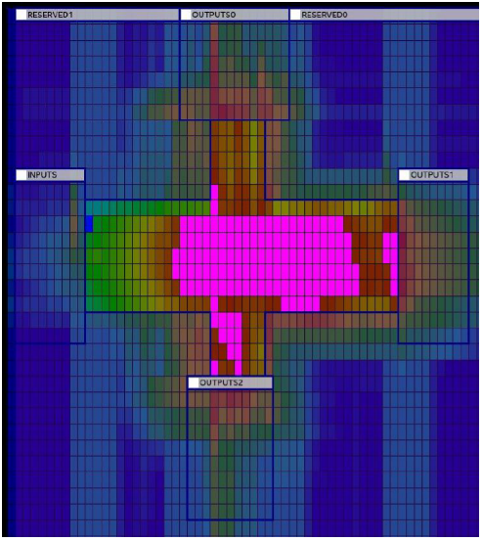
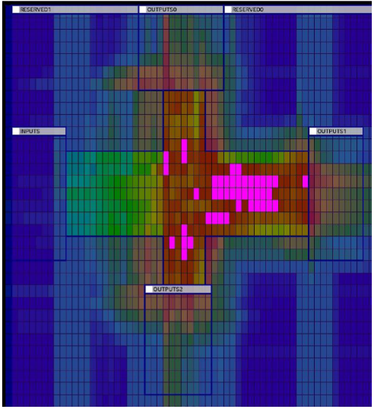
Optimizing Routing Congestion
Congestion occurs when too many signals routed in the same area of the FPGA
High contention for tracks and switch boxes
Congested regions must be routed around
Creates long distances, even for close placements
Strategies:
Minimize resources
Use time multiplexing or Network-on-Chip (NoC)
Pipelining interconnect may help, but can also hurt
Don’t know what nets will require additional FFs before routing
Optimize fanout
Congested Region
Less- Congested Region

Slide 17
Optimizing Fanout
Strategy 1: register duplication
Problem: difficult to place all sinks close to high-fanout source
Solution: replicate fanout source register (FF₁)
Limitation: increases fan-out of preceding signal (FF₀)
Can potentially create new bottleneck between FF₀ and duplicated FF₁ (steals slack)
Deciding amount of duplication can be tricky
Can be automatic or manually specified per signal
Original Circuit
Optimized Circuit
FF₀
FF₀
High fanout from FF₁ creates long distances to FF₂ and FF₇
Duplicated FF₁ shortens longest connection
FF₁
FF₁
FF₁
FF₂
FF₃
FF₄
FF₅
FF₆
FF₇
FF₂
FF₃
FF₄
FF₅
FF₆
FF₇

Slide 18
Optimizing Fanout
Strategy 2: pipelined fanout trees
Handles high fanout across multiple cycles of lower fanout
e.g. 3 cycles of 2-fanout instead of 1 cycle of 8-fanout
Limitations:
Increases FF usage and latency
Manual implementation is awkward, may require exploration
Hierarchical proximity register chains help automate
But place restrictions on code
Optimized Circuit
FF₀
FF
FF
Original Circuit
FF₀
FF
FF
FF
FF
FF₁
FF₂
FF₃
FF₄
FF₅
FF₆
FF₇
FF₈
FF₁
FF₂
FF₃
FF₄
FF₅
FF₆
FF₇
FF₈

Slide 19
Summary
Timing optimization involves iterative optimization of cell/logic and interconnect delays
Logic optimizations
Reduce logic inputs
Pipelining, retiming
Many device-specific optimizations
Interconnect optimizations
Minimize resources and fanout
Pipelined interconnect
NoC, time-multiplexing
Next presentation will demonstrate simple code example

