Slide 1
Heterogeneous Parallel Programming
Background and OpenCL Overview
Greg Stitt
Professor
Department of Electrical and Computer Engineering
University of Florida

Slide 2
Heterogeneous Parallel Programming
Multiple languages/frameworks
Complicated APIs, platform models, memory hierarchies
Overwhelming to learn initially
Important to understand basic idea first
Then, map that idea on to specific constructs and models of a given framework
Basic Idea:
Given a data structure and algorithm to compute
Identify parallelization strategy for computation
Define kernels (i.e., functions) that correspond to the parallel operations
A kernel will usually access a small portion of the data and produce a small portion of the output
Create threads (i.e., kernel instances) to execute kernels according to parallelization strategy
Heterogeneous parallel programming usually uses numerous threads that collectively produce all outputs with as much parallelism as possible
By contrast, traditional software uses a single thread to produce all outputs
2

Slide 3
Heterogeneous Parallel Programming
Programming goal: divide computation on data structure across parallel threads
Original Code
1) Determine Parallelization Strategy:
2) Define kernel
for (int i=0; i < N; i++) {
c[i] = a[i] + b[i];
}
a[0]
b[0]
a[1]
b[1]
a[2]
b[2]
a[N-1]
b[N-1]
kernel(int i) {
c[i] = a[i] + b[i];
}
+
+
+
. . . . . . . .
+
c[0]
c[1]
c[2]
c[N-1]
3) Create threads
Thread 0
Thread 1
Thread 2
Thread N-1
4) Framework schedules threads onto processing elements
PE 0
PE 1
PE 2
. . . . . . . .
PE N-1
3

Slide 4
Heterogeneous Parallel Programming
What if parallelization strategy creates more threads than processing elements?
e.g., vector add of 1 million element array has potentially 1 million threads
No architecture has millions of processing elements
Solution: time multiplex threads across shared processing elements
Threads usually switch when one thread is waiting for memory, helps hide long memory latencies
When thread counts reaches architecture maximum, each thread generates multiple outputs
Note: fewer threads can provide more performance if scheduling overhead is significant
Thread 8
Thread 9
Thread 10
Thread 11
Time
Thread 4
Thread 5
Thread 6
Thread 7
Thread 0
Thread 1
Thread 2
Thread 3
PE 0
PE 1
PE 2
PE 3
4

Slide 5
Heterogeneous Parallel Programming
Why is this hard?
Creating a functional implementation is often straightforward
Creating an optimized implementation is often very difficult
Code might theoretically achieve portability across platforms
However, code is rarely performance-portable
Code must be optimized different for different architectures
Different architectures have different number and type of resources
Threads must often be grouped strategically
Memory transfer is often programmer’s responsibility, hierarchy can be complex
Thread synchronization between requires fundamental understanding of parallel-programming challenges
Ultimately, developer might require knowledge of each architecture
5

Slide 6
OpenCL
Problem: different vendors required different programming solutions
Nvidia used CUDA
Intel used OpenMP, MPI, Pthreads, many others
FPGAs use VHDL and Verilog
Khronos group formed to come up with standard
Goal: unify programming for heterogeneous and/or multi-core architectures
Includes many industrial members to cover all needs
OpenCL was the resulting language/framework
Supported by wide range of device types and vendors
Widely “battle tested” on real-life applications
6

Slide 7
OpenCL
Basic Idea:
Define kernels in separate language from “host” code
Provide API to create threads, communicate with kernels, synchronize
Parallelization strategy: perform all adds in parallel
If not sufficient processing elements, framework will automatically schedule multiple work-items onto same processing elements
Sequential Code
Corresponding Kernel
for (int i=0; i < N; i++) {
c[i] = a[i] + b[i];
}
__kernel void mul(__global const float *a,
__global const float *b,
__global float *c) {
int i = get_global_id(0);
c[i] = a[i] + b[i];
}
Execute entire loop by creating N threads (i.e. work-items)
7

Slide 8
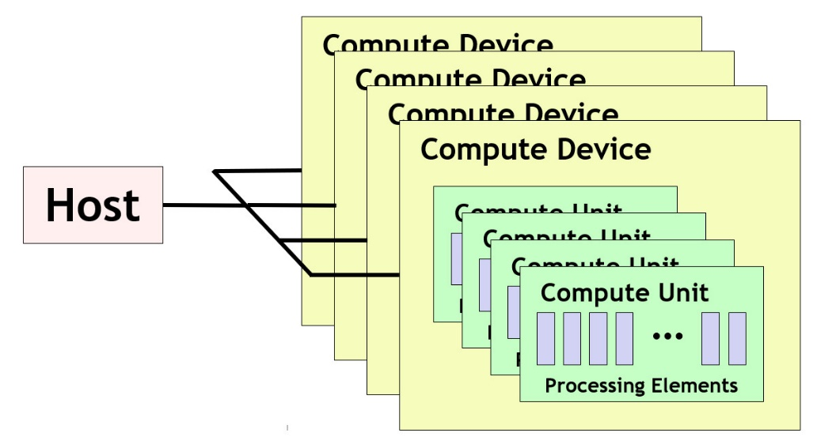
OpenCL Platform Model
Platform model defines the topology of compute resources
A single host which controls multiple compute devices
e.g., CPUs, GPUs, FPGAs, etc.
Each compute device consists of one or more compute units
e.g., cores in CPUs, streaming multiprocessors (SMs) in GPUs
Each compute unit consists of multiple processing elements
Fundamental compute resources that execute work items (i.e., threads)
e.g., cores or streaming processors in a GPU
Note that this platform model does not usually have an obvious mapping onto FPGA accelerators
We will see how FPGAs work later
8

Slide 9
OpenCL Execution Model
Host uses OpenCL API to manage and interface with compute devices
CPUs, GPUs, FPGAs
API for host code has bindings for multiple languages (C, C++, Python)
Work submitted to processing elements in the form of kernels
Written in an extension of C99, called OpenCL C
C++ for OpenCL, a C++17-based language, can also be used
After submission, kernels execute in parallel with host
Execution organized across work-items
Work-item: fundamental item of execution (CUDA threads)
Conceptually similar to thread
Each work-item represents an instance of a kernel
Executed on a processing element
9

Slide 10
OpenCL Work-Items
Host program specifies the number of work-items for a kernel
Generally equal to the number of parallel tasks/threads that can be executed in parallel
Number of work-times specified by “NDRange”
N-dimensional data structure representing all threads
N chosen by programmer based on characteristics of data
Purpose: provides kernels with thread information to determine data to access
e.g., vector add would create work-item for each element of input array
Corresponds to a 1D NDRange
vector<float> a, b;
….
NDRange range(a.size()); // creates 1D range with one work-item for each element of vector
10

Slide 11
OpenCL NDRange
What is the purpose of the NDRange?
A kernel instance (i.e., work-item) needs to know its index within the NDRange:
Index determines inputs to read and outputs to write
get_global_id(0) returns the kernel’s index (0 requests id within first dimension)
Sequential Code
for (int i=0; i < N; i++) {
c[i] = a[i] + b[i];
}
i = get_global_id(0)
// i == 2
c[2] = a[2] + b[2]
i = get_global_id(0)
// i == 0
c[0] = a[0] + b[0]
i = get_global_id(0)
// i == 1
c[1] = a[1] + b[1]
………
Corresponding Kernel
__kernel void mul(__global const float *a,
__global const float *b,
__global float *c) {
int i = get_global_id(0);
c[i] = a[i] + b[i];
}
Work-Item 0
Work-Item 1
Work-Item 2
11

Slide 12
OpenCL NDRange
NDRange can be N dimensional
OpenCL implementations required to support 3 dimensions
Multiple dimensions can be useful when data structure being processed has multiple dimensions
e.g., assign a work-item to each pixel in an image
Note: multiple-dimensional NDRange is for convenience
N dimensions can always be handled with 1D range via appropriate indexing computations
Host Code
get_global_size(0) == 5
Returns # work-items in the 0 (first) dimension
NDRange range2D(5, 8);
get_global_size(1) == 8
Returns # work-items in the 1 (second) dimension
12

Slide 13
OpenCL 2D Range Example
Simple 2D example
Take two inputs with same dimensions (assume to be grayscale)
Average the values of each pixel across images, output new averaged image
Parallelization strategy: create work-item for each pixel
Note: kernel inputs are not multi-dimensional (no pointers to pointers)
Serialized when buffered for OpenCL device
Must calculate index in 1D buffer
Kernel Code
Host Code
__kernel void img_avg(__global const float *a,
__global const float *b,
__global float *c) {
int x = get_global_id(0); // Specifies index in x dimension
int y = get_global_id(1); // Specifies index in y dimension
int index = y * get_global_size(0) + x;
c[index] = (a[index] + b[index]) / 2;
}
NDRange range2D(rows, cols);
13

Slide 14
OpenCL Work Groups
Developer will often partition NDRange into “work-groups”
Each work-group will execute on a single compute-unit (but single unit can execute multiple groups)
Nvidia Streaming Multiprocessor (compute unit) has 64-128 CUDA cores (processing elements)
Intel core (compute unit) has vector instructions with 8-12 slots (processing elements)
Compute unit definition may vary across implementations
If developer doesn’t specify work-groups, runtime will choose them automatically
NDRange global(10); // 10 total work-items
NDRange local(2); // 2 work-items per work group (10/2 = 5 total work groups)
queue.enqueueNDRangeKernel(kernel, NullRange, global, local); // Creates the NDRange with groups
Global Size = 10 (entire NDRange)
WG 0
WG 1
WG 2
WG 3
WG 4
Local Size = 2
14

Slide 15
OpenCL Work Groups
Why use work-groups?
Work-items within a group can share local resources (if provided by architecture)
Work-items within a group can be synchronized
Might align with application behavior (e.g., window operations)
Significant optimization potential
Choose appropriate work-group size based on processing elements in compute unit
Unfortunately, # of processing elements not always known
Leverage spatial locality when multiple work-items work on overlapping data
Useful parameter for tuning code for particular architecture
Can be synchronized
Cannot be synchronized
WG 0
WG 1
WG 2
WG 3
WG 4
15

Slide 16
OpenCL Work Groups
Global IDs:
0
1
2
3
4
5
6
7
8
9
Local IDs:
0
1
0
1
0
1
0
1
0
1
get_global_size(0) == 10
get_local_size(0) == 2
Total number of work groups = get_global_size(0) / get_local_size(0) = 5
Assumes global size is multiple of local size (required by some OpenCL versions)
get_global_id(0) returns value between 0 and 9 (every work-item has unique global ID)
get_local_id(0) returns value between 0 and 1
Multiple work-items have same local id
Note that work-groups must have same # of dimensions as global NDRange
1D Range requires 1D work groups, 2D Range requires 2D work groups, etc.
16

Slide 17
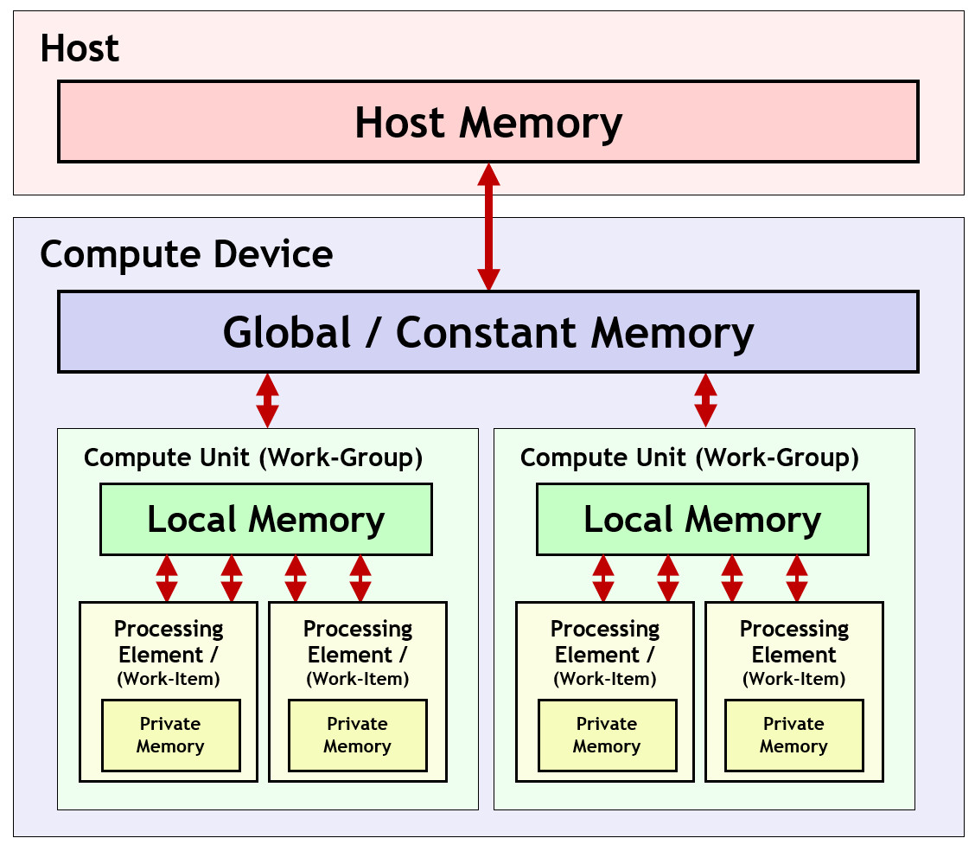
OpenCL Memory Model
Memory model defines memory hierarchy used by kernels
Supporting hardware assumed to implement this hierarchy
Host memory
Available only to the host CPU
e.g., CPU RAM
Global/Constant memory
Available to all compute units in a compute device
e.g., GPU external RAM
Local memory
Available to all processing elements in a compute unit
e.g., small memory shared between cores
Private memory
Available to a single processing element
e.g., registers for a single core
All memory transfers must be explicit!
17

Slide 18
OpenCL Execution Sequence
Complete sequence for executing an OpenCL program:
Query for available OpenCL platforms and devices
Create a context for one or more OpenCL devices in a platform
Create and build programs for OpenCL devices in the context
Select kernels to execute from the programs
Create memory objects for kernels to operate on
Create command queues to execute commands on an OpenCL device
Enqueue data transfer commands into the memory objects, if needed
Enqueue kernels into the command queue for execution
Enqueue commands to transfer data back to the host, if needed
18

Slide 19
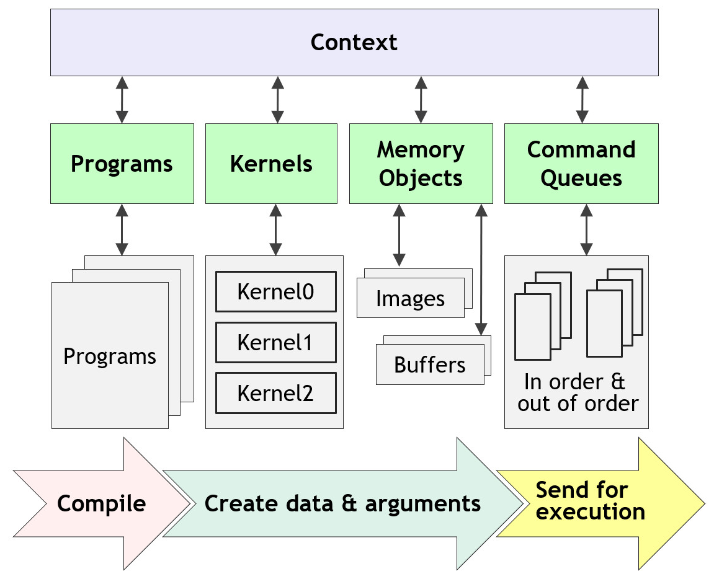
OpenCL Context
A “context” ties together the programs, kernels, memory objects, and command queues
19

Slide 20
OpenCL Host Code
Query for available platform and device (using C++ bindings):
// Get the default platform
cl::Platform default_platform = all_platforms[0];
std::cout << "Using platform: " <<default_platform.getInfo<CL_PLATFORM_NAME>() << "\n";
// Print out available devices on that platform
std::vector<cl::Device> all_devices;
default_platform.getDevices(CL_DEVICE_TYPE_ALL, &all_devices);
if (all_devices.size() == 0) {
std::cout << " No devices found.\n"; exit(1);
}
cl::Device default_device = all_devices[0];
std::cout << "Using device: " << default_device.getInfo<CL_DEVICE_NAME>() << "\n";
20
Example from https://ulhpc-tutorials.readthedocs.io/en/latest/gpu/opencl/

Slide 21
OpenCL Host Code
Create an OpenCL “context”:
Encapsulates command queues, memory, kernels, etc. (basically combines everything)
cl::Context context({default_device});
Define code objects (sources for kernels):
cl::Program::Sources sources;
21
Example from https://ulhpc-tutorials.readthedocs.io/en/latest/gpu/opencl/

Slide 22
OpenCL Host Code
Allocate memory on device:
// Create normal C/C++ arrays (_h suffix specifies this is host memory)
const int SIZE = 10;
int A_h[] = { 0, 1, 2, 3, 4, 5, 6, 7, 8, 9 };
int B_h[] = { 10, 9, 8, 7, 6, 5, 4, 3, 2, 1 };
int C_h[] = { 0, 0, 0, 0, 0, 0, 0, 0, 0, 0 };
// Create buffers on the device for each array
cl::Buffer A_d(context, CL_MEM_READ_ONLY, sizeof(int) * SIZE);
cl::Buffer B_d(context, CL_MEM_READ_ONLY, sizeof(int) * SIZE);
cl::Buffer C_d(context, CL_MEM_WRITE_ONLY, sizeof(int) * SIZE);
Create “Queue”
Object for issuing commands to devices from host
cl::CommandQueue queue(context, default_device);
22
Example from https://ulhpc-tutorials.readthedocs.io/en/latest/gpu/opencl/

Slide 23
OpenCL Host Code
Transfer input arrays to device buffers:
// Create normal C/C++ arrays (_h suffix specifies this is host memory)
queue.enqueueWriteBuffer(A_d, CL_TRUE, 0, sizeof(int) * SIZE, A_h);
queue.enqueueWriteBuffer(B_d, CL_TRUE, 0, sizeof(int) * SIZE, B_h);
Build the OpenCL kernel
Uses run-time compilation (other methods exist)
// String representing kernel code (can also be specified in different file)
std::string kernel_code =
" void kernel simple_add(global const int* A, global const int* B, global int* C) { "
" C[get_global_id(0)] = A[get_global_id(0)] + B[get_global_id(0)]; "
" }
cl::Program::Sources sources;
sources.push_back({ kernel_code.c_str(), kernel_code.length() }); // Add kernel code to list of sources
cl::Program program(context, sources); // Create the OpenCL program
// Compile the program
if (program.build({ default_device }) != CL_SUCCESS) {
std::cout << " Error building: " << program.getBuildInfo<CL_PROGRAM_BUILD_LOG>(default_device) << "\n"; exit(1);
}
23
Example from https://ulhpc-tutorials.readthedocs.io/en/latest/gpu/opencl/

Slide 24
OpenCL Host Code
Start execution of the kernel
cl::make_kernel<cl::Buffer, cl::Buffer, cl::Buffer> simple_add(cl::Kernel(program, "simple_add"));
// Create the ND Range (1D in this case) using SIZE total work-items
cl::NDRange global(SIZE);
// Start the kernel by specifying the queue to use, the NDRange (global), and the buffers for the parameters
// Then, wait for completion
simple_add(cl::EnqueueArgs(queue, global), A_d, B_d, C_d).wait();
Read the results back from the device
// Reads the device buffer (C_d) into host array (C_h)
queue.enqueueReadBuffer(C_d, CL_TRUE, 0, sizeof(int) * SIZE, C_h);
Done!
See https://github.com/ULHPC/tutorials/blob/devel/gpu/opencl/code/exercise1.cpp for complete code
24
Example from https://ulhpc-tutorials.readthedocs.io/en/latest/gpu/opencl/

Slide 25
OpenCL Additional Topics
Use of local and private memory
Requires explicit transfers in kernel code
Synchronization of work-items in a work-group
As kernel code gets more complex, some work-items need to wait until other work-items complete
Example:
16 work items do a vector-multiply and store the result in local memory
1 of those work items accumulates the products (after all 16 finish the multiply)
Pipes
Enabling “deep” parallelism across kernels
Very important for FPGAs
Numerous optimization strategies
25
Example from https://ulhpc-tutorials.readthedocs.io/en/latest/gpu/opencl/

