Slide 1
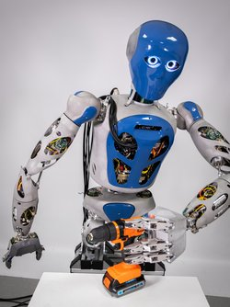
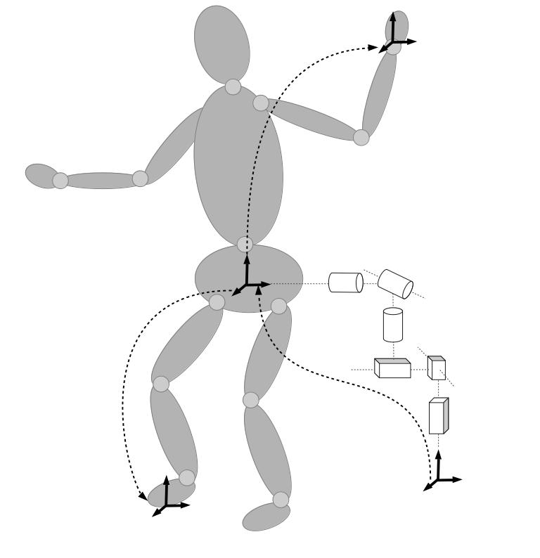







$$A=πr^{2}{}_{}ass$$
Controller
Scene
Tasks, Constraints
Solver
Pose Control
HLS
Force Control
Velocity
qpOASES
$${\dot{v}}_{r},v_{r},x_{r}$$
$${\dot{v}}_{d}, v_{d}$$
TSID
$$QP$$
$${\ddot{q}}^{∗},{\dot{q}}^{∗},q^{∗},τ^{∗}$$
Potential Field
proxQP
Joint Limits
Reduced
TSID
eiquadprog
…
…
qpSwift
Robot
Kinematics/
Dynamics
Robot Model
$$v,x$$
KDL
$$\dot{q},q$$
RBDL
Pinocchio
ARC-OPT
WBC Library
HyRoDyn

