Slide 1
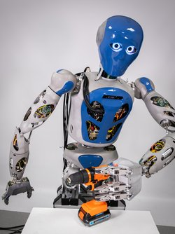
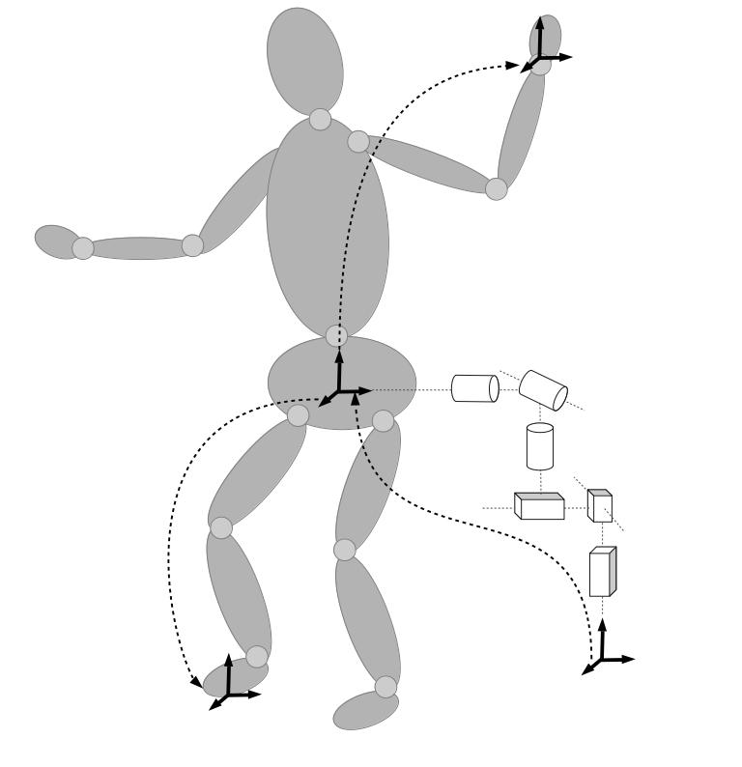
Controller
Scene
Tasks, Constraints
Solver
Pose Control
HLS
Force Control
Velocity
qpOASES
TSID
QP
Potential Field
proxQP
Joint Limits
Reduced
TSID
eiquadprog
…
…
qpSwift
Robot
Kinematics/
Dynamics
Robot Model
KDL
RBDL
Pinocchio
ARC-OPT
WBC Library
HyRoDyn

