Slide 1
Determined GAN
RECOMMENDATION SYSTEM FOR MULTIPLE GAN ARCHITECTURE USING DETERMINED AI
TEAM MEMBERS:
G S, ARCHANA
RR, SOUMYA
JOLLY, JINU MARIAM
DHIMATE, VIKRANT MAH
CHOUBEY, YOGESH KUMAR
C, SHIJU

Slide 2
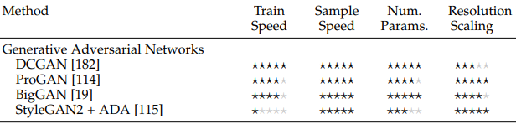
PROJECT OBJECTIVE
Data plays a crucial role in today's world of fast-growing technology.
In many fields there is a growing issue in data analysis, like data unavailability due to ethical and legislative restrictions, biases in data, etc.
To address data unavailability, people are leveraging machine learning algorithms such as Generative Adversarial Networks (GAN) to augment data from existing samples.
With many GAN algorithm it is practically impossible to predict which algorithm best fits the problem in question, unless many algorithms are tested.
Based on research, Deep generative models differ in terms of training and test speed, parameter efficiency, sample quality, sample diversity, and ability to scale to high resolution data.
In this hackathon we used Determined AI to accelerate GAN exploration by increasing the training speed, distributed training and help customer to pick the right GAN Architecture.

Slide 3
APPLICATION VERTICALS | USE CASES
Health care | GAN in medical image processing. Cycle-GAN in medical imaging analysis. Latest applications of GAN in medical informatics and bioinformatics. GAN in medical image generation and cell gene imputation. Link: https://www.frontiersin.org/articles/10.3389/fpubh.2020.00164/full
HPC (High performance computing) | With HPC and AI support Increases ROI, drives innovation, quicker resolution of challenging issues, improve quality etc. But as the use of HPC and AI grows and becomes more mainstream at enterprises, meeting customer requirements in every industry, and GAN also can add value here. Link: https://www.hpe.com/psnow/doc/a00112284enw.pdf?jumpid=in_pdfviewer-psnow
Other fields | Generative Adversarial Networks have been consistently showing huge potential and developments in the area of Art, Music, Semi Supervised learning, Handling Missing data, Drug Discovery, and unsupervised learning. Link: https://www.researchsquare.com/article/rs-300223/v1

Slide 4
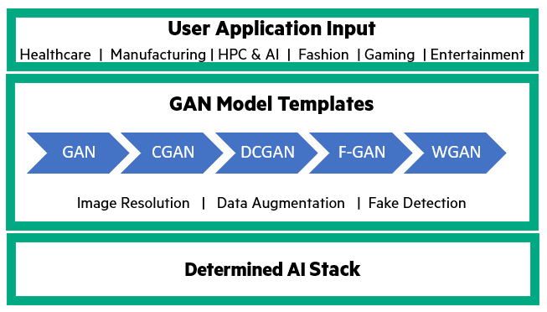
Our Approach
This hackathon we tried to explore how Determined AI can accelerate GAN exploration.
Using Determined AI, we are proposing to support multiple GAN model templates.
This will help user to bring in their use cases and run it across multiple GAN model with the following benefits
  Helps to train model faster and obtain comparative analysis of the solution across model with distributed training.
  Find better models with advanced hyperparameter tuning.
  This helps customer to take a well informed and efficient solution for their problem.

Slide 5
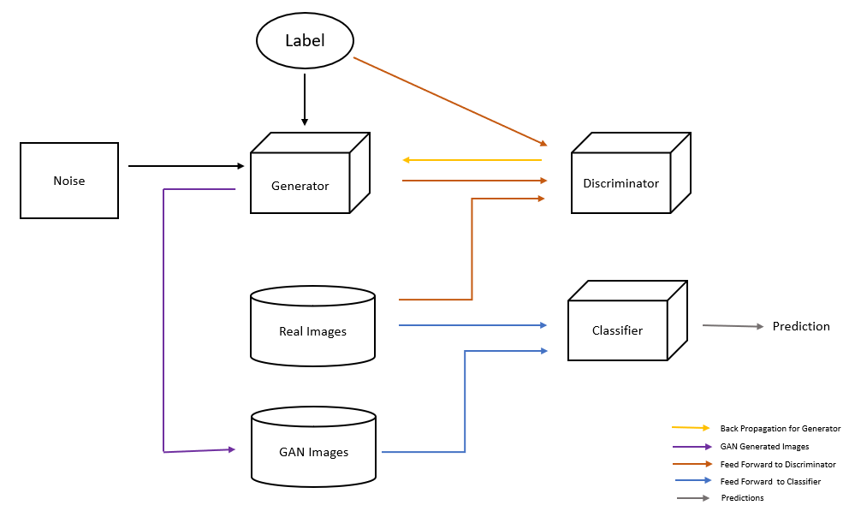
Our implementation
We explored one GAN model, viz, conditional GAN to generate images.
These generated images are then passed to a basic CNN classifier, to train it on extended datasets containing both real and synthetic data, to observe accuracy and time taken for execution.
Dataset used :
    MNIST dataset of handwritten digits (training data – 60000 images and test data – 10000 images).
    CGAN generated MNIST data (1k images)
CGAN contain two adversarial networks, a generator and a discriminator, both conditioned on some additional information called class labels.
The goal is to create label specific images so that it can converge faster with images like the labelled image distribution.
.

Slide 6
Steps to execute
1. Run CGAN code to generate images.
2. Run CNN classifier using CGAN generated images and MNIST data.
For more information on execution refer readme file (https://github.Com/ARCHANAGSR/determined-gan)
Note:
Due to TF API conformance usage issues, sending multiple input to the model was infeasible. This partially ported stage(1) code is available for reference in our github.
Based on the pointers from Determined AI team, we will continue to explore on this.
For now, the output of step(1) from collab is taken as an input to step(2) in Determined AI.

Slide 7
Technological Implementation
What makes our hackathon project interesting ?
  Replacing part of original data with generated image, this helps train the model with different structures or scenario of data than already available. Helping us to train model across different types of data and biased data etc.
Does the interaction with determined ai and the api demonstrate quality model development?
  Determined AI provided a better environment for code structuring, comparative metrics validation, metrics visualization, parallel distribution of workload etc. supporting faster qualitative development of code.
Determined AI gave a clear structure to port the code.
  Yes.
Potential impact
  It has huge impact for many verticals and leveraging GAN in an accelerated way.
  With determined AI we were able to experiment the model with different scenario of parameters with few changes in code.

Slide 8
Creativity:
How creative and unique is the project?
  Our project is unique as it creates a template for most common case of data augmentation, using Determined AI. It is a recommendation to pick the efficient model quickly.
Is the machine learning use case not commonly seen?
  GAN is an evolving field, and such explorations are captured in pockets. Here we want to create templates for larger adoption.
Use of distributed training
  Though we did not get resources for distributed training, still use case is a potential for distributed hackathon.
Does the project show the best use of distributed training with determined?
  Yes.

Slide 9
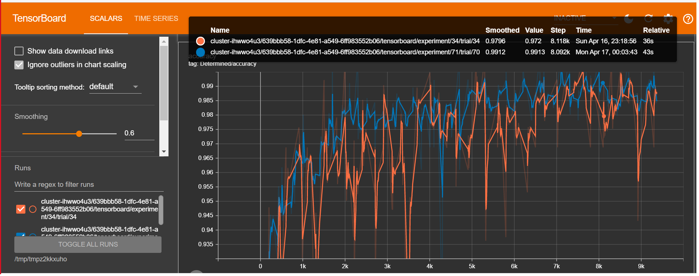
OBSERVATIONS
A screenshot of your best metrics from the Determined web UI :
INFERENCE:
We observe that by replacing the original data with CGAN generated data we get the similar accuracy as with using original MNIST data.
We infer that in this way the model can be trained with synthetic data thus training it for non existing data scenarios as well as addressing the issue of bias in data without any significant loss in accuracy.
Fig. Shows the comparative analysis of classifier runs between original MNIST data and 59k MNIST+ 1k CGAN generated images.

Slide 10
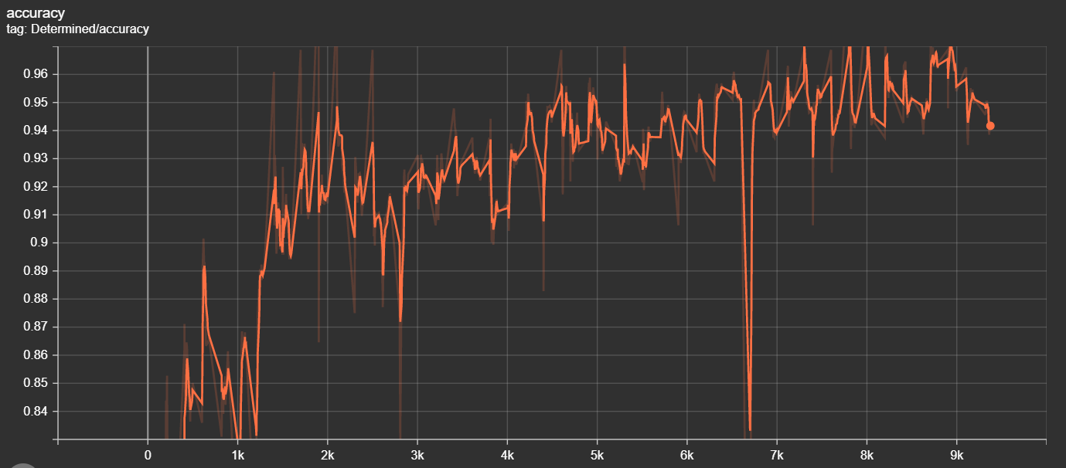
OBSERVATIONS
Data | Validation Accuracy
Original MNIST 60K | 0.9912
59K MNIST + 1K CGAN | 0.9919
30K MNIST + 30K CGAN | 0.9860
Fig. Accuracy graph of classifier run for data with 30k MNIST + 30k CGAN data

Slide 11
Acknowledgements
Authors would like to acknowledge,
for guidance and inspiration,
    S, MADHUSOODHANA CHARI
    NAMBIAR, DIVYA C
    HARISH.R
Determined AI TEAM for COMPLETE SUPPORT,
    ILIA
    RYAN
    GHODGAONKAR, ISHA
    HIROKI ASAKURA

Slide 12
DEMO
GIT : https://github.com/ARCHANAGSR/Determined-GAN

Slide 13
Updates
We are now successful in porting the Conditional GAN code to Determined AI platform (https://github.Com/ARCHANAGSR/determined-gan/tree/main/dai_integrated_cgan).
With this work we are able to generate new MNIST handwritten digits images. These images can then be used in our CNN classifier already ported in Determined AI platform (https://github.Com/ARCHANAGSR/determined-gan/tree/main/detai_classifier).

Slide 14
Thank YOU

