Slide 1

Data Carpentry: workshops to increase data literacy for researchers

Slide 2

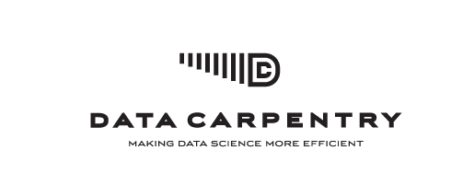
What is Data Carpentry?
Researchers should be able to retrieve, view, manipulate, analyze and store their's and other's data in an open and reproducible way. Researchers learn best when material is taught in their domain, so workshops will be domain-specific.
Training specifically designed for scientists
http://datacarpentry.org
for novices:
there are no prerequisites, and no prior knowledge about the tools is assumed
Partner organisation to Software Carpentry
Hands-on workshops

Slide 3










Who is Data Carpentry
Project lead:
Tracy K. Teal (Michigan State University)
Steering Committee:
Karen A. Cranston (National Evolutionary Synthesis Center, NESCent)
Hilmar Lapp (National Evolutionary Synthesis Center, NESCent)
Ethan White (Utah State University)
Greg Wilson (Software Carpentry Foundation)
Karthik Ram (University of California)
Aleksandra Pawlik (University of Manchester)
Administrators: Tracy Teal (DC) and Giacomo Peru (SSI)
Assessment support: Shari Ellis, iDigBio
Instructors: international volunteer network
Funders and partnership organisations

Slide 4
Target audience
SKILLS
Multiple disciplines
bioinformatics
ecology
genomics
sociology
digital humanities
neuroscience
geosciences
….
Different levels of career
PhD students
postdoctoral researchers
research assistants
researchers in industry
….
Full
computational
lab
skillset
Good knowledge of programming (R, Python or other), structured data, metadata, proficiency in building workflows and automating tasks
Some knowledge of scripting, using workflow tools, command line
Data + spreadsheets + some statistics and…?

Slide 5
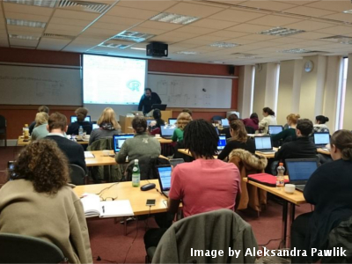
Workshops & Curriculum
2 days
Hands-on
Qualified instructors
Helpers
Post-it notes!
Core curriculum
Effective use of spreadsheets
Limitations and caveats of data analysis using spreadsheets
Moving from spreadsheets into more powerful tools (R or Python)
Using databases (introduction to SQL)
Workflows and automating repetitive tasks (command line shell and shell scripts)

Slide 6
Progress so far
Workshops:
10 in total
4 at the NSF BIO Centers
iDigBio
BEACON
SESYNC
NESCent
Data Carpentry workshops in the UK, Finland and Bangalore (CODATA)
Hackathons for material development
Genomics materials hackathon at CSHL
ELIXIR hackathon in Finland
Plans for Geospatial data lessons hackathon
Open source materials https://github.com/datacarpentry/
Partnership with Software Carpentry Foundation

Slide 7

Plans for the future
Workshops and hackathons in the United States and internationally
Aim for 24 workshops in the first calendar year (2015)
Working with ELIXIR Europe and UK to run workshops there and Research
Platforms in Australia.
Working to develop a sustainable plan for delivering workshops and
developing material in new domains (NSF, Moore Foundation)

Slide 8
Our workshop
Focused on learning R and text mining, introducing tools and concepts
Ben Marwick is a professor in anthropology at University of Washington and he developed these materials.

Slide 9
Welcome!

