Slide 1



Superstore Business Intelligence Report

Slide 2

Learning Objectives
This project was undertaken to develop a deeper understanding of data analysis and visualization using Power BI. The key learning objectives include:
1. Data Import and Preparation
- Understanding how to import Excel files into Power BI.
- Cleaning and transforming data using Power Query Editor.
- Handling missing values, duplicate records, and incorrect data types.
-
GOAL
Source :
www.freepik.com/

Slide 3
Learning Objectives
2.Data Modeling and Relationships
- Establishing relationships between multiple tables using primary and foreign keys.
- Resolving many-to-many relationships using a bridge table.
- Understanding cardinality and direction of relationships in Power BI.
GOAL
Source :
www.freepik.com/

Slide 4
Learning Objectives
3. Data Visualization and Dashboard Creation
- Creating different types of charts (Pie, Line, Tree Map, Stacked Bar, Waterfall, Ribbon).
- Applying appropriate aggregations like sum, average, and count for meaningful insights.
- Customizing dashboards for better readability with labels, colors, and themes.
GOAL
Source :
www.freepik.com/

Slide 5
Learning Objectives
4.Business Insights and Decision-Making
- Identifying trends in sales, profit, and shipping costs.
- Understanding the impact of different regions, cities, and product categories on revenue.
-Analyzing order priority and its effect on business performance
GOAL
Source :
www.freepik.com/

Slide 6
Learning Objectives
5.Problem-Solving and Troubleshooting
- Resolving issues related to data relationships and duplicate values.
- Enabling and configuring map visuals for geographical analysis.
- Refining reports based on usability and readability
GOAL
Source :
www.freepik.com/

Slide 7
Learning Objectives
6. Report Presentation and Interpretation
- Structuring a Power BI report to make it easy to understand for stakeholders.
- Summarizing key findings through interactive dashboards.
- Providing actionable insights for business improvement
GOAL
Source :
www.freepik.com/

Slide 8
Learning Objectives
These objectives ensure that the project not only improves technical Power BI skills but also enhances data-driven decision-making abilities.
GOAL
Source :
www.freepik.com/

Slide 9
Tools and Technology used
This project was executed using the following tools and technologies:
1. Power BI
- Used for data visualization, report building, and dashboard creation.
- Features used: Power Query Editor, Data Modeling, Relationship
Management, and various chart types (Pie, Line, Tree Map, Waterfall, Ribbon, etc.).

Slide 10
Tools and Technology used
*2. Microsoft Excel
- Source file format containing the Superstore dataset
- Used for initial data storage and exploration before importing into Power BI.

Slide 11
Tools and Technology used
T3. Power Query Editor (Built-in in Power BI)
- Used for *data cleaning and transformation*, including:
\
- Removing unnecessary columns
- Changing data types
- Handling missing values and duplicates

Slide 12
Tools and Technology used
T
4. Power BI DAX (Data Analysis Expressions)
- Applied for *custom calculations and measures* (if any, like sum of sales, average profit, etc.

Slide 13
Tools and Technology used
5. Power BI Relationship Manager
- Used for *establishing relationships* between multiple tables (Orders, Returns, Users).
- Applied a *bridge table* to handle many-to-many relationships

Slide 14
Tools and Technology used
6. Power BI Themes and Formatting Tools
- Applied for *visual customization*, including color themes, labels, and font styles.
These tools and technologies helped in transforming raw sales data into an interactive, easy-to-understand dashboard for business analysis.

Slide 15
Methodology
The project follows a structured approach to analyze sales and profitability data using Power BI. The methodology consists of the following key steps:
1. Data Collection and Import
- The dataset was obtained in *Excel format* (Superstore dataset).
- Imported into *Power BI* using the "Import from Excel" option.
- Verified the dataset structure, ensuring all required tables (Orders, Returns, Users) were available.

Slide 16
Methodology
2. Data Cleaning and Transformation
- Opened *Power Query Editor* to preprocess the data.
- *Removed unnecessary columns* (Column 26, Column 27) as they contained no useful data.
- *Changed data types*:
- Converted *Order Date* and *Ship Date* to *Date format*.
- Converted *Profit, Sales, Discount, and Unit Price* to *Number format*.
- *Handled missing values*:
- The *Product Base Margin* column had *1% missing values*, which were replaced with the column average.

Slide 17
Methodology
3. Data Modeling and Relationships
- Established *relationships between tables* to ensure data consistency:
- *Orders Table → Returns Table: Created a **Bridge Table (ID Bridge)* to resolve the *many-to-many relationship* due to duplicate Order IDs.
- *Orders Table → Users Table: Linked using the **Region column*.

Slide 18
Methodology
4. Data Visualization
Various visualizations were created to represent key business insights:
Pie Charts*
- Total Sales by *State/Province*
- Total Sales by *Region*
- Total Sales by *City*
- Average Profit by *Region*
- Total Shipping Cost by *Ship Mode*
- Average Unit Price by *Product Category*

Slide 19
Methodology
Line Chart
- Monthly Profit Trend (*Order Date vs. Sum of Profit*)
Tree Map
- *Product Category-wise Sales, grouped by **Technology, Furniture, and Office Supplies*

Slide 20
Methodology
stacked Bar Chart
- Sales Count by Order Priority
*Waterfall Chart*
- *Profit Analysis Over Time, grouped by **Product Category*
*Ribbon Chart*
- *Sales Trend Over Time, based on **Order Date vs. Sum of Sales*

Slide 21
Methodology
5. Report Customization
- Applied *consistent color themes* to improve readability.
- Renamed charts to provide *clear and meaningful titles*.
- Ensured *data labels were visible* for easy interpretation.
- Configured *filters and slicers* for interactive report exploration.

Slide 22
Methodology:
6. Insights and Business Use Cases
- Identified *top-performing states, cities, and regions* in terms of sales and profit.
- Analyzed *profit trends over time* to detect seasonal changes.
- Evaluated *shipping costs by mode* to optimize logistics expenses.
- Examined *product category performance* to aid inventory and pricing decisions.
- Assessed *order priority distribution* for supply chain improvements.

Slide 23
Methodology:
Conclusion*
By following this methodology, the project successfully transformed raw sales
data into a *structured and interactive Power BI dashboard, providing valuable
insights for **business decision-making*.
.

Slide 24
Problem statement:
In today's competitive retail market, businesses need *data-driven insights* to optimize their sales, improve profitability, and enhance operational efficiency.
The *Superstore dataset* contains information on sales, profits, shipping costs, and customer demographics across different states, cities, and regions. However, without proper analysis, it is challenging to identify:

Slide 25
Problem Statement:
Which *regions, states, and cities* contribute the most to overall sales and profit?
- How *shipping costs* vary across different shipping modes and their impact on profitability?
- What are the *profitability trends over time*, and how do they fluctuate seasonally?
- Which *product categories* generate the highest sales and profits?
- How does *order priority* impact the overall business performance?
.

Slide 26
Problem Statement:
This project aims to develop an *interactive Power BI dashboard* that will
transform raw sales data into meaningful insights through *visualizations such as
bar charts, pie charts, line charts, tree maps, waterfall charts, and ribbon charts.
These insights will help businesses **make informed decisions on sales strategies, cost reduction, and inventory management*.
.

Slide 27
Solution:
To address the challenges outlined in the problem statement, a *Power BI dashboard* was developed using the *Superstore dataset.
The solution follows a structured approach, including **data preprocessing, modeling, and visualization*, to transform raw data into meaningful business insights.

Slide 28
Solution:
1. Data Import and Cleaning
- Imported the *Excel file* into Power BI, ensuring all necessary tables (*Orders, Returns, and Users*) were included.
- Used *Power Query Editor* for data cleaning:
- Removed unnecessary columns (*Column 26, Column 27*) as they contained no relevant data.
- Changed *data types* for numerical, date, and categorical fields to ensure consistency.

Slide 29
Solution:
Handled missing values in the *Product Base Margin* column by replacing them with the column average
2. Data Modeling and Relationships
- Established relationships between tables to ensure seamless data analysis:
*Orders Table → Returns Table: Created a **Bridge Table (ID Bridge)* to resolve the *many-to-many relationship* due to duplicate Order IDs.

Slide 30
Solution:
Orders Table → Users Table: Linked using the **Region column* to associate regional managers.
3. Data Visualization and Dashboard Development
To gain actionable insights, various *charts and visuals* were created based on key business metrics:
*Bar and Pie Charts*
- *Total Sales by State, City, and Region* – Identified the top-performing and least profitable locations.

Slide 31
Solution:
Average Profit by Region* – Analyzed profitability variations across different regions.
- *Total Shipping Cost by Ship Mode* – Evaluated logistics costs for different shipping methods.
- *Average Unit Price by Product Category* – Compared pricing across different product categories.

Slide 32
Solution:
Line Chart
- *Month-wise Profit Trend* – Identified seasonal sales trends and profitability fluctuations.
Card Visuals
- Displayed *Total Sales, Total Profit, and Total Quantity Ordered* for quick business overview.

Slide 33
Solution:
*Additional Custom Visuals*
- *Tree Map* – Grouped product categories (*Technology, Furniture, Office Supplies*) to show sales distribution.
- *Stacked Bar Chart* – Analyzed order priority and its impact on sales.
- *Waterfall Chart* – Visualized profit variations over time across different product categories.
- *Ribbon Chart* – Showed sales trends over time based on order date.

Slide 34
Solution:
4. Customization and Report Optimization*
- Applied *consistent color themes* and *data labels* to enhance readability.
- Used *filters and slicers* for interactive exploration of insights.
- Renamed visuals with *clear and meaningful titles* for better interpretation.

Slide 35
Solution:
5. Insights and Business Use Cases*
- *Sales Distribution*: Identified the best and worst-performing regions, cities, and states.
- *Profitability Trends*: Helped track profit variations over time and optimize pricing strategies.
- *Shipping Cost Analysis*: Provided insights on cost-effective shipping methods.
- *Customer Behavior Analysis*: Revealed which product categories and order priorities were most preferred.

Slide 36
Solution:
Conclusion*
By implementing this *Power BI-based business intelligence solution, raw sales data was transformed into **interactive dashboards* that provide actionable insights.
These insights enable businesses to make *informed decisions*, optimize sales strategies, and improve overall profitability.

Slide 37
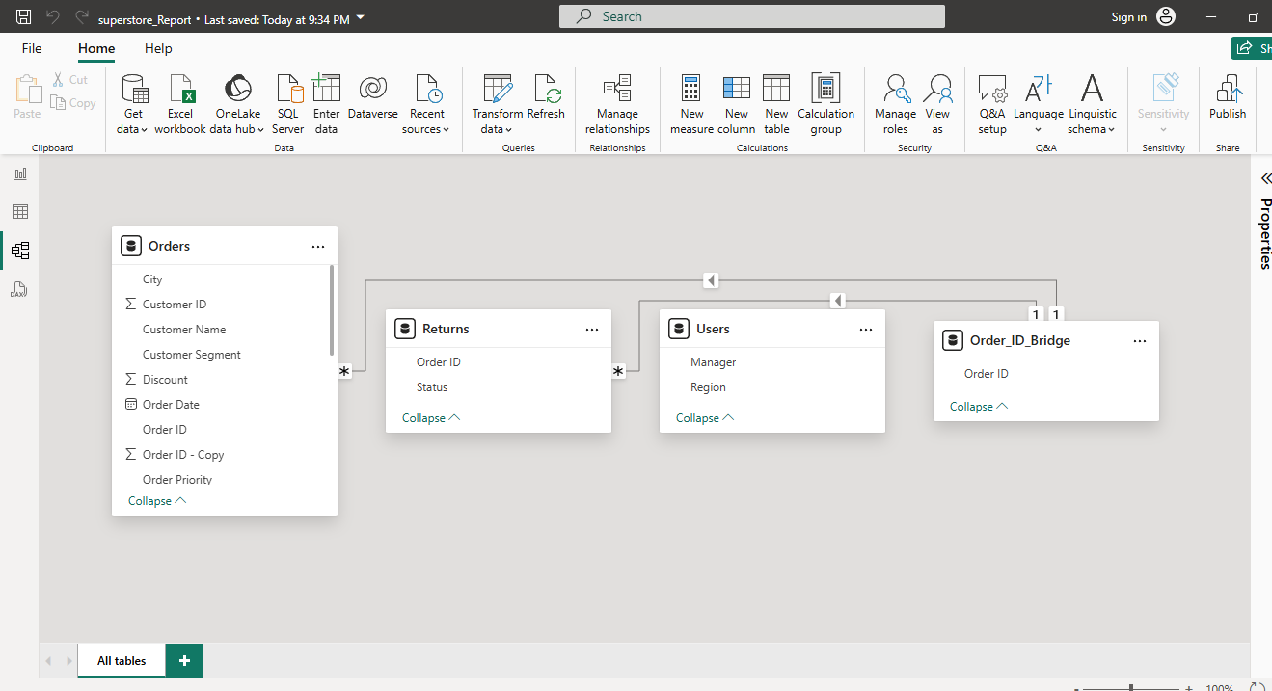
Screenshot of Output:

Slide 38
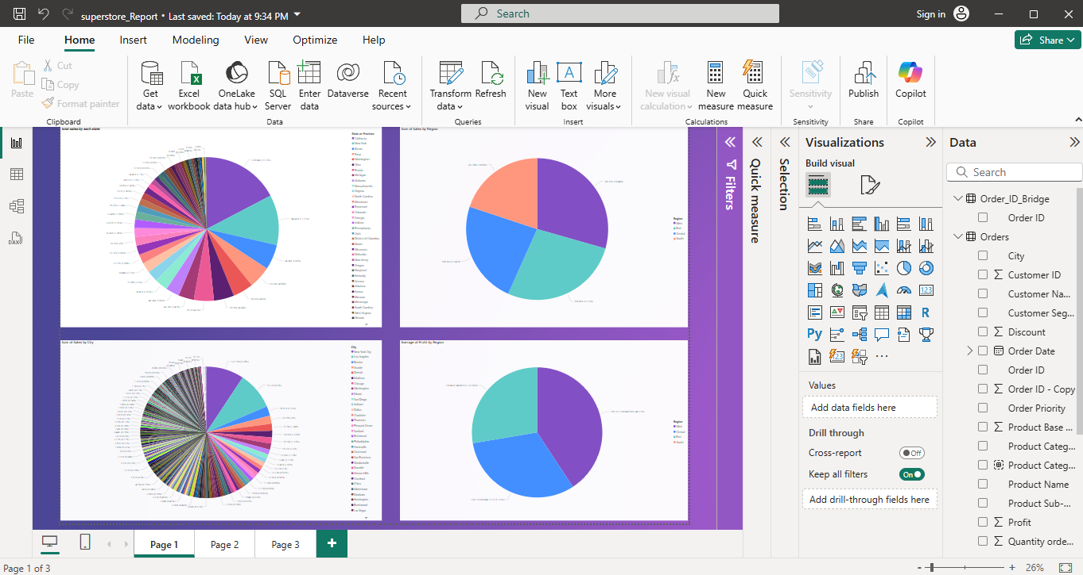
Screenshot of Output:

Slide 39
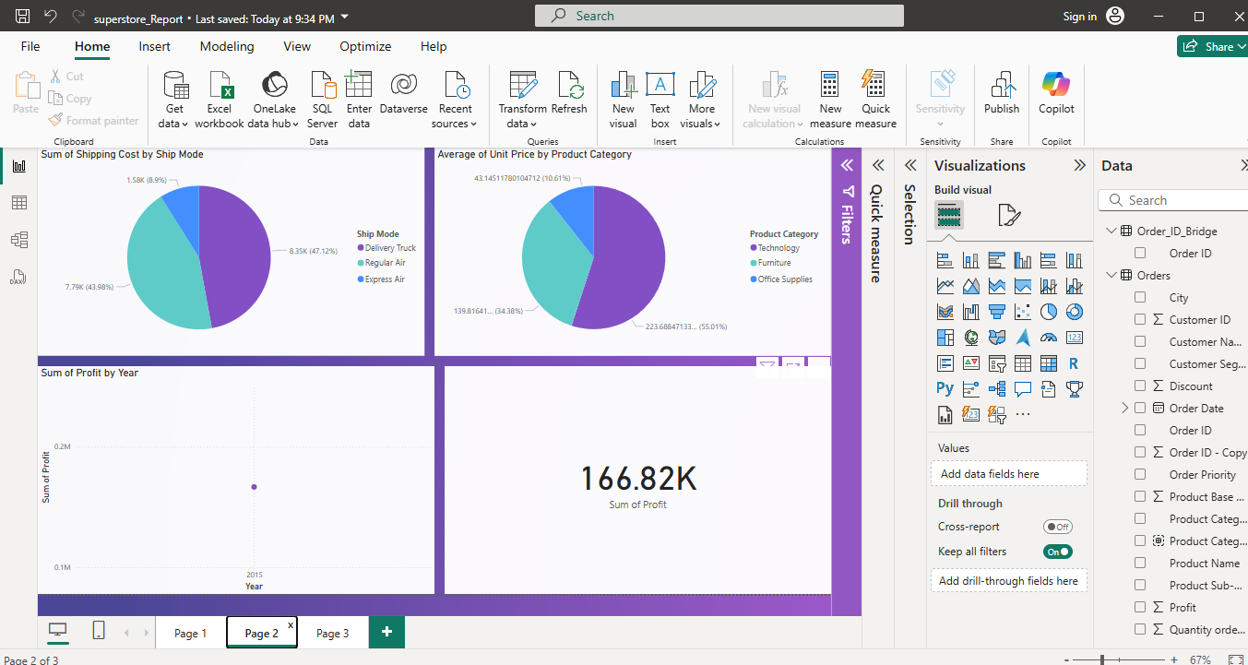
Screenshot of Output:

Slide 40
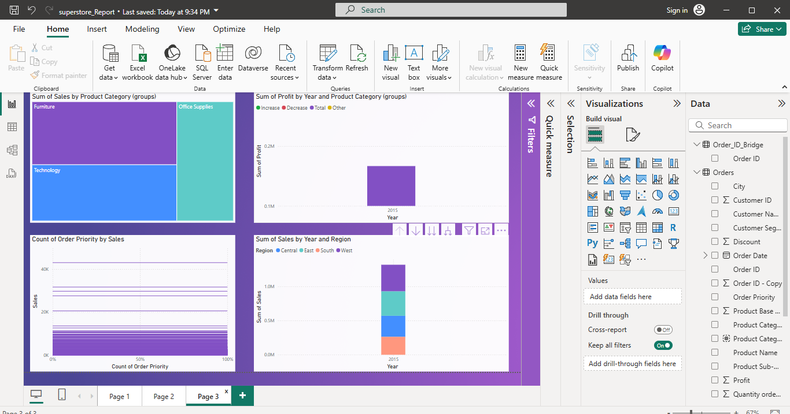
Screenshot of Output:

Slide 41
Conclusion:
This project successfully transformed raw sales data from the *Superstore dataset* into a structured, *interactive Power BI dashboard* that provides valuable business insights.
By leveraging *data cleaning, modeling, and visualization techniques, the report highlights key trends in **sales, profit, shipping costs, and customer behavior*.
The dashboard enables businesses to:
- Identify *top-performing regions, states, and cities* in terms of sales and profitability.

Slide 42
Conclusion:
Analyze *monthly profit trends* to understand seasonal variations.
- Optimize *shipping costs* by evaluating different ship modes.
- Assess *product category performance* to improve inventory management.
- Evaluate *order priority distribution* to enhance supply chain efficiency.

Slide 43
Conclusion:
Through the use of *bar charts, pie charts, line charts, tree maps, waterfall charts, and ribbon charts, the project provides a **visually intuitive and data-driven approach* to decision-making.
The insights derived from this report can help businesses improve their *sales strategies, operational efficiency, and overall profitability*
This project demonstrates the power of *Power BI as a business intelligence tool* in turning raw data into actionable insights, making it an essential asset for data-driven decision-making.

