Slide 1
INFORMATION MANAGEMENT SYSTEM
Abhishek kumar
16BCS2814
Android Project

Slide 2
Content
An introduction to Information System
Meaning of Information Management System
Characteristic of IMS
The aim of IMS
Benefits of IMS

Slide 3
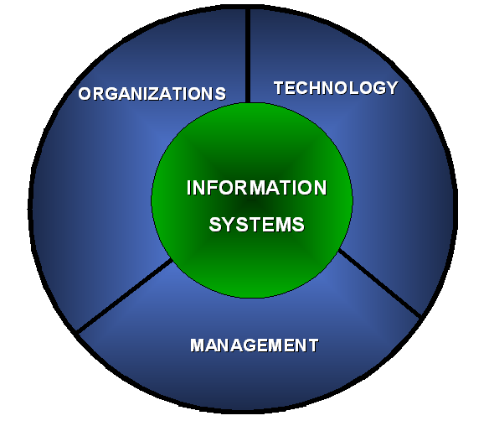

Meaning Of Information Systems
An information system is an organized combination of people, hardware, software, communications Networks and data resources that collects, transforms, and disseminates information in an organization.

Slide 4

INFORMATION MANAGEMENT SYSTEM(IMS)
The IMS is defined as a system based on the database of the evolved for the purpose of providing information to the people in the organization.

Slide 5
Management information systems are distinct from regular information systems in that they are used to analyze other information systems applied in operational activities in the organization. MIS involve three primary resources: technology, information, and people.
Management information systems are regarded to be a subset of the overall internal controls procedures in a business, which cover the application of people, documents, technologies, and procedures used by management accountants to solve business problems such as costing a product, service or a business-wide strategy.

Slide 6
Role Of IMS
The role of MIS in an organization can be compared to the role of heart in the body.
The information is the blood and MIS is the heart. In the body the heart plays the role of supplying pure blood to all the elements of the body including the brain.
The MIS plays exactly the same role in the organization.
The system ensures that an appropriate data is collected from the various sources, processed, and sent further to all the needy destinations.

Slide 7
The system is expected to fulfill the information needs of an individual, a group of individuals, the management functionaries: the managers and the top management.
The MIS satisfies the diverse needs through a variety of systems such as Query Systems, Analysis Systems, Modeling Systems and Decision Support Systems.
The MIS helps in Strategic Planning, Management Control, Operational Control and Transaction Processing.

Slide 8
Characteristics of IMS
Management-oriented: The basic objective of IMS is to provide information support to the management in the organization for decision making.
Management directed: When IMS is management-oriented, it should be directed by the management because it is the management who tells their needs and requirements more effectively than anybody else.
Integrated: It means a comprehensive or complete view of all the subsystems in the organization of a company.

Slide 9
Common data flows: The integration of different subsystems will lead to a common data flow which will further help in avoiding duplicacy and redundancy in data collection, storage and processing.
Heavy planning-element: The preparation of MIS is not a one or two day exercise. It usually takes 3 to 5 years and sometimes a much longer period.
Subsystem concept: When a problem is seen in 2 sub parts, then the better solution to the problem is possible.

Slide 10
Common database: This is the basic feature of MIS to achieve the objective of using MIS in business organizations.
Computerized: MIS can be used without a computer. But the use of computers increases the effectiveness and the efficiency of the system.
User friendly/Flexibility: An MIS should be flexible.
Information as a resource: Information is the major ingredient of any MIS.

Slide 11


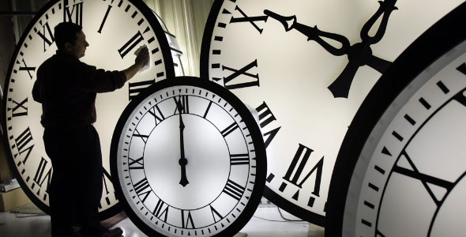

Features of IMS
Timeliness
Accuracy
Consistency
Completeness
Relevance

Slide 12

Aim of Information Management System
The main aim of IMS is to inform management and help them make informed decisions about management and the way the business is run.

Slide 13
Types Of IMS
Transaction processing systems: These systems process a large volume of routine, recurring transactions.
Operations information systems: These systems gather comprehensive data, organize it and summarize it in a form that is useful for managers.
Decision support systems: These systems help mangers with the necessary information to make intelligent decisions.
Expert systems: They are meant to mimic humans in making decisions in a specific field.

Slide 14

Benefits of IMS
It improves personal efficiency.
It expedites problem solving(speed up the progress of problems solving in an organization).
It facilitates interpersonal communication
It promotes learning or training.
It increases organizational control.

Slide 15
It generates new evidence in support of a decision.
It creates a competitive advantage over competition.
It encourages exploration and discovery on the part of the decision maker.
It reveals new approaches to thinking about the problem space.
It helps automate the Managerial processes.

Slide 16
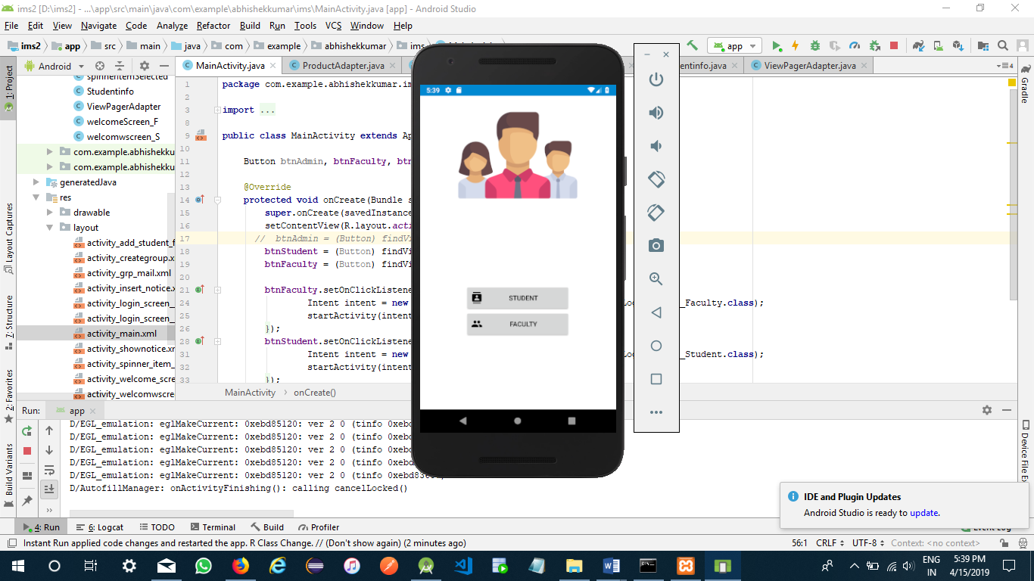
Working project

Slide 17
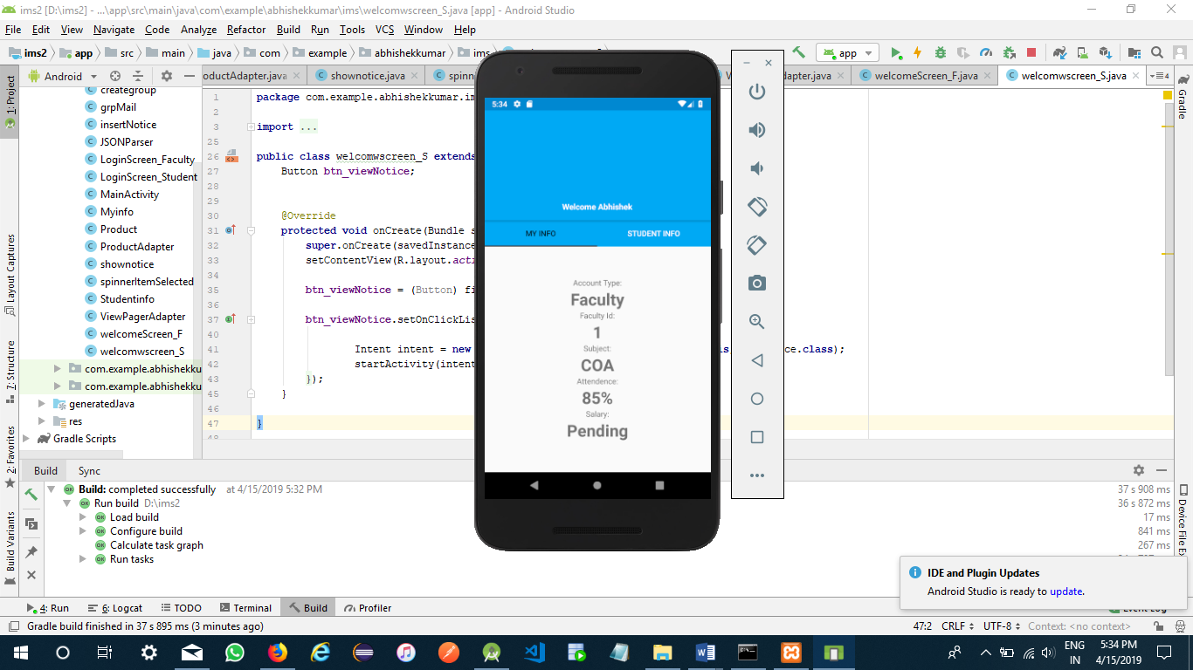
authenticated

Slide 18
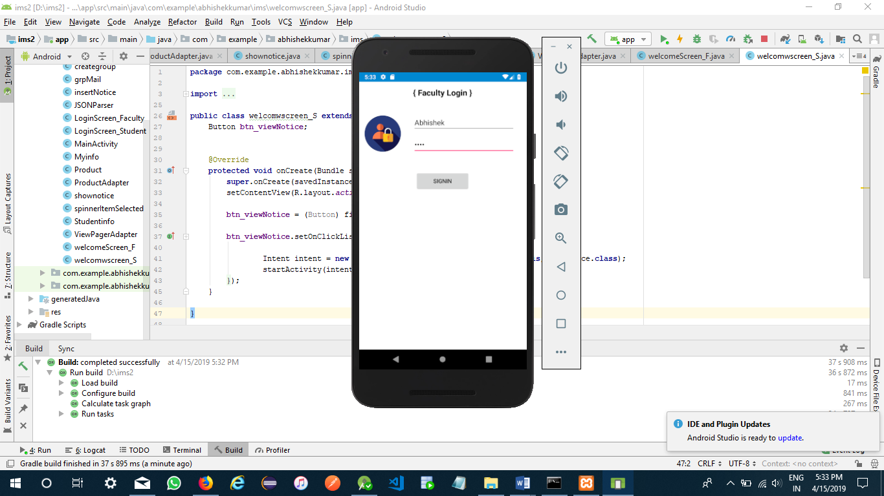
login

