Slide 1
Secure data hiding in images using steganography
DATA HIDING USING STEGANOGRAPHY
Presented By: A. Imanth
Student Name : A. Imanth
College Name & Department : Madanapalle Institute of Technology and Science. CSE-cybersecurity.

Slide 2
OUTLINE
Problem Statement
Technology used
Wow factor
End users
Result
Conclusion
Git-hub Link
Future scope

Slide 3
Problem Statement
Problem Statement: Develop a robust method for securing data hidden within steganographic images to prevent unauthorized access by hackers. It focuses on enhancing the encryption techniques used in steganography also ensuring data integrity, and providing a mechanism for detecting and mitigating potential security breaches and unauthorized access.

Slide 4
Technology used
Python IDLE(Integrated Development and Learning Environment):
The Python IDLE is a lightweight, user-friendly IDE that comes bundled with python. It provides a simple text editor, an interactive shell, and basic debugging tools to facilitate writing and testing python code efficiently.
Python Libraries used:
cv2: The OpenCV library is used for computer vision tasks. It provides tools for image processing, video capture, and analysis, including features like face detection, object identification, and more.
string: The string library is the collection of string operations and constants. It includes functions for string manipulation, such as formatting, searching, and modifying strings.
os: The os library provides a way of using operating system-dependent functionalities. It includes functions for interacting with the file system, handling directories, and executing system commands.
Platform:
Windows requirements- windows 7 or later, 4gb RAM, 10gb Storage, multi-core processor.
additional notes- 64-bit,32-bit Windows operating systems.

Slide 5
Wow factors
1. Enhanced Security Algorithms: Implement advanced encryption techniques to secure the hidden data within the images. By combining steganography with robust cryptographic methods, your project can offer a higher level of security against unauthorized access.
2. Multi-Format Steganography: Extend the steganography methods to support various file formats beyond images, such as audio, video, and text files. This versatility can make your project applicable to a wider range of use cases and industries.
3. Steganalysis and Detection: Incorporate tools and methods for detecting steganographic content within files. This feature can help in identifying potential threats and ensuring the integrity of the hidden data, making your project valuable for cybersecurity applications.
4. User-Friendly Interface: Design an intuitive and easy-to-use interface that simplifies the process of embedding and extracting hidden data. A well-designed interface can make your project more accessible to users with varying levels of technical expertise.

Slide 6
End users
Steganography can have a diverse range of end users for various purposes:
Government Agencies.
Military Organizations.
Cybersecurity Professionals.
Journalists.
Researchers.

Slide 7
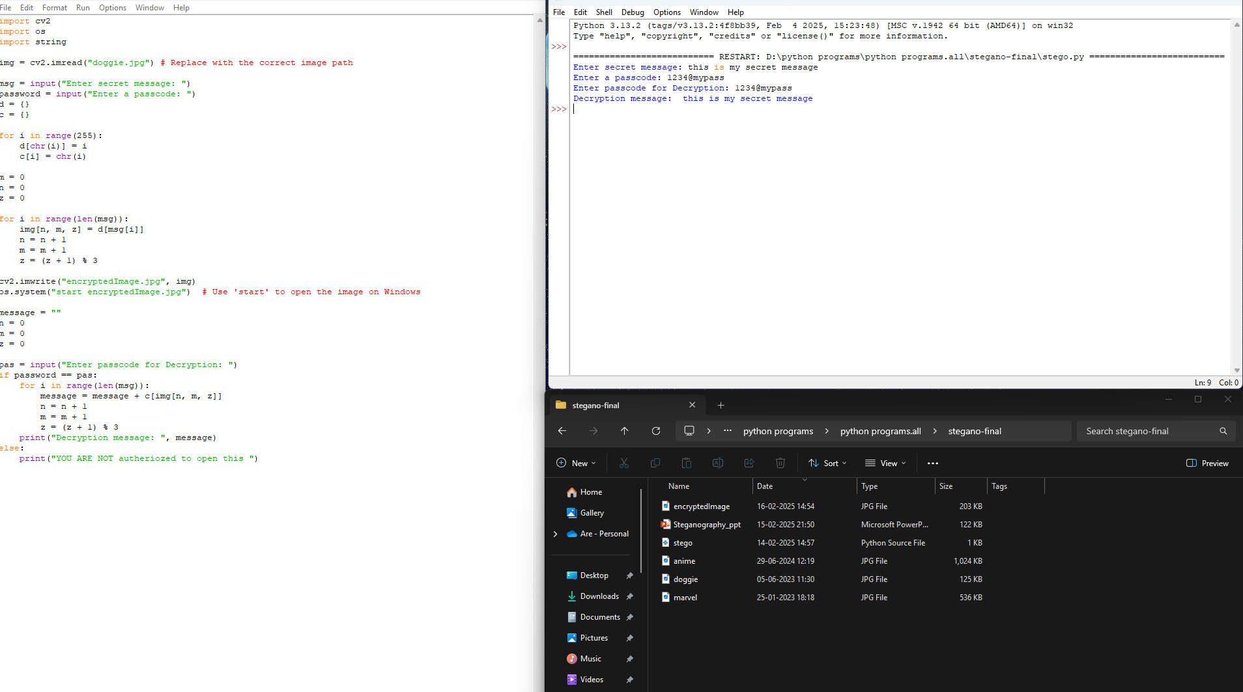
Results

Slide 8
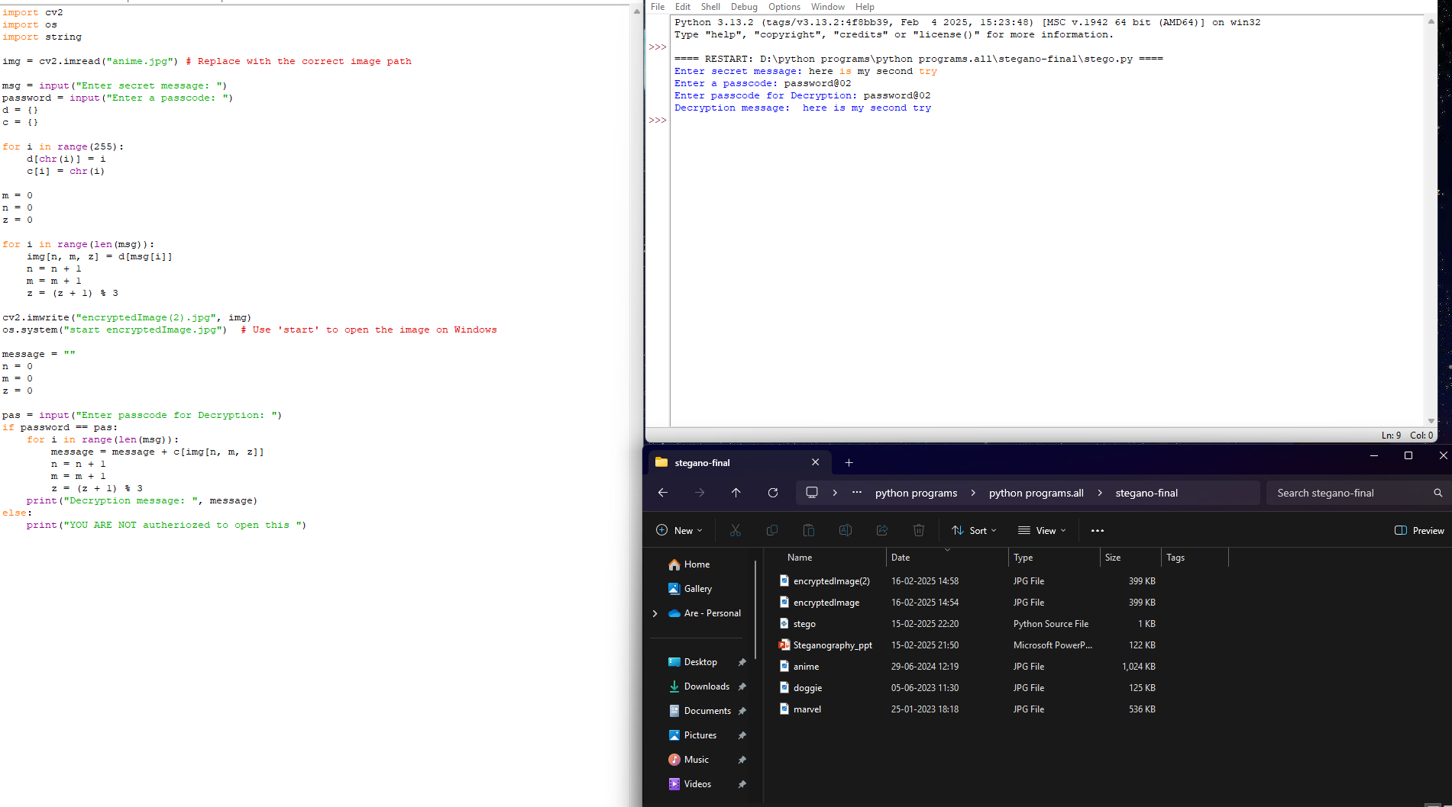
Results

Slide 9
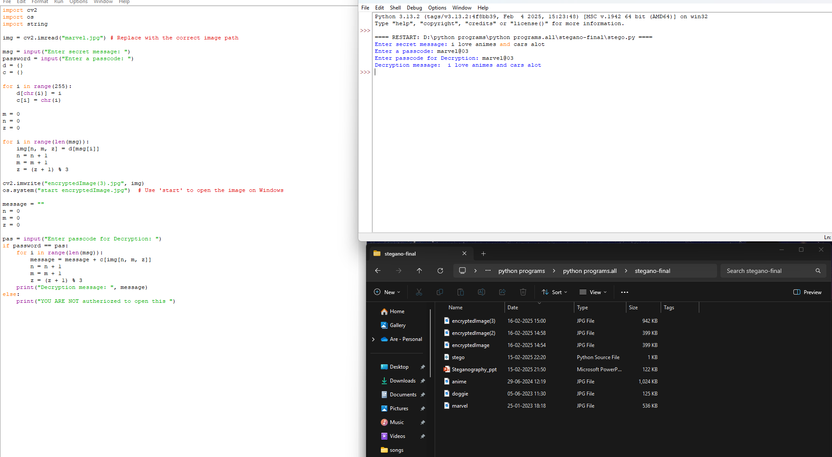
Results

Slide 10
Conclusion
Conclusion:
This steganography project successfully addresses the challenge of securing data hidden within steganographic images. By leveraging advanced encryption techniques and embedding them in image pixels. This will ensure data integrity and protection against unauthorized access. The user-friendly interface allows for dynamic input of message and encryption keys, making the process more accessible and efficient. It not only strengthens data protection but also contributes to the border field of cybersecurity, demonstrating the potential of steganography in safeguarding sensitive information.

Slide 11
GitHub Link
Git hub link: https://github.com/ARE-IMANTH/Steganography-Project.git

Slide 12
Future scope(optional)
Integration with blockchain Technology: combining steganography and blockchain can enhance the security and traceability of hidden data, making it impossible for unauthorized access or for tampering it.
Advanced Encryption Techniques: Continuously improving the encryption methods used in steganography can enhance overall security and robustness of hidden data, making it more resistant to evolving cyber threats.
Secure Communication for IoT Devices: Integrating steganography can provide secure communication channels for connected devices, protecting sensitive data transmitted between smart devices.

Slide 13
THANK YOU

